Slide 1
Today’s Agenda
Introduction
Cramer’s rule
Classification of numerical methods
CSE 257 Numerical Method

Slide 2

Introduction
A system of linear algebraic equations in n unknowns x_{i} (i = 1, 2, 3, . . ., n) is written in the format
The coefficients a_{ij} and the constants b_{i} (i = 1, 2, 3, . . ., n) are given here.
A solution is a set of values x_{i} (i = 1, 2, 3, . . ., n) which satisfy the above equations
CSE 257 Numerical Method

Slide 3
Homogeneous System
The equations are called homogeneous system if b_{i} (i = 1, 2, 3, . . ., n) are equal to zero.
The equations are called non-homogeneous system if at least one b_{i} is not equal to zero.
CSE 257 Numerical Method

Slide 4
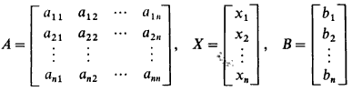
In Matrix Format
The equations can be written in matrix format
Where A is the matrix of coefficients, X is a column vector whose elements are x_{i} (i = 1, 2, 3, . . ., n) and B is also a column vector whose components are b_{i} (i = 1, 2, 3, . . ., n).
CSE 257 Numerical Method

Slide 5



Matrix’s Basic
Determinant: the determinant of the matrix
is written and has the value
Singular matrix: A square matrix that does not have a matrix inverse. A matrix is singular iff its determinant is 0, some examples
CSE 257 Numerical Method

Slide 6


Solution of Non-Homogeneous System
CSE 257 Numerical Method

Slide 7
Classification of numerical methods
Two types of solving methods
  Direct
  Iterative
Direct method
  Gives the exact solution after a finite number of arithmetical operations
  While using computer, this method gives poor result due to various errors in numerical approximation
Iterative method
  Starts with an initial value
  Gets a sequence of approximations
  Some times converges, diverges also
  Suitable for computer due to simplicity and uniformity
CSE 257 Numerical Method

Slide 8
Cramer's Rule
Gabriel Cramer was a Swiss mathematician (1704-1752)

Slide 9
Cramer's Rule
Cramer’s Rule is a method for solving linear simultaneous equations. It makes use of determinants and so a knowledge of these is necessary before proceeding.
Cramer’s Rule relies on determinants

Slide 10
Simultaneous Equations
a set of two or more equations, each containing two or more variables whose values can simultaneously satisfy both or all the equations in the set, the number of variables being equal to or less than the number of equations in the set

Slide 11
Linear Equations
The linear function y = mx + b can be re-written in many forms, for example –mx + y = b. This is a special case of the linear equation ax + by = c.
The points satisfying a linear equation, no matter which form it is written in, form a line.

Slide 12
Cramer’s Rule
The solution of the equations
using determinants is given by
Here,
D = the determinant of the coefficients
Di = a determinant obtained from D, where the ith column is replaced by the column vector B
CSE 257 Numerical Method

Slide 13
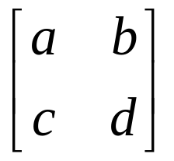
Coefficient Matrices
You can use determinants to solve a system of linear equations.
You use the coefficient matrix of the linear system.
Linear System Coeff Matrix ax+by=e cx+dy=f

Slide 14
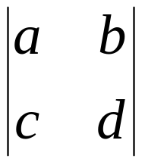

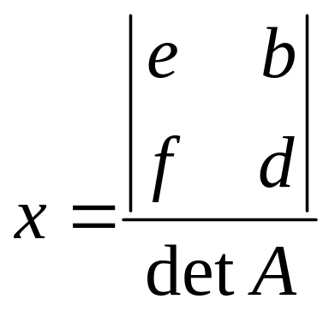
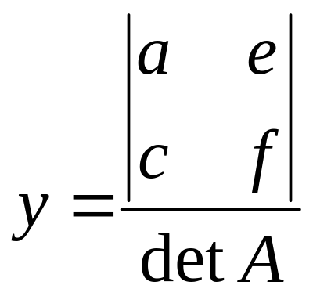
Cramer’s Rule for 2x2 System
Let A be the coefficient matrix
Linear System Coeff Matrix ax+by=e cx+dy=f
If detA 0, then the system has exactly one solution:
and
= ad – bc

Slide 15
Key Points
The denominator consists of the coefficients of variables (x in the first column, and y in the second column).
The numerator is the same as the denominator, with the constants replacing the coefficients of the variable for which you are solving.

Slide 16
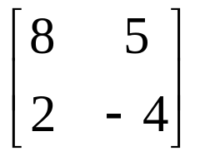
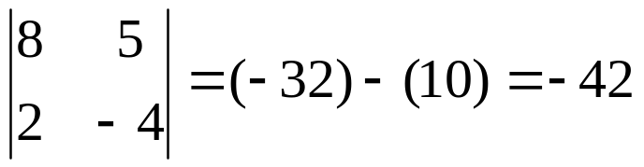
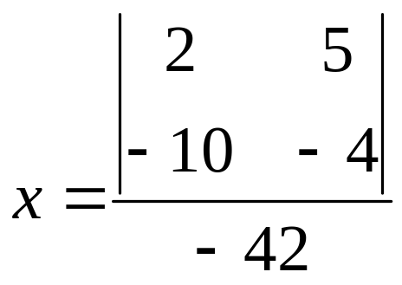
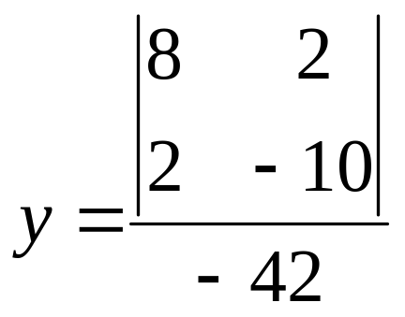
Example - Applying Cramer’s Rule on a System of Two Equations
Solve the system:
8x+5y= 2
2x-4y= -10
The coefficient matrix is: and
So:
and

Slide 17
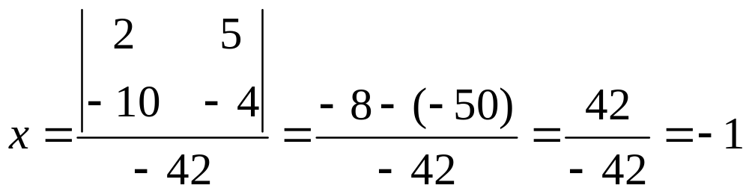
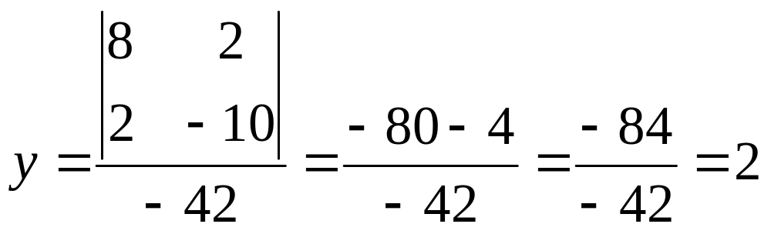
Solution: (-1,2)

Slide 18
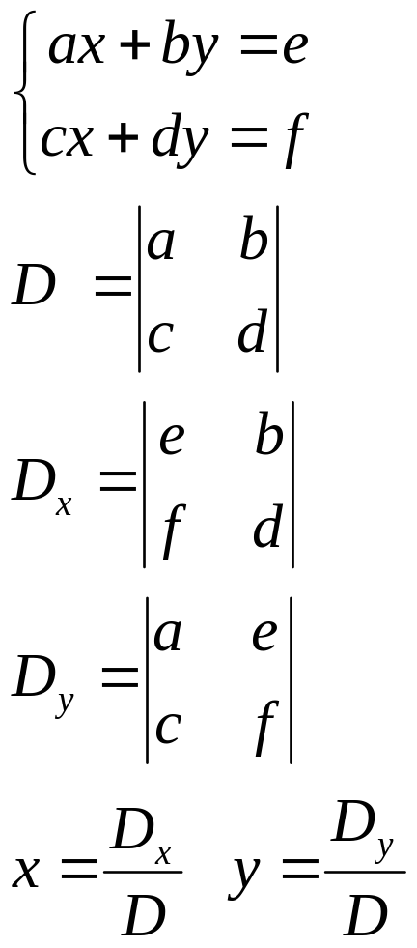
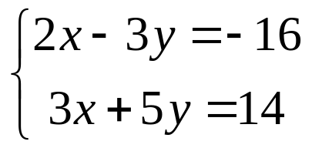
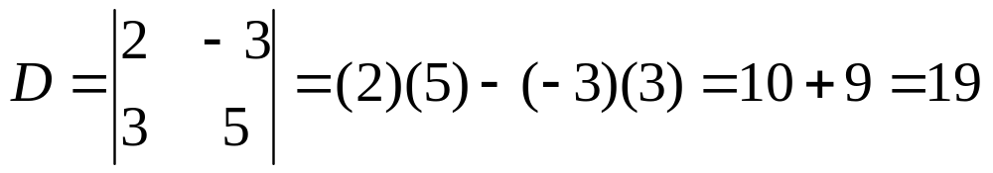
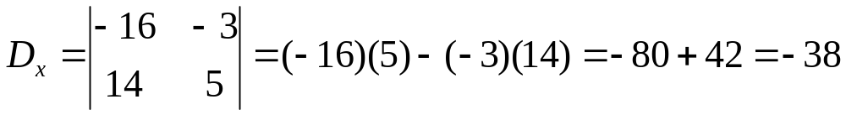
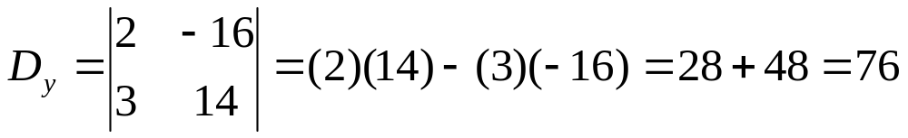
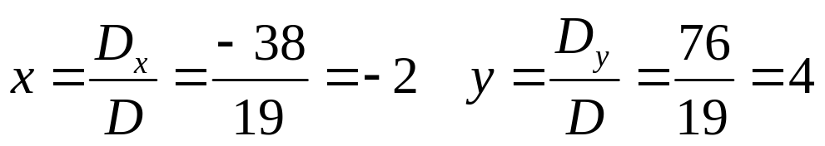
Applying Cramer’s Rule on a System of Two Equations

Slide 19
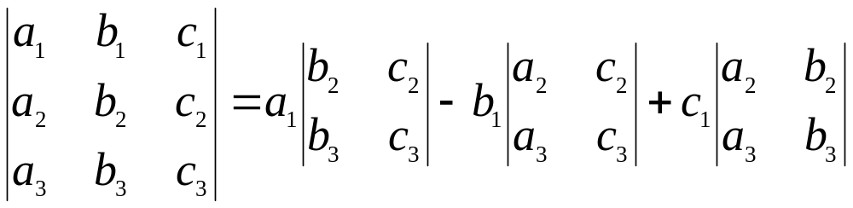
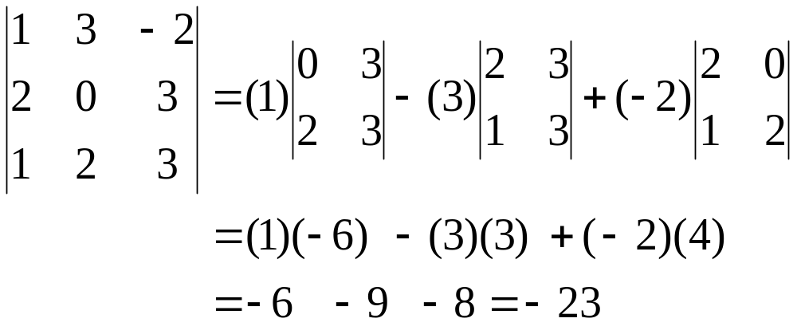
Evaluating a 3x3 Determinant
(expanding along the top row)
Expanding by Minors (little 2x2 determinants)

Slide 20
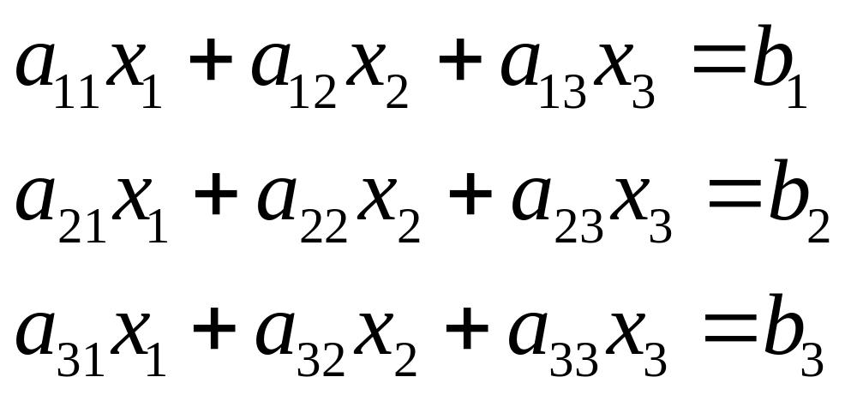
Using Cramer’s Rule to Solve a System of Three Equations
Consider the following set of linear equations

Slide 21
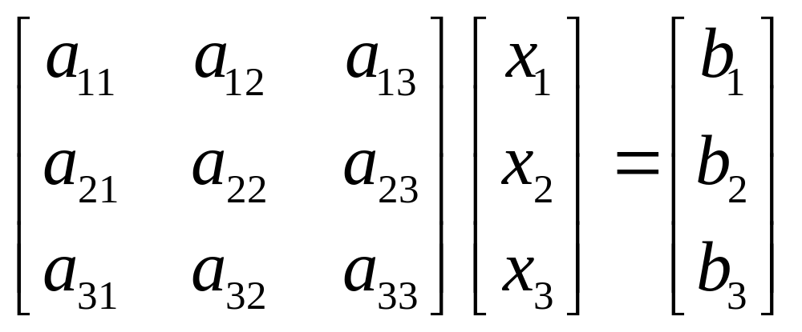
Using Cramer’s Rule to Solve a System of Three Equations
The system of equations above can be written in a matrix form as:

Slide 22
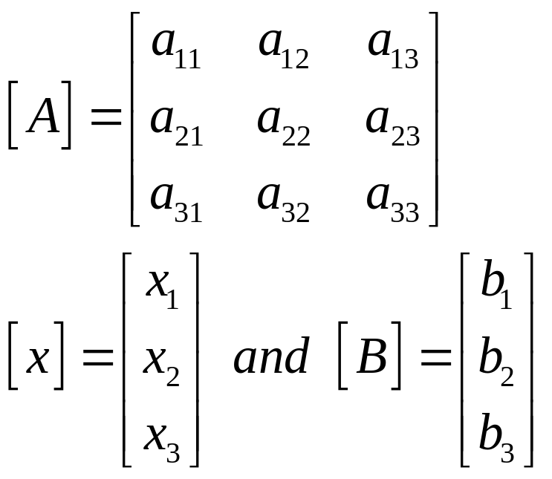
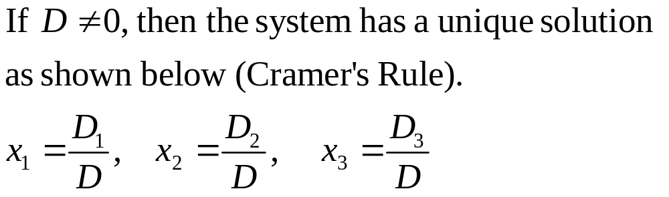
Using Cramer’s Rule to Solve a System of Three Equations
Define

Slide 23
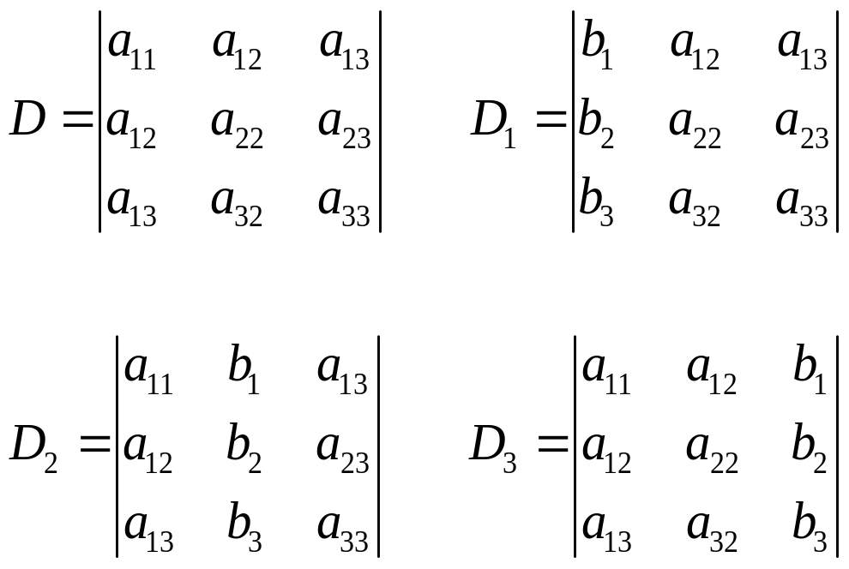
Using Cramer’s Rule to Solve a System of Three Equations
where

Slide 24
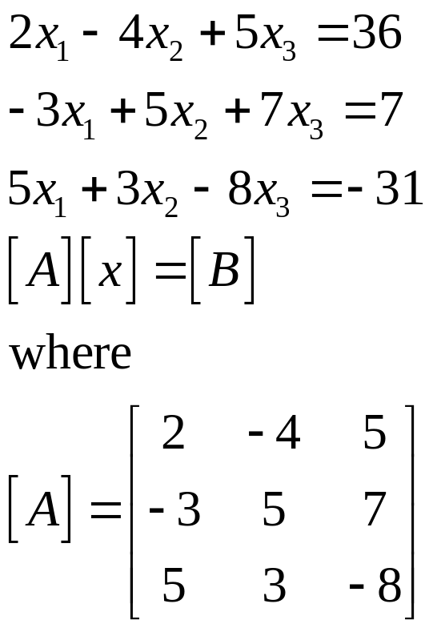
Example 1
Consider the following equations:

Slide 25
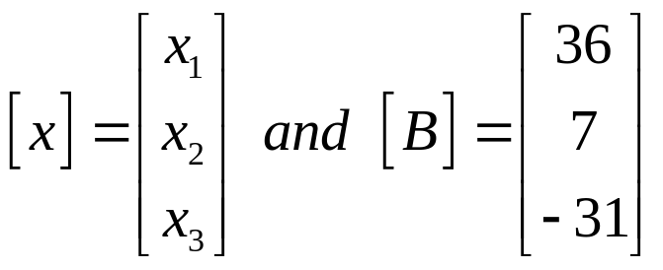
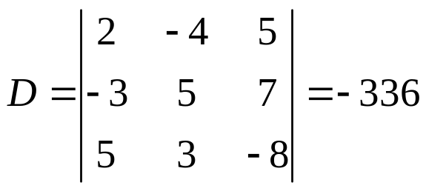
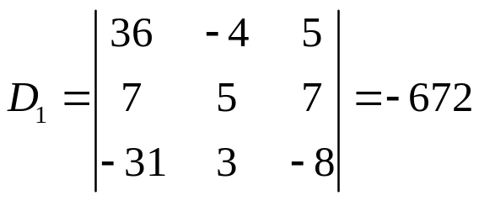
Example 1

Slide 26
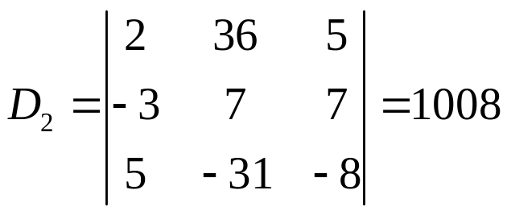
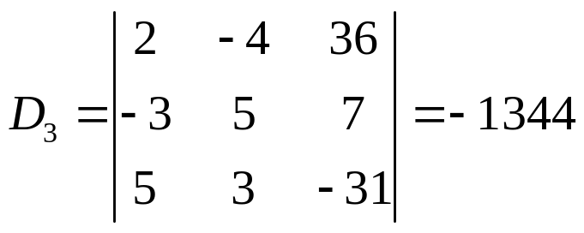
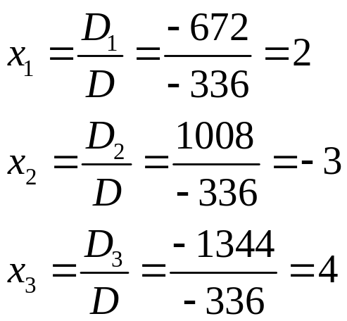
Example 1

Slide 27
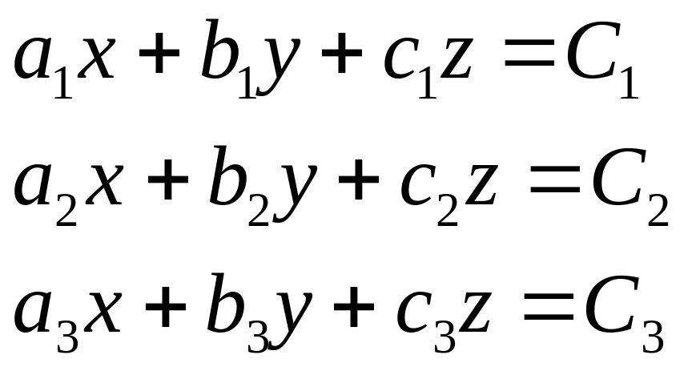
Cramer’s Rule - 3 x 3
Consider the 3 equation system below with variables x, y and z:

Slide 28
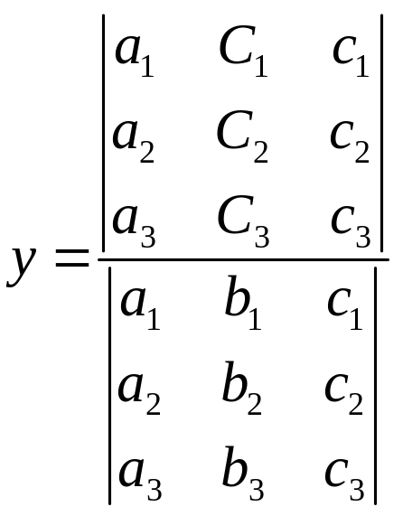
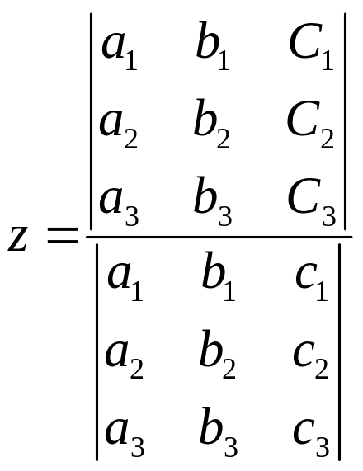
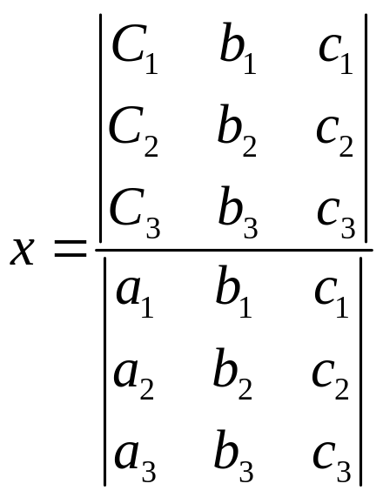
Cramer’s Rule - 3 x 3
The formulae for the values of x, y and z are shown below. Notice that all three have the same denominator.

Slide 29
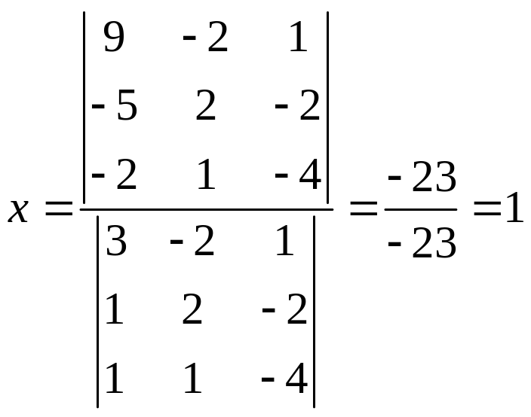
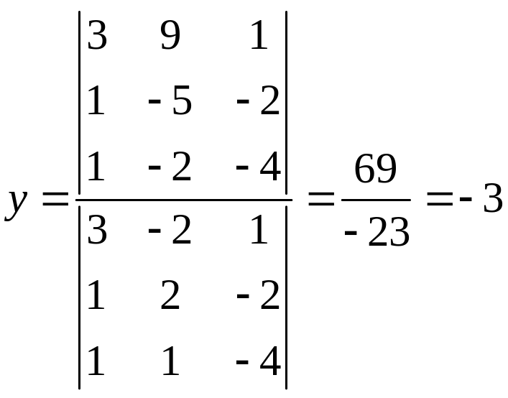
Example 1
Solve the system : 3x - 2y + z = 9
x + 2y - 2z = -5
x + y - 4z = -2

Slide 30
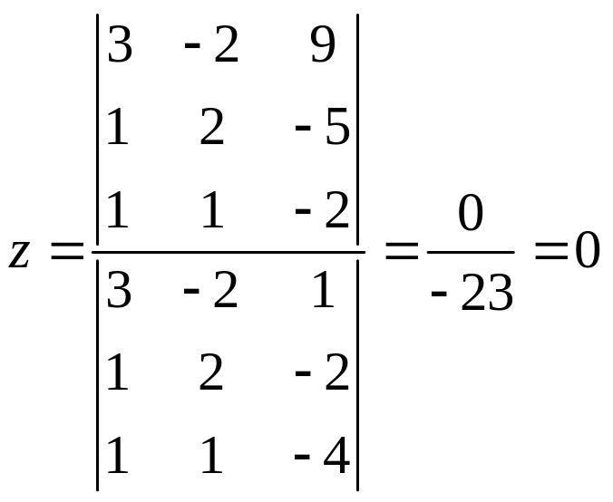
Example 1
The solution is
(1, -3, 0)

Slide 31
Cramer’s Rule
Not all systems have a definite solution. If the determinant of the coefficient matrix is zero, a solution cannot be found using Cramer’s Rule because of division by zero.
When the solution cannot be determined, one of two conditions exists:
  The planes graphed by each equation are parallel and there are no solutions.
  The three planes share one line (like three pages of a book share the same spine) or represent the same plane, in which case there are infinite solutions.

