Slide 1
AI Virtual Keyboard

Slide 2

Presented By,
Presented To,
Md.Imran Nazir(ID: 19202103248)
Afsana Akter (ID: 19202103295)
Ibrahim Khalil (ID: 19202103397)
Kaniz Farzana(192021030413)
Humayra Ferdous
(Lecturer)
Department Of CSE
Bangladesh University of Business & Technology(BUBT)

Slide 3

Contents of Presentation
01
Motivation
Introduction
02
Objective
03
04
Requirements
Implementation
06
Limitation
05
08
Future Work
07
Conclusion

Slide 4

Introduction
Voice command and finger-tip recognition for typing.
No need for physical interaction with a traditional keyboard.
Convenient solution for text input.
Ideal for individuals with mobility issues.

Slide 5
Objective
02
Hassle free typing experience.
Physical keyboard keys often not works.
On screen keyboard is a alternative but not a better solution than AI Virtual Keyboard.
Create touchless convenient alternative traditional physical keyboard.

Slide 6

Motivation
Cost-effective than physical keyboards as it does not require the production.
Helps people with physical disabilities or mobility issues to type without physical keys.
Works on low-resource devices with limited processing power.

Slide 7
System Requirments
Software & Libraries
Hardware
PyCharm
Python v3.7
CV2
CVZONE
Pynput
Windows 7 or above
Processor Core i3
128GB SSD/HDD
4GB RAM

Slide 8
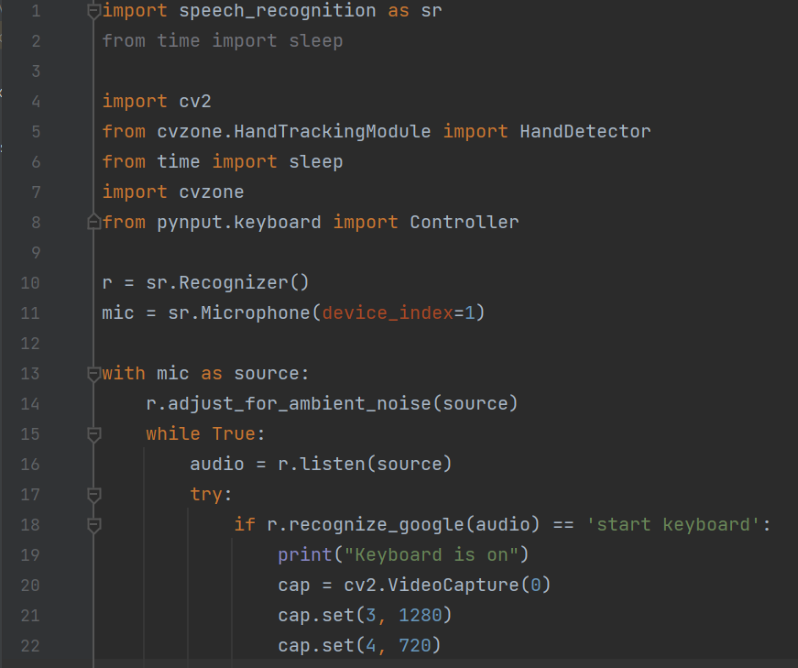
Implementation
…
B

Slide 9
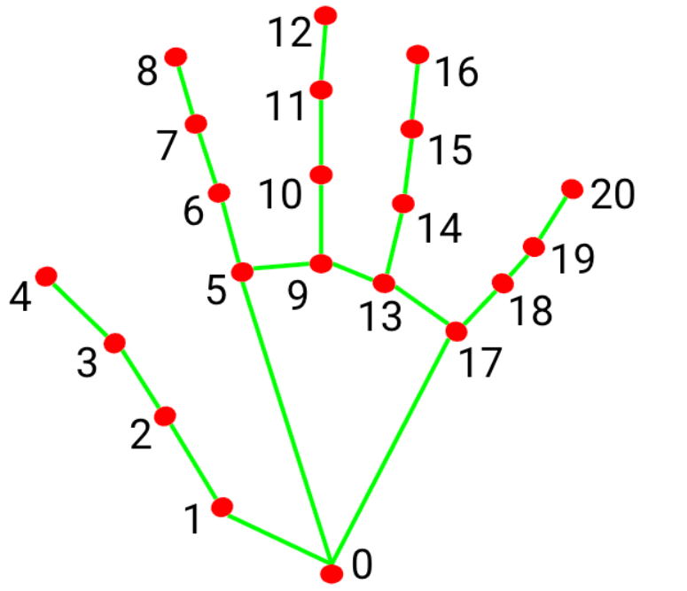
Hand Detector
Ctrl

Slide 10
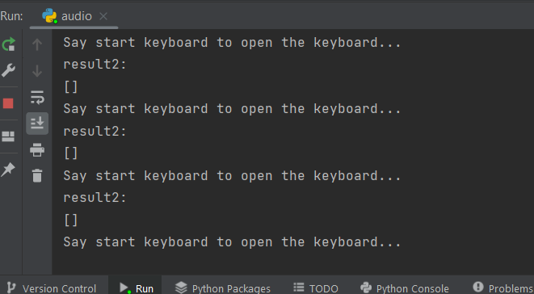
Voice Command
?

Slide 11
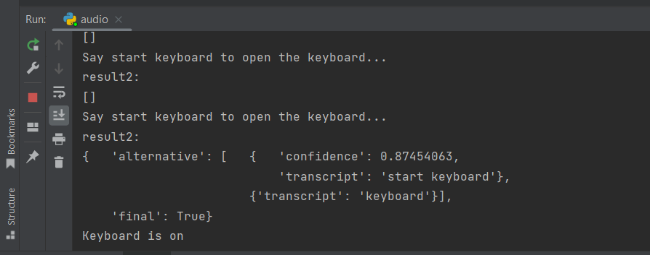
Voice Recognization
Ctrl
C

Slide 12
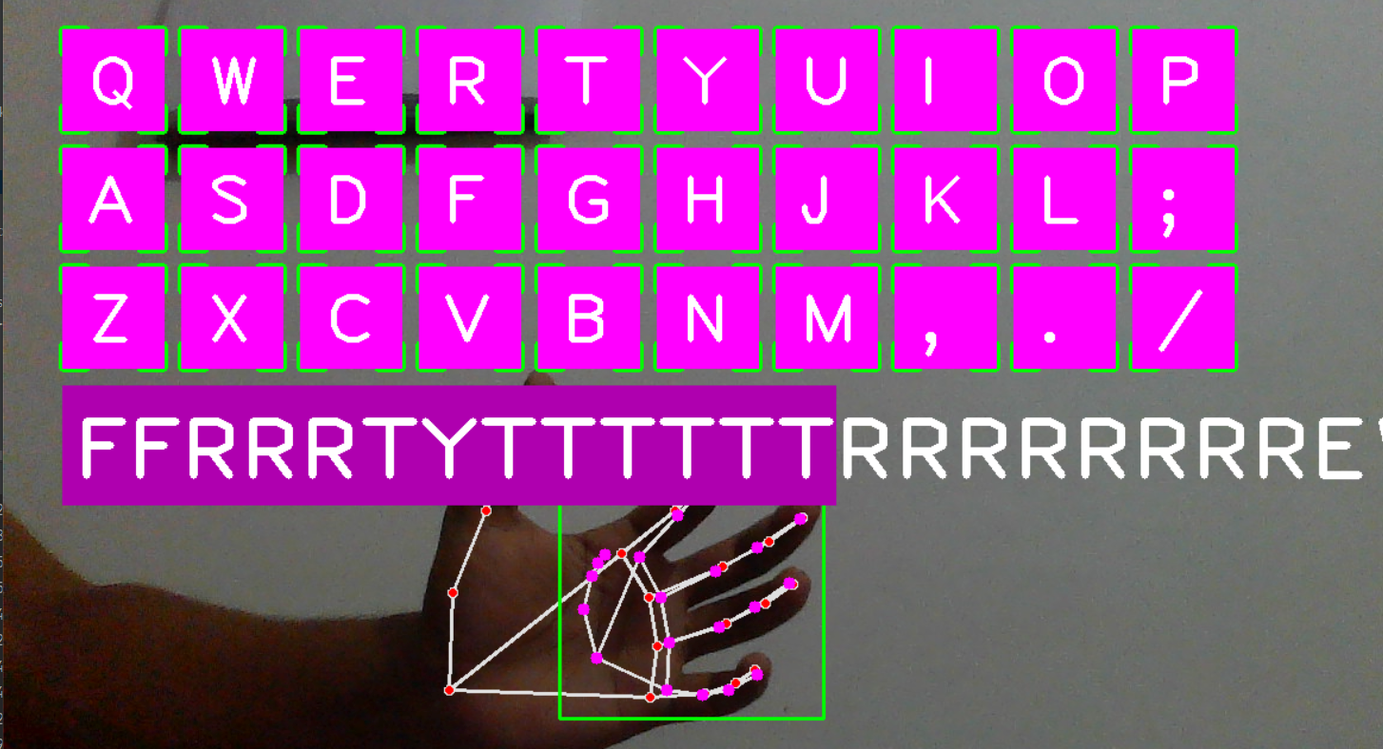
Open Keyboard

Slide 13
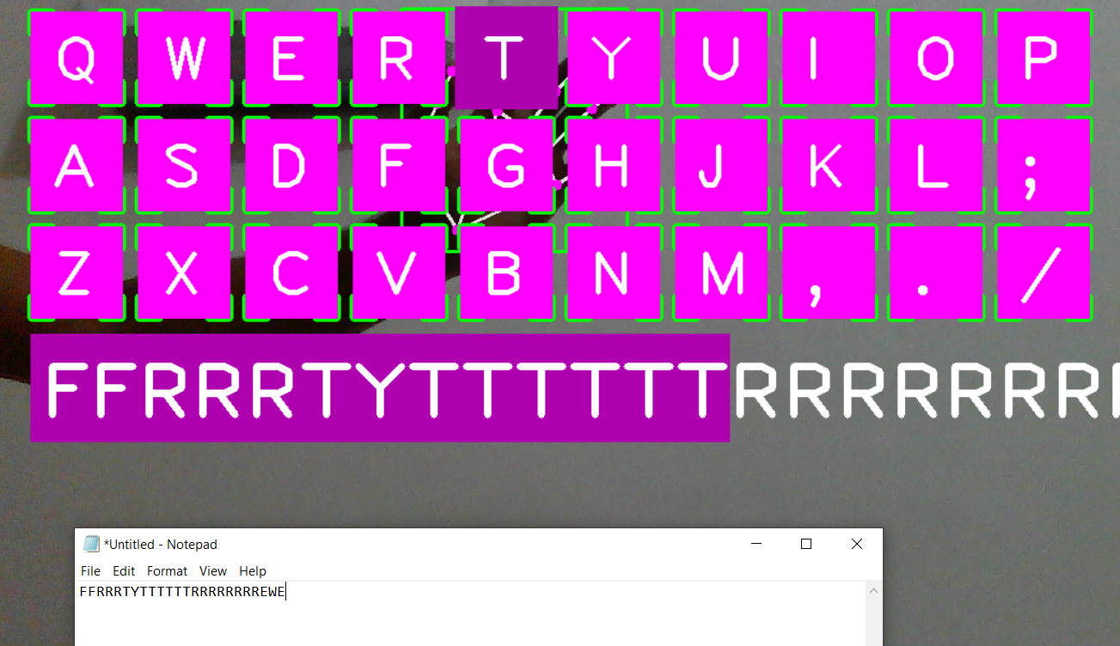
Typing on Notepad

Slide 14
Limitation
Can not write using voice command.
Voice command can not recognize in sound pollution.

Slide 15
Conclusion
Enables users to type on a keyboard without the need for a physical keyboard.
Several advantages, including convenience, portability, and accessibility.
Used when our normal keyboard fails.

Slide 16
Future Work
Enhance compatibility & customizable user interface
Typing using voice command.
Integration of AI mouse with the keyboard.

Slide 17


Any Questions?

