Slide 1

LLMs and RAG: Redefining the Future of AI Applications
Afsana Akther Asha Rittika Mitra
Data Scientist Senior Data Analytics
Wells Fargo Wells Fargo
Notes:
Slide 1 - Self Intro
Good afternoon, everyone. Thank you for joining our session today – LLMs and RAG -Retrieval Augmented Documentation and how it can be used for Intelligent Document Search.
My name is Afsana and I work for the AI/ML Model Development team at Wells Fargo Commercial Banking line of business.
I request my co-presenter to introduce herself as well.

Slide 2

Outline
Introduction
Understanding RAG Pipeline
Advanced RAG
Applications
Demo: RAG in Action
Q/A
Retrieval-Augmented Generation (RAG) enhances the capabilities of LLMs by integrating external knowledge retrieval mechanisms during the generation process.
Instead of relying solely on the LLMs’ pre-trained knowledge, RAG fetches relevant information from external data sources like databases, documents, or APIs. LLMs and RAG are transforming the landscape of AI applications, enabling high efficient, context-aware, and scalable solutions.
Our session will explore the synergy between LLMs and RAG with an interactive element to show RAG-LLM integrations in action.
Notes:
Slide 2 - Outline
Today first we are going to cover:
The introduction of RAG and why do we need RAG
(and then we will) Understand each component in RAG pipeline in details
(and then we will look at some of the) Advance techniques in RAG
(and we will look at) Applications of RAG
Our session will also explore the synergy between LLMs and RAG with an project demonstration to show RAG-LLM integrations in action.

Slide 3
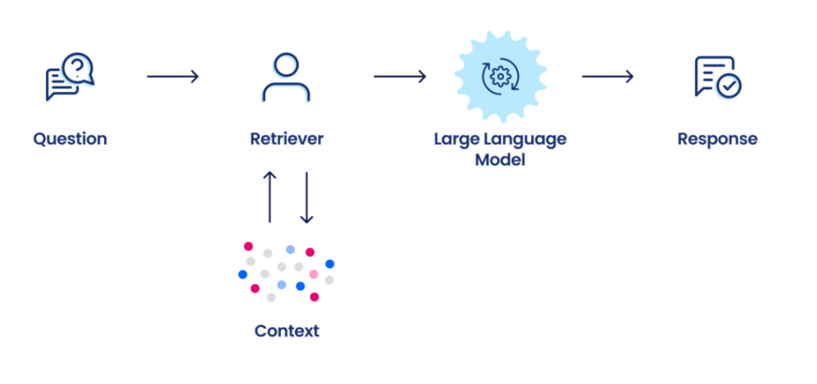
Introduction
Problem: LLM’s understanding of the world is limited to the data they’ve been trained on …
So, when we ask the LLM about an event it hasn’t seen, it will respond that:
It doesn’t know the answer; or
Provides some hallucinated answer
Solution: Provide LLM with additional information
Approaches to providing additional information:
1. Input via prompt
Input has token limit, so not scalable
If input is long, hard to identify relevant information
2. Fine-tuning
Takes long time to train
High cost of computing
3. RAG
Provide LLM with access to domain-specific knowledge
Low cost of computing
Reduce hallucinations
Notes:
Slide 3 - Introduction
Everyone must have use some ChatGPT or GenAI model for question-answering task.
But, one problem that we might face, these LLM understanding is limited to the data that they have been trained on.
Hence, when, if we ask LLM about some event that hasn't seen or it hasn't been trained on, it might respond that it doesn't know the answer or it might provide some hallucinated answer or a made-up answer.
So, the simple solution to this is that just provide LLM with additional information, from which it can answer our question.
And there are three main options to provide these additional information:
1) First option is that - to provide the additional information through prompt.
But, the limitation here is that every LLM has some input token limit, and hence it is not scalable and also if the input is very long, the LLM might have hard time to identify the relevant information from the long context.
It is not scalable, like, we cannot simply dump 100 pages of document in the prompt, LLM prompt.
2) So, second option we have is fine-tuning the LLM on the additional information.
But this takes long time to train, and also it has higher costs of computing, it is also impractical to fine-tune the LLM, every time we have some new information, right!
3) The third most practical option that we have at this moment (people came up with) is RAG - where we provide the LLM access to domain-specific knowledge and we employ our retrieval step in between to provide the additional context to it.
And it is obvious, if there’s low cost of computing and it provides actually correct answer, hence we get to reduce hallucinations.

Slide 4
Evolution of Information Retrieval
Manual Indexing and Card Catalogs
(Pre-Digital Era)
Keyword-Based Search
(1960s-1980s)
Vector Space Models
(1970s-1990s)
Probabilistic Models
(1990s-2000s)
Neural Network Information Retrieval
(2010s)
Transformer-Based Retrieval
(2020s)
Word Embeddings (Word2Vec, GloVe)
RNNs and CNNs for document-query matching
Challenges with scalability
TF-IDF (Token frequency)
Unable to capture semantic meanings
Exact Matching
Struggled with synonyms and polysemy (multiple meaning of same word
BM25: Probabilistic model based on TF-IDF
Sparse representation
Lacked deep contextual understanding
BERT-based models fine-tuned for retrieval tasks (Sentence-BERT)
Dense representation: Captured contextual meaning
Required more computational resources
RAG combines retrieval techniques (dense/sparse methods) with generation models to create contextually accurate responses
Notes:
Slide 4 - Evolution of Information Retrieval
Information Retrieval or retrieval around RAG pipeline has been around since a long time.
Before the digital era, people used to do manual indexing or used card catalogs for matching.
And then came keyword-based search algorithms - where query and document matches found with the help of exact matching.
But it struggled with cases of synonyms or in the case of polysemy - where the word might have multiple meanings.
Then around after 1970s to 1990s came some vector space models. Lot of us (some people) may be familiar with this TF-IDF based representation - which is a sparse representation of every word in the vocabularies based on frequencies - token frequencies.
But since it was very sparse representation, it was not able to capture semantic meanings.
Then came probabilistic model like BM25 - which was based on the TF-IDF representation.
It was also sparse representation; hence it lacked deep contextual understanding.
Then with the advent of neural networks, the representation of words, became much more denser, using word embedding models like Word2Vec or Glove.
And combined them with RNNs or recurrent neural networks, we could do document query matching.
But it had challenges with scalability. We know that RNN is based on serial computation, hence it is not scalable.
And transformer-based models solved this problem, using parallel computation.
So, all the sequence of text is processed parallelly, hence its more scalable.
With the advent of these models - transformer-based models, we started using BERT based models for retrieval task.
One famous such model is Sentence-Bert, and they captured dense representation of sentences.
Hence, it uses more contextual meaning.
But the downside here is that, it required more computational resources.
So, RAG typically combines both dense and sparse representation methods, with generation models, to create contextually accurate responses.

Slide 5
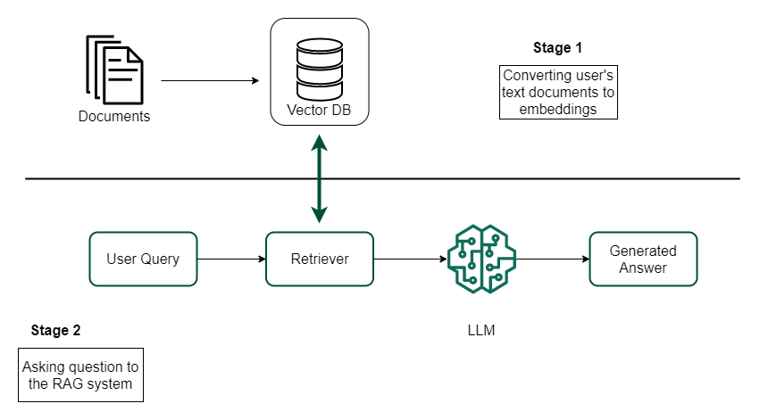
RAG Pipeline
Notes:
Slide 5 - RAG pipeline
Now, let's come to the RAG pipeline.
Here, we have divided into two stages:
1) In first stage, we, the users have their own documents.
So, these documents first need to be converted to number or vectors and these vectors need to be stored somewhere called Vector database.
We will go through each part of the steps in details in the coming slides.
2) And the stage 2 is actual question-answering or where the interaction with the RAG system happens, where we ask some questions and expect some answer from the LLM.

Slide 6
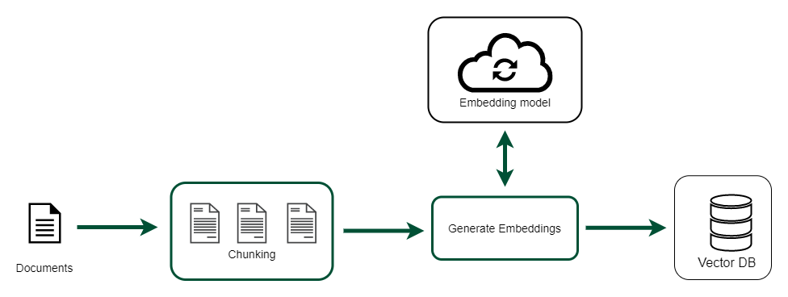
RAG Pipeline
Stage 1: Pre-processing
Chunking
Embedding
Indexing
Notes:
Slide 6 - RAG pipeline - Preprocessing
So coming to the first stage, it is further divided into chunking, embedding and indexing - where first our documents are converted into smaller chunks.
And we generate embeddings for each chunk.
And these embeddings are stored in a vector database, which is later on used for the retrieval task.

Slide 7
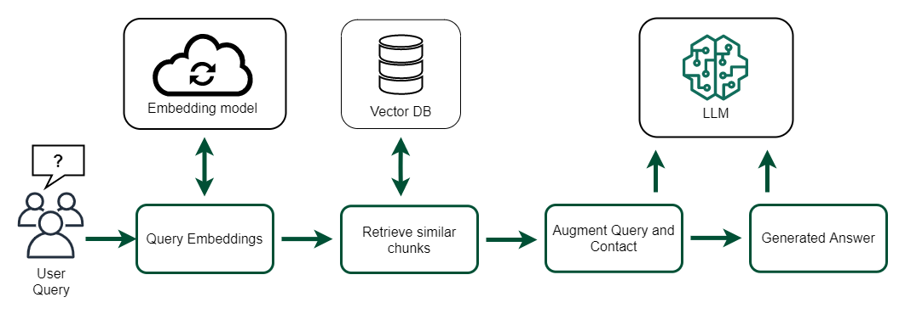
RAG Pipeline
Stage 2: RAG in action
Retrieval
Augmentation
Generation
Notes:
Slide 7 - RAG pipeline: RAG in action
And in the second stage, users query is first converted to query embeddings, using the same embedding model as in the previous step.
And these embeddings are matched with the chunked embeddings from the vector database, to retrieve similar chunks.
And then these retrieved chunks are augmented with user's original questions.
And then the whole prompt is provided to LLM, to get the final answer.

Slide 8
Step 1: Chunking
Large documents are divided into smaller, more manageable pieces called “chunks
These chunks are then indexed and used during the retrieval phase
Chunking serves multiple purposes:
Efficiency: smaller chunks reduces computational overhead during retrieval
Relevance: precise chunks increase the likelihood of retrieving relevant information
Chunking strategies:
Fixed size
Recursive
Semantic
Chunking
Embedding
Indexing
Retrieval
Augmentation
Generation
Notes:
Slide 8 - Chunking
From the first stage, this is the first step , called chunking - where large documents are divided into smaller and more manageable pieces of texts, which are also called “chunks”.
And these chunks converted into embeddings and later on used for the retrieval.
So, with chunking, we observe more efficiency.
Because having smaller chunks reduces computational overhead during the retrieval phase.
And also improves relevance, because the more precise chunks we have, the more chances of retrieving relevant information from our whole documents.
So, how is this chunking done? or how the documents are broken down into chunks?
So, there are three main strategies, that we are going to talk about.
First is fixed size chunking, second is recursive and third is semantic chunking.

Slide 9
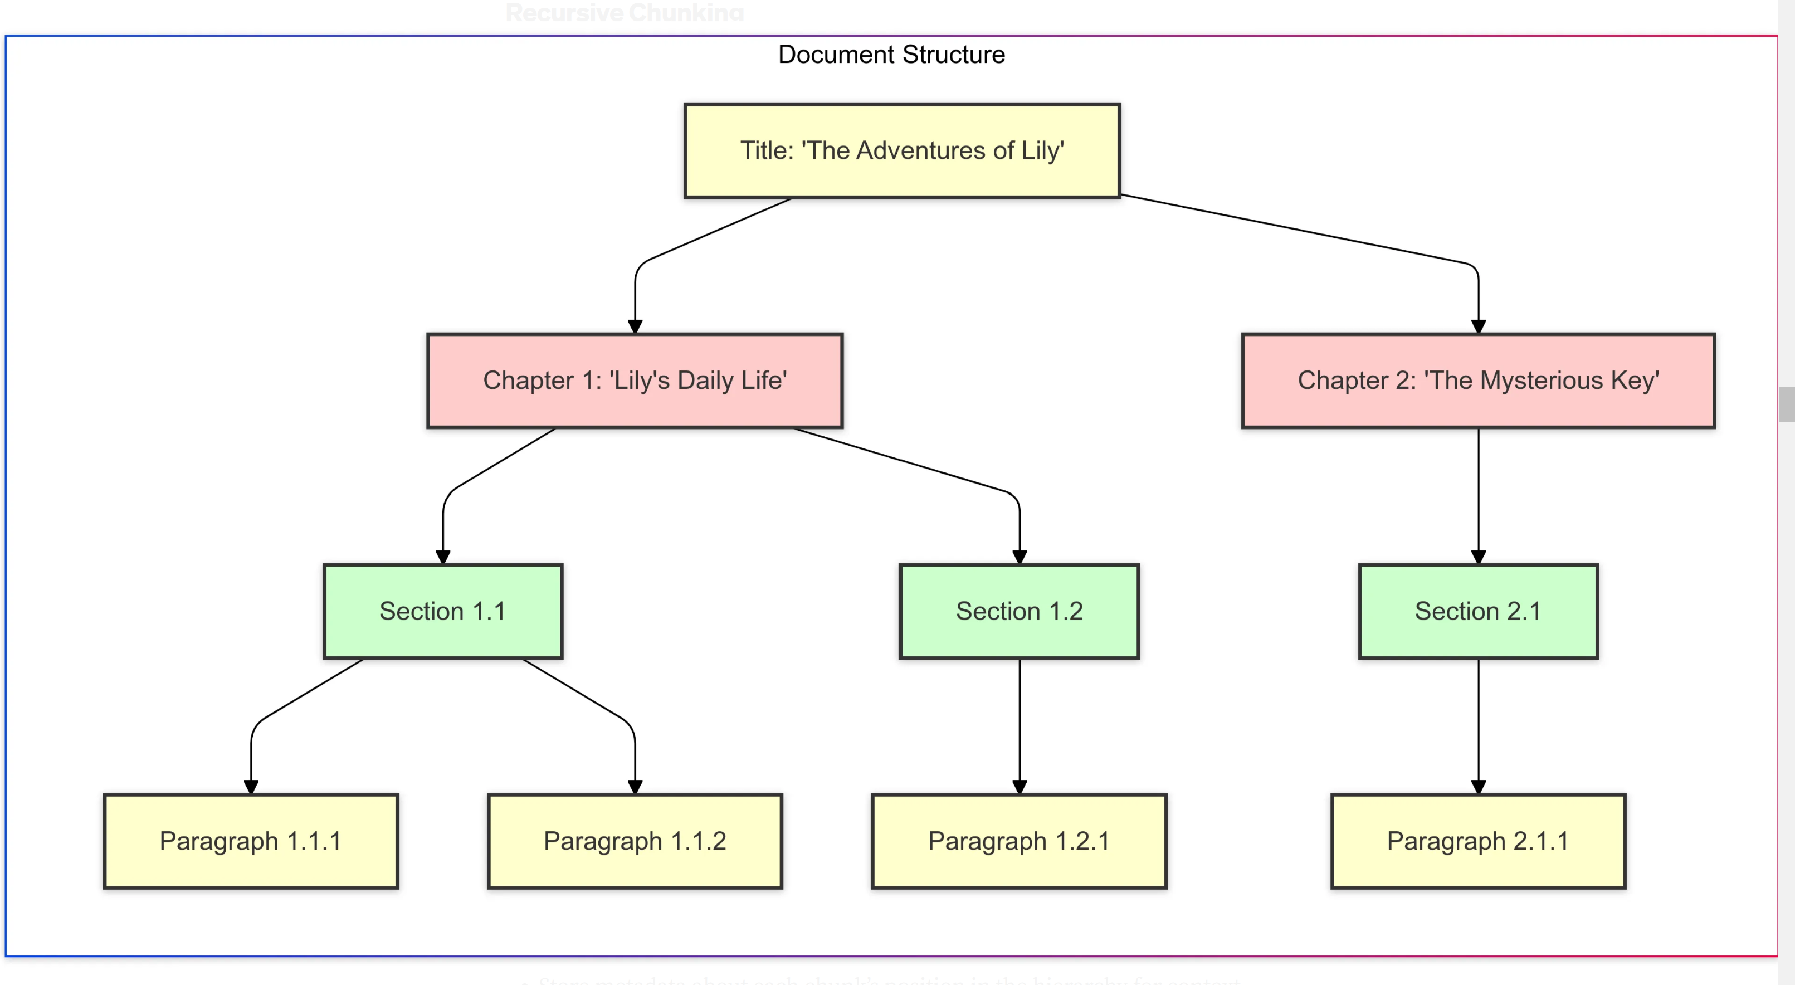
Chunking Strategies
Fixed size
Fixed number of tokens/characters/sentences
Simple, but context can be lost
Recursive
Breaks down text progressively into smaller chunks
Uses hierarchical delimiters like heading, subheadings, paragraphs, and sentences
Maintains the document’s structural relationships
Example: Recursive Chunking
Chunking
Embedding
Indexing
Retrieval
Augmentation
Generation
Notes:
Slide 9 - Chunking strategies - Fixed and Recursive
In Fixed Size chunking, we pre-defined some fixed number of tokens, characters or sentences.
And based on that number, the whole document would be further divided.
This is simple method, but the context can be lost, because the breakpoints can be arbitrary.
The whole theme or the topic can be split arbitrarily between two chunks.
So, that is the problem with Fixed Sized chunking.
Hence, there came more improvement to it - with recursive chunking - where it takes into the consideration of document's structure and breaks down the text progressively into smaller chunks, by using some hierarchy present in the documents like heading, subheading, then paragraphs, sentences etc.
As you can see in the example, our document is a book called "The adventures of Lily".
It is first divided into chapters, each chapter is then divided in sections and sections into paragraphs and so on.
And these paragraphs are kept together in one chunk, hence context is not lost.

Slide 10
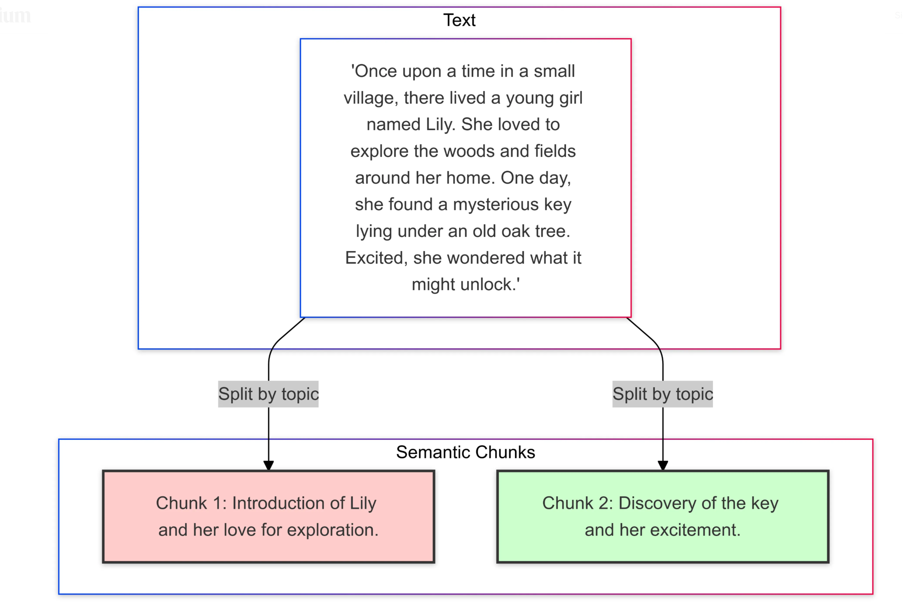
Chunking Strategies
Semantic chunking
Utilizes embeddings to split text based on semantic meaning, ensuring each chunk is cohesive in topic or idea
Chunks are meaningfully grouped, improved retrieval accuracy
However, semantic analysis can be time-consuming
Example: Semantic Chunking
Chunking
Embedding
Indexing
Retrieval
Augmentation
Generation
Notes:
Slide 10 - Chunking strategies - Semantic
The third strategy is semantic chunking - where we utilize embedding models to generate some embeddings, of sentences, in sequence.
And we compare consecutive sentences embeddings.
And if we find that two consecutive sentences embeddings have larger distance, then that point is considered as a break point.
And that way we split the whole documents into topics.
So, for example, in this example, if you see, the first two sentences talk about theme - a common theme, called maybe, "Introduction of Lily" and the last two sentences talk about "Discovery of the key and her excitement".
So that way common themes are kept together in the chunks.
But this takes lot of time, because we are using embedding model to find these embeddings, hence it's time consuming compared to other two methods.

Slide 11





Step 2: Embeddings
Embedding maps input unstructured text into numerical space with fewer dimensions to be used in retrieval
Text → Embedding Vector ($v_{1},v_{2, }$,……, $v_{n })$
Word embeddings
One word → One vector
Cosine similarity metric for assessing text similarity: $\cos{θ_{1}}> \cos{θ_{2}}$
Sentence embeddings:
One text chunk → One vector
○ King
$$θ_{2}$$
○ Lion is the king of the jungle
$$θ_{1}$$
○ Queen
$$θ_{2}$$
$$θ_{1}$$
○ The tiger hunts in the forest
○ Man
○ Woman
○ Everybody loves New York!
Chunking
Embedding
Indexing
Retrieval
Augmentation
Generation
Notes:
Slide 11 - Embeddings
After converting the documents into chunks, we come to this step called “Embeddings”.
And Embeddings are nothing but a vector representation of our unstructured text.
So, our text is converted to numbers, typically a vector that is called as "embedding vector".
In word embedding, every word is represented as one vector
And similar words should lie closer in the vector space.
That was the whole idea of converting the words to vectors.
But in RAG, we are more interested into sentence embeddings - where one text chunk should have one vector representation.
In this example - "Lion is the king of jungle" and "The tiger hunts in the forest" - these two sentences are quite similar, compared to the third sentence, which is completely about some different topic like - "Everybody loves New York!".
So with this sentence embeddings, we try to keep similar sentences closer in the vector space.

Slide 12
Sentence Embeddings are used in a RAG System
Question → Text Embedding Q
Chunk 1 → Text Embedding C1
Chunk 2 → Text Embedding C2
……
Chunk n → Text Embedding Cn
Retrieve the top relevant chunks through ranking cosine similarities between sentence embeddings pairs (Q, C1), (Q, C2),…,(Q, Cn)
Convert the text question and document chunks into numerical vectors
Sentence transformers leverage transformer architectures to create embeddings that capture the semantic meaning of entire sentence
Examples of sentence transformers: All-MiniLM, GTR-T5, BGE
Chunking
Embedding
Indexing
Retrieval
Augmentation
Generation
Notes:
Slide 12 - Sentence Embeddings
So these sentence embeddings are used in a RAG system.
The question or the query is also converted to embedding, using the same embedding model.
And we get its vector representation called Q.
And all the chunks from 1 to n, get their vector representation called C1 to Cn.
And we compare our query with every chunk embedding to find the cosine similarities between all these pairs.
And then the top score are chosen in the retrieval phase.
The sentence transformers are the models which are used to get these sentence embeddings.
And some of the examples are these - All-MiniLM, GTR-T5, BGE.

Slide 13
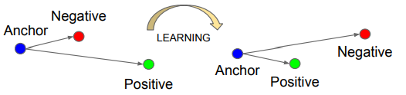

Fine tuned Embedding Model
Fine tune embedding models to improve Retrieval performance of our RAG system
The notion of similarity in this case is (question, relevant-context) pairs
The model is trained on the dataset format:
Anchor: Questions
Positive: Relevant context
Negative: Irrelevant context
Training with triplet loss ensures that:
Questions and relevant context are closer
Questions and irrelevant context are pushed apart
Triplet loss
$$L_{tri}={\left[\begin{matrix} \\ D\left(f_{a},f_{p}\right)−D\left(f_{a},f_{n}\right)+m\end{matrix}\right]}_{+}$$
Chunking
Embedding
Indexing
Retrieval
Augmentation
Generation
Notes:
Slide 13 - Fine tuning Embedding
And these models are typically pre-trained on some common tasks.
But to improve these models' retrieval performance, for our RAG system, we need to fine tune these models.
If we do this fine tuning, it can improve the retrieval performance.
So in this case, the notion of similarity is the question and responding relevant context, for that question.
So, these pairs need to be closer and irrelevant context should be further in the vector space.
So it is trained on using a Triplet Loss function - where it has three parts: Anchor, Positive and Negative. In our case, Anchor is the Question, Positive is Relevant context and Negative is Irrelevant context.
And as you can see in the figure, after learning is done, we try to keep anchor and positive closer, and push the negative apart from the anchor, in other words, question and relevant context we try to keep them closer in the vector space.

Slide 14
rittikabose109@gmail.com
Indexing
Vector database provides an efficient storage and data management for vector embeddings
The process of storing vector embeddings is called as indexing
Appropriate Nearest Neighbor (ANN) search algorithms ensure fast retrieval.
Vector DB Companies
Pinecone
Chroma
Weaviate
FAISS
Zilliz
Chunking
Embedding
Indexing
Retrieval
Augmentation
Generation
Notes:
Slide 14 – Indexing
So once we get embeddings for all of our chunks, we need to store them somewhere.
So vector database provides a storage mechanism for these embeddings and also for data management for the vector embeddings.
And storing this vector embeddings is called “Indexing”.
And there are some indexing algorithms based on approximate nearest neighbors - which ensure faster retrieval.
And some of the common vector database companies are: these - Pinecone, Chroma, Weaviate

Slide 15
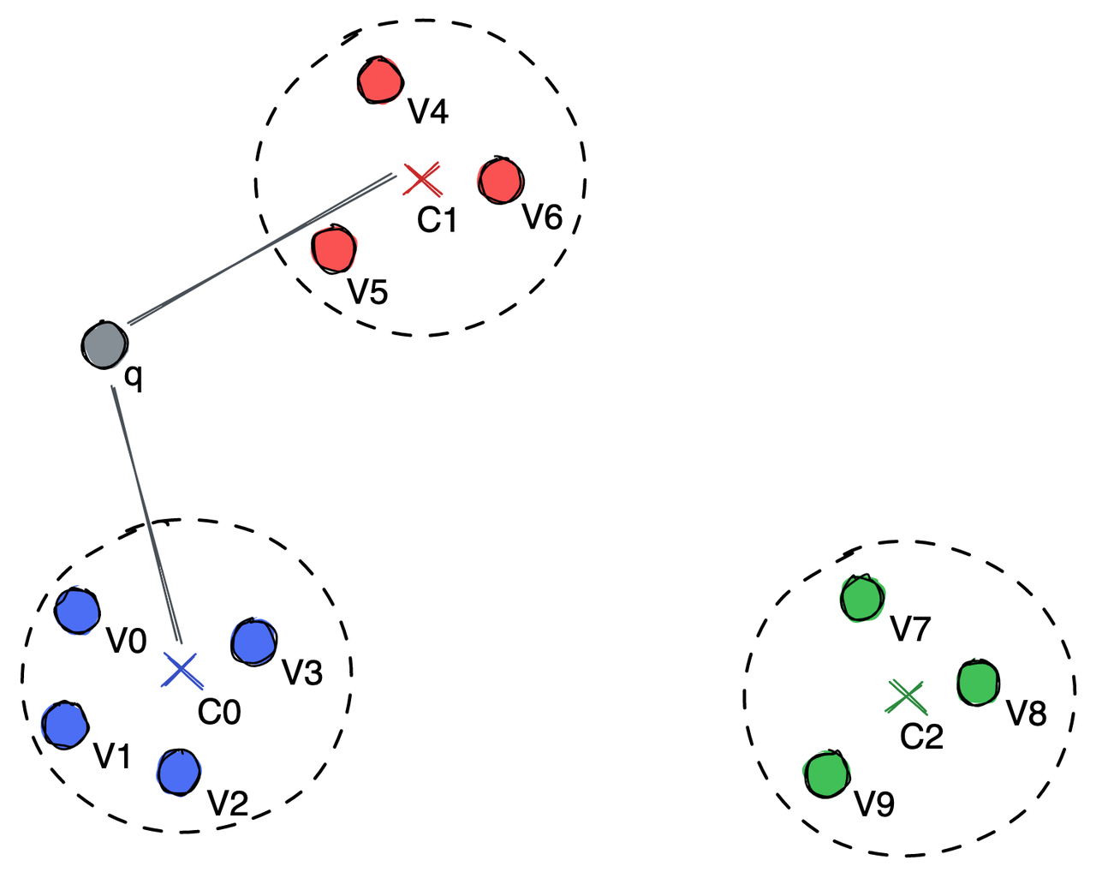
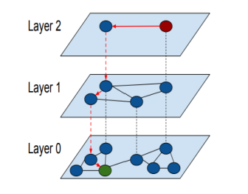
rittikabose109@gmail.com
Indexing Algorithms
Flat Indexing
Similarity between the query vector and every other vector in the index is computed
Easy to implement, accurate, but very slow
Locality Sensitive Hashing (LSH)
Similar vectors are hashed to the same bucket
Query vector is hashed and compare with vectors that hashed with same value
Faster than flat indexing
Inverted File (IVF)
Vector space is partitioned into clusters and centroids of each cluster are found
Searching is done over all vectors in the cluster with closet centroid to query vector
Balance between speed and accuracy
Hierarchical Navigable Small Worlds (HNSW)
Organized vectors into multi-layered graph structure
Facilities fast nearest neighbor searches
Efficient in handling large datasets
IVF Indexing
HNSW Indexing
Chunking
Embedding
Indexing
Retrieval
Augmentation
Generation
Notes:
Slide 15 - Indexing algorithms
There are these four indexing algorithms - how we store these embeddings into vector database.
1)First most simplest one is flat indexing - where without any manipulation, every vector is stored in the index and while retrieval the query vector is compared with all the vectors in the index.
And then top ones are found.
This is easy to implement, also accurate but very slow because it utilizes all the comparison in this case.
2) Next one is Locality Sensitive Hashing algorithm - where similar vectors are first hashed using some hashing function and put into same bucket.
And when we have this query vector, it is also hashed and compared with all the vectors that hashed with the same value.
So this is faster than flat indexing because the number of comparison are lower, we only look at the vector that is hashed with same value.
3)Third method which is similar to LSH - that is called “Inverted File”.
In this case, the vector space is partitioned into clusters and the centroids of each cluster are found.
And when we have this query vector, we first find the closest centroids to the query vector
And then search only into the chunk embeddings in the same cluster.
So this achieves balance between speed and accuracy.
4)And the last algorithm is Hierarchical Navigable Small Worlds (HNSW).
This is also commonly used in all these vector databases.
It is a much more complex algorithm.
And in this algorithm we organize the vectors in a multilayered graph structure as shown in the figure.
This also facilitates fast nearest neighbor searches and it is very efficient in handling larger datasets.
So these are complex algorithms. We will provide more details on these on our Whova discussion page.

Slide 16
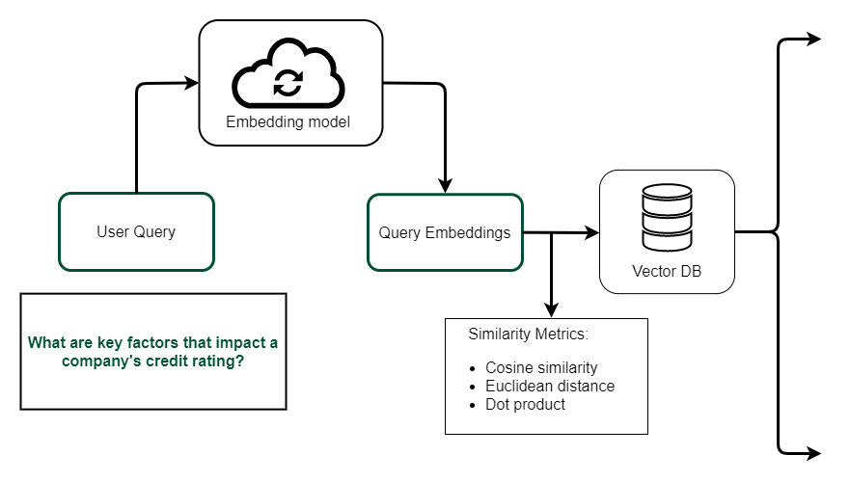
rittikabose109@gmail.com
Step 4: Retrieval
Chunk 1:
“Credit ratings assess the creditworthiness of a borrower based on factors such as financial performance, debt levels, and repayment history.”
Chunk 2:
“Macroeconomic conditions, such as interest rates and inflation, also play a significant role in determining a company’s credit rating.”
Chunk 3:
“Non-financial factors, such as corporate governance, management stability, and industry-specific risks, are often considered in credit evaluations.”
Chunk 4:
“Regulatory changes or compliance issues can negatively affect credit ratings, especially in industries like banking and finance.”
Top k retrieved chunks (e.g. k=4)
Chunking
Embedding
Indexing
Retrieval
Augmentation
Generation
Notes:
Slide 16 - Retrieval
So now we have chunk stored as embeddings in the vector database.
The fourth step is the actual retrieval phase - where we have some query - for example, from financial domain, some questions like - "what are key factors that impact a company's credit rating?".
So, this question is first converted to vectors or embeddings, using the embedding model.
And then using some similarity metric like - cosine similarity, Euclidean distance or dot product, we find the top chunks from our vector database that is matched with our query.
So for example, in this case, our k is 4 - meaning we are retrieving top 4 chunks.
And the four chunks look something like this.
Every chunk is talking about some factor that impacts a company's rating.

Slide 17
Step 5: Augmentation
User Query
Instruction: You are and AI assistant specializing in finance. Based on the provided information, answer the query in a concise and clear manner.
Context:
Question:
Retrieved Chunks
Prompt to the LLM
Prompt template
Chunking
Embedding
Indexing
Retrieval
Augmentation
Generation
Notes:
Slide 17 - Augmentation
After we retrieve only the relevant chunks, we augment these chunks with user's query and then we provide the prompt to the LLM.
So, typically a RAG prompt template look like this - where we first provide some "instructions" like - "based on provided information, answer the query".
And then we have these places for context and the question.

Slide 18
Augmentation
Instruction: You are and AI assistant specializing in finance. Based on the provided information, answer the user’s query in a concise and clear manner.
Context:
1. Credit ratings assess the creditworthiness of a borrower based on factors such as financial performance, debt levels, and repayment history.
2. Macroeconomic conditions, such as interest rates and inflation, also play a significant role in determining a company’s credit rating.
3. Non-financial factors, such as corporate governance, management stability, and industry-specific risks, are often considered in credit evaluations.
4. Regulatory changes or compliance issues can negatively affect credit ratings, especially in industries like banking and finance.
Question: What are the key factors that impact a company’s credit rating?
User Query
Retrieved Chunks
Prompt to the LLM
Chunking
Embedding
Indexing
Retrieval
Augmentation
Generation
Notes:
Slide 18 - Augmentation (continue)
And after filling in with the retrieved chunks it look something like this.
So for the context - now we have filled in all the four relevant chunks and then we ask the question.
Now the LLM has the whole understanding of context as well, instead of from simply asking the question.

Slide 19

Step 6: Generation
The key factors that impact a company’s credit rating include its financial performance, debt levels, and repayment history. Macroeconomic conditions like interest rates and inflation also play a significant role. Non-financial factors, such as corporate governance, management stability, and industry-specific risks, are considered as well. Additionally, regulatory changes or compliance issues can negatively affect ratings, particularly in regulated sectors like banking and finance.
Prompt to the LLM
Generated answer
Chunking
Embedding
Indexing
Retrieval
Augmentation
Generation
Notes:
Slide 19 - Generation
And then this prompt is provided to the LLM.
And now it will give some answer using all the context and the query.

Slide 20
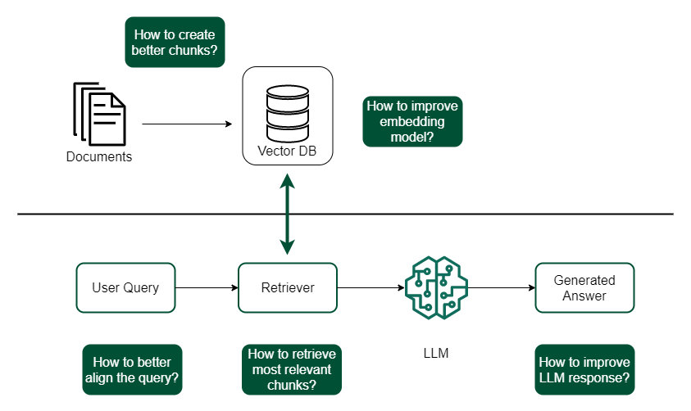
Challenges
Notes:
Slide 20 - Challenges
In every step of this pipeline, there are certain challenges.
Like in the chunking phase - a question can be ask - "How to create better chunks".
So for this we can use appropriate chunking strategy.
And then "How to improve the embedding model?"
For this we can use certain fine tuning techniques, to improve embedding model
Then the user's question can be very ill-formed, it can be ambiguous
The challenge her is that how to better align the query
And then "How to retrieved most relevant chunks" on the user's query.
And finally how to improve the LLM response
The response can be improved by fine-tuning the LLM, specifically for the rag task

Slide 21
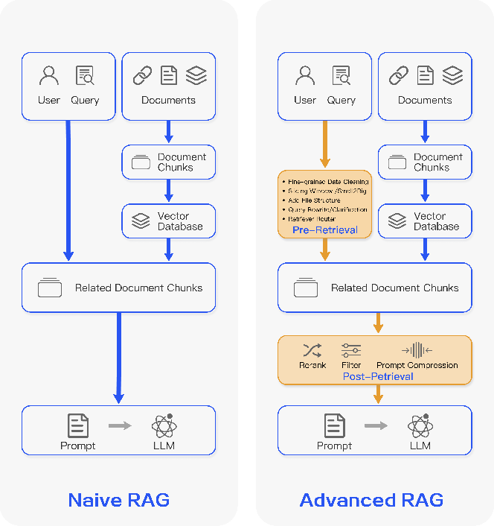
Advanced RAG
Pre-retrieval
Indexing enhancement: improve quality of indexed content by using metadata
Query enhancement: Make user’s question clearer and more suitable for retrieval task
Post-retrieval
Re-ranking: organizing retrieved documents in optimal way
Context compression: select essential information before sending to LLM
Gao, Yunfan, et al. “Retrieval-augmented generation for large language models: A survey.” (2023).
Notes:
Slide 21 - Advance RAG
So some of these challenges could be overcome by certain techniques - which are included in this advance RAG method
It is divided into two phases: first is pre-retrieval method, second is post re-trieval
So to improve some of the thing in pre-retrieval.
We can improve the indexing or improve the quality of the chunks by using some metadata or augmenting some information in the chunk.
Second thing is query enhancement - where we can make the question of the user more clear before performing the retrieval
And in post-retrieval, this one method is called re-ranking - where after retrieving the documents, we order them in a better way
And another method is context compression, where before providing LLM with the context, we only select the essential information, before sending it to LLM

Slide 22
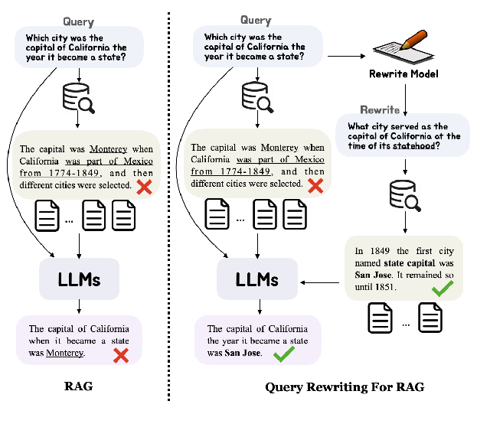
Query Enhancement
Original query could be complex, ambiguous or not well organized → Retrieval becomes difficult.
Query enhancement methods help to better align user’s query for retrieval task:
Query Expansion
Complex question broken down to simpler sub-questions by prompting LLMs
Query Transformation
Use LLMs to rewrite the queries
Query Routing
Extract keywords from query and filter the chunks based on metadata
What is the use of model 12345?
What is the purpose of ABC Policy?
Keyword extraction from queries
Mao, Shengyu, et al. “RaFe: Ranking Feedback Improves Query Rewriting for RAG.” (2024).
Notes:
Slide 22 - Query enhancement
So let's talk more details on the query enhancement
So the original query the user is asking could be complex, in some cases ambiguous or not well-organized
In this case the retrieval becomes very difficult
So some of these methods to align users better for the retrieval task:
First is "Query expansion" - where when the question is very complex, it is broken down into simplest of sub-questions, by using LLMs
And then sub-questions are further used for the retrieval task
Next method is "Query Transformation" - where we use LLMs to rewrite the queries.
So, we have included this example from a paper by Mao et all. And it demonstrate why rewriting improve the performance of the model
Like, for example, the query here - the original query was "Which city was the capital of California the year it became a state"
Then in the retrieval phase, it picked wrong chunk, and hence the answer was wrong - "the capital of California when it became a state was Monterery"
But then by rewriting user query, the original query is converted to different query or rereturn query - which is in this case "What city served as the capital of California at the time of its statehood?"
So simple method of rewriting helps in better retrieval.
Now it has picked out the correct chunks, which mentions "San Jose", LLM answers this correctly like "The capital of California the year it become a state was San Jose"
So this example demonstrate by simply rewriting the query, LLM can help.
And the third method is query writing - where we extract some keyword from the query first and then the chunks are retrieved based on the metadata
For example, we have some questions regarding models we work on - like "what is the use of model number 1234?".
So, this 1234 number can be extracted and then only the chunks specific to this number could be retrieved, could be searched from
Another example we have this question related to internal policy - like "what is the purpose of ABC policy"
Now we extract the keyword ABC and only look through those those chunks
So these methods improve the retrieval

Slide 23
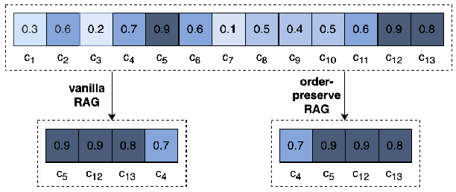
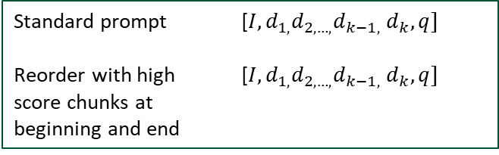
Re-ranking
Re-ranking reorders the retrieved document chunks before sending it to LLM
Rule-based
Descending order of relevance scores
Order-preserve RAG → maintains original order of chunks
Retrieval re-ordering → keeping important chunks at both ends
Model-based
Prompt LLMs to re-rank the retrieved chunks
Train a model for re-ranking task. e.g. cohere rerank, bge-reranker-large
Order-preserve RAG
Standard prompt [$I,d_{1,}d_{2, …,}d_{k−1,}$ $d_{k},q]$
Reorder with high [$I,d_{1,}d_{2, …,}d_{k−1,}$ $d_{k},q]$
score chunks at
beginning and end
Yu, Tan, Anbang Xu, and Rama Akkiraju. "In Defense of RAG in the Era of Long-Context Language Models." (2024)
Jin, Bowen, et al. “Long-Context LLMs Meet RAG: Overcoming Challenges for Long Inputs in RAG.” (2024)
Reorder
Notes:
technique used to refine the initial search results obtained from a retrieval system, with the goal of improving their relevance and accuracy. In the context of RAG retrieval, re-ranking acts as a quality control mechanism that helps our librarian (the LLM) fine-tune the list of potential responses before generating the final answer.
https://medium.com/@csakash03/mastering-re-ranking-for-superior-llm-rag-retrieval-a-comprehensive-guide-931daf0c68f7

Slide 24
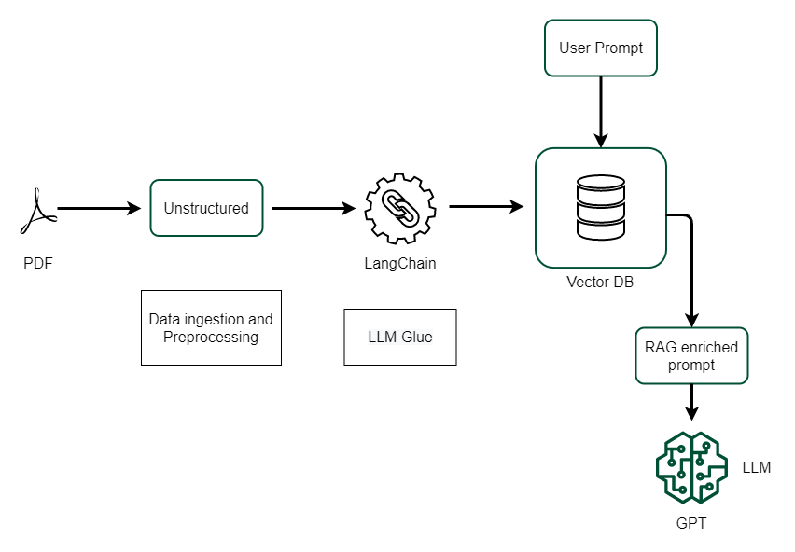
RAG workflow using LangChain
Document Ingestion and Vectorization:
Text data (e.g., PDFs, files) is ingested.
The data is converted into vector embeddings using a pre-defined embedding model.
The vectors are stored in a persistent vector database (like Chroma).
2. Query Understanding:
User inputs a query.
The query is transformed into an embedding using the same embedding model.
3. Vector Similarity Search:
The query embedding is matched against the vector database to retrieve the most relevant documents.
4. Contextual Response Generation:
Retrieved documents are passed as context to Ollama.
LLM generates a response that integrates the retrieved information with its inherent language understanding.
5. Feedback Loop (Optional):
Responses are evaluated for accuracy and relevance, allowing for iterative improvements in document indexing and retrieval.
Notes:
This workflow demonstrates how LangChain can streamline the integration of retrieval with generative models, making it easier to build applications that provide data-driven, context-aware responses.

Slide 25
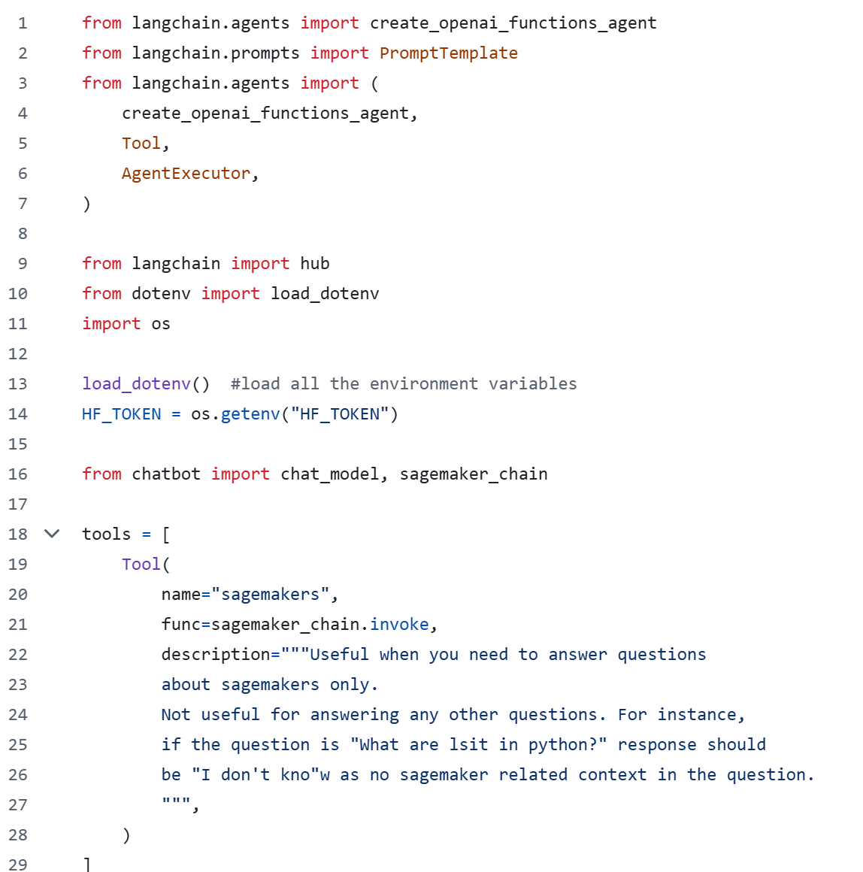
Demo: RAG in Action
Github link - https://github.com/Rittika-Mitra/rag-pipeline
The Readme file describes how the RAG pipeline has been created using LangChain.
Notes:
We have used here Langchain framework to create a vector based RAG model, which has its inbuilt Agent (LLMs that can make decisions and use tools) to build more sophisticated applications.
And The RAG vector based model is created which we can feed in the input document/pdf or multiple pdfs to provide response.
LangChain RAG Agent - This step involves setting up the LangChain Retrieval-Augmented Generation (RAG) Agent which can scrape web content, retrieve relevant documents, and generate answers to user queries based on the retrieved content.

Slide 26
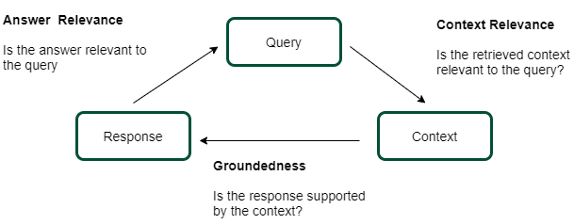
Evaluation of RAG System
Evaluation objectives
Retrieval quality: Evaluating the effectiveness of the context sourced by the retriever component
Generation quality: capacity to synthesize coherent and relevant answers from the retrieved context
Es, Shahul, et al. "Ragas: Automated evaluation of retrieval augmented generation." (2023)
Notes:
Evaluating Retrieval-Augmented Generation (RAG) systems involves assessing both the retrieval and generation components, focusing on metrics like relevance, accuracy, and faithfulness to ensure the system delivers helpful
and accurate responses

Slide 27
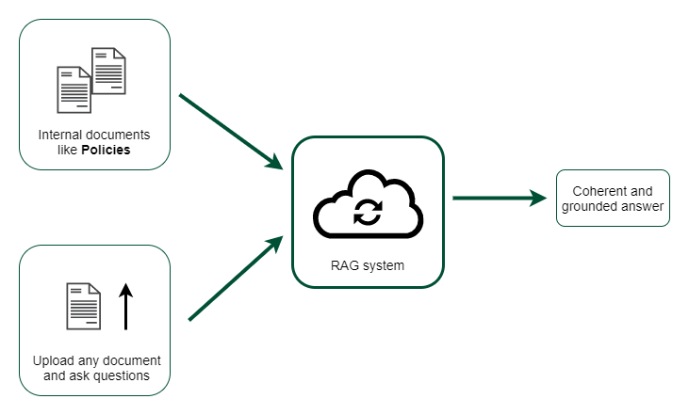
Applications in Financial Industry
Notes:
In financial services, RAG can be used to extract and synthesize relevant information from:
extensive financial databases
transaction records
market data
regulatory documents
Think of it like an AI financial advisor that understands complex queries and can instantly sift through millions of financial records, market reports, and regulatory guidelines to provide accurate, context-aware answers.

Slide 28

Thank You
Contact Information:
Afsana Akther Asha
https://www.linkedin.com/in/afsanaasha
Rittika Bose
https://www.linkedin.com/in/rittika-bose

