Slide 1

Handsignify
AI-Based Real-Time Sign Language Detection
Presented by Gurajala Laasyapriya
-23102C010036

Slide 2

Bridging Communication Gaps
AI enhances real-time sign language communication effectively.
PROJECT OVERVIEW
2

Slide 3
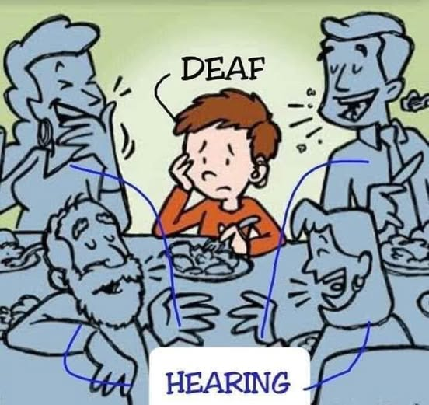
Problem Statement
Communication gap exists between hearing and speech-impaired individuals.
Limited awareness and understanding of sign language among the general public.
Lack of real-time, user-friendly translation tools for effective interaction.

Slide 4
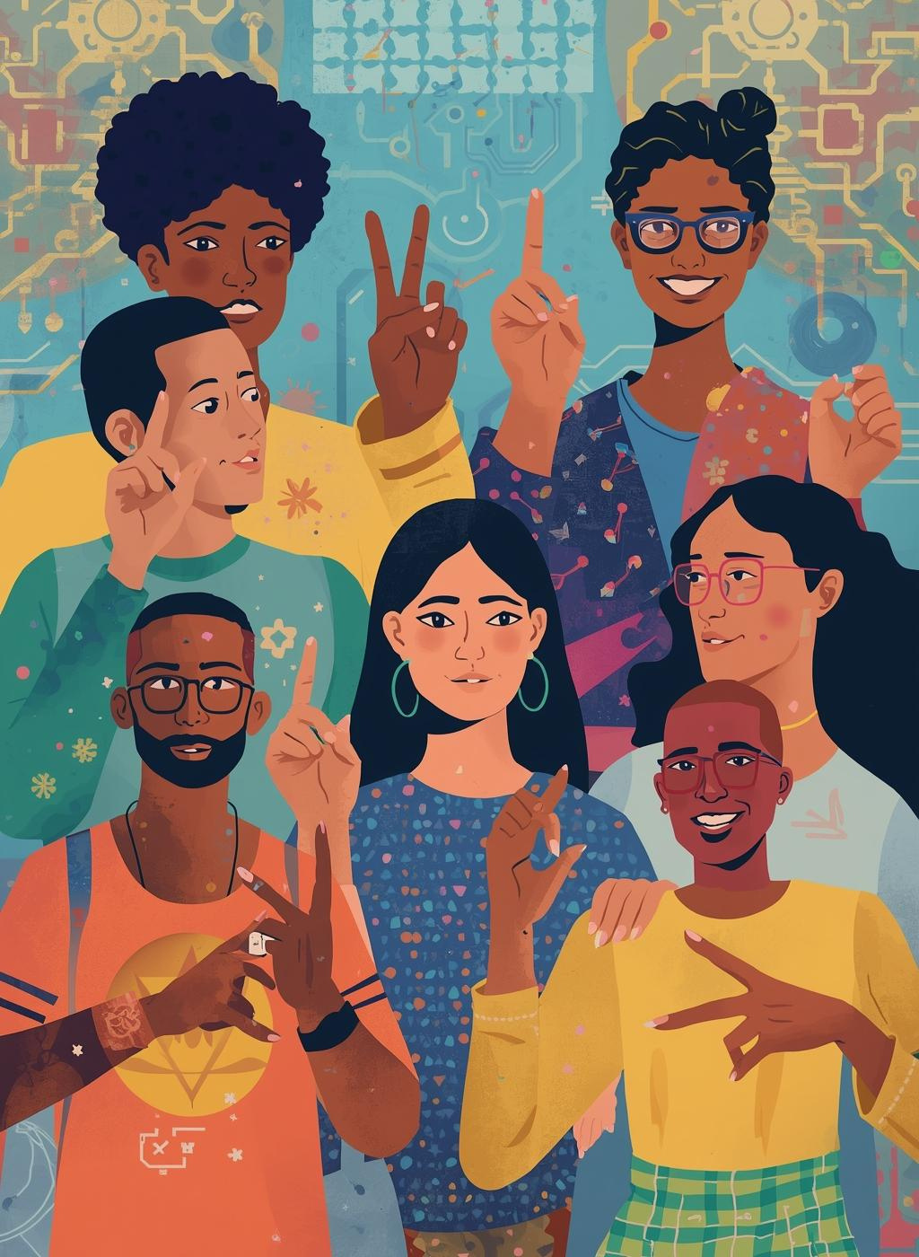
Communication Barriers
Challenges Faced by the Deaf Community
Lack of a common communication medium.
Low awareness of sign language among the public.
Dependence on interpreters, which limits privacy and independence.
Challenges in real-time interactions in daily and professional life.
Resulting social exclusion and limited accessibility.
4

Slide 5

Project Objectives
Accessibility
Our system enhances accessibility for the hearing impaired by translating sign language gestures into spoken language in real-time.
Communication
By using AI technology, we enhance interactions between hearing and non-hearing individuals, promoting inclusivity and a more connected society.
AI Accuracy
Our project uses advanced machine learning to improve sign language recognition accuracy, enabling precise gesture interpretation for better communication in diverse environments.
KEY TAKEAWAYS
5

Slide 6

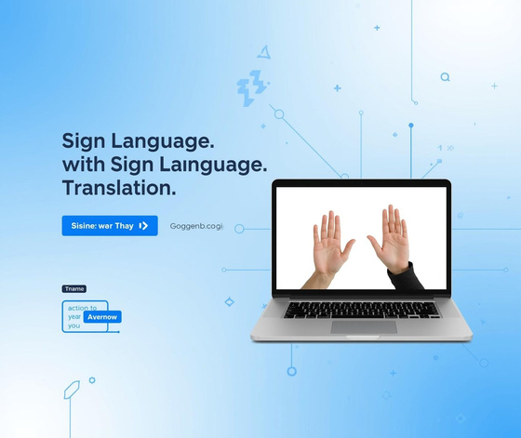
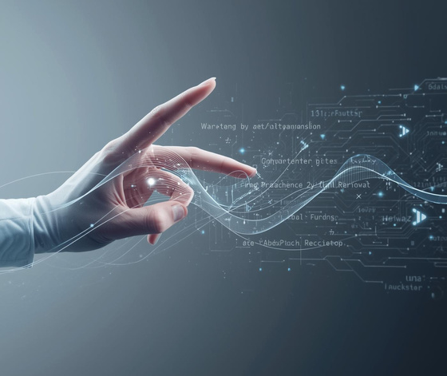
Features of HandSignify
Real-Time Detection
User-Friendly Interface
Translation Capabilities
HandSignify enables real-time sign language recognition using advanced algorithms for seamless communication.
The platform offers an intuitive interface with simple controls and clear visuals for easy navigation and a better user experience.
The system translates sign language into text and speech, enabling easy and inclusive communication.
6

Slide 7




Technology Stack
Python
Flask
OpenCV
TensorFlow
7

Slide 8
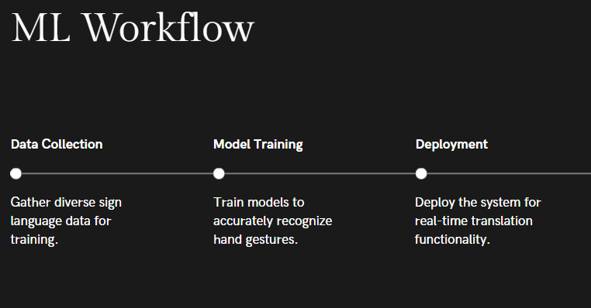
8

Slide 9
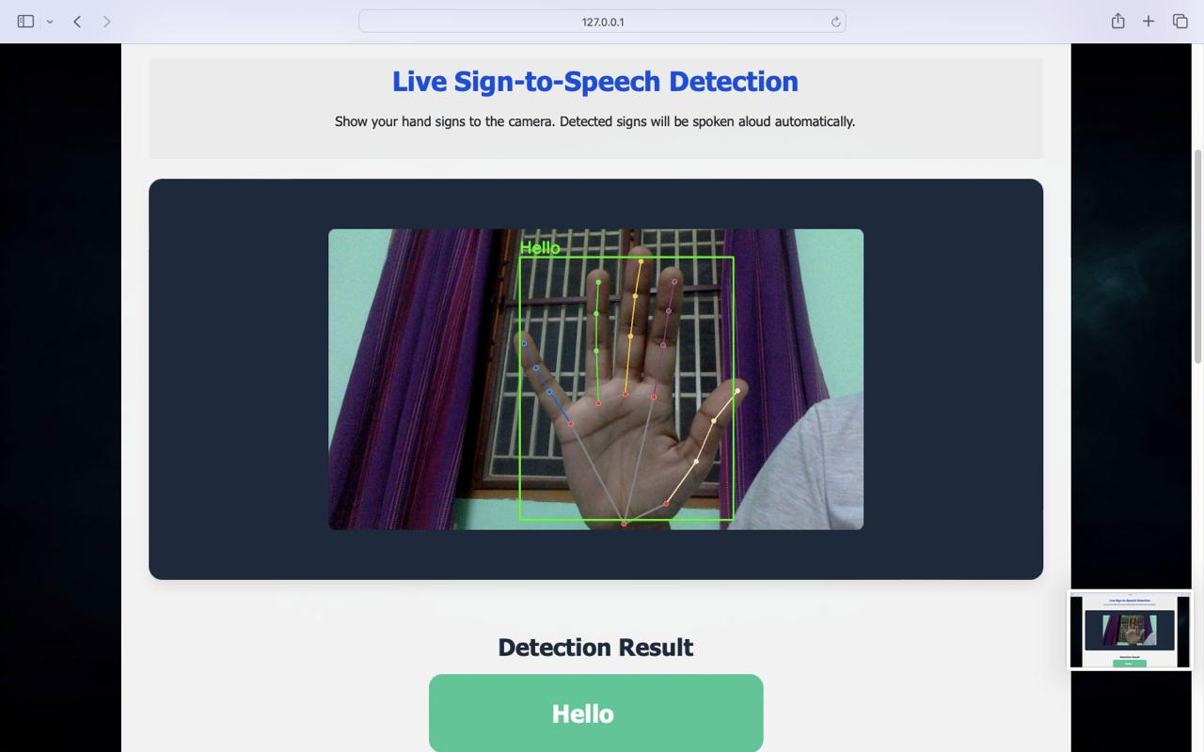
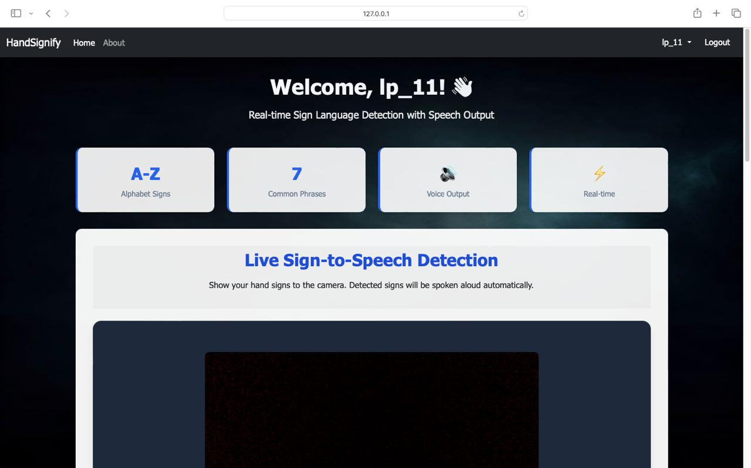
System in Action
Hand Gesture Detection
Real-Time Translation
9

Slide 10

Challenges Faced
Environmental Factors
Environmental conditions can significantly impact gesture recognition accuracy. Variations in lighting, background noise, and physical environment can hinder the system's performance and reliability.
Data Limitations
Insufficient and unbalanced training data can lead to overfitting. A diverse dataset is crucial for effective model training, improving sign language detection efficiency.
Computational Complexity
The algorithms used for real-time processing can be computationally intensive, requiring optimization to ensure seamless performance while maintaining accuracy in gesture recognition and translation.
Real-Time Processing
Achieving real-time processing demands efficient algorithms and high computational power, which can be a challenge in deployment, especially on low-resource devices like mobile phones or embedded systems.
ADDITIONAL CONSIDERATIONS
10

Slide 11
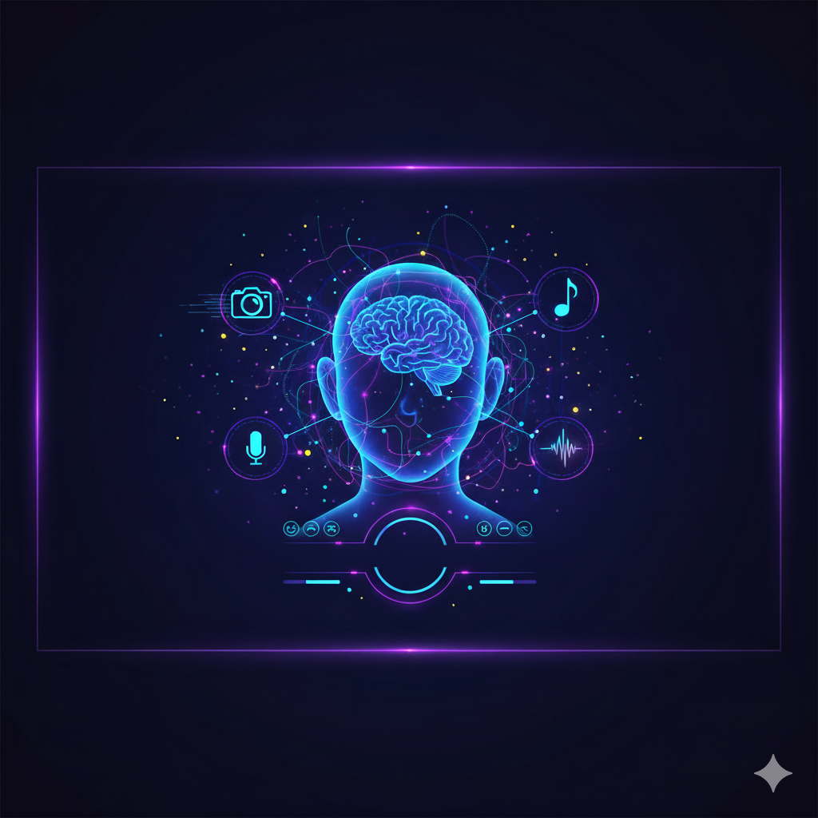
Future Scope
Develop a mobile application for on-the-go sign translation.
Add multilingual support for regional and international languages.
Integrate with video conferencing platforms for real-time conversations.
Enhance accuracy using deep learning and larger gesture datasets.
Extend functionality to two-way translation — text/speech to sign gestures.
11

Slide 12

Conclusion
The Future of Communication
HandSignify represents a breakthrough in accessibility, harnessing AI to bridge communication gaps. By transforming sign language into text, it empowers individuals to connect seamlessly and inclusively.
FINAL THOUGHTS
12

Slide 13

THANK YOU

