Slide 1
presented to:
ASHADUZZAMAN
Lecturer
department of CSE
AFSANA KABIR
182002068
RAZIA SULTANA
182002079

Slide 2
STUDENT MENAGMENT SYSTEM
contents
LOGIN
REGESTRATION
MAIN PAGE
a

Slide 3
STUDENT MENAGMENT SYSTEM
contents
LOGIN
REGESTRATION
MAIN PAGE

Slide 4
STUDENT MENAGMENT SYSTEM
contents
STUDENT RESULTS
STUDENT INFO
PREVIOUS PAGE
a

Slide 5
STUDENT MENAGMENT SYSTEM
contents
STUDENT RESULTS
STUDENT INFO
PREVIOUS PAGE

Slide 6
1. INTRODUCTION
MOTIVATION
In computer science, a Design and Analysis of Algorithm is a particular way of organizing data in a computer so that it can be used efficiently.
It can implement on or more particular Abstract Data Types (ADT), which are the means of specifying the contract of operations and their complexity.
In comparison, it is a concrete implementation of the contract provided by an ADT.
Data structures provide a means to manage large amounts of data efficiently for uses such as large databases and internet indexing services.
Usually, efficient data structures are key to designing efficient algorithms. Some formal design methods and programming languages emphasize data structures, rather than algorithms, as the key organizing factor in software design. Storing and retrieving can be carried out on data stored in both main memory and secondary memory.
The implementation of a data structures usually requires writing a set of procedures that create and manipulate instances of that structure.
The efficiency of data structure cannot be analyzed separately from those operations. T
his observation motivates the theoretical concept of abstract data type, a data structure that is defined indirectly by the operations that may be performed on it, and mathematical properties of those operations (including their space and time cost).

Slide 7
Problem Definition
To create a Student Result System using ‘JAVA’ Language involving concepts of Searching and Sorting and its analysis. This software will contain all the necessary information regarding student’s record.

Slide 8
Objective of Project
The objective of the project is to create a Student Result System to store the Name, Roll no., Marks of different student using a linear data structure using C programming. In this software one can very easily add student’s record, sort student’s record, search student’s record, compute (using algorithms) and view all student’s records. This application stand out among all other software in a way that it is user friendly and can be modified easily as per the requirements. It allows user to add new/view/sort/search records.

Slide 9
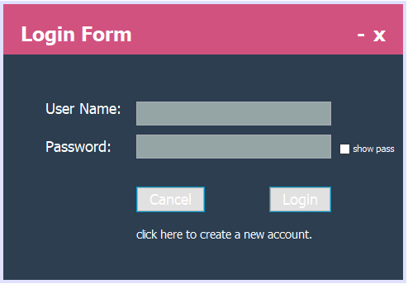
PROJECT VIEW

Slide 10
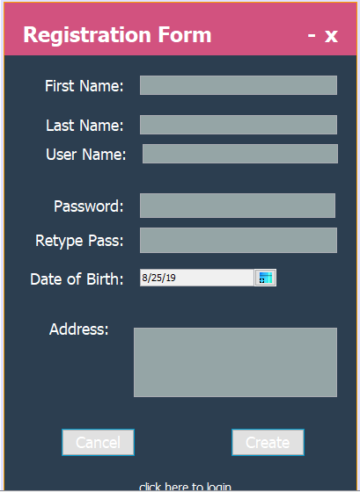
PROJECT VIEW

Slide 11
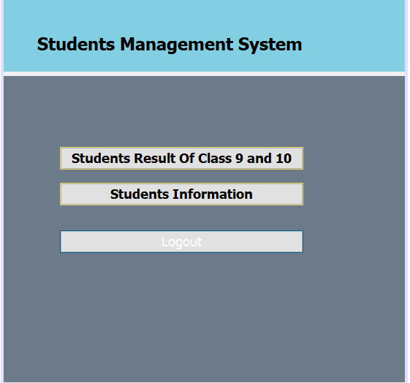
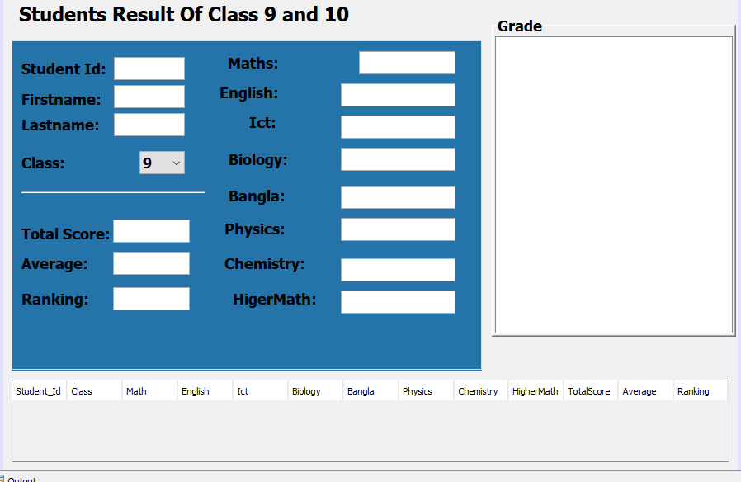
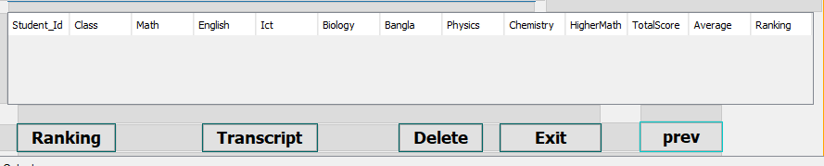
PROJECT VIEW

Slide 12
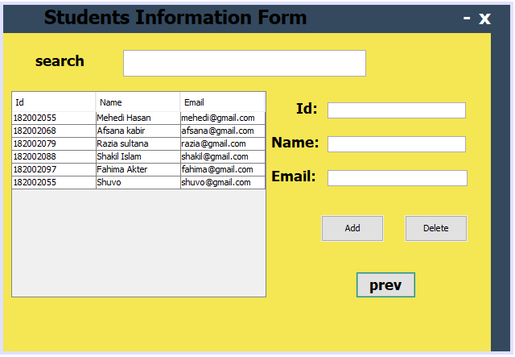
PROJECT VIEW

Slide 13
CONCLUSION
1.The projects clearly depicts that the Student Result System is very efficient.
2. It shows how the concept of File Handing can be used in database management system in absence of databases like Oracle, MySql etc.
3.Although, this software can be further modified to be used as multitasking and bigger software, but it effectively works under the condition of limited resources and time.

Slide 14
THANK YOU

