Slide 1
If else statement
Presented by presented to
Reduan Ahamed Mr. Rana
Id:182002045 Senior Lecturer of CSE department
Sec:DA 182 batch

Slide 2
Content
What is if else statement
If else structure
How does if/else work internally in a program

Slide 3
An if else statement in programming is a conditional statement that runs a different set of statements depending on whether an expression is true or false
if(condition)
{ // Statements inside body of if }
else
{ //Statements inside body of else }

Slide 4
if/else work internally in a program

Slide 5

Two Content Layout with Table
#include <stdio.h>
int main()
{
int a, b, c;
printf("Enter three numbers: ");
scanf("%d %d %d", &a, &b, &c);
if (a>b&&a>c)
{
printf("%d ", a);
}
if(b>a&&b>c )
{
printf("%d ", b);
}
if(c>a&&c>b)
{
printf("%d ", c);
}
return 0;
}
a b c
a>b&&a>c b>a&&b>c c>a&&c>b
First bullet point here
Second bullet point here
Third bullet point here

Slide 6
Two Content Layout with Table
#include <stdio.h>
int main()
{
int a, b, c;
printf("Enter three numbers: ");
scanf("%d %d %d", &a, &b, &c);
if (a>b)
{
if(a>c)
printf("%d ", a);
else
printf("%d ", c);
}
else
{
if(b>c)
printf("%d", b);
else
printf("%d",c);
}
return 0;
}
a b c
a>b&&a>c b>a&&b>c c>a&&c>b
a>b a>c b>a b>c c>a c>b
First bullet point here
Second bullet point here
Third bullet point here

Slide 7
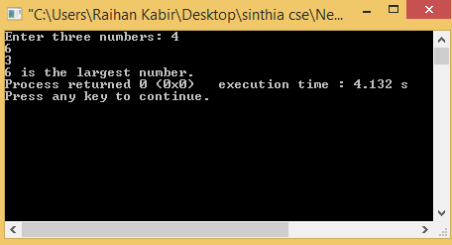
output
#include <stdio.h>
int main()
{
int a, b, c;
printf("Enter three numbers: ");
scanf("%d %d %d", &a, &b, &c);
if (a>b)
{
if(a>c)
printf("%d ", a);
else
printf("%d ", c);
}
else
{
if(b>c)
printf("%d", b);
else
printf("%d",c);
}
return 0;
}

Slide 8
THANK YOU

