Slide 1

Classifications of 8086
Interrupts

Slide 2
Classifications of 8086 Interrupts
Presented by:
Afsana Kabir Sinthia
Id: 182002068
Sec: 182DB
Dept: CSE
Presented To:
MD. Safial Islam Ayon
Lecturer
Dept : CSE

Slide 3


Introduction Ot Operating System
CONTENT OF
THIS SLIDE
What is Interrupts
Classifications of 8086 Interrupts
Hardware
Software

Slide 4
Classifications of 8086 Interrupts
What is
Interrupts
An interrupt is a signal sent to the processor that interrupts the current process. It may be generated by a hardware device or a software program.

Slide 5
Classifications of 8086 Interrupts
Classifications of 8086
Interrupts
8086 Interrupts
Hardware
Software
256 Interrupts
Maskable
Non maskable

Slide 6


Classifications of 8086 Interrupts
Hardware
Interrupts
Hardware interrupt is caused by any peripheral device by sending a signal through a specified pin to the microprocessor.
CPU

Slide 7
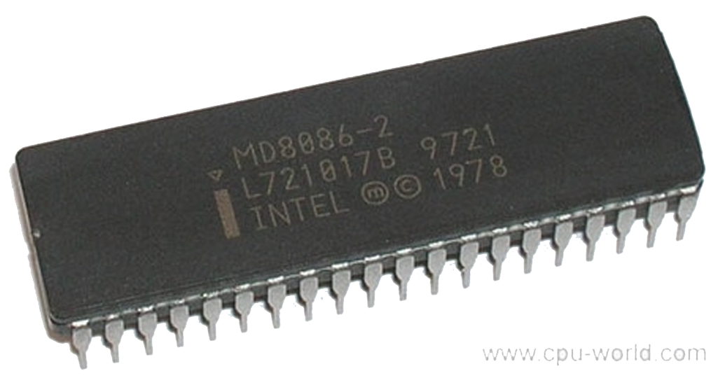
Classifications of 8086 Interrupts
Maskable
CPU
The INTR is a maskable interrupt
NMI
17
INTR
18
Non-maskable
--------------------------------------------------------------------------------------------------------------------------------------------------------------------------------------------------------------------------------------------------------------------------------------------------------------------------------------------------------
Service routine

Slide 8
Software interrupt
Brand New Bag
USD 3550
Special Price
BUY NOW
program

Slide 9
Classifications of 8086 Interrupts
Working procedure of
INT
Software Interrupt
Vector
table
Stack
<//>
CS
IP
ISR

Slide 10
THANK YOU

