Slide 1
Relevance-based Radio Resource Management for Machine Learning Units
Ph.D. Defense of Afsaneh Gharouni
University of Kaiserslautern-Landau, in cooperation with Nokia Munich
December 14th, 2023
Chairman: Prof. Dr.-Ing. Norbert When
Examiners: Prof. Dr.-Ing. Hans D. Schotten
Prof. Dr.-Ing. Peter Rost (Karlsruhe Institute of Technology)

Slide 2
Part 1
Introduction
Relevance-based Bit Allocation
Relevance-based Wireless Resource Allocation
Relevance-based Time Domain Signal Overhead Reduction
Conclusion and Outlook
My contributions
Chapter 1 of the dissertation

Slide 3
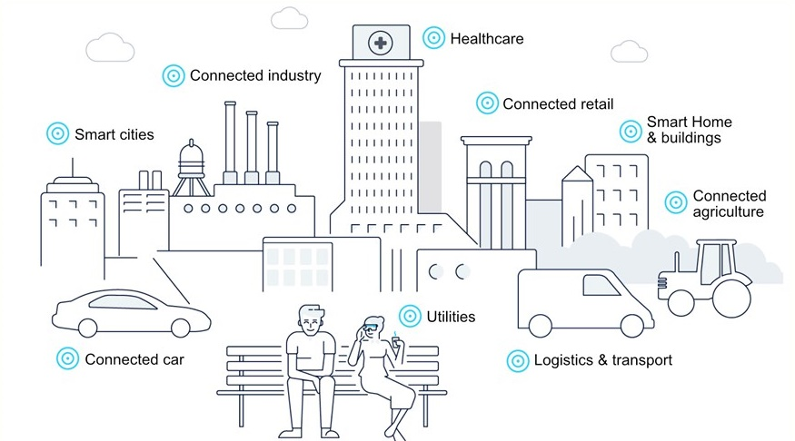
Introduction
Motivation
Traditional communications systems designed to support of human-to-human communication.
Machine Learning (ML) expected to play a key role in 6G.
Many ML units (MLUs) in the network create burdens and new requirements (e.g. on data transmission and storage).
Future communications systems designed to support communication of MLUs.
Support of MLUs in mobile network during inference
Notes:
“These traditional approaches are showing serious limitations, especially in view of the increased complexity of communication networks.” ComSoc

Slide 4
Introduction
Motivation
Node A
in Network
Node B
in Network
Machine Learning Unit
(MLU)
Final output
Communications goal: Delivering syntax from A to B

Slide 5
Introduction
Motivation
Node A
in Network
Node B
in Network
+ distortion
Machine Learning Unit
(MLU)
Final output
Communications goal: Delivering syntax from A to B
ML can handle distortion at its input → less distortion tolerance, more relevant input attributes
How to measure the MLU input relevance such that it can be used by the network?

Slide 6

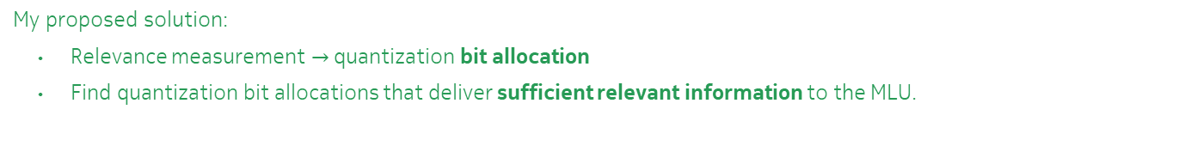

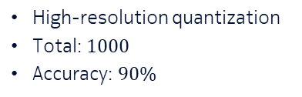

Introduction
High-level Problem Formulation & Solution
How to measure the MLU input relevance such that it can be used by the network?
A compression technique to map continuous values to discrete values
Baseline:
User
gNB
$10$ bits
$${\hat{x}}_{1}$$
MLU
High-resolution quantization
Total: $1000$
Accuracy: $90\%$
$10$ bits
$${\hat{x}}_{100}$$
My proposed solution:
Relevance measurement $→$quantization bit allocation
Find quantization bit allocations that deliver sufficient relevant information to the MLU.
How relevance-based bit allocations can be used by the network?

Slide 7




Introduction
Bit Allocation Use A) for Improved Resource Utilization
Resource (e.g., bandwidth)
Bit allocation:
1st $50$: $10$bits
2nd $50$: $10$ bit
$1000$ bits
$90\%$ acc.
New bit allocation #1:
1st $50$: $10$bits
2nd $50$: $1$ bit
$550$ bits → 45% gain
$90\%$ acc.
Solution:
Solution:
MLU
$${\hat{x}}_{1}$$
MLU
$${\hat{x}}_{1}$$
$${\hat{x}}_{100}$$
$${\hat{x}}_{100}$$
$$90\%$$
MLU accuracy
10-bits quantization
New bit allocation #1

Slide 8

Introduction
Bit Allocation Use B) for Scarce Resource Utilization
Resource (e.g., bandwidth)
New bit allocation #1:
1st $50$: $10$bits
2nd $50$: $1$ bit
$550$ bits → 45% gain
$90\%$ acc.
New bit allocation #2:
1st $50$: $5$bits
2nd $50$: $1$ bit
$300$ bits → 70% gain
$84\%$ acc. → 6% loss
Solution:
Solution:
MLU
$${\hat{x}}_{1}$$
MLU
$${\hat{x}}_{1}$$
Scarce resources
$${\hat{x}}_{100}$$
$${\hat{x}}_{100}$$
$$90\%$$
MLU accuracy
10-bits quantization
New bit allocation #1
New bit allocation #2 → best effort performance
How to find such bit allocations and employ them for use A) and B)?

Slide 9
Introduction
Overview
To address, “How to find such bit allocations and employ them for use A) and B)” and more:
MLU Input Relevance captured in (three domains):
Quantization Bit Allocation
Radio Resource Allocation
Time Domain
Signal Overhead Reduction
Case study:
Indoor environment classification
Case study:
A network of inverted pendulums
on carts
Case study:
Conditional handover preparation

Slide 10
Introduction
Overview
To address, “How to find such bit allocations and employ them for use A) and B)” and more:
MLU Input Relevance captured in (three domains):
Quantization Bit Allocation
Part 2
Radio Resource Allocation
Part 3
Time Domain
Signal Overhead Reduction
Part 4
Case study:
Indoor environment classification
Case study:
A network of inverted pendulums
on carts
Case study:
Conditional handover preparation
How to find such bit allocations and employ them for improved resource utilization?

Slide 11
Part 2
Introduction
Relevance-based Bit Allocation
Relevance-based Wireless Resource Allocation
Relevance-based Time Domain Signal Overhead Reduction
Conclusion and Outlook
Quantization Bit Allocation
Indoor environment classification
Chapters 3 and 4 of the dissertation
Publications [1] and [2]

Slide 12




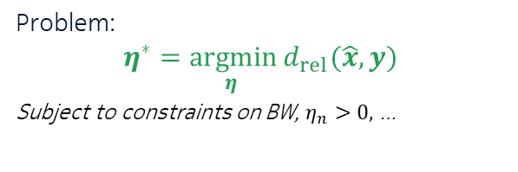





Relevance-based Bit Allocation
Problem Formulation
$${\hat{x}}_{1}$$
Problem:
$$η^{∗}=\underset{η }{argmin}{d_{rel}(\hat{x}, y)}$$
Subject to constraints on BW, $η_{n}>0,$ …
$$x_{1}$$
Quant. $η_{1}bits$
$${\hat{x}}_{1}$$
MLU
Comm. Network
$$y$$
…
…
$${\hat{x}}_{N}$$
$${\hat{x}}_{N}$$
$$x_{N}$$
Quant. $η_{n}bits$
$$d_{rel}→𝔼\left\{{\left(x_{n}−{\hat{x}}_{n}\right)}^{2}\right\} ?$$
Assumption: ML parameters are not changing.
Objectives:
MLU: black-box
Applicability: Multiterminal, No Gaussian distribution and independency assumptions, …
Relevance consideration
$$d_{rel}→ ?$$

Slide 13
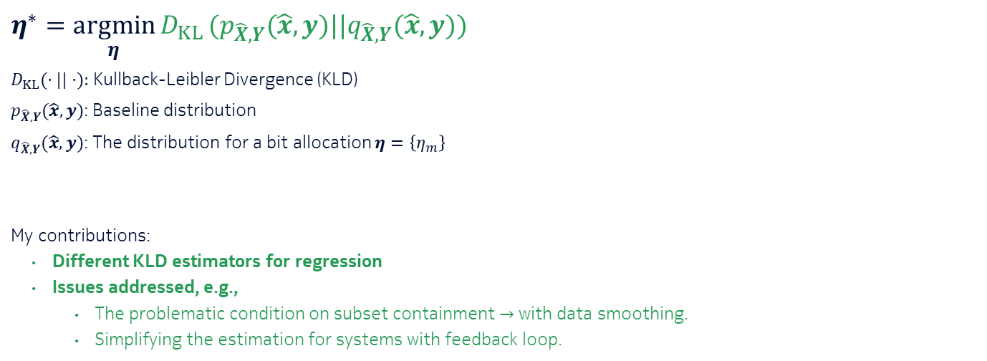
Relevance-based Bit Allocation
KLD-based Solution (1/3)
KLD
Comprehensive (input and output)
Higher order statistics
Inherent normalization
$$η^{∗}=\underset{η}{argmin}{D_{KL}}(p_{\hat{X}, Y}(\hat{x}, y)||q_{\hat{X}, Y}(\hat{x}, y))$$
$D_{KL}(⋅||⋅):$ Kullback-Leibler Divergence (KLD)
$p_{\hat{X}, Y}(\hat{x}, y)$: Baseline distribution
$q_{\hat{X}, Y}(\hat{x}, y)$: The distribution for a bit allocation $η=\left\{η_{m}\right\}$
My contributions:
Different KLD estimators for regression
Issues addressed, e.g.,
The problematic condition on subset containment $→$ with data smoothing.
Simplifying the estimation for systems with feedback loop.

Slide 14

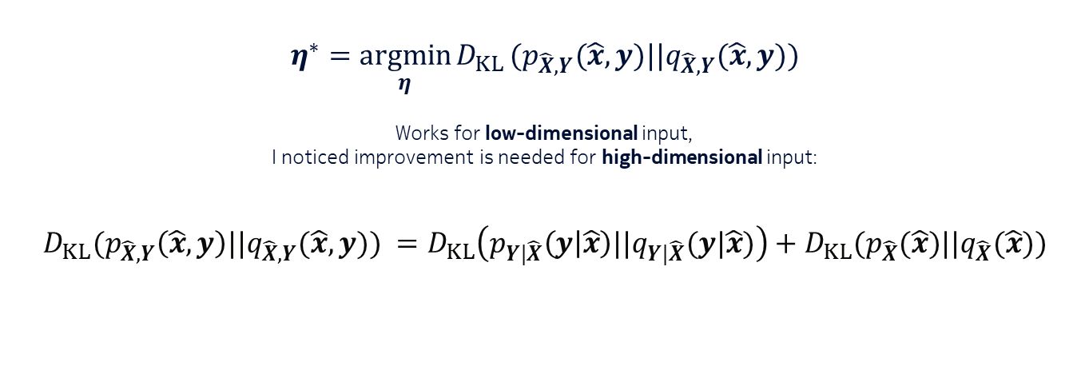
Relevance-based Bit Allocation
KLD-based Solution (2/3)
$$η^{∗}=\underset{η}{argmin}{D_{KL}}(p_{\hat{X}, Y}(\hat{x}, y)||q_{\hat{X}, Y}(\hat{x}, y))$$
Works for low-dimensional input,
I noticed improvement is needed for high-dimensional input:
$$D_{KL}(p_{\hat{X}, Y}\left(\hat{x}, y\right)||q_{\hat{X}, Y}(\hat{x}, y)) =D_{KL}\left(p_{Y|\hat{X}}\left(y | \hat{x}\right)||q_{Y|\hat{X}}(y|\hat{x})\right)+D_{KL}(p_{\hat{X}}(\hat{x})||q_{\hat{X}}(\hat{x}))$$
Syntax → Relevance
Relevance-based
Syntax-based
Dominant for
high-dimensional input
$≈𝔼_{x_{j}}\{d log(\frac{R_{q}(x_{j})}{R_{p}(x_{j})})\}$

Slide 15

Relevance-based Bit Allocation
KLD-based Solution (3/3)
$$η^{∗}=\underset{η}{argmin}{D_{KL}}(p_{\hat{X}, Y}(\hat{x}, y)||q_{\hat{X}, Y}(\hat{x}, y))$$
Works for low-dimensional input.
For high-dimensional input, I propose using the conditional KLD:
$$η^{∗}=\underset{η}{argmin}{D_{KL}}\left(p_{Y|\hat{X}}\left(y | \hat{x}\right)||q_{Y|\hat{X}}(y|\hat{x})\right)$$

Slide 16
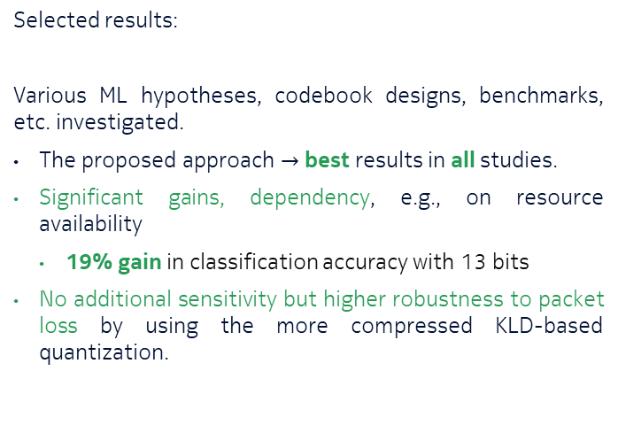
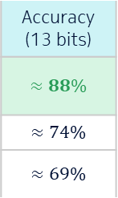
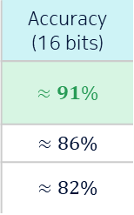
Relevance-based Bit Allocation
Indoor Environment Classification
Selected results:
Various ML hypotheses, codebook designs, benchmarks, etc. investigated.
The proposed approach $→$ best results in all studies.
Significant gains, dependency, e.g., on resource availability
19% gain in classification accuracy with 13 bits
No additional sensitivity but higher robustness to packet loss by using the more compressed KLD-based quantization.
Bit allocation
KLD-based (proposed)
Equal bits
MSE-based
Accuracy (13 bits)
$≈88\%$
$≈74\%$
$≈69\%$
Accuracy (16 bits)
$≈91\%$
$≈86\%$
$≈82\%$
*Full-resolution accuracy: 99.5%
How to use KLD−based bit allocations for radio resource allocation with changing channel quality?
Notes:
NN classifier & vector quantization: FCF is more relevant

Slide 17
Part 3
Introduction
Relevance-based Bit Allocation
Relevance-based Wireless Resource Allocation
Relevance-based Time Domain Signal Overhead Reduction
Conclusion and Outlook
Radio Resource Allocation
A network of pendulums on carts with a central control system
Chapter 6 of the dissertation
Publication [3]

Slide 18








Relevance-based Wireless Resource Allocation
Problem
How to use KLD−based bit allocations for radio resource allocation with changing channel quality?
$${\hat{x}}_{1,1}$$
Multiple Access Channel
MLU$1$
$$x_{1,1}$$
Quant.
$$⋯$$
Quant.
$$⋯$$
Quant.
MLU$M$
$$⋯$$
$${\hat{x}}_{M,N}$$
$$x_{M,N}$$
Quant.
$$N_{RB}$$
Central control with various MLUs
BW $→N_{RB}$ resource blocks (RBs)
Time and user dependent channel coefficients,
RB length in time ≤ the coherence time
Notes:
Multiple Access

Slide 19


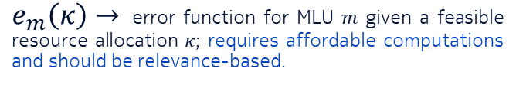
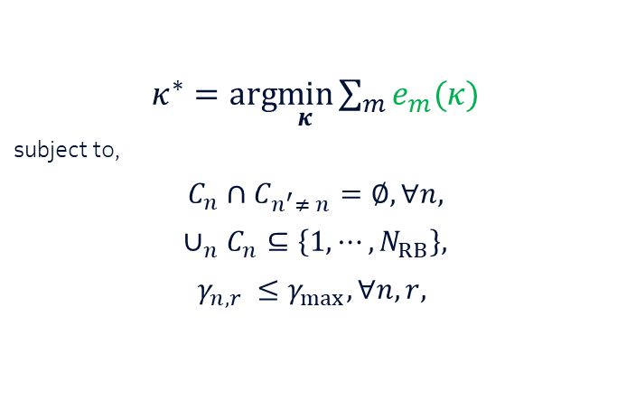
Relevance-based Wireless Resource Allocation
Problem
Conventional resource allocation Quality of Service (QoS) $→$ utilities targeting sum rate
Relevance-based resource allocation QoS $→$targets MLU performance:
$κ^{∗}=arg\min_{κ}{\sum_{m}{e_{m}(κ)}}$
subject to,
$$C_{n}∩C_{n^{′}≠ n}=∅, ∀n,$$
$$∪_{n}C_{n}⊆\left\{1, ⋯, N_{RB}\right\},$$
$$γ_{n,r }≤γ_{max}, ∀n,r,$$
$e_{m}\left(κ\right)→$ error function for MLU $m$ given a feasible resource allocation $κ$; requires affordable computations and should be relevance-based.
only one source is scheduled on each RB
union of allocated RBs is a subset of available RBs
constrains on transmission power, $γ_{n,r }$is the SNR at $n$th source on $r$th RB
$e_{m}\left(κ\right)→$ Usual ML performance metrics
$$e_{m}\left(κ\right)→ ?$$

Slide 20
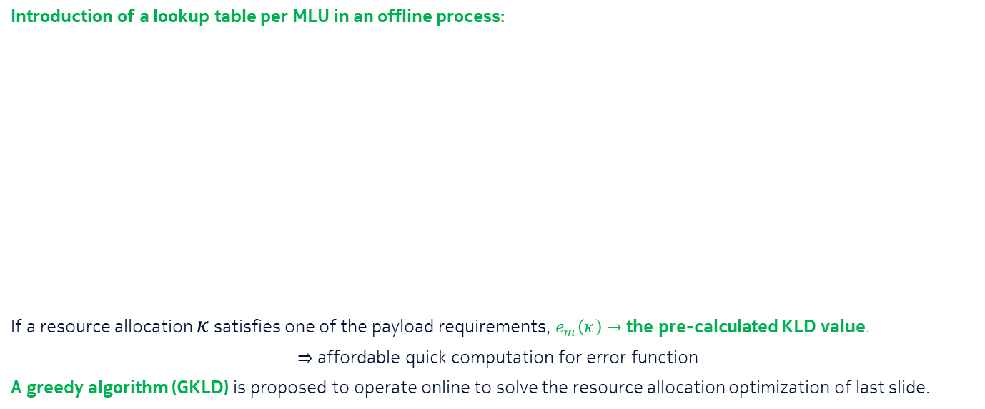
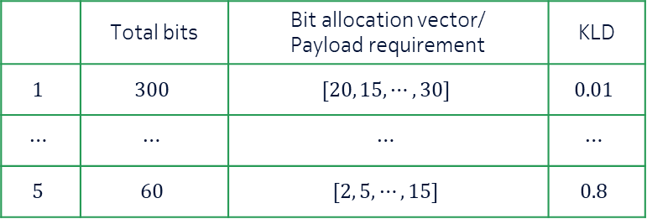
Relevance-based Wireless Resource Allocation
Solution (1/2)
Introduction of a lookup table per MLU in an offline process:
If a resource allocation $κ$ satisfies one of the payload requirements, $e_{m}\left(κ\right)→$ the pre-calculated KLD value.
$⇒$ affordable quick computation for error function
A greedy algorithm (GKLD) is proposed to operate online to solve the resource allocation optimization of last slide.
A lookup table with various KLD-based bit allocations for MLU $m$
 | Total bits | Bit allocation vector/ Payload requirement | KLD
$$1$$ | $$300$$ | $$[20, 15, ⋯, 30]$$ | $$0.01$$
$$⋯$$ | $$⋯$$ | $$⋯$$ | $$⋯$$
$$5$$ | $$60$$ | $$[2, 5, ⋯, 15]$$ | $$0.8$$
Notes:
Some distribution estimators do not give true distributions.

Slide 21

Relevance-based Wireless Resource Allocation
Solution (2/2)
The overview of the proposed solution:
Offline part:
Deriving a lookup table per MLU
The lookup tables are input for the scheduler.
Online part:
The scheduler constantly gets channel coefficients of available resource blocks (RBs).
The GKLD uses a novel QoS and achieving a best effort MLU performance instead of throughput maximization.
KLD-based Lookup Table for MLU 1
…
Offline
KLD-based Lookup Table for MLU $M$
Channel coefficients
on available RBs
Scheduler
Uses GKLD
Online,
inference mode
Scheduler

Slide 22
Relevance-based Wireless Resource Allocation
Network of Inverted Pendulums on Carts
Selected results:
Here, benchmark is equal bit assignment lookup tables and scheduler maximizing sum rate.
 | Number of RBs | Number of sources | Max SNR (dB) | Overall steady state error
Benchmark | 64 | 32 | 0 | 0%
KLD lookup tables & GKLD | 64 | 40 | 0 | 0%
Notes:
Max SNR is defined for each pendulum per RB

Slide 23
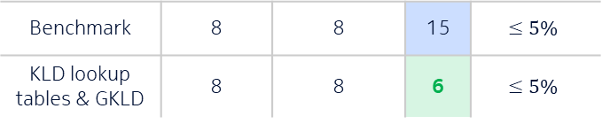


Relevance-based Wireless Resource Allocation
Network of Inverted Pendulums on Carts
Selected results:
Here, benchmark is equal bit assignment lookup tables and scheduler maximizing sum rate.
 | Number of RBs | Number of sources | Max SNR (dB) | Overall steady state error
Benchmark | 64 | 32 | 0 | 0%
KLD lookup tables & GKLD | 64 | 40 | 0 | 0%
Benchmark | 8 | 8 | 9 | 41%
KLD lookup tables & GKLD | 8 | 8 | 9 | 0.25%
Gain: 8 more sources
Gain: $≥40\%$ less error probability
Gain: $9$ dB
Benchmark | 8 | 8 | 15 | $$≤5\%$$
KLD lookup tables & GKLD | 8 | 8 | 6 | $$≤5\%$$
Notes:
Max SNR is defined for each pendulum per RB

Slide 24
Part 4
Introduction
Relevance-based Bit Allocation
Relevance-based Wireless Resource Allocation
Relevance-based Time Domain Signal Overhead Reduction
Conclusion and Outlook
Time Domain
Signal overhead reduction for conditional handover preparation
Chapter 5 of the dissertation
Publication [4]

Slide 25
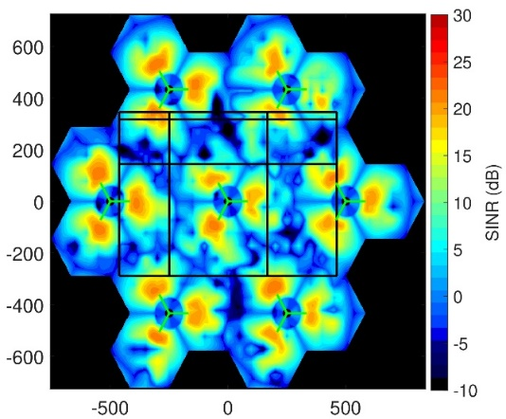

Relevance-based Time Domain Signal Overhead Reduction (SOR)
Conditional Handover (CHO) Preparation
Should a quantized packet of data be transmitted? $→$ SOR classifier
Selected results:
 | CHO prep | Successful CHOs | Ping Pong | Radio Link Failure | SOR gain
3GPP (Benchmark) | 2.91 | 1.99 | 0.040 | 0.19 | -
The SOR classifier & 3GPP | 2.91 | 1.97 | 0.039 | 0.21 | 28.5%
The SOR classifier & KLD bit allocation | 3.51 | 1.95 | 0.035 | 0.21 | 53%
Simulation Layout
Notes:
Simulation with 21 cells, 500 street users, 105 pedestrians

Slide 26
Part 5
Introduction
Relevance-based Bit Allocation
Relevance-based Wireless Resource Allocation
Relevance-based Time Domain Signal Overhead Reduction
Conclusion and Outlook
Chapters 7 of the dissertation

Slide 27
Conclusion
The proposed framework circumvents syntax and focuses on the semantics/relevance of MLU input during inference.

Slide 28
Conclusion
The proposed framework circumvents syntax and focuses on the semantics/relevance of MLU input during inference.
Low and high levels of relevance rather than not relevant and relevant input components.

Slide 29
Conclusion
The proposed framework circumvents syntax and focuses on the semantics/relevance of MLU input during inference.
Low and high levels of relevance rather than not relevant and relevant input components.
The proposed approaches deliver the best outcome in all studies:
In many cases, the best outcome implies significant gains.
More significant gains when having limited resources.

Slide 30
Conclusion
The proposed framework circumvents syntax and focuses on the semantics/relevance of MLU input during inference.
Low and high levels of relevance rather than not relevant and relevant input components.
The proposed approaches deliver the best outcome in all studies:
In many cases, the best outcome implies significant gains.
More significant gains when having limited resources.
Higher robustness using the proposed bit allocation in presence of packet loss.
$$\text{Goal} \text{achieved}\text{: }\text{More} \text{efficient} \text{MLU} \text{support} \text{by} \text{measuring} \text{MLU} \text{input} \text{relevance}$$

Slide 31
Outlook
Enhanced search algorithms to cope with adaptive scenarios, i.e., non-fixed MLUs.
Joint optimization of bit allocation, codebook and MLU training.
Impact of input space partitioning combined with the proposed bit allocation.
Resource allocation with asynchronized requests
Impact of other methods for distribution and KLD estimations
Impact of having MLU trained for dealing with missing values
Heterogeneous network of MLUs and various priority levels.
Notes:
Retraining of the MLU with the selected bit allocations

Slide 32
List of Publications
A. Gharouni, P. Rost, A. Maeder and H. Schotten, “Impact of Bit Allocation Strategies on Machine Learning Performance in Rate Limited Systems”, IEEE Wireless Communications Letters, vol. 10, no. 6, pp. 1168-1172, June 2021.
A. Gharouni, P. Rost, A. Maeder and H. Schotten, “Divergence-based Bit Allocation for Indoor Environment Classification”, IEEE 7th World Forum on Internet of Things (WF-IoT), pp. 639-644, 2021.
A. Gharouni, P. Rost, A. Maeder and H. Schotten, “Relevance-Based Wireless Resource Allocation for a Machine Learning-Based Centralized Control System”, IEEE 32nd Annual International Symposium on Personal, Indoor and Mobile Radio Communications (PIMRC), 2021.
A. Gharouni, U. Karabulut, A. Enqvist, P. Rost, A. Maeder and H. Schotten, “Signal Overhead Reduction for AI-Assisted Conditional Handover Preparation”, Mobile Communication - Technologies and Applications; 25th ITG-Symposium, Osnabrueck, November 2021.

Slide 34





Relevance-based Bit Allocation
Indoor Environment Classification
Real measurements
CTF: Channel Transfer Function
FCF: Frequency Coherence Function
2404 input attributes $→$ high-dimensional
$$CTF_{1}$$
MLU
$$⋯$$
$${CTF}_{1202}$$
Indoor Environment
$${FCF}_{1}$$
$$⋯$$
Lobby
Sport hall
Corridor
Lab
$$FCF_{1202}$$

Slide 35

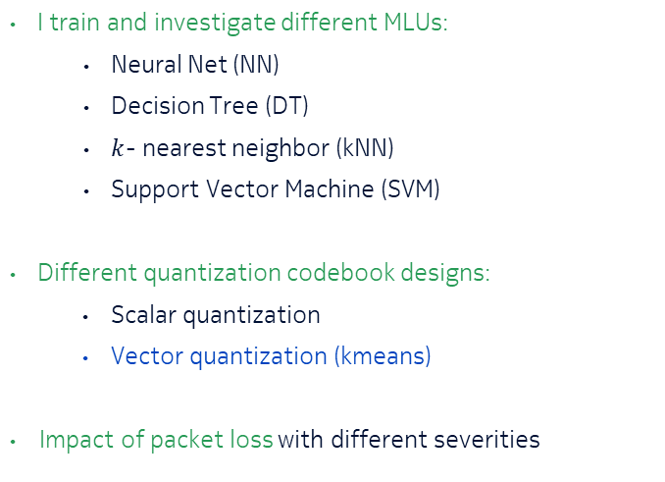



Relevance-based Bit Allocation
Indoor Environment Classification
$$CTF_{1}$$
MLU
I train and investigate different MLUs:
Neural Net (NN)
Decision Tree (DT)
$k$- nearest neighbor (kNN)
Support Vector Machine (SVM)
Different quantization codebook designs:
Scalar quantization
Vector quantization (kmeans)
Impact of packet loss with different severities
$$⋯$$
$$CTF_{1202}$$
Indoor Environment
$$FCF_{1}$$
$$⋯$$
$$FCF_{1202}$$
Application of the proposed conditional KLD
Benchmarks: MSE-based and equal bit assignment
I study dependency of the achieved gains:

Slide 36
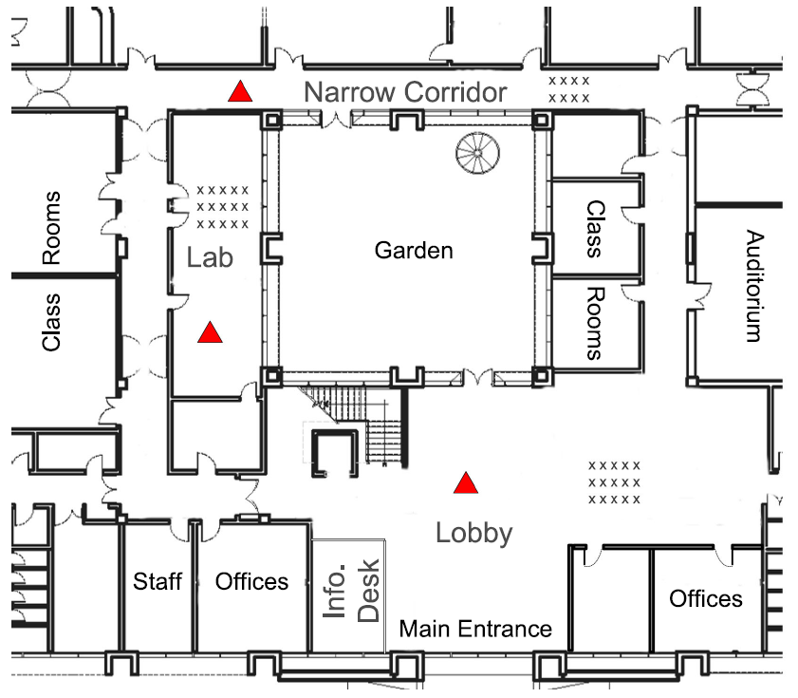
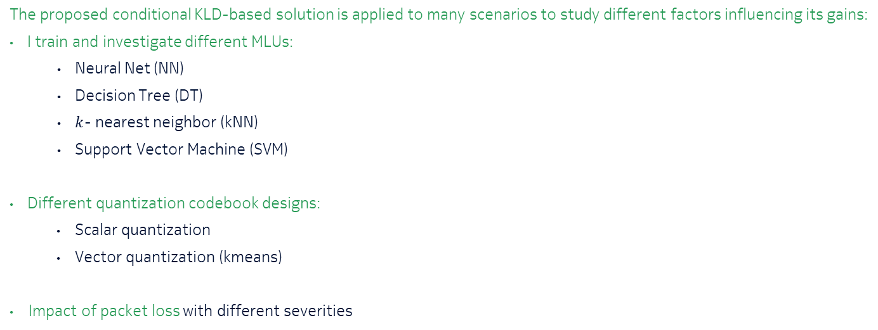
Relevance-based Bit Allocation
Indoor Environment Classification
The proposed conditional KLD-based solution is applied to many scenarios to study different factors influencing its gains:
I train and investigate different MLUs:
Neural Net (NN)
Decision Tree (DT)
$k$- nearest neighbor (kNN)
Support Vector Machine (SVM)
Different quantization codebook designs:
Scalar quantization
Vector quantization (kmeans)
Impact of packet loss with different severities
Dataset is available online.

Slide 37
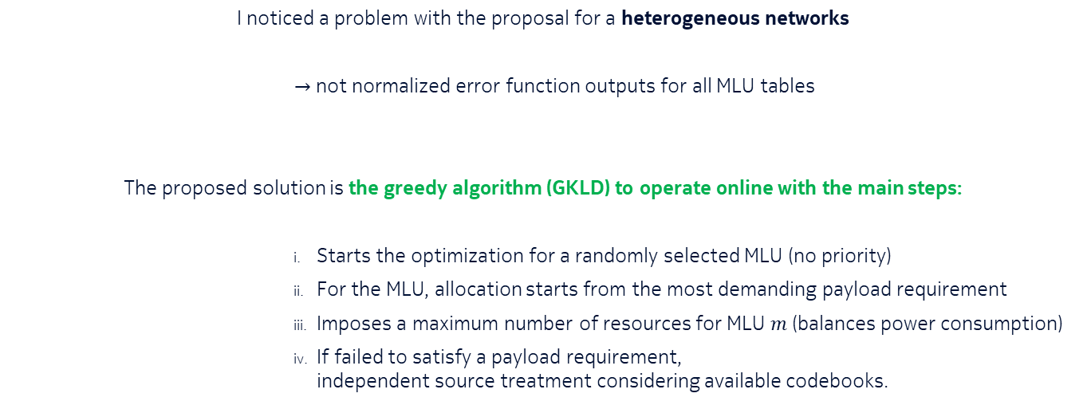
Relevance-based Wireless Resource Allocation
Solution (2/3)
I noticed a problem with the proposal for a heterogeneous networks
$→$ not normalized error function outputs for all MLU tables
The proposed solution is the greedy algorithm (GKLD) to operate online with the main steps:
Starts the optimization for a randomly selected MLU (no priority)
For the MLU, allocation starts from the most demanding payload requirement
Imposes a maximum number of resources for MLU $m$ (balances power consumption)
If failed to satisfy a payload requirement, independent source treatment considering available codebooks.

Slide 38



Relevance in Time Domain
Problem
Signal Overhead Reduction (SOR) for Conditional Handover (CHO) preparation:
My contributions:
On top of quantization, relevance in time domain is considered.
For quantization, these issues are addressed:
Shrinking the search space for finding the bit allocations with heuristics.
Time-dependent relevance of attributes
MLU
(CNN)
No CHO/ Cell_ID
gNB
RSRP values
RSRP: Reference Signal Received Power
CNN: Convolutional NN
$$\text{How} \text{to} \text{account} \text{for} \text{relevance} \text{in} \text{time} \text{domain}\text{?}$$

Slide 39
Relevance in Time Domain
Solution
Relevance of MLU input in time domain:
Should the quantized data be transmitted?
A so-called SOR classifier learns which data is related to a no-CHO scenario with high certainty.
The SOR classifier is linear model (logistics regression)
I study different classifiers and their impact on mobility key performance indicators.
SOR Classifier
at user
MLU
(CNN)
No CHO/ Cell_ID
gNB
SOR Classifier
at user

Slide 40
Relevance in Time Domain
Overview
Signal Overhead Reduction (SOR) for Conditional Handover (CHO) preparation
My contributions:
For quantization, these issues are addressed:
Shrinking the search space for finding the bit allocations with heuristics.
Time-dependent relevance of attributes
For Relevance in time domain:
“Should a quantized packet of data should be transmitted?” is answered.
How to account for relevance in time domain? Remove?

Slide 41
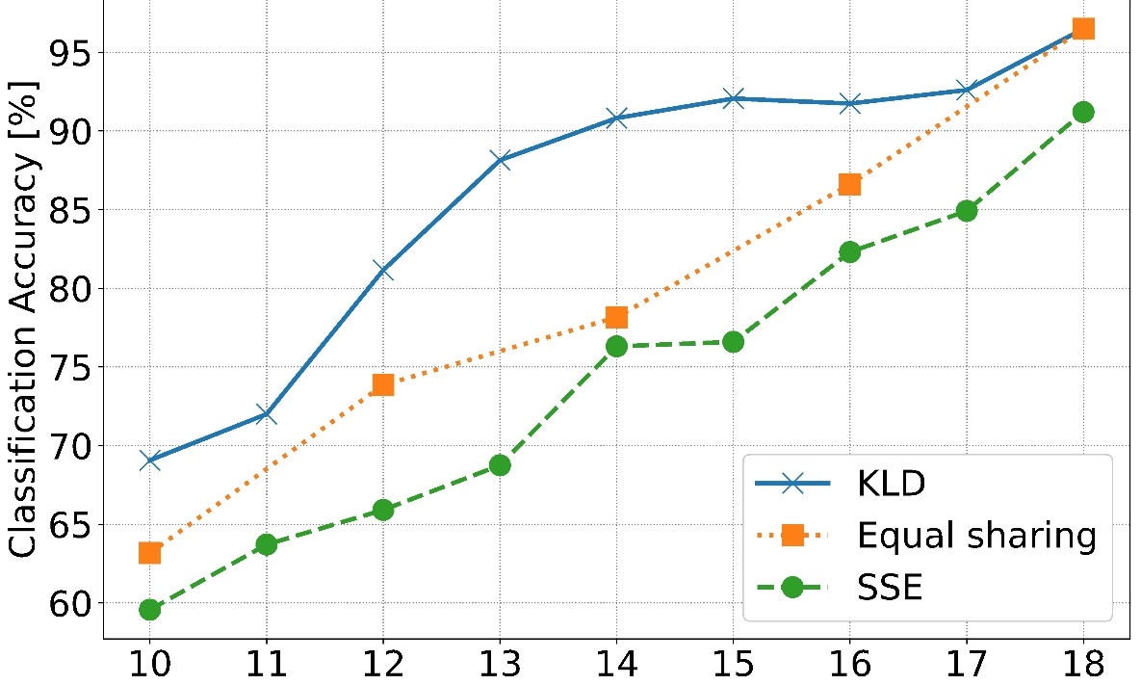
Relevance in terms of Divergence-based Bit Allocation
Selected Results
NN as the classifier (no packet-drops)
Total number of bits
*SSE: Sum of Squared Errors (over $x$ and $\hat{x}$)
Notes:
$14 −17 bits→$ extra bits for CTF in KLD…
80% $→4$bits gain

Slide 42
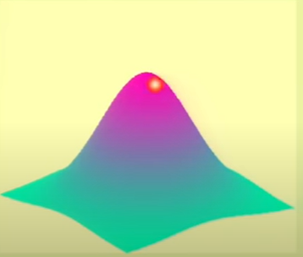
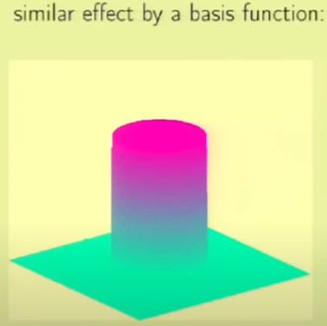

RBF
$$h\left(x\right)=\sum_{k}{w_{k}exp}(−γ{\left|\left|x−μ_{k}\right|\right|}^{2})$$
$k$ can be equal to $n,$ and $μ_{k}=x_{n}$ as in simulations
Notes:
Not a highly nonlinar problem (everything works 😐) so, …
Center (bump) in those pics ~ closest x_n…
kNN not exactly but can be seen like that.. With only impact from one centroid
Gamma could be a learning parameter, w_k can be simply calculated → EM applied with 2 iterative steps: 1) w_k fixed, find gamma with SGD, 2) gamma fixed and fine the weights
https://work.caltech.edu/library/161.pdf

Slide 43
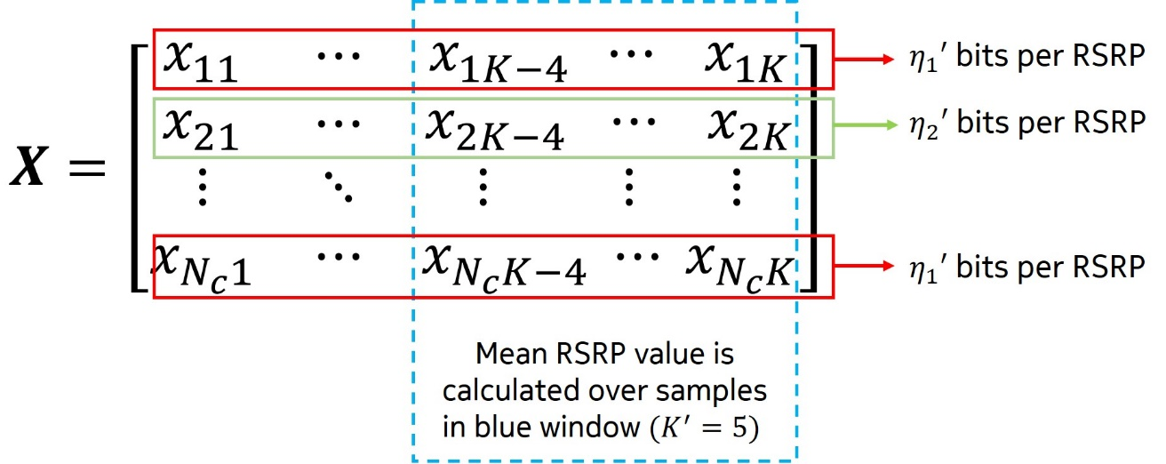
Alternating Relevance and Heuristic to Shrink the Search Space

Slide 44
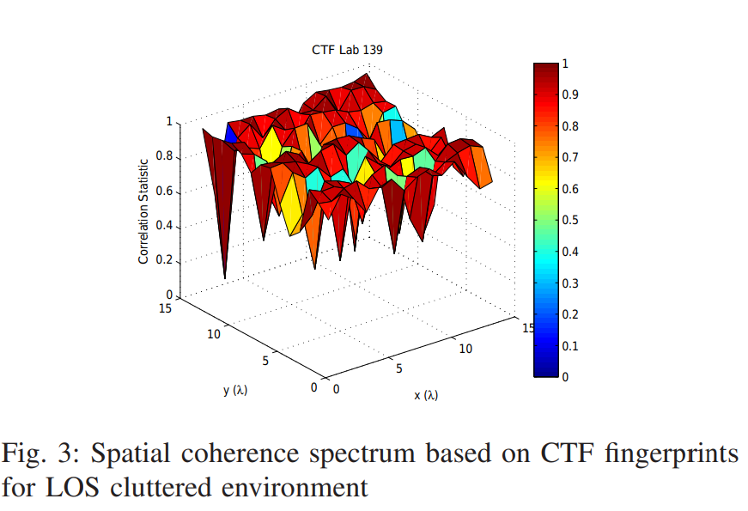
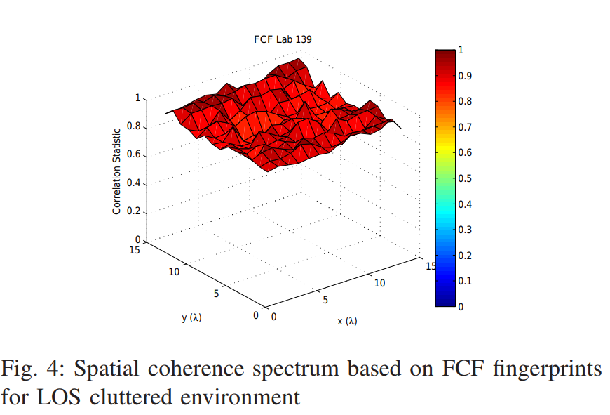
FCF and CTF Visualization
[https://ieeexplore.ieee.org/stamp/stamp.jsp?tp=&arnumber=7696430]

Slide 45
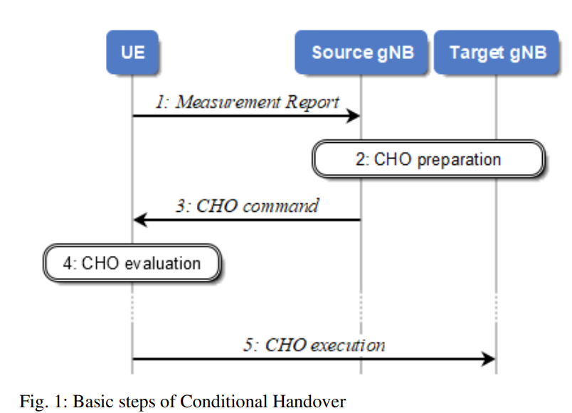
CHO
https://ieeexplore.ieee.org/stamp/stamp.jsp?tp=&arnumber=9824571
Notes:
Measurement Report comprising the results for potential candidate target cells.

