Slide 1
CSE491: Cloud Computing
Software Defined Storage (SDS):
OpenStack Swift
--Jannatun.noor@bracu.ac.bd

Slide 2
Available Object Storages in Open source
SWIFT
CEPH
JETS3T

Slide 3
Swift Use Cases
What is it?
Object Storage System.
Massively Scalable.
Runs on commodity hardware.
An S3 like solution
What is not?
Hard drive / File system.
NFS / SMB share
Block Storage.
Any SAN/NAS/DAS
Not even a CDN ????

Slide 4
Swift Use Cases contd.
Multi-tenancy
Ideal for Public or Private Clouds
Different URLs, groups of users, access codes, fine-grained privileges.
Backups
Write-once, read-never (long-term archiving).
Disaster recovery.
Web content
Write many, read many
File sharing websites (temporary access)
Static websites or media focused blogs (i.e. Imgur)
Large Objects
Medical / Scientific Images
Store your fancy Images from the moon (i.e. NASA)
Store your VM from the cloud

Slide 5
History
Rackspace Cloud Files V1
Distributed Storage
Centralized Metadata
PostgreSQL DB
2009 : Rackspace Cloud Files V2 (SWIFT)
Full redesign and rewrite, opensource
API compatible with Amazon S3
Worked Closely with ops
Distributed storage and metadata
Logical placement, based on Algorithm

Slide 6
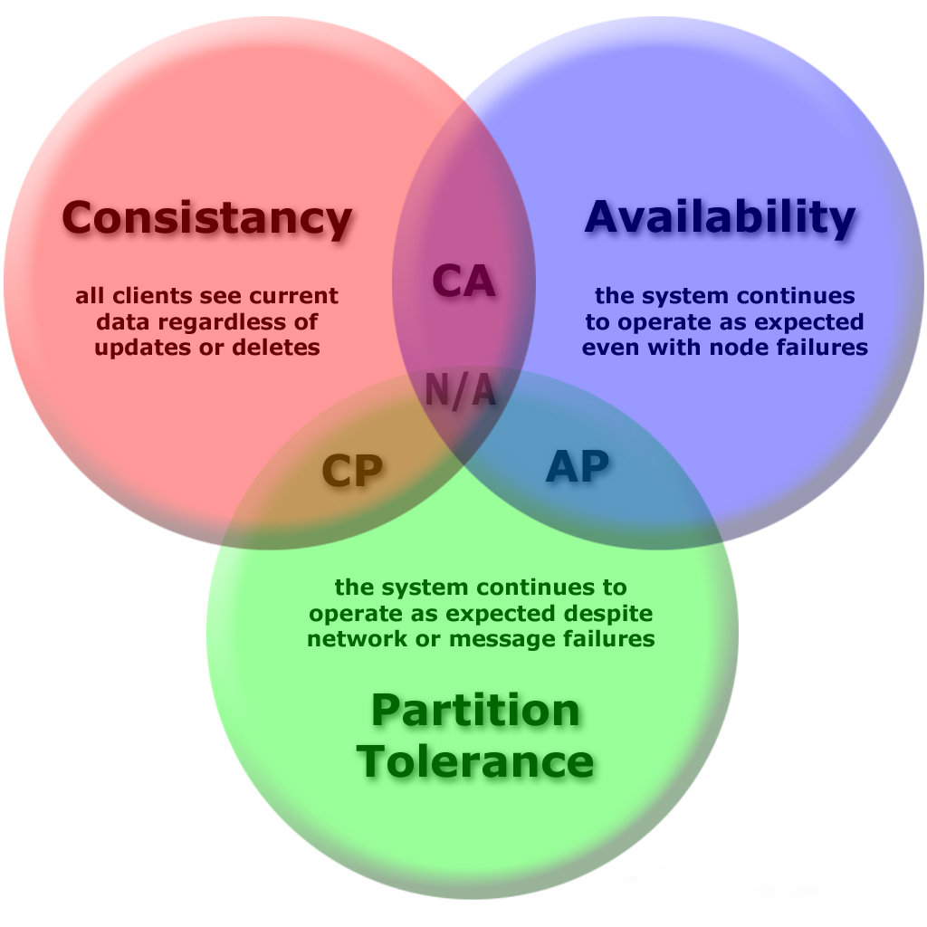
CAP Theorem
It is impossible for a distributed computer system to simultaneously provide all three of C, A, P.
In 2012 Brewer clarified some of his positions, including why the oft-used "two out of three" concept can be misleading or misapplied, and the different definition of consistency used in CAP relative to the one used in ACID.

Slide 7
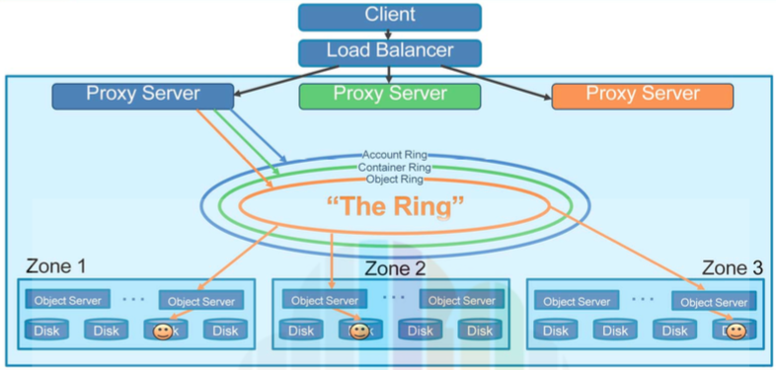
Swift Architecture

Slide 8
Swift Architecture contd. Components
Proxy Servers: handle all incoming API Requests.
Rings: mapping between the logical location of data to locations on particular disks.
Zones: represent a location that can isolate data. This could be a drive, a server, a cabinet, a switch, or even a datacenter.
Partition: store Objects, Account databases and Container databases.

Slide 9
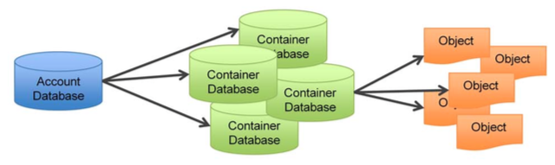
Swift Architecture contd. Components contd.
Account: determines rights to Containers and Objects.
Account Database: a list of all Containers spread throughout the cluster that are usable by an Account.
Container: a logical storage space.
Container Database: handles listings of what objects are in which container.
Object: the data to be stored, such as documents or images.

Slide 10
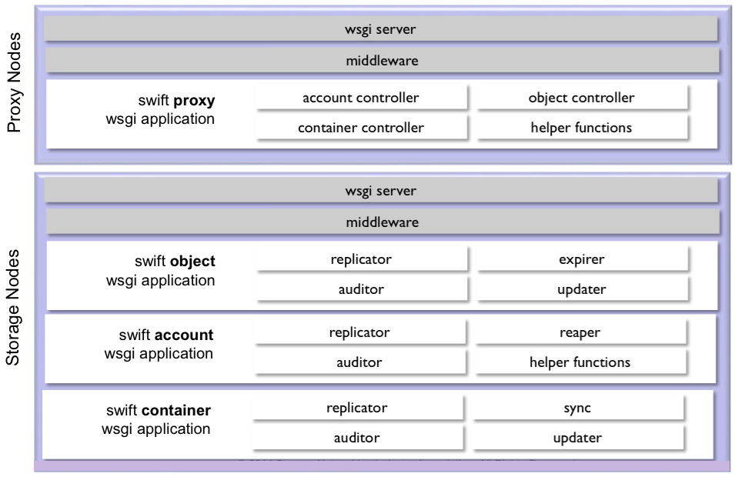
Swift Architecture contd. Services

Slide 11
Swift Architecture contd. Consistency Process
Auditor:
Scan the disks on their node to ensure that the stored data has not suffered file system corruption.
Replicator:
Ensure that enough copies of the most recent version of the data are stored where they should be in the cluster.
Handle object and container deletions
Account reaper:
When the account reaper locates an account marked as deleted, it begins stripping out all objects and containers associated with the account, ultimately removing the account record itself.
To provide a buffer against error, the reaper can be configured with a delay so that it will wait for a specified period of time before it starts deleting data.
Container and object updaters:
Container updater consistency process is responsible for keeping the container listings in the accounts up-to-date. Additionally, it updates the object count, container count, and bytes used in the account metadata.
Object updater updates the container listing as well as the object count and bytes used in the container metadata.
Object expirer:
Allows designated objects to be automatically deleted at a certain time.

Slide 12

Swift Architecture contd. Proxy Servers
Load Balancer(s)
Proxy Server
Proxy Server
Proxy Server
Handle all incoming API requests.
Will determine the storage node based on the URL of the objects.
Use a shared-nothing architecture and can be scaled as needed based on projected workloads.
A large number of failures are also handled in the Proxy Server. For example, if a server is unavailable for an object PUT, it will ask the ring for a handoff server and route there instead.
Also coordinates responses, and coordinates timestamps.

Slide 13
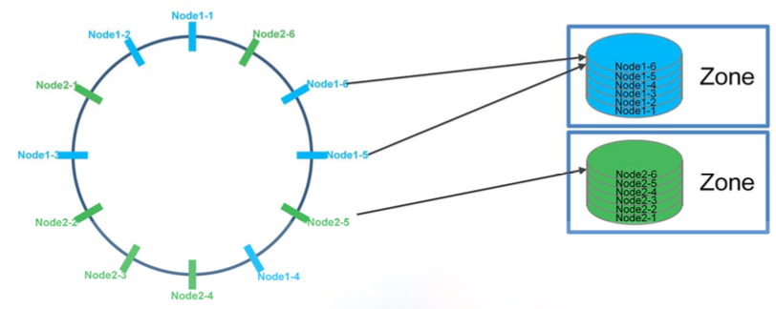
Swift Architecture contd. The Ring
Mapping between entities stored and their physical locations on disk, an index.
The Ring maintains this mapping with zones, devices, partitions and replicas.
Each partition in the Ring is replicated three times across the cluster in different zones.
Rings are built through consistent hashing algorithm. The ring is used by the Proxy server and several background processes (like replication).
The ring is also responsible for determining which devices are used for handoff in failure scenarios.

Slide 14
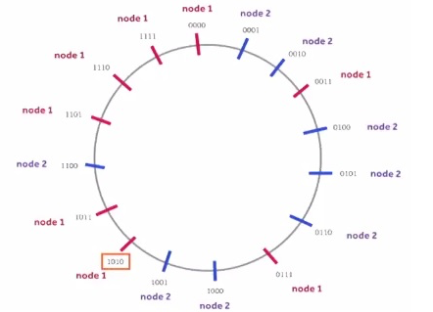
Swift Architecture contd. The Ring contd.
Hash(suffix + “ipvl/user1/container1/image.jpg” + prefix) =
1010
1011001101 …
node 1

Slide 15
Swift Architecture contd. The Ring contd.
The ring is a static data structure maintained external to the cluster (tools provided)
Devices are assigned to partitions with several policies (regions, zones, etc.) and constraints to assure fault tolerance and load balancing
Md5*(suffix + name + prefix) = index
Ring
Idx | 0 | 1 | 2 | 3 | …
Device | Region 1 Zone 2 Weight 1 … | Region 1 Zone 2 Weight 1 … | Region 1 Zone 2 Weight 1 … | Region 1 Zone 2 Weight 1 … | …
Part # is Idx
partition
Idx | 0 | 1 | 3 | 4 | 5 | …
Copy 0 | 11 | 21 | 23 | 14 | 20 | …
Copy 1 | 22 | 89 | 35 | 40 | 54 | …
Copy 2 | 49 | 71 | 93 | 67 | 33 | …
lookup val is Idx
e.g.,
_replica2part2dev[2][7956] = device of 3rd replica of part 7956

Slide 16
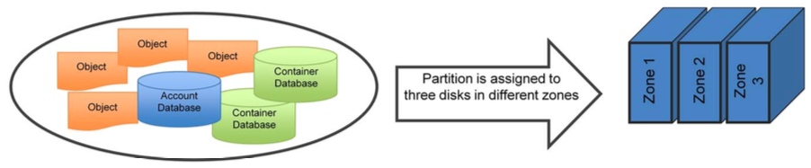
Swift Architecture contd. Partitions
A partition is a collection of stored data, including Account, Container & Object Servers.
The System Replicator and Object upload / download operate on Partitions.
Num of partitions stored in one node = (num of replicas * total num of partions) / num of nodes.
Choosing part_power :
Immutable once chosen.
At least 100 per disk
Bigger part_power -> bigger lookup table -> more memory used ( but lookups stay fast)

Slide 17
Swift API
Simple Rest API
GET, POST, DELETE, HEAD, OPTIONS
Simple Response Code
2xx is good
3xx redirect
4xx is bad client
5xx is bad servers etc
Binding for different languages : python, ruby, java …
Multiple CLI tools: python-swiftclient, jcloud, log
Example of metadata (Headers) :

Slide 18
Swift Architecture contd. Process for a PUT
Client
1
Proxy Server
Proxy Server
Proxy Server
The Ring
3
2
4
Object Server
Object Server
Object Server
Object Server
Object Server
Object Server
Disk
Disk
Disk
Disk
Disk
Disk
Disk
Disk
Disk
Disk
Disk
Disk

Slide 19
Swift Architecture contd. Process for a GET
Client
1
Proxy Server
Proxy Server
Proxy Server
The Ring
2
3
Object Server
Object Server
Object Server
Object Server
Object Server
Object Server
Disk
Disk
Disk
Disk
Disk
Disk
Disk
Disk
Disk
Disk
Disk
Disk

Slide 20
Swift Architecture contd. Process for a DELETE
Client
1
Proxy Server
Proxy Server
Proxy Server
The Ring
2
3
4
Object Server
Object Server
Object Server
Object Server
Object Server
Object Server
Disk
Disk
Disk
Disk
Disk
Disk
Disk
Disk
Disk
Disk
Disk
Disk

