Slide 1
Docker
Overview and Use Case
--Jannat

Slide 2
Topics
What is Virtualization?
What is Containerization
Advantages of Containerization over Virtualization
Introduction to Docker
Benefits of Docker
Virtualization vs Containerization
Docker Installation
Dockerfile, Docker Image & Docker Container
What is Docker Hub?
Docker Architecture
Docker Compose
Basic command outputs

Slide 3
Preliminary
Docker is gaining popularity and its usage is spreading like wildfire.The reason for Docker’s growing popularity is the extent to which it can be used in an IT organization. Very few tools out there have the functionality to find itself useful to both developers and as well as system administrators. Docker is one such tool that truly lives up to its promise of Build, Ship and Run.
In simple words, Docker is a software containerization platform, meaning you can build your application, package them along with their dependencies into a container and then these containers can be easily shipped to run on other machines.
For example: Let's consider a linux based application which has been written both in Ruby and Python. This application requires a specific version of linux, Ruby and Python. In order to avoid any version conflicts on user’s end, a linux docker container can be created with the required versions of Ruby and Python installed along with the application. Now the end users can use the application easily by running this container without worrying about the dependencies or any version conflicts.
These containers uses Containerization which can be considered as an evolved version of Virtualization. The same task can also be achieved using Virtual Machines, however it is not very efficient.

Slide 4
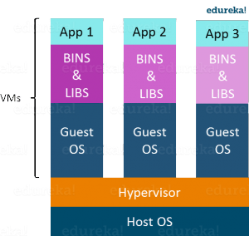
Virtualization
Virtualization is the technique of importing a Guest operating system on top of a Host operating system.
This technique was a revelation at the beginning because it allowed developers to run multiple operating systems in different virtual machines all running on the same host. This eliminated the need for extra hardware resource.
The advantages of Virtual Machines or Virtualization are:
Multiple operating systems can run on the same machine
Maintenance and Recovery were easy in case of failure conditions
Total cost of ownership was also less due to the reduced need for infrastructure

Slide 5
Virtualization (Cont.)
Virtualization also has some shortcomings.
Running multiple Virtual Machines in the same host operating system leads to performance degradation. This is because of the guest OS running on top of the host OS, which will have its own kernel and set of libraries and dependencies. This takes up a large chunk of system resources, i.e. hard disk, processor and especially RAM.
Another problem with Virtual Machines which uses virtualization is that it takes almost a minute to boot-up. This is very critical in case of real-time applications.
Following are the disadvantages of Virtualization:
Running multiple Virtual Machines leads to unstable performance
Hypervisors are not as efficient as the host operating system
Boot up process is long and takes time
These drawbacks led to the emergence of a new technique called Containerization.

Slide 6
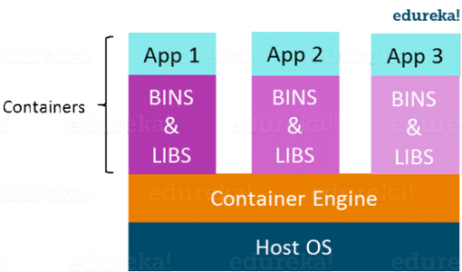
Containerization
Containerization is the technique of bringing virtualization to the operating system level.
While Virtualization brings abstraction to the hardware, Containerization brings abstraction to the operating system.
Do note that Containerization is also a type of Virtualization.
Containerization is however more efficient because there is no guest OS here and utilizes a host’s operating system, share relevant libraries & resources as and when needed unlike virtual machines.

Slide 7
Containerization (Cont.)
Application specific binaries and libraries of containers run on the host kernel, which makes processing and execution very fast.
Even booting-up a container takes only a fraction of a second. Because all the containers share, host operating system and holds only the application related binaries & libraries.
They are lightweight and faster than Virtual Machines.
Advantages of Containerization over Virtualization:
Containers on the same OS kernel are lighter and smaller
Better resource utilization compared to VMs
Boot-up process is short and takes few seconds

Slide 8
Benefits of Docker
As a developer, I can build a container which has different applications installed on it and give it to my QA team who will only need to run the container to replicate the developer environment.
Now, the QA team need not install all the dependent software and applications to test the code and this helps them save lots of time and energy.
This also ensures that the working environment is consistent across all the individuals involved in the process, starting from development to deployment.
The number of systems can be scaled up easily and the code can be deployed on them effortlessly.

Slide 9
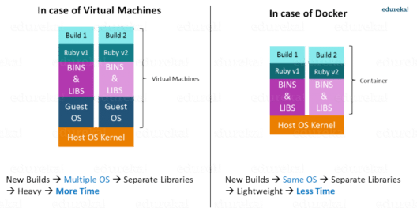
Virtualization vs Containerization
Virtualization and Containerization both let you run multiple operating systems inside a host machine.
Virtualization deals with creating many operating systems in a single host machine. Containerization on the other hand will create multiple containers for every type of application as required.

Slide 10
Docker Installation
jannat@jannat-lp:~$ sudo apt-get remove docker docker-engine docker.io containerd runc
$ sudo apt-get update
$ sudo apt-get install apt-transport-https ca-certificates curl gnupg-agent software-properties-common
$ curl -fsSL https://download.docker.com/linux/ubuntu/gpg | sudo apt-key add -
jannat@jannat-lp:~$ sudo apt-key fingerprint 0EBFCD88
jannat@jannat-lp:~$ sudo add-apt-repository \
> "deb [arch=amd64] https://download.docker.com/linux/ubuntu \
> $(lsb_release -cs) \
> stable"
jannat@jannat-lp:~$ sudo apt-get update
jannat@jannat-lp:~$ sudo apt-get install docker-ce docker-ce-cli containerd.io

Slide 11
Docker Installation
jannat@jannat-lp:~$ sudo docker run hello-world
Unable to find image 'hello-world:latest' locally
latest: Pulling from library/hello-world
1b930d010525: Pull complete
Digest: sha256:c3b4ada4687bbaa170745b3e4dd8ac3f194ca95b2d0518b417fb47e5879d9b5f
Status: Downloaded newer image for hello-world:latest
Hello from Docker!
This message shows that your installation appears to be working correctly.
To generate this message, Docker took the following steps:
1. The Docker client contacted the Docker daemon.
2. The Docker daemon pulled the "hello-world" image from the Docker Hub.
(amd64)
3. The Docker daemon created a new container from that image which runs the
executable that produces the output you are currently reading.
4. The Docker daemon streamed that output to the Docker client, which sent it
to your terminal.
To try something more ambitious, you can run an Ubuntu container with:
$ docker run -it ubuntu bash
Share images, automate workflows, and more with a free Docker ID:
https://hub.docker.com/
For more examples and ideas, visit:
https://docs.docker.com/get-started/

Slide 12
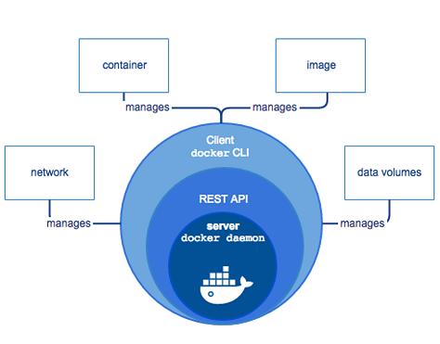
Docker’s Workflow
First, let us take a look at Docker Engine and its components so we have a basic idea of how the system works. Docker Engine allows you to develop, assemble, ship, and run applications using the following components:
Docker Daemon: A persistent background process that manages Docker images, containers, networks, and storage volumes. The Docker daemon constantly listens for Docker API requests and processes them.
Docker Engine REST API: An API is used by applications to interact with the Docker daemon. It can be accessed by an HTTP client.
Docker CLI: A command-line interface client for interacting with the Docker daemon. It significantly simplifies how you manage container instances and is one of the key reasons why developers love using Docker.

Slide 13
Docker’s Workflow (Cont.)
At first, Docker client talks to the Docker daemon, which performs the heavy lifting of the building, running, as well as distributing our Docker containers.
Fundamentally, both the Docker client and daemon can run on the same system.
We can also connect a Docker client to a remote Docker daemon.
In addition, by using a REST API, the Docker client and daemon, communicate, over UNIX sockets or a network interface.

Slide 14
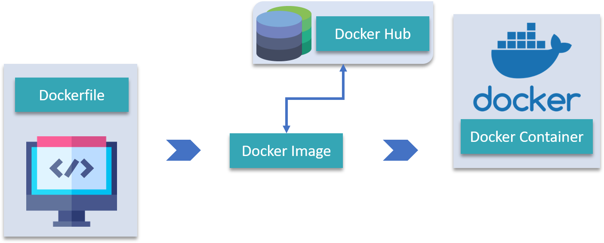
Few important concepts: Dockerfile, Docker Image, Docker Container, Docker Hub
Docker Image is created by the sequence of commands written in a file called as Dockerfile.
When this Dockerfile is executed using a docker command it results into a Docker Image with a name.
When this Image is executed by “docker run” command it will by itself start whatever application or service it must start on its execution.
Docker Hub:
Docker Hub is like GitHub for Docker Images. It is basically a cloud registry where you can find Docker Images uploaded by different communities, also you can develop your own image and upload on Docker Hub, but first, you need to create an account on DockerHub.

Slide 15
Docker Architecture
Docker’s Client
Docker Host
Docker Objects
1. Images
2. Containers
3. Networks
Bridge
Host
Overlay
None
Macvlan
4. Storage
Data Volumes
Volume Container
Directory Mounts
Storage Plugins
Docker’s Registry/Hub

Slide 16
Docker Architecture
The architecture of Docker uses a client-server model and consists of the Docker’s Client, Docker Host, Network and Storage components, and the Docker Registry/Hub. Let’s look at each of these in some detail.
Docker’s Client
Docker users can interact with Docker through a client. When any docker commands runs, the client sends them to dockerd daemon, which carries them out. Docker API is used by Docker commands. It is possible for Docker client to communicate with more than one daemon.
Docker Host
The Docker host provides a complete environment to execute and run applications. It comprises of the Docker daemon, Images, Containers, Networks, and Storage. As previously mentioned, the daemon is responsible for all container-related actions and receives commands via the CLI or the REST API. It can also communicate with other daemons to manage its services.
Docker’s Registry/Hub
Docker registries are services that provide locations from where you can store and download images. In other words, a Docker registry contains Docker repositories that host one or more Docker Images. Public Registries include two components namely the Docker Hub and Docker Cloud. You can also use Private Registries. The most common commands when working with registries include: docker push, docker pull, docker run

Slide 17
Docker Architecture (Cont.)
Docker Objects
1. Images
Images are nothing but a read-only binary template that can build containers.
They also contain metadata that describe the container’s capabilities and needs.
Images are used to store and ship applications.
An image can be used on its own to build a container or customized to add additional elements to extend the current configuration.
You can share the container images across teams within an enterprise with the help of a private container registry, or share it with the world using a public registry like Docker Hub.
Images are the core element of the Docker experience as they enable collaboration between developers in a way that was not possible before.

Slide 18
Docker Architecture (Cont.)
Docker Objects
2. Containers
Containers are sort of encapsulated environments in which you run applications.
Container is defined by the image and any additional configuration options provided on starting the container, including and not limited to the network connections and storage options.
Containers only have access to resources that are defined in the image, unless additional access is defined when building the image into a container.
You can also create a new image based on the current state of a container.
Since containers are much smaller than VMs, they can be spun in a matter of seconds, and result in much better server density

Slide 19
Docker Architecture (Cont.)
Docker Objects
3. Networks
Docker networking is a passage through which all the isolated container communicate. There are mainly five network drivers in docker:
Bridge: It is the default network driver for a container. You use this network when your application is running on standalone containers, i.e. multiple containers communicating with the same docker host.
Host: This driver removes the network isolation between docker containers and docker host. You can use it when you don’t need any network isolation between host and container.
Overlay: This network enables swarm services to communicate with each other. You use it when you want the containers to run on different Docker hosts or when you want to form swarm services by multiple applications.
None: This driver disables all the networking.
macvlan: This driver assigns mac address to containers to make them look like physical devices. It routes the traffic between containers through their mac addresses. You use this network when you want the containers to look like a physical device, for example, while migrating a VM setup.

Slide 20
Docker Architecture (Cont.)
Docker Objects
4. Storage
You can store data within the writable layer of a container but it requires a storage driver. Being non-persistent, it perishes whenever the container is not running. Moreover, it is not easy to transfer this data. With respect to persistent storage, Docker offers four options:
Data Volumes: They provide the ability to create persistent storage, with the ability to rename volumes, list volumes, and also list the container that is associated with the volume. Data Volumes are placed on the host file system, outside the containers copy on write mechanism and are fairly efficient.
Volume Container: It is an alternative approach wherein a dedicated container hosts a volume and to mount that volume to other containers. In this case, the volume container is independent of the application container and therefore you can share it across more than one container.
Directory Mounts: Another option is to mount a host’s local directory into a container. In the previously mentioned cases, the volumes would have to be within the Docker volumes folder, whereas when it comes to Directory Mounts any directory on the Host machine can be used as a source for the volume.
Storage Plugins: Storage Plugins provide the ability to connect to external storage platforms. These plugins map storage from the host to an external source like a storage array or an appliance. You can see a list of storage plugins on Docker’s Plugin page.

Slide 21
Difference between Docker Swarm, Compose, and Networks
Docker Compose is basically used to run multiple Docker Containers as a single server. Let me give you an example:
Suppose if I have an application which requires WordPress, Maria DB and PHP MyAdmin. I can create one file which would start both the containers as a service without the need to start each one separately. It is really useful especially if you have a microservice architecture.
Docker Swarm: Docker Swarm is the term which is used when you are trying to manage containers across multiple physical or virtual machines.
Docker Compose: This term is used when you are trying to define a multi-container application.
Docker Networks: It helps you achieve where you would want your containers to be able to talk to each other and also to the external world.

Slide 22
Difference between Docker Swarm, Compose, and Networks (Cont.)
Docker Compose is a tool to define and run multi-container applications. Multi-container applications are applications where multiple containers work together to provide the required functionality.
You define your application in the Compose file.
You can run your application with the `docker-compose` command. The `docker-compose` command takes your Compose file as input and makes sure that your application’s state is what you described in the Compose file (we call this the desired state).
Docker Compose can run your multi-container application on a SINGLE HOST ONLY, it cannot run your application on a computer cluster.
If you want to run your application on a COMPUTER CLUSTER, then you need Docker Swarm.

Slide 23
Difference between Docker Swarm, Compose, and Networks (Cont.)
Docker Swarm runs multi-container applications, just like Compose does. The key difference is that Swarm schedules and manages your containers across multiple machines, while Compose schedules and manages containers on a single host only.
You can use a standard Compose file to deploy your application to the Swarm. It’s the same Compose file that you use with Compose, but some options are limited to either Swarm or Compose in the Compose file.

Slide 24
Difference between Docker Swarm, Compose, and Networks (Cont.)
Docker Networks is a toolset to define how your containers connect to each other.
It is an architecture design decision to specify which containers talk to each other on the same network, how many networks your application has to separate concerns and what technologies you use to create gateways between these networks.
You define your network configuration in the Compose file. (You can create and manage Docker networks with the `docker network` command, but it’s better to define you configuration in the form of code in the Compose file.)
You usually define your own networks, these are called user defined networks.

Slide 25
Some commands output
jannat@jannat-lp:~$ systemctl status docker
● docker.service - Docker Application Container Engine
Loaded: loaded (/lib/systemd/system/docker.service; enabled; vendor preset: enabled)
Active: active (running) since Thu 2019-10-24 13:33:41 +06; 13min ago
Docs: https://docs.docker.com
Main PID: 20276 (dockerd)
Tasks: 14
CGroup: /system.slice/docker.service
└─20276 /usr/bin/dockerd -H fd:// --containerd=/run/containerd/containerd.sock

Slide 26
Some commands output
jannat@jannat-lp:~$ sudo docker pull ubuntu
Using default tag: latest
latest: Pulling from library/ubuntu
22e816666fd6: Pull complete
079b6d2a1e53: Pull complete
11048ebae908: Pull complete
c58094023a2e: Pull complete
Digest: sha256:a7b8b7b33e44b123d7f997bd4d3d0a59fafc63e203d17efedf09ff3f6f516152
Status: Downloaded newer image for ubuntu:latest
docker.io/library/ubuntu:latest

Slide 27
Some commands output
jannat@jannat-lp:~$ sudo docker info
Client:
Debug Mode: false
Server:
Containers: 1
Running: 0
Paused: 0
Stopped: 1
Images: 2
Server Version: 19.03.4
Storage Driver: overlay2
Network: bridge host ipvlan macvlan null overlay
Log: awslogs fluentd gcplogs gelf journald json-file local logentries splunk syslog
……..

Slide 28
Some commands output
jannat@jannat-lp:~$ sudo docker images
REPOSITORY TAG IMAGE ID CREATED SIZE
ubuntu latest cf0f3ca922e0 5 days ago 64.2MB
hello-world latest fce289e99eb9 9 months ago 1.84kB
**************
root@jannat-lp:/home/jannat# cd /var/lib/docker/
root@jannat-lp:/var/lib/docker# ls
builder buildkit containers image network overlay2 plugins runtimes swarm tmp trust volumes
root@jannat-lp:/var/lib/docker/containers# ls
c132c5b907824242f4acb94adf2bdfada1c1dc0611ea385b0cf879cb4289ca1b
********************************************

Slide 29
Some commands output
#### running a docker container in iterative mode
jannat@jannat-lp:~$ sudo docker run -it ubuntu
root@9cd9097fb108:/# ls
bin boot dev etc home lib lib64 media mnt opt proc root run sbin srv sys tmp usr var
root@9cd9097fb108:/# cd home/
root@9cd9097fb108:/home# ls
root@9cd9097fb108:/home# ifconfig
bash: ifconfig: command not found
root@9cd9097fb108:/home# ip addr
bash: ip: command not found
root@9cd9097fb108:/home# ls
root@9cd9097fb108:/home# cd ~
root@9cd9097fb108:~# ls
root@9cd9097fb108:~# python
bash: python: command not found
root@9cd9097fb108:~# pwd
/root
root@9cd9097fb108:~# touch abc
root@9cd9097fb108:~# ls
abc
root@9cd9097fb108:~# echo "efjeljfklhjfg">>abc
root@9cd9097fb108:~# cat abc
efjeljfklhjfg
root@9cd9097fb108:~# exit
Exit

Slide 30
Some commands output
/// new container using same image
jannat@jannat-lp:~$ sudo docker run -it ubuntu /bin/bash
root@12bbfd6c3441:/# cp /root/.
./ ../ .bashrc .profile
root@12bbfd6c3441:/# cat /etc/os-release
root@12bbfd6c3441:/# apt-get update
...
Reading package lists... Done
root@12bbfd6c3441:/# apt-get install net-tools
...
root@12bbfd6c3441:/# ifconfig
eth0: flags=4163<UP,BROADCAST,RUNNING,MULTICAST> mtu 1500
inet 172.17.0.2 netmask 255.255.0.0 broadcast 172.17.255.255
ether 02:42:ac:11:00:02 txqueuelen 0 (Ethernet)
RX packets 11729 bytes 18265904 (18.2 MB)
RX errors 0 dropped 0 overruns 0 frame 0
TX packets 7337 bytes 501203 (501.2 KB)
TX errors 0 dropped 0 overruns 0 carrier 0 collisions 0

Slide 31
Some commands output
jannat@jannat-lp:~$ sudo docker ps -a
CONTAINER ID IMAGE COMMAND CREATED STATUS PORTS NAMES
12bbfd6c3441 ubuntu "/bin/bash" 12 minutes ago Exited (0) 12 seconds ago mystifying_curran
9cd9097fb108 ubuntu "/bin/bash" 18 minutes ago Exited (0) 13 minutes ago happy_ritchie
c132c5b90782 hello-world "/hello" About an hour ago Exited (0) About an hour ago epic_hodgkin

Slide 32
Some commands output
jannat@jannat-lp:~$ sudo docker start 9cd9097fb108
9cd9097fb108
jannat@jannat-lp:~$ sudo docker ps -a
CONTAINER ID IMAGE COMMAND CREATED STATUS PORTS NAMES
0c33075d3df7 ubuntu/curl "/bin/bash" 2 minutes ago Exited (0) 59 seconds ago compassionate_mcclintock
56e72bdc1605 ubuntu/curl "/bin/bash" 3 minutes ago Exited (0) 3 minutes ago pensive_yalow
7001192b0198 ubuntu/curl "/bin/bash" 5 minutes ago Exited (0) 5 minutes ago quizzical_roentgen
7e2166c3b3bf ubuntu/curl "/bin/bash" 5 minutes ago Exited (0) 5 minutes ago recursing_bell
12bbfd6c3441 ubuntu "/bin/bash" 19 minutes ago Exited (0) 7 minutes ago mystifying_curran
9cd9097fb108 ubuntu "/bin/bash" 25 minutes ago Up 44 seconds happy_ritchie
c132c5b90782 hello-world "/hello" 2 hours ago Exited (0) 2 hours ago epic_hodgkin

Slide 33
Some commands output
jannat@jannat-lp:~$ sudo docker attach 9cd9097fb108
root@9cd9097fb108:/# python
bash: python: command not found
root@9cd9097fb108:/# pip install python
bash: pip: command not found
root@9cd9097fb108:/# ls
bin boot dev etc home lib lib64 media mnt opt proc root run sbin srv sys tmp usr var
root@9cd9097fb108:/# cd /root/
root@9cd9097fb108:~# ls
abc
root@9cd9097fb108:~# cat abc
efjeljfklhjfg

Slide 34
Some commands output
jannat@jannat-lp:~$ sudo docker commit 3a819128ce43 jubuntu:25-10-2019-001
sha256:3f75d4ab1d82518169d4683dcab58a090f497a1041ec1598a39969797cc94a15
jannat@jannat-lp:~$ docker images
REPOSITORY TAG IMAGE ID CREATED SIZE
jubuntu 25-10-2019-001 3f75d4ab1d82 8 seconds ago 184MB
ubuntu/curl latest 3a4bf8ff60f5 2 hours ago 106MB
ubuntu latest cf0f3ca922e0 5 days ago 64.2MB
hello-world latest fce289e99eb9 9 months ago 1.84kB
jannat@jannat-lp:~$ docker container ls -a
CONTAINER ID IMAGE COMMAND CREATED STATUS PORTS NAMES
3a819128ce43 ubuntu/curl "/bin/bash" 12 minutes ago Exited (1) 3 minutes ago quizzical_ellis

Slide 35
Ways to use Containers
To run a single task: This could be a shell script or a custom app.
Interactively: This connects you to the container similar to the way you SSH into a remote server.
In the background: For long-running services like websites and databases.

Slide 36
Run a single task in an Alpine Linux container
Run the following command in your Linux console. docker container run alpine hostname
The output below shows that the alpine:latest image could not be found locally. When this happens, Docker automatically pulls it from Docker Hub. After the image is pulled, the container’s hostname is displayed (888e89a3b36b in the example below).
jannat@jannat-lp:$ docker container run alpine hostname Unable to find image 'alpine:latest' locally
latest: Pulling from library/alpine
……...
Status: Downloaded newer image for alpine:latest
888e89a3b36b

Slide 37
Run an interactive Ubuntu container
Run a Docker container and access its shell. docker container run --interactive --tty --rm ubuntu bash
In this example, we’re giving Docker three parameters:
--interactive says you want an interactive session.
--tty allocates a pseudo-tty.
--rm tells Docker to go ahead and remove the container when it’s done executing.
The first two parameters allow you to interact with the Docker container. We’re also telling the container to run bash as its main process (PID 1). When the container starts you’ll drop into the bash shell with the default prompt root@<container id>:/#. Docker has attached to the shell in the container, relaying input and output between your local session and the shell session in the container.

Slide 38
Run an interactive Ubuntu container (Cont.)
Run the following commands in the container. ls / will list the contents of the root director in the container, ps aux will show running processes in the container, cat /etc/issue will show which Linux distro the container is running, in this case Ubuntu 18.04.3 LTS. ls / ps aux cat /etc/issue
Type exit to leave the shell session. This will terminate the bash process, causing the container to exit. Exit
Note: As we used the --rm flag when we started the container, Docker removed the container when it stopped. This means if you run another docker container ls --all you won’t see the Ubuntu container.

Slide 39
Run a background MySQL container
Background containers are how you’ll run most applications. Here’s a simple example using MySQL.
Run a new MySQL container with the following command. docker container run \
--detach \
--name mydb \
-e MYSQL_ROOT_PASSWORD=my-secret-pw \
mysql:latest
--detach will run the container in the background.
--name will name it mydb.
-e will use an environment variable to specify the root password (NOTE: This should never be done in production).
As the MySQL image was not available locally, Docker automatically pulled it from Docker Hub. Unable to find image 'mysql:latest' locallylatest: Pulling from library/mysql
aa18ad1a0d33: Pull complete
…..
….

Slide 40
Run a background MySQL container (Cont.)
As long as the MySQL process is running, Docker will keep the container running in the background.
List the running containers. docker container ls
Notice your container is running. CONTAINER ID IMAGE COMMAND CREATED STATUS PORTS NAMES
3f4e8da0caf7 mysql:latest "docker-entrypoint..." 52 seconds ago Up 51 seconds 3306/tcp mydb

Slide 41
Run a background MySQL container (Cont.)
You can check what’s happening in your containers by using a couple of built-in Docker commands: docker container logs and docker container top. docker container logs mydb
This shows the logs from the MySQL Docker container. <output truncated>
2017-09-29T16:02:58.605004Z 0 [Note] Executing 'SELECT * FROM INFORMATION_SCHEMA.TABLES;' to get a list of tables using the deprecated partition engine. You may use the startup option '--disable-partition-engine-check' to skip this check.
2017-09-29T16:02:58.605026Z 0 [Note] Beginning of list of non-natively partitioned tables
2017-09-29T16:02:58.616575Z 0 [Note] End of list of non-natively partitioned tables
Let’s look at the processes running inside the container. docker container top mydb
You should see the MySQL daemon (mysqld) is running in the container. PID USER TIME COMMAND
2876 999 0:00 mysqld

Slide 42
Run a background MySQL container (Cont.)
Although MySQL is running, it is isolated within the container because no network ports have been published to the host. Network traffic cannot reach containers from the host unless ports are explicitly published.
List the MySQL version using docker container exec. docker container exec allows you to run a command inside a container. In this example, we’ll use docker container exec to run the command-line equivalent of mysql --user=root --password=$MYSQL_ROOT_PASSWORD --version inside our MySQL container. docker exec -it mydb \
mysql --user=root --password=$MYSQL_ROOT_PASSWORD --version
You will see the MySQL version number, as well as a handy warning. mysql: [Warning] Using a password on the command line interface can be insecure.
mysql Ver 14.14 Distrib 5.7.19, for Linux (x86_64) using EditLine wrapper

Slide 43
Run a background MySQL container (Cont.)
You can also use docker container exec to connect to a new shell process inside an already-running container. Executing the command below will give you an interactive shell (sh) inside your MySQL container. docker exec -it mydb sh
Notice that your shell prompt has changed. This is because your shell is now connected to the sh process running inside of your container.
Let’s check the version number by running the same command again, only this time from within the new shell session in the container. mysql --user=root --password=$MYSQL_ROOT_PASSWORD --version
Notice the output is the same as before.
Type exit to leave the interactive shell session. exit

Slide 44
Reference
https://www.edureka.co/blog/docker-tutorial
https://docs.docker.com/
https://www.edureka.co/blog/docker-commands/
https://www.edureka.co/blog/docker-architecture/
https://www.quora.com/Whats-the-difference-between-Docker-Swarm-Docker-Compose-and-Docker-Networks
https://training.play-with-docker.com/beginner-linux/#Task_0

