Slide 1
DATA ANALYST · CAPSTONE PROJECT
Investor Churn
Intelligence Platform
Understanding why investors leave — and how to retain them
Afsar Ahamed | ECE, MVJ College | CGPA 8.4 | 64,374 investor records
Tools: MySQL · Python · Power BI · Matplotlib · Seaborn

Slide 2
PROBLEM STATEMENT & DATASET OVERVIEW
The Problem
64,374
30,493
An investment platform with 64,000+ investors faces a 47.4% churn rate — nearly 1 in 2 investors stops using the platform.
This analysis identifies
who is churning, why they leave, and surfaces actionable retention strategies for business leaders.
Total Investors
Churned
33,881
47.4%
Active
Churn Rate
Dataset Features (12 columns)
CustomerID · Age · Gender · Tenure
Usage Frequency · Support Calls · Payment Delay
Subscription Type · Contract Length · Total Spend
Last Interaction · Churn (target)

Slide 3
KEY FINDINGS & CHURN DRIVERS
Monthly contracts churn most
Mid-tenure is the danger zone
51.6%
55–56%
Monthly plan investors churn at 51.6% vs 44.0% for Quarterly — a 7.6pp gap. Contract upgrade is the #1 retention lever.
Investors at 25–60 months tenure churn at 55–56% — far higher than new investors at 31.8%. Loyalty programs needed at month 24.
Payment delay predicts churn
High support calls signal churn
21+ days risk
6.4 vs 4.5
Investors with 21+ day payment delays churn significantly more than on-time payers. Payment friction is a strong early warning signal.
Churned investors averaged 6.4 support calls vs 4.5 for active investors — a 42% difference. High call volume = intervention needed.
Analysis based on 64,374 investor records · MySQL 8.0 · Python (Pandas, Seaborn)

Slide 4
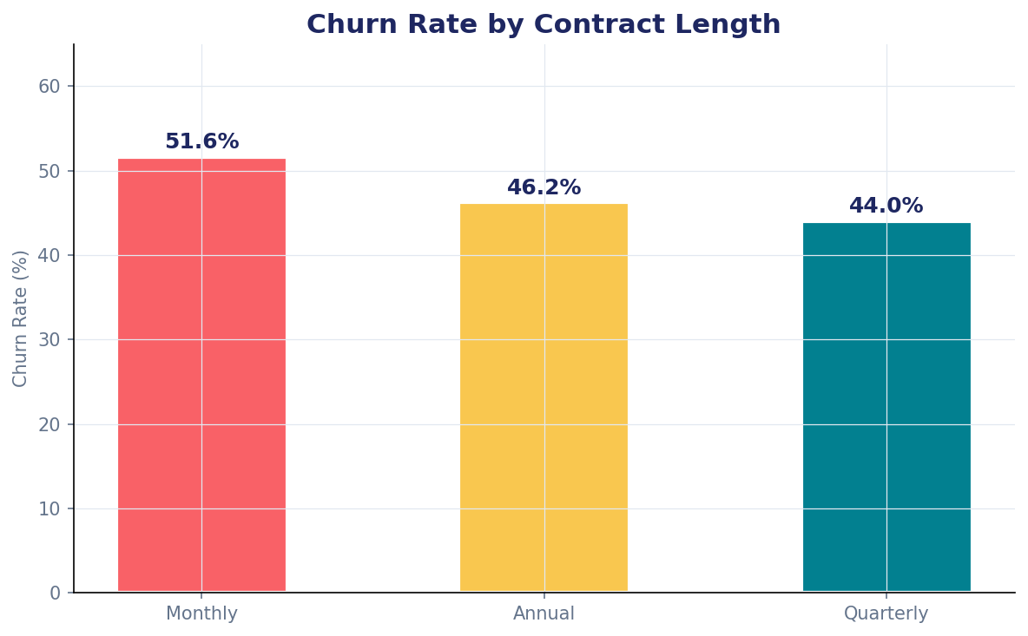
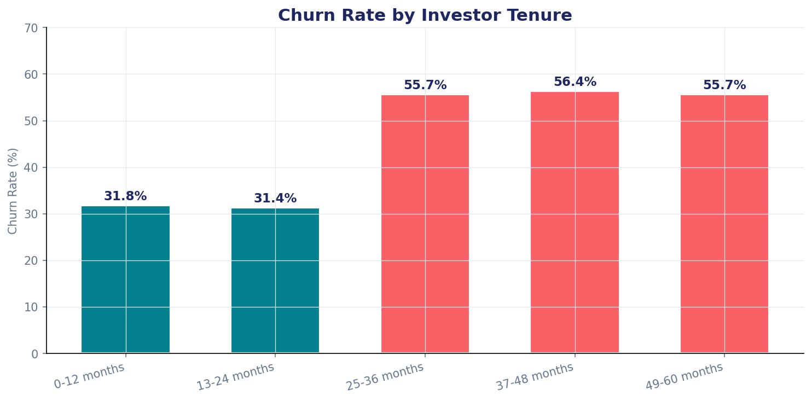
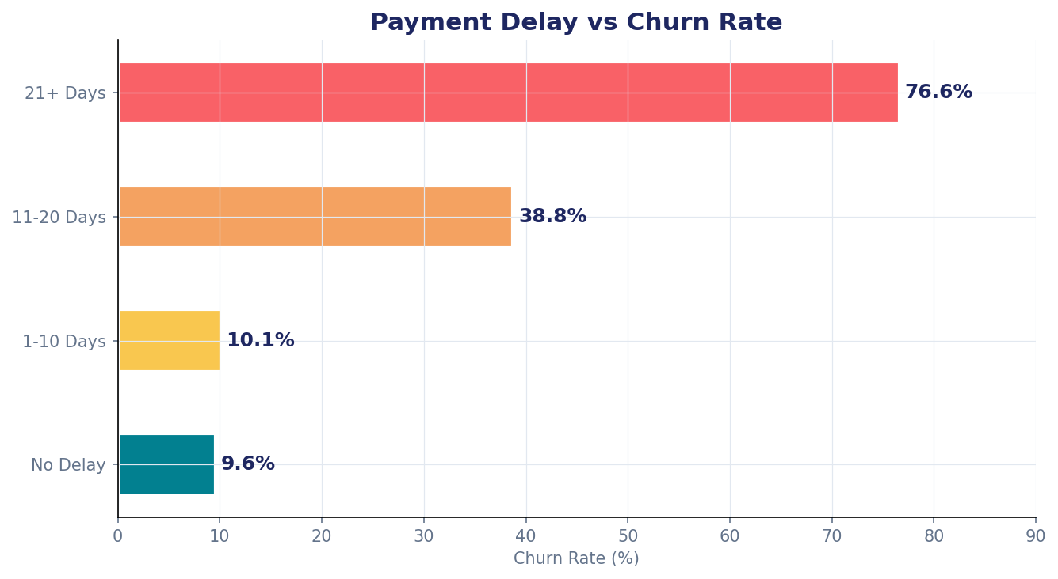
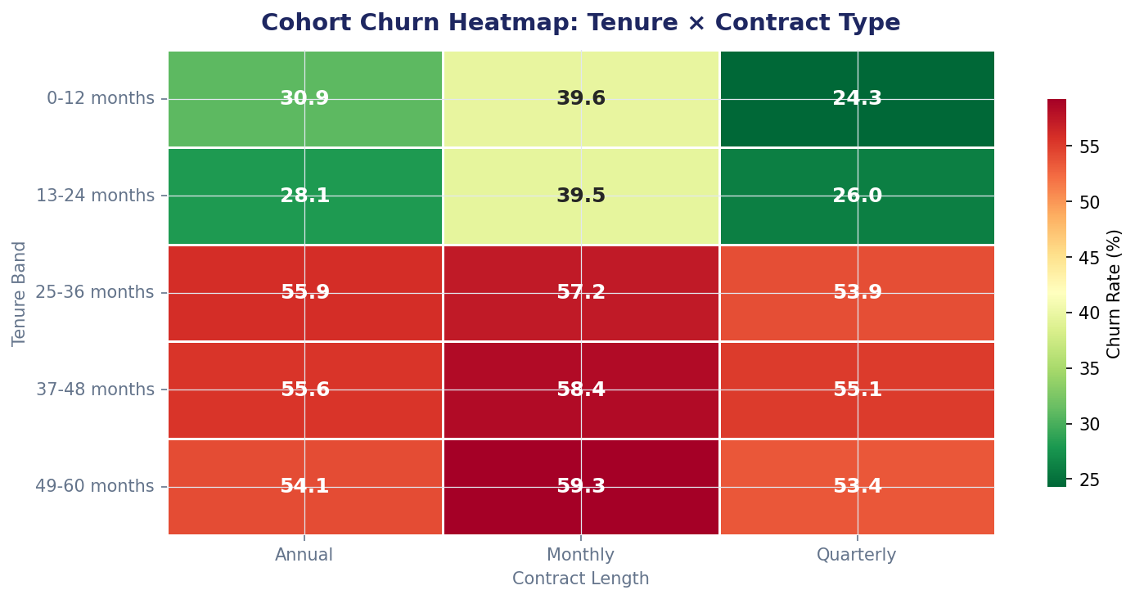
ANALYSIS CHARTS & DASHBOARD

Slide 5
STRATEGIC RECOMMENDATIONS
What TapInvest should do to reduce churn by 10–15%
01
Convert monthly users to quarterly/annual plans
Monthly investors churn at 51.6%. Targeted upgrade offers with fee waivers or bonus returns can reduce churn by ~7pp across that segment.
02
Launch a Month-24 retention programme
Churn spikes at 25–36 months. Deploy a loyalty reward at exactly month 24 — milestone bonus, dedicated RM, or exclusive product access.
03
Flag high-support + high-delay investors for outreach
Build a risk score (already in the SQL). Investors with 5+ support calls AND 15+ day payment delay trigger an automated intervention workflow.
04
Re-engage dormant investors (last login > 22 days)
This segment shows the highest churn. Automated personalised push notifications, portfolio performance updates, or a proactive RM check-in call.
Afsar Ahamed · afsarmulla256@gmail.com · linkedin.com/in/afsar-ahamed2 · CGPA 8.4 | MVJ College of Engineering

