Slide 1


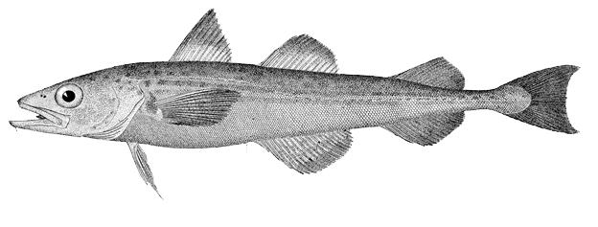

AI Pollock
BSAI Groundfish Plan Team
Steven J. Barbeaux, Jim Ianelli, Ivonne Ortiz, Ned Laman
November 15, 2022

Slide 2
Model
Same as 2020 models
Model 15.1 – same as 2020 management model
AMAK age-structured model with block selectivity on single fishery
Model 15.2 – same as 2020 alternative model
Model 15.1 with age specific natural mortality
Provided for contrast only

Slide 3
Data Summary
Source | Data | Years
NMFS AI Bottom Trawl Survey | Survey Biomass | 1991, 1994, 1997, 2000, 2002, 2004, 2006, 2010, 2012, 2014, 2016, 2018, 2022
NMFS AI Bottom Trawl Survey | Survey Age Data | 1991, 1994, 1997, 2000, 2002, 2004, 2006, 2010, 2012, 2014, 2016, 2018
AKFIN Domestic Blend | Total Catch | 1991-2022
Ianelli et al. 2001 | Total Catch | 1978-1990
Observer Program | Fishery Age Data | 1978-1987, 1994-1996, 1998, 2018
AICASS | Fishery Age Data | 2006 - 2008

Slide 4
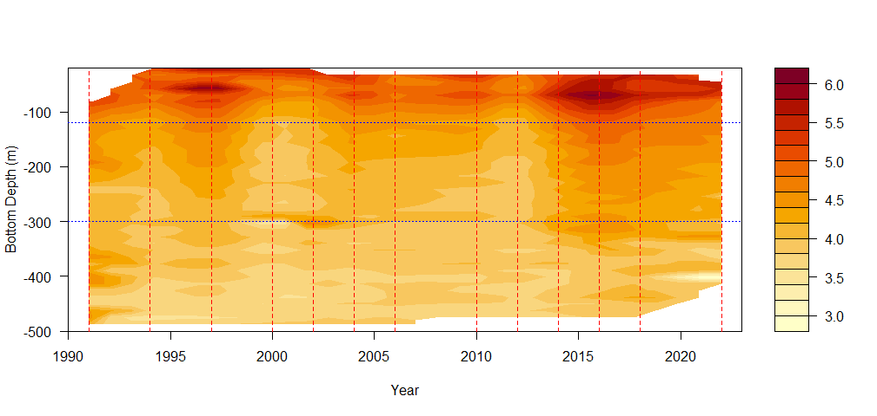
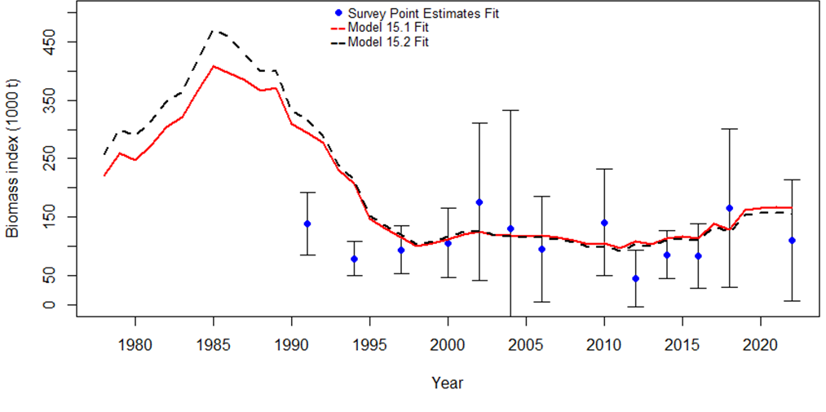
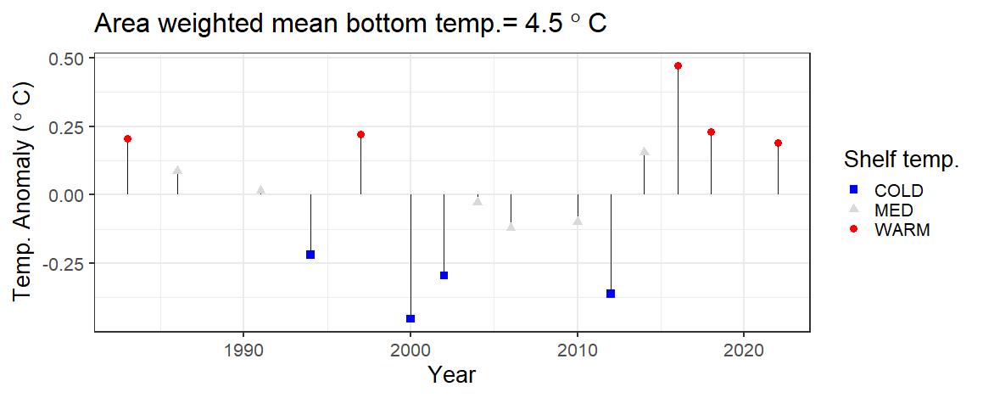
Survey Index – Aleutian Islands Bottom Trawl
2022 survey biomass 34% drop since 2018
Continued warm conditions

Slide 5
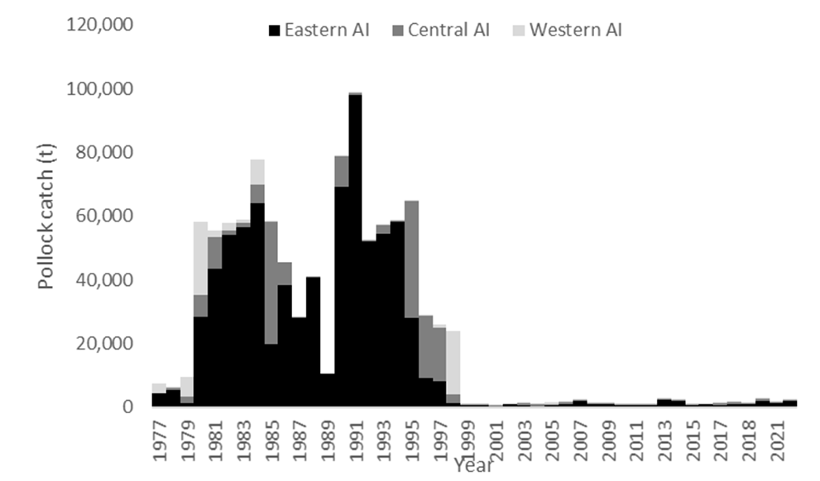
Catch – Fishery Sector
Continued low catch
< 3200 t annually since 1999
2,726 t in 2022
1,840 t in 2021

Slide 6
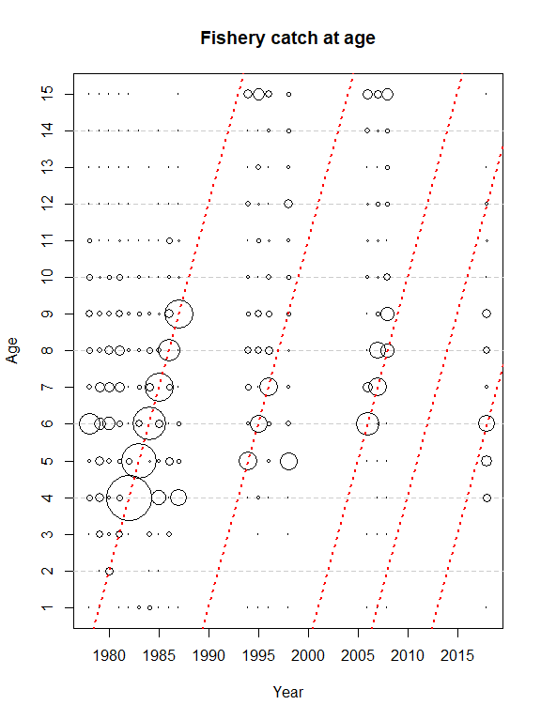
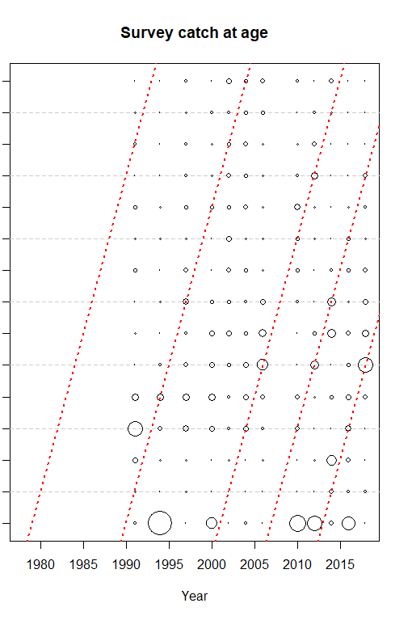
Age composition data
No new age data since 2018
Notes:
Increase in mean length from 2010-2015, with relatively stable mean length over previous 5 years.

Slide 7
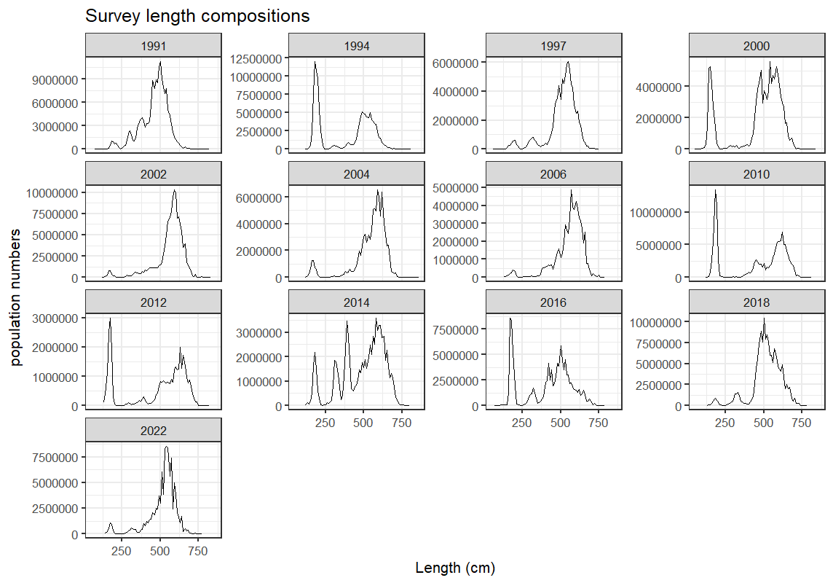
Survey size composition
Few small fish in 2018 and 2022
Very similar size composition for 2018 and 2022

Slide 8
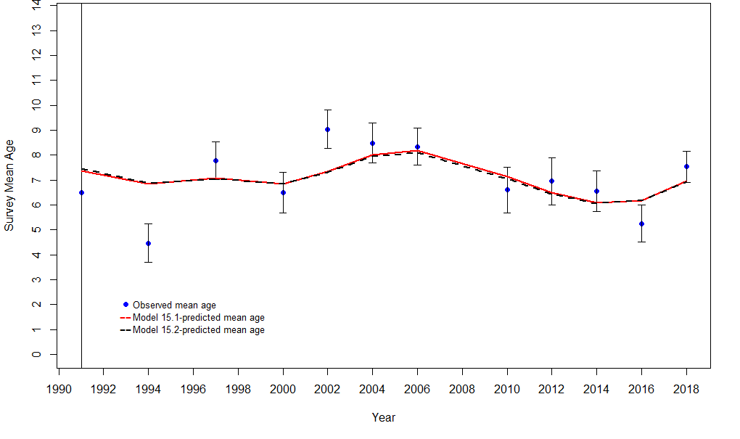
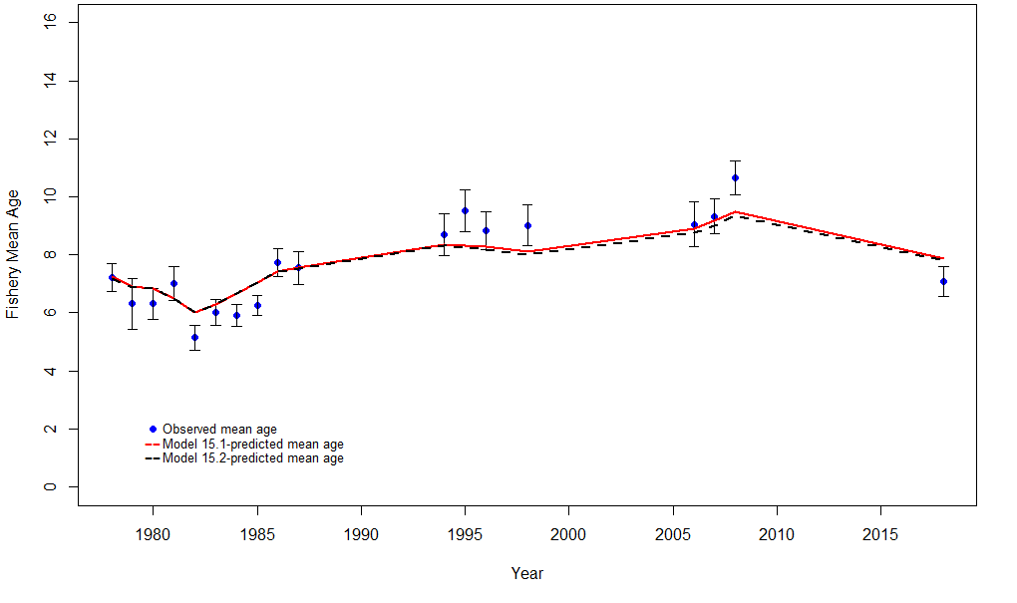
Fit to age composition data
Survey
Fishery

Slide 9
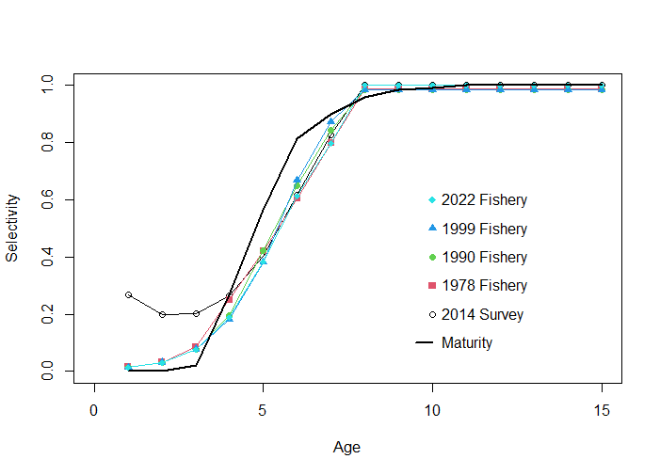
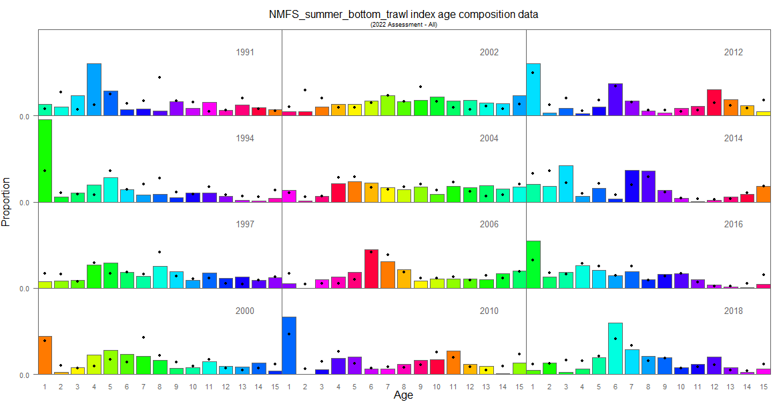
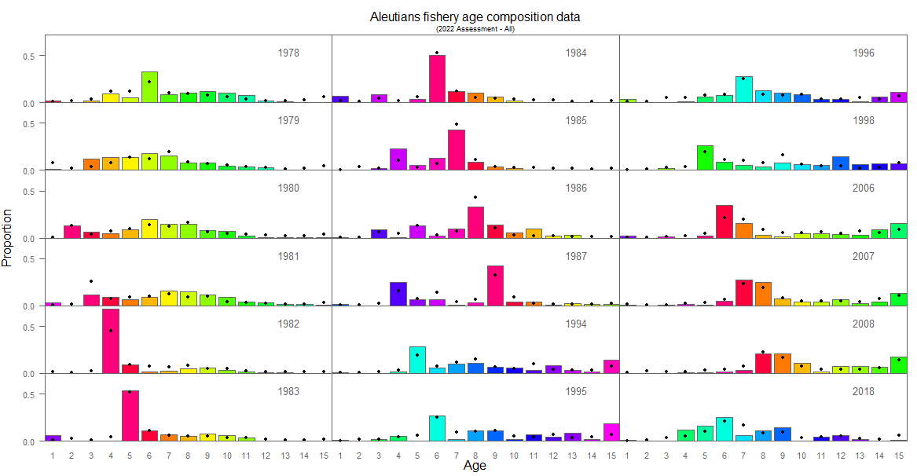
Selectivity and Fits to age composition data
Survey age composition
Fishery age composition

Slide 10
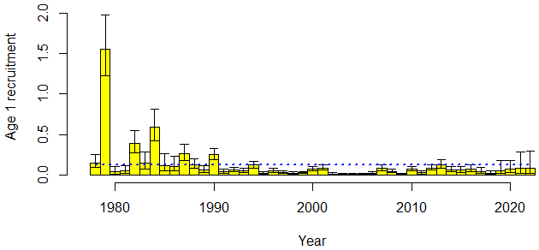
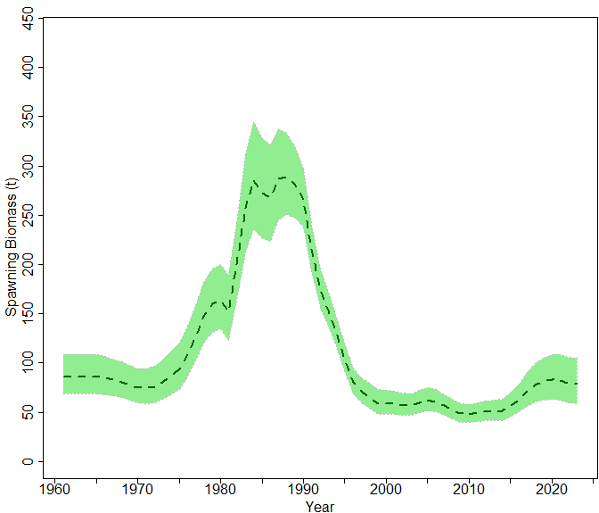
Model 15.1 Time Series
Continued low recruitment
Continued low spawning biomass with relatively flat trajectory over last 3 years.

Slide 11
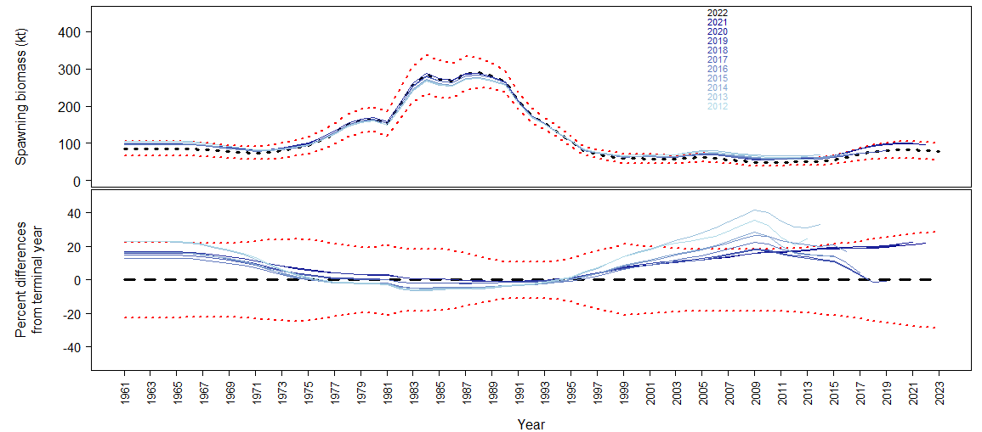
Model 15.1 – Retrospective analysis
Consistently low positive bias on Mohn’s ρ for SSB
Mohn’s ρ = 0.156

Slide 12
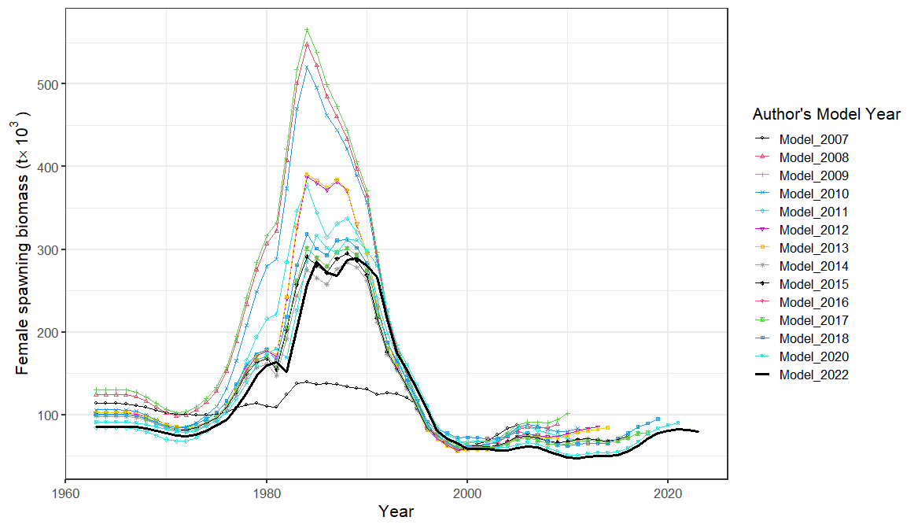
Stock assessment models over time
Same models since 2015
Apparent positive bias (Mohn’s ρ = ~0.32)

Slide 13
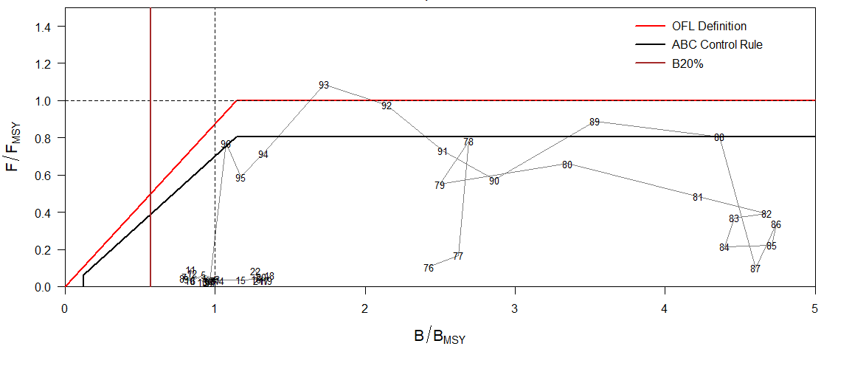
Phase plane
Very low exploitation for the previous 23 years.
Continued low abundance and biomass
Notes:
Plot of fishing mortality rate relative to F35% and female spawning biomass relative for B 35% for status

Slide 14
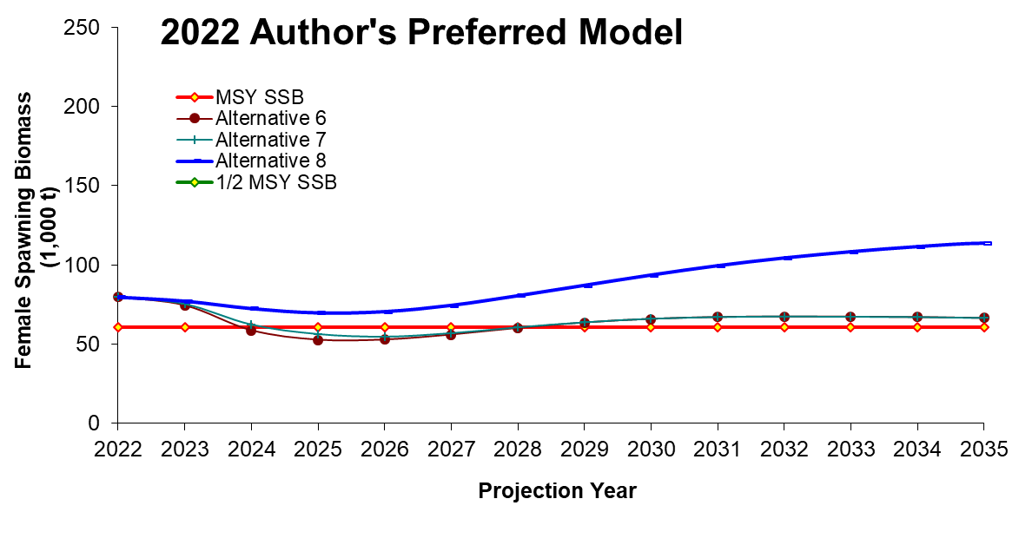
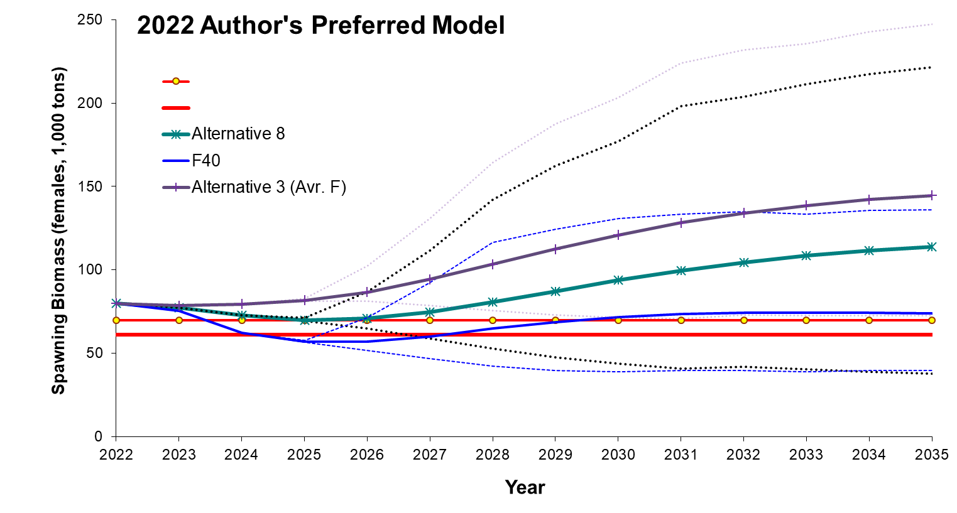
New Series ensemble – Projection scenarios
Not overfishing
Not overfished
Not approaching an overfished condition
With average recruitment projected decline through 2026
Notes:
Model graph of Spawning Stock Biomass with B40% and B35% reference lines

Slide 15
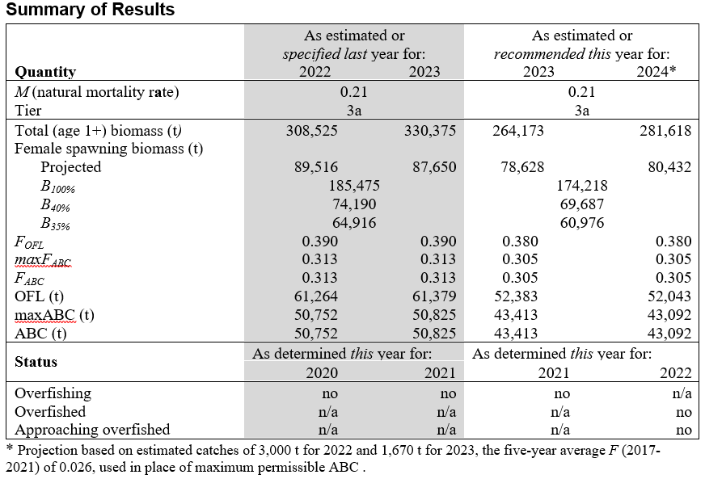
Harvest Recommendation
maxABC is well above the 19,000 t cap
Notes:
Summary table with last year and recommendation for this year values, highlight ABC and OFL

Slide 16
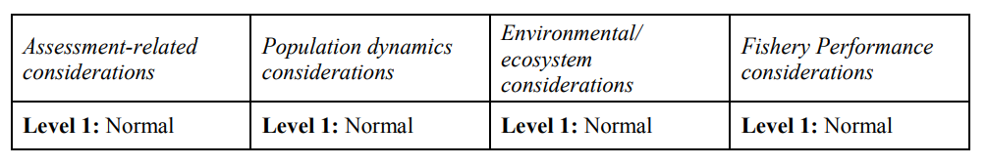
Risk Table
Assessment : No heightened concerns
Pop. Dynamics: All concerns captured within the models and ensemble.
Environment/Ecosystem: No heighted concerns except continued heatwave similar to 2018.
Fishery Performance: No heightened concerns.

Slide 17
QUESTIONS?

