Slide 1
Projection model approaches for N. Pacific Groundfish
James Ianelli
AFSC REFM Division
Seattle WA
1:2:3 4-5-6
Notes:
A. The *specific management uses* you foresee arising from your work. Strategic projections? Include in stock assessment? Better natural mortality estimation? Provide indicators? Design a reserve?
Etc.
B. Specific evaluation of data quality and uncertainty, and data priorities. What primary needs *haven't* been collected, or need to be continued, to make your modeling most useful?

Slide 2
Anybody get that?
Question:
Now it (may be)
1:2:3 pm (3 seconds after 1:02 pm)
on
04/05/06
Will this record happen again in our lifetimes?

Slide 3
Outline
Overview
File layout and options
Projection options
Single species aspects
Multispecies aspects
Estimation features

Slide 4
Projection model application
Single method to get consistent projections for ABC and OFL estimates
Independent of stock assessment approach
Need to provide multi-year values
Used for status determination

Slide 5
7 standard scenarios
Maximum permissible ABC level
½ Maximum permissible
Author’s adjusted ABC level
5-year average F
No fishing
Overfishing status determination
Overfished status determination
These can be easily changed in the code, and catch-feedback is allowed as an option (8).

Slide 6
History
Early 1990s recognition that a buffer is desirable between ABC and OFL
F_{ABC} = F_{35%}
F_{OFL} = F_{30%}
Also that for depressed stocks, F should be adjusted downwards
Late 1990s F_{OFL} set equal to F_{MSY}
Proxy for F_{msy} ~ F_{35%}
F_{ABC}=F_{40%}
A Precautionary Approach
Target reference points safely below limit reference points
Stocks harvested less aggressively when biomass is low
Stocks harvested less aggressively when uncertainty is high

Slide 7
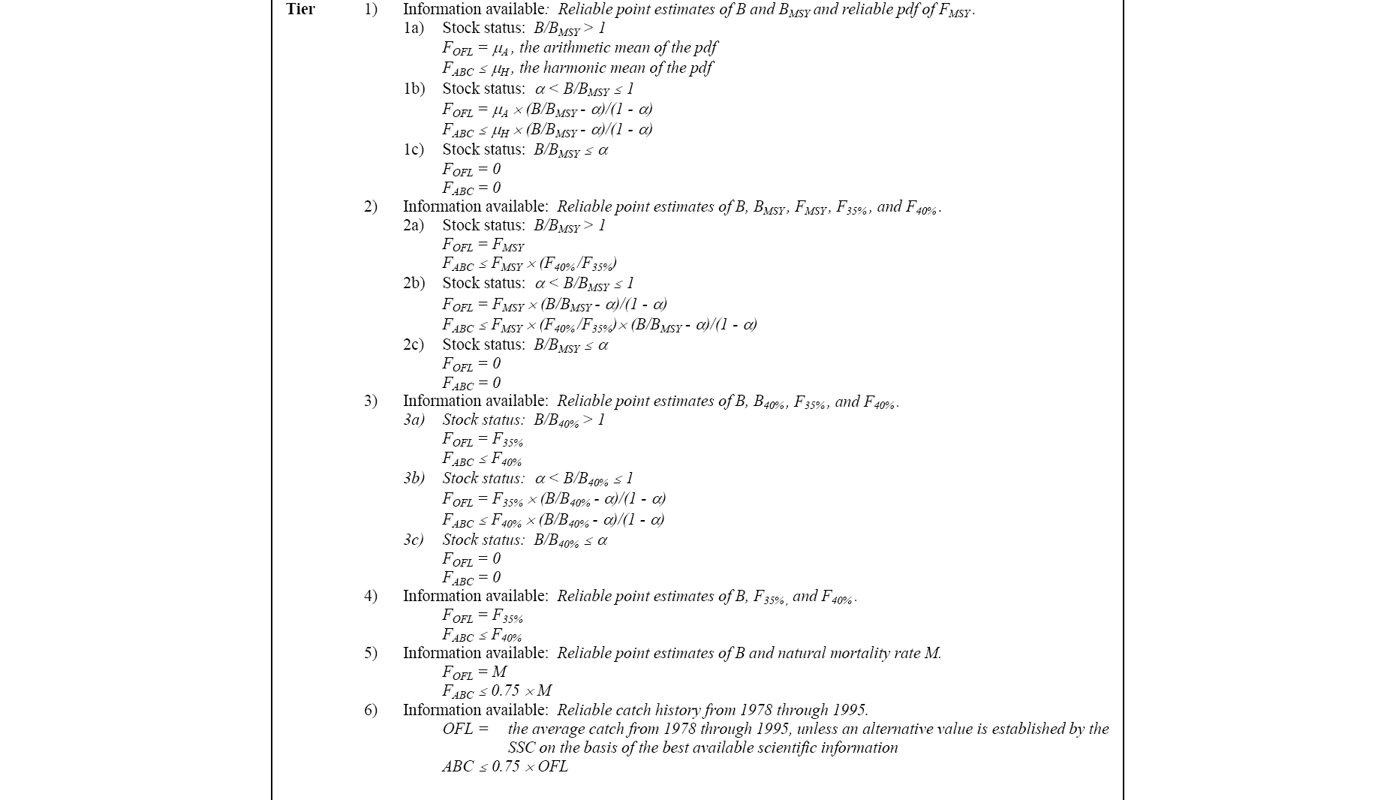

Slide 8
Some critical decisions
BRP (Biological reference points) required
Since stock-recruitment relationship estimates are lacking:
SPR proxies are used
Based on some “mean” recruitment
Alaska groundfish stock policy to use estimates from 1978 onwards
B_{35%} used for Bmsy proxy

Slide 9
Model and software developments
Uniformity among approaches
Transparent ability to deal with split sex, multi-fishery cases
Stock projection assumption alternatives
Conditioning stock-recruitment relationship
Given stock-recruitment model output and
Assumptions (e.g., Fmsy=F35% etc)
Features
Ability to evaluate catch-variability
E.g., Mean-Var/2 maximization
Ability to implement NSG1 modifications
Multi-species technical interactions possible
Ability to easily mesh with MSEs
Use projection model in “automatic mode”

Slide 10
Schematic
Assessment &
Conditioning
Compute biological
quota rules for
each species
Estimated species composition by fishery & area
Constraint specifications
Simulate
assessment
data
Simulation loop
Standard
simulation
approach
“New” assessment
Projection loop
Compute biological
quota rules for
each species
Numerically optimize
catch over all fisheries
given constraints
Constraint specifications
Update each population given realized catch
Model output
(species biomass, fishery catch/revenue, …)

Slide 11
Issues
Current stock-size uncertainty
Parameter uncertainty
Alternative 3b calculations
Tier 1 implementation methods for two and three-year projections

Slide 12
Outline
Overview
File layout and options
Projection options
Single species aspects
Multispecies aspects
Estimation features

Slide 13
Projection steps…
1) Run the stock assessment model making note of the main demographic results, current numbers at age and historical stock-recruitment estimates
2) Edit the stock-specific input files .
3) Edit the catch projections file which includes assumptions about future catch
4) Edit the “setup.dat” file which includes assumptions about projection specifications
5) Run the projection model (e.g., use file “run.bat”)
6) Save and evaluate results :
bigfile.out Full output file containing catch in every simulated year
bigsum.dat Summarized version of bigfile.out
F_profile.out Profile of main characteristics over fishing mortality
srec.out Details on stock-recruitment data that were fit
means.out General projection results by species and alternatives
percentiles.out Gives percentiles of simulation results and variability
7) Repeat steps 4)-6) as desired for different model configurations etc.
8) Repeat steps 3)-7) as desired for different impacts of near-term catch levels
9) Repeat steps 1)-8) as desired to evaluate different model results.
DOS batch files suck, awk…BUT

Slide 14
Readme.txt
Species file differences:
To see a simple species file (single fishery and sex) open bsai_atka.dat or bsai_pop.dat
To see a species file with multiple sexes defined (and differing natural mortality rates) open goa_atf.dat
To see a species file with multiple fisheries and sexes defined open bsai_gturb.dat
To run a single scenario on a single stock:
copy setup1.dat setup.dat
run bsai_pop (where bsai_pop is a stock selected that has a file named bsai_pop_spcat.dat)
check out output files in myfile_out directory...
To run multiple scenarios on a single stock:
copy setup2.dat setup.dat
“run bsai_pop”
To run multiple scenarios on a multiple stocks:
open data\bsai_spcat.dat {copy setup2.dat to setup.dat}
“run bsai”
here BSAI_spcat.dat exists and contains the list of species and the catch levels

Slide 15
Batch files suck…
@echo off
if NOT exist data\%1_spcat.dat ( echo ---------------
echo.
echo Oops...Error!!!!
echo.
echo File data\%1_spcat.dat appears to be missing...
echo.
echo Exiting....
echo ---------------
exit /B
)
copy data\%1_spcat.dat spp_catch.dat
main -nox -nohess
if NOT exist %1_out mkdir %1_out
copy *.out %1_out\
copy main.rep %1_out\report.out
copy alt2_proj.rep %1_out\alt2_proj.out
call awk1 %1

Slide 16
NR>1{
{i= $1" "$2" "$3}
{ c[i]++ }
{ abc[i]+=$4}
{ ofl[i]+=$5}
{ cat[i]+=$6}
{ ssb[i]+=$7}
{ f[i]+=$8}
{totb[i]+=$9}
}
END {
{print "Alt Stock Year ABC OFL Catch SSB F Total_Biom"}
for (i in abc) {
print i, abc[i]/c[i], ofl[i]/c[i], cat[i]/c[i], ssb[i]/c[i], f[i]/c[i], totb[i]/c[i] }
}

Slide 17
Example output
Datafiles.xls
Srfits.xls
Fprofiles.xls
TAC_Fits.xls

Slide 18
Example multispecies result

Slide 19
Outline
Overview
File layout and options
Projection options
Single species aspects
Multispecies aspects
Estimation features

Slide 20
Estimation features
SPR rates solved simply
Not part of normal ADMB “parameters”
Stock-recruitment parameters are estimated
Ricker and Beverton-Holt are options
Ricker tends to be more stable for estimation

Slide 21
Stock-recruitment fits
“Conditioned” means that F_{35%} = F_{msy}
“Unconditioned” means just fit available data…
Shown in order of effect

Slide 33
Effect on yield curves…

Slide 35
v

Slide 36
Additional “conditioning”
Ignore Stock-recruitment information from assessment
Assume B35% and F35% are proxies for Bmsy and Fmsy
What stock-recruitment relationships satisfy this constraint?
Stock-recruitment data still used (for estimates of variability)

Slide 37
Additional conditioning

Slide 40
Tests for behavior
What difference does it make?
What if a stock gets hit really hard?
How do current “unfished” estimates compare with “unfished” in a stock-recruitment context?

Slide 41
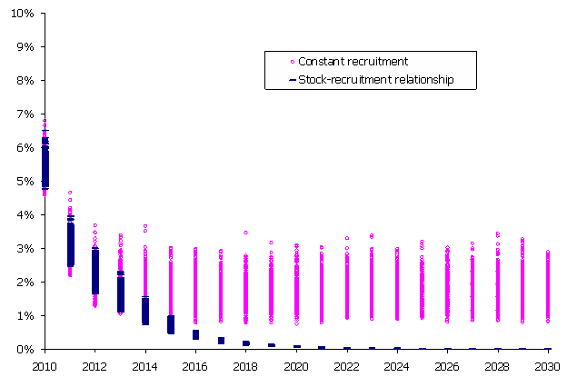
Extreme catch rates
With control-rule
Without control-rule

Slide 42
Data exploration
Bivariate plots of stock TACs relative to each other
Linear regression and GAM model explorations

Slide 43
Data: BSAI TAC proportions
Relative
to other
TAC proportions
1989-2004

Slide 44
Pollock
TACs
Relative to
other species
ABCs
Proportion of TAC
ABC (thousands of t)

Slide 45
Pacific cod
Proportion of TAC
ABC (thousands of t)

Slide 46
Yellowfin sole
Proportion of TAC
ABC (thousands of t)

Slide 47
Next steps
Test some more complicated TAC-Catch rules
E.g., re-implement the constrained optimization
Accommodate anticipated changes
Alt 3b, NSG1…
Revisions as needed

