Slide 1
Comparison of Stock Synthesis Model Runs
EBS, EBS_WRUS, EBS_WGOA, EBS_WGOA_WRUS, ALL
Summary of differences across models

Slide 2
Summary of Model Differences
Domestic-only models (EBS, EBS_WRUS, EBS_WGOA, EBS_WGOA_WRUS) produce nearly identical results.
Inclusion of WGOA or WBS survey indices (without catches) does not change stock dynamics appreciably.
ALL model (with WBS fishery) shows higher SSB and recruitment but much higher F.
WBS fishery exploitation is highly variable and often extreme (F > 1.0).
Overall: U.S.-only models indicate moderate exploitation; ALL model reveals higher total exploitation across the stock.

Slide 3
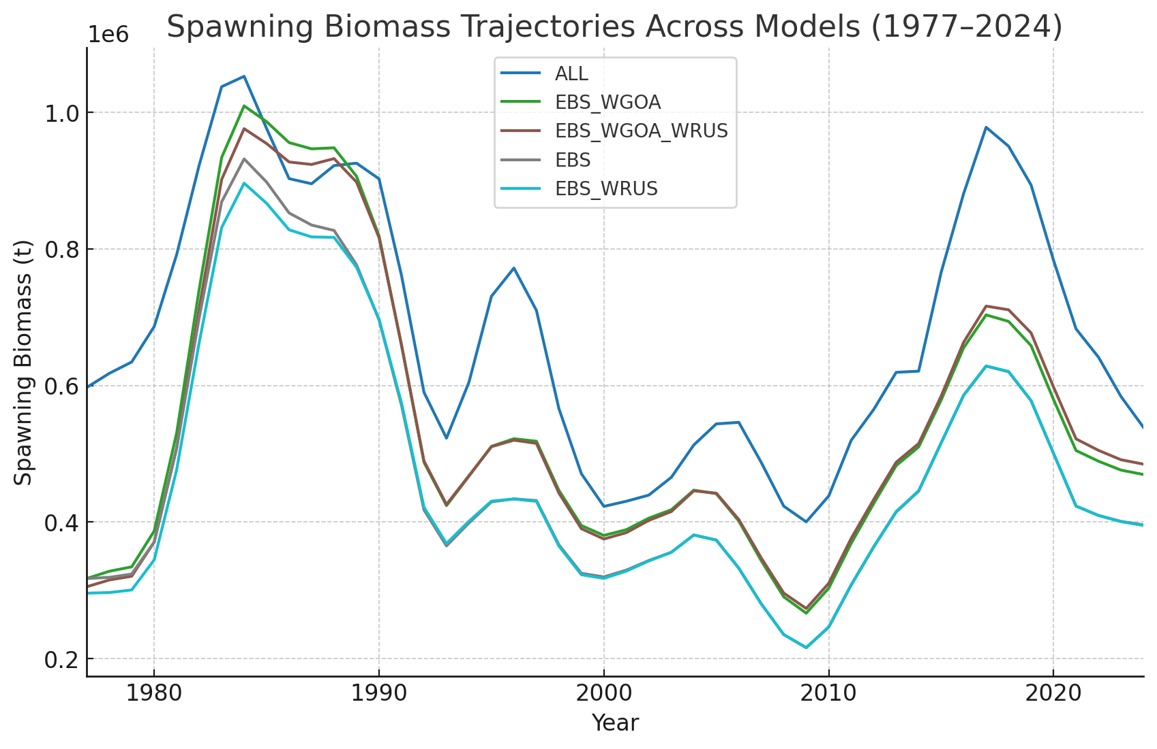
Spawning Biomass Trajectories

Slide 4
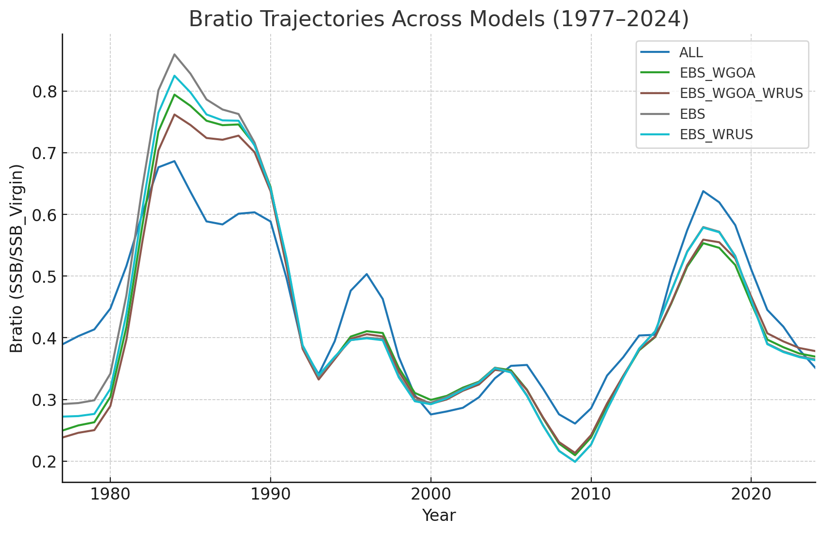
Bratio Trajectories

Slide 5
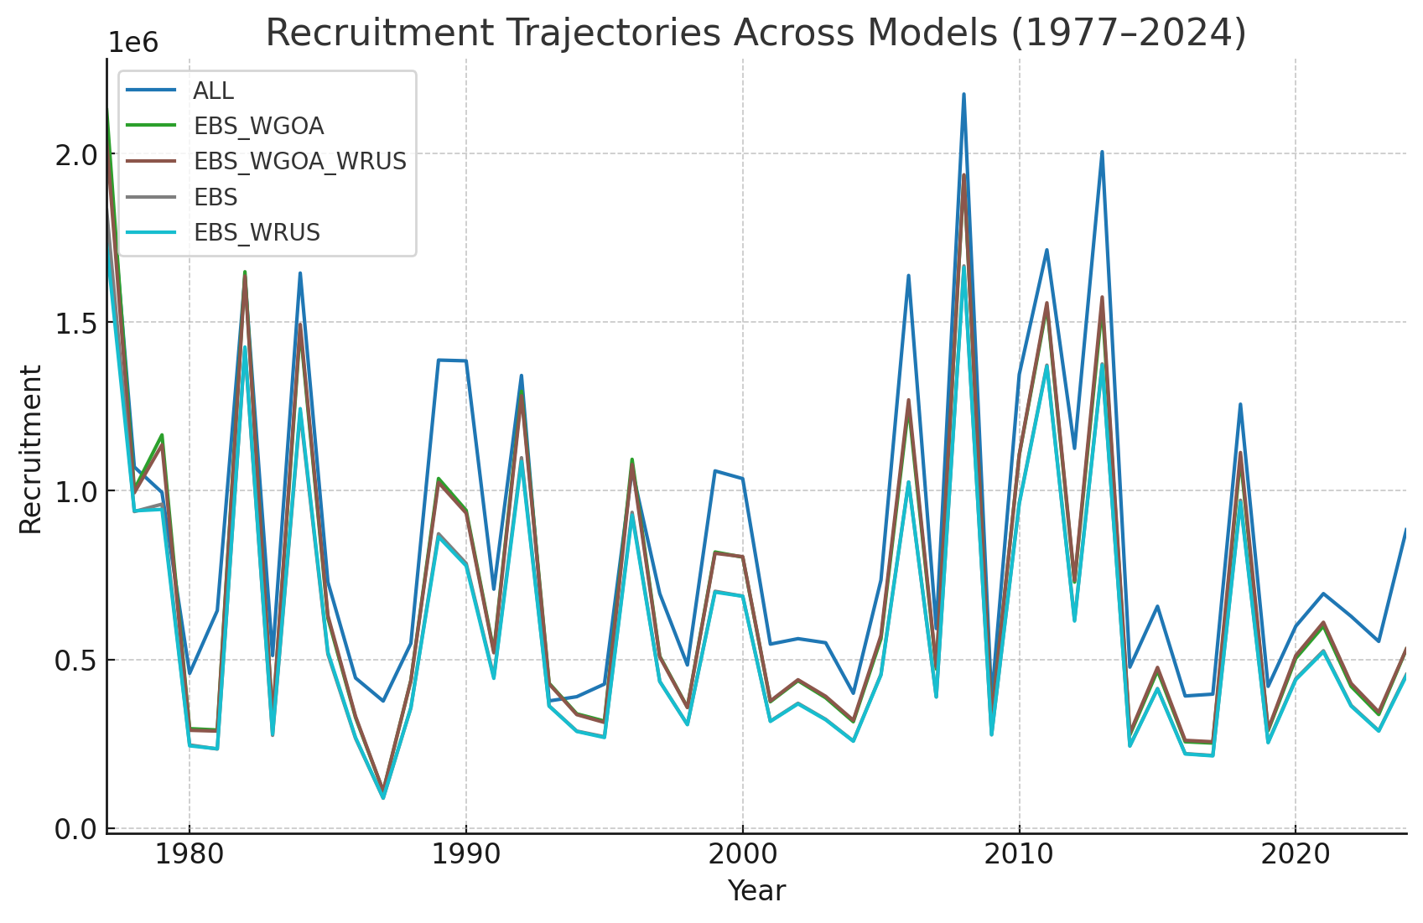
Recruitment Trajectories

Slide 6
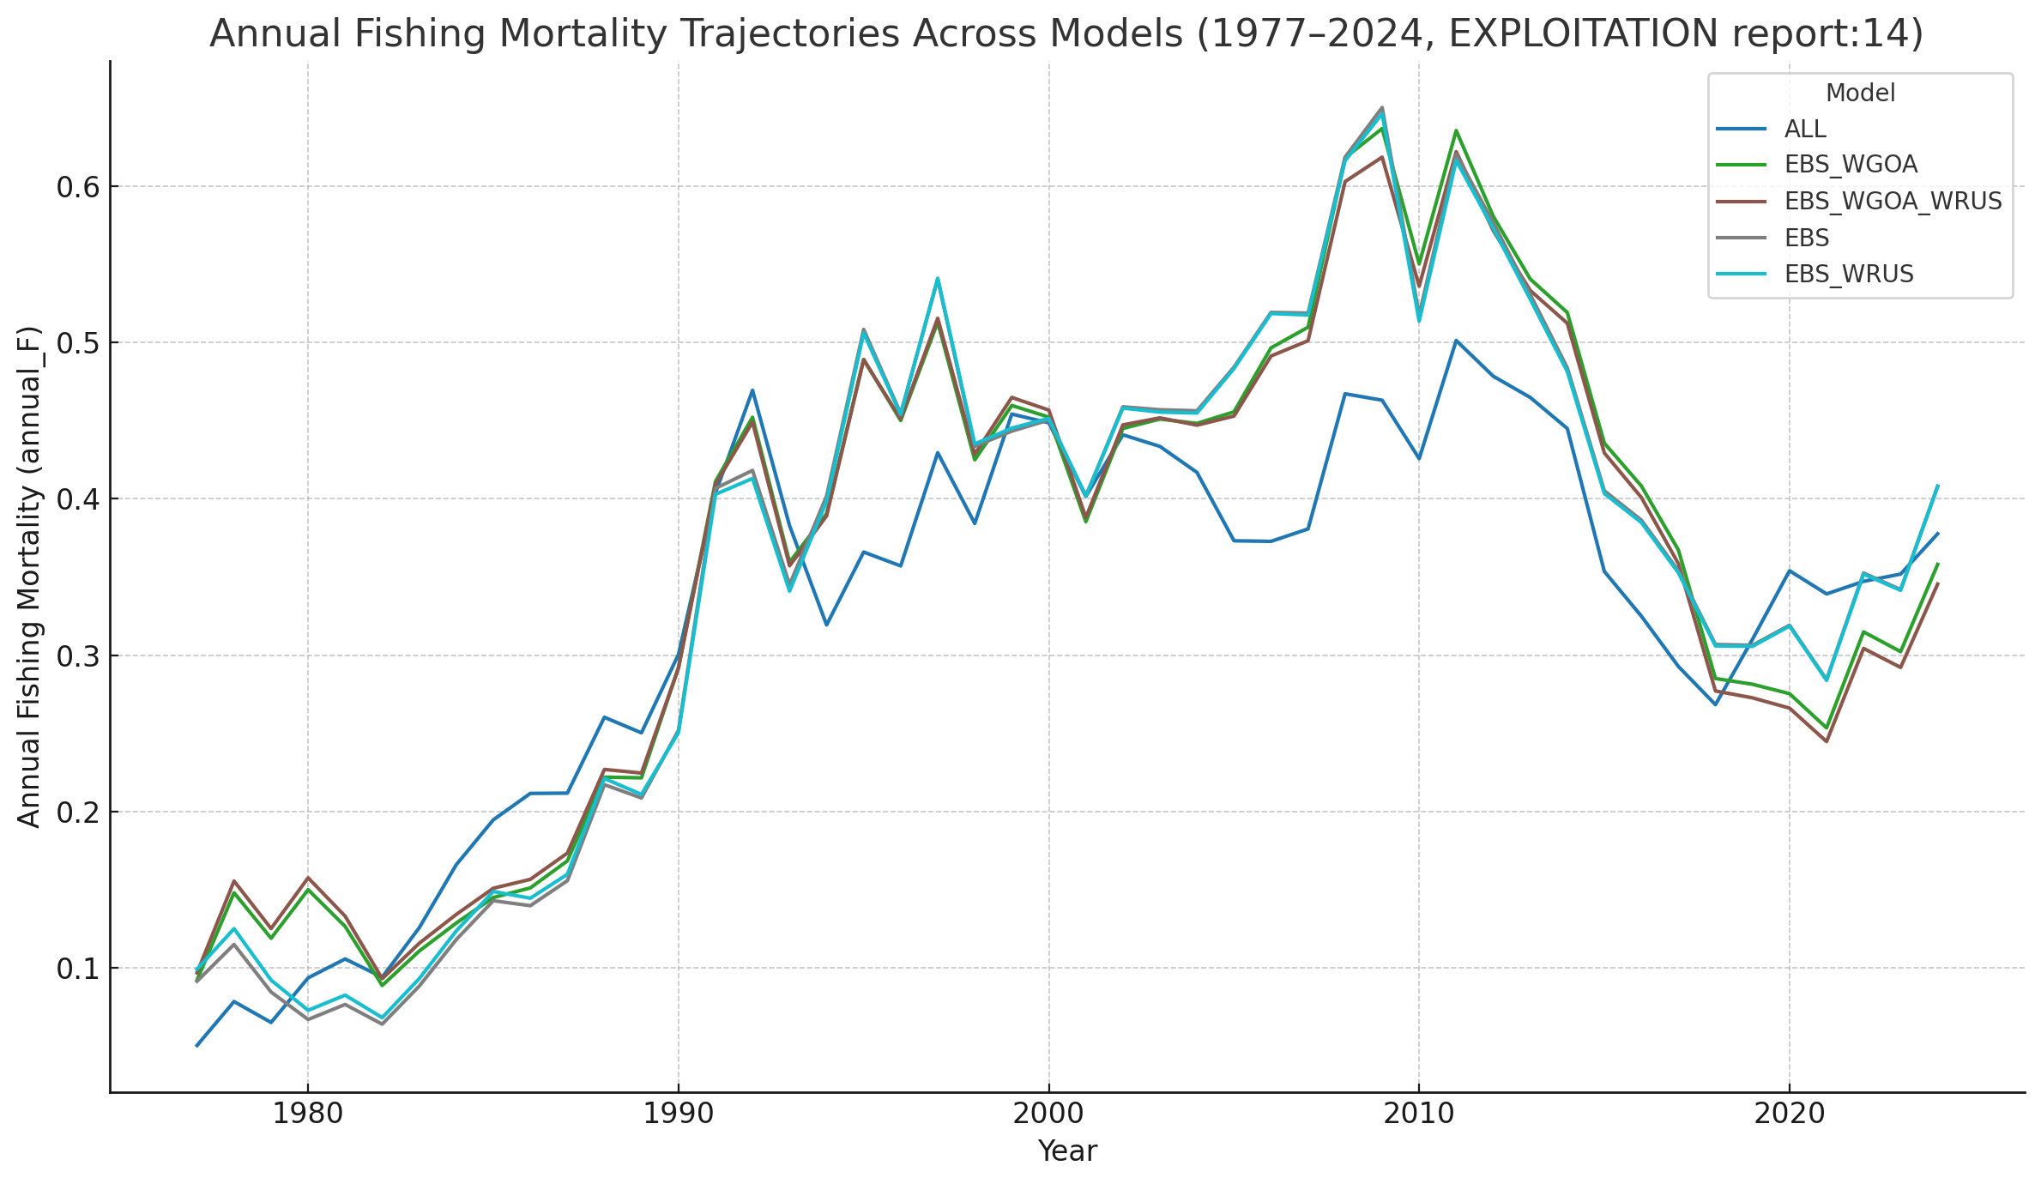
Annual Fishing Mortality Trajectories

Slide 7
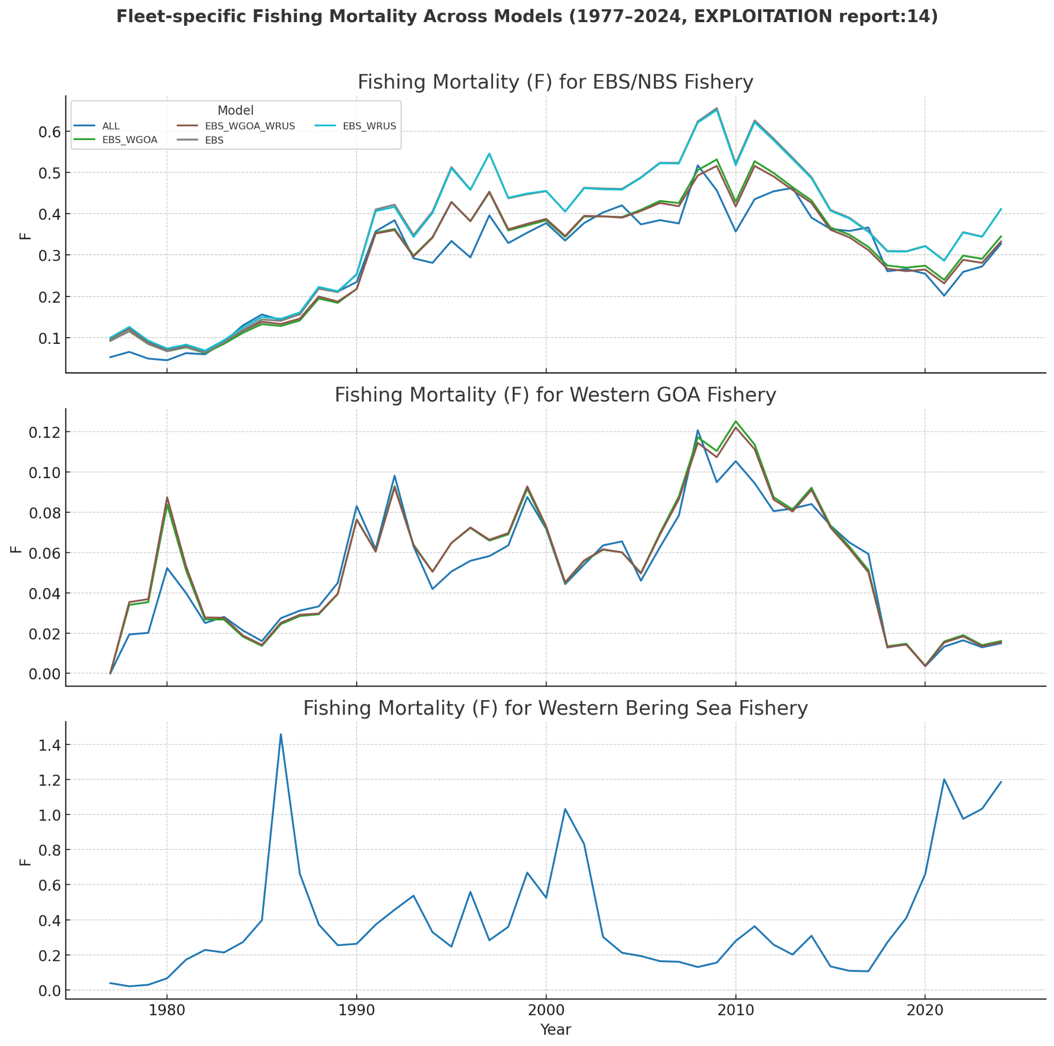
Fleet-specific Fishing Mortality (EXPLOITATION report:14)

Slide 8
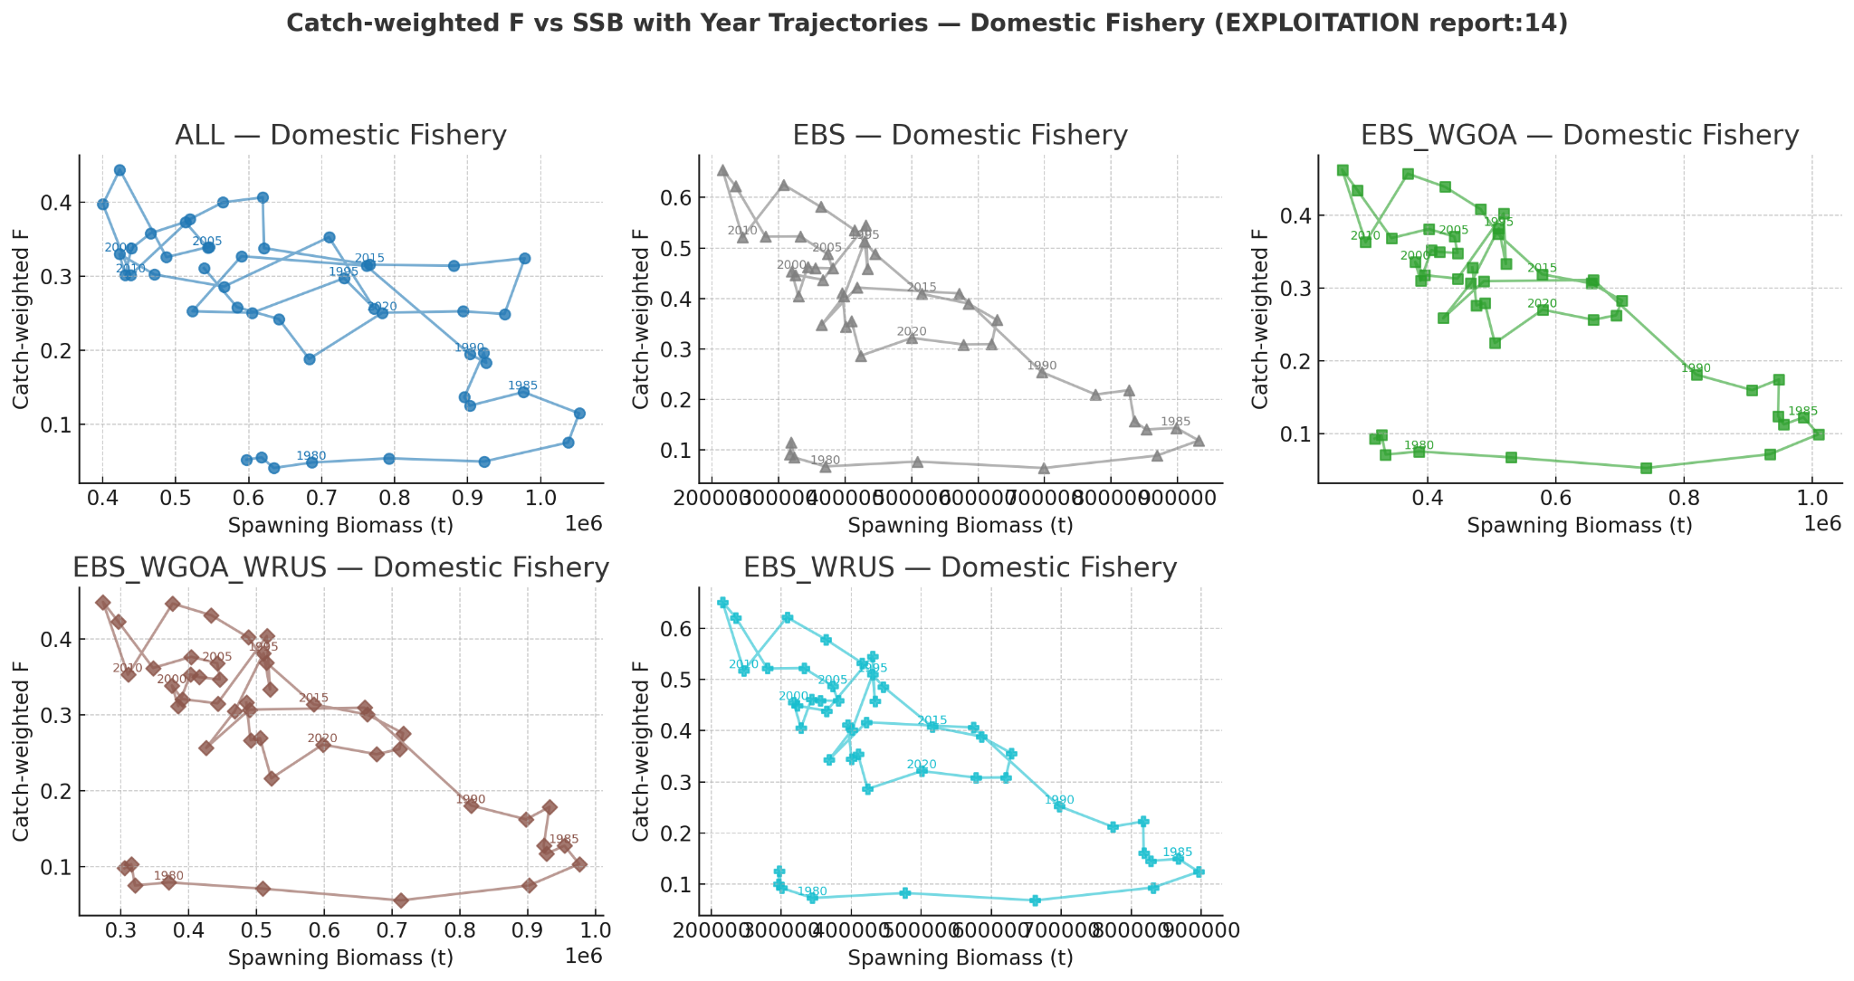
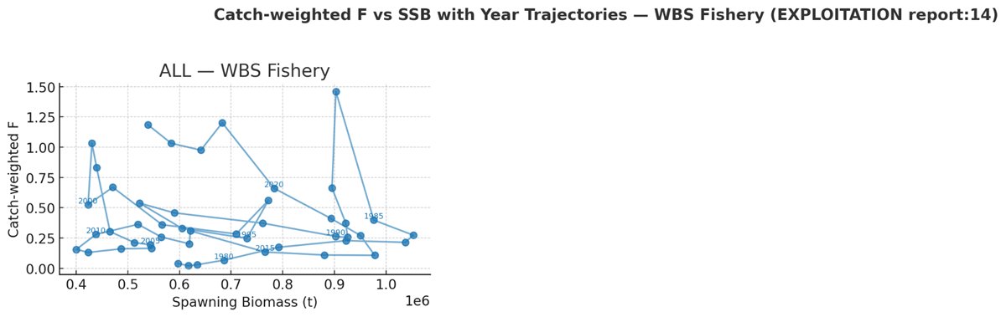
Catch-weighted F vs SSB — Domestic Fisheries

Slide 9
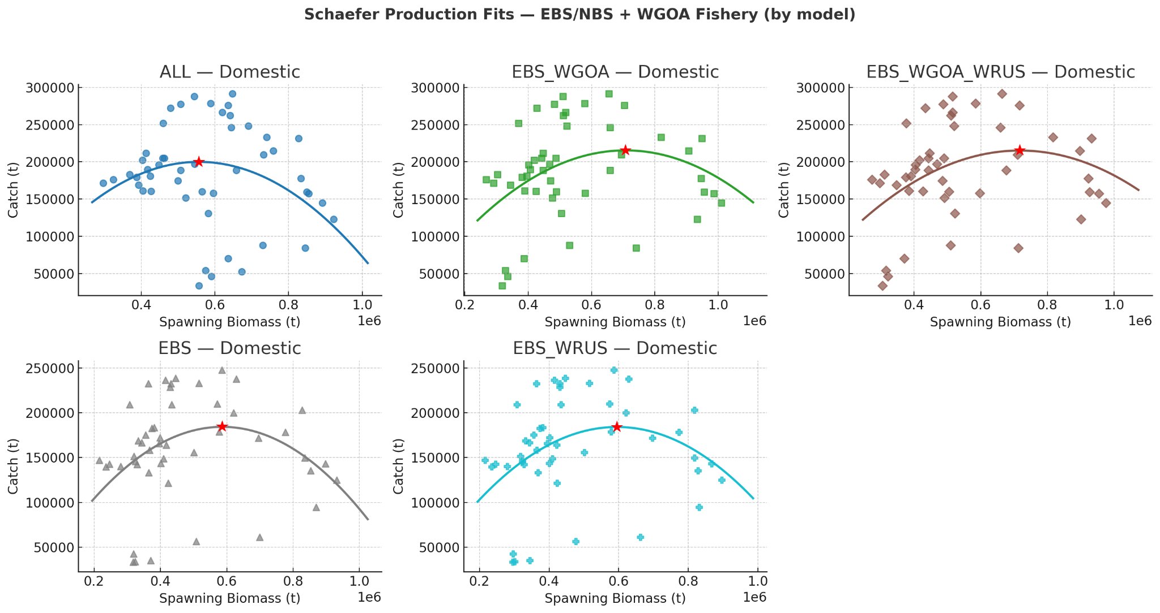
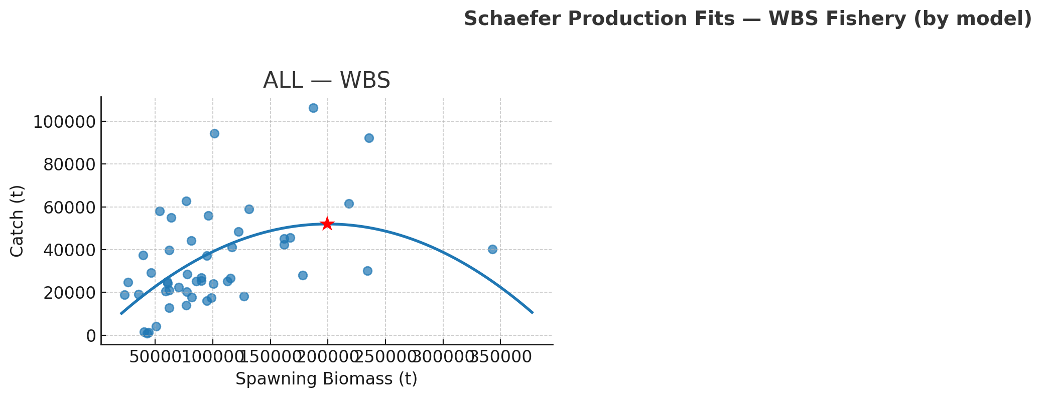
Schaefer Production Fits

Slide 10
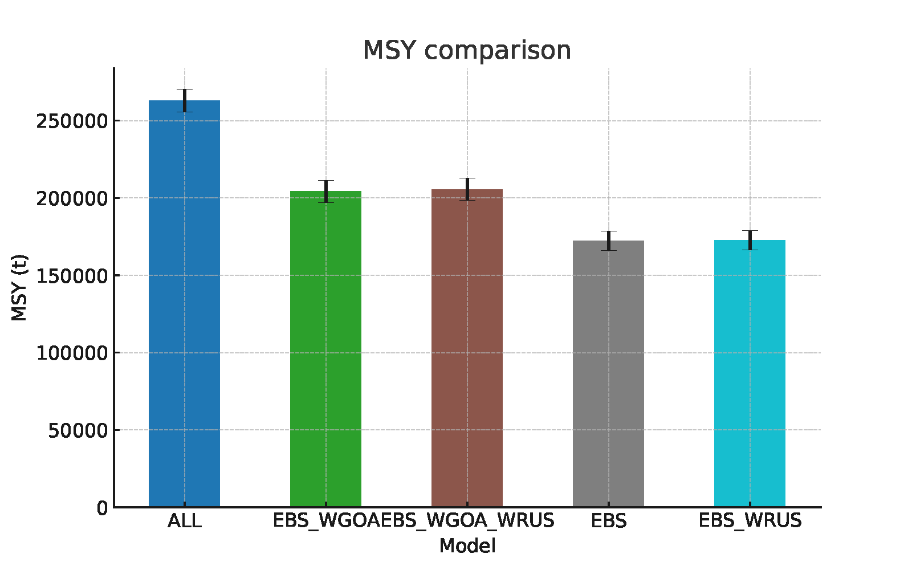
MSY Comparison

Slide 11
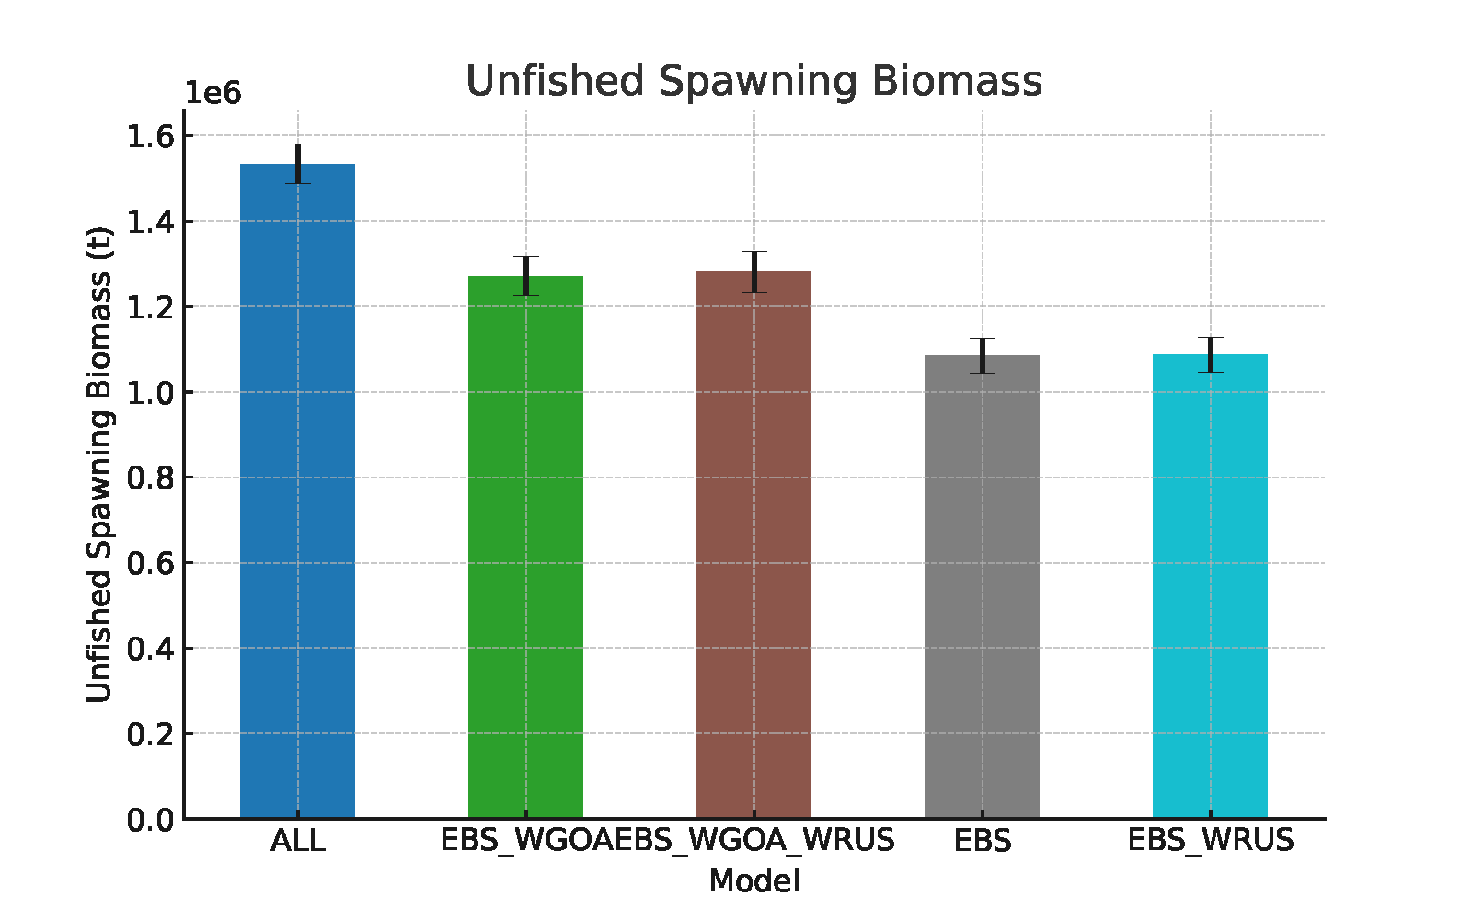
Unfished Spawning Biomass

Slide 12
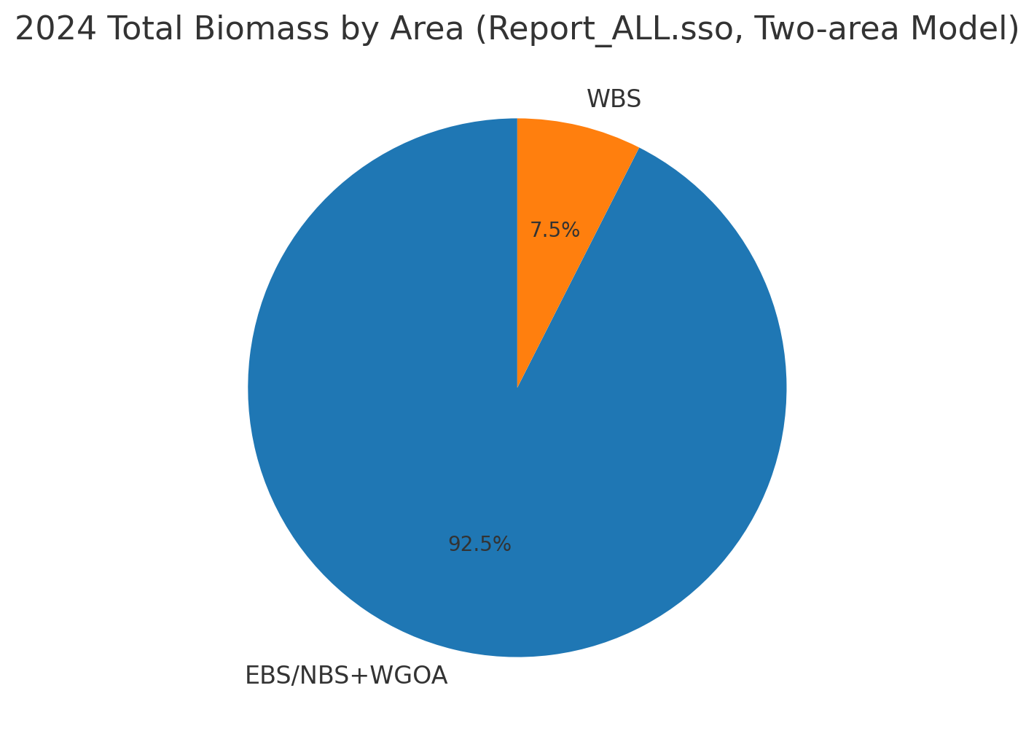
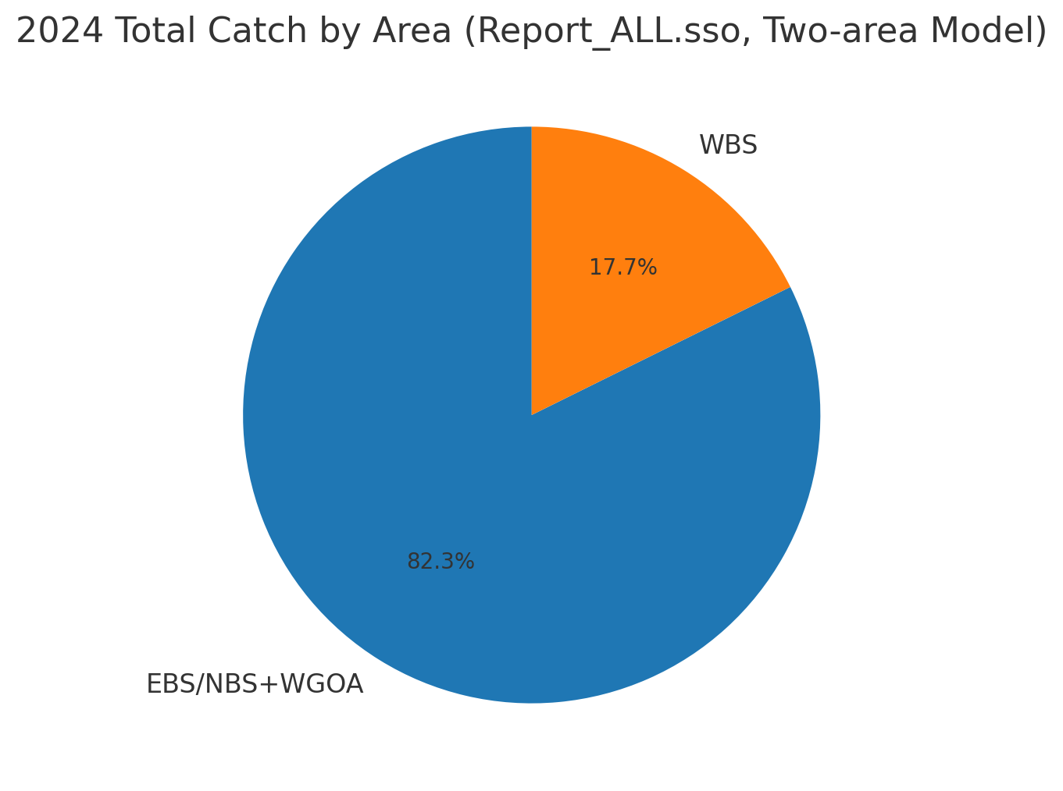

Slide 13
