Slide 1
Comparison of Stock Synthesis Model Runs
EBS, EBS_WRUS, EBS_WGOA, EBS_WGOA_WRUS, ALL
Summary of differences across models

Slide 2
Summary of Model Differences
Domestic-only models (EBS, EBS_WRUS, EBS_WGOA, EBS_WGOA_WRUS) produce nearly identical results.
Inclusion of WGOA or WBS survey indices (without catches) does not change stock dynamics appreciably.
ALL model (with WBS fishery) shows higher SSB and recruitment but much higher F.
WBS fishery exploitation is highly variable and often extreme (F > 1.0).
Overall: U.S.-only models indicate moderate exploitation; ALL model reveals higher total exploitation across the stock.

Slide 3
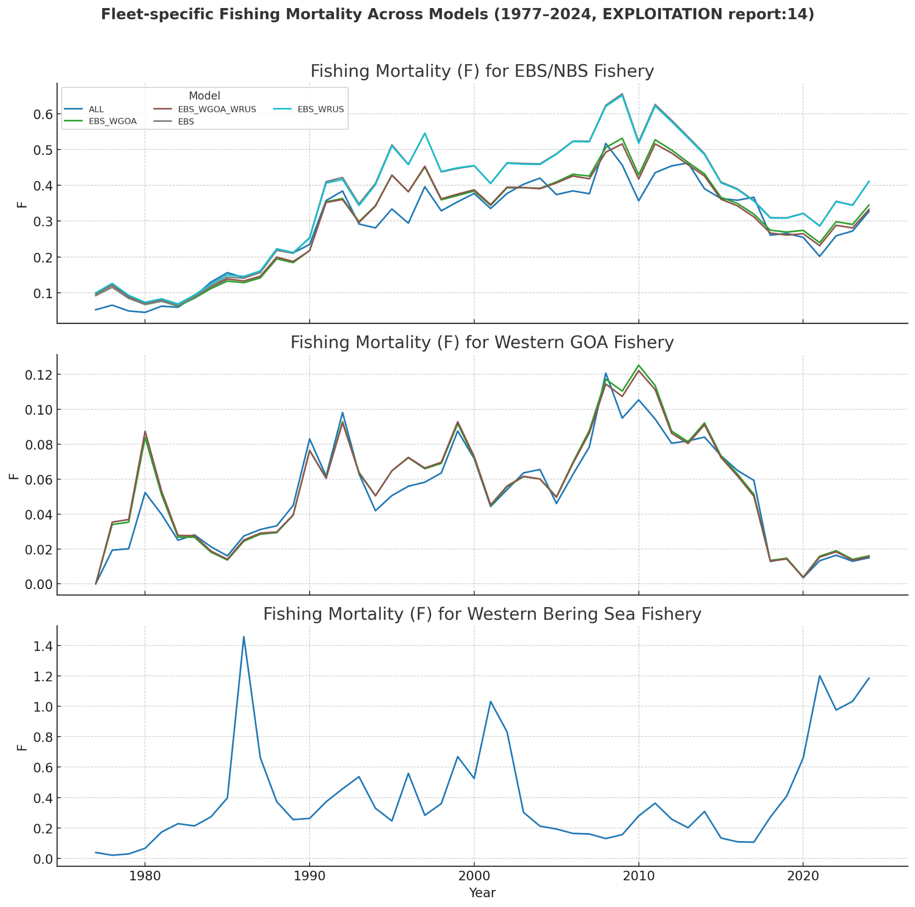
Fleet-specific Fishing Mortality (EXPLOITATION report:14)

Slide 4
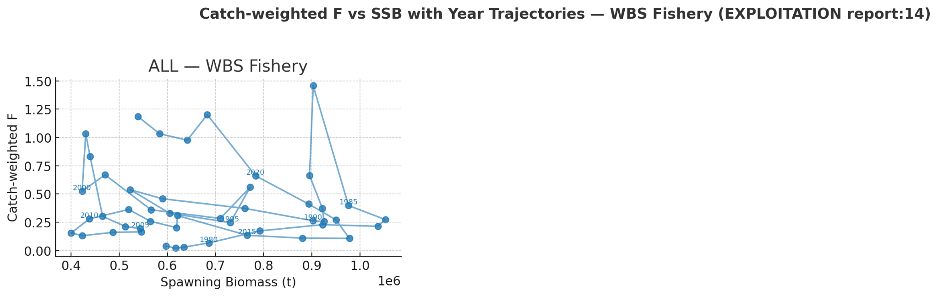
Catch-weighted F vs SSB — WBS Fishery

Slide 5
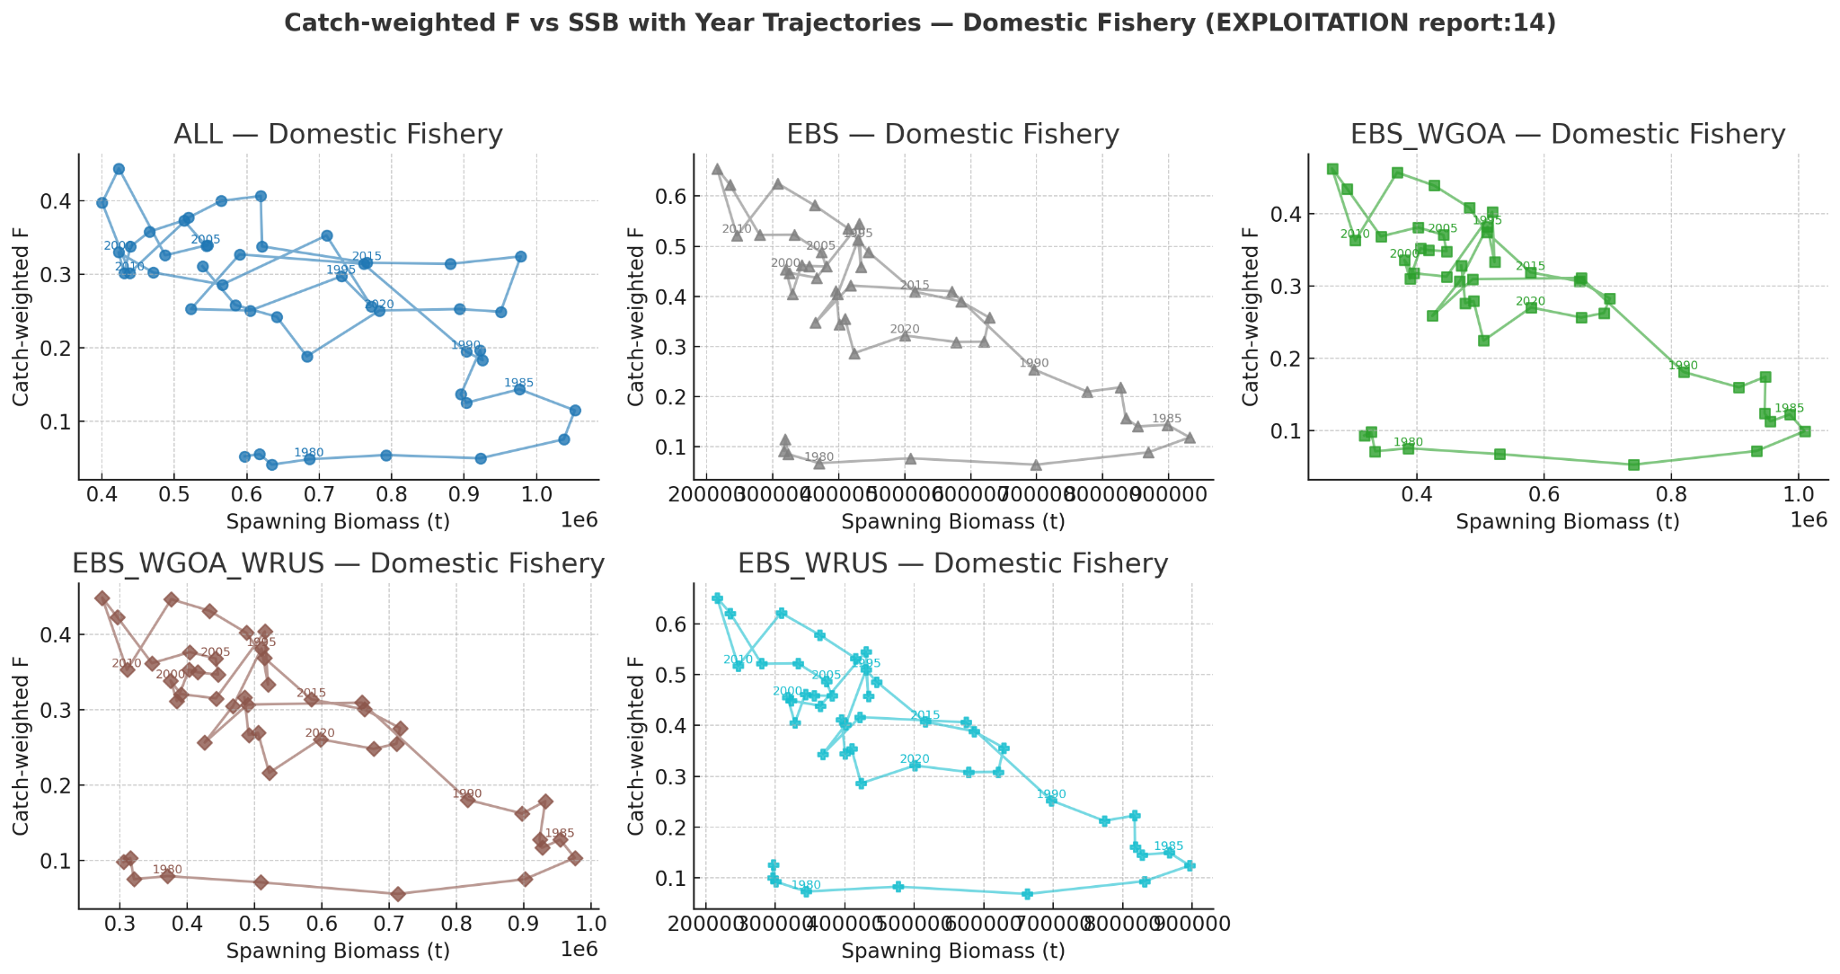
Catch-weighted F vs SSB — Domestic Fisheries

Slide 6
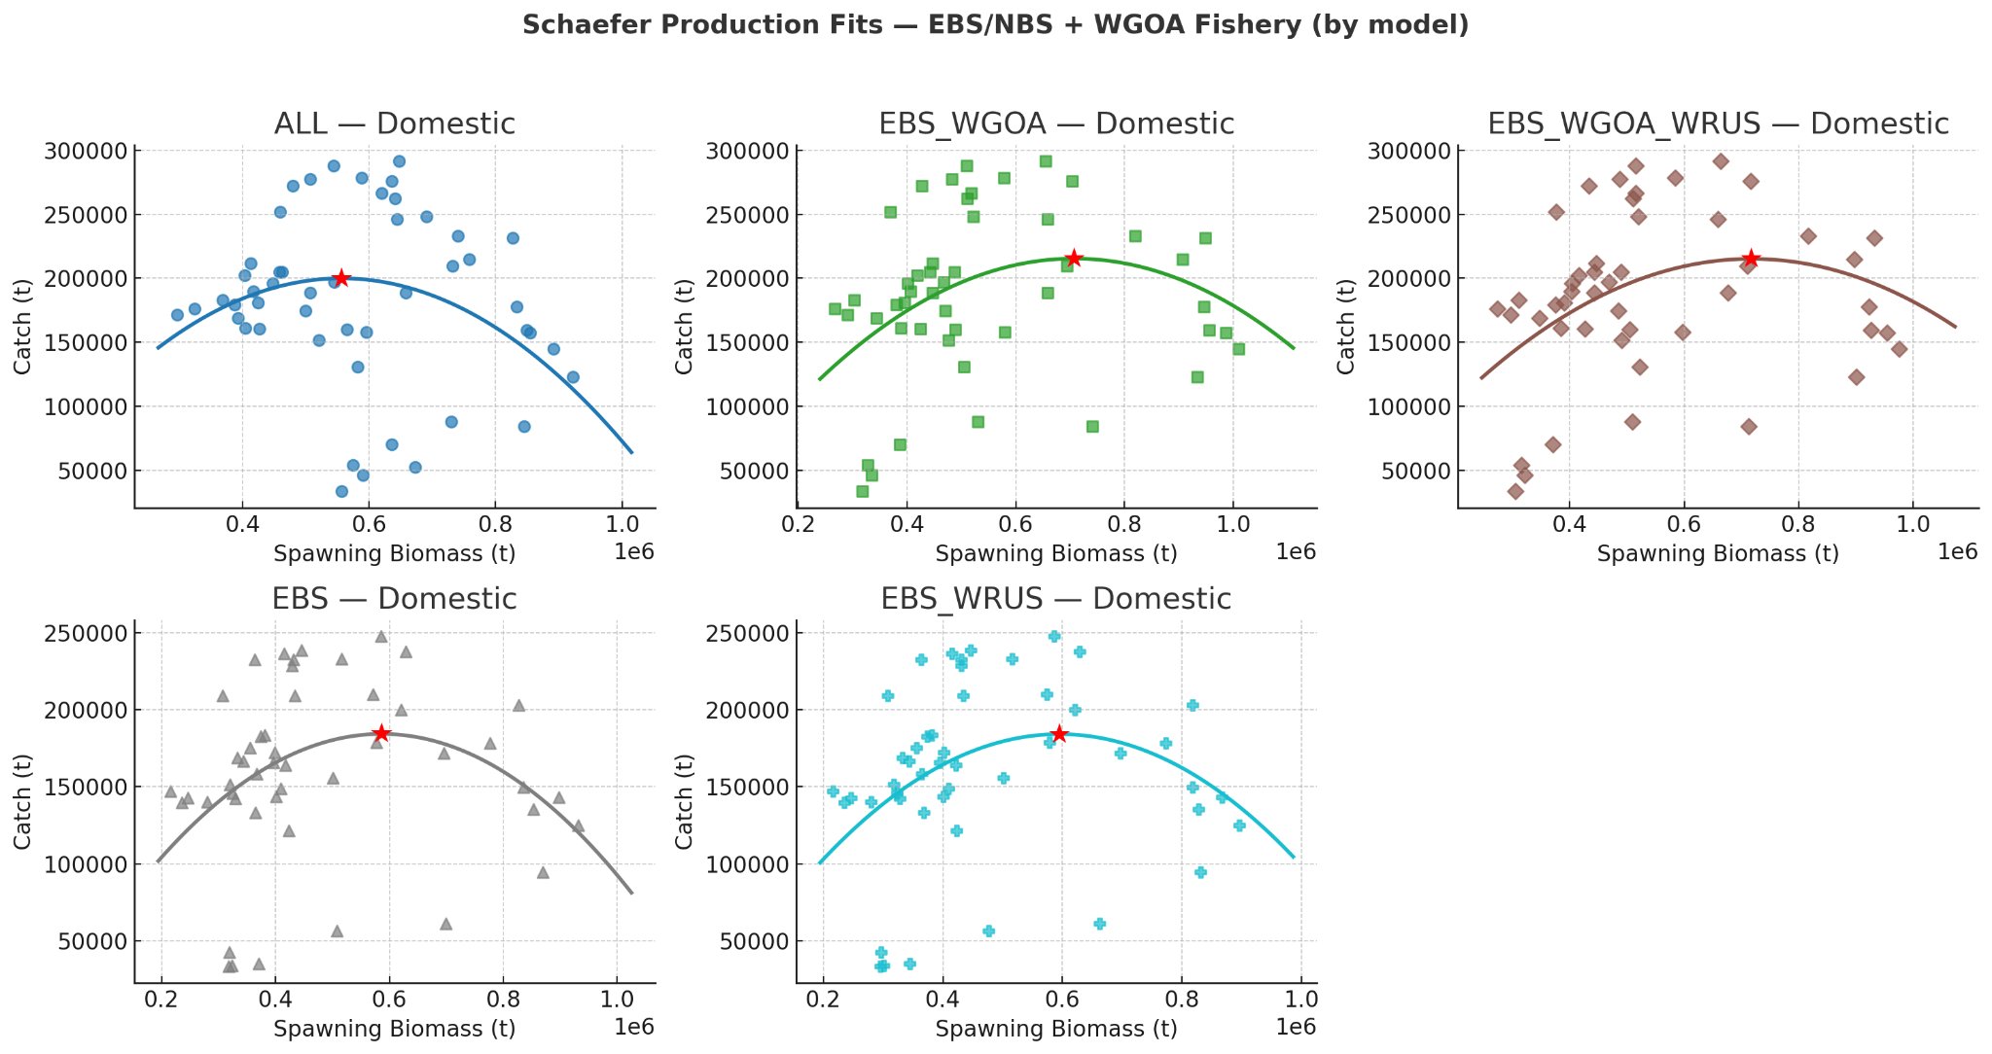
Schaefer Production Fits — Domestic Fisheries

Slide 7
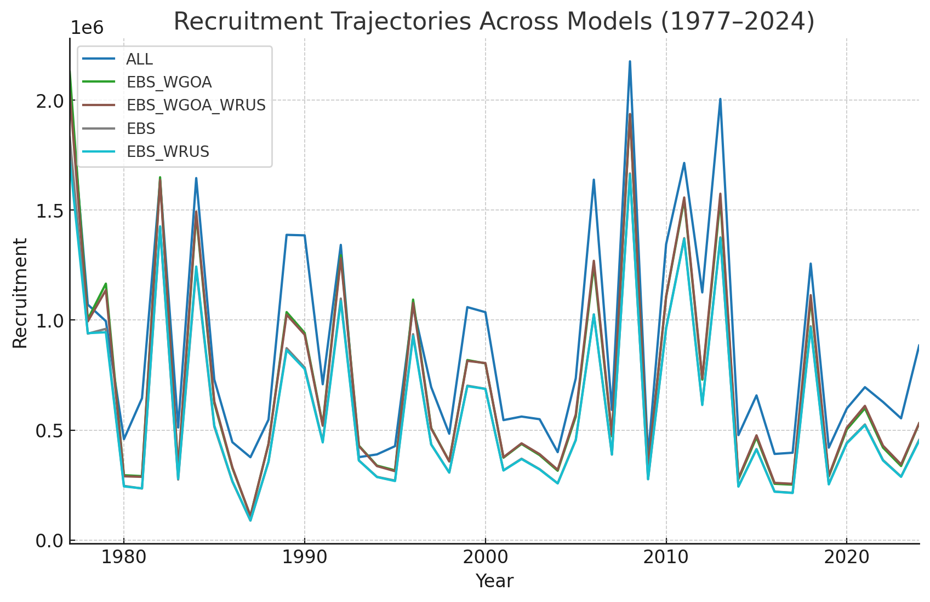
Recruitment Trajectories

Slide 8
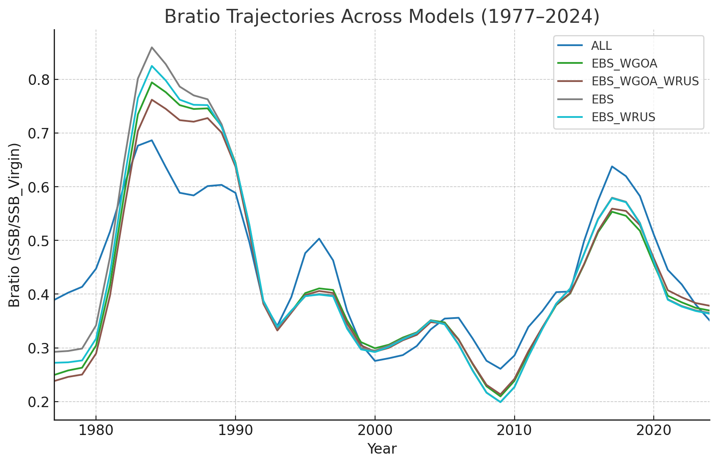
Bratio Trajectories

Slide 9
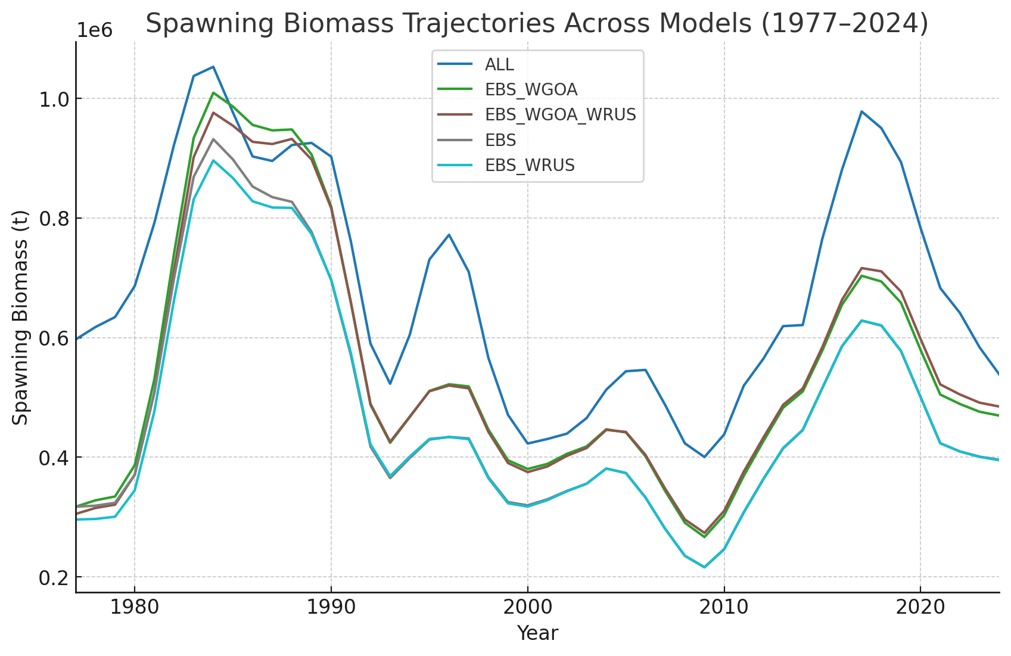
Spawning Biomass Trajectories

Slide 10
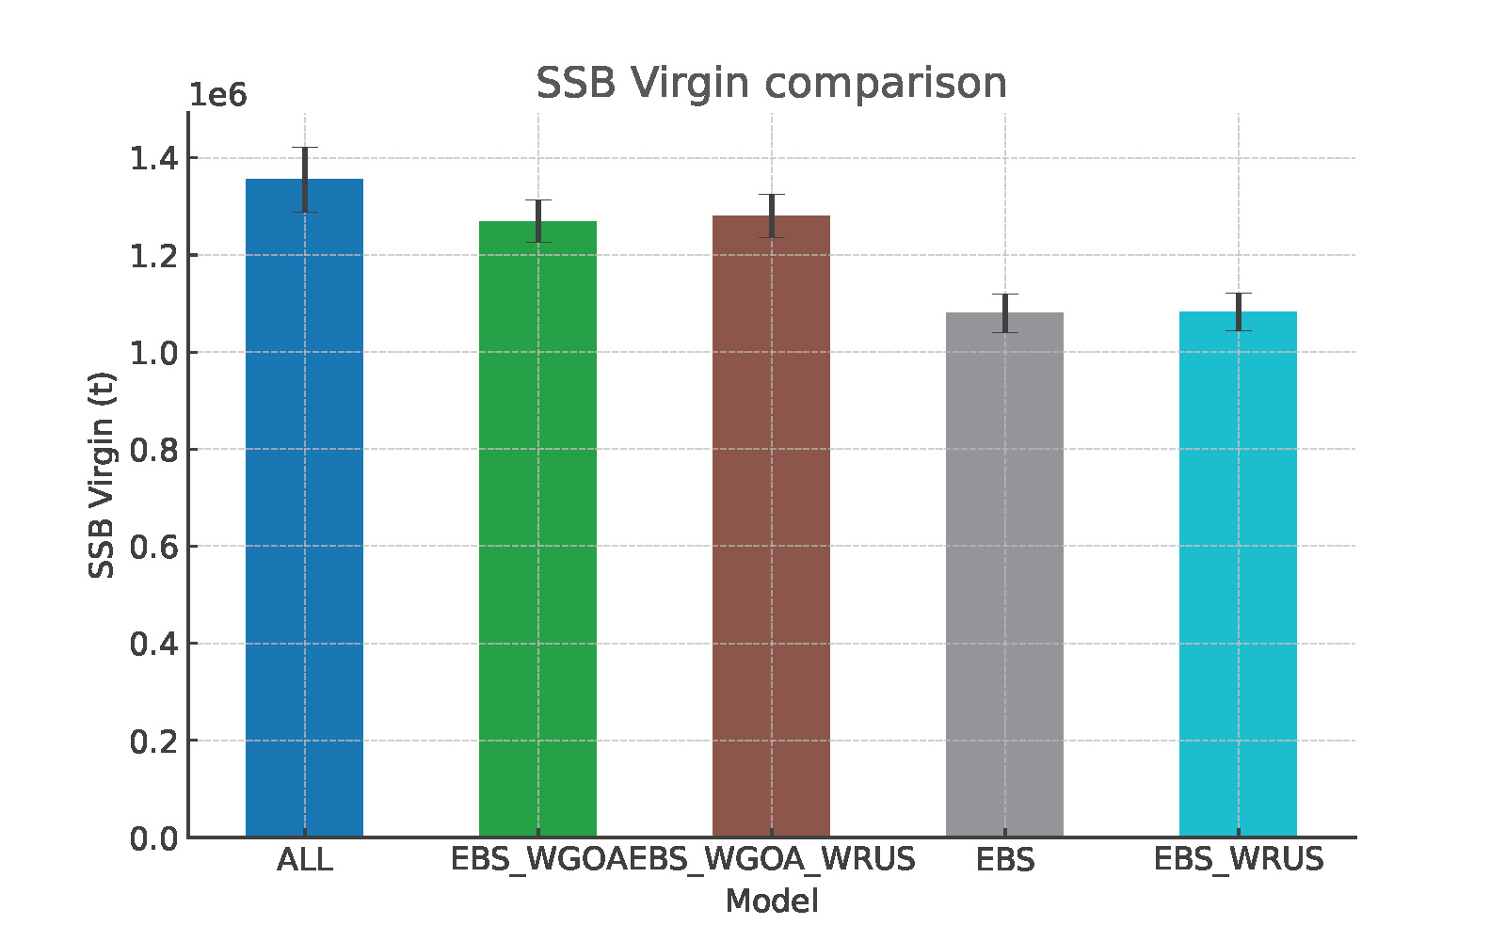
SSB Virgin Comparison

Slide 11
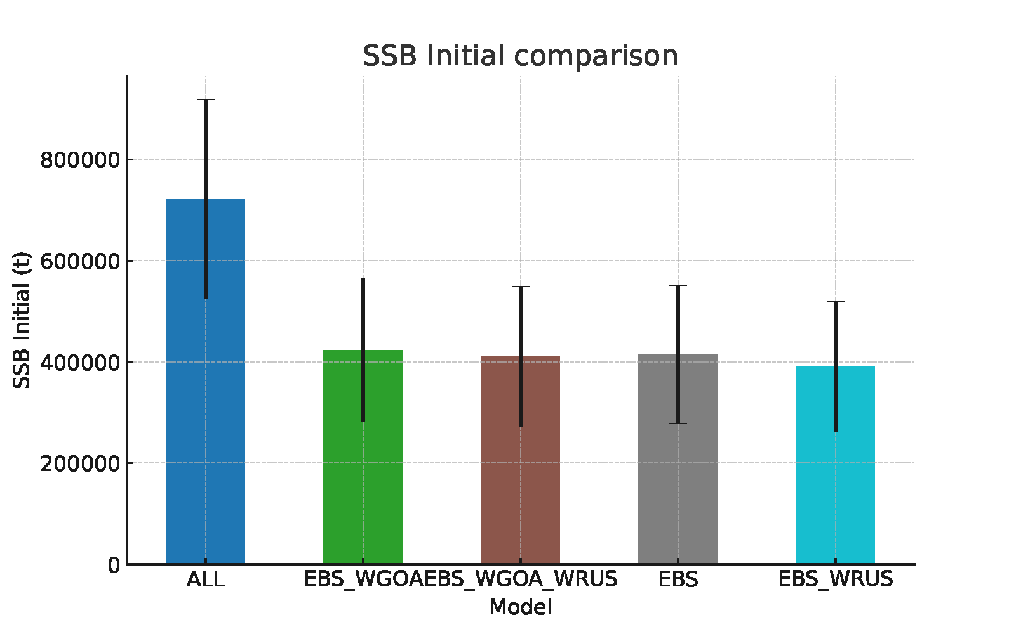
SSB Initial Comparison

Slide 12
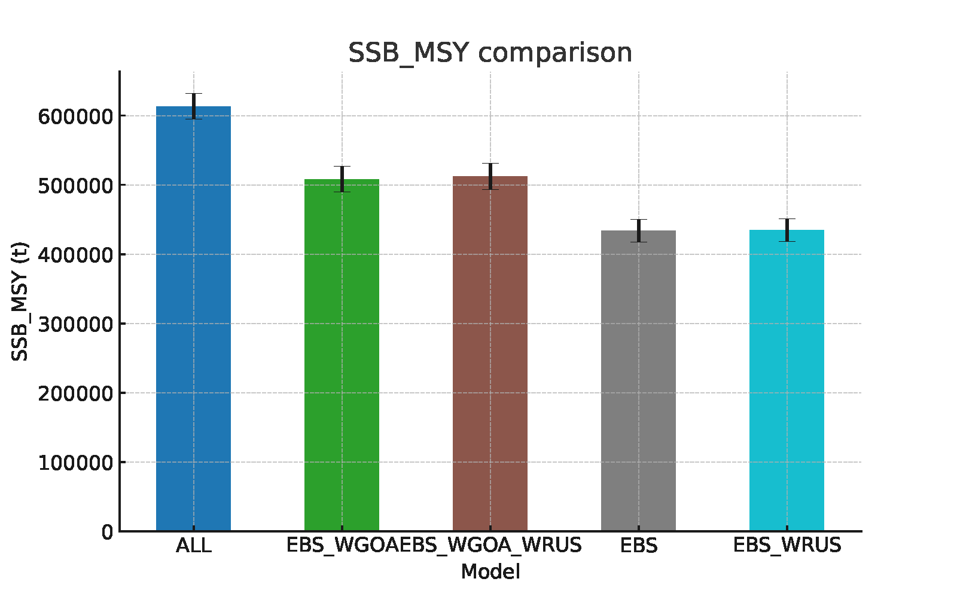
SSB_MSY Comparison

Slide 13
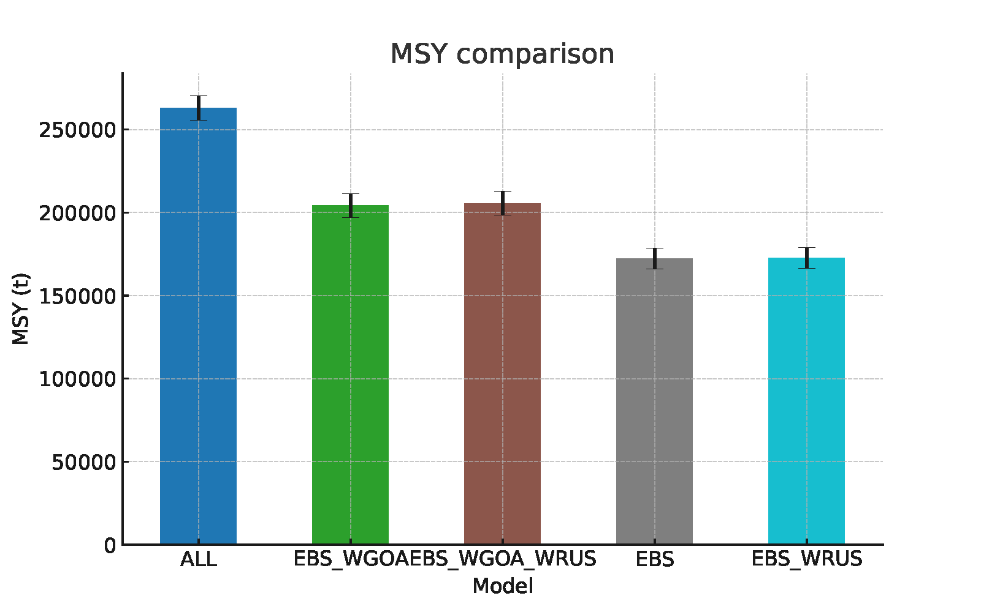
MSY Comparison

Slide 14
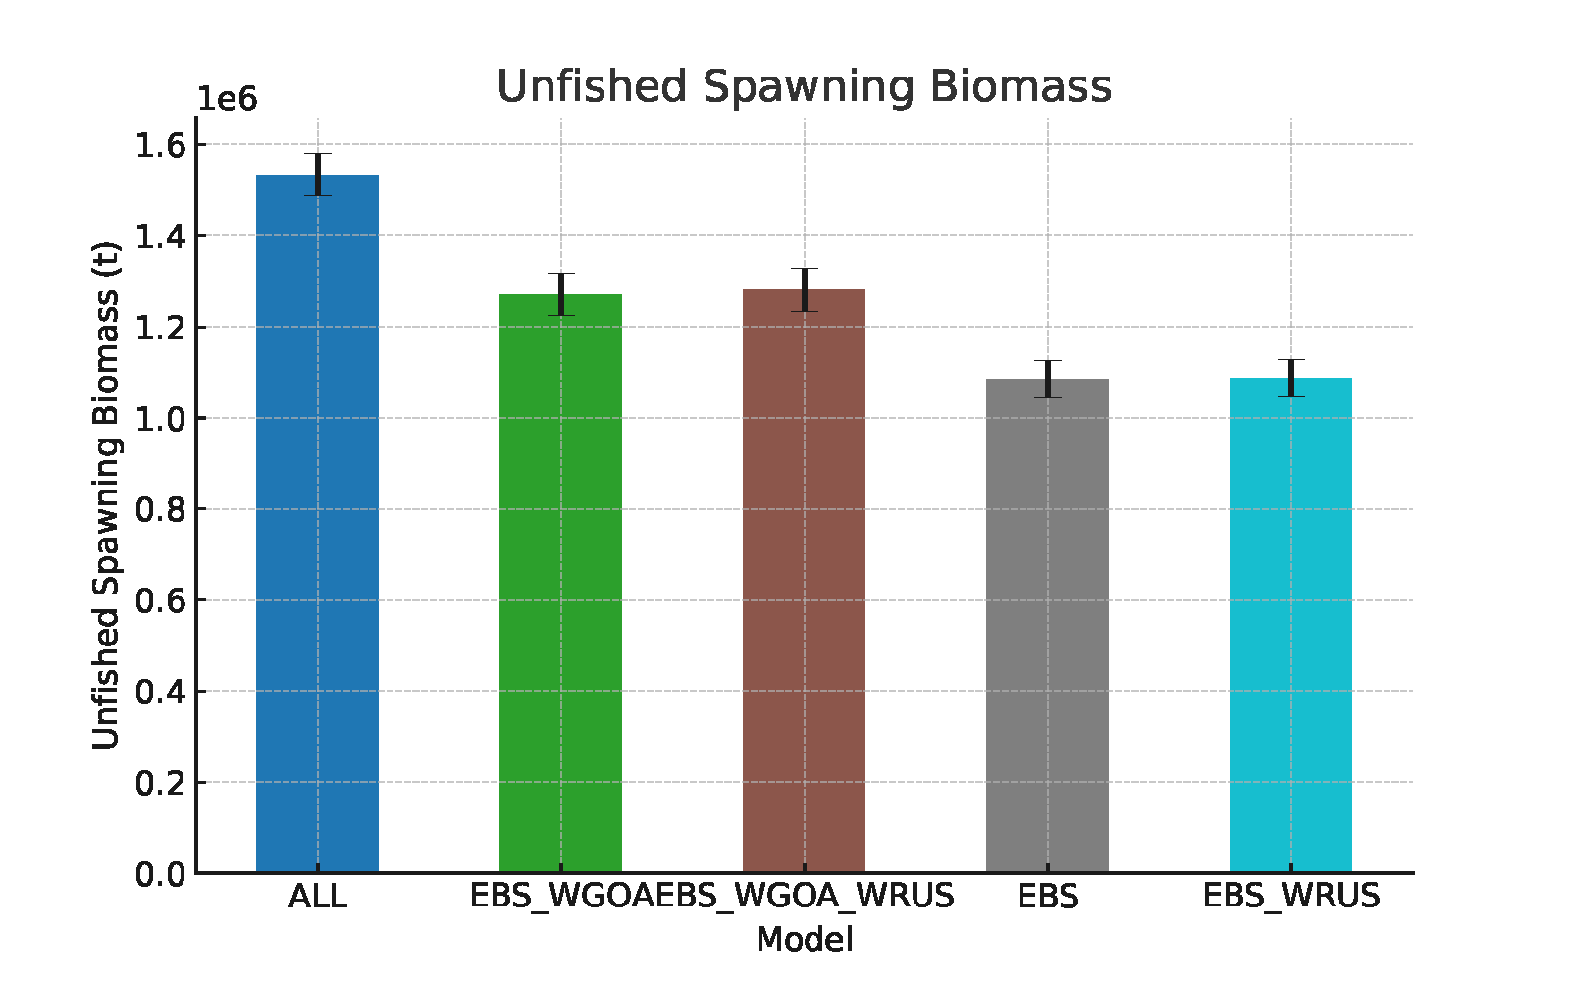
Unfished Spawning Biomass

Slide 15
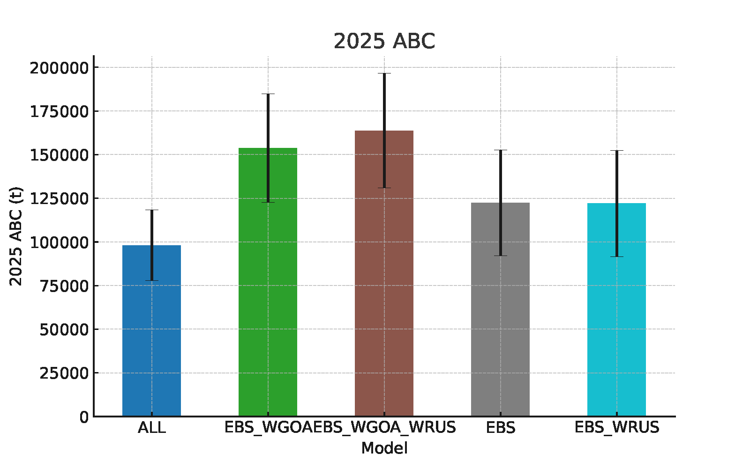
2025 ABC Comparison

