Slide 1
Pacific Cod Stock Dynamics: US and Russian Components
Spawning biomass, exploitation, and climate context
1977–2024

Slide 2
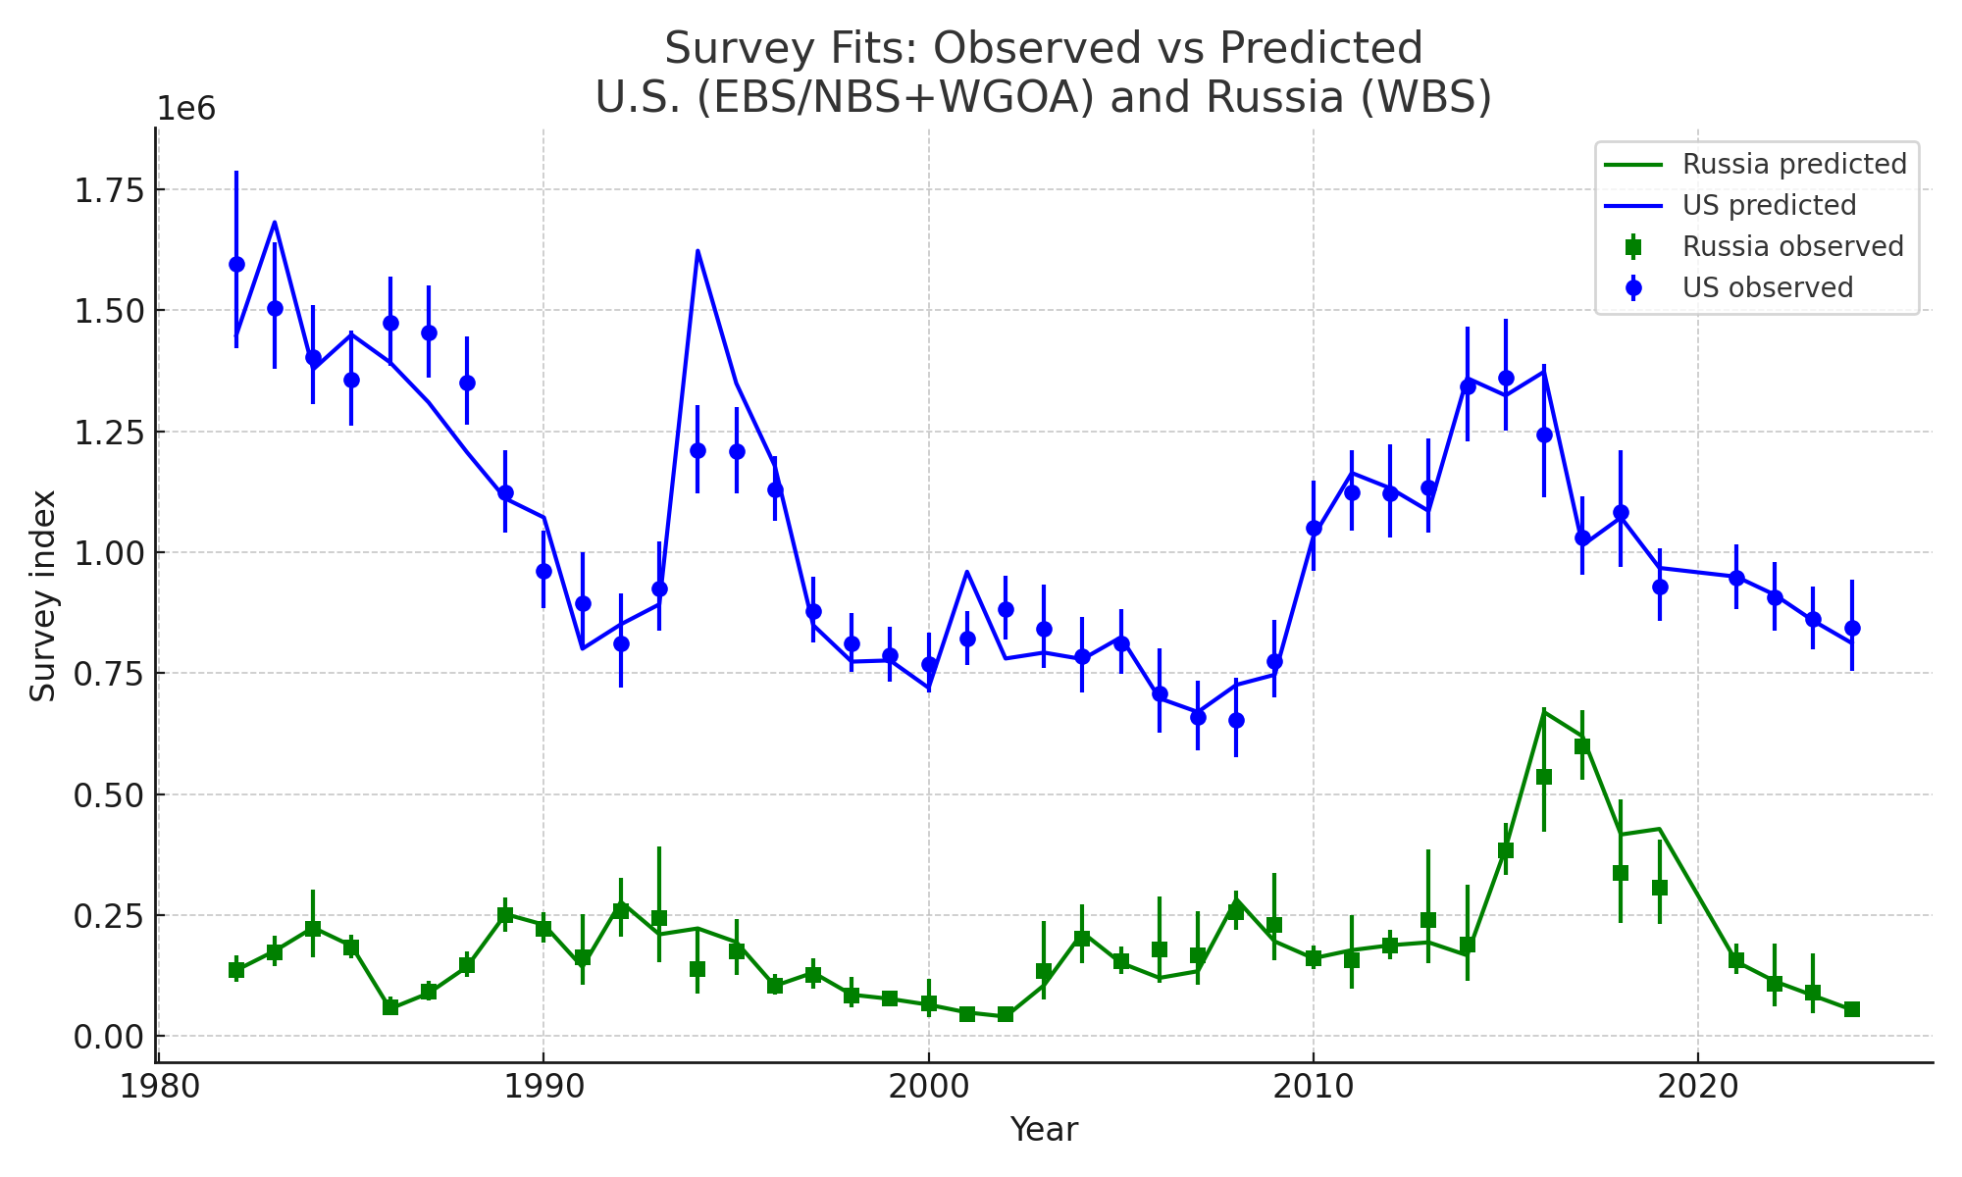
Survey Index Fits (Observed vs Predicted)

Slide 3
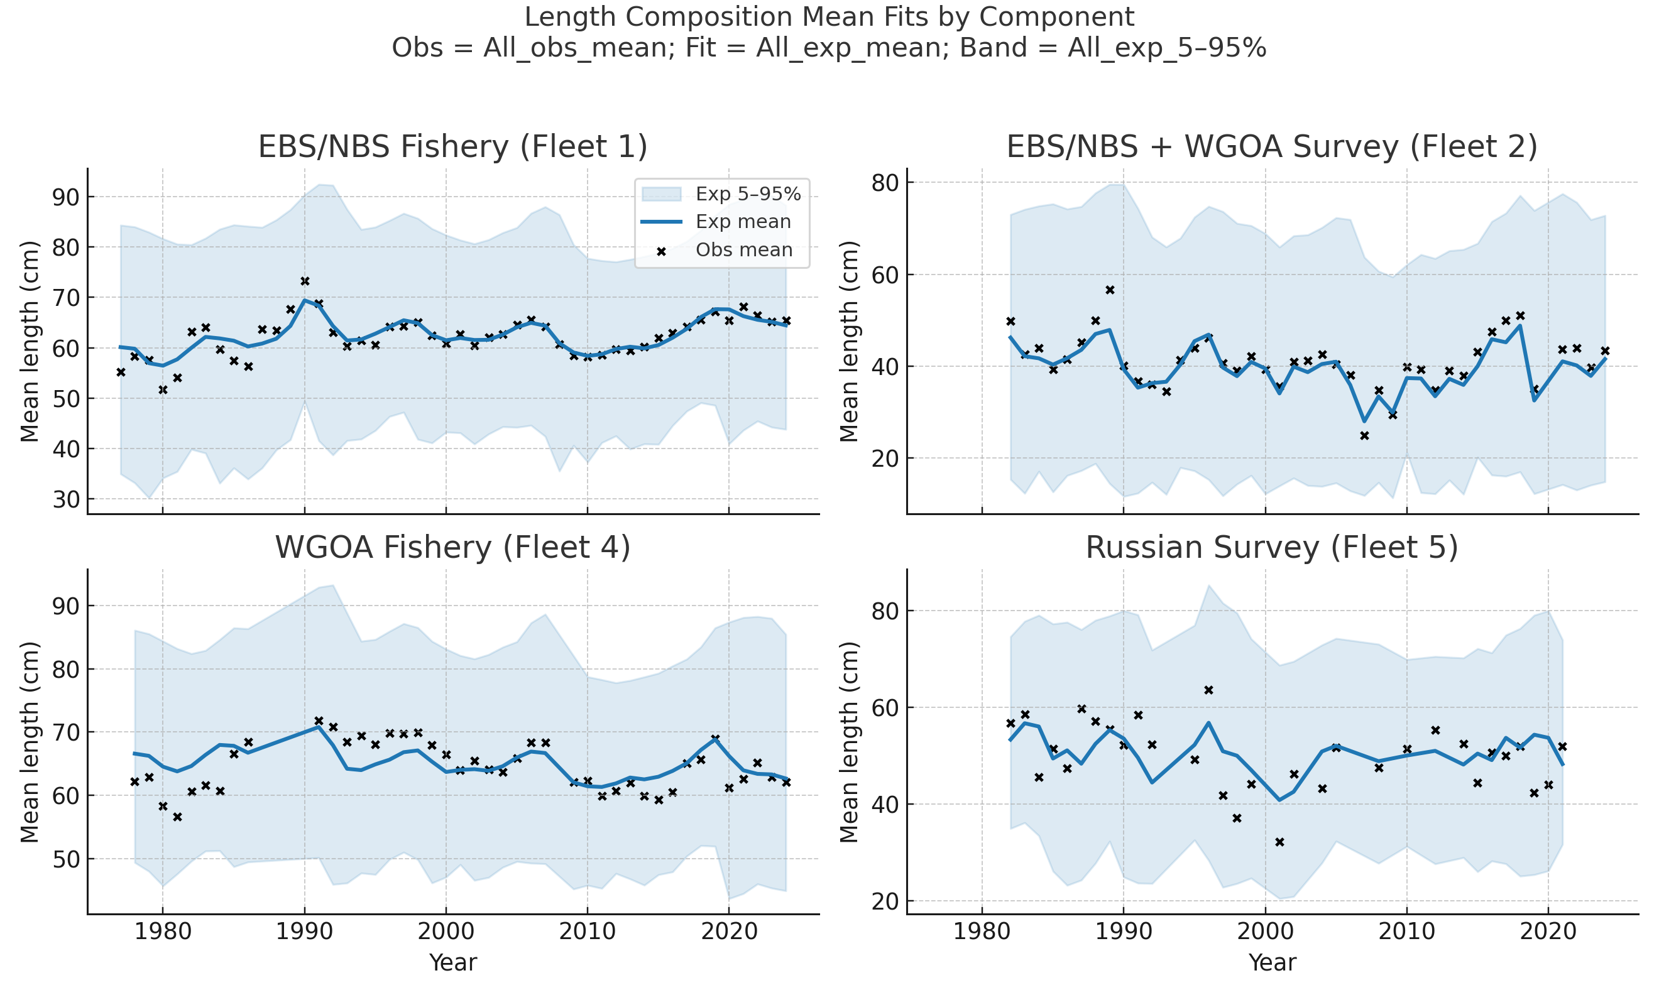
Length Composition Mean Fits by Component

Slide 4
Key Results
US spawning biomass peaked at 0.92 Mt in 1983; declined post-2016
Russian WBS biomass pulse in 2017 (~0.34 Mt, 35% of total)
Russian catches >350 kt (2018–2021); US catches stable ~650 kt
Exploitation peaked near F=1.4 in 2021, driven by WBS
Warm 2010s anomalies aligned with WBS surge

Slide 5
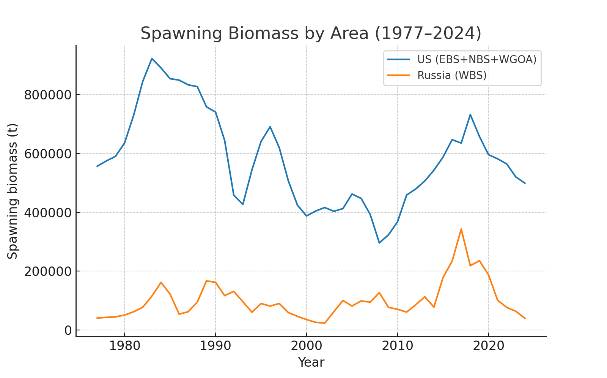
Spawning Biomass by Area (1977–2024)

Slide 6
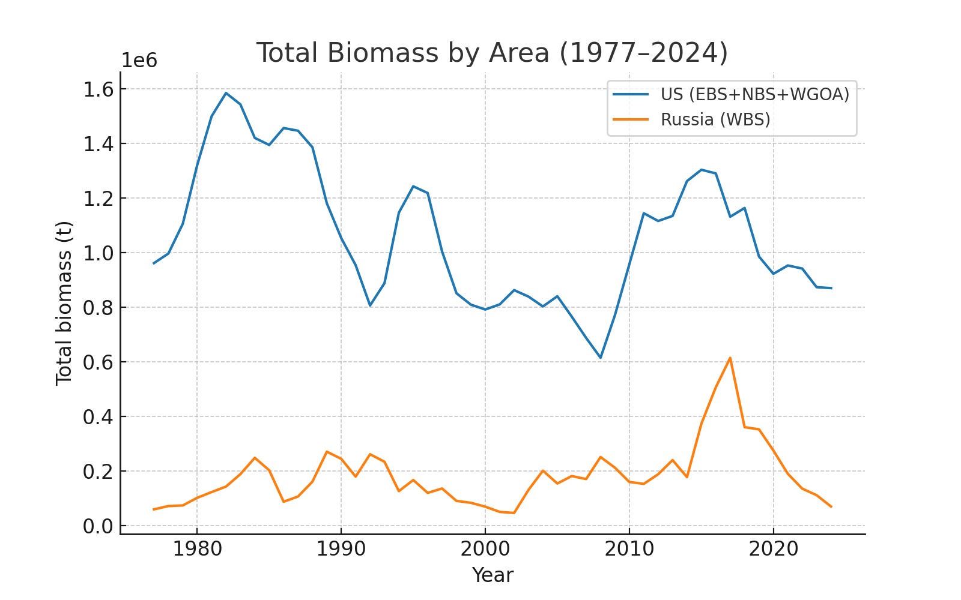
Total Biomass by Area (1977–2024)

Slide 7
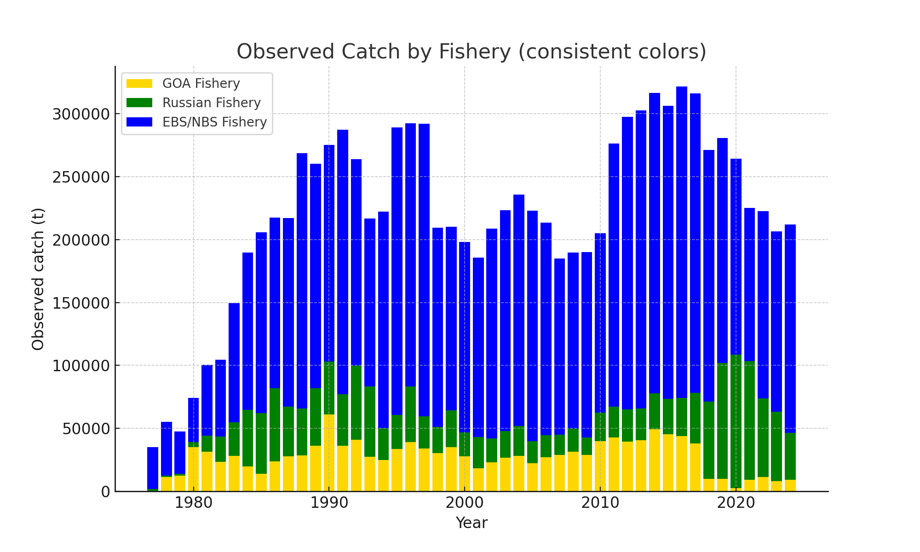
Observed Catch by Fishery

Slide 8
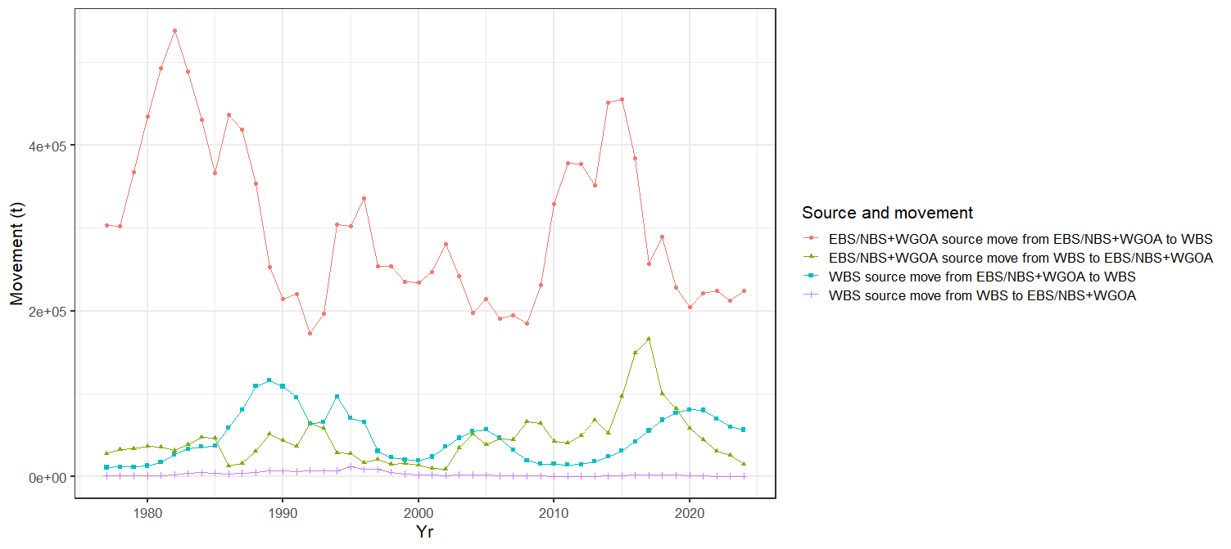
Movement by Recruitment Source, Annual Source Area and Destination

Slide 9
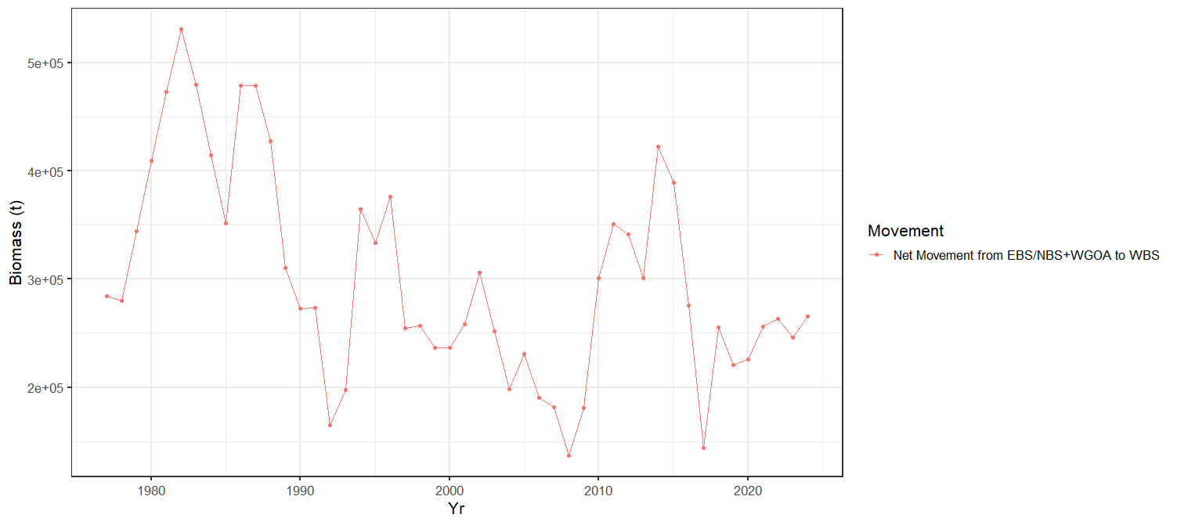
Net Movement from EBS/NBS+WGOA to WBS

Slide 10
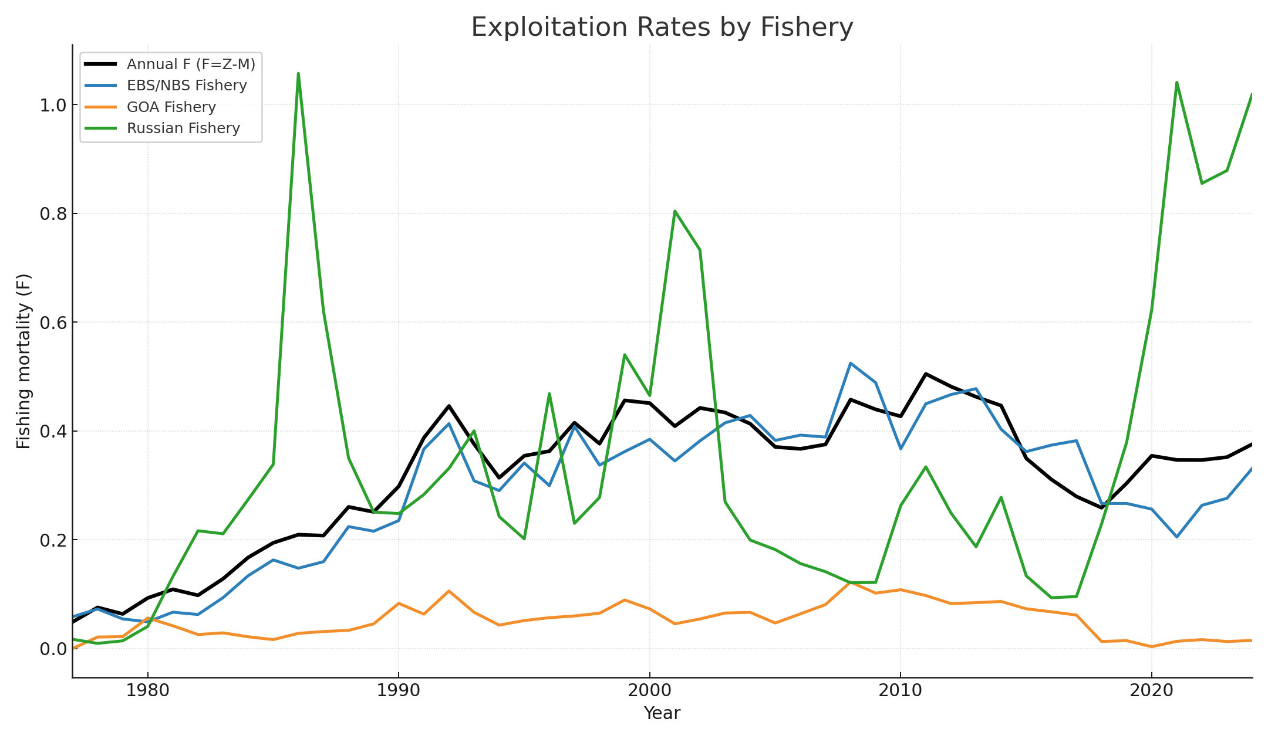
Exploitation Rates by Fishery

Slide 11
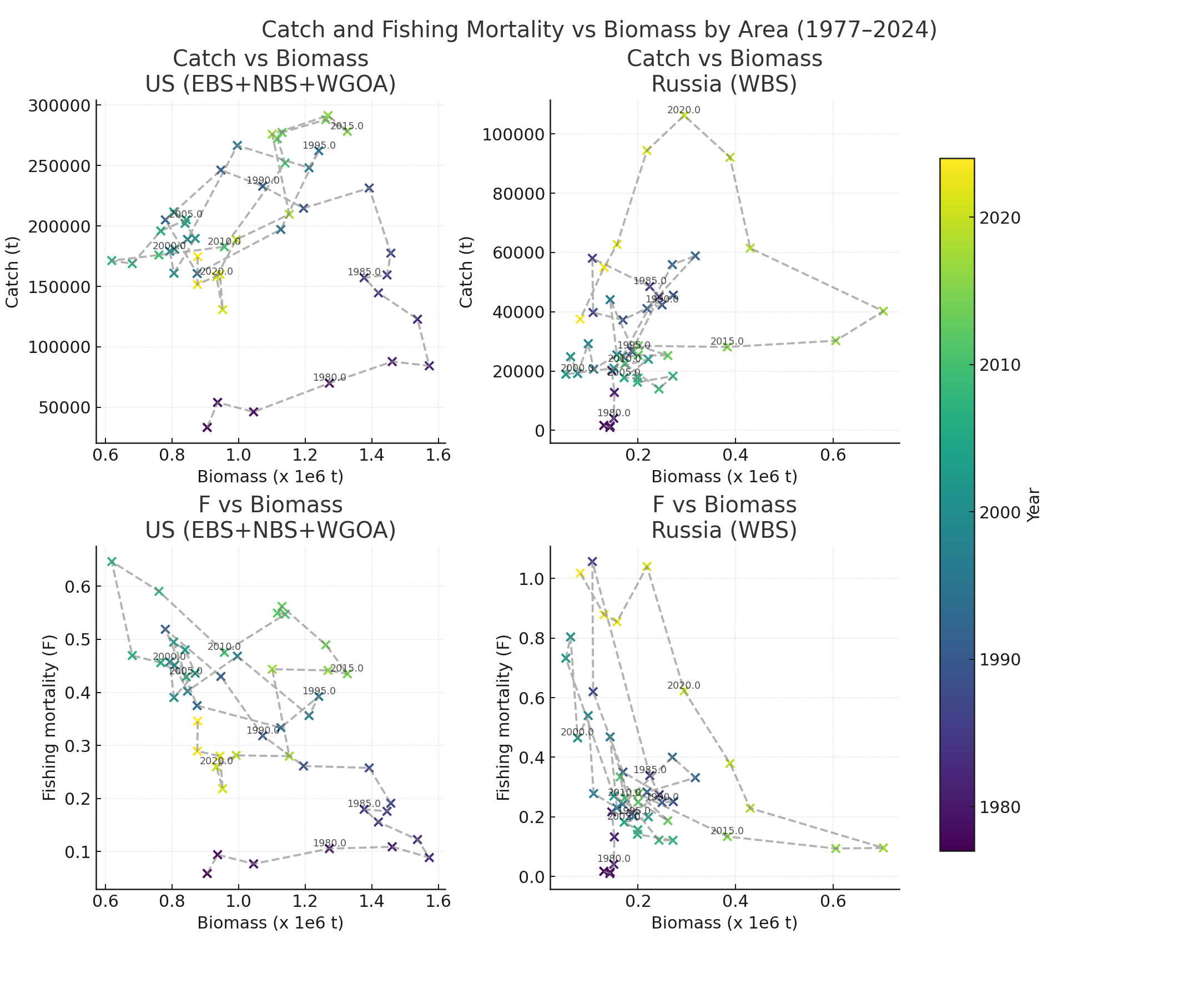
Catch and Fishing Mortality vs Biomass by Area (1977–2024)

Slide 12
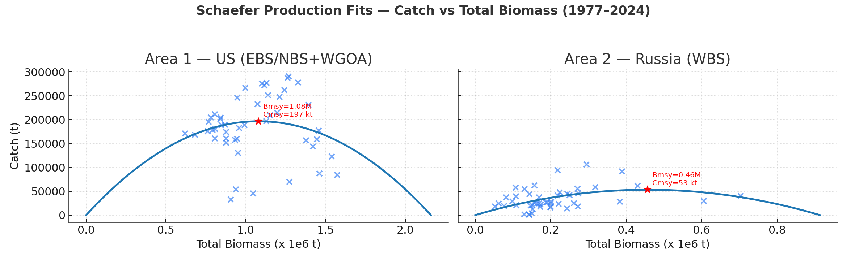
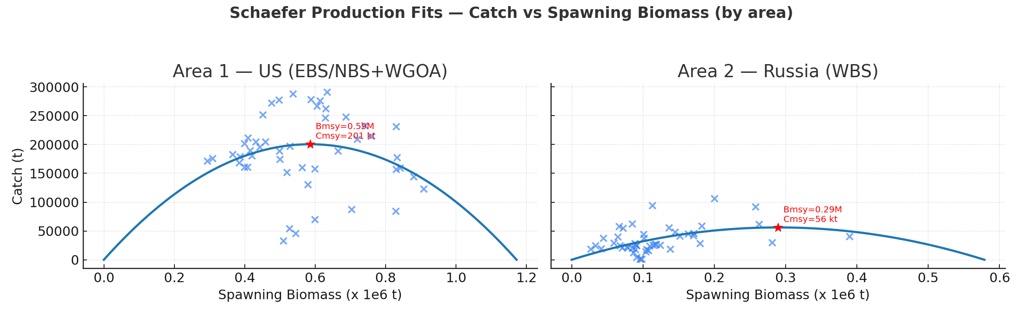

Slide 13
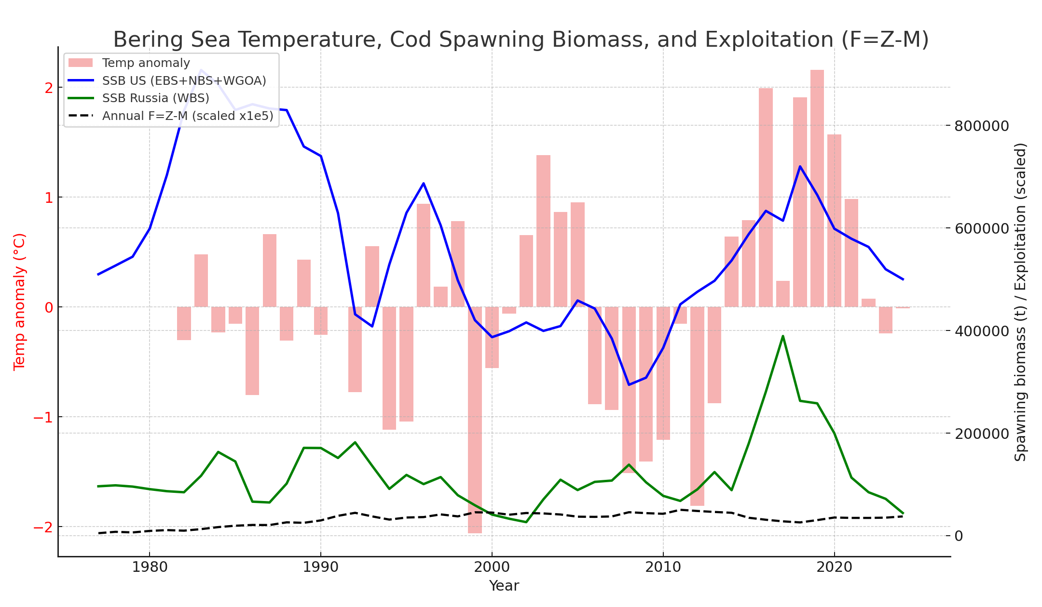
Climate, Biomass, and Exploitation (1977–2024)

Slide 14
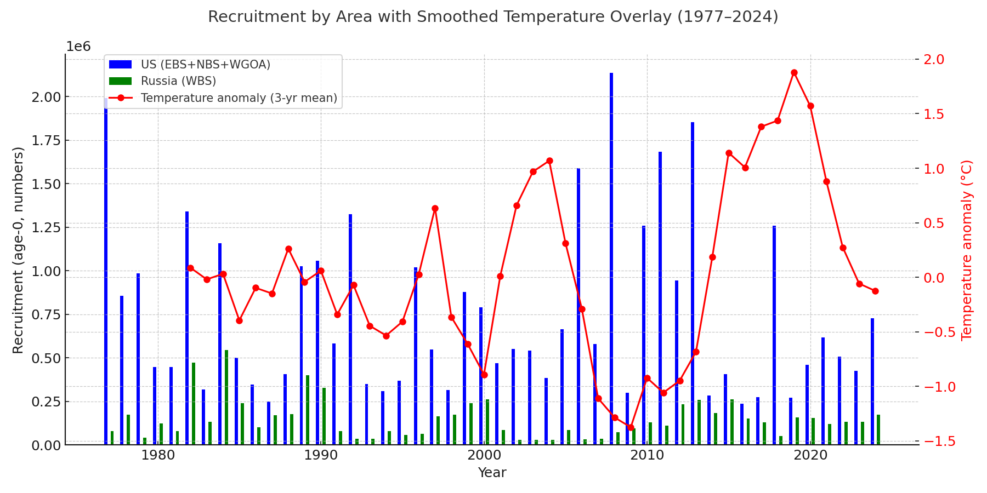
Recruitment by Region with 3-year Smoothed Temperature

Slide 15
Management Implications
Warm-period expansions into Russian waters added major biomass
These pulses were heavily fished by Russian fleets, raising total F
Excluding Russian data underestimates both biomass and removals
Climate variability drives distribution shifts; management must adapt

