Slide 1


BSAI Flathead sole Partial update
Maia sosa kapur – 18 nov 2021
MAIA.KAPUR@NOAA.GOV

Slide 2
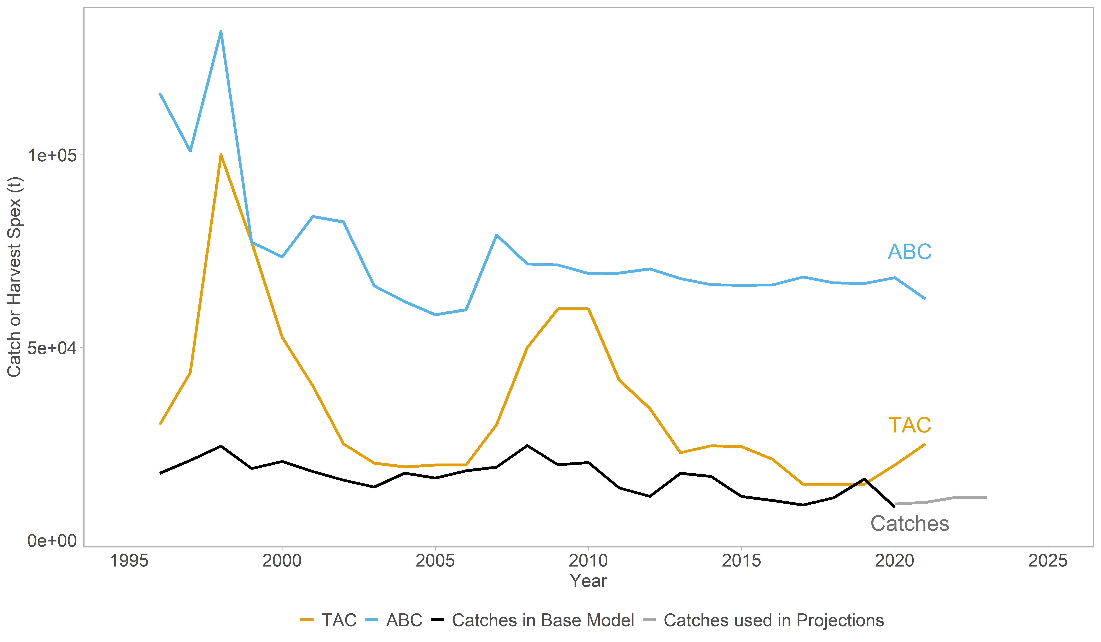
Catches ~75% of TAC in recent decade
Notes:
TAC in 2019 is 14,500t according to fed register; catch used in model and on AKFIN is 15,879

Slide 3
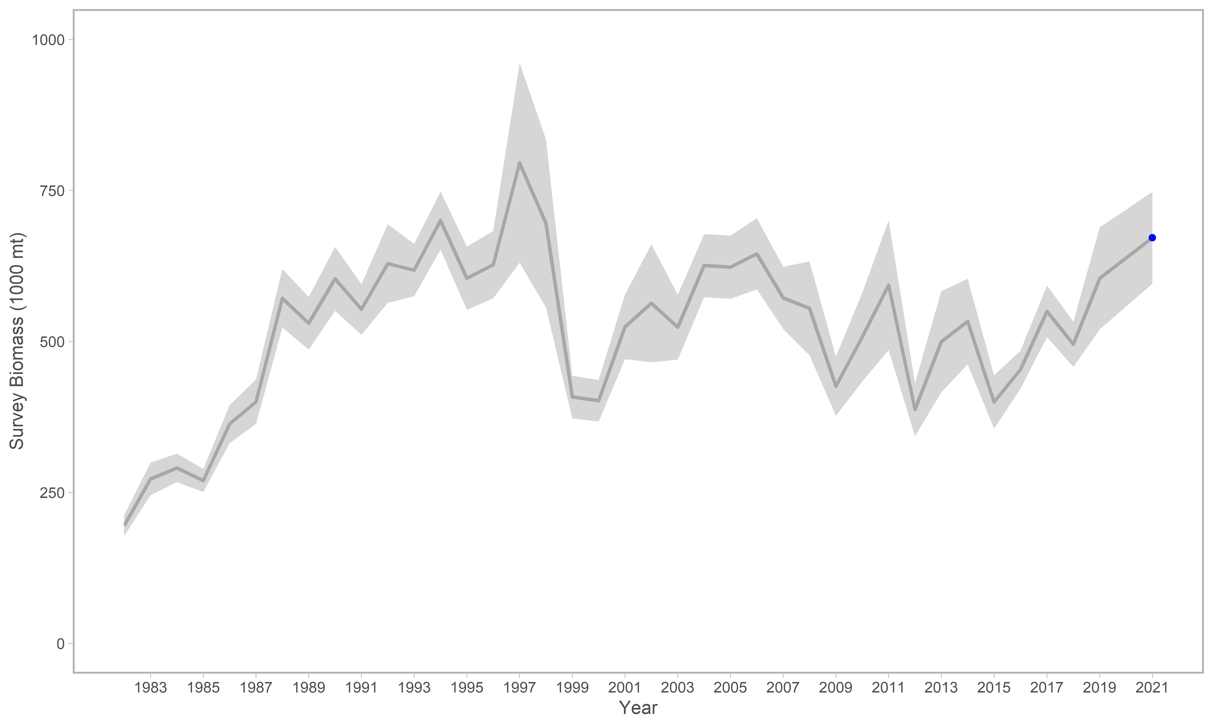
Survey biomass increasing
Notes:
The blue points are not included in the partial update.
This assessment used a single survey index of "total" Hippoglossoides spp. biomass that included the EBS “standard” survey areas and AI survey areas for the years 1982-2021 (Table 2). As was done in the 2020 assessment, a linear regression is used to estimate a relationship between EBS shelf Hippoglossoides spp. survey biomass estimates and AI survey biomass estimates; this relationship is used to estimate AI survey biomass in years when no AI survey occurred (by using the linear equation to find an AI biomass estimate in a particular year based on the EBS biomass estimate for that year).

Slide 4
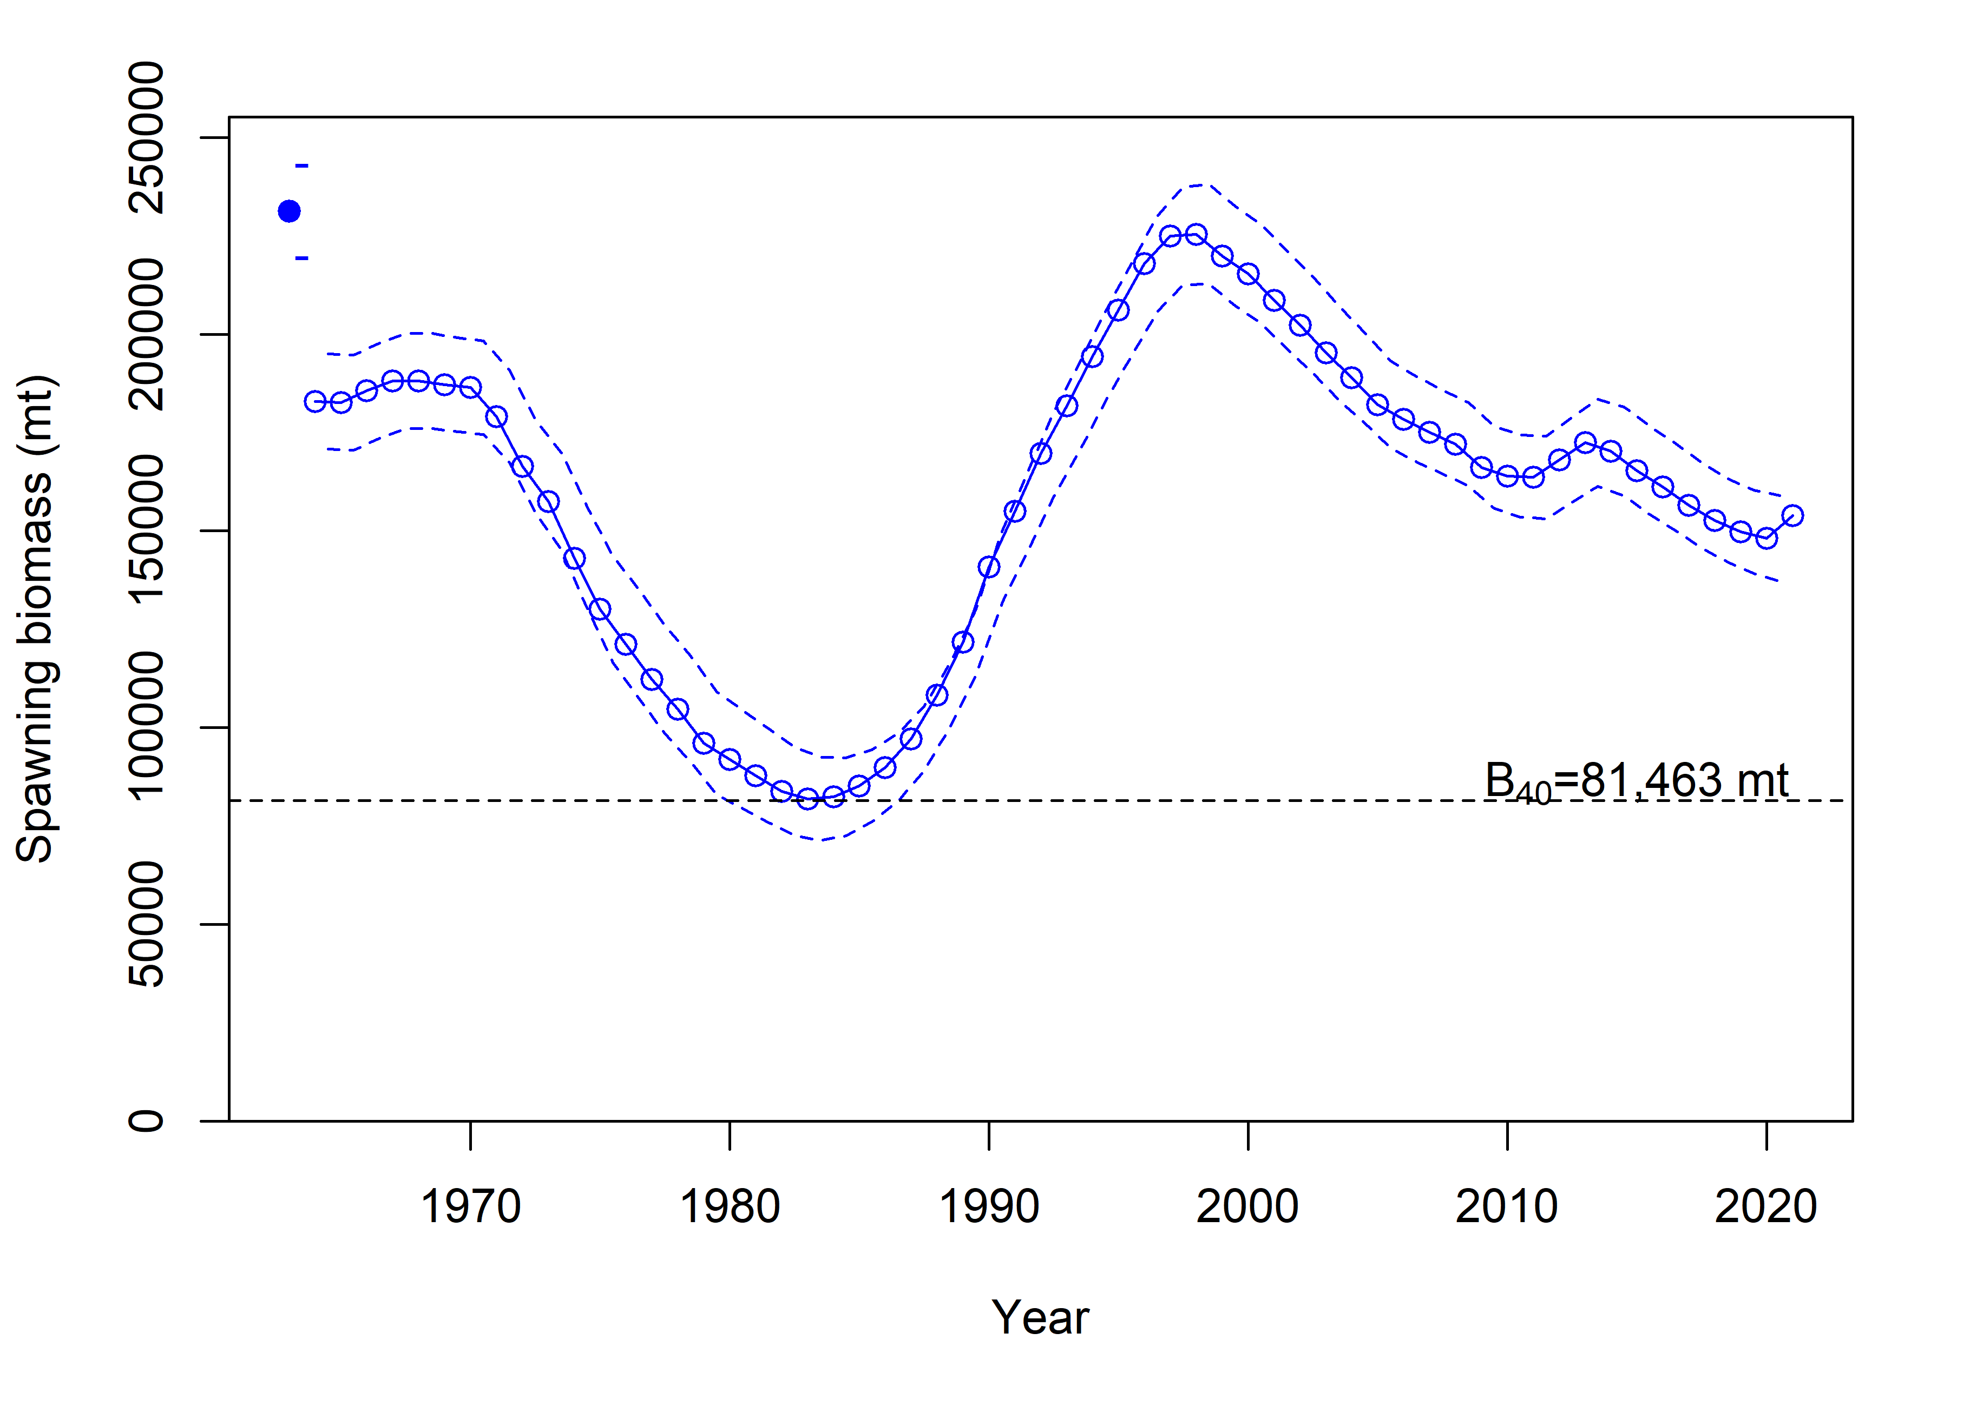
Ssb HIGH AND STABLE
Notes:
Time series from last full assessment with updated 2022 B40

Slide 5
Quantity | As estimated or specified last year for: |  | As estimated or recommended this year for:
 | 2021 | 2022 | 2022 | 2023
M (natural mortality rate) | 0.2 | 0.2 | 0.2 | 0.2
Tier | 3a | 3a | 3a | 3a
Projected total (3+) biomass (t) | 602,497 | 608,576 | 608,631 | 612,001
Projected Female spawning biomass (t) | 150,433 | 154,906 | 155,379 | 160,748
B_{100%} | 203,658 | 203,658 | 203,658 | 203,658
B_{40%} | 81,463 | 81,463 | 81,463 | 81,463
B_{35%} | 71,280 | 71,280 | 71,280 | 71,280
F_{OFL} | 0.46 | 0.46 | 0.46 | 0.46
maxF_{ABC} | 0.37 | 0.37 | 0.37 | 0.37
F_{ABC} | 0.37 | 0.37 | 0.37 | 0.37
OFL (t) | 75,863 | 77,763 | 77,967 | 80,034
maxABC (t) | 62,567 | 64,119 | 64,288 | 65,988
ABC (t) | 62,567 | 64,119 | 64,288 | 65,988
Status | As determined last year for: |  | As determined this year for:
 | 2019 | 2020 | 2020 | 2021
Overfishing | no | n/a | no | n/a
Overfished | n/a | no | n/a | no
Approaching overfished | n/a | no | n/a | no
Notes:
The ABC for flathead sole is 40,175 t in 2022 and 40,046 t in 2023 and the OFL is 48,928 t in 2022 and 48,757 t in 2023. The new ABC recommendation and OFL values are similar to those developed in 2020 for 2022 (39,851 t and 48,534 t, respectively).

Slide 6
Next full assessment
Explore enabling recruitment devs in recent period (<5y)
Explore summary biomass cutoff
Method for combining BS/AI survey data
Potential catchability/temperature relationship via VAST
Continued cleanup of data inputs, ghost fleets
Notes:
These are Cole’s suggestions.
In 2020 model the RDs are fixed to zero 2017 fwd
Summary biomass is 3+ - unclear why. Zero maturity thru age 5
SSC said summer bottom temp might not bet ‘adequate’ descriptor. We know they correlate with growth rates as well as catchability, and affect spatial distribution. Dropped from earlier assessments because uncorrelated with survbio, but we could look at the model-based index.

