Slide 1
GOA Flathead Sole Partial Assessment
Cole Monnahan
November 2020

Slide 2
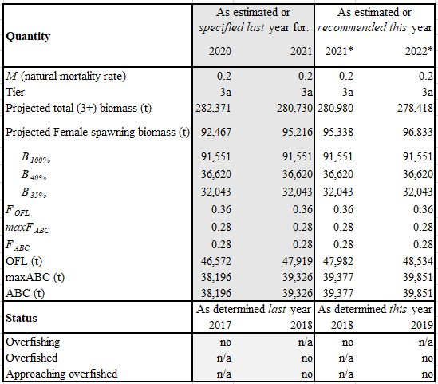
Executive summary
Catches used for projections: 1,965 t for 2020 2,269 t for 2021 2,269 t for 2022
2021 recommended ABC is 3.1% decrease from 2020 ABC

Slide 3
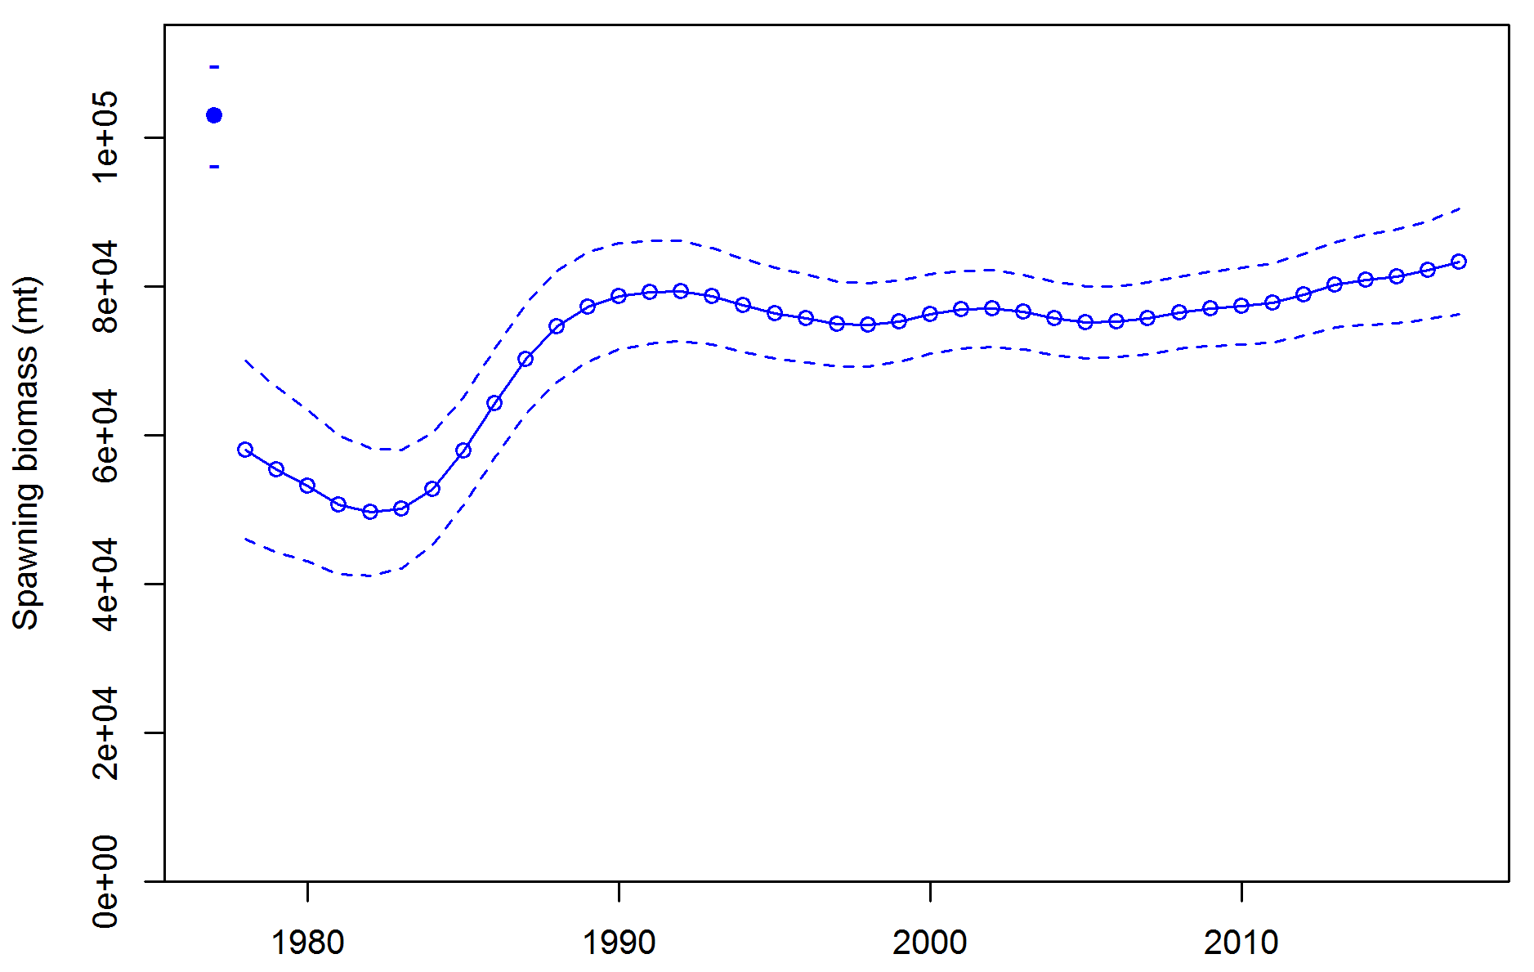
Spawning biomass (from 2017 assessment) is increasing
Exploitation is consistently low

Slide 4
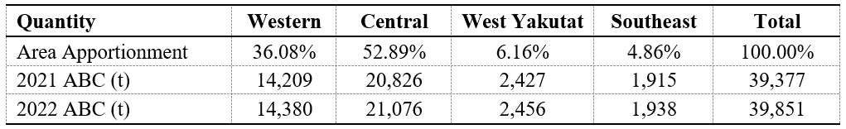
Apportionment
Area apportionment calculated from random effects model estimates by area
No survey in 2020 so no change in apportionment percentages

