Slide 1


GOA Flathead sole Partial update
Maia sosa kapur – 16 nov 2021
MAIA.KAPUR@NOAA.GOV

Slide 2
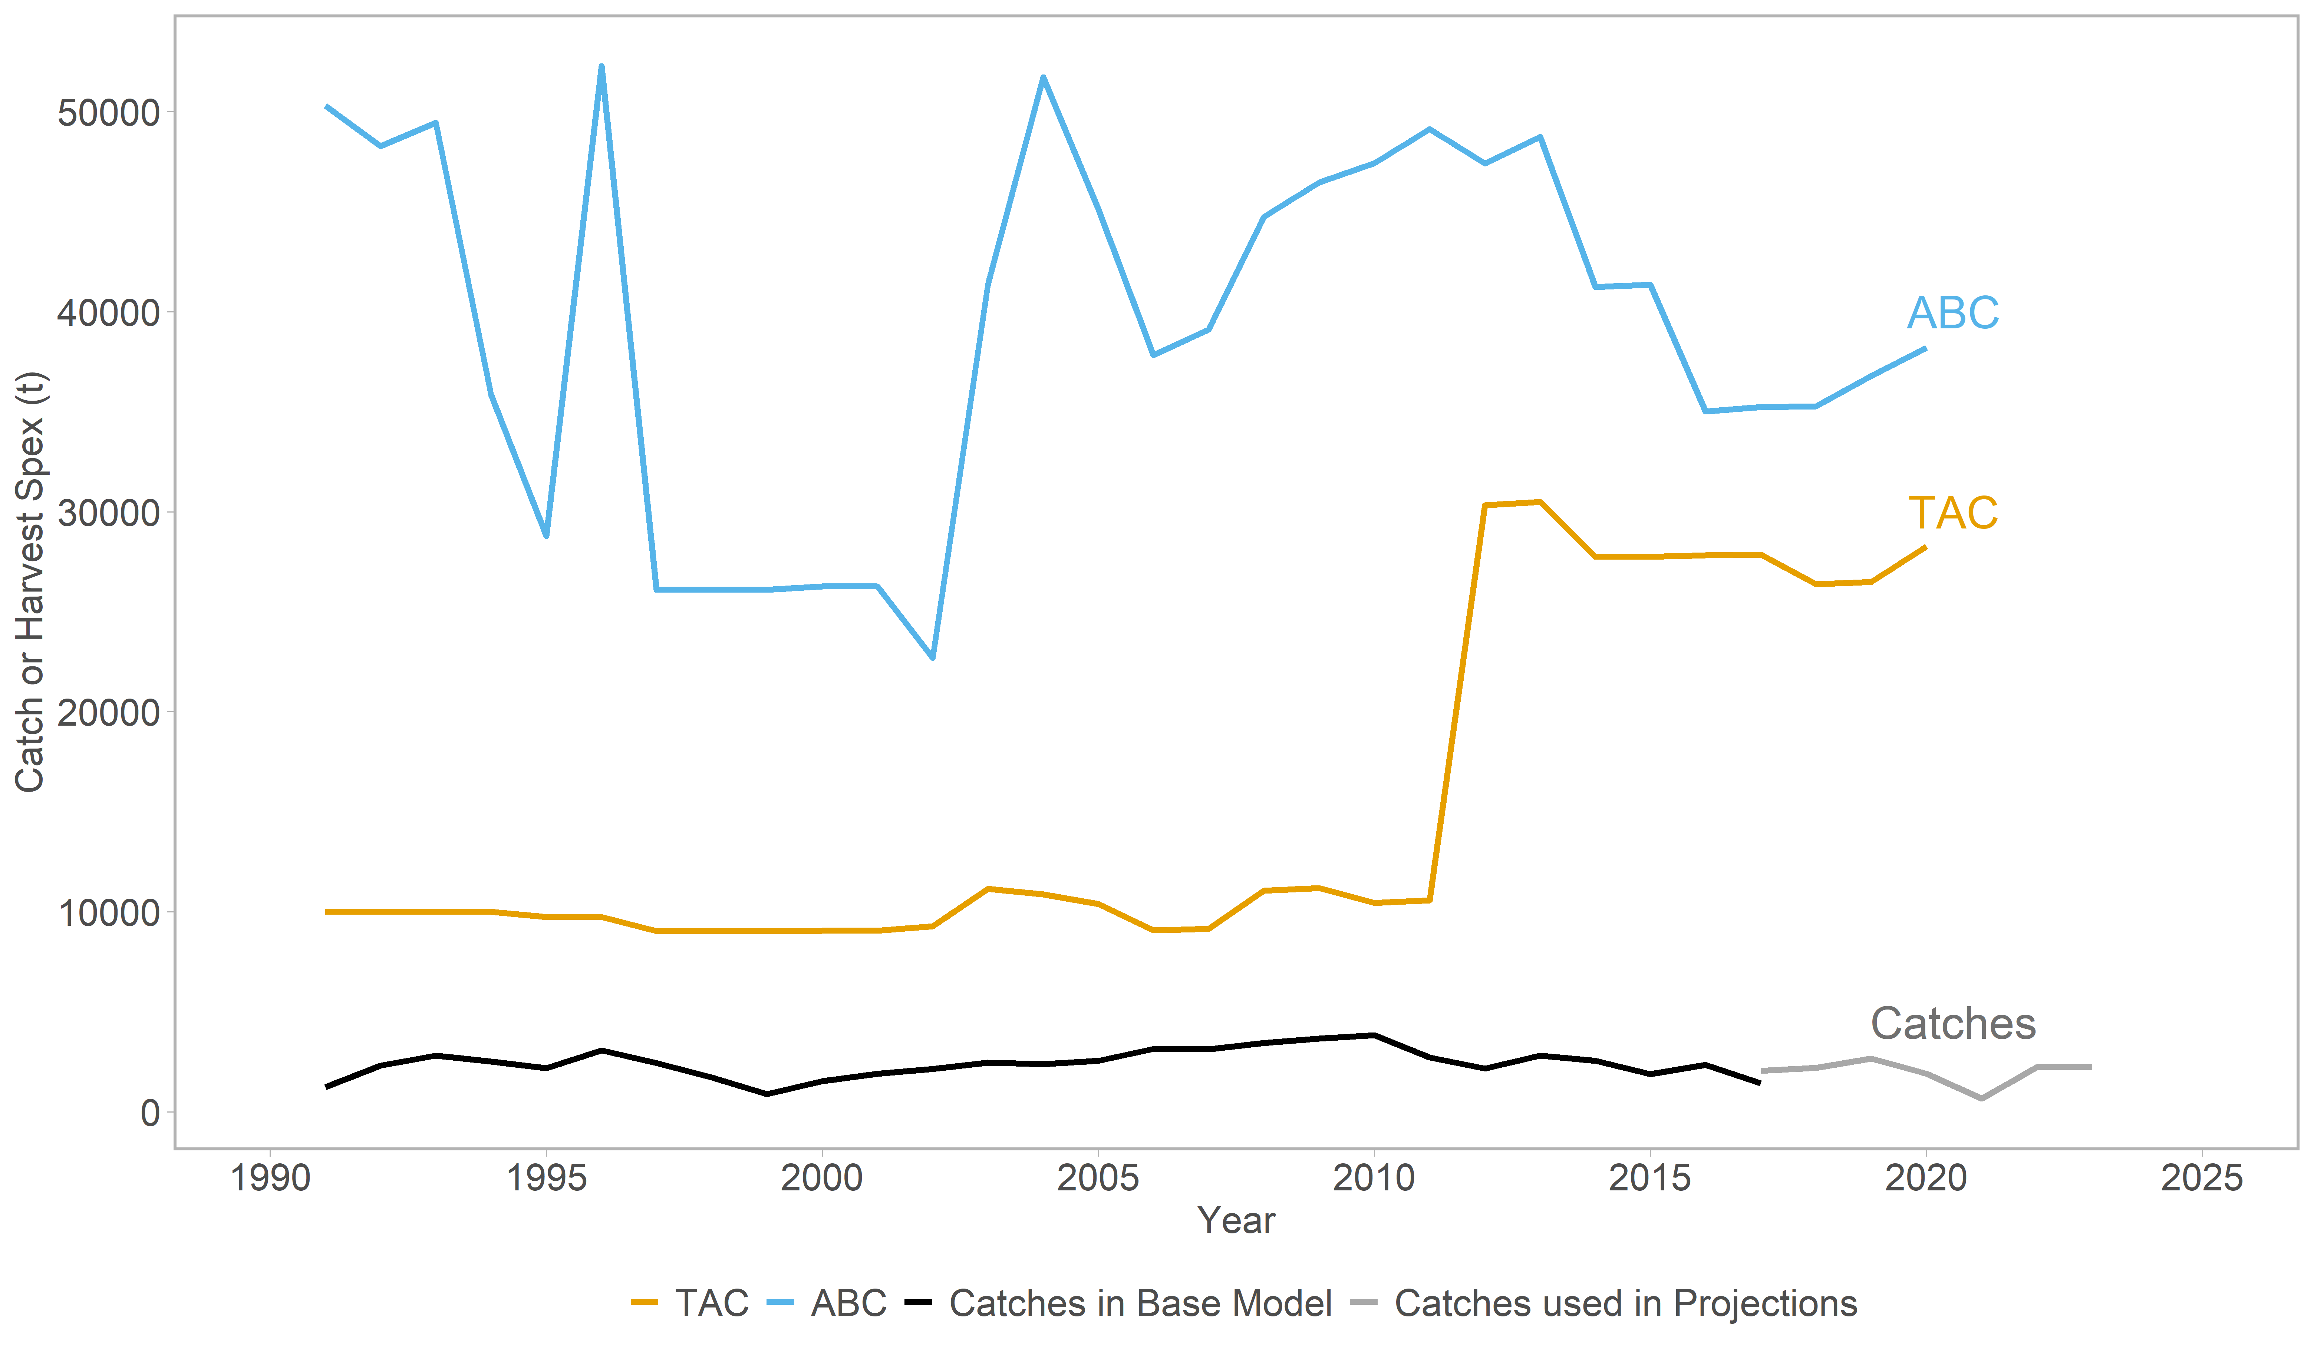
Catches << tac < abc
Notes:
2020 catch: 1911T
2021 extrapolated: 673 t
2022-23 forecast = 2251 (average)
This is a bycatch

Slide 3
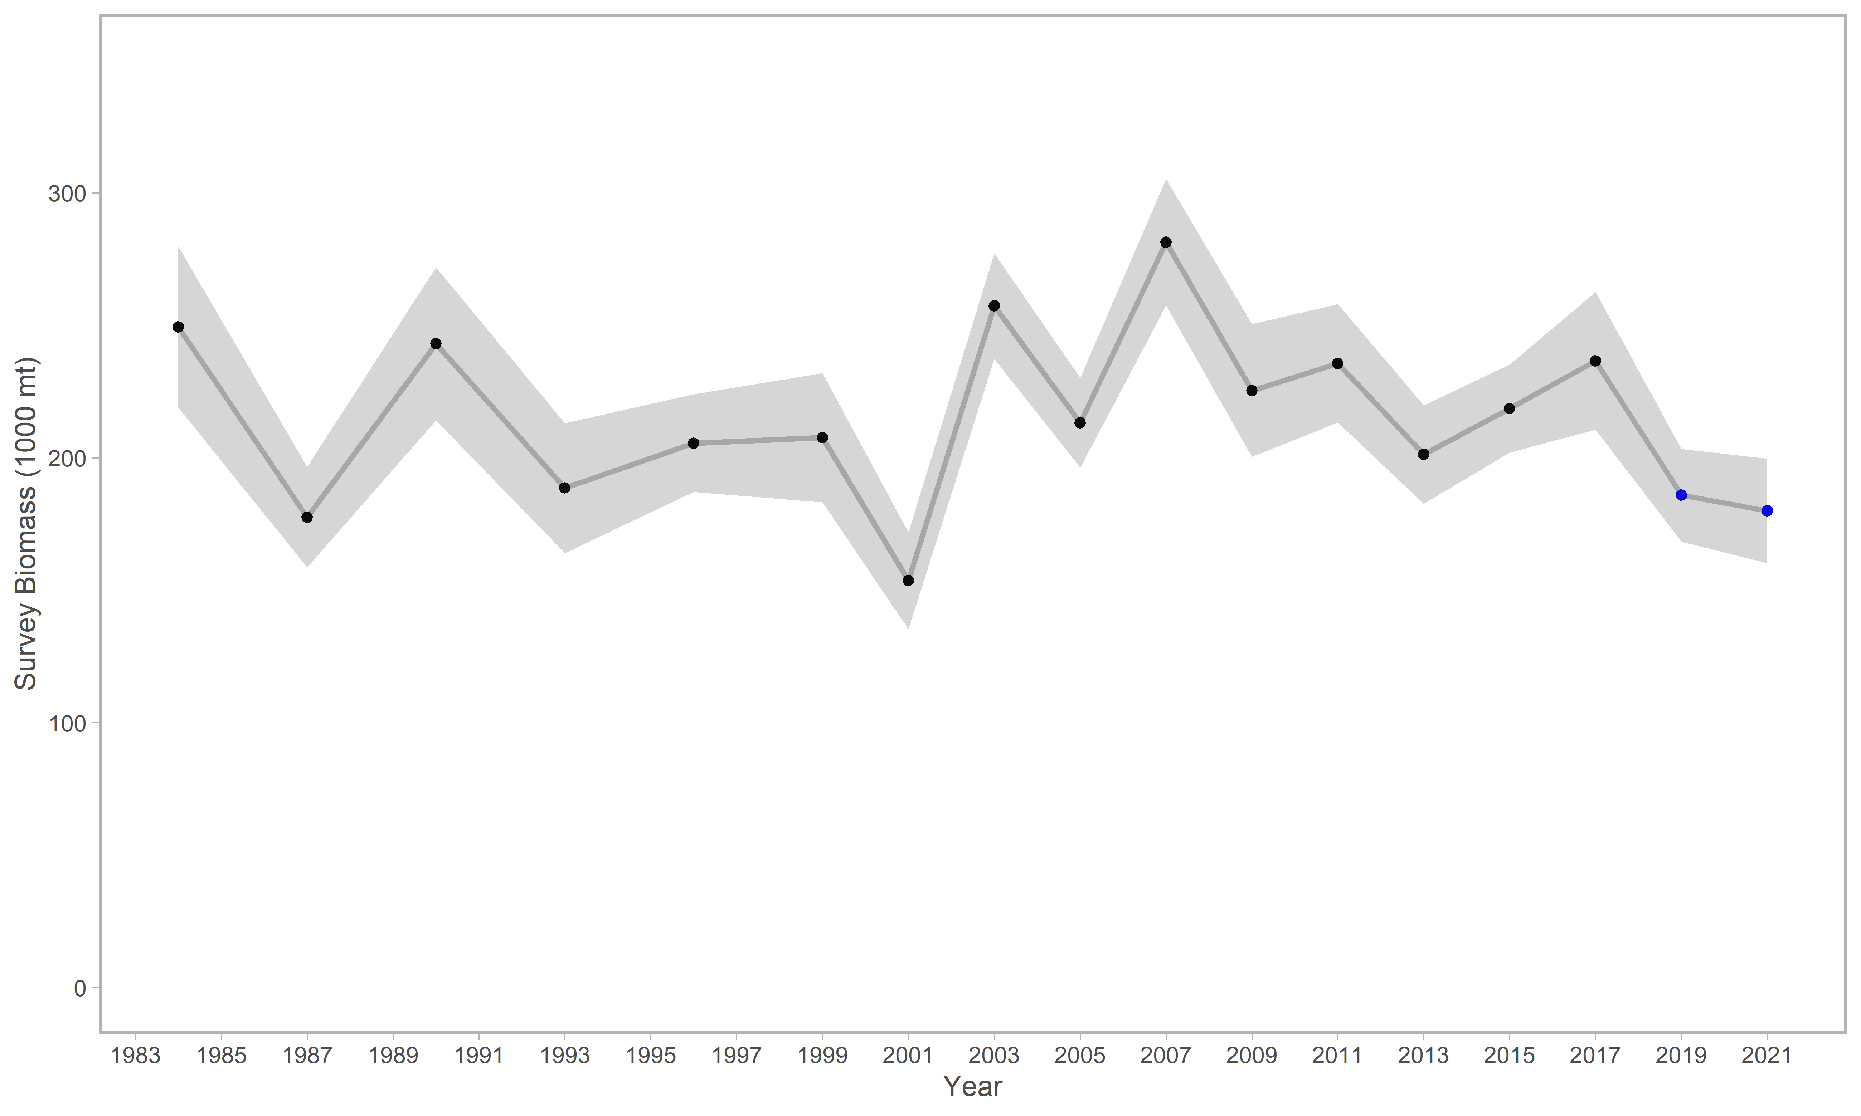
Survey biomass below peak, but stable
Notes:
The blue points are not included in the partial update; both are reflected in RE table

Slide 4
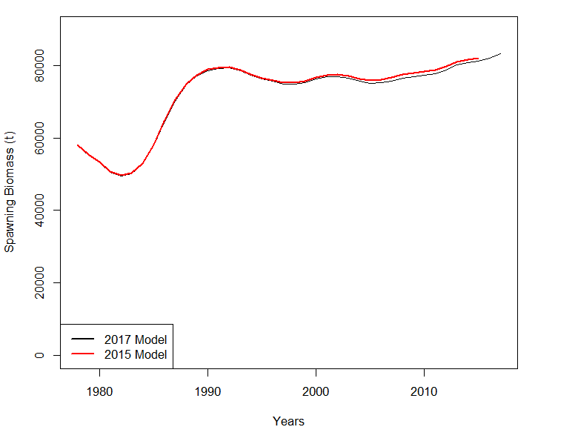
Ssb HIGH AND STABLE
2022 B_{40%} = 32,043t
Notes:
From 2017 full assessment: Time series of spawning biomass for the proposed 2017 model and the accepted 2015 model (the same as the 2017 Model without 2016-2017 data).

Slide 5
Abc apportionment
Quantity | Western |  | Central |  | West Yakutat |  | Southeast
 | 2020 | 2021 | 2020 | 2021 | 2020 | 2021 | 2020 | 2021
Area Apportionment | 36.08% | 36.73% | 52.89% | 54.84% | 6.16% | 3.76% | 4.86% | 4.67%
2022 ABC (t) | 14,492 | 14,755 | 21,243 | 22,033 | 2,474 | 1,511 | 1,952 | 1,876
2023 ABC (t) | 14,445 | 14,708 | 21,176 | 21,962 | 2,466 | 1,506 | 1,946 | 1,870
Grey columns from last partial;
blue columns include 2021 survey in random effects model.
Notes:
This table shows values from last partial (RE run on survey data thru 2019) as well as current (include 2021 data) applied to 22, 23 projected ABC.
WGOA had a decrease which is
No major discrepancies between approaches; basically you get a little more in WGOA & CGOA, less in WY
ABC 2022, 2023 = 40,175, 40,046

Slide 6
Quantity | As estimated or specified last year for: |  | As estimated or recommended this year for:
 | 2021 | 2022 | 2022 | 2023
M (natural mortality rate) | 0.2 | 0.2 | 0.2 | 0.2
Tier | 3a | 3a | 3a | 3a
Projected total (3+) biomass (t) | 280,980 | 278,418 | 279,975 | 276,796
Projected Female spawning biomass (t) | 95,338 | 96,833 | 97,614 | 97,876
B_{100%} | 91,551 | 91,551 | 91,551 | 91,551
B_{40%} | 36,620 | 36,620 | 32,043 | 32,043
B_{35%} | 32,043 | 32,043 | 36,620 | 36,620
F_{OFL} | 0.36 | 0.36 | 0.36 | 0.36
maxF_{ABC} | 0.28 | 0.28 | 0.28 | 0.28
F_{ABC} | 0.28 | 0.28 | 0.28 | 0.28
OFL (t) | 47,982 | 48,534 | 48,928 | 48,757
maxABC (t) | 39,377 | 39,851 | 40,175 | 40,046
ABC (t) | 39,377 | 39,851 | 40,175 | 40,046
Status | As determined last year for: |  | As determined this year for:
 | 2019 | 2020 | 2020 | 2021
Overfishing | no | n/a | no | n/a
Overfished | n/a | no | n/a | no
Approaching overfished | n/a | no | n/a | no
Notes:
The ABC for flathead sole is 40,175 t in 2022 and 40,046 t in 2023 and the OFL is 48,928 t in 2022 and 48,757 t in 2023. The new ABC recommendation and OFL values are similar to those developed in 2020 for 2022 (39,851 t and 48,534 t, respectively).

Slide 7
Next full assessment
Bridging to latest Stock Synthesis*
Analyze ageing error/introduce ageing error matrix
Explore relationship between M and q (likelihood profiles)
Explore scientific uncertainty (fixed parameters)
Notes:
switching to latest SS v likely will result in different model (survey data entry format & ALK). Significant bridging required.

