Slide 1

2021 Partial Update for GOA Flathead Sole Feedback on assessment plan
Maia Sosa Kapur
maia.kapur@noaa.gov
September 2021 GOA Plan Team

Slide 2
Flathead sole – partial update
Last full assessment for GOA was 2017 (Stock Synthesis v3.24O; 04/10/2013)
Updating to latest SS should happen during next full assessment
Survey biomass index data (thru 2019) do not suggest major conservation concern
Catches consistently ~10% of TACs since 2010
Notes:
switching to latest SS v likely will result in different model (survey data entry format & ALK). Significant bridging required.
Survey concern even less so if we were to use the model-based (VAST) index – comparison figure at end. Vals very stable no matter what.

Slide 3
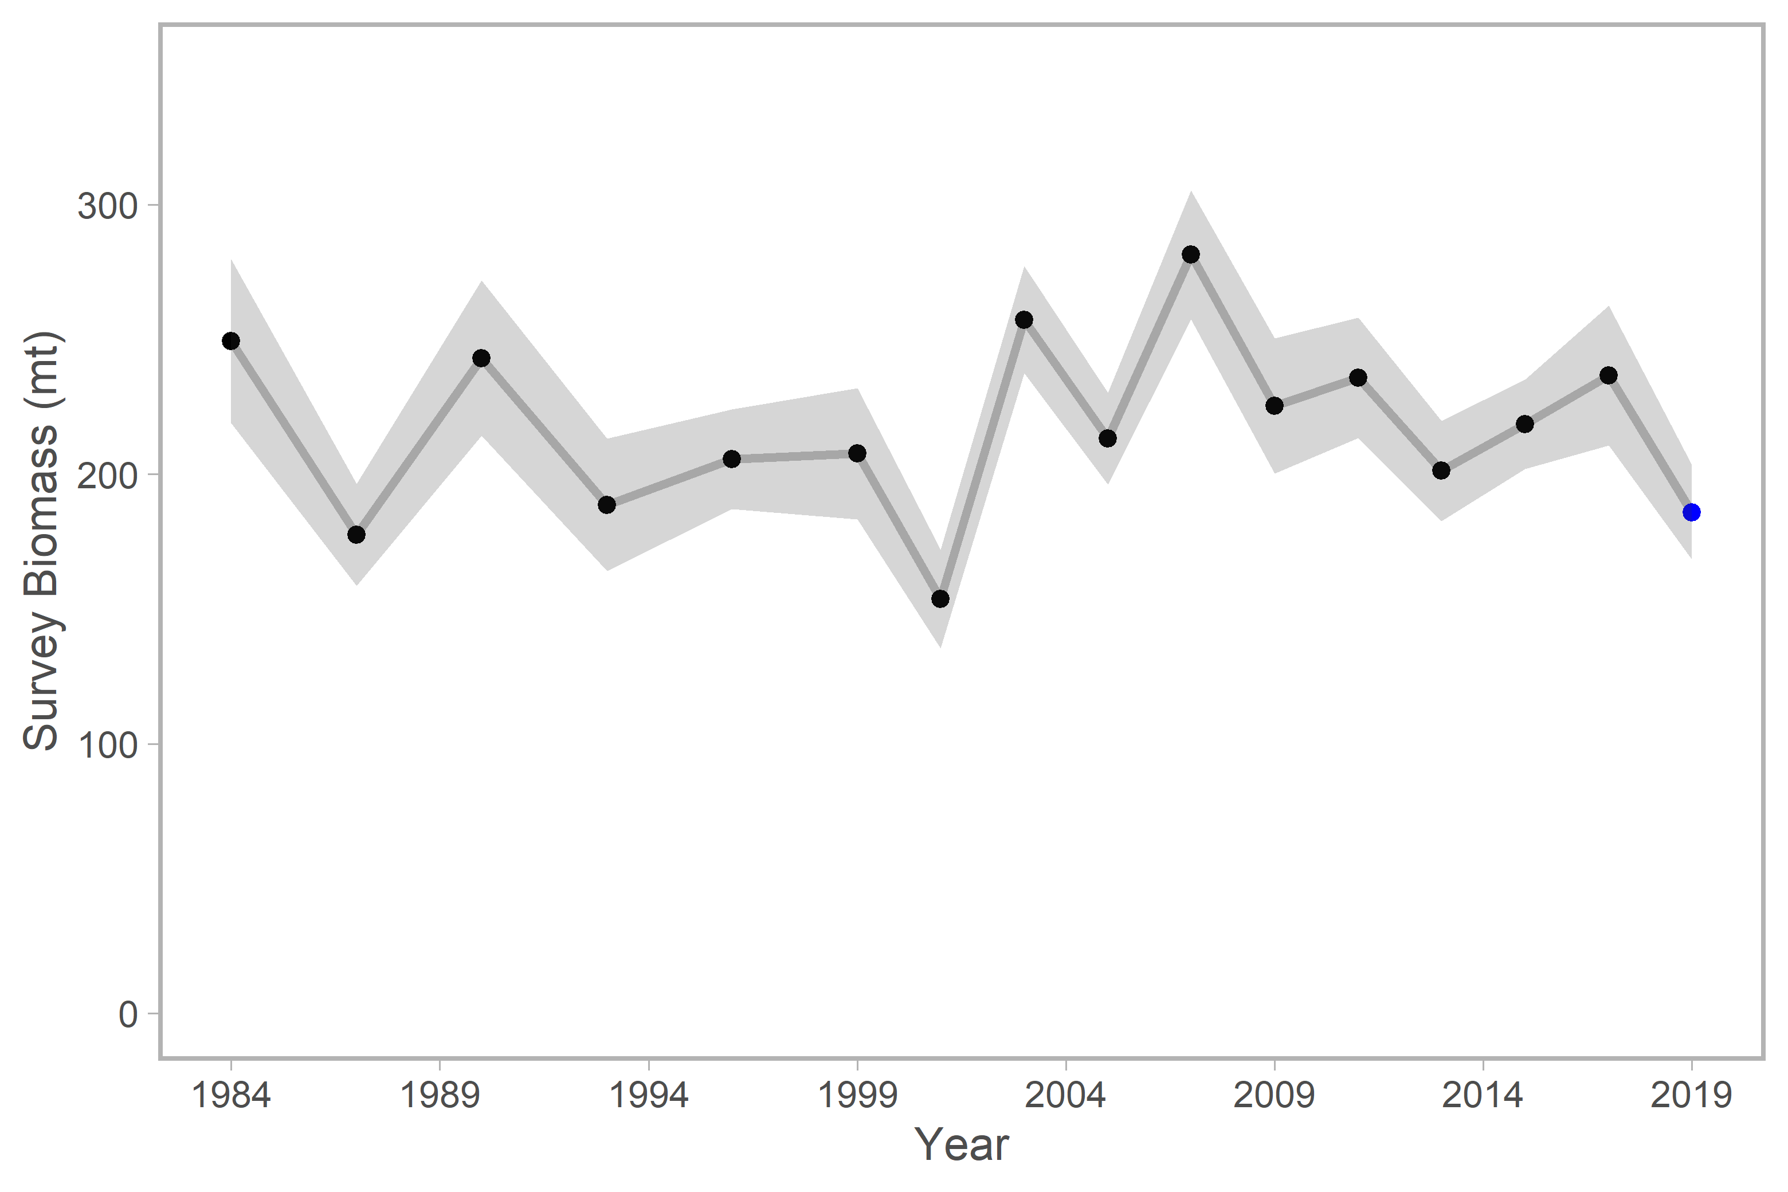
Design-based survey index (through 2019)
Notes:
Note that the base model only has index of abundance and lcomp data thru 2017. Ages thru 2015.

Slide 4
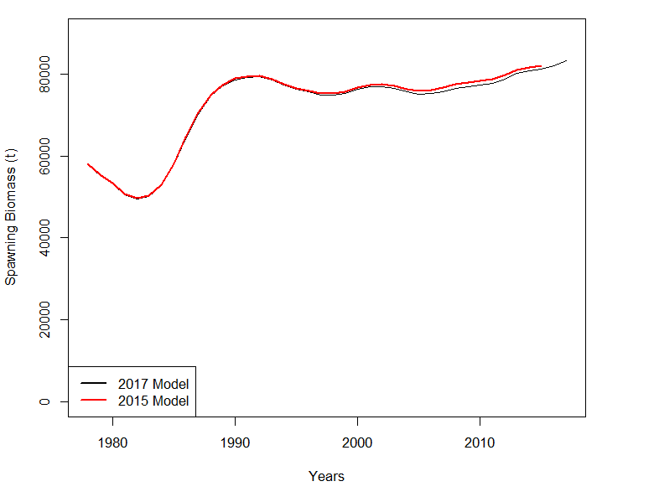
SSB High & Stable
In last partial update: 2021 B_{40%} = 36,620t
Notes:
From 2017 full assessment: Time series of spawning biomass for the proposed 2017 model and the accepted 2015 model (the same as the 2017 Model without 2016-2017 data).
2021 B40% = 36620

Slide 5
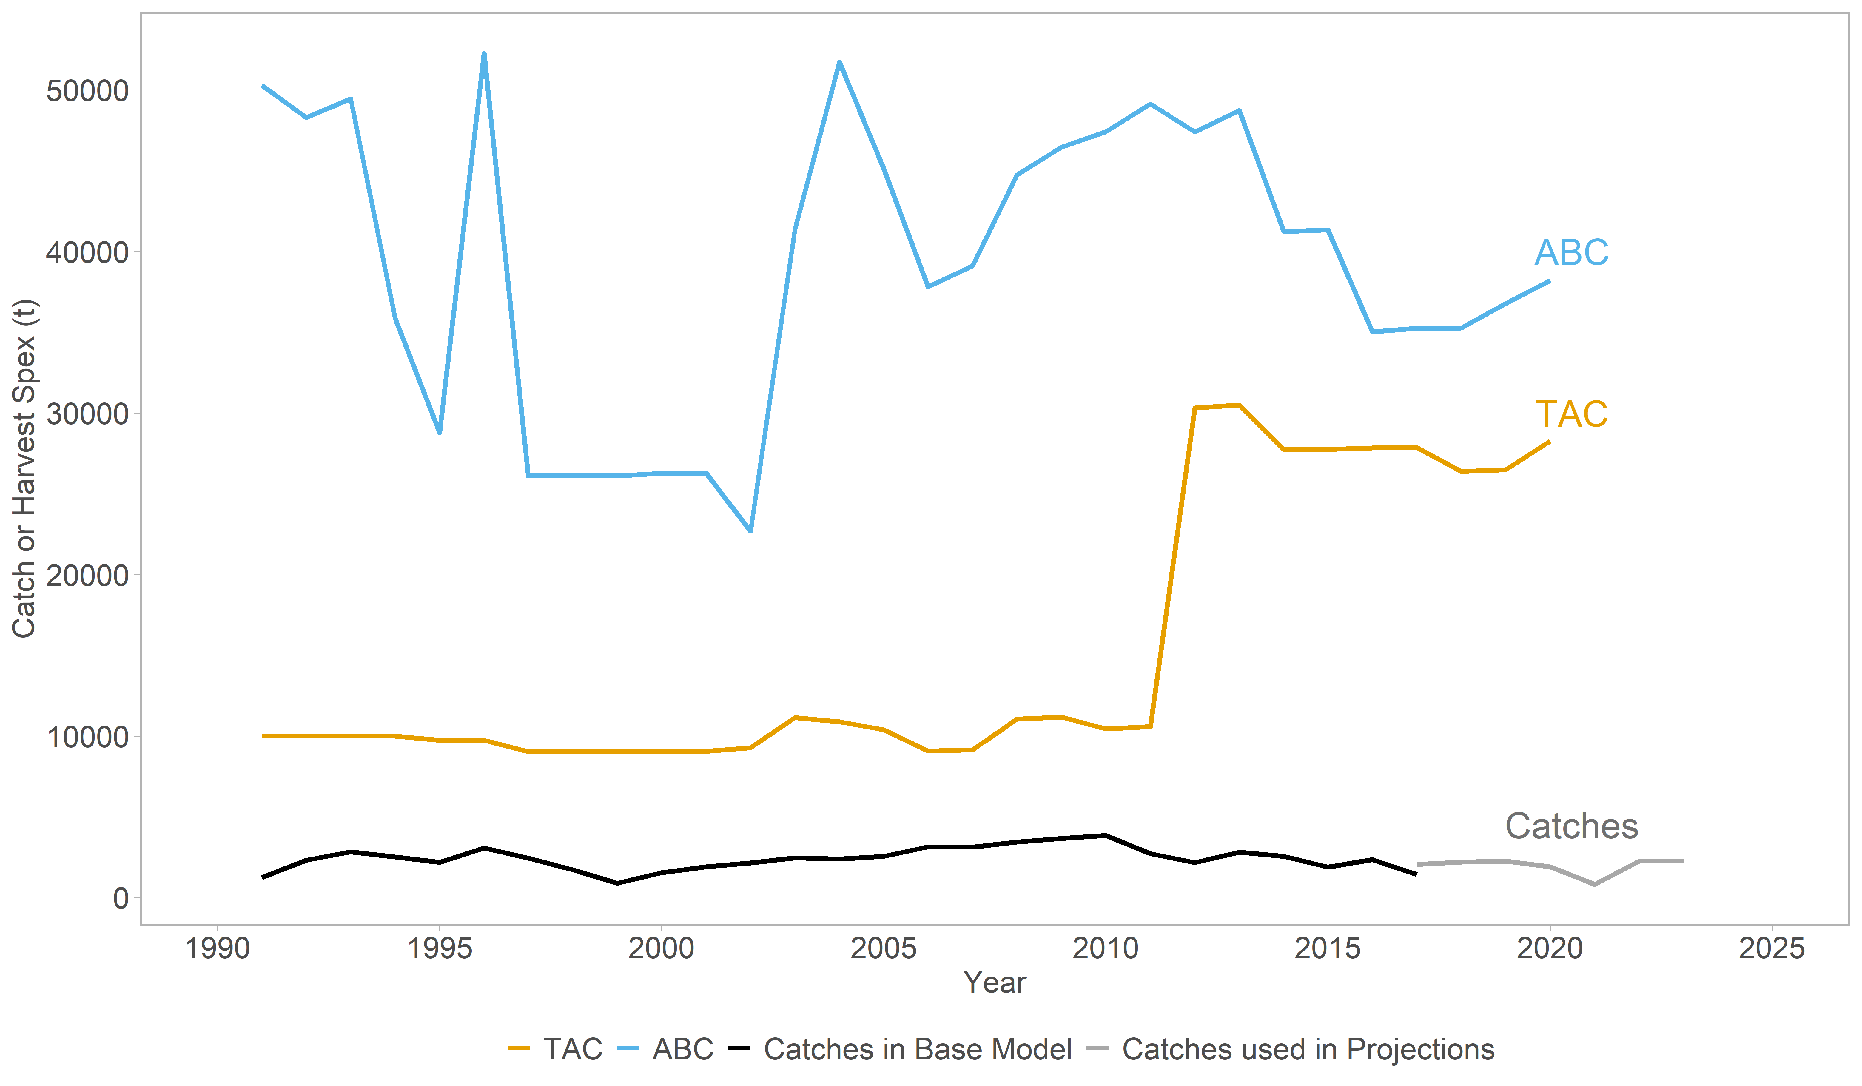
Catches << TACs < ABCs

Slide 6
Flathead sole – partial update
Last full assessment for GOA was 2017 (Stock Synthesis v3.24)
Updating to latest SS should happen during next full assessment
Survey biomass index data (thru 2019) do not suggest major conservation concern
Catches consistently ~10% of TACs since 2010
Risk of inconsistent projections
We recommend keeping a standard partial update this cycle
Guidance: is the PT comfortable with presentation of a standard partial update in Nov? Anything else to see in report?
Notes:
Especially because don’t have time to properly include survey comp data, nor fully tune the model with new data, a kludge which involved just adding 2021 biomass risks the introduction of inconsistency between projections.
Want to ask the Plan Team if they’re OK with standard partial update, and if so if there’s anything supplementary they’d like to see in the report?

Slide 8
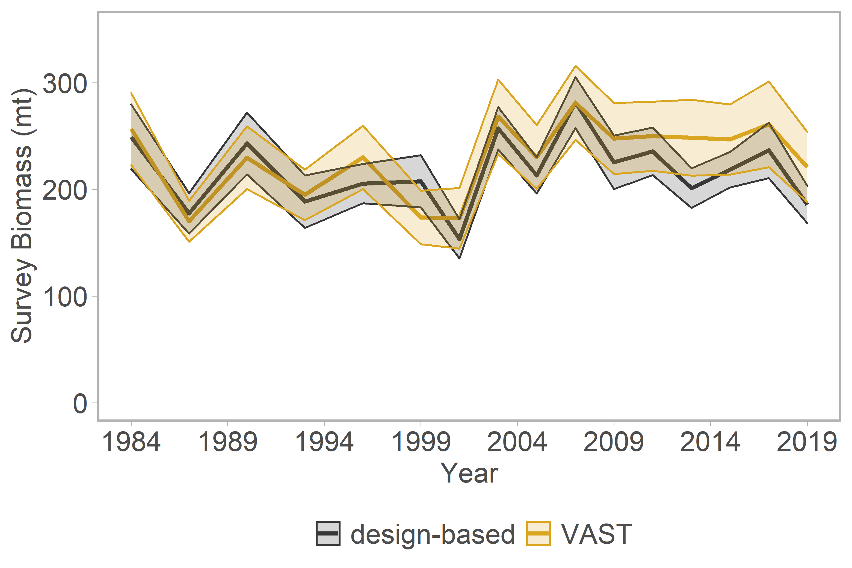
Comparison of model- and design-based indices thru 2019
Notes:
Note that VAST isn’t used in any model as of now. This was the last hindcast results from the GOA modeling group. Have not yet seen either model/design for 2021.

Slide 9
SSC/Plan Team Comments from 2017 Assessment
Analyze ageing error/introduce ageing error matrix
Explore relationship between M and q (likelihood profiles)
Explore scientific uncertainty (fixed parameters)

