Slide 1
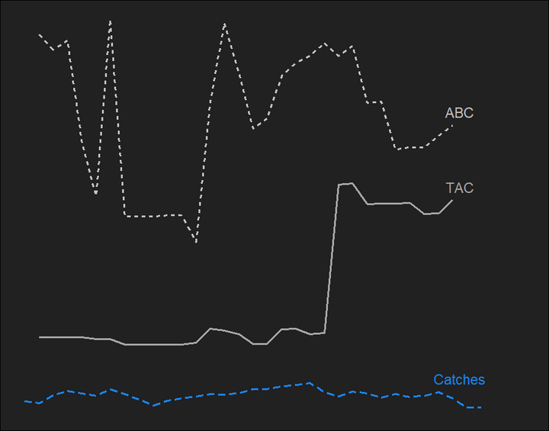
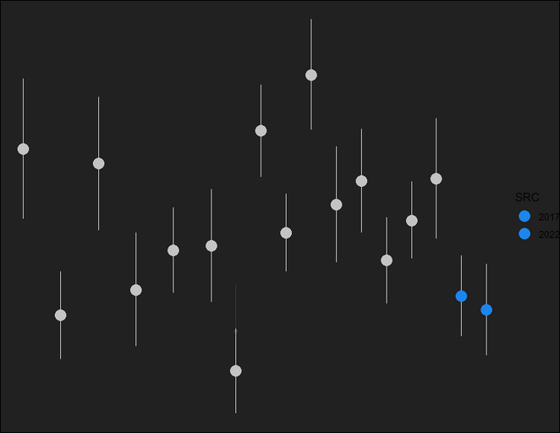
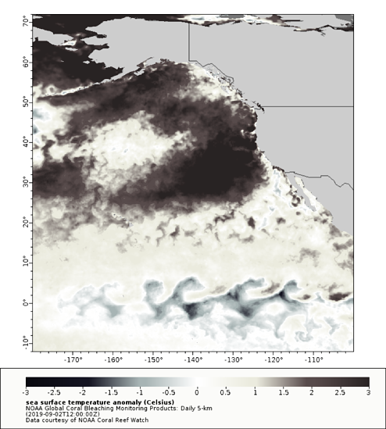
GOA Flathead Sole: Data
Last two years of survey down
2016 MHW likely catching up with data
Catch is <10% ABC
Approaching bycatch status
Still highest in Central GOA
Not out of historical range
Reduced prey availability
Lower recruitment devs and mean lengths

Slide 2
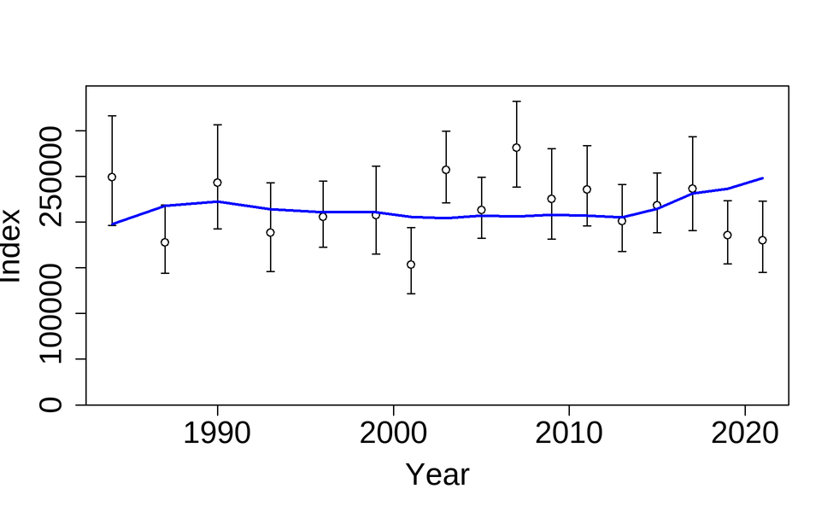
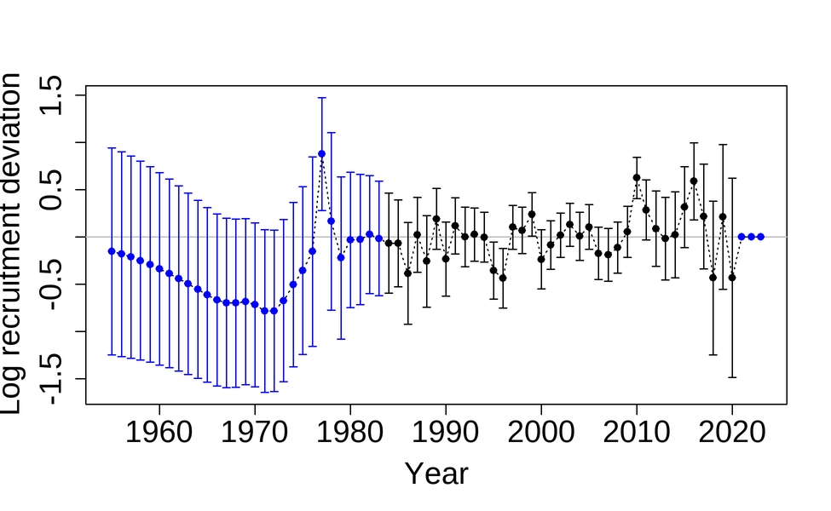

GOA Flathead Sole: Model
No Changes to Model
Recruitment
ABC
Slight overfit last two years of survey data with q, M, weighting constraints
Keep an eye on response to climactic conditions
in 2023 is 48,161 t, ~1% difference from last year
Model is structurally stable and robust to new data

