Slide 1
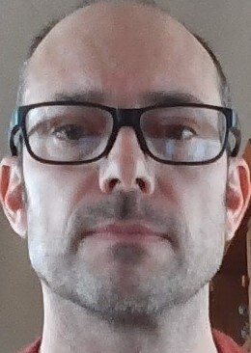
Gulf of Alaska Dusky Rockfish
Ben Williams, Pete Hulson, Chris Lunsford, Cecilia O’Leary
Notes:
Previous identity has proved to be overly complex to apply, reducing buy-in. The old brand guide did not perform well in the difficult balancing act between consistency and sameness.

Slide 2
Dusky rockfish
Alternative data explorations:
VAST explorations - Model 15.5a(2020):
A = poisson-delta, gamma, 500 knots
B = poisson-delta, gamma, 750 knots
C = delta, lognormal, 1000 knots
D = delta, lognormal, 750 knots
E = poisson-delta, lognormal, 750 knots
F = delta, gamma, 750 knots
Alternative model explorations:
Length plus group
Age plus group
Length and age plus group
Notes:
VAST A – bridge model from 2020 links GAP standards and MESA methods
VAST B – 2020 accepted model with more knots

Slide 3
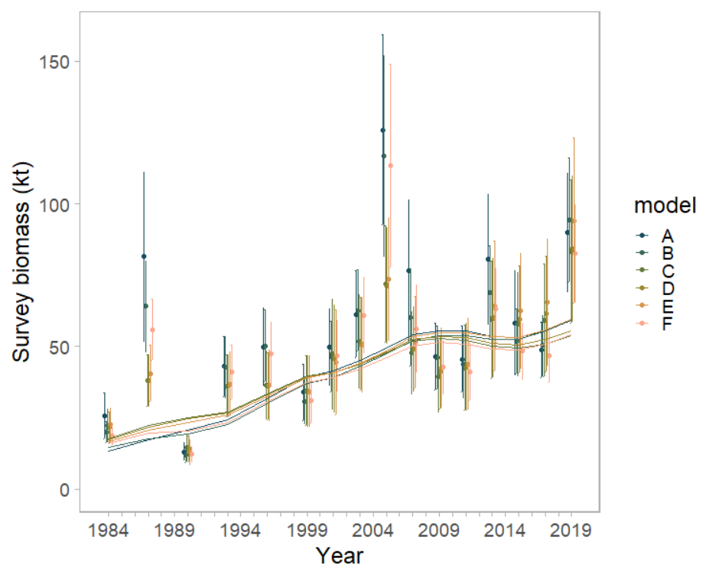
Dusky rockfish – survey biomass
Notes:
Two clusters of input estimates from VAST (ABF & CDE) – model estimated outputs are fairly similar

Slide 4
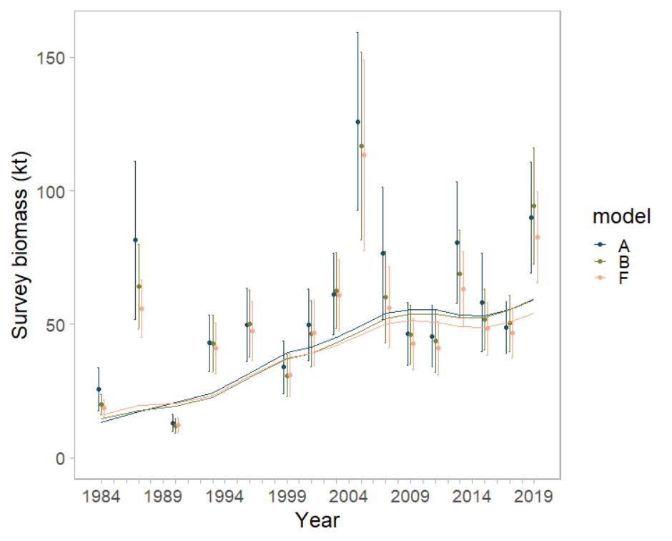
Dusky rockfish – survey biomass
Notes:
Two clusters of input estimates from VAST (ABF & CDE) – model estimated outputs are fairly similar

Slide 5
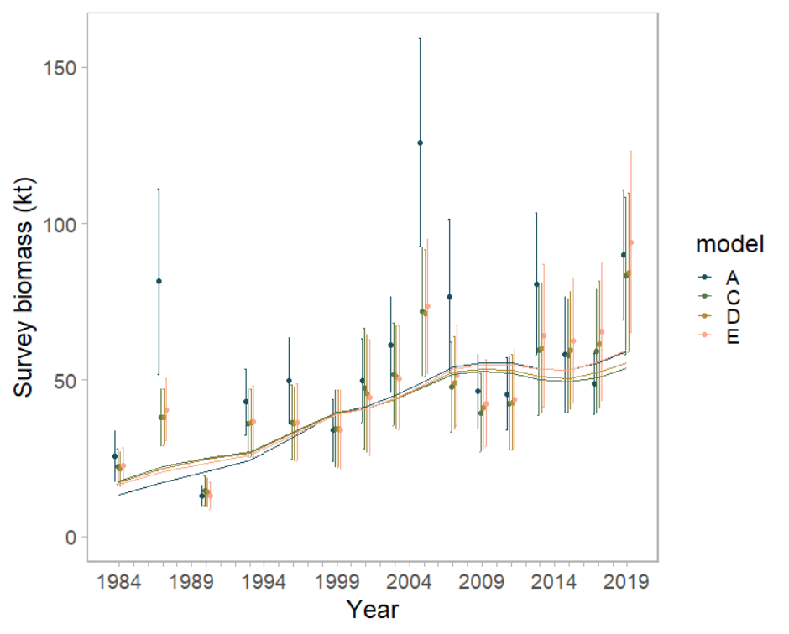
Dusky rockfish – survey biomass
Notes:
Two clusters of input estimates from VAST (ABF & CDE) – model estimated outputs are fairly similar

Slide 6
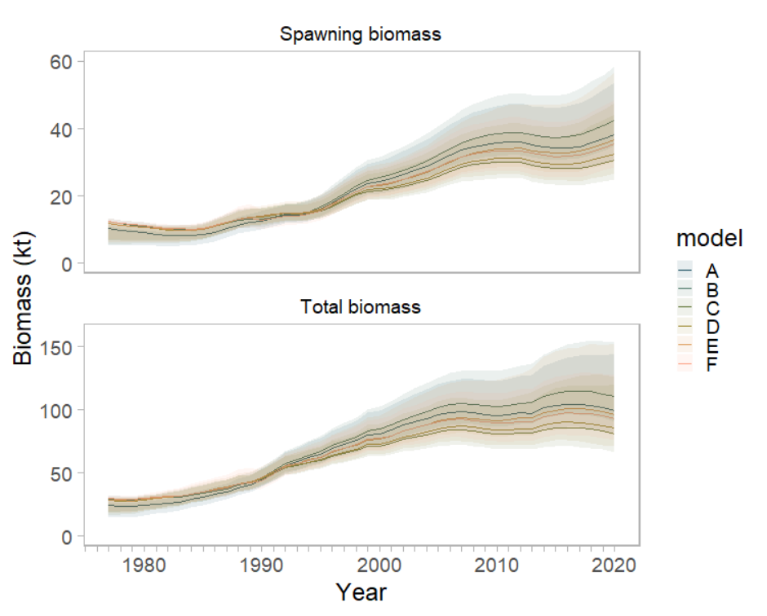
Dusky rockfish – biomass
Notes:
Changes in survey biomass do have an effect on total and spawning biomass

Slide 7
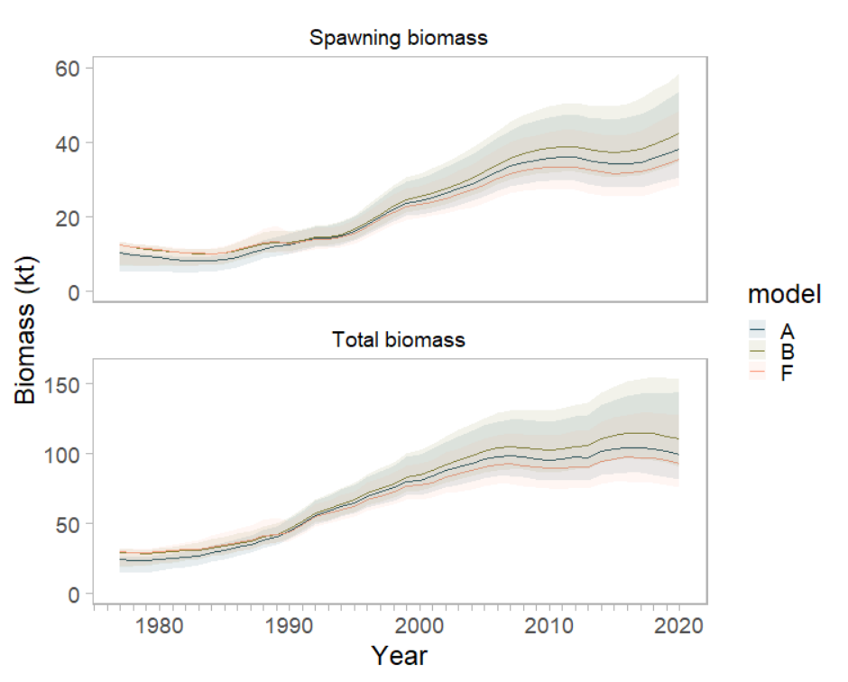
Dusky rockfish – biomass
Notes:
Changes in survey biomass do have an effect on total and spawning biomass = B & F above and below current VAST (default settings increases biomass) – B is current GAP default settings

Slide 8
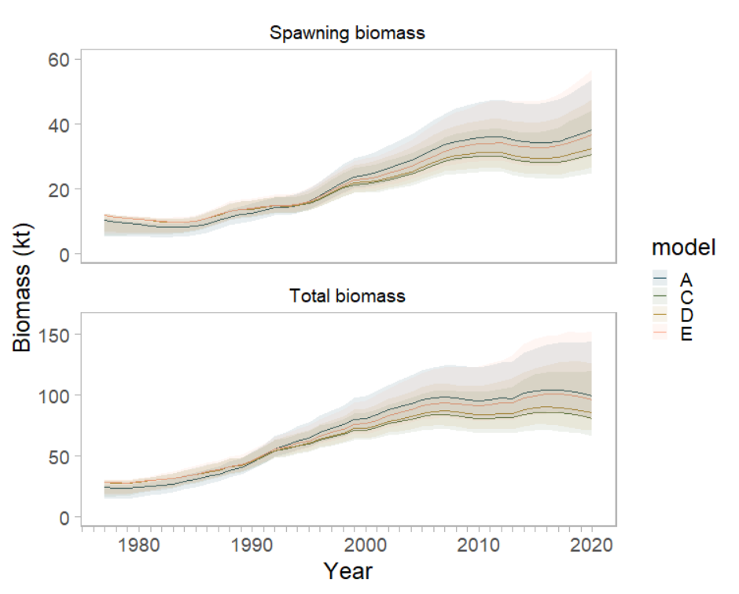
Dusky rockfish – biomass
Notes:
Changes in survey biomass do have an effect on total and spawning biomass, CDE all below current settings

Slide 9
Dusky rockfish
Alternative data explorations:
VAST explorations - Model 15.5a(2020):
A = poisson-delta, gamma, 500 knots
B = poisson-delta, gamma, 750 knots
C = delta, lognormal, 1000 knots
D = delta, lognormal, 750 knots
E = poisson-delta, lognormal, 750 knots
F = delta, gamma, 750 knots
Recommendation:
Likely use VAST option E
maintains the use of the delta model (reduced bias)
same # of knots as default GAP settings
residual “diagnostics” (not shown)
precautionary relative to default GAP settings
Notes:
Recommend moving forward with one of these models – survey input values are least variable across time
why? what about these settings make them less variable?
(2) is less variable actually preferred? Or, does it just mask that we are sampling a species that has variable catch rates by modeling it out?

Slide 10
Dusky rockfish
Alternative model explorations:
Length plus group
Age plus group
Length and age plus group
Notes:
VAST A – bridge model from 2020 links GAP standards and MESA methods
VAST B – 2020 accepted model with more knots

Slide 11
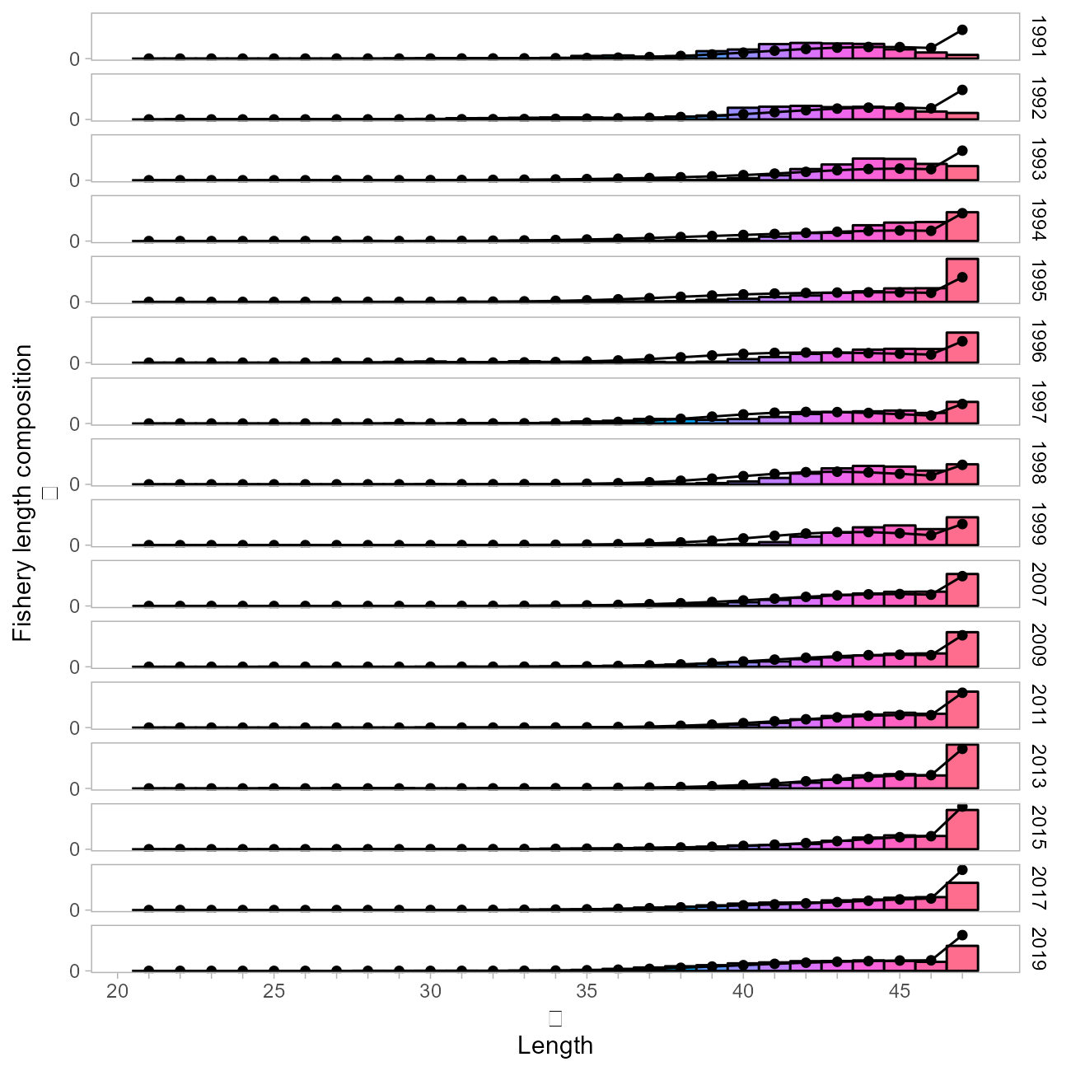
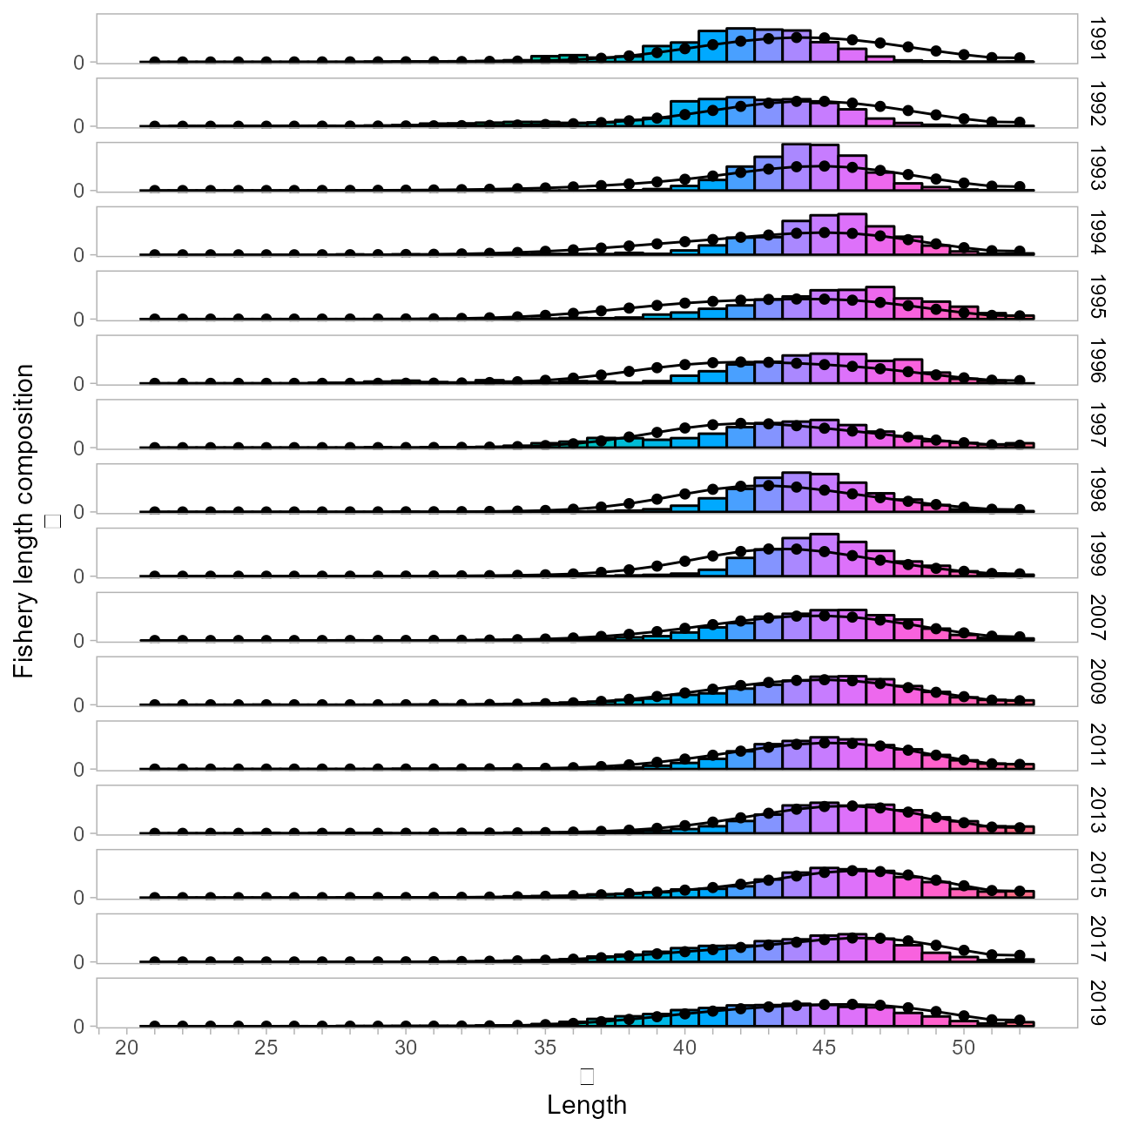
Dusky rockfish – length plus group
Fishery
Increased
Notes:
Added 5 bins to the length comps

Slide 12
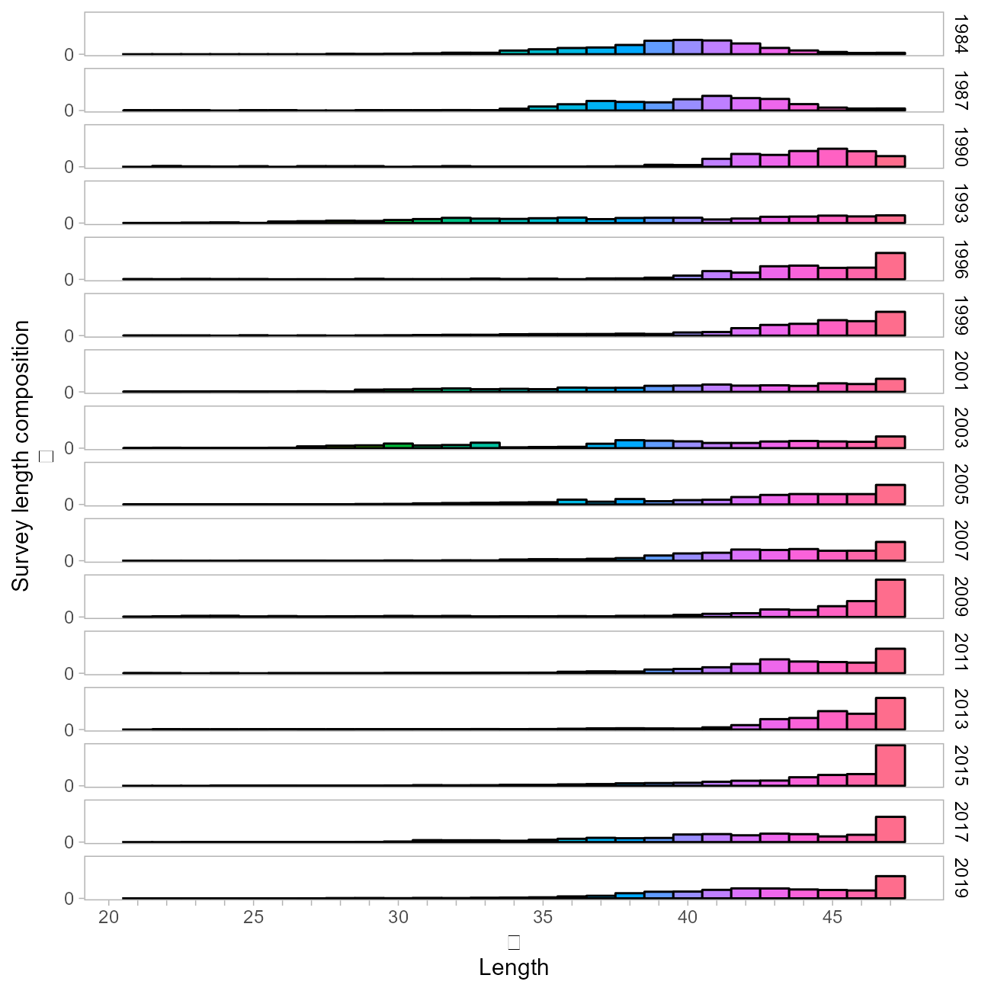
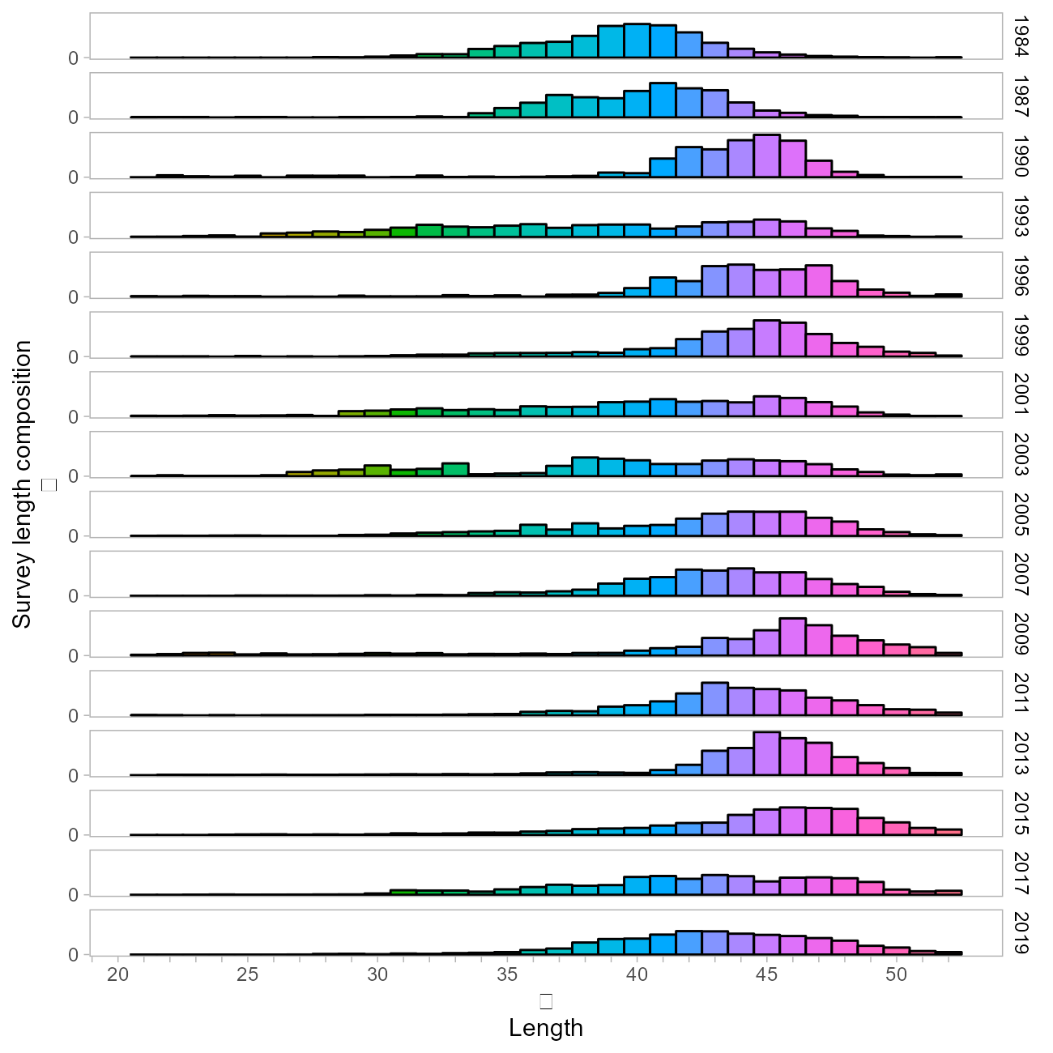
Dusky rockfish – length plus group
Survey
Increased
Notes:
Survey lengths not used in the model.

Slide 13
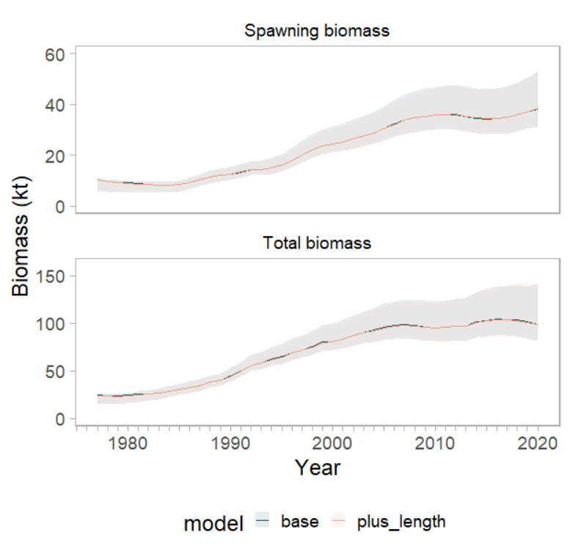
Dusky rockfish – length plus group
Notes:
No meaningful change in biomass estimates

Slide 14
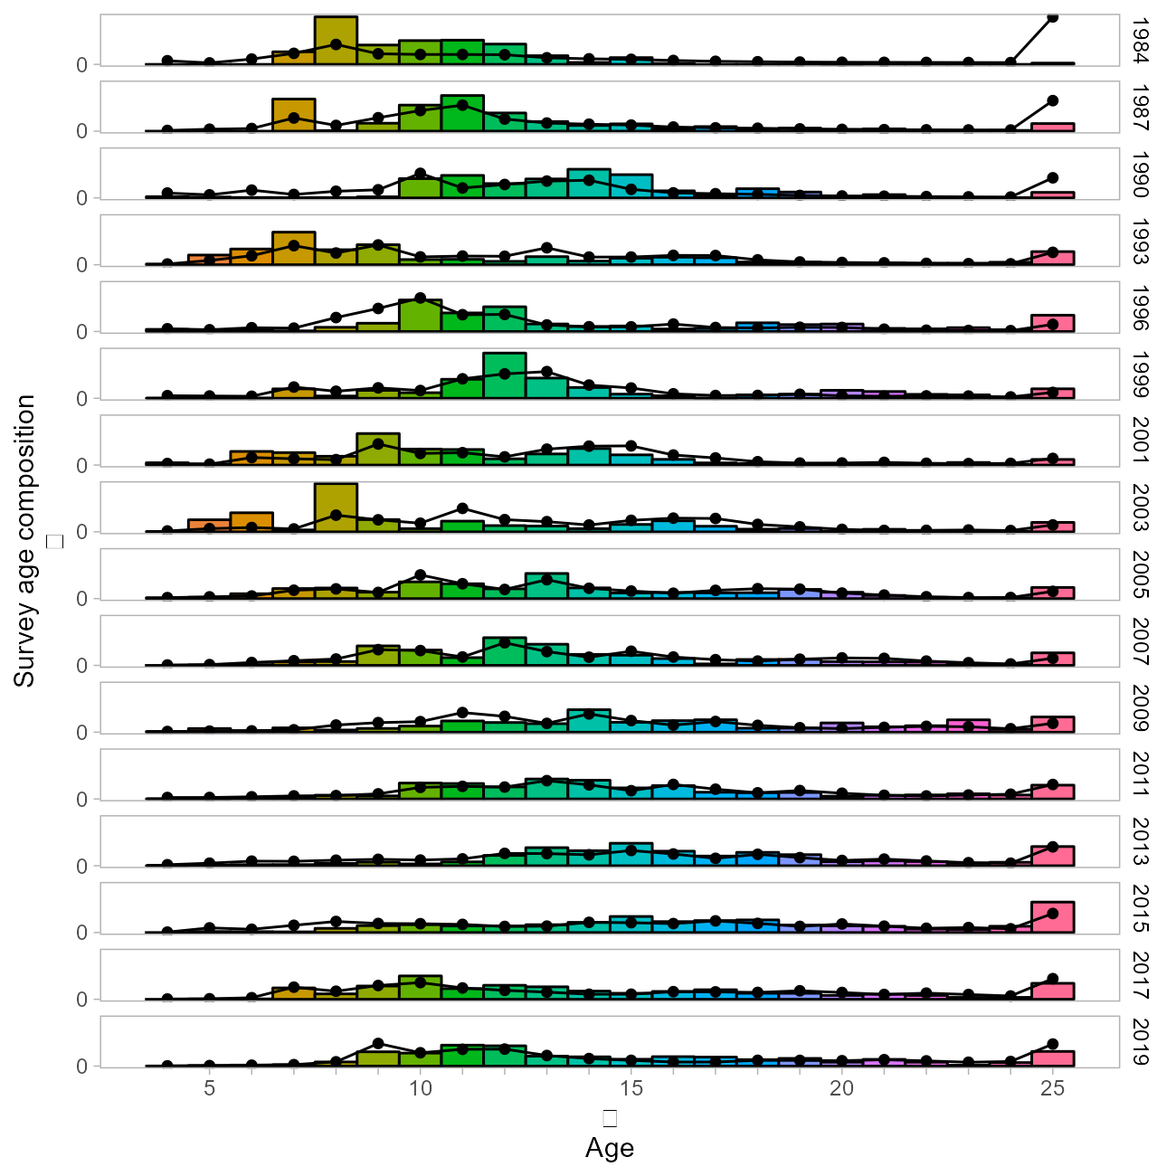
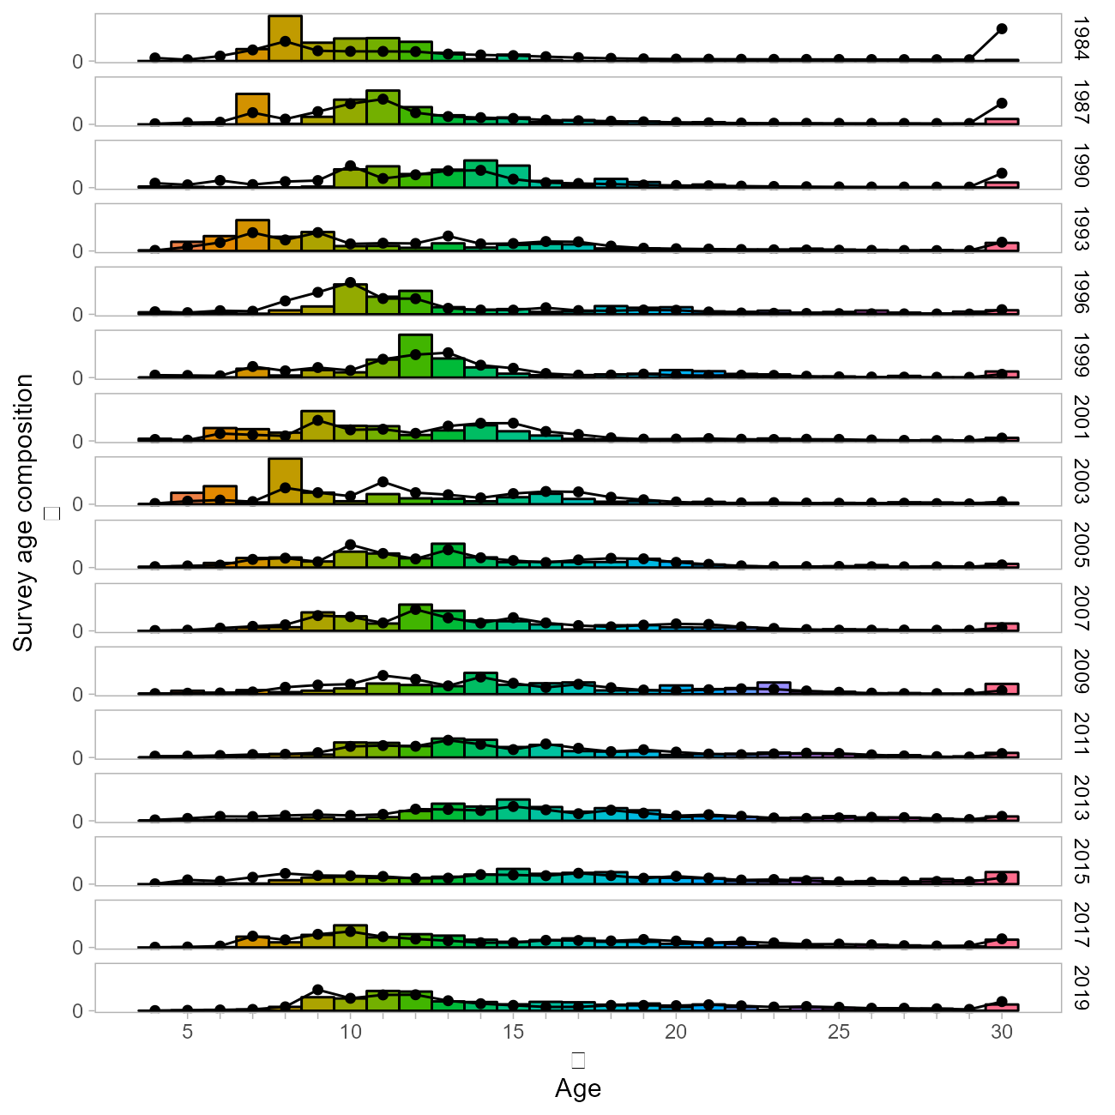
Dusky rockfish – age plus group
Survey
Increased
Notes:
Added 5 bins to age plus group
Note that the survey data from the 1980s will be dropped

Slide 15
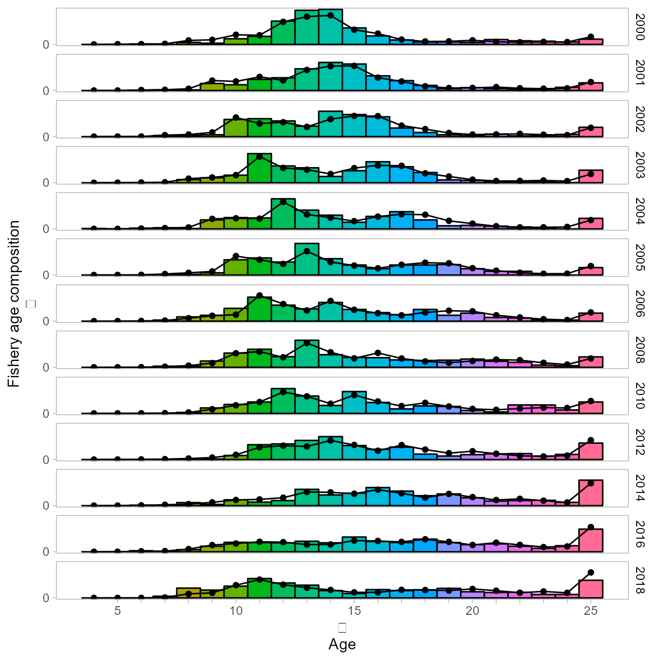
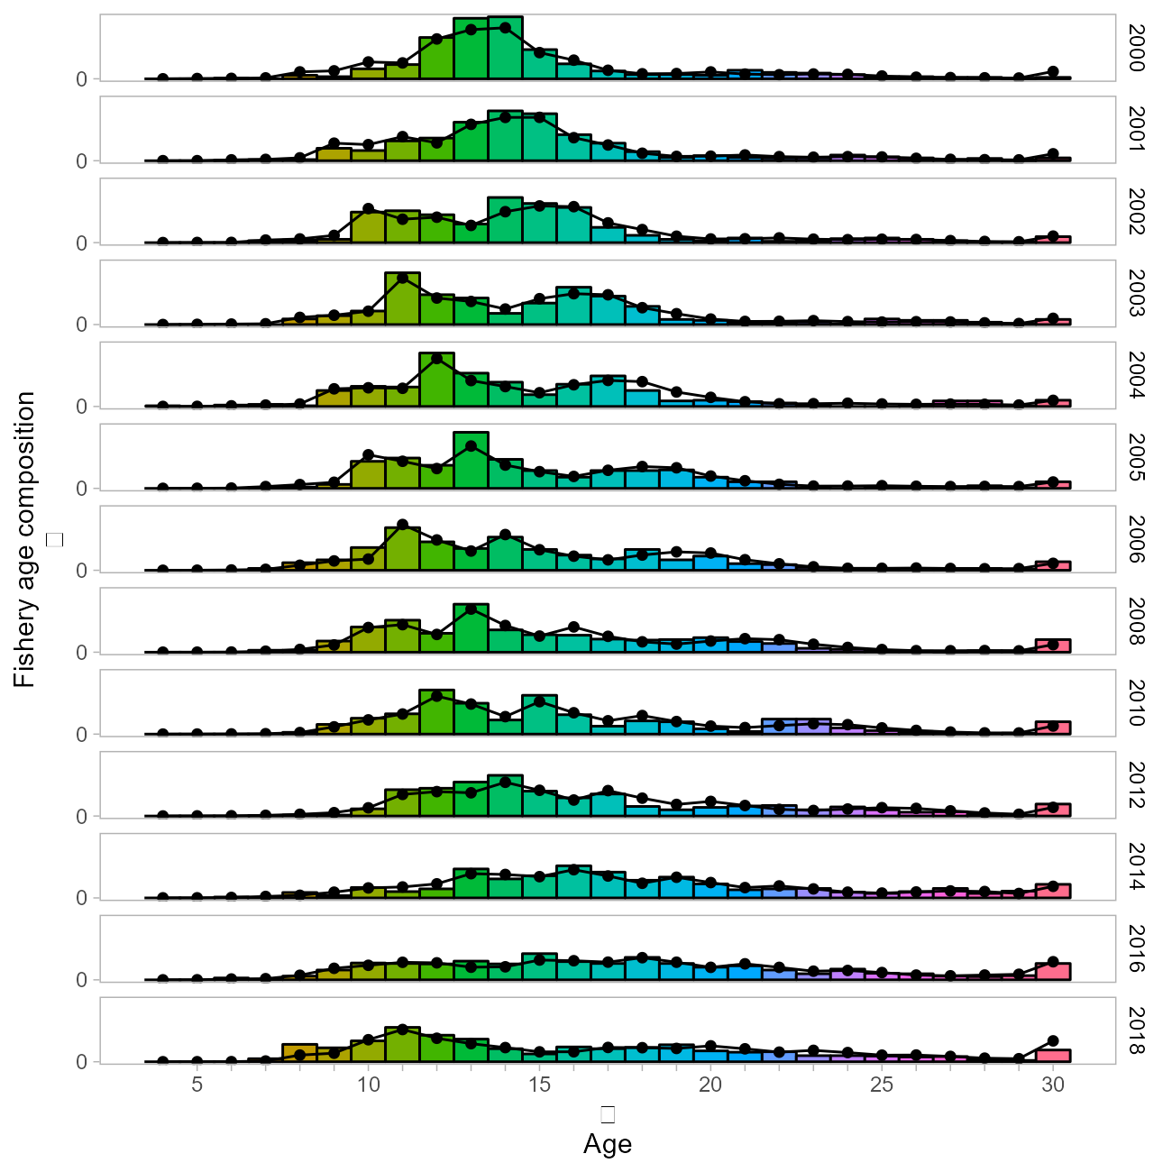
Dusky rockfish – age plus group
Fishery
Increased

Slide 16
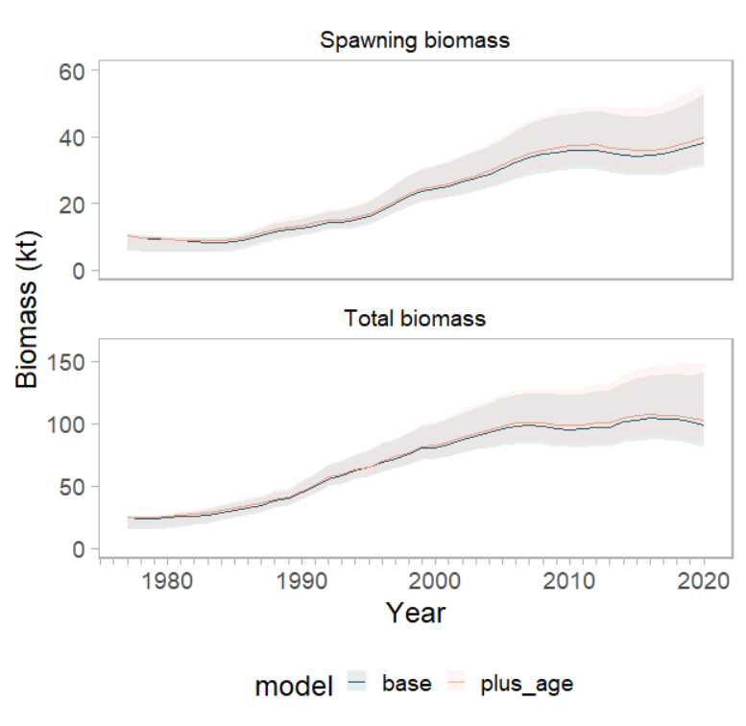
Dusky rockfish – age plus group
Notes:
Slight change in biomass with an increased age plus group (same results from increasing age and length plus groups).

Slide 17
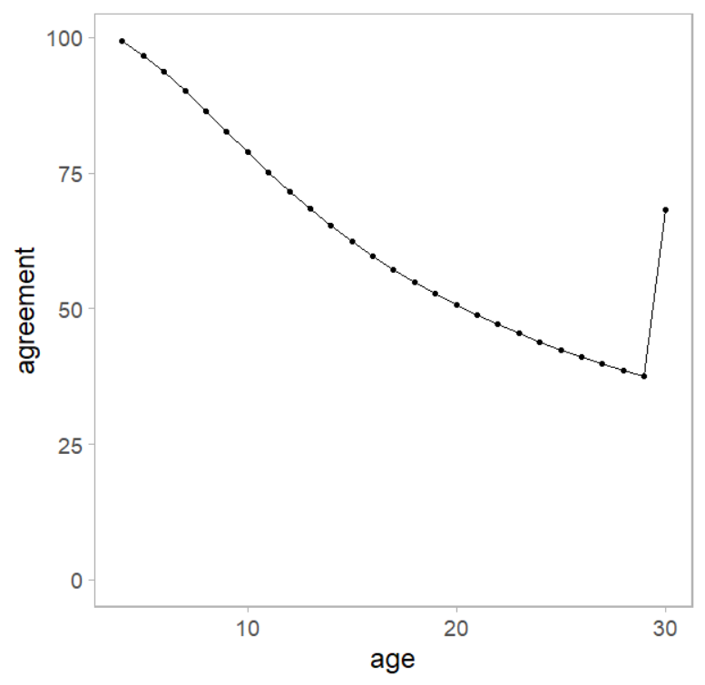
Dusky rockfish – age plus group
Notes:
Some issues with age error – by extending the plus group we are only lightly informing the model due to low agreement particularly after age-20
Note the plus group is for all plus ages - very low for ~ 30 years

Slide 18
Dusky rockfish – plus groups
 | Base | Length | Age | Age/Length
Parameters | 124 | 124 | 130 | 130
Likelihoods
Data | 332.8 | 340.1 | 350.7 | 356.6
Survey - age | 124.8 | 124.4 | 131.9 | 132.1
Fishery - age | 32.8 | 32.8 | 38.9 | 38.7
Fishery - length | 49.2 | 55.9 | 52.2 | 57.6
Notes:
Recommend incorporating both age and length increased plus groups – research focus on aging?

Slide 19
Questions?
ben.williams@noaa.gov

