Slide 1

Gulf of Alaska Dusky Rockfish
Ben Williams, Pete Hulson, Chris Lunsford, Kari Fenske

Slide 2
Dusky rockfish
2021 Partial assessment
Tier 3a species
Only catches updated for projection model
Final 2020 catch (2,198 t)
Estimated catches for 2021-2023
SSC requested ‘stair step’ ABC reduction from maxABC
Recommended 2021 ABC: 5,372 t
Lower than 2020 ABC: 5, 389 t

Slide 3
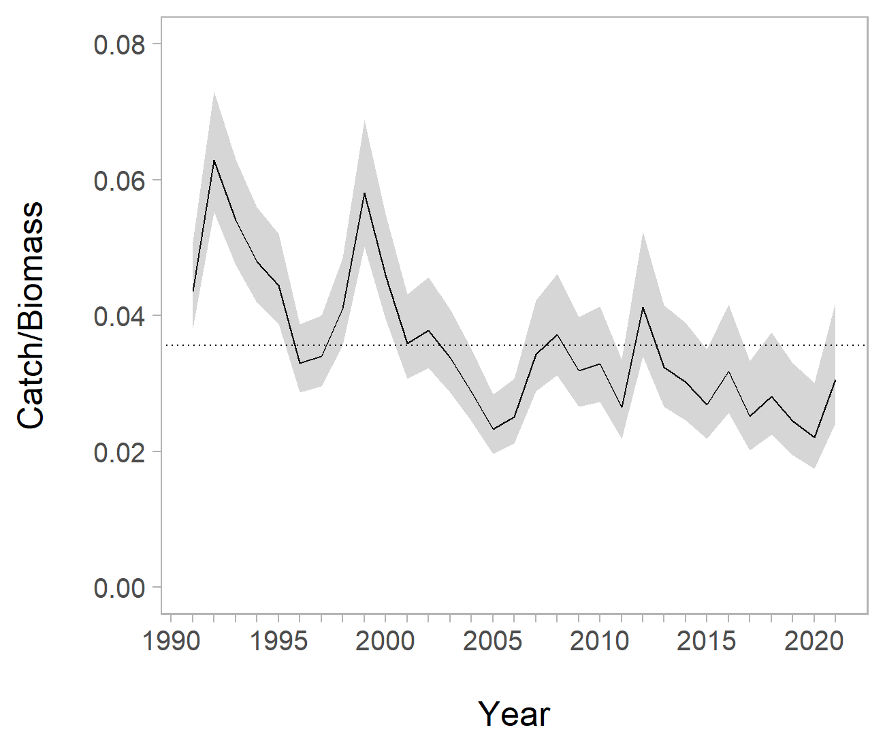
Dusky rockfish – Exploitation rate

Slide 4
Dusky rockfish – apportionment
Year | Measure | Western | Central | Eastern | Total
2022 | ABC | 269 | 4,534 | 569 | 5,372
2022 | OFL |  |  |  | 8,614
2023 | ABC | 259 | 4,373 | 549 | 5,181
2023 | OFL |  |  |  | 8,146
Notes:
Note the 1 ton get placed in the OROX

Slide 5
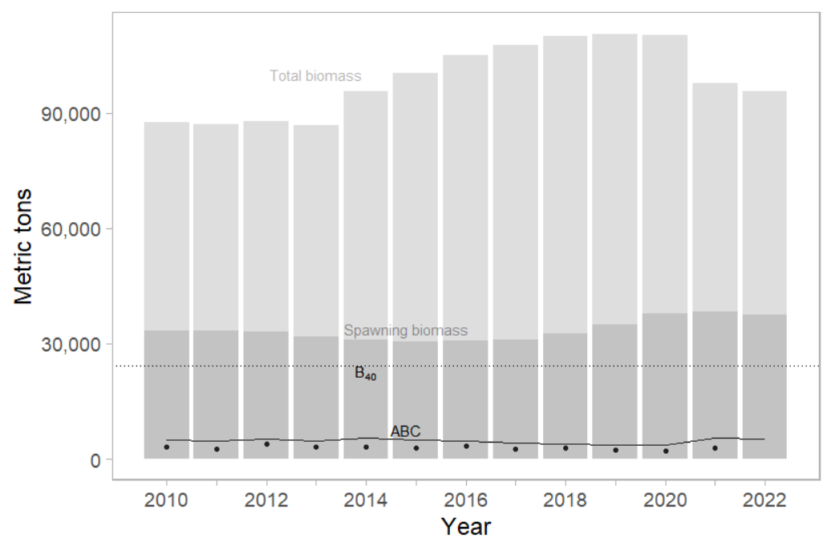
Dusky rockfish
Notes:
Solid black line is ABC, dots are catch

Slide 6
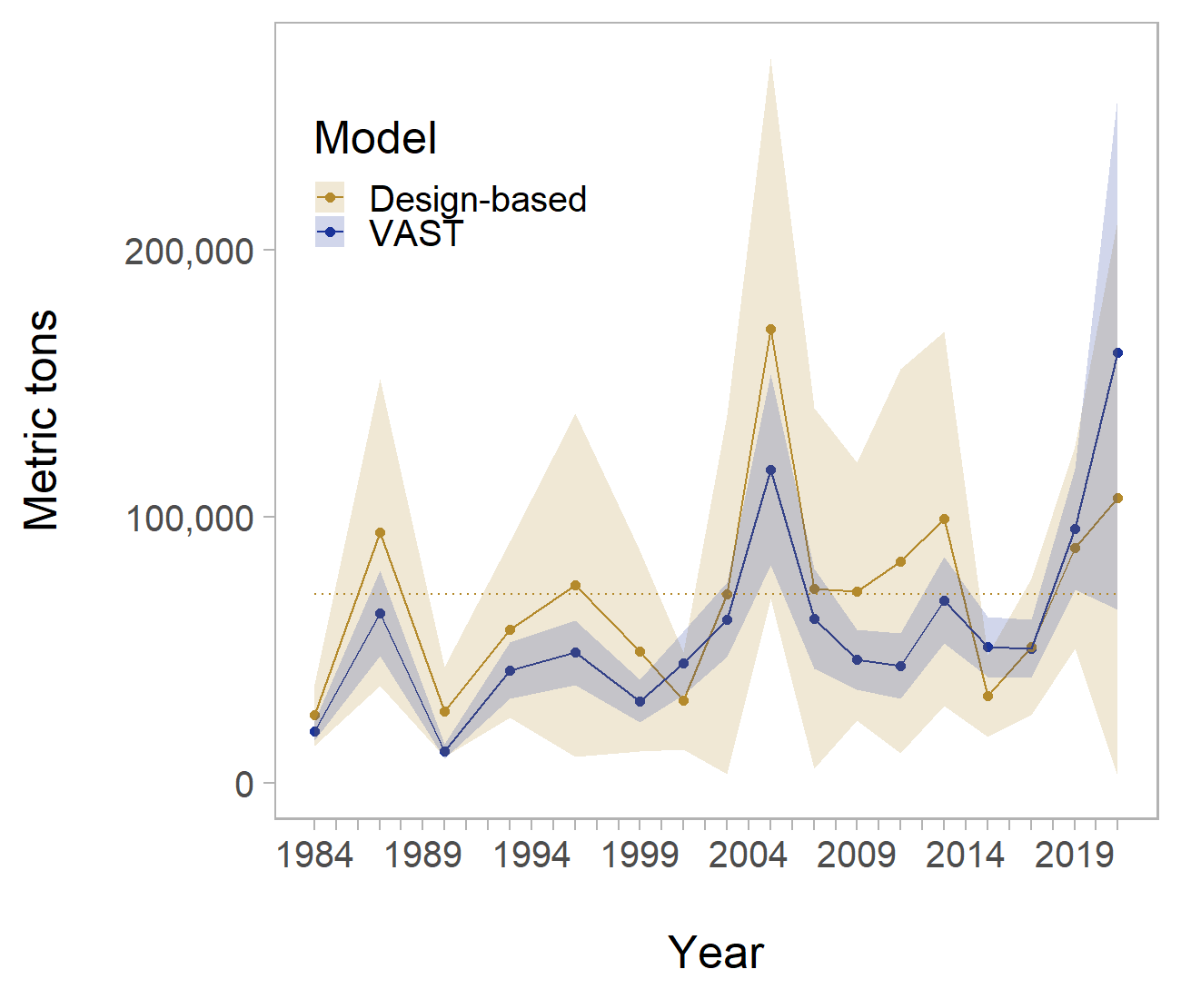
Dusky rockfish – 2021 survey

Slide 7
Dusky rockfish – summary
ABC projected to decrease through 2023
Full assessment will be conducted in 2022
Explore survey weighting
Data weighting
Length comp plus group

Slide 8
Questions?
ben.williams@noaa.gov

