Slide 1

Gulf of Alaska Northern Rockfish
Ben Williams, Pete Hulson, Chris Lunsford, Curry Cunningham
Notes:
Previous identity has proved to be overly complex to apply, reducing buy-in. The old brand guide did not perform well in the difficult balancing act between consistency and sameness.

Slide 2
Northern rockfish
No changes to model 18.2
Data changes:
- Catch updated through Oct 2020
- Survey biomass (2019)
- Survey age comps (2019)
- Fishery age comps (2018)
- Fishery length comps (2019)
- Age error matrix update
Changes are presented iteratively
Model 18.2 (2020) – previous accepted model uses VAST “bridge” estimate
Model 18.2a (2020) – previous accepted model uses VAST GAP estimate
Model 18.2b (2020) – Model 18.2a with updated age error matrix
Notes:
Added data
VAST bridge model
VAST GAP model – using this

Slide 3
Northern rockfish – VAST settings
 | VAST settings
Model | Computed by | Knots | Depth | Obs model | PCR | Bias correction
Model 18.2 (2018) | MESA | 1000 | all | delta | lognormal | No
Model 18.2 (2020) | GAP | 500 | <700 m | delta-gamma | lognormal | No
Model 18.2a (2020) | GAP | 500 | <700 m | delta-gamma | gamma | Yes

Slide 4
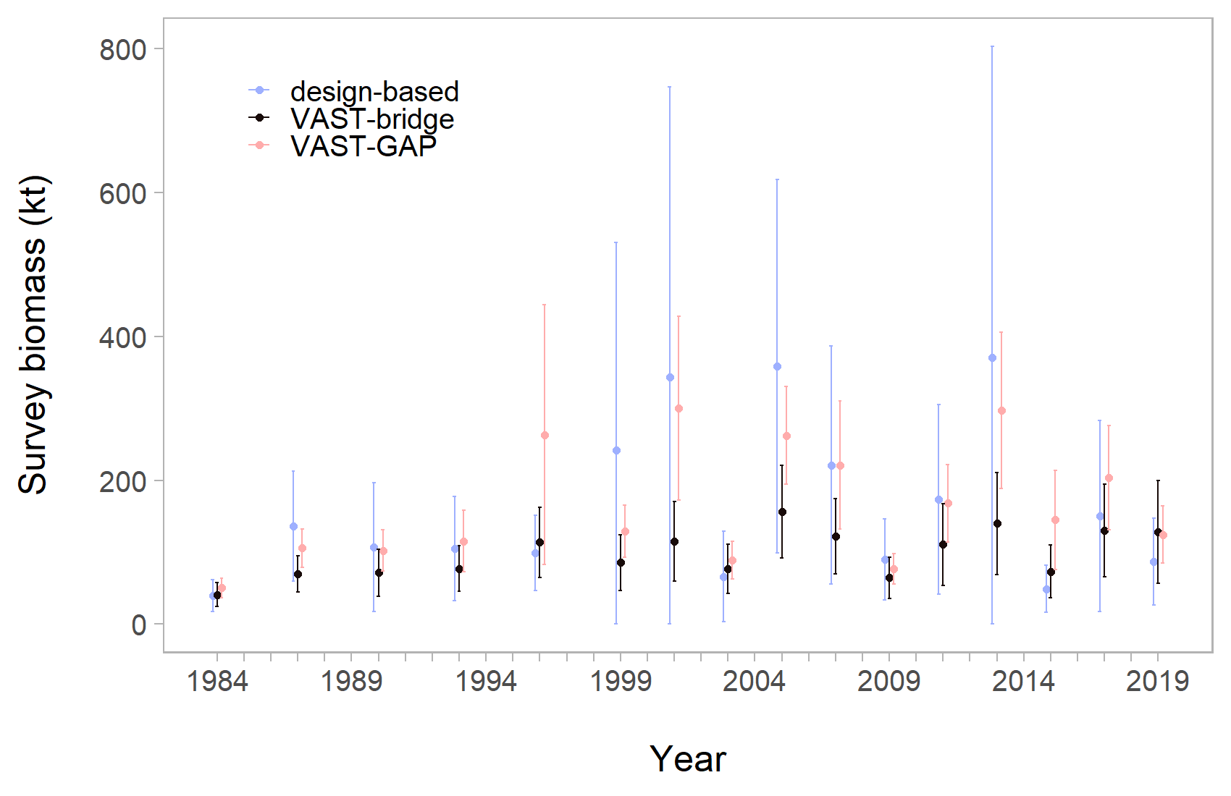
Northern rockfish – survey biomass
Notes:
The bridge model is slightly lower than the 2018 model
The GAP model is higher, though follows same trend lines

Slide 5
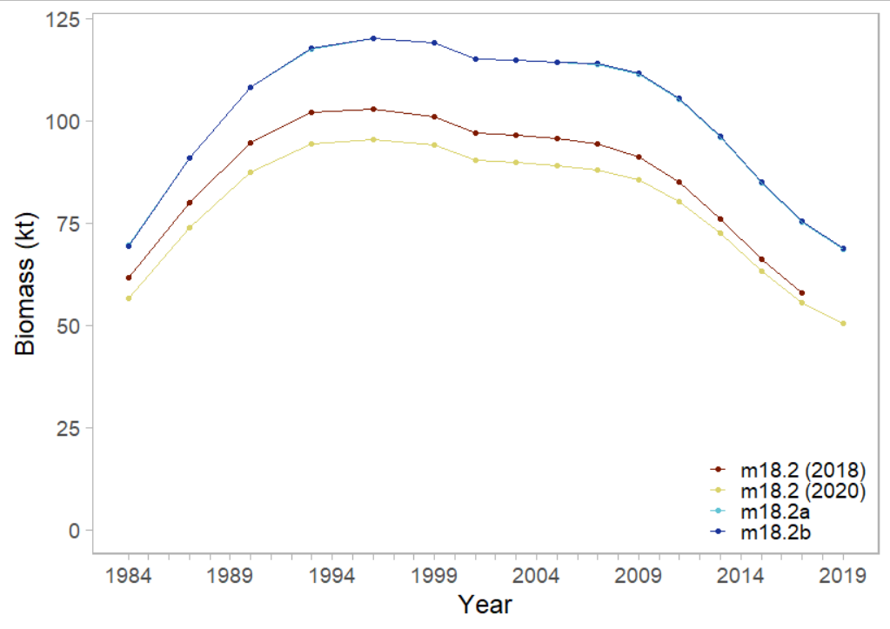
Northern rockfish – survey biomass
Notes:
The bridge model is slightly lower than the 2018 model
The GAP model is higher, though follows same trend lines

Slide 6
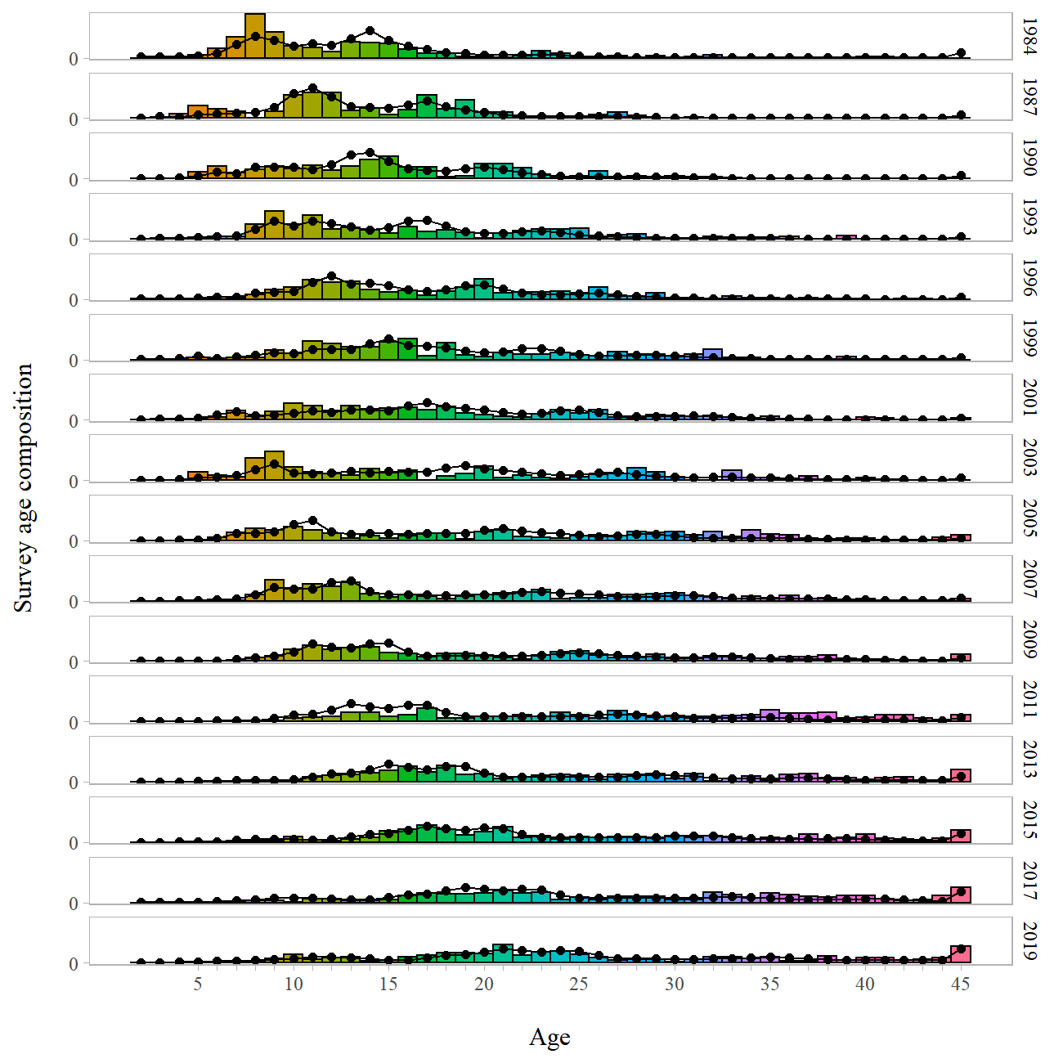
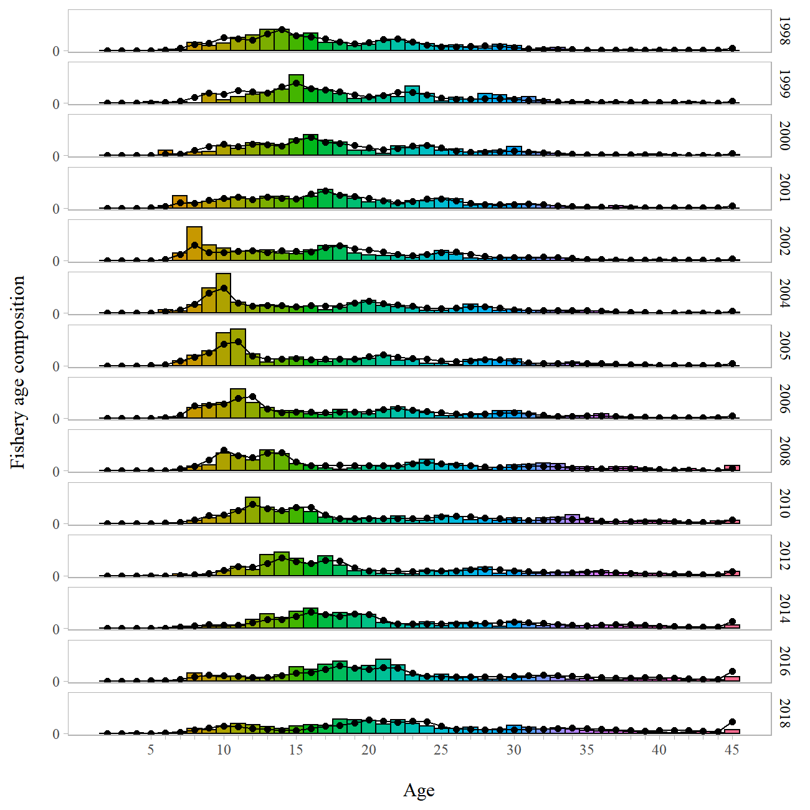
Northern rockfish – age
Survey
Fishery
Notes:
Ages are well distributed – seeing some signal ~ age 10 smallish recruitment
See similar age trends in survey and fishery

Slide 7
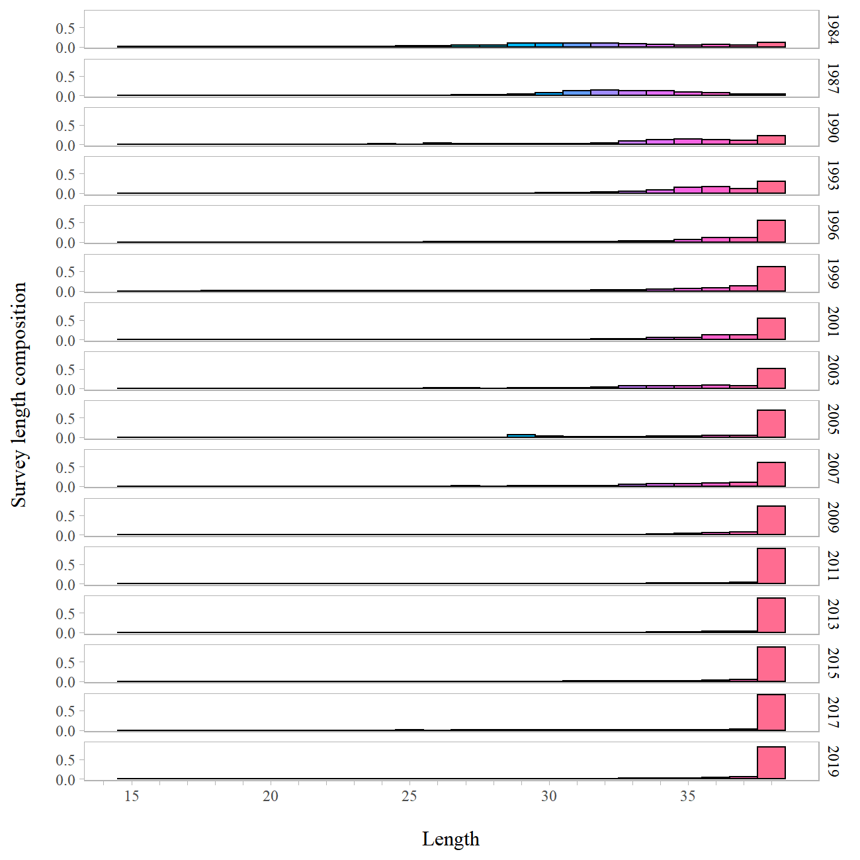
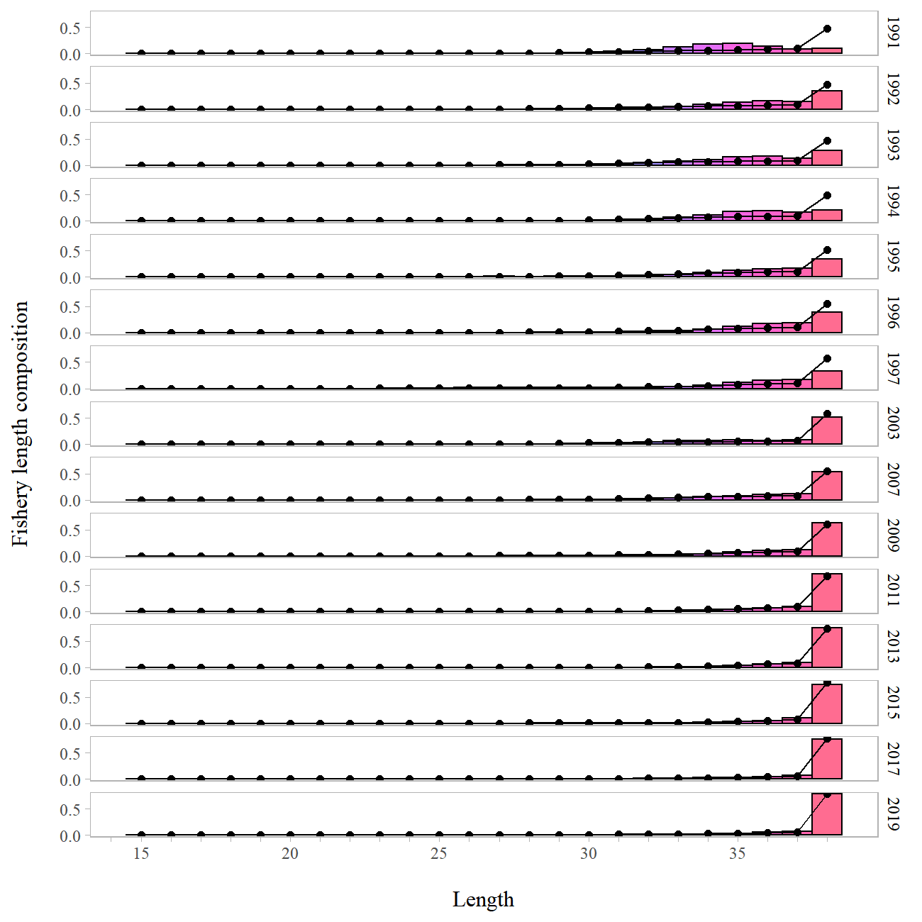
Northern rockfish – length
Survey
Fishery
Notes:
Survey lengths not used in the model.
Need to push out the plus group

Slide 8
Northern rockfish – length
Survey
Fishery
Q for Plan Team:
Specific recommendations for plus group examinations?
Notes:
Survey lengths not used in the model.
Need to push out the plus group

Slide 9
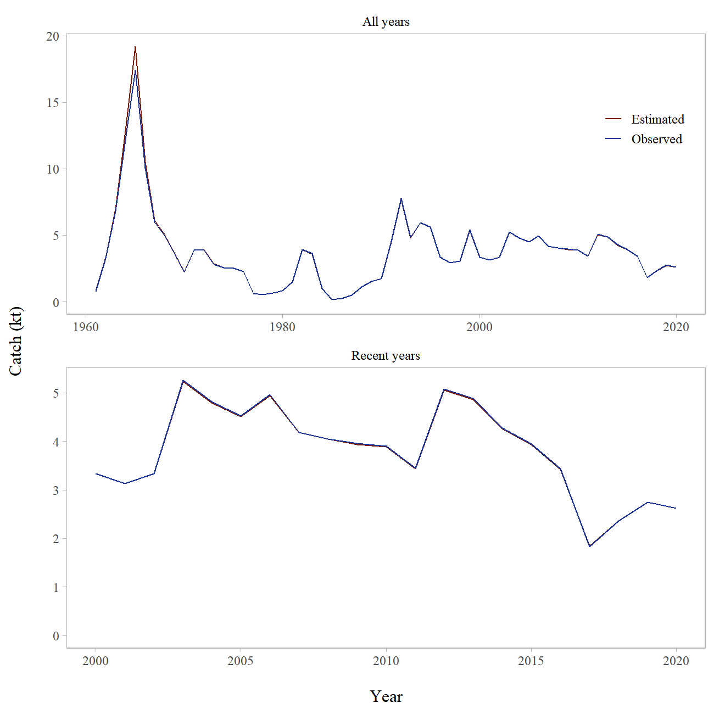
Northern rockfish – catch

Slide 10
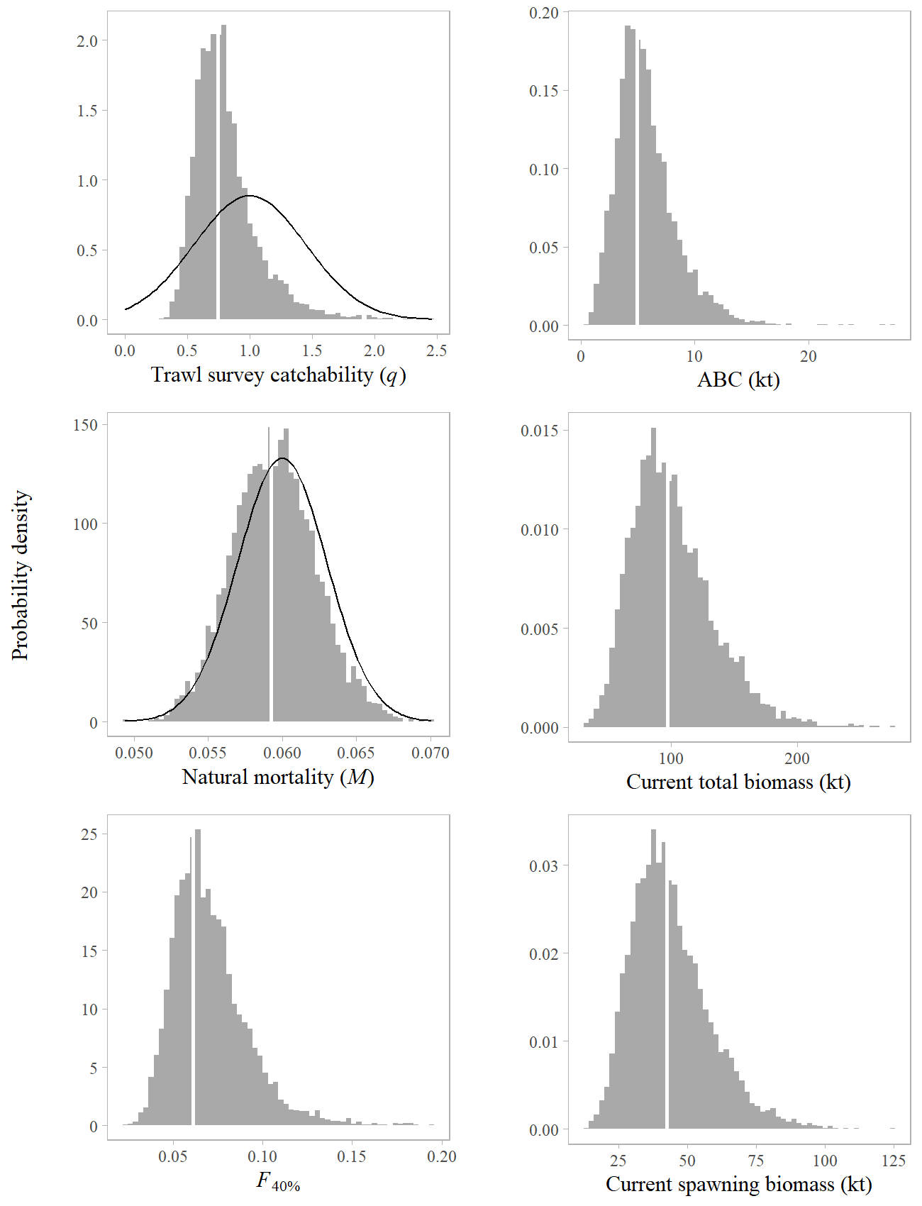
Northern rockfish – m18.2b results

Slide 11
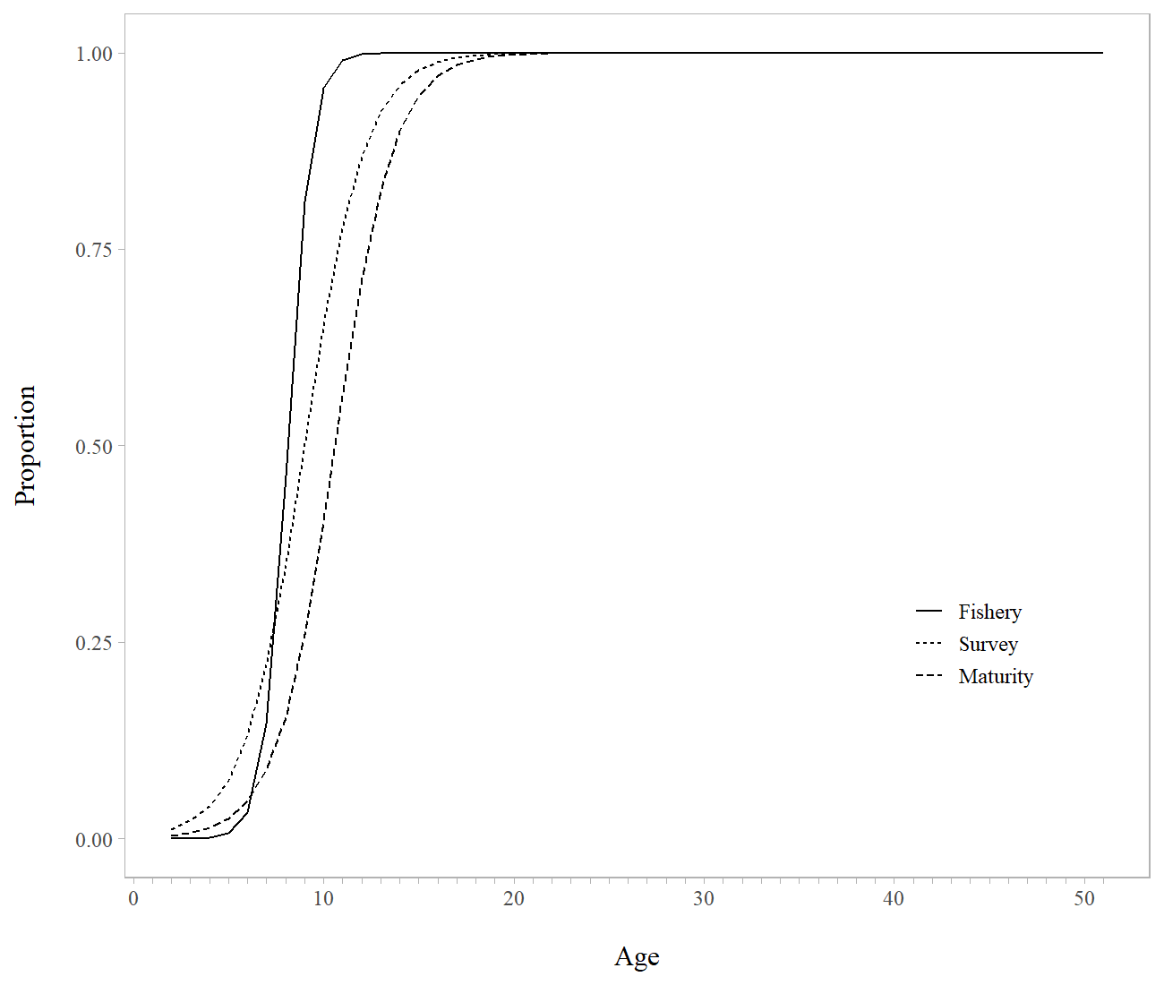
Northern rockfish – m18.2b results
Notes:
Selectivity is younger than maturity – generally not a good thing

Slide 12
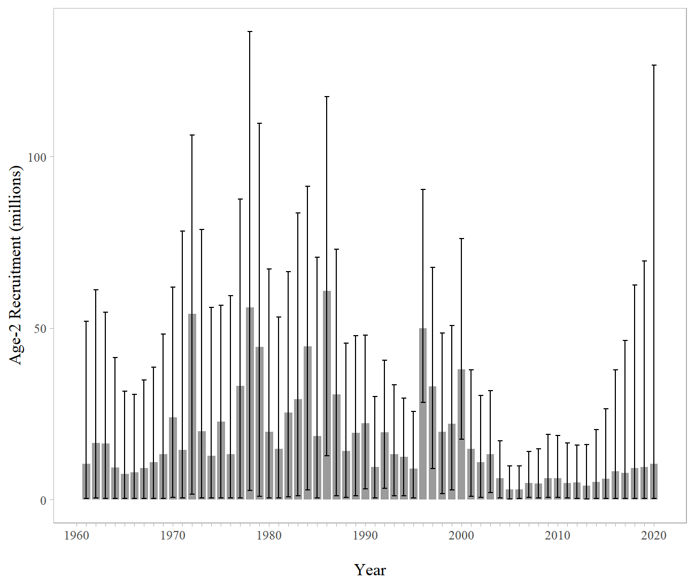
Northern rockfish – m18.2b results
Notes:
Huge variance about recruitment

Slide 13
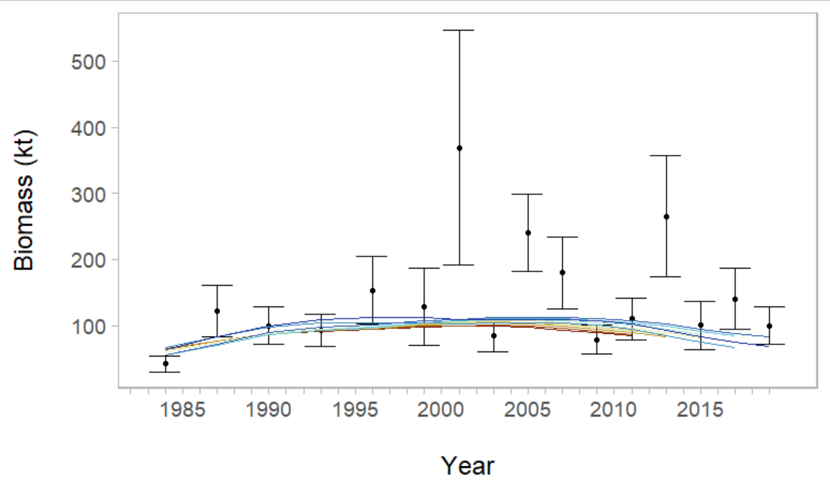
Northern rockfish – m18.2b results
Notes:
Survey biomass retrospective

Slide 14
Northern rockfish – m18.2b results
Qs for Plan Team:
- Continue VAST explorations
- Use GAP VAST output
- Design-based & weighting
- Time varying q
Notes:
Survey biomass retrospective

Slide 15
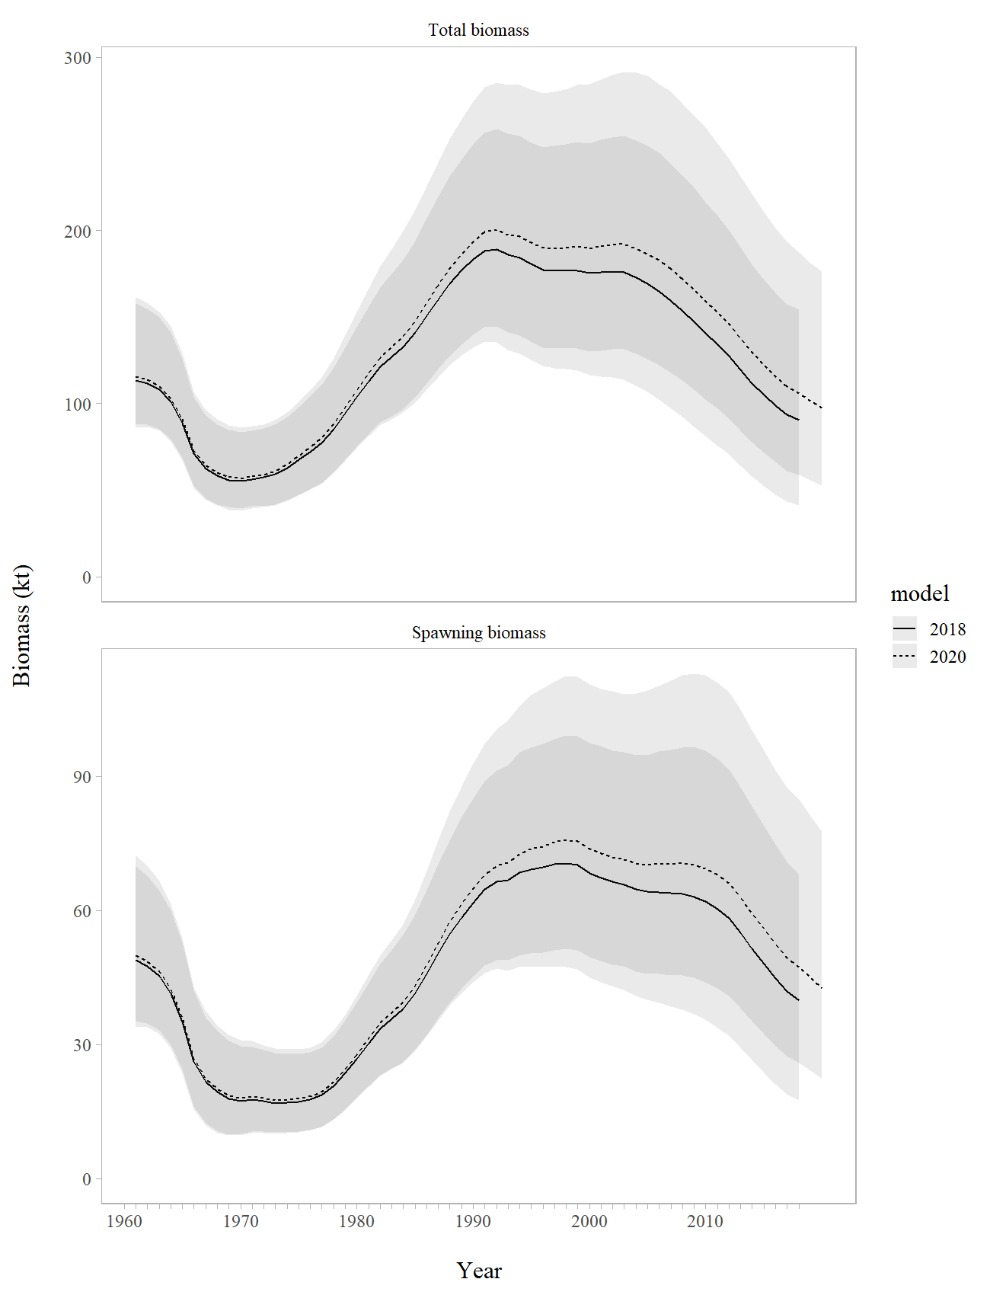
Northern rockfish – m18.2b results
Notes:
Survey biomass retrospective

Slide 16
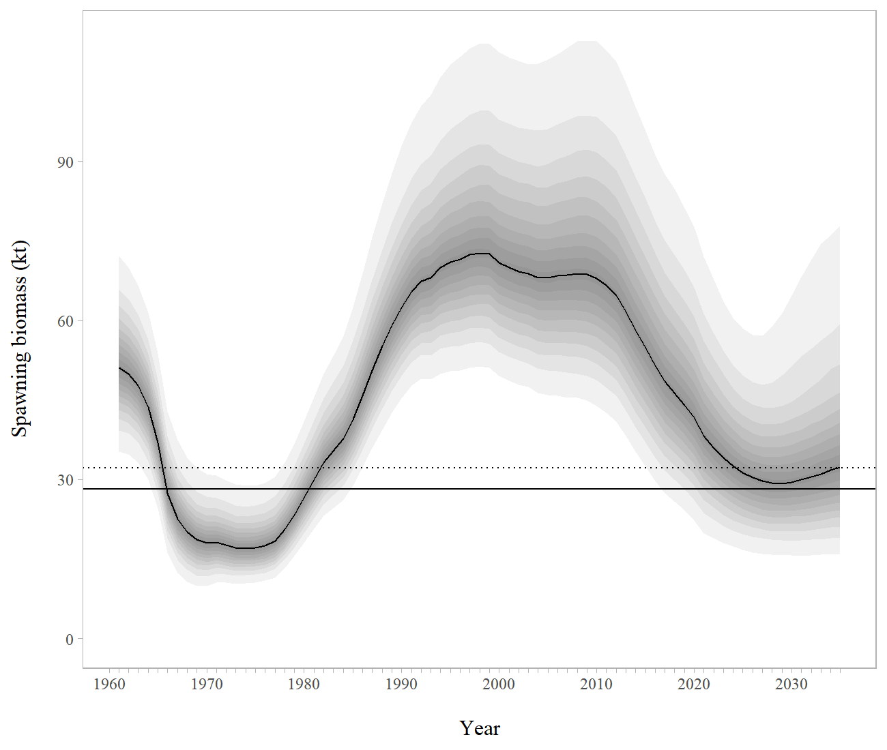
Northern rockfish – m18.2b results
Notes:
SSB following the same general pattern from the last full assessment

Slide 17
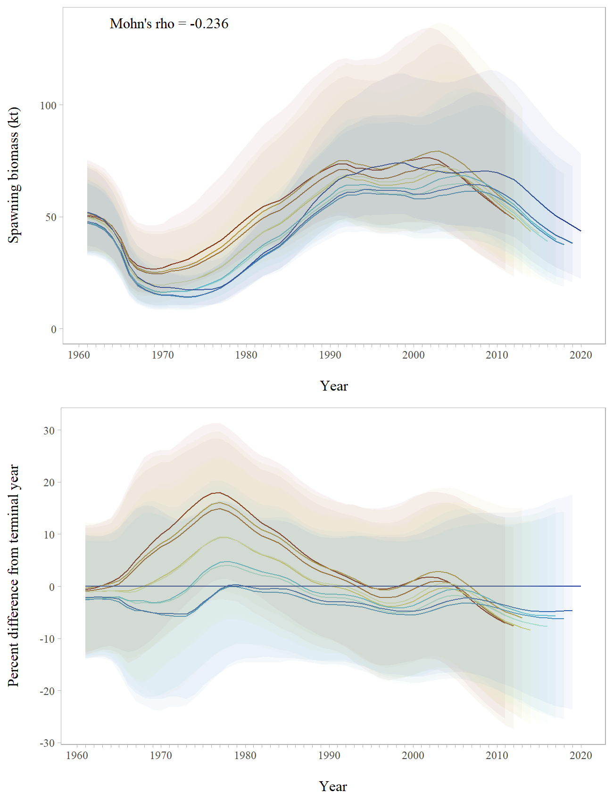
Northern rockfish – m18.2b results
Notes:
SSB retro is in the preferred direction

Slide 18
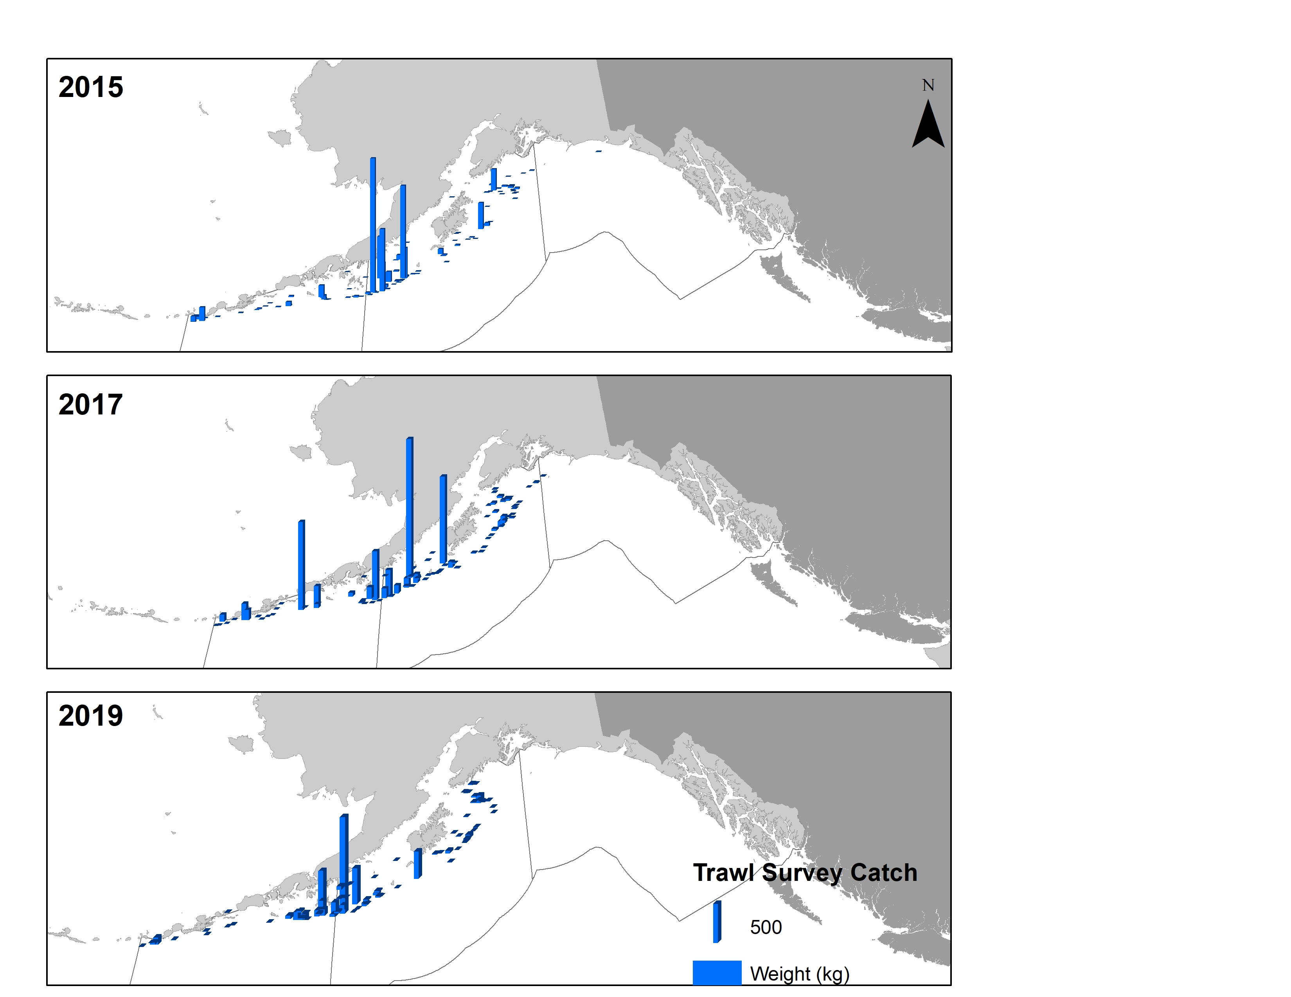
Northern rockfish – m18.2b results
Notes:
Trawl survey biomass has moved westward

Slide 19
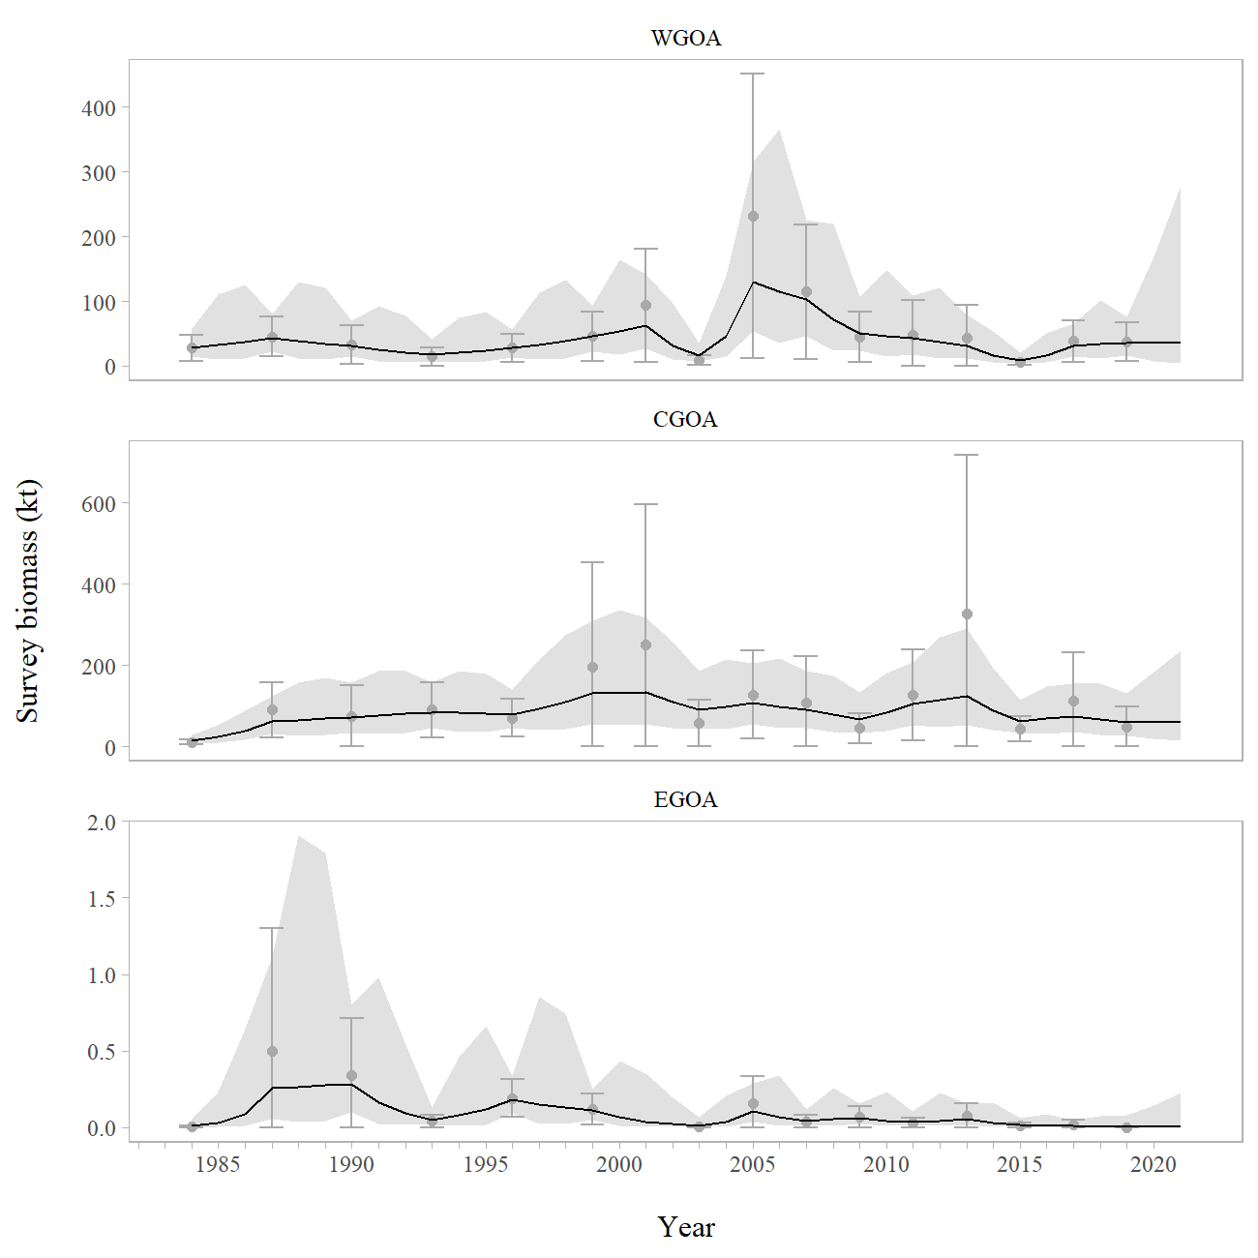
Northern rockfish – apportionment
Notes:
Movement reflected in the random effects model

Slide 20
Northern rockfish – apportionment
WGOA: 26% → 38% 2,023 t
CGOA: 74% → 62% 3,334 t
EGOA: <1% 1 t
Notes:
Movement reflected in the random effects model

Slide 21
Northern rockfish – risk table
Assessment: Level 1
Pop dynamics: Level 1
Enviro: Level 1
Fishery: Level 1
Reasoning: No increase in concern for the metrics.

Slide 22
Northern rockfish
 | As estimated or |  | As estimated or
 | specified last year for: |  | recommended this year for:
Quantity | 2020 | 2021 | 2021 | 2022¹
M (natural mortality) | 0.059 | 0.059 | 0.059 | 0.059
Tier | 3a | 3a | 3a | 3a
Projected total (age 2+) biomass (t) | 85,057 | 83,108 | 102,715 | 99,597
Projected female spawning biomass (t) | 34,410 | 32,435 | 42,791 | 40,462
B_{100%} | 76,199 | 76,199 | 84,832 | 84,832
B_{40%} | 30,480 | 30,480 | 33,933 | 33,933
B_{35%} | 26,670 | 26,670 | 29,691 | 29,691
F_{OFL} | 0.073 | 0.073 | 0.073 | 0.073
maxF_{ABC} | 0.061 | 0.061 | 0.061 | 0.061
F_{ABC} | 0.061 | 0.061 | 0.061 | 0.061
OFL (t) | 5,143 | 4,898 | 6,396 | 6,088
max ABC (t) | 4,312 | 4,107 | 5,358 | 5,100
ABC (t) | 4,312 | 4,107 | 5,358 | 5,100
 | As determined last year for: |  | As determined this year for:
Status | 2018 | 2019 | 2019 | 2020
Overfishing | No | n/a | No | n/a
Overfished | n/a | No | n/a | No
Approaching overfished | n/a | No | n/a | No
Notes:
Movement reflected in the random effects model

Slide 23
Questions?
ben.williams@noaa.gov

