Slide 1
GOA Northern Rockfish - Partial assessment
Ben Williams

Slide 2
Northern Rockfish
Tier 3a species
Only catches updated for projection model
Catch update
Final 2020 catch (2,385 t)
Estimated catches for 2021-2023
Recommended 2021 ABC: 5,147 t
Lower than 2020 ABC: 5,358 t

Slide 3
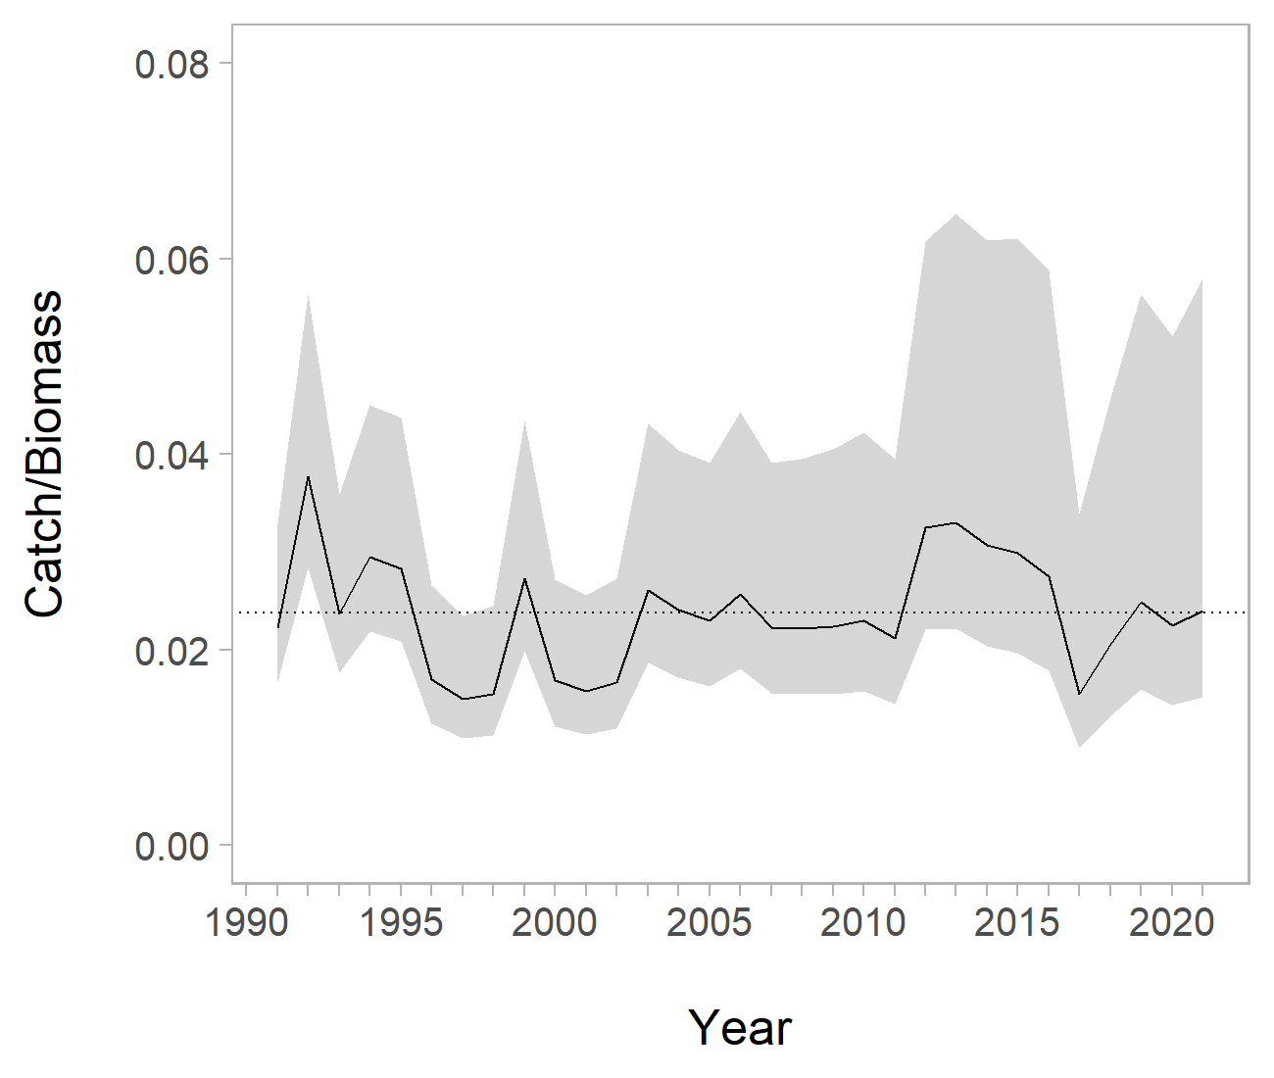
Northern Rockfish - Exploitation rate

Slide 4
Northern Rockfish - Apportionment
Year | Measure | Western | Central | Eastern | Total
2022 | ABC | 1,944 | 3,202 | 1 | 5,141
2022 | OFL |  |  |  | 6,143
2023 | ABC | 1,859 | 3,061 | 1 | 4,921
2023 | OFL |  |  |  | 5,874

Slide 5
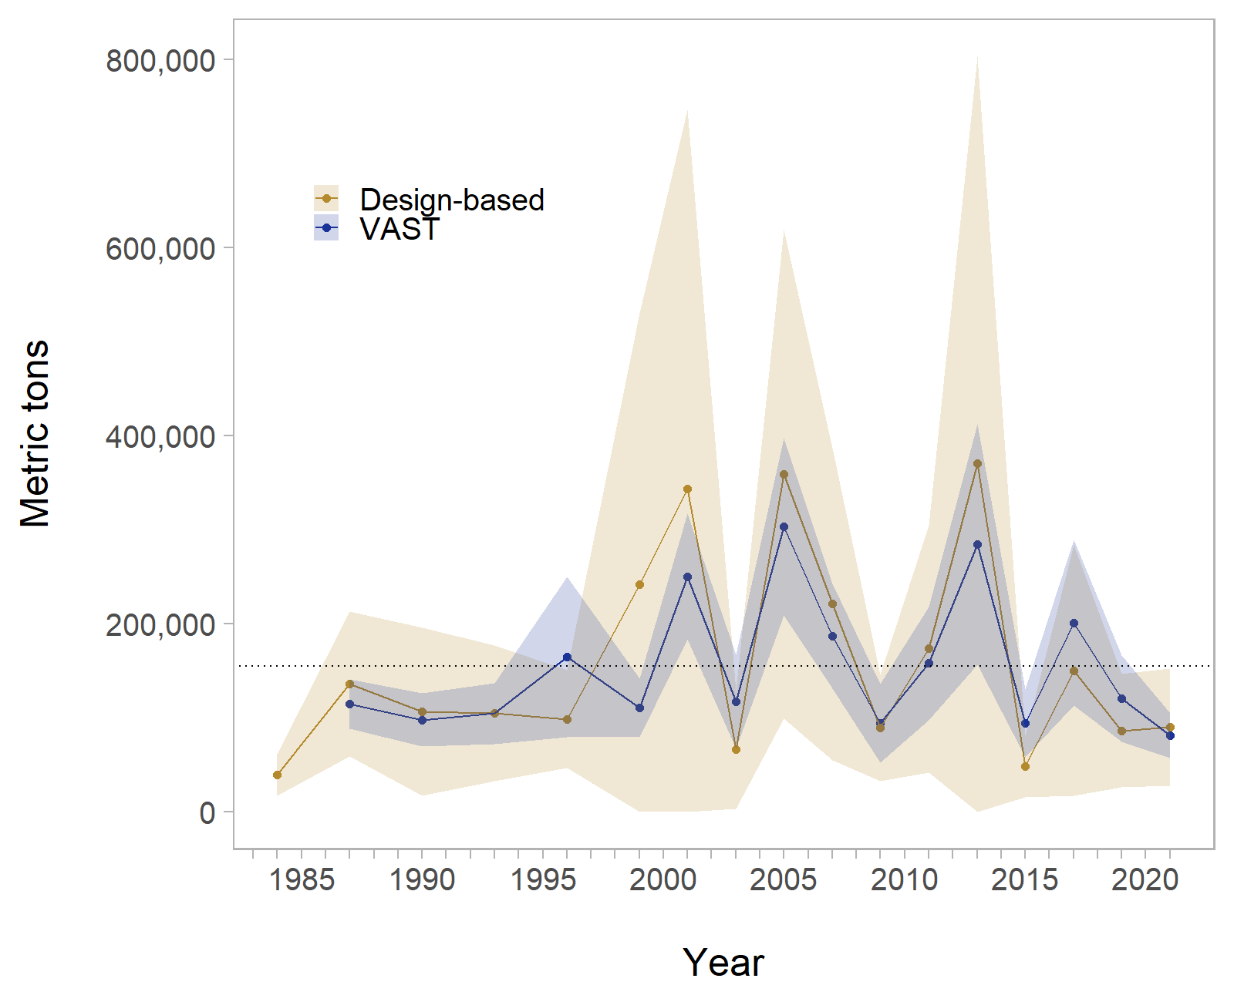
2021 Survey

