Slide 1

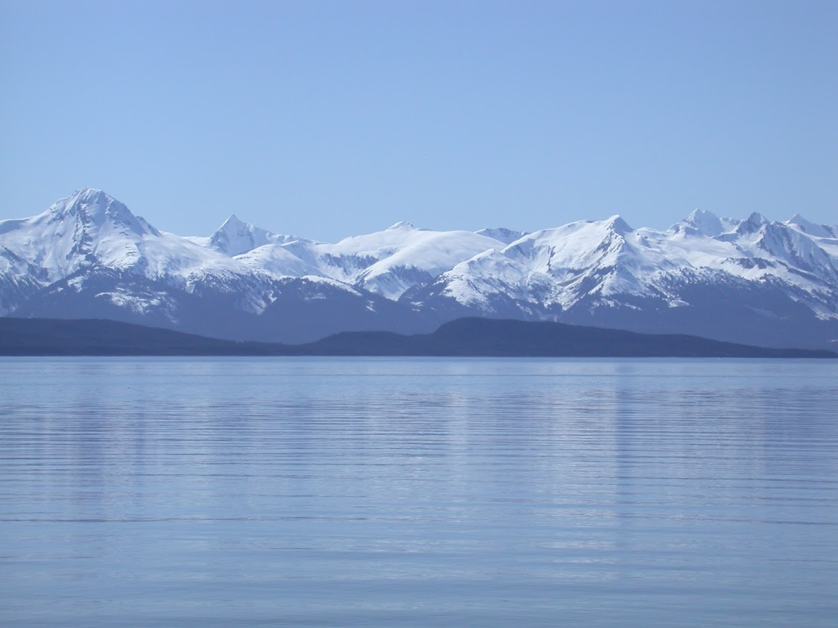


Northern Rockfish
GOA Groundfish Plan Team
Ben Williams, Pete Hulson, Chris Lunsford, and Bridget Ferriss
November, 2022

Slide 2
Teams or SSC Comments
“The Team recommends all GOA authors evaluate any bottom trawl survey information used in their assessment prior to 1990 including the 1984 and 1987 surveys and conduct sensitivity analyses to evaluate their usefulness to the assessment” (PT, November 2021)
The 1980s survey data has been removed – iterative model evaluations were completed.
The Team recommends evaluating how the definition of the length composition plus group, and alternative data-weighting methods, affect model performance.” (Plan Team, November 2015
The length plus group has been increased and alternative data-weighing methods are explored
The SSC also agrees with the high priority placed on improving maturity-at-age information for northern rockfish.” (SSC, December 2018)
A preliminary examination of skip spawning is presented
Notes:
PT/SSC comments being addressed IN THIS PRESENTATION ONLY

Slide 3
Data Summary
Source | Data | Years
NMFS Groundfish survey | Survey biomass | 1990-1999 (triennial), 2001-2019 (biennial), 2021
 | Age composition | 1990-1999 (triennial), 2003-2019 (biennial), 2021
U.S. trawl fishery | Catch | 1961-2020, 2021-2022
 | Age composition | 1998-2002, 2004-2006, 2008-2018 (biennial), 2020
 | Length composition | 1991-1997, 2003, 2007-2019 (biennial), 2021
Notes:
PT/SSC comments being addressed IN THIS PRESENTATION ONLY

Slide 4
Model variants
Model | Description
base | 2020 model (m18.2b) and results (includes 1980s survey data)
m18.2b | base model w/data updated through 2022, using GAP default VAST
m22 | m18.2b using GAP default VAST (survey data 1990+)
m22.1 | m22 w/increased length plus group
m22.1a | m22.1 w/Francis re-weighting
m22.1b | m22.1a w/survey biomass weight set to 1
Notes:
PT/SSC comments being addressed IN THIS PRESENTATION ONLY

Slide 5
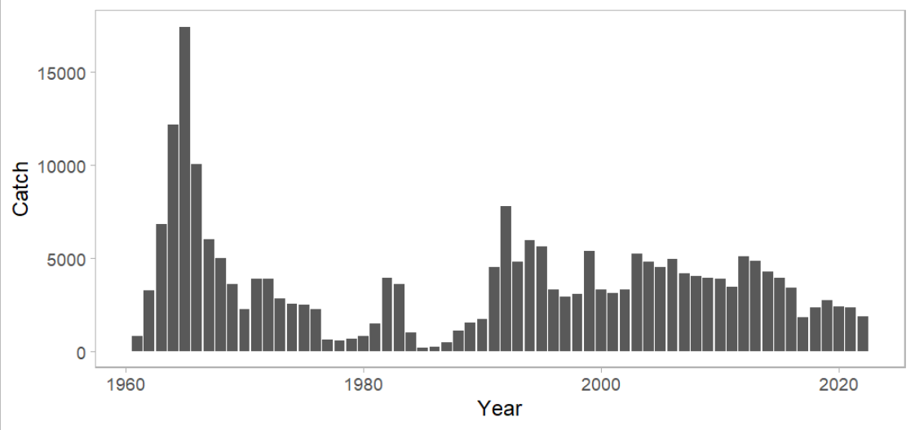
Catch
Notes:
PT/SSC comments being addressed IN THIS PRESENTATION ONLY

Slide 6
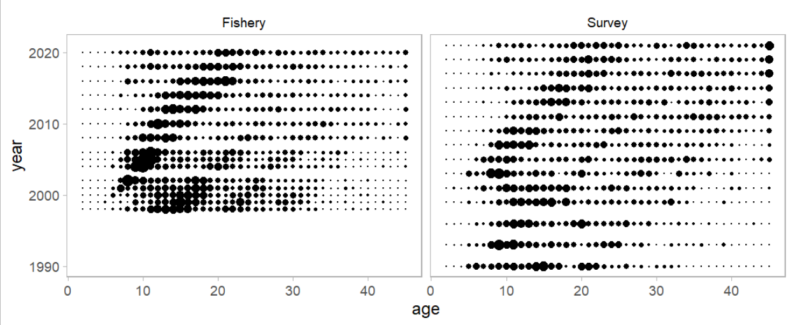
Inputs - age composition
Notes:
PT/SSC comments being addressed IN THIS PRESENTATION ONLY

Slide 7
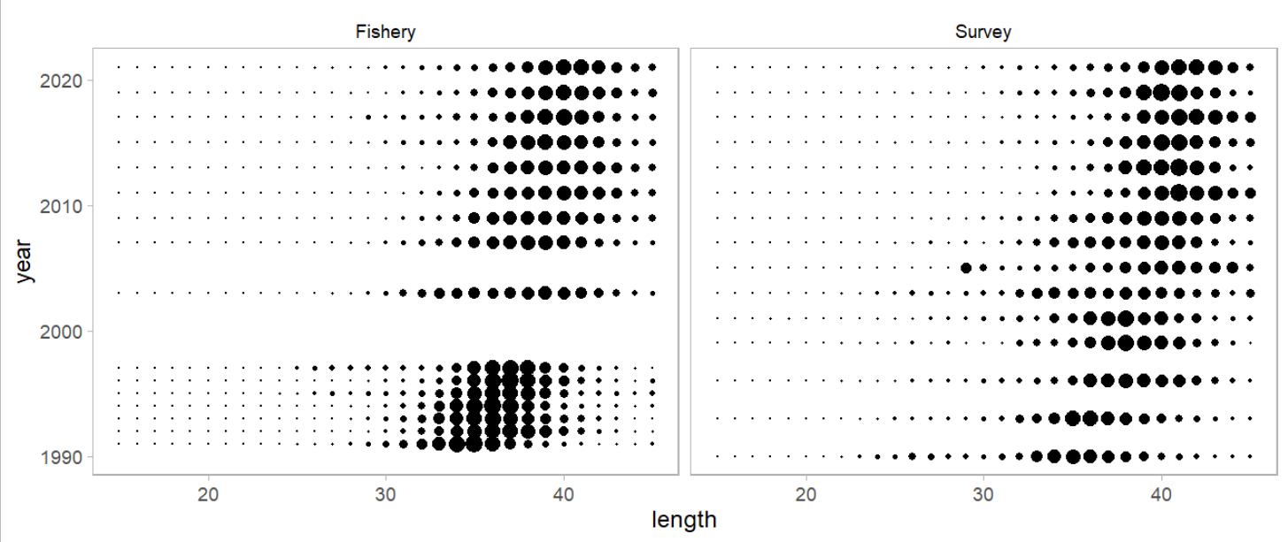
Inputs – size composition
Notes:
PT/SSC comments being addressed IN THIS PRESENTATION ONLY

Slide 8
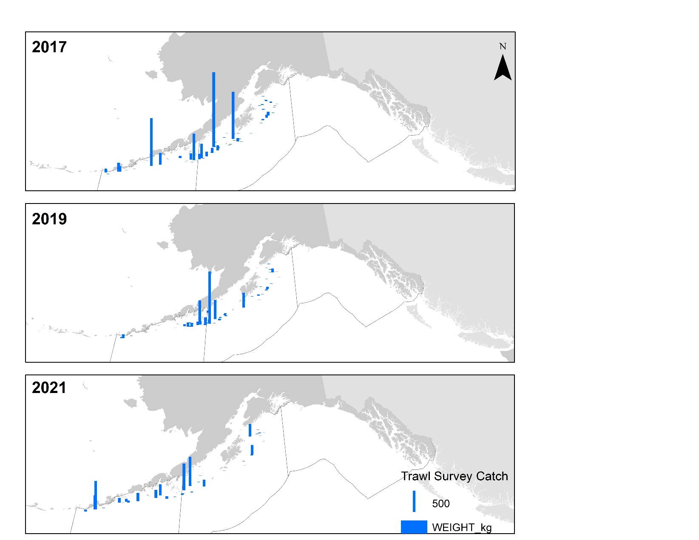
Survey - biomass
Notes:
PT/SSC comments being addressed IN THIS PRESENTATION ONLY

Slide 9
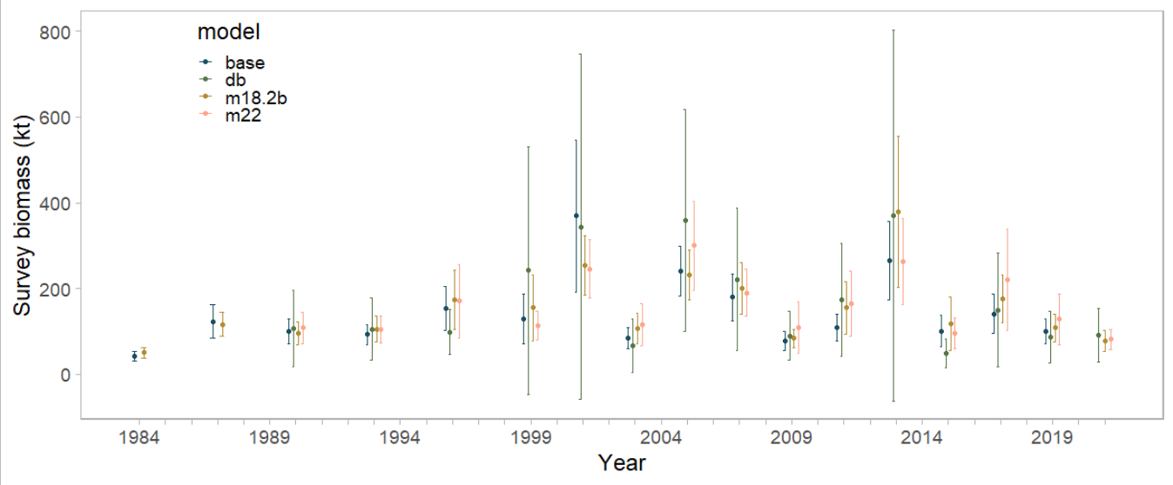
Survey - biomass
Notes:
PT/SSC comments being addressed IN THIS PRESENTATION ONLY

Slide 10
Model summary
Model | Description
base | 2020 model (m18.2b) and results (includes 1980s survey data)
m18.2b | base model w/data updated through 2022
m22 | m18.2b using GAP default VAST (survey data 1990+)
m22.1 | m22 w/increased length plus group
m22.1a | m22.1 re-weighted
m22.1b | m22.1 re-weighted, with survey weight = 1
Notes:
PT/SSC comments being addressed IN THIS PRESENTATION ONLY

Slide 11
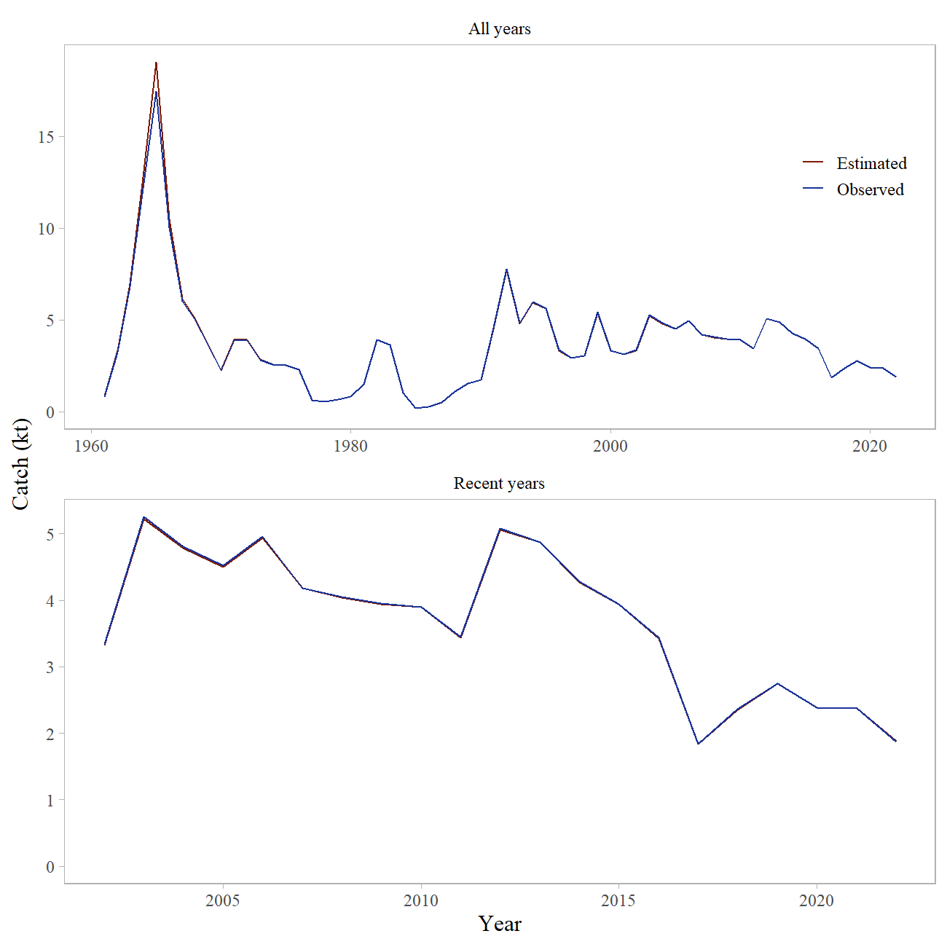
Model Fit - Catch
Notes:
PT/SSC comments being addressed IN THIS PRESENTATION ONLY

Slide 12
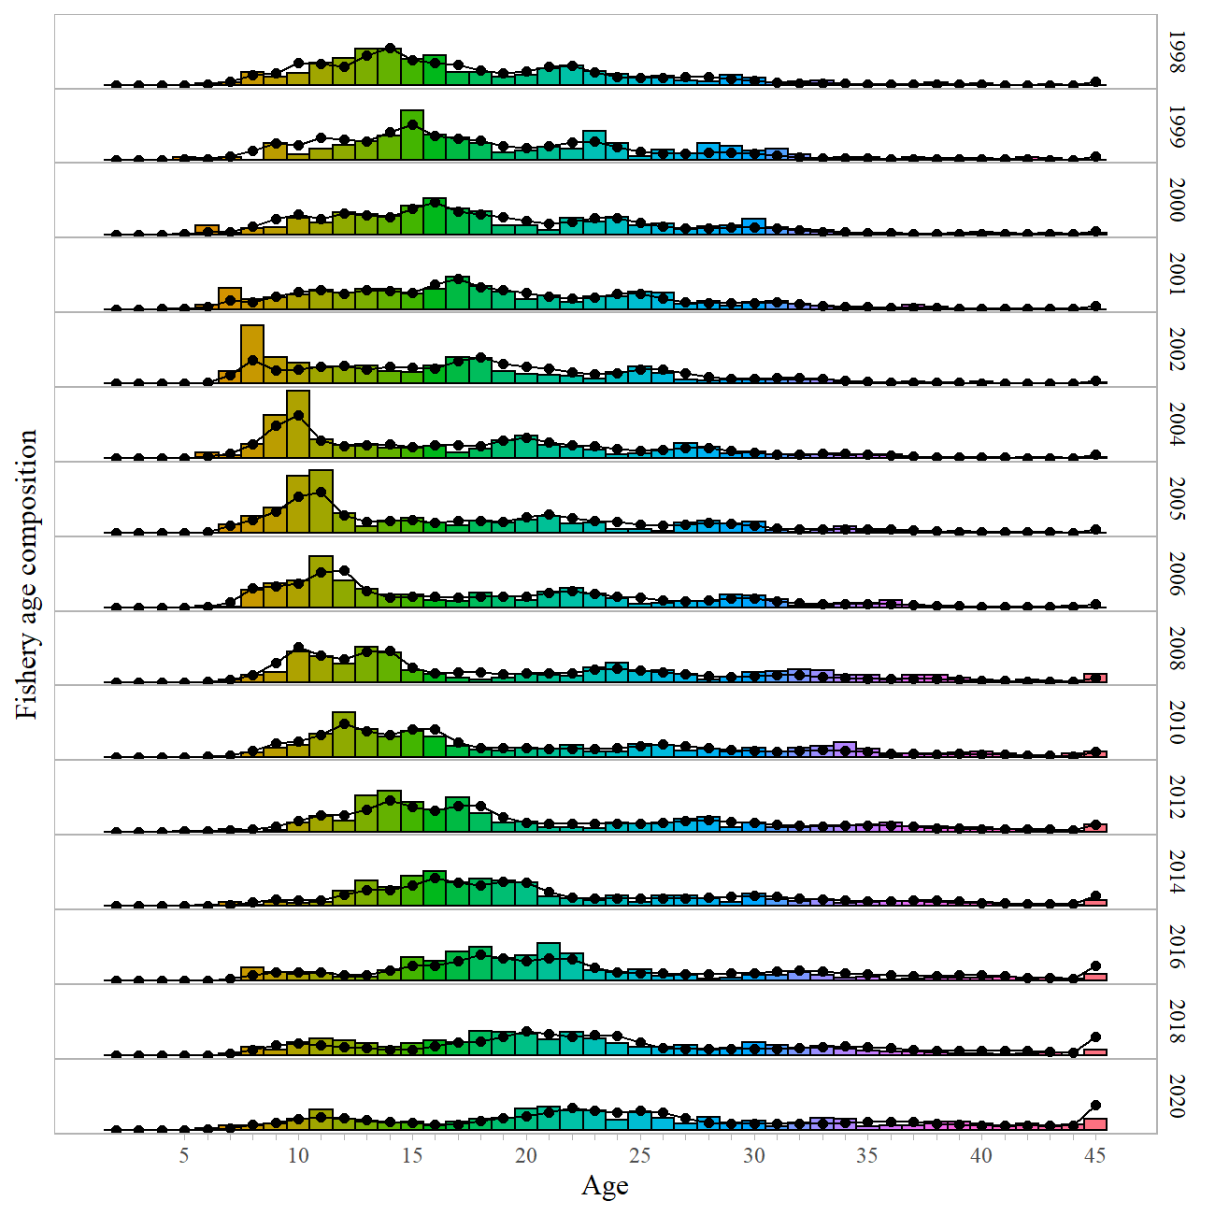
Model Fit – Fishery age comp
Notes:
PT/SSC comments being addressed IN THIS PRESENTATION ONLY

Slide 13
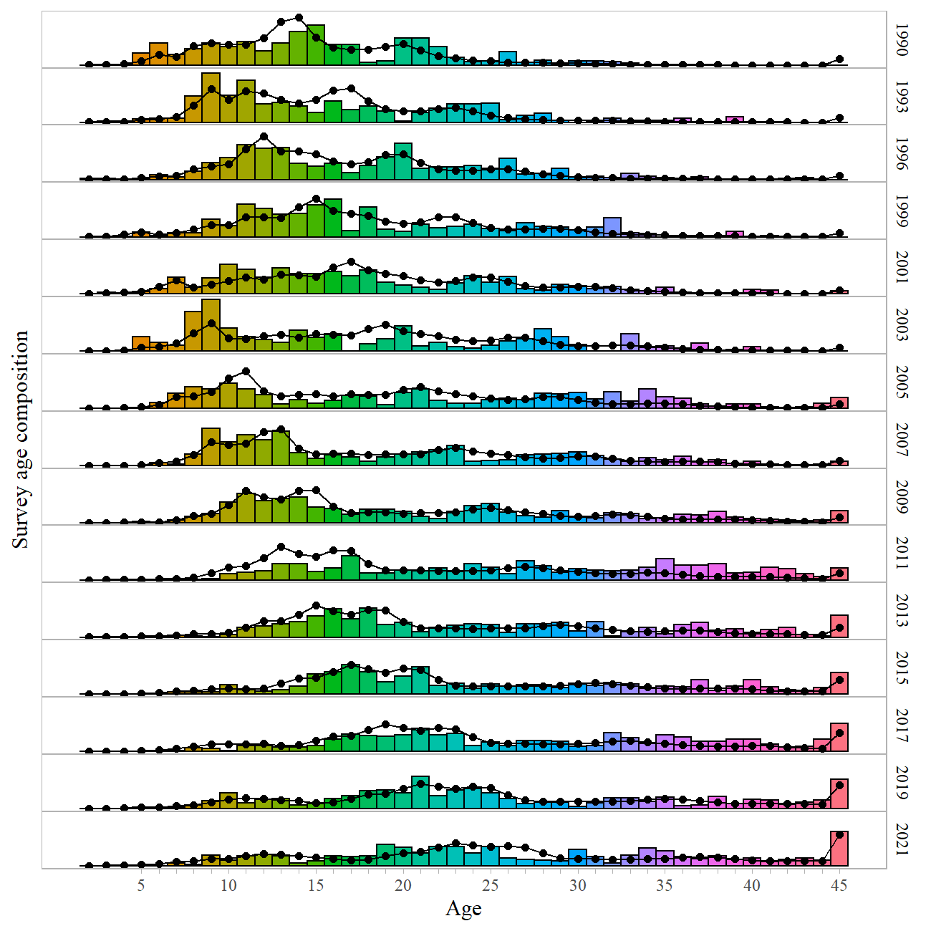
Model Fit – Survey age comp
Notes:
PT/SSC comments being addressed IN THIS PRESENTATION ONLY

Slide 14
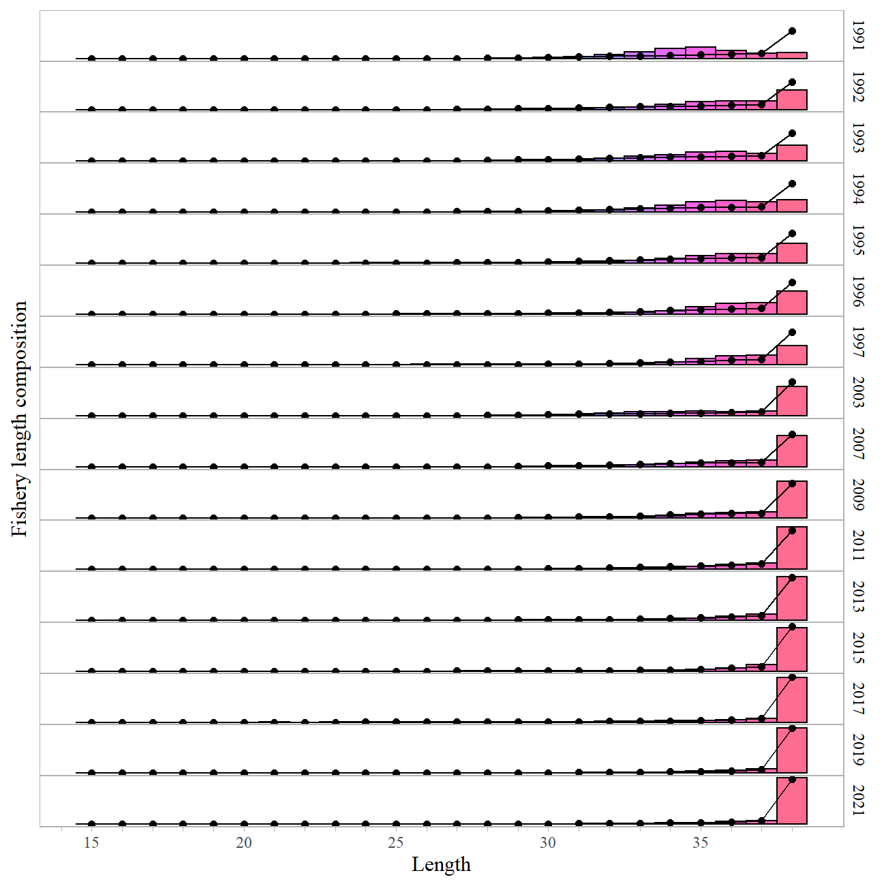
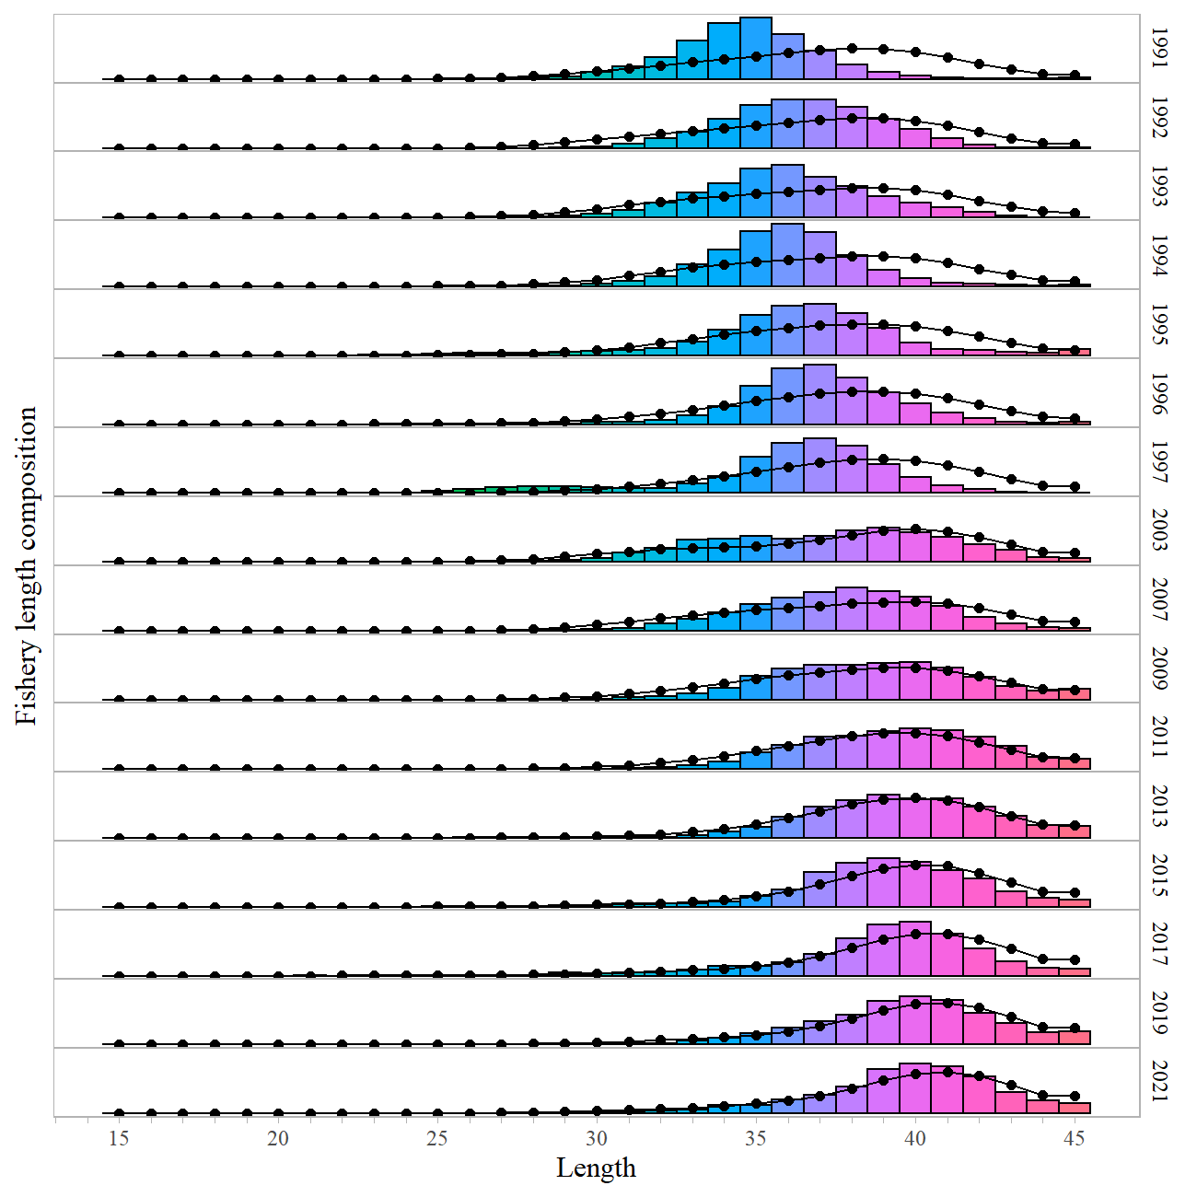
Model Fit – Fishery length comp
Notes:
PT/SSC comments being addressed IN THIS PRESENTATION ONLY

Slide 15
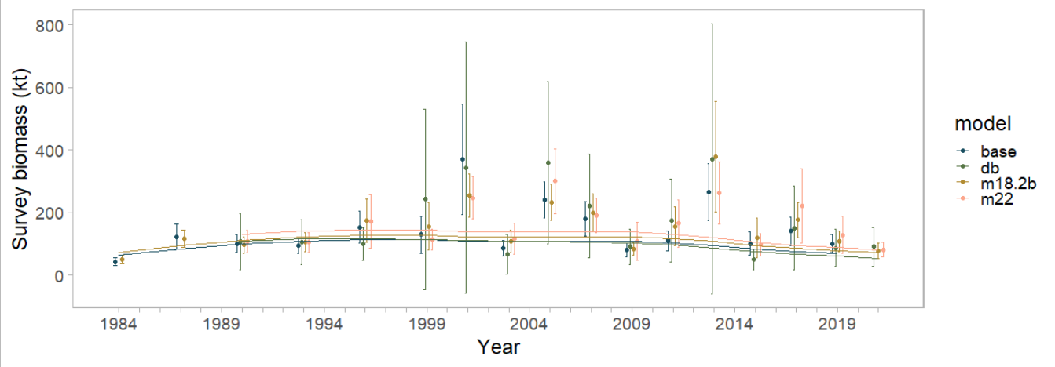
Survey - biomass
Notes:
PT/SSC comments being addressed IN THIS PRESENTATION ONLY

Slide 16
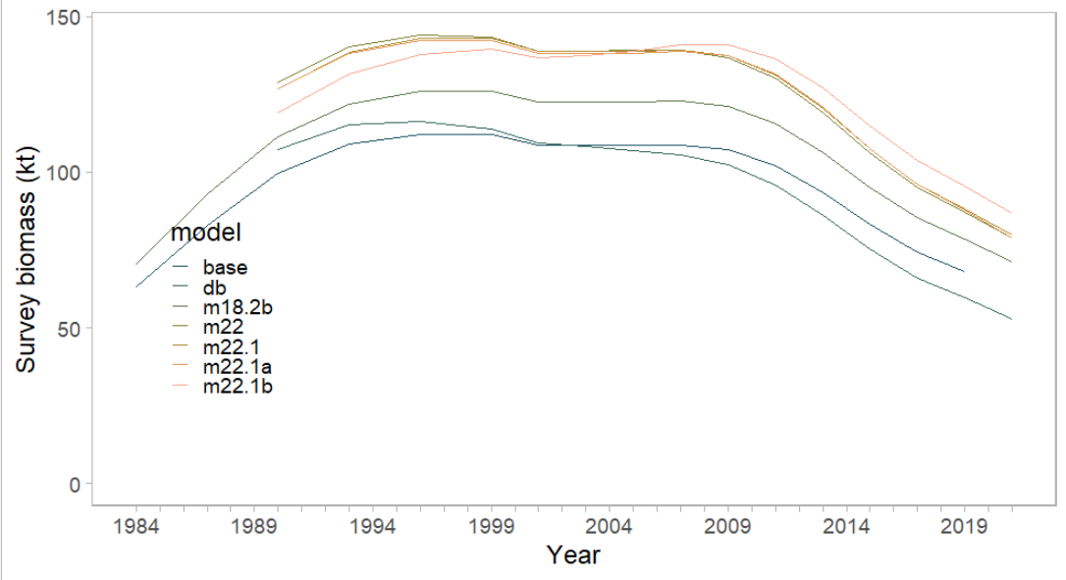
Survey - biomass
Notes:
PT/SSC comments being addressed IN THIS PRESENTATION ONLY

Slide 17
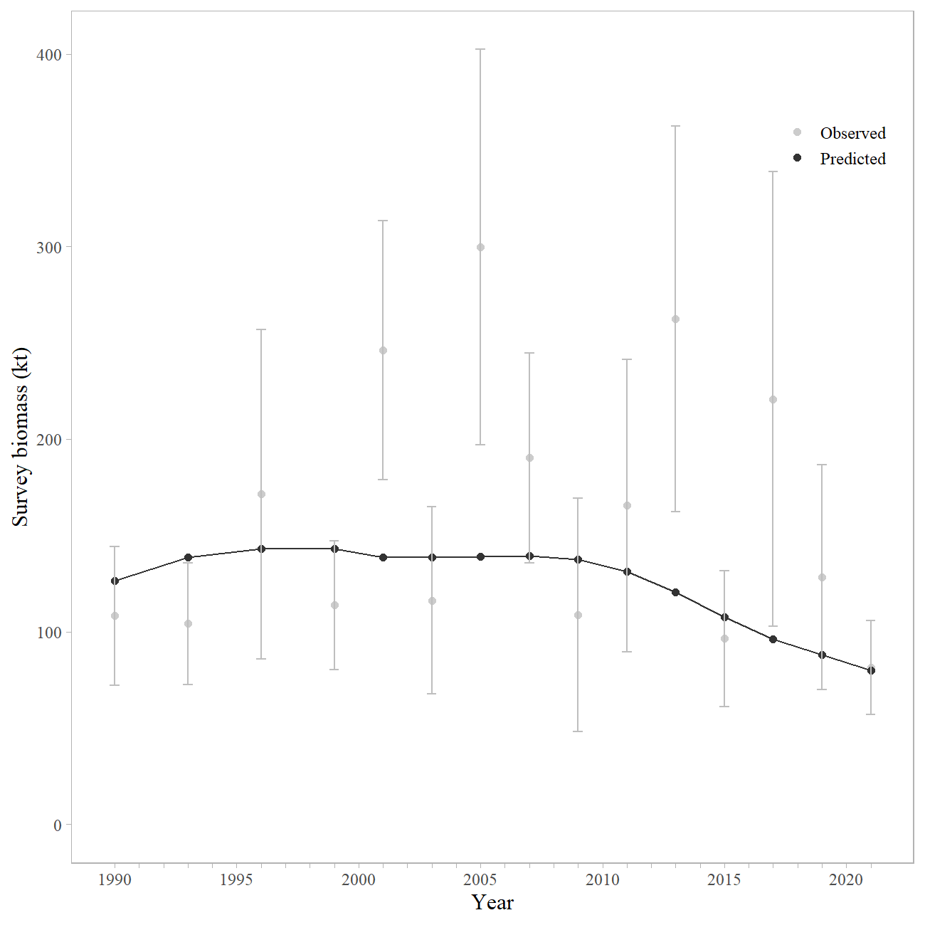
Survey - biomass
Notes:
PT/SSC comments being addressed IN THIS PRESENTATION ONLY

Slide 18
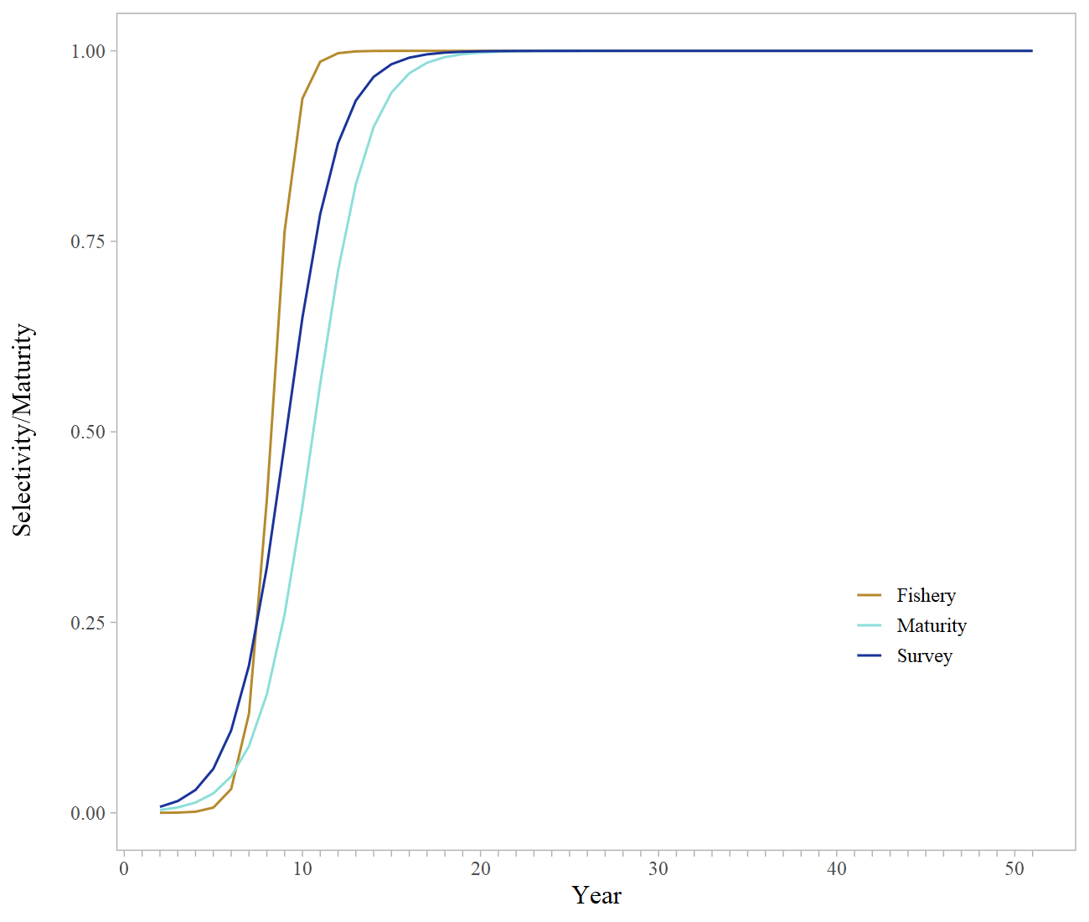
Model Fit - Selectivity
Notes:
PT/SSC comments being addressed IN THIS PRESENTATION ONLY

Slide 19
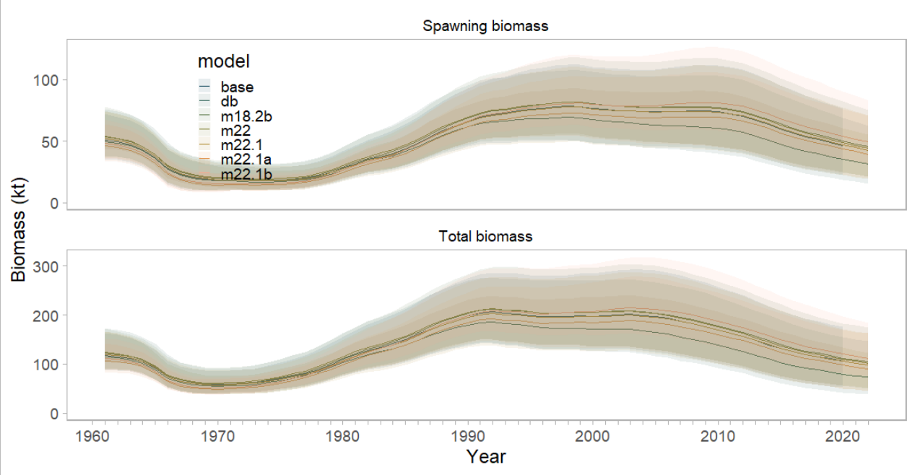
Biomass
Notes:
PT/SSC comments being addressed IN THIS PRESENTATION ONLY

Slide 20
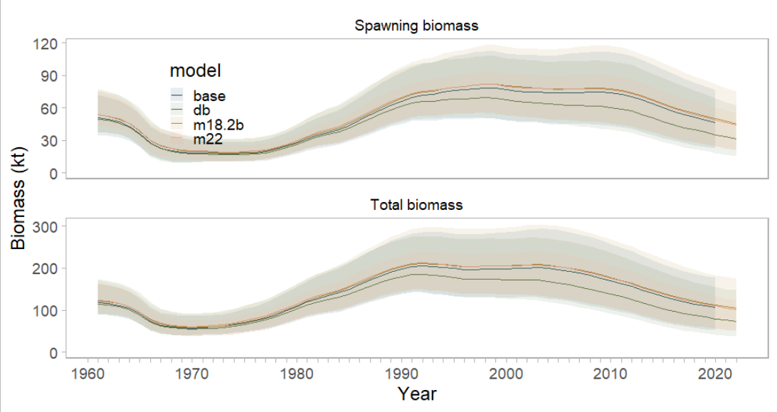
Biomass
Notes:
PT/SSC comments being addressed IN THIS PRESENTATION ONLY

Slide 21
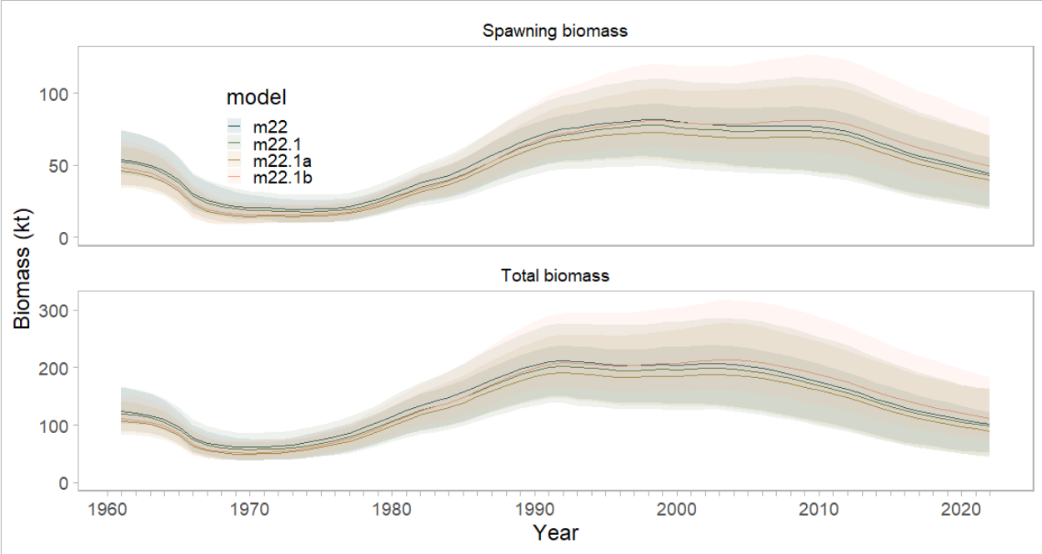
Biomass
Notes:
PT/SSC comments being addressed IN THIS PRESENTATION ONLY

Slide 22
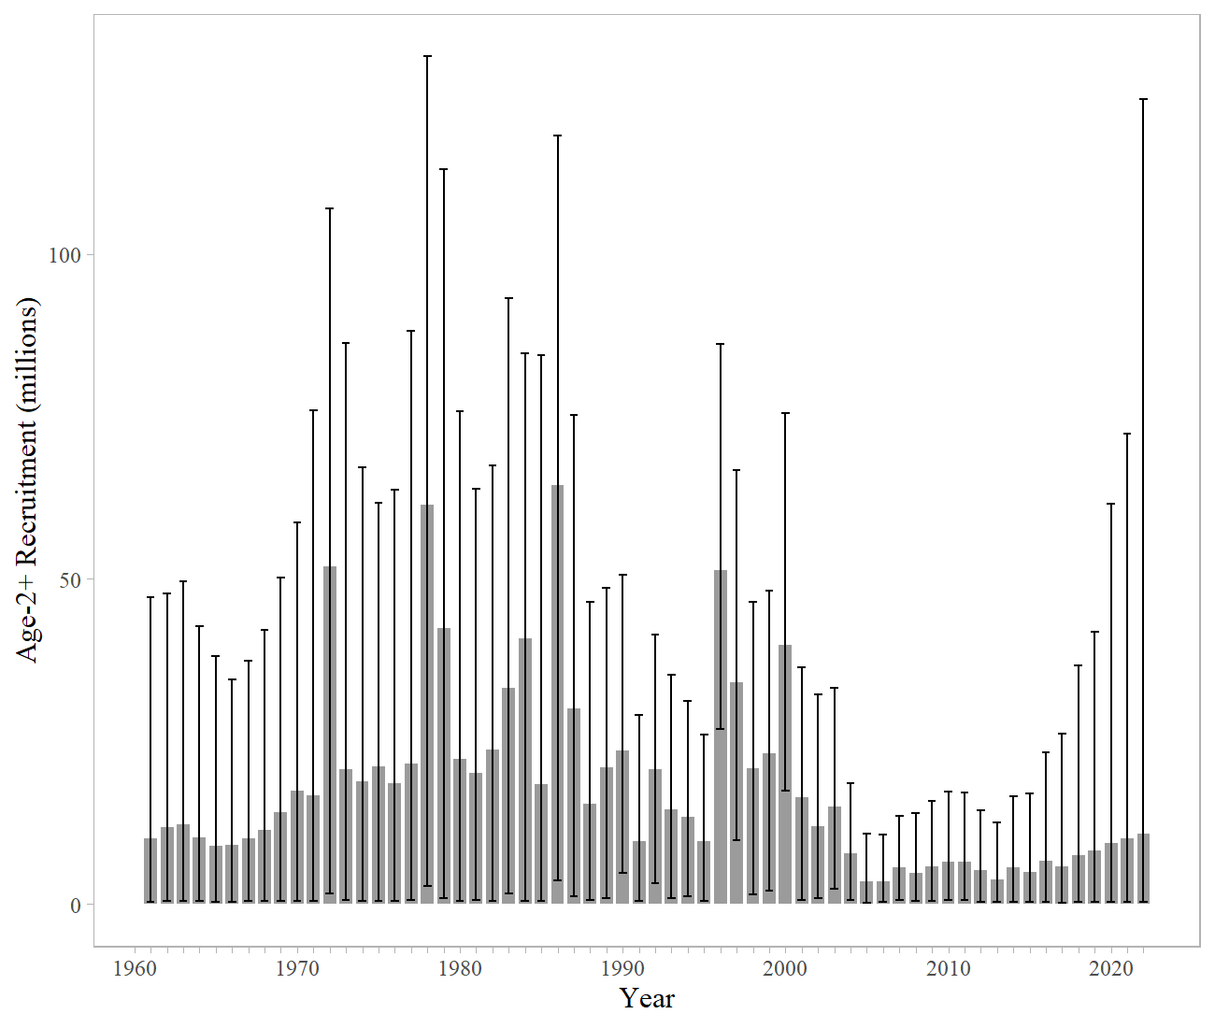
Recruitment
Notes:
PT/SSC comments being addressed IN THIS PRESENTATION ONLY

Slide 23
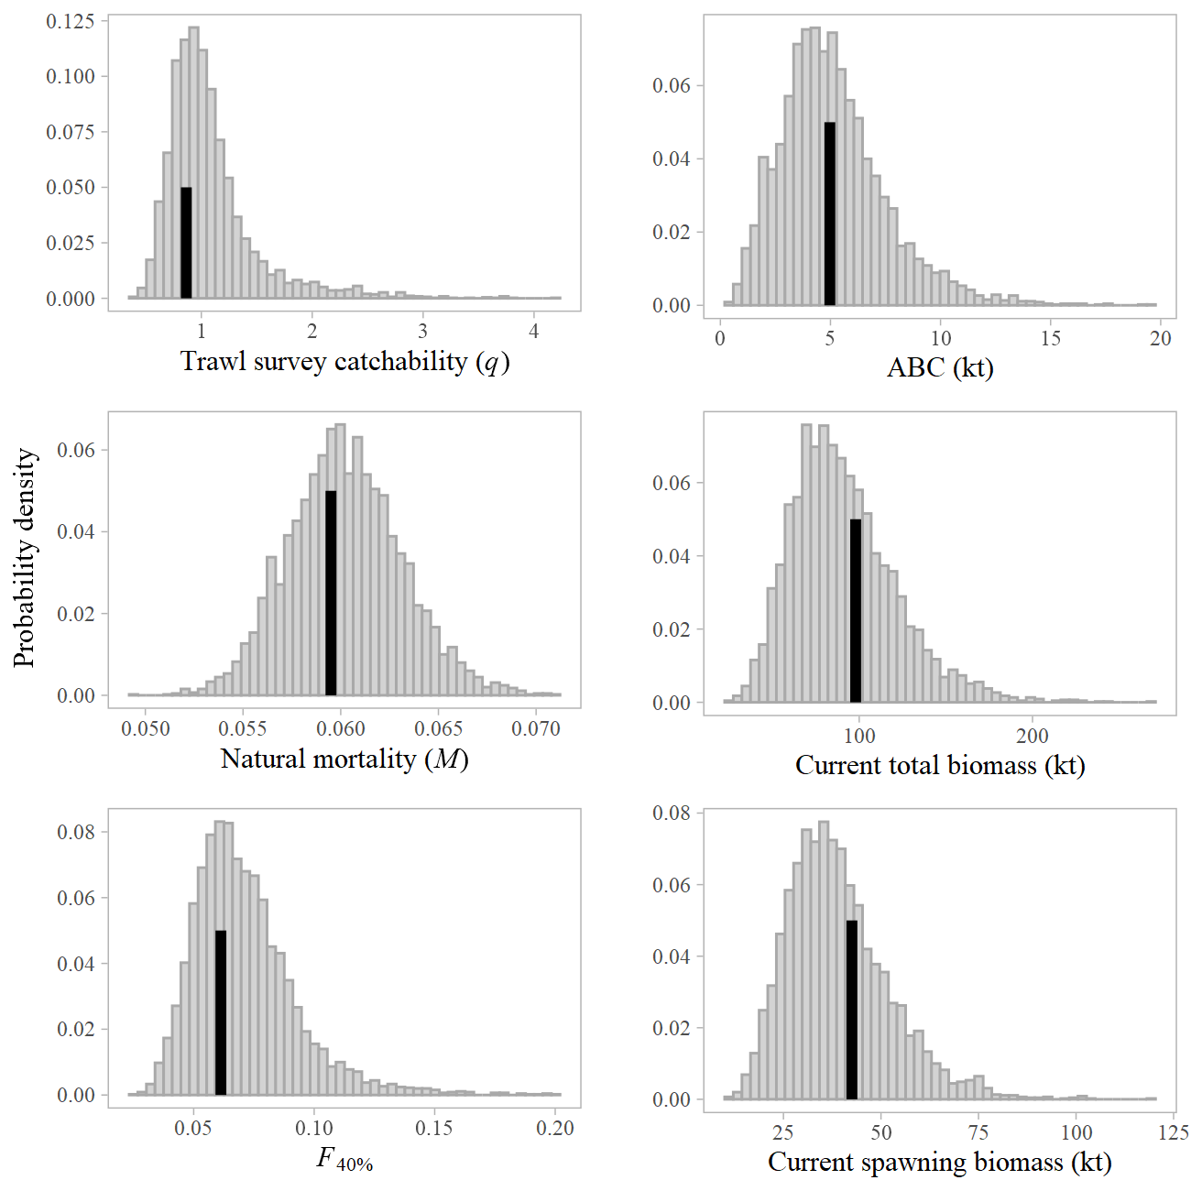
Parameters
Notes:
PT/SSC comments being addressed IN THIS PRESENTATION ONLY

Slide 24
Likelihoods | base | m18.2b | m22 | m22.1 | m22.1a | m22.1b | db
Catch | 0.126 | 0.098 | 0.083 | 0.091 | 0.173 | 0.246 | 0.0549
Survey biomass | 11.504 | 11.041 | 6.148 | 6.022 | 6.023 | 22.268 | 2.399
Fishery ages | 37.429 | 40.917 | 41.078 | 40.177 | 100.979 | 99.894 | 41.198
Survey ages | 68.741 | 67.118 | 66.057 | 69.160 | 119.246 | 119.669 | 65.404
Fishery lengths | 46.267 | 49.996 | 50.704 | 67.907 | 131.253 | 131.536 | 50.906
Maturity | 23.501 | 23.501 | 23.501 | 23.501 | 23.501 | 23.501 | 23.501
Data | 164.067 | 169.171 | 164.070 | 183.356 | 357.674 | 373.612 | 159.962
Penalties/Priors
Recruitment devs | 8.931 | 8.780 | 8.757 | 8.640 | 9.847 | 10.024 | 8.936
F regularity | 5.601 | 5.499 | 5.471 | 5.457 | 5.942 | 6.074 | 5.435
M prior | 0.067 | 0.062 | 0.020 | 0.014 | 0.012 | 0.048 | 0.011
q prior | 0.374 | 0.255 | 0.099 | 0.052 | 0.015 | 0.096 | 0.171
Objective function | 249.270 | 253.990 | 248.650 | 267.750 | 443.720 | 460.080 | 244.743
Parameter estimates
# parameters | 181 | 185 | 185 | 185 | 185 | 185 | 185
M | 0.059 | 0.059 | 0.059 | 0.059 | 0.060 | 0.059 | 0.059
q | 0.678 | 0.725 | 0.819 | 0.865 | 0.926 | 0.821 | 0.768
rec | 3.487 | 3.515 | 3.530 | 3.504 | 3.409 | 3.465 | 3.42
F40 | 0.061 | 0.061 | 0.061 | 0.061 | 0.061 | 0.061 | 0.06
Projected total biomass | 102,661 | 101,479 | 99,365 | 95,559 | 86,908 | 108,108 | 71,504
Projected spawning biomass | 42,774 | 42,135 | 41,102 | 39,463 | 36,402 | 45,876 | 28,871
B100 | 84,832 | 85,282 | 83,815 | 82,350 | 78,318 | 89,078 | 69,952
B40 | 33,933 | 34,113 | 33,526 | 32,940 | 31,327 | 35,631 | 27,981
ABC | 5,357 | 5,251 | 5,147 | 4,972 | 4,573 | 5,726 | 3,632
Notes:
PT/SSC comments being addressed IN THIS PRESENTATION ONLY

Slide 25
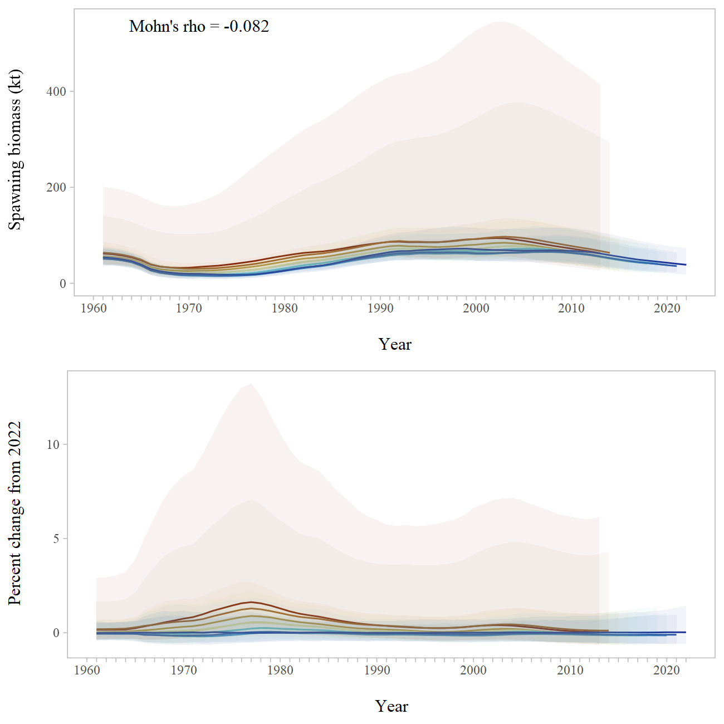
Retrospective
Notes:
PT/SSC comments being addressed IN THIS PRESENTATION ONLY

Slide 26
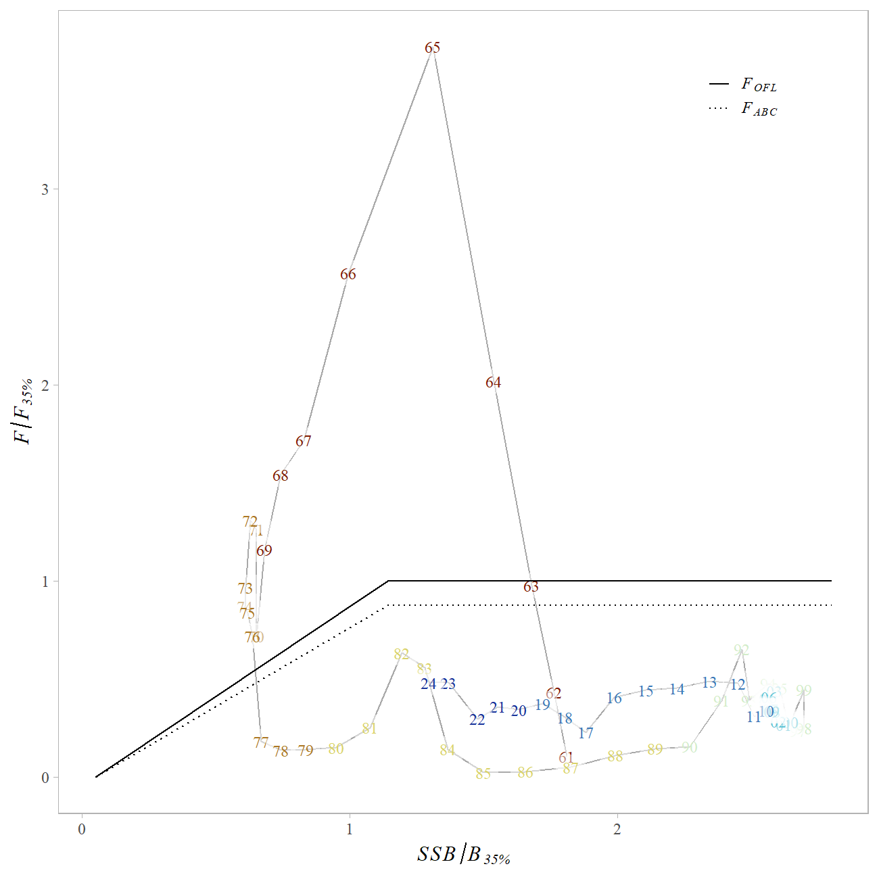
Phase Plane
Notes:
Plot of fishing mortality rate relative to F35% and female spawning biomass relative for B 35% for status

Slide 27
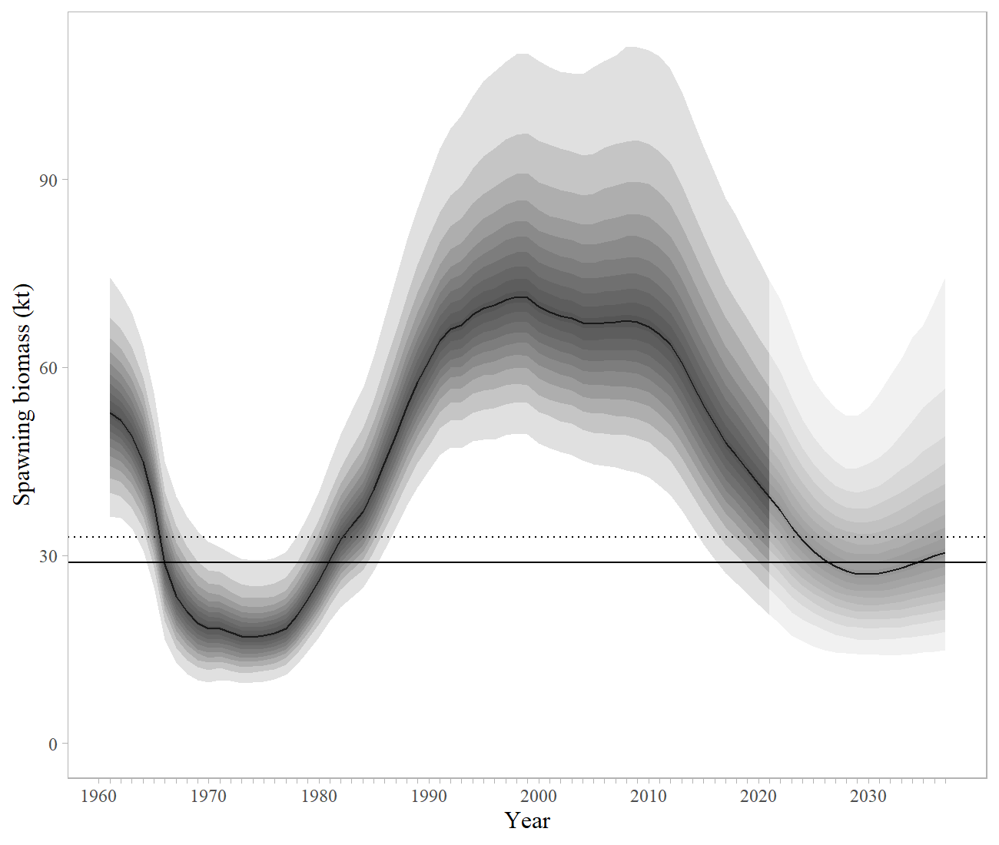
Projection
Notes:
PT/SSC comments being addressed IN THIS PRESENTATION ONLY

Slide 28
Risk Table
Assessment-related considerations | Population dynamics considerations | Environmental/ ecosystem considerations | Fishery Performance
Level 1: No increased concerns | Level 2: Substantially increased concerns | Level 1: No increased concerns | Level 1: No increased concerns
Assessment – Changing from a design-based model to a VAST-based estimate has made the survey biomass estimates more realistic (less overall fluctuation) though the model continues to fit these data poorly.
Population dynamics – consistent low recruitment, skip spawning has been observed for this stock, levels unknown
Environmental - environmental mechanisms for changes in survival and productivity of dusky rockfish remain unknown, though indication that structural epifauna habitat may be decreasing
Fishery performance - catches are well below ABC

Slide 29
Harvest Recommendation
 | As estimated or specified last year for: |  | As estimated or recommended this year for:
Quantity/Status | 2022 | 2023 | 2023* | 2024*
M (natural mortality) | 0.059 | 0.059 | 0.059 | 0.059
Tier | 3a | 3a | 3a | 3a
Projected total (age 2+) biomass (t) | 100,371 | 96,045 | 95,452 | 93,022
Projected female spawning biomass (t) | 40,474 | 37,408 | 39,445 | 37,470
B_{100%} | 84,832 | 84,832 | 82,350 | 82,350
B_{40%} | 33,933 | 33,933 | 32,940 | 32,940
B_{35%} | 29,691 | 29,691 | 28,822 | 28,822
F_{OFL} | 0.073 | 0.073 | 0.074 | 0.074
maxF_{ABC} | 0.061 | 0.061 | 0.061 | 0.061
F_{ABC} | 0.061 | 0.061 | 0.061 | 0.061
OFL (t) | 6,143 | 5,874 | 5,927 | 5,661
maxABC (t) | 5,147 | 4,921 | 4,965 | 4,742
ABC (t) | 5,147 | 4,921 | 4,965 | 4,742
 | As determined last year for: |  | As determined this year for:
Status | 2021 | 2022 | 2022 | 2023
Overfishing | No | n/a | No | n/a
Overfished | n/a | No | n/a | No
Approaching overfished | n/a | No | n/a | No

Slide 30
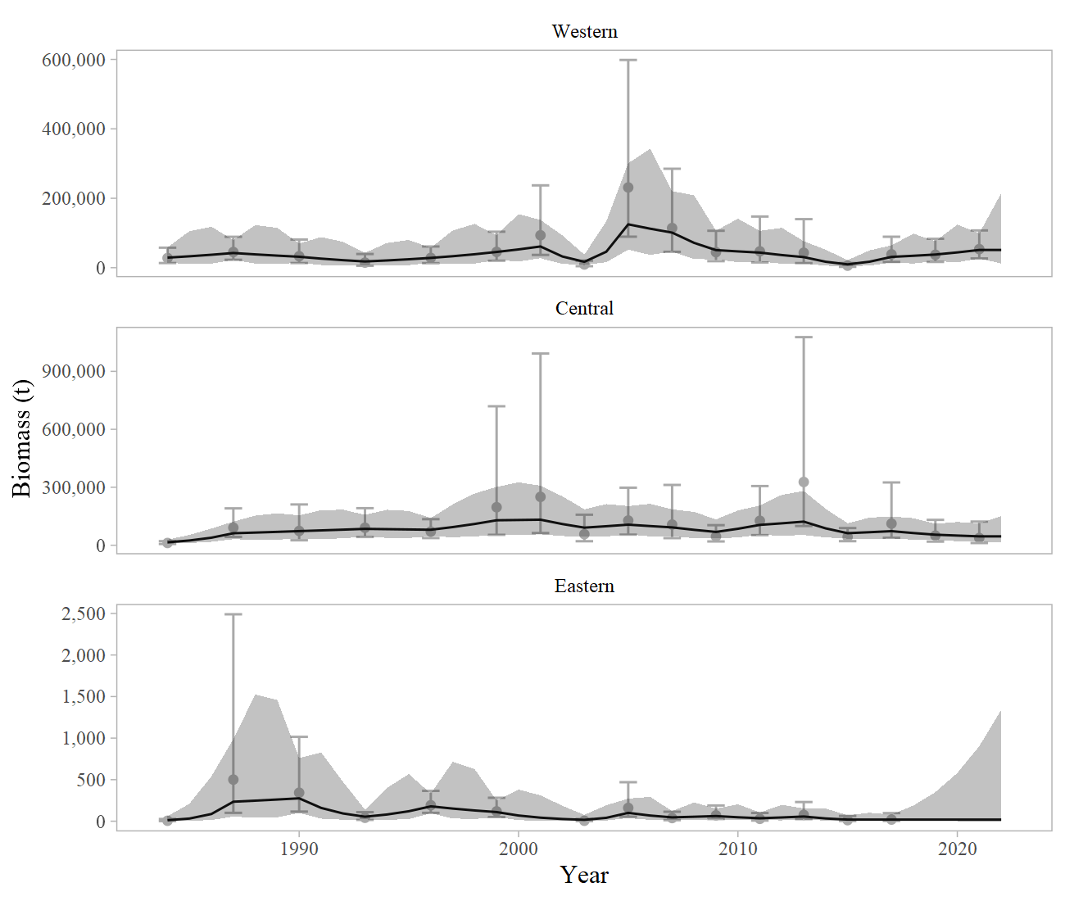
Apportionment
Western 37.76% → 52.65%
Central 62.22% → 47.33%
Eastern 0.02% → 0.02%

Slide 31
Apportionment
 |  | Western | Central | Eastern¹ | Total
Area Apportionment |  | 52.65% | 47.33% | 0.02% | 100%
2023 | ABC (t) | 2,614 | 2,350 | 1 | 4,965
2023 | OFL (t) |  |  |  | 5,927
2024 | ABC (t) | 2,497 | 2,244 | 1 | 4,742
2024 | OFL (t) |  |  |  | 5,661
¹For management purposes the small ABC in the Eastern area is combined with the Other Rockfish complex.
Notes:
Table where applicable, including random effects model graphs and final apportionment table

Slide 32
Conclusions
Recommendation
Increase length plus group (model 22.1)
Data Gaps and Future Research Priorities
We have no information on larval, post-larval, or early-stage juvenile northern rockfish
Habitat requirements are either unknown or anecdotal – research to identify HAPC
Aging is a continual issue (challenging to age well)
Reproductive biology is poorly understood, though skip spawning has been observed – the spatial and temporal extent of skip spawning should be a research priority
Exploration of data weighting, possibly the inclusion of a variance inflation parameter to increase the variance on VAST estimated trawl surveys

Slide 33
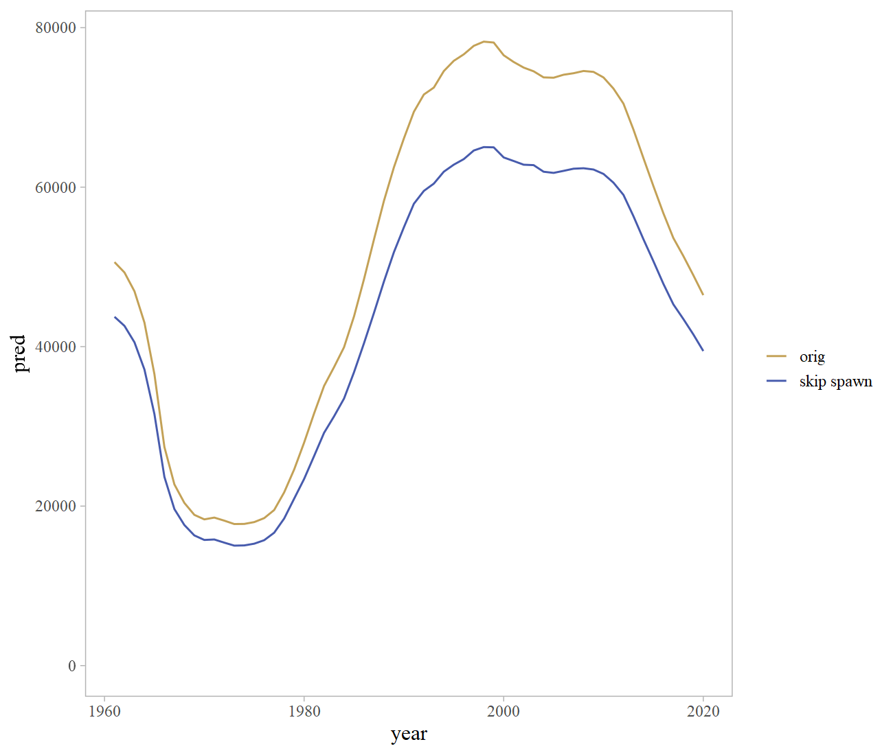
Maturity

Slide 34
Of note - PSC
Species Group | 2018 | 2019 | 2020 | 2021 | 2022
Bairdi Tanner Crab | 321 | 64 | 1,146 | 2,279 | 180
Blue King Crab | 0 | 0 | 0 | 0 | 0
Chinook Salmon | 336 | 410 | 655 | 1,042 | 1,116
Golden (Brown) King Crab | 324 | 223 | 60 | 114 | 136
Halibut | 100 | 115 | 111 | 179 | 128
Herring | 0 | 2 | 0 | 0 | 1
Non-Chinook Salmon | 325 | 380 | 723 | 1,628 | 4,002
Opilio Tanner (Snow) Crab | 0 | 0 | 0 | 0 | 0
Red King Crab | 0 | 0 | 0 | 0 | 0

Slide 35

QUESTIONS?
CONTACT:
ben.williams@noaa.gov

