Slide 1
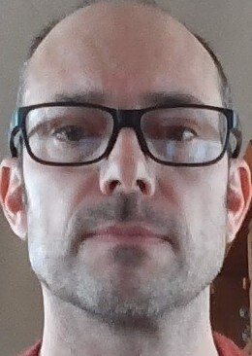
Gulf of Alaska Northern Rockfish
Ben Williams, Pete Hulson, Chris Lunsford

Slide 2
Northern rockfish
Model examinations:
Extended length plus group
Francis reweighting
Explore survey abundance weighting
Previously accepted model Model 18.2b(2020)

Slide 3
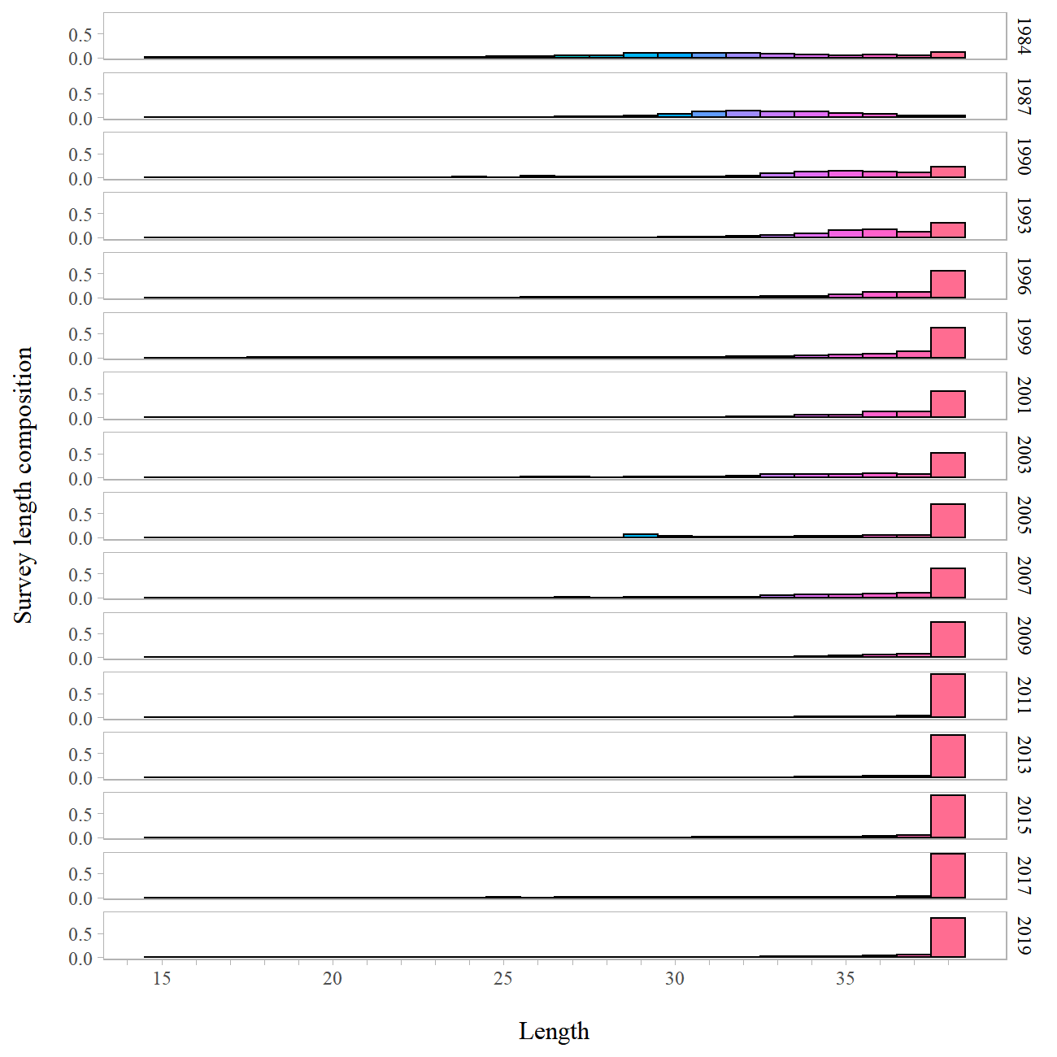
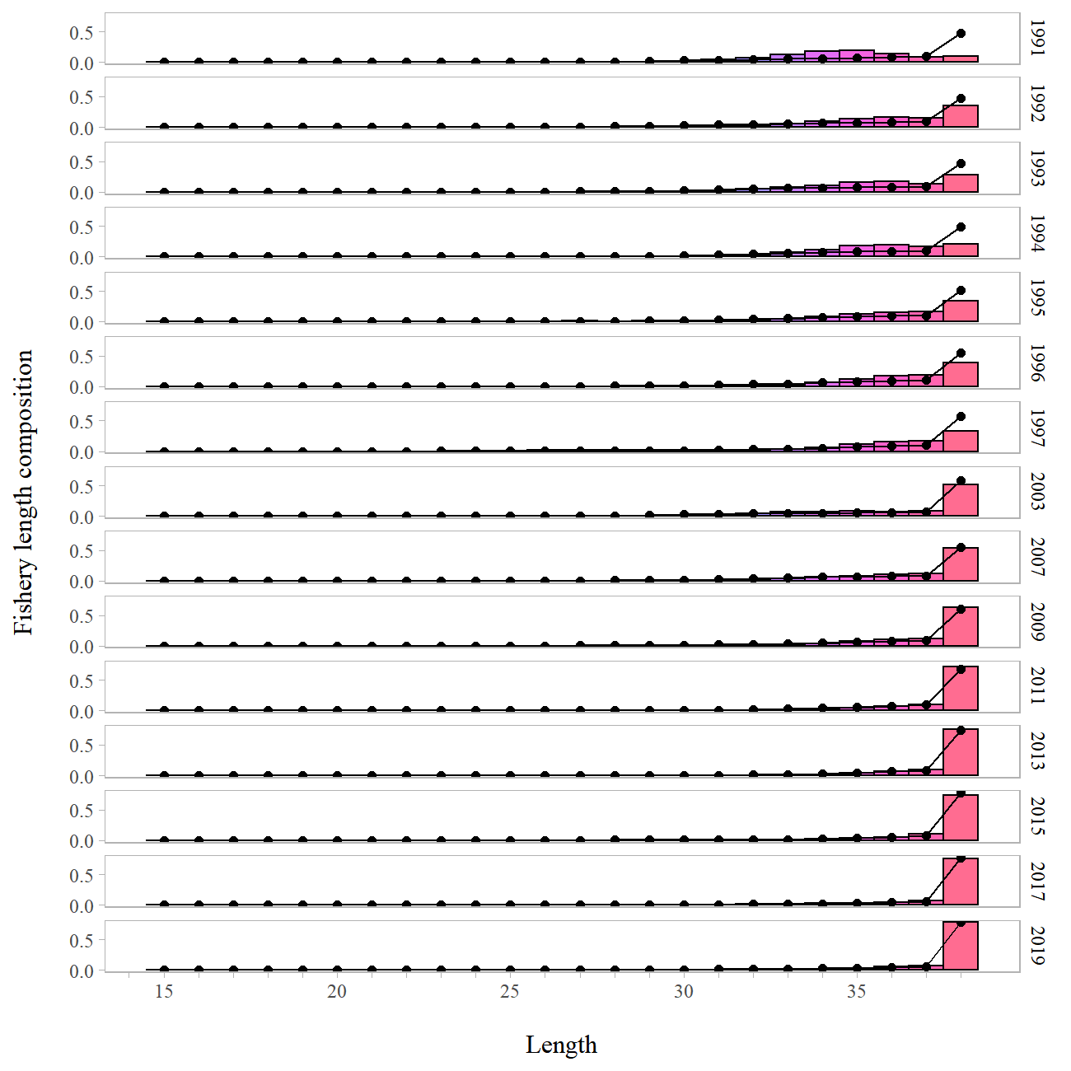
Northern rockfish – length
Survey
Fishery
Notes:
Survey lengths not used in the model.
Need to push out the plus group

Slide 4
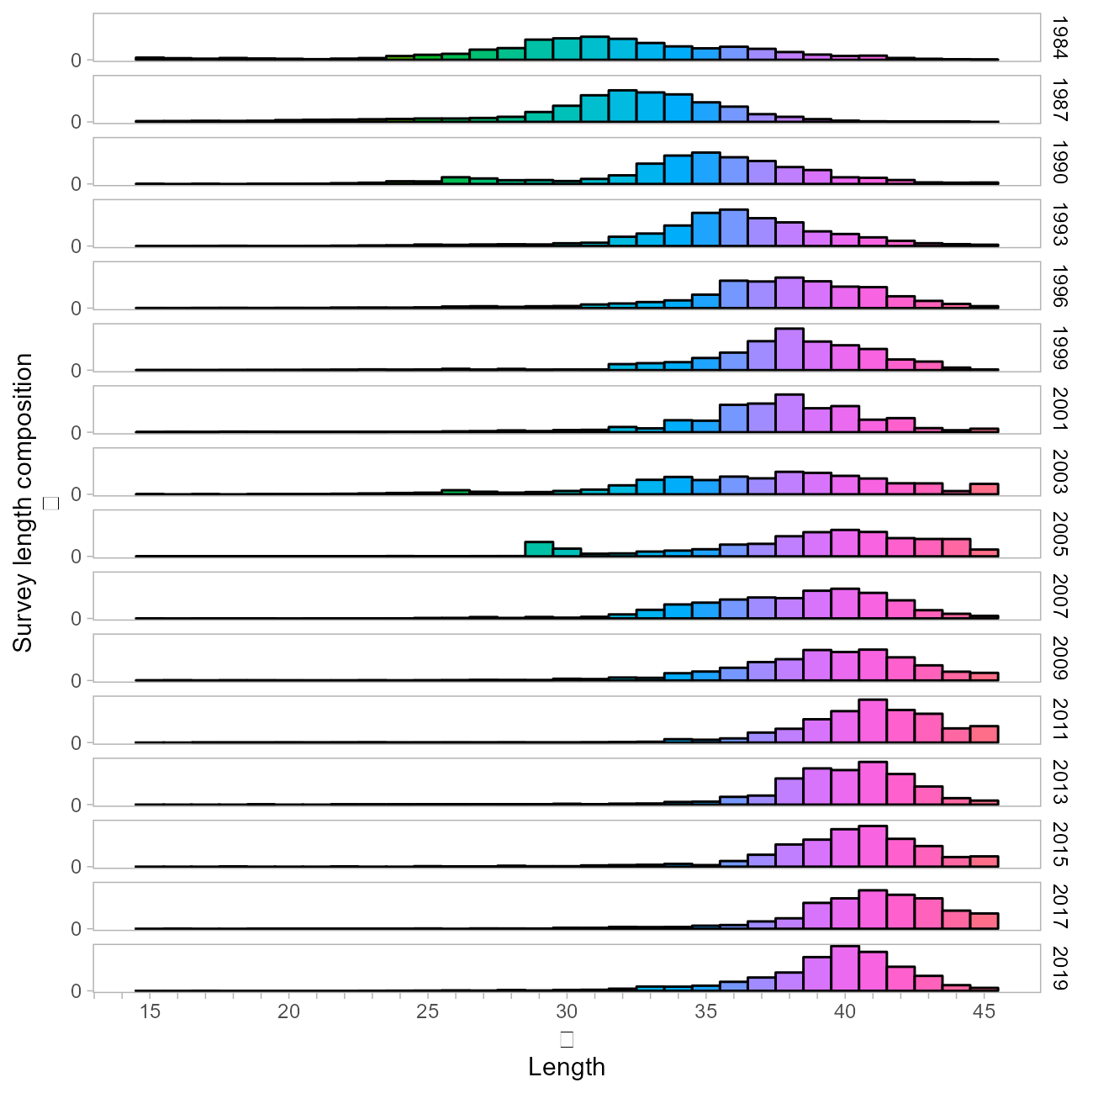
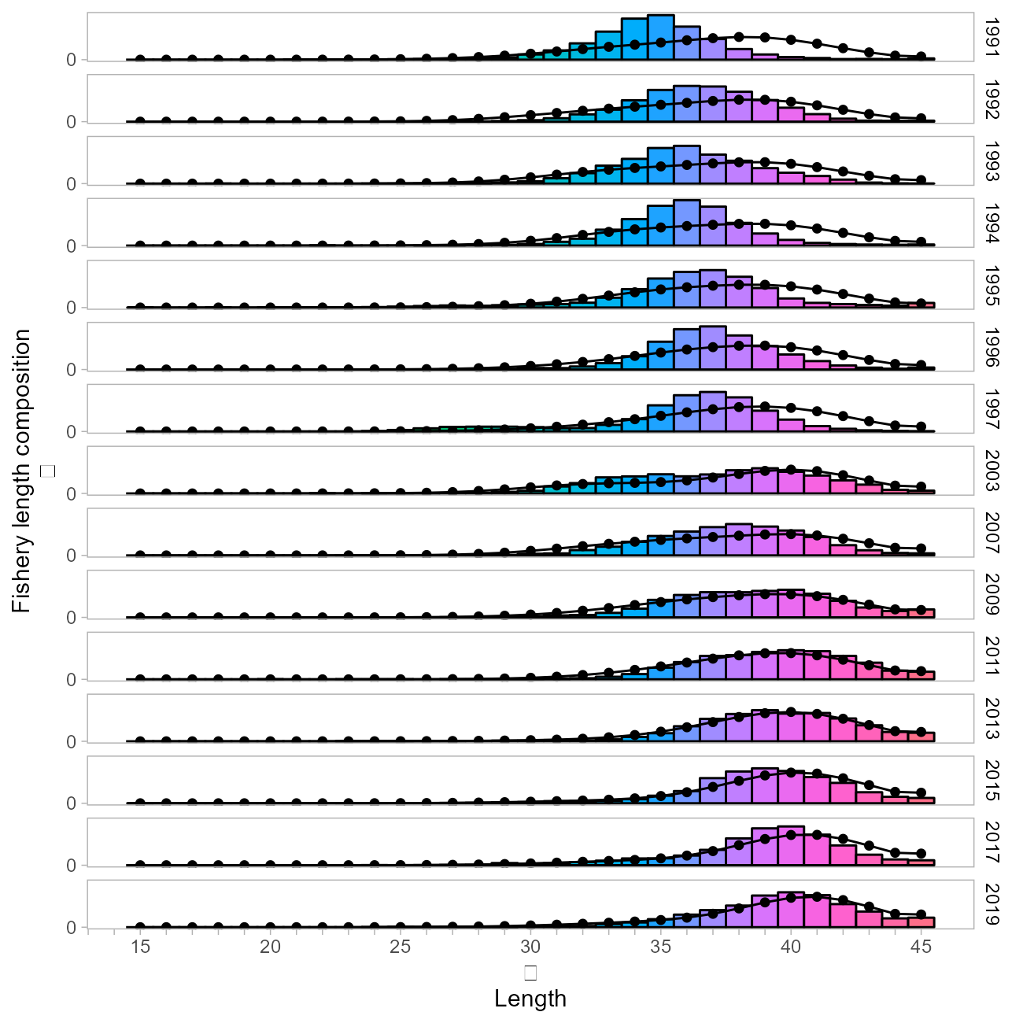
Northern rockfish – length
Survey
Fishery
Notes:
Plus group now catches decreasing end of normal distribution

Slide 5
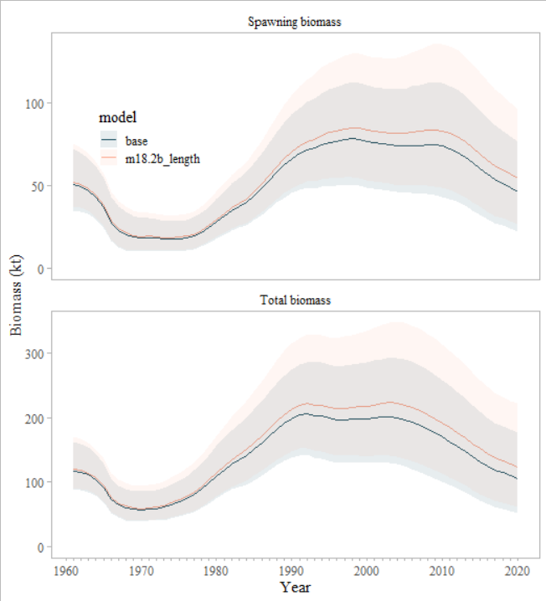
Northern rockfish – length
Survey
Notes:
Length plus group increases biomass

Slide 6
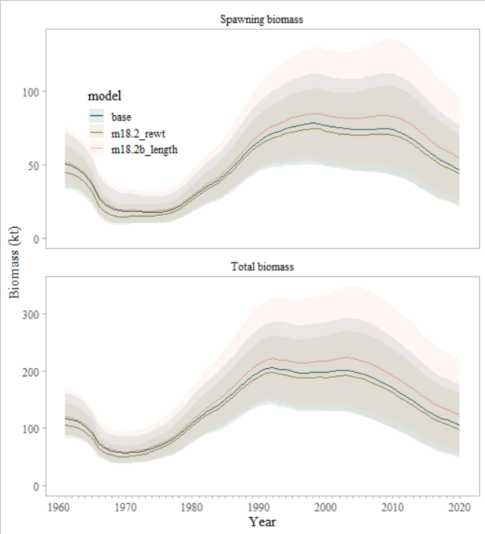
Northern rockfish – Francis re-weighting
Notes:
Re weighting drop the biomass down slightly

Slide 7
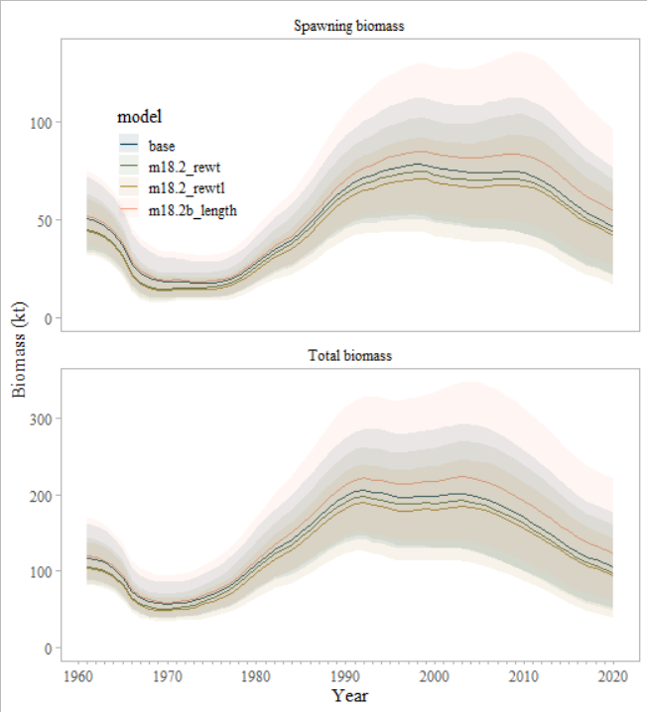
Northern rockfish – Francis re-weighting/length
Notes:
Re weighting on the increased length plus group drops the biomass down again

Slide 8
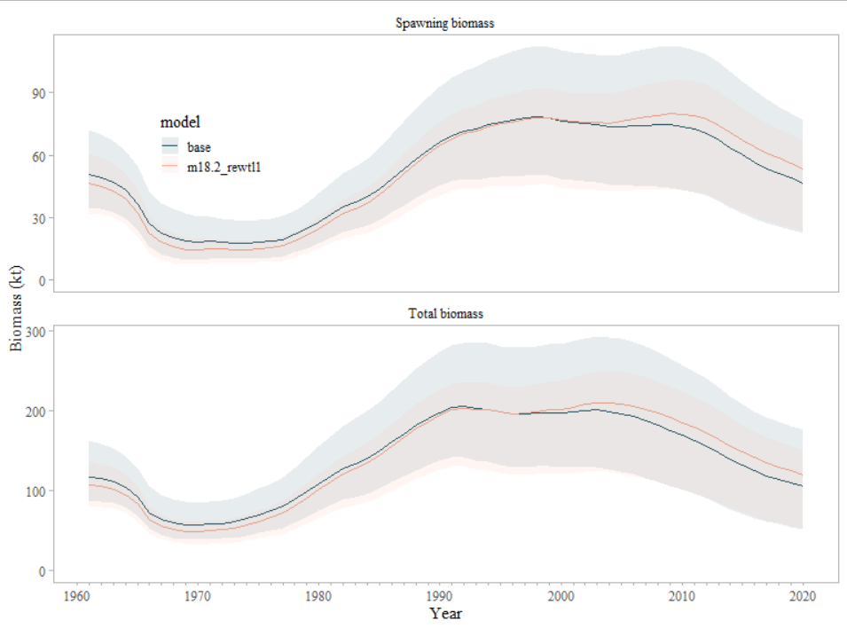
Northern rockfish – Francis re-weighting/length – survey wt = 1
Notes:
Change survey weight to 1 then do francis reweighting

Slide 9
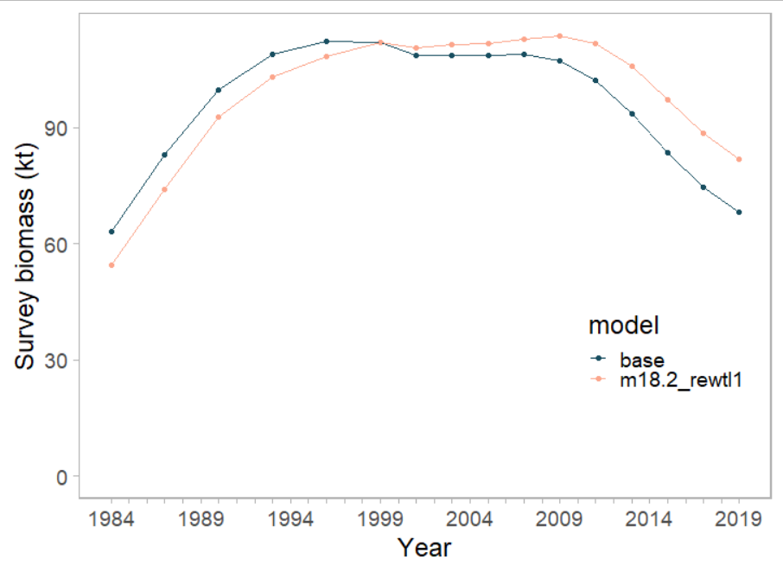
Northern rockfish – Francis re-weighting/length – survey wt = 1
Notes:
Can see the changes coming from the survey

Slide 10
Northern rockfish
 | Base | Francis | Length | Francis length | Survey wt = 1
Parameters | 181
Likelihoods
Data | 164 | 323.9 | 186 | 342.3 | 366.8
Survey – age | 68.7 | 122.6 | 70.9 | 120.5 | 125.3
Fishery – age | 37.4 | 91.1 | 37.3 | 87.3 | 85.6
Fishery - length | 46.2 | 98.4 | 66.4 | 123.2 | 116.0
Weights
Survey – age | 0.5 | 0.88 | 0.5 | 0.83 | 0.84
Fishery – age | 0.5 | 1.27 | 0.5 | 1.25 | 1.25
Fishery - length | 0.5 | 1.07 | 0.5 | 0.93 | 0.88

Slide 11
Northern rockfish
Model examinations:
Extended length plus group
Francis reweighting
Explore survey abundance weighting
Previously accepted model Model 18.2b(2020)

Slide 12
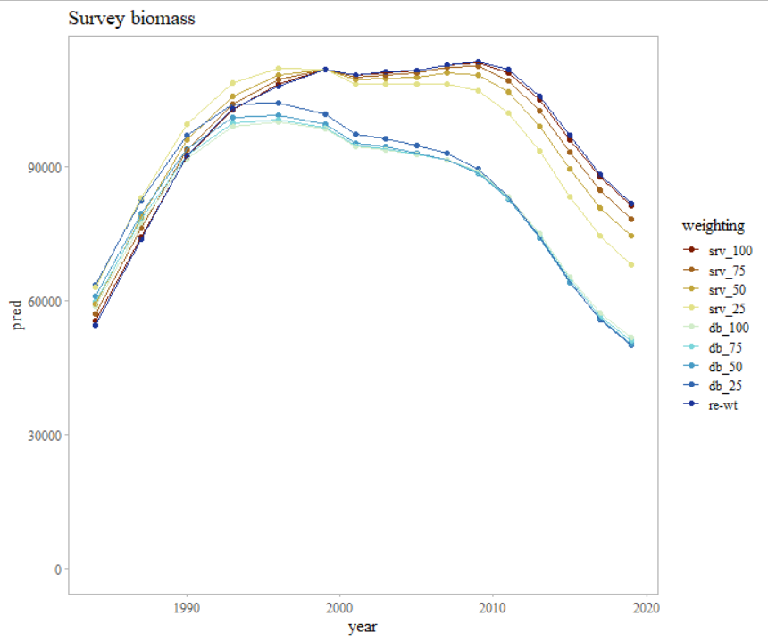
Northern rockfish
Notes:
Same survey inputs – different survey weight in the .ctl file
Looking at design-based and VAST
*Currently set to survey is based on vast 0.25
* Note that db are essentially the same results at all weights – because the variance is so large that it doesn’t matter

Slide 13
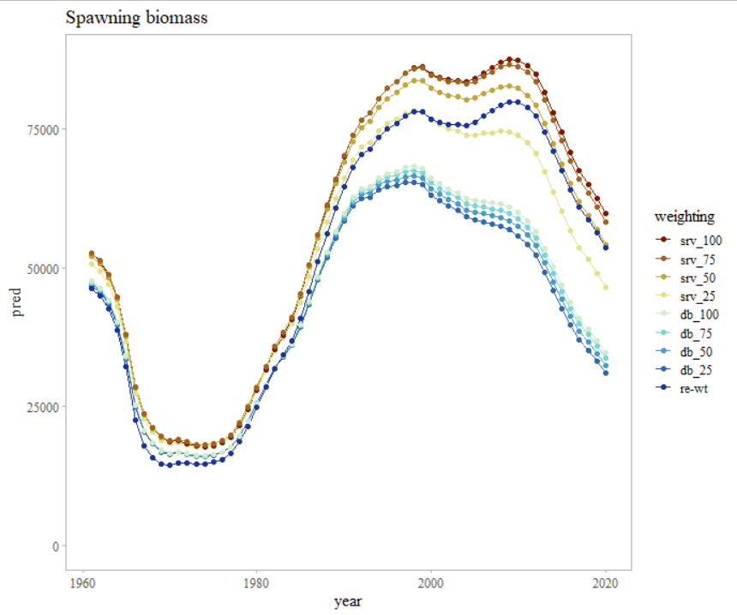
Northern rockfish

Slide 14
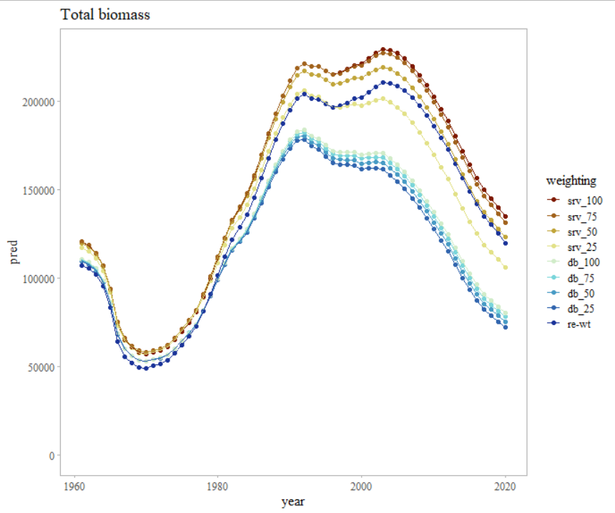
Northern rockfish

Slide 15
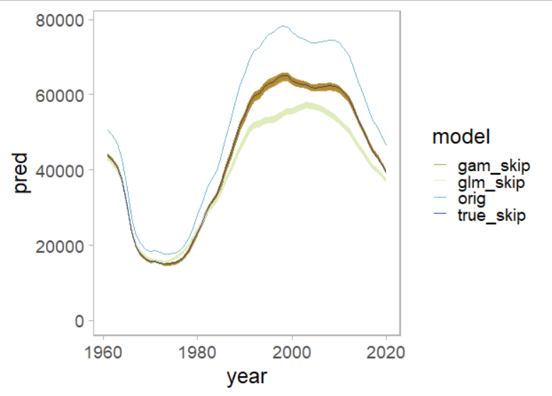
Northern rockfish – skip spawning

Slide 16
Questions?
ben.williams@noaa.gov

