Slide 1
Gulf of Alaska Pacific Ocean Perch
September 2025 - Groundfish Plan Team Ben Williams

Slide 2
Pacific ocean perch
Change in lead author
Framework change
Minor model corrections
Input data changes

Slide 3
Framework change
Bridge model to RTMB
Results equivalent to ADMB model
Base model (model 2020.1) using 2023 data inputs.
The RTMB assessment model and the associated comparison code are available on GitHub.
RTMB Model Code:
ADMB vs. RTMB Comparison Code:.

Slide 4
Framework change
Same parameter inputs as the ADMB model, though left unbounded in the RTMB implementation.
Key outputs
Total biomass, spawning biomass, etc. are equivalent
nLL values are near identical, differing by a few decimal points

Slide 5
Framework change - parameters
Item | ADMB | RTMB | Difference
M | 0.0743 | 0.0743 | 0.0000
q | 1.7361 | 1.7361 | 0.0000
Log mean recruitment | 4.4492 | 4.4492 | 0.0000
Log mean F | -2.6131 | -2.6131 | 0.0000
2024 Total biomass | 649,941.00 | 649,941.11 | 0.1070
2024 Spawning biomass | 227,991.00 | 227,991.19 | 0.1945
2024 OFL | 47,466.30 | 47,466.28 | -0.0154
2024 F OFL | 0.1192 | 0.1192 | 0.0000
2024 ABC | 39,718.90 | 39,718.89 | -0.0104
2024 F ABC | 0.0990 | 0.0990 | 0.0000

Slide 6
Framework change - nLL
Likelihood | ADMB | RTMB | Difference
Catch | 0.2181 | 0.2181 | 0.0000
Survey | 16.4416 | 16.4416 | 0.0000
Fish age | 25.0028 | 25.0028 | 0.0000
Survey age | 29.2822 | 29.2822 | 0.0000
Fish size | 66.2258 | 66.2259 | 0.0001
Recruitment | 10.6027 | 10.6027 | 0.0000
F regularity | 6.1405 | 6.1405 | 0.0000
SPR penalty | 0.0000 | 0.0000 | 0.0000
M prior | 1.8299 | 1.8299 | 0.0000
q prior | 0.4241 | 0.4241 | 0.0000
Sigma R prior | 7.9849 | 7.9849 | 0.0000
Sub total | 164.1526 | 164.1527 | 0.0001

Slide 7
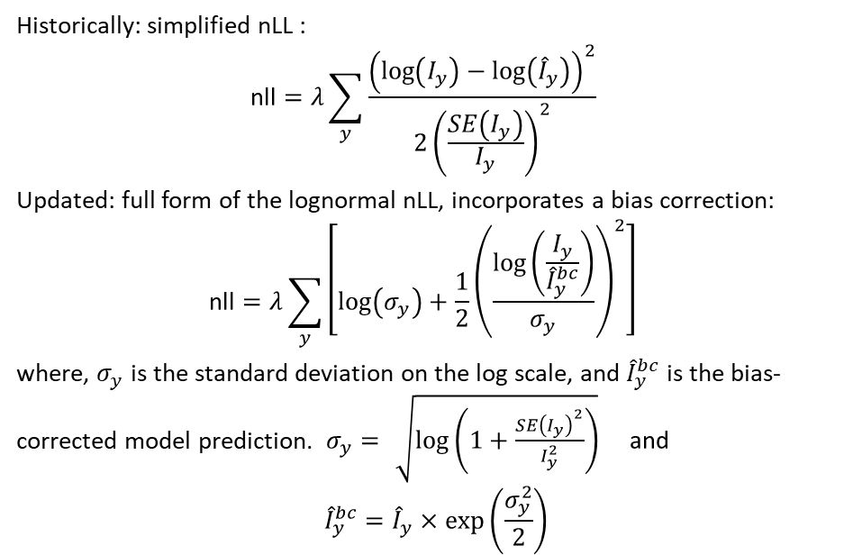
Model corrections - Survey nLL
Historically: simplified nLL :
$$\text{nll}=λ\sum_{y}^{​}{\frac{{\left(log\left(I_{y}\right)−log\left({\hat{I}}_{y}\right)\right)}^{2}}{2{\left(\frac{SE\left(I_{y}\right)}{I_{y}}\right)}^{2}}}$$
Updated: full form of the lognormal nLL, incorporates a bias correction:
$$\text{nll}=λ\sum_{y}^{​}{\left[log\left(σ_{y}\right)+\frac{1}{2}{\left(\frac{log\left(\frac{I_{y}}{{\hat{I}}_{y}^{bc}}\right)}{σ_{y}}\right)}^{2}\right]}$$
where, $σ_{y}$ is the standard deviation on the log scale, and ${\hat{I}}_{y}^{bc}$ is the bias-corrected model prediction. $σ_{y}=\sqrt{log\left(1+\frac{SE{\left(I_{y}\right)}^{2}}{I_{y}^{2}}\right)} \text{and}$
$${\hat{I}}_{y}^{bc}={\hat{I}}_{y}×exp\left(\frac{σ_{y}^{2}}{2}\right)$$

Slide 8
Model corrections - Survey nLL
Historically: simplified nLL :
Results:
- Parameter values are consistent
- ~2 t increase in total and spawning biomass
- Similar OFL/ABC values

Slide 9
Model corrections - Selectivity
Selectivity is modeled using 4 time-blocks
- The 2nd time block was not scaled to a max of 1
- This can lead to an underestimate of F for that time period
Results:
Negligible changes to model outputs.

Slide 10
Model/Data examinations:
Survey biomass likelihood
Fishery selectivity 2nd time block adjustment
GAP GOA re-stratification

Slide 11
Bullets
When you click the Render button a document will be generated that includes:
Content authored with markdown
Output from executable code

Slide 12
Code
When you click the Render button a presentation will be generated that includes both content and the output of embedded code. You can embed code like this:
[1] 2

