Slide 1
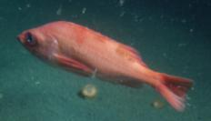
GOA Pacific ocean perch
Pete Hulson, Ben Williams, Ben Fissel, Bridget Ferriss, Madison Hall, Ellen Yasumiishi, and Darin Jones
Notes:
Previous identity has proved to be overly complex to apply, reducing buy-in. The old brand guide did not perform well in the difficult balancing act between consistency and sameness.
This presentation introduces branding goals and outlines proposed changes to the brand standards guide.

Slide 2
BLUF:
No assessment changes for 2021
Continue to work on model developments (outlined at the end)
Notes:
Previous identity has proved to be overly complex to apply, reducing buy-in. The old brand guide did not perform well in the difficult balancing act between consistency and sameness.
This presentation introduces branding goals and outlines proposed changes to the brand standards guide.

Slide 3
Outline:
Input data
Model fits
Model results
Recommendations
Apportionment
Risk table
Future work
Notes:
Previous identity has proved to be overly complex to apply, reducing buy-in. The old brand guide did not perform well in the difficult balancing act between consistency and sameness.

Slide 4
Input data
New data:
2021 survey biomass
2020 fishery ages
updated catch
Notes:
The NMFS Emblem is the key to a stronger brand.

Slide 5
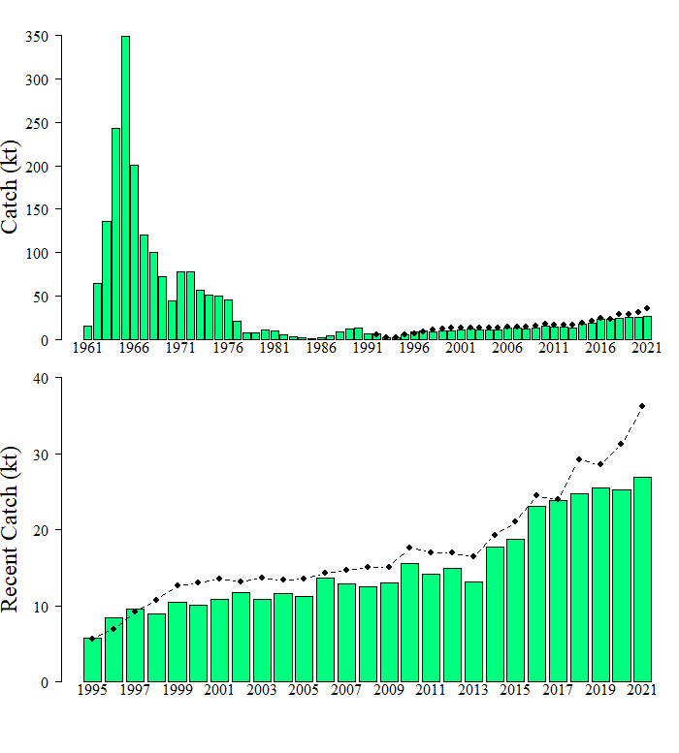
Catch
Since 2018, catch < TAC
Notes:
Overview of the terminology behind the main identifier.

Slide 6
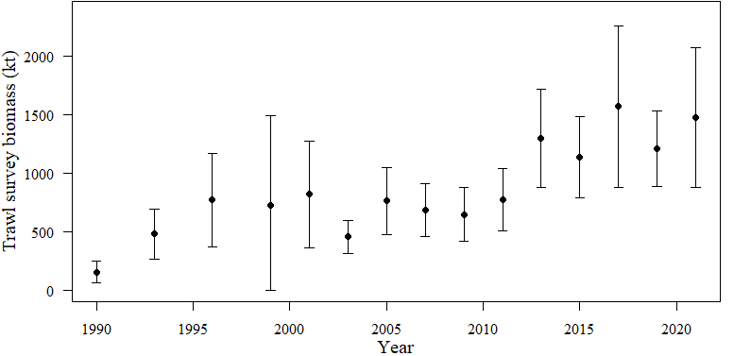
Trawl survey biomass
2021 2nd largest in time series (CV=21%)
Notes:
Overview of the terminology behind the main identifier.

Slide 7
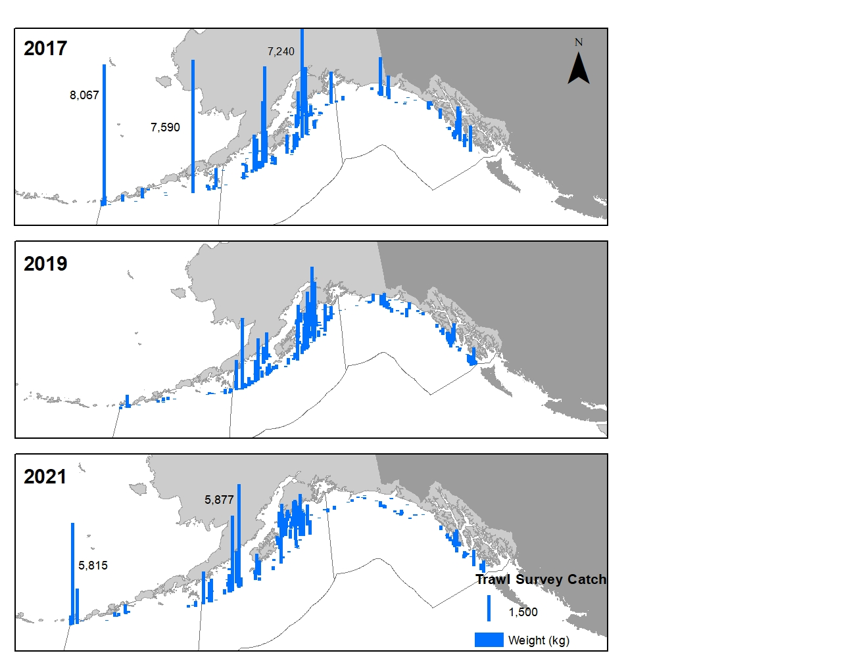
Trawl survey catch distribution
Increase in West and Central, decrease in East
Notes:
Overview of the terminology behind the main identifier.

Slide 8
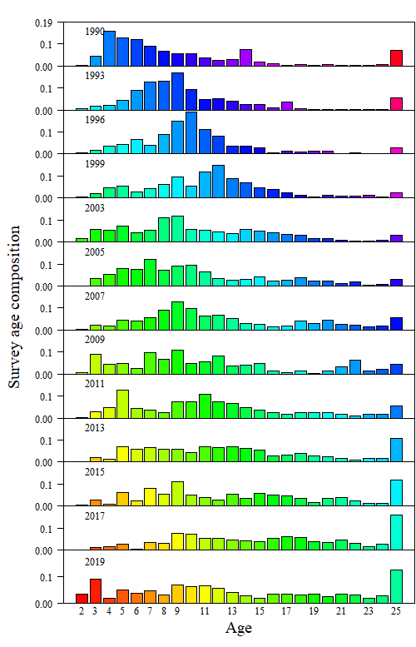
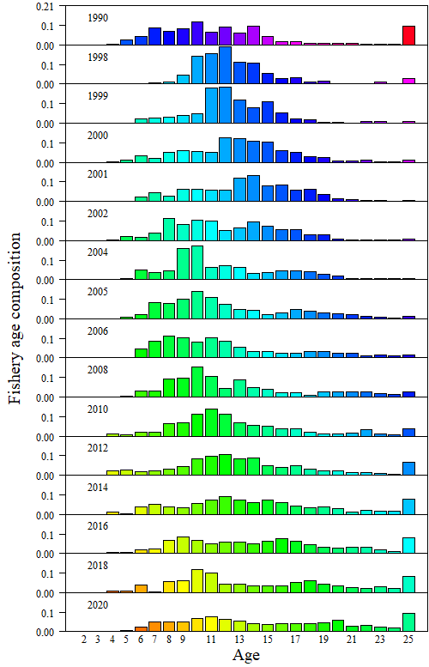
Age composition
- Baby of the blob: 2016 year-class showing up in survey, not in fishery yet
- Getting largish plus age group
Notes:
Overview of the terminology behind the main identifier.

Slide 9
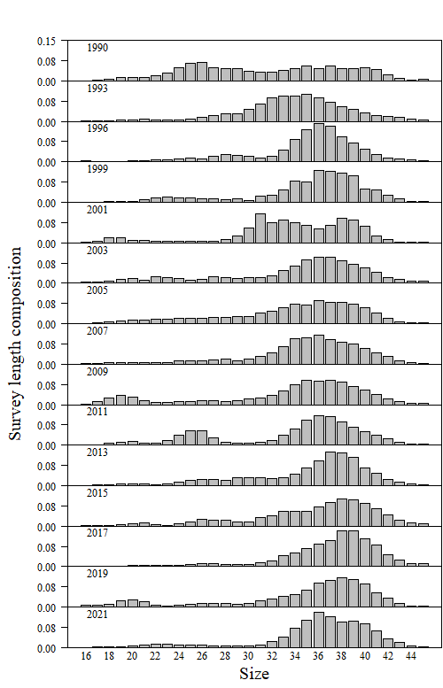
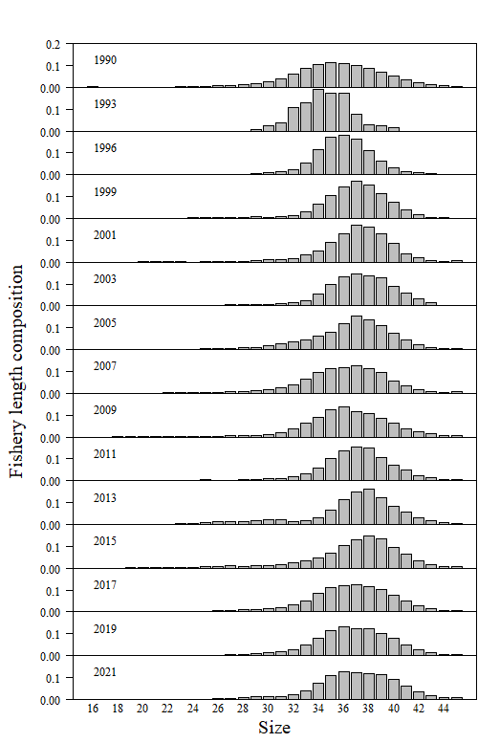
Length composition
- Next time: include most recent survey size comp
- CIE: include fishery size in sensitivity
Notes:
Overview of the terminology behind the main identifier.

Slide 10
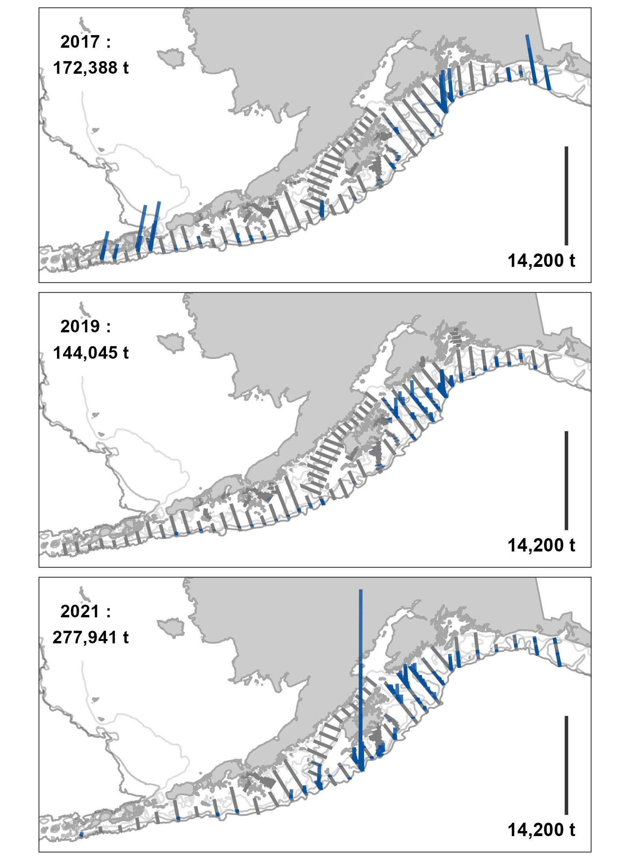
Acoustic catch distribution
Like trawl survey, majority of distribution in CGOA
Notes:
Overview of the terminology behind the main identifier.

Slide 11
Acoustic Biomass/Length comps
- Agreement in trend since 2017
- Acoustic survey didn’t see 2016 year class
Notes:
Overview of the terminology behind the main identifier.

Slide 12
Model fits
Catch
Trawl survey
Age comp
Length comp
Notes:
The NMFS Emblem is the key to a stronger brand.

Slide 13
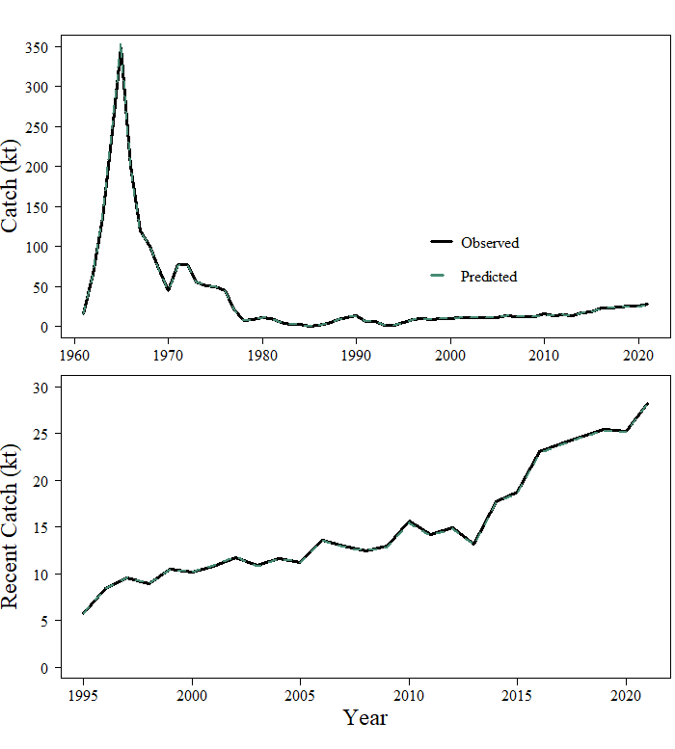
Catch fit
Recent catch increasing over time in general
Notes:
Overview of the terminology behind the main identifier.

Slide 14
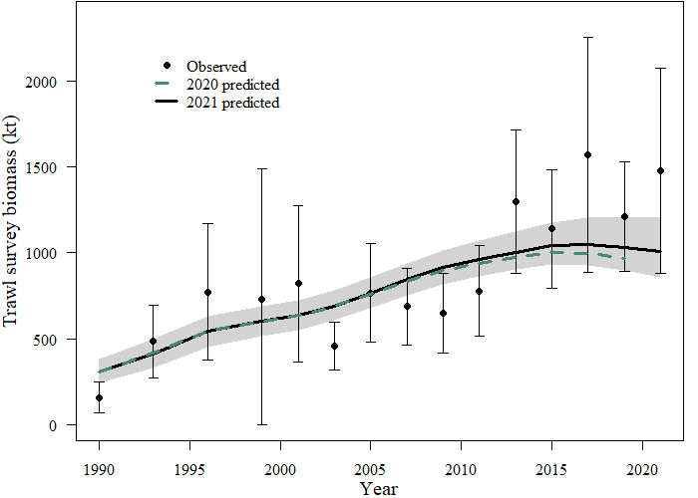
Trawl survey biomass fit
Slightly better fit compared to 2020 assessment
Notes:
Overview of the terminology behind the main identifier.

Slide 15
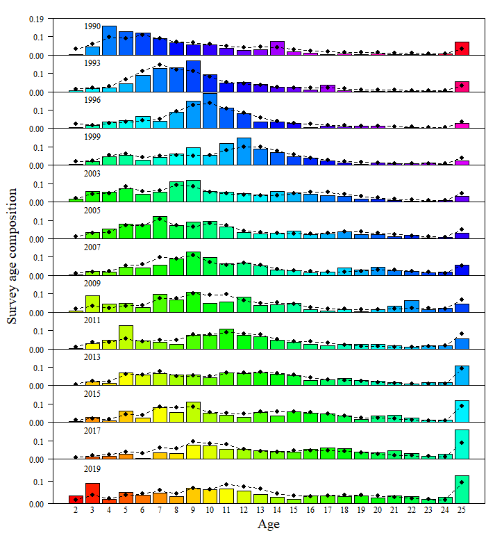
Survey age comp fit
- Still not quite fitting the 2016 year class
- Could improve fit to plus age group
Notes:
Overview of the terminology behind the main identifier.

Slide 16
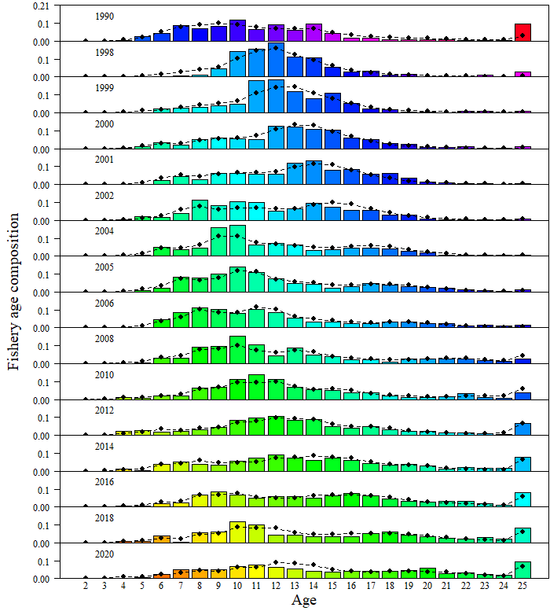
Fishery age comp fit
In 2020, age-10s from 2018 (now 12) didn’t show up
Notes:
Overview of the terminology behind the main identifier.

Slide 17
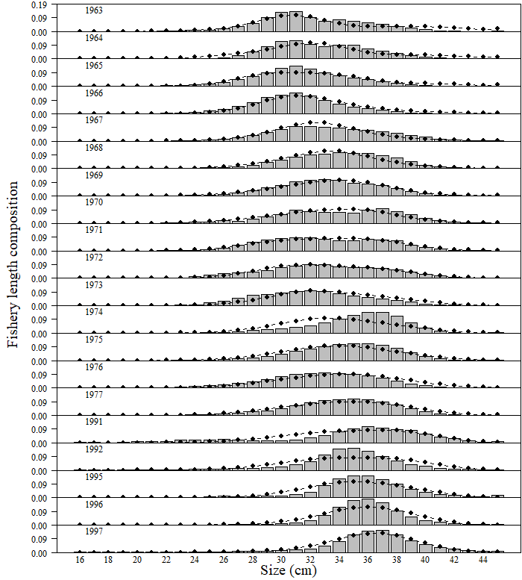
Fishery length comp fit
Nothing particularly unusual
Notes:
Overview of the terminology behind the main identifier.

Slide 18
Overall fit
Likelihoods | 20.1 (2020) | 20.1 (2021)
Catch | 0.17 | 0.19
Survey Biomass | 15.65 | 16.28
Fishery Ages | 19.34 | 20.90
Survey Ages | 25.65 | 26.37
Fishery Sizes | 65.06 | 65.37
Maturity | 103.52 | 103.52
Data-Likelihood | 229.39 | 232.63
Penalties/Priors
Recruitment Devs | 10.56 | 11.05
F Regularity | 5.92 | 5.95
σ_{r} prior | 7.85 | 7.80
q prior | 0.50 | 0.53
M prior | 2.23 | 2.09
Objective Fun Total | 256.45 | 260.06
Minor differences with data fit, larger difference with penalties/priors
Notes:
Overview of the terminology behind the main identifier.

Slide 19
Model results
Main parameters & uncertainty
Selectivity/maturity
Recruitment
Biomass
Retrospective
Management/projections
Notes:
The NMFS Emblem is the key to a stronger brand.

Slide 20
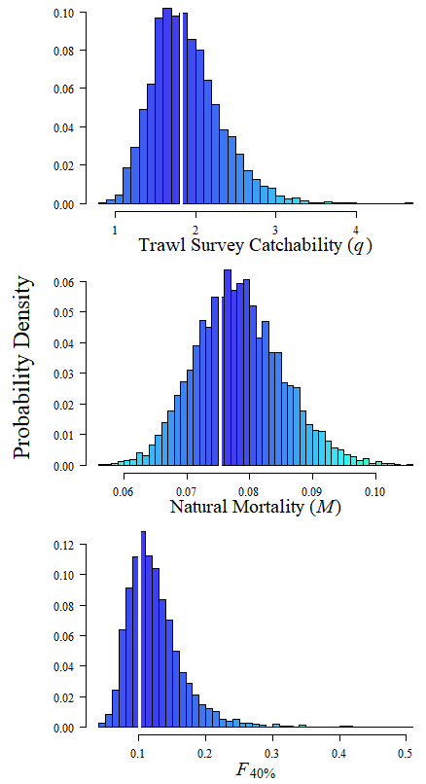
Main parameters
Parameter Ests. | 20.1 (2020) | 20.1 (2021)
Active parameters | 164 | 166
q | 1.80 | 1.82
M | 0.076 | 0.075
σ_{r} | 0.77 | 0.77
Mean Recruitment | 84.07 | 84.71
F_{40%} | 0.10 | 0.10
Not much changed from last year
Notes:
Overview of the terminology behind the main identifier.

Slide 21
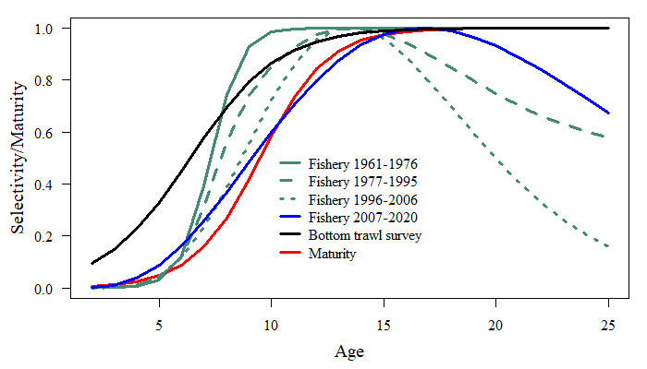
Selectivity/maturity
Continuing to look at adding flexibility to fishery selectivity
Notes:
Overview of the terminology behind the main identifier.

Slide 22
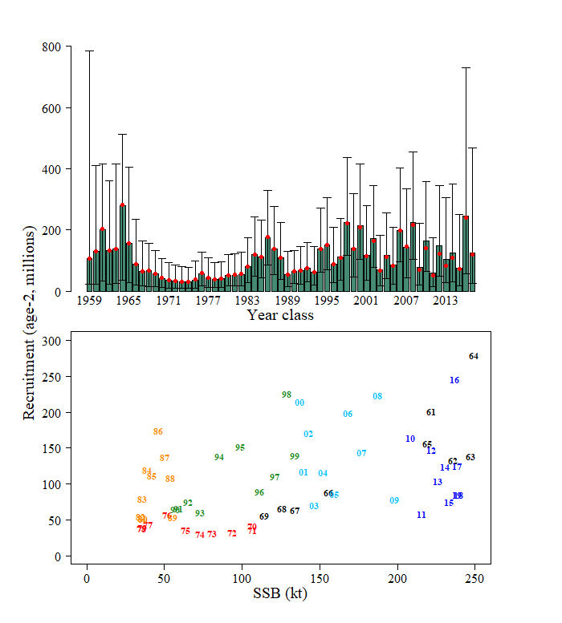
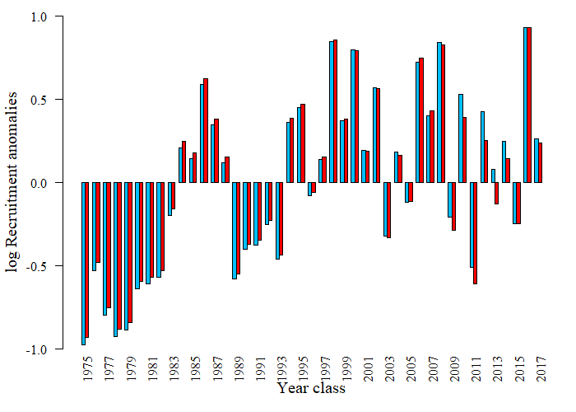
Recruitment
Similar to 2020 assessment estimates
Notes:
Overview of the terminology behind the main identifier.

Slide 23
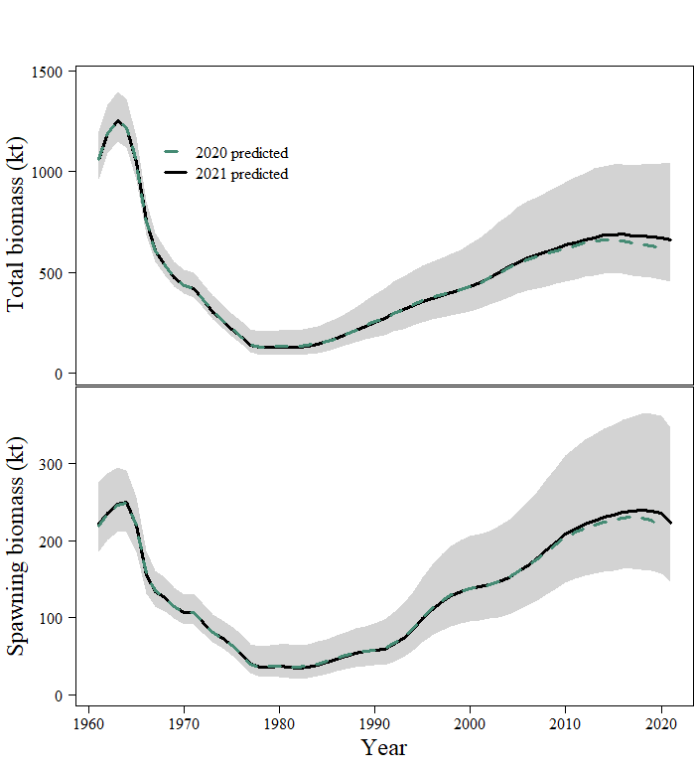
Biomass
Recent increase compared to 2020 assessment
Notes:
Overview of the terminology behind the main identifier.

Slide 24
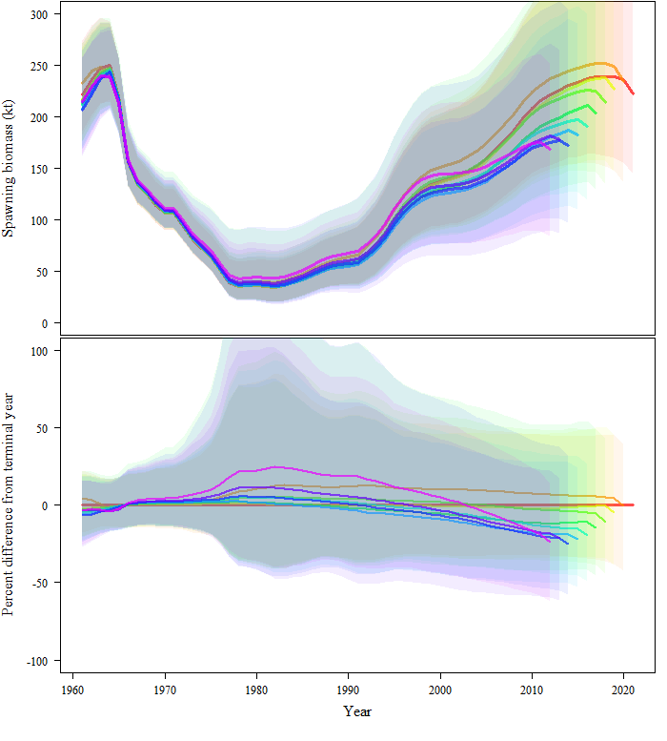
Retrospective
Mohn’s rho = -0.16 (-0.15 in 2020)
Continuing to be a negative pattern (increasing biomass with each year added)
Notes:
Overview of the terminology behind the main identifier.

Slide 25
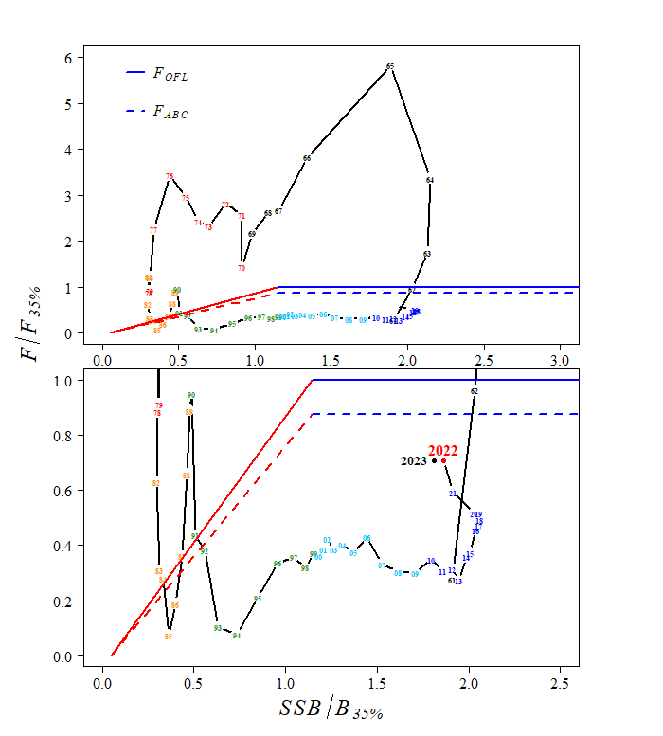
Management path
Still under control rule
Notes:
Overview of the terminology behind the main identifier.

Slide 26
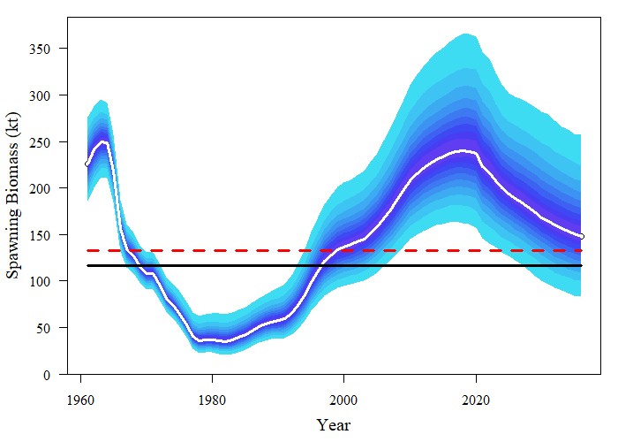
Projections
Projected decrease in next 10 years
Notes:
Overview of the terminology behind the main identifier.

Slide 27
Recommendations
 | As estimated or specified last year for: |  | As estimated or recommended this year for:
Quantity | 2021 | 2022 | 2022 | 2023¹
M (natural mortality) | 0.076 | 0.076 | 0.075 | 0.075
Tier | 3a | 3a | 3a | 3a
Projected total (age 2+ ) biomass (t) | 613,522 | 597,732 | 650,832 | 634,907
Projected Female spawning biomass | 207,096 | 198,179 | 216,635 | 210,257
B_{100%} | 317,035 | 317,035 | 331,917 | 331,917
B_{40%} | 126,814 | 126,814 | 132,767 | 132,767
B_{35%­} | 110,962 | 110,962 | 116,171 | 116,171
F_{OFL} | 0.120 | 0.120 | 0.120 | 0.120
maxF_{ABC} | 0.100 | 0.100 | 0.100 | 0.100
F_{ABC} | 0.100 | 0.100 | 0.100 | 0.100
OFL (t) | 42,977 | 41,110 | 45,580 | 44,196
maxABC (t) | 36,177 | 34,602 | 38,268 | 37,104
ABC (t) | 36,177 | 34,602 | 38,268 | 37,104
Status | As determined last year for: |  | As determined this year for:
 | 2019 | 2020 | 2020 | 2021
Overfishing | No | n/a | No | n/a
Overfished | n/a | No | n/a | No
Approaching overfished | n/a | No | n/a | No
Notes:
The NMFS Emblem is the key to a stronger brand.

Slide 28
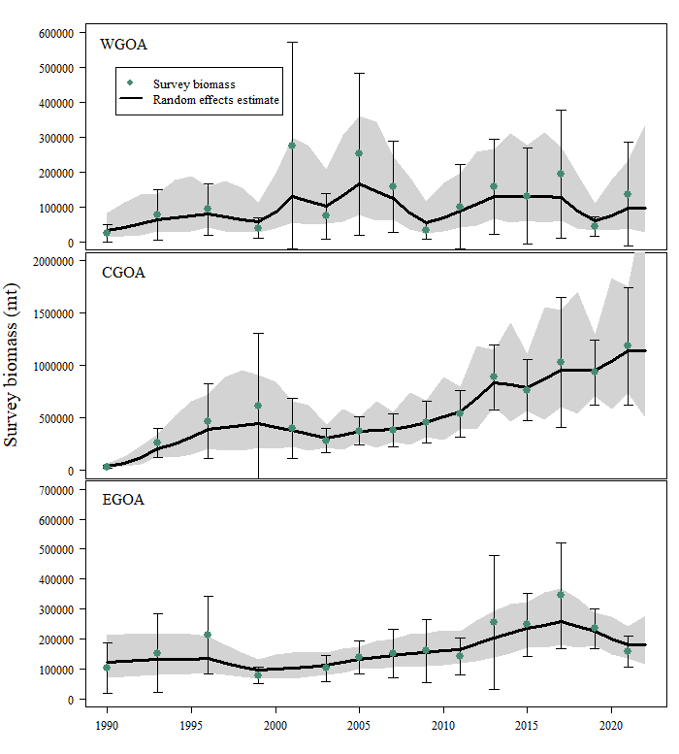
Apportionment
Notes:
Previous identity has proved to be overly complex to apply, reducing buy-in. The old brand guide did not perform well in the difficult balancing act between consistency and sameness.

Slide 29
Apportionment
↑58% in WGOA, ↑12% in CGOA, ↓17% WYAK, ↓36% in EY/SE
Area Apportionment | Western | Central | Eastern | Total
 | 6.8% | 80.5% | 12.7% | 100%
2022 Area ABC (t) | 2,602 | 30,806 | 4,860 | 38,268
2023 Area ABC (t) | 2,523 | 29,869 | 4,712 | 37,104
 | W. Yakutat | E. Yakutat/Southeast | Total
 | 29% | 71% | 100%
2022 Area ABC (t) | 1,409 | 3,451 | 4,860
2023 Area ABC (t) | 1,366 | 3,346 | 4,712
 | W/C/W. Yakutat | E. Yakutat/Southeast | Total
2022 Area OFL (t) | 41,470 | 4,110 | 45,580
2023 Area OFL (t) | 40,211 | 3,985 | 44,196
Notes:
Previous identity has proved to be overly complex to apply, reducing buy-in. The old brand guide did not perform well in the difficult balancing act between consistency and sameness.

Slide 30
Risk table
No changes in risk table since 2020
Assessment-related: consistent retrospective patter could be indicative of misspecification
Pop’n dynamics: sudden increase in biomass not reflected in dynamics of model
No recommended change to ABC
Assessment-related considerations | Population dynamics considerations | Environmental/ ecosystem considerations | Fishery Performance considerations
Level 2: No apparent concern | Level 2: Substantially increased concerns | Level 1: No apparent concern | Level 1: No apparent concern
Notes:
Previous identity has proved to be overly complex to apply, reducing buy-in. The old brand guide did not perform well in the difficult balancing act between consistency and sameness.

Slide 31
Looking ahead
Continue working on model recommendations from SSC/Plan Team, Internal review team, and CIE (Appendix 9B)
Work with GAP in 2022 to understand differences with VAST
Notes:
The NMFS Emblem is the key to a stronger brand.

Slide 32
Cool current work
Science-Industry Rockfish Research Collaboration in Alaska (SIRCCA), Madison Hall (Appendix 9C)
Pilot study in 2021, continue in 2022, gear up for 2023 and 2025
Notes:
The NMFS Emblem is the key to a stronger brand.

Slide 33
Notes:
Previous identity has proved to be overly complex to apply, reducing buy-in. The old brand guide did not perform well in the difficult balancing act between consistency and sameness.

