Slide 1
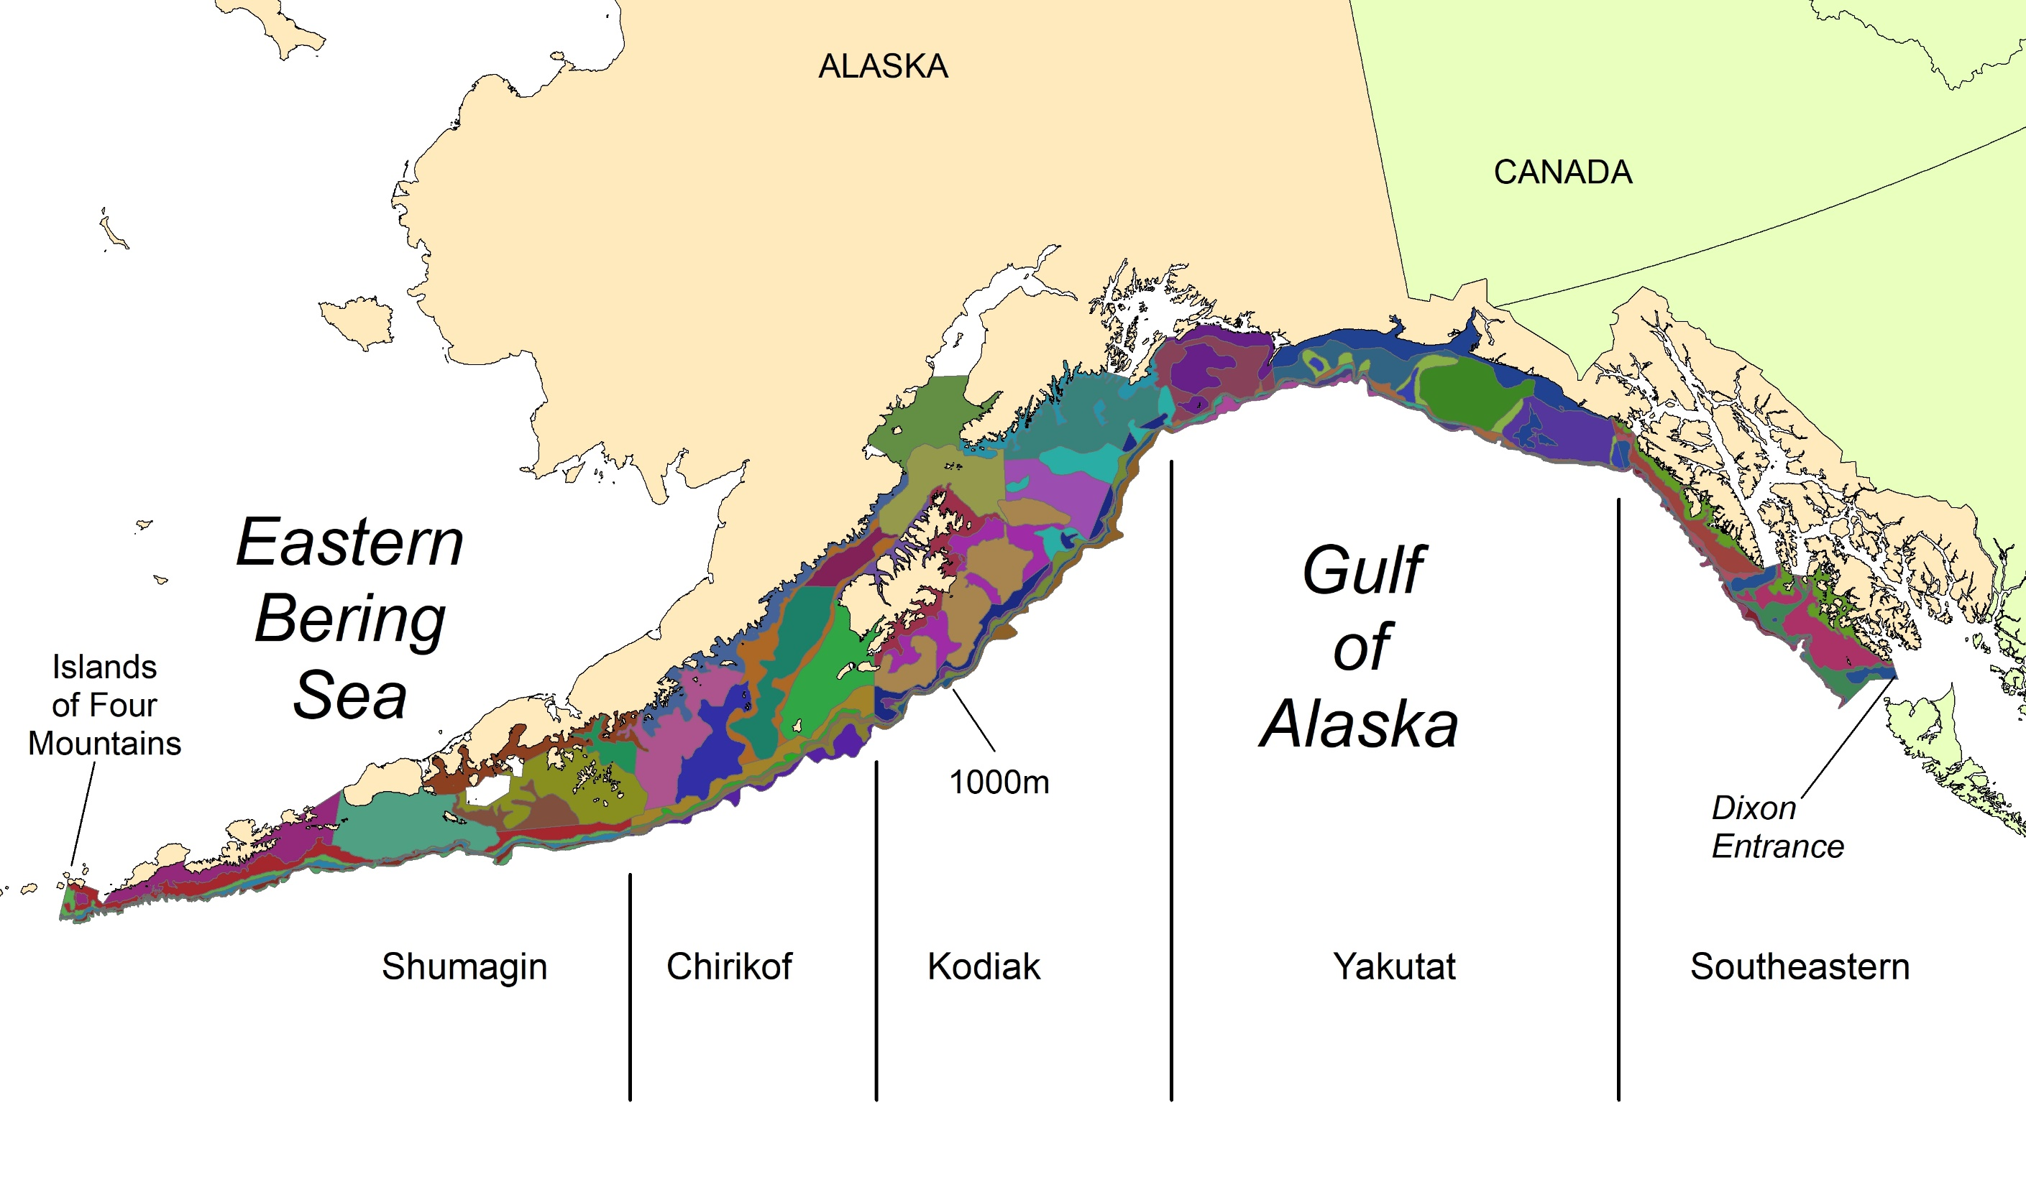
338,626 km² area
59 strata
80-777 km²
Depth zones
0-100 m
101-200 m
201-300 m
301-500 m
501-700 m
701-1000 m
Notes:
The Gulf of Alaska bottom trawl survey area extends from the Islands of Four Mountains in the west to Dixon Entrance in the east.
Depths range from 0 to 1000 meters.
The total area is about 340,000 km^2 and is divided into 5 large regions;
Shumagin, Chirikof, Kodiak, Yakutat and Southeastern.
There are 6 depth zones;
0-100m, 101-200m, 201-300m, 301-500m, 501-700m, 701-1000m
Crossing the 6 depth zones with the 5 regions, and sub-dividing by some significant geographic features such as banks and gullies, results in 59 strata.
Biomass is calculated for each of these 59 strata by averaging the catch rates (kg/km^2) of all tows within each strata and multiplying by the strata area.
Let’s look at the Kodiak area to see the station pattern and how the survey is conducted.

