Slide 2
Summary of Restratification
 | Historical Strata (1984-2023) | 2025 Restratification (2025-on)
Stratum variables | INPFC areas (Figure 1); Depth bins (e.g., 1-100 m, 101-200 m); terrain (shelf/gully/slope) | NMFS areas (Figure 2); Depth Depth bins are allowed to differ among NMFS areas.
Total strata | 59 strata (54 strata when survey only extends to 700 m) | 30 strata (25 strata when survey only extends to 700 m)
Allocation criteria | Neyman allocation: stratum area, stratum variance, tow cost Species weighting: biomass and ex-vessel value | Bethel algorithm: stratum area, stratum variance Minimizes CV across species set for a given total sample size
Notes:
The third component of the STRS design is that last row there and that is how we allocate effort across strata. The historical design uses single-species neyman allocations that are blended together to get an optimal allocation, weighting by the ex-vessel value of the species set.
The new design uses this bethel algorithm which focuses on minimizing the expected CV across the species set for a specific total sample size. We see this as an improvement as it is more flexible to precision needs intended for stock assessment, as the index and the associated precision are used in many assessments.

Slide 3

What is the objective? Minimize variance of the mean/total estimate
Knowns
Total sample size $N$
Stratum 1, 2, …, L
Size of the stratum $N_{1}, N_{2}, …, N_{L}$
Sample stratum variance
Variables
Stratum effort $n_{1}, n_{2}, …, n_{L}$
Constraints
Sum of stratum effort = $N$

Slide 4
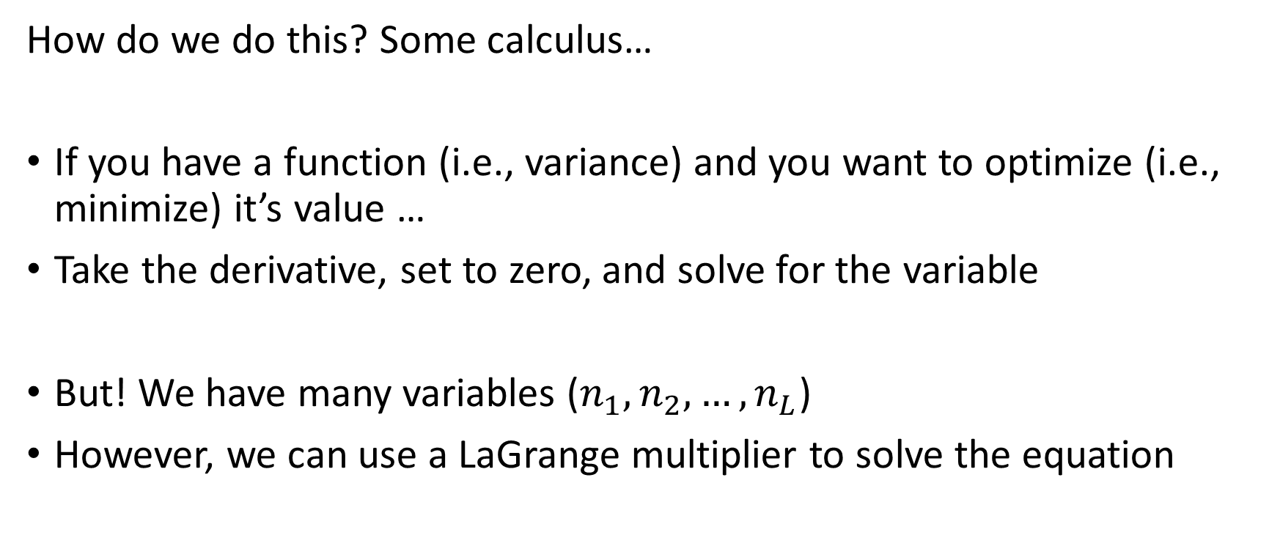
What is the objective? Minimize variance of the mean/total estimate
How do we do this? Some calculus…
If you have a function (i.e., variance) and you want to optimize (i.e., minimize) it’s value …
Take the derivative, set to zero, and solve for the variable
But! We have many variables ($n_{1}, n_{2}, …, n_{L}$)
However, we can use a LaGrange multiplier to solve the equation

Slide 5

What is the objective? Minimize Variance of the Total
$$\operatorname{minimize}{var\left(T\right)=\sum_{h=1}^{L}{\frac{N_{h}^{2}s_{h}^{2}}{n_{h}} (1 − \frac{n_{h}}{N_{h}})}}$$
$$subject to$$
$$\sum_{h=1}^{L}{n_{h}}=n (equal stratum cost)$$
(LaGrange nonsense…)
$$n_{h}=n\frac{N_{h}s_{h}}{\sum_{h=1}^{L}{N_{h}s_{h}}}$$
(Neyman Allocation)

Slide 6
How to extend to multispecies STRS design?
Neyman allocation is a single-species optimization
Because there is variation in species distributions across species set, no one survey design will fully minimize variance for all species at one time
There are tradeoffs of any multispecies survey design (good for some species, not great for others..)
Which species to include?
All major groundfish commercially caught, contained within the GOA FMP
Which species to prioritize?
Species with higher economic value (combination of ex-vessel price and biomass)

Slide 7
How to extend to multispecies STRS design?
Pull ex-vessel prices and biomass of species set
Conduct Neyman allocation for each species in each year (going back to 1996?)
Stratum effort: weighted average across species’ specific Neyman allocations
year | species | biomass (mt) | ex-vessel price | weight
2021 | Pacific ocean perch | 1478939.5 | 286.338 | 0.27
 | walleye pollock | 528841.3 | 374.442 | 0.13
 | shortspine thornyhead | 68224.2 | 1960.314 | 0.08
 | arrowtooth flounder | 1132191.7 | 110.13 | 0.08
 | Pacific cod | 174414.1 | 638.754 | 0.07
2009 | Pacific cod | 752650.9 | 638.754 | 0.26
 | walleye pollock | 703631.3 | 374.442 | 0.14
 | arrowtooth flounder | 1772029.3 | 110.13 | 0.10
 | Pacific ocean perch | 649448.8 | 286.338 | 0.10
 | shortspine thornyhead | 78795.4 | 1960.314 | 0.08
1999 | walleye pollock | 633804.9 | 374.442 | 0.16
 | Pacific ocean perch | 727063.5 | 286.338 | 0.14
 | Pacific cod | 306412.9 | 638.754 | 0.14
 | shortspine thornyhead | 77335.6 | 1960.314 | 0.10
 | arrowtooth flounder | 1262151.2 | 110.13 | 0.10

Slide 8
How do we adjust effort?
Changes in survey effort do happen (before or during survey)
AI 2022: in season station dropping
GOA 2023: 30 potential bonus stations
Same principles of sampling theory can be applied to effort adjustments
Useful in prioritizing stations or strata to adjust effort

Slide 9
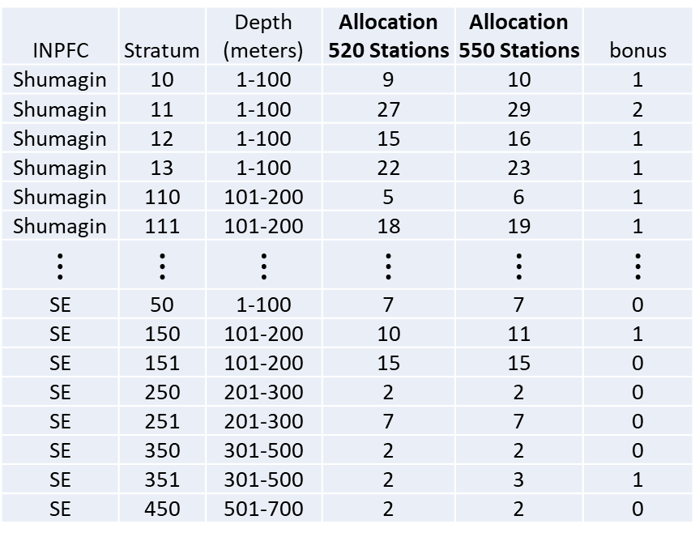
How do we adjust effort?
Changes in survey effort do happen (before or during survey)
AI 2022: in season station dropping
GOA 2023: 30 potential bonus stations
Same principles of sampling theory can be applied to effort adjustments
Useful in prioritizing stations or strata to adjust effort
INPFC | Stratum | Depth (meters) | Allocation 520 Stations | Allocation 550 Stations | bonus
Shumagin | 10 | 1-100 | 9 | 10 | 1
Shumagin | 11 | 1-100 | 27 | 29 | 2
Shumagin | 12 | 1-100 | 15 | 16 | 1
Shumagin | 13 | 1-100 | 22 | 23 | 1
Shumagin | 110 | 101-200 | 5 | 6 | 1
Shumagin | 111 | 101-200 | 18 | 19 | 1
$$⋮$$ | $$⋮$$ | $$⋮$$ | $$⋮$$ | $$⋮$$ | $$⋮$$
SE | 50 | 1-100 | 7 | 7 | 0
SE | 150 | 101-200 | 10 | 11 | 1
SE | 151 | 101-200 | 15 | 15 | 0
SE | 250 | 201-300 | 2 | 2 | 0
SE | 251 | 201-300 | 7 | 7 | 0
SE | 350 | 301-500 | 2 | 2 | 0
SE | 351 | 301-500 | 2 | 3 | 1
SE | 450 | 501-700 | 2 | 2 | 0
G:\GOA\GOA 2023\Station Allocation\Extra files\GOA2023_bonus_station_summary.xlsx

Slide 10
How do we adjust effort?
Shumagin | 8 |  | Yakutat | 4
101-200 | 2 |  | 101-200 | 3
1-100 | 5 |  | 1-100 | 1
201-300 | 1 |  | 201-300 | 0
301-500 | 0 |  | 301-500 | 0
501-700 | 0 |  | 501-700 | 0
Chirikof | 6 |  | Southeast | 2
101-200 | 3 |  | 101-200 | 1
1-100 | 3 |  | 1-100 | 0
201-300 | 0 |  | 201-300 | 0
301-500 | 0 |  | 301-500 | 1
501-700 | 0 |  | 501-700 | 0
Kodiak | 10 |  | Grand Total | 30
101-200 | 6
1-100 | 3
201-300 | 1
301-500 | 0
501-700 | 0
Changes in survey effort do happen (before or during survey)
AI 2022: in season station dropping
GOA 2023: 30 potential bonus stations
Same principles of sampling theory can be applied to effort adjustments
Useful in prioritizing stations or strata to adjust effort
G:\GOA\GOA 2023\Station Allocation\Extra files\GOA2023_bonus_station_summary.xlsx

Slide 11
Multispecies Neyman Allocation Overview
Advantages
Challenges
Neyman allocation is easy to implement
Objective of minimizing variance is directly related to our purposes
Design is influenced by species we “care about”
Allocation is informed by previous surveys
Unclear how the blending of allocations affect species variance, hard to evaluate species tradeoffs
Further emphasis on species is hard to do without playing around the species weights
Low-value species (e.g., ATF, POP) can have a large influence because of their biomass
We filter out really high-value species (halibut and sablefish) because they have too high of a weight in the allocation

Slide 12
Restratification of the GOA STRS Design
Restratified GOA STRS design (2025 -) : multispecies Bethel algorithm
Objective: optimal allocation of stations across strata that minimizes total effort that meet species-specific precision targets
i.e., for a given level of precision across the species set, what is the minimal sample size required?
Don’t we want the allocation that provides the best precision given the total sample size like the Neyman allocation?
With many non-overlapping species, no one optimal allocation scheme will be optimal to all species in the species set,
We have to carefully “tune” these precision constraints to provide the best design across species

Slide 13
Bounding and tuning CV constraints
Precision (CV)
Notes:
Here is a simple diagram to help explain one approach we’ve taken to set CV constraints objectively.
Consider a spectrum of survey designs, where those further to the lower right provide more precise abundance estimates for a given species, but at the cost of higher sampling effort.
Obviously, due to differences in distributions among species, we cannot expect better precision from a multispecies stratified random survey than from the same design optimized for a single focal species, represented by the red point. So this represents a useful lower bound to our CV constraints in the multispecies case.
On the other end of the spectrum, we should be able to obtain better precision than what would be expected under simple random sampling. So, we use the expected CV given simple random sampling as an upper bound, initializing our CV constraints at that value particular to each species, and then incrementally reduce the CV constraints across species and repeat the optimization until we can no longer improve precision without a sample size that is greater than the total survey effort we have resources for.

Slide 14
Bounding and tuning CV constraints
Simple Random Sampling
Single-Species STRS
Precision (CV)
Notes:
Here is a simple diagram to help explain one approach we’ve taken to set CV constraints objectively.
Consider a spectrum of survey designs, where those further to the lower right provide more precise abundance estimates for a given species, but at the cost of higher sampling effort.
Obviously, due to differences in distributions among species, we cannot expect better precision from a multispecies stratified random survey than from the same design optimized for a single focal species, represented by the red point. So this represents a useful lower bound to our CV constraints in the multispecies case.
On the other end of the spectrum, we should be able to obtain better precision than what would be expected under simple random sampling. So, we use the expected CV given simple random sampling as an upper bound, initializing our CV constraints at that value particular to each species, and then incrementally reduce the CV constraints across species and repeat the optimization until we can no longer improve precision without a sample size that is greater than the total survey effort we have resources for.

Slide 15
Bounding and tuning CV constraints
Simple Random Sampling
Single-Species STRS
More Precise (Lower CV),
Higher Total Effort
Multispecies STRS
Notes:
Here is a simple diagram to help explain one approach we’ve taken to set CV constraints objectively.
Consider a spectrum of survey designs, where those further to the lower right provide more precise abundance estimates for a given species, but at the cost of higher sampling effort.
Obviously, due to differences in distributions among species, we cannot expect better precision from a multispecies stratified random survey than from the same design optimized for a single focal species, represented by the red point. So this represents a useful lower bound to our CV constraints in the multispecies case.
On the other end of the spectrum, we should be able to obtain better precision than what would be expected under simple random sampling. So, we use the expected CV given simple random sampling as an upper bound, initializing our CV constraints at that value particular to each species, and then incrementally reduce the CV constraints across species and repeat the optimization until we can no longer improve precision without a sample size that is greater than the total survey effort we have resources for.

Slide 16
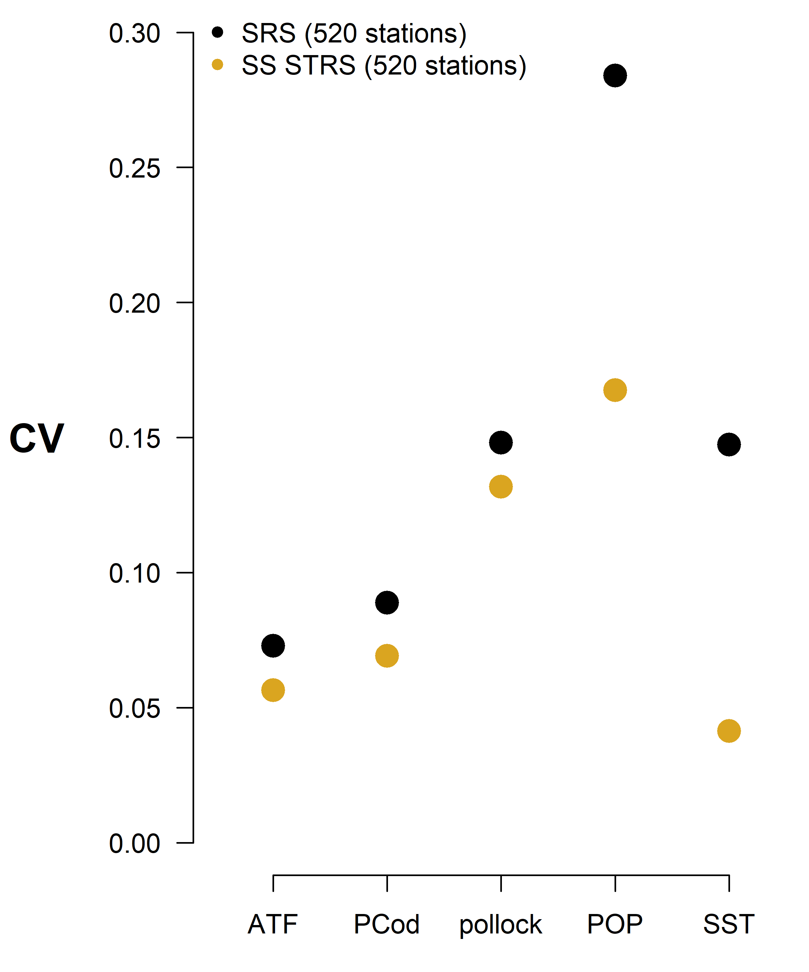

Slide 17
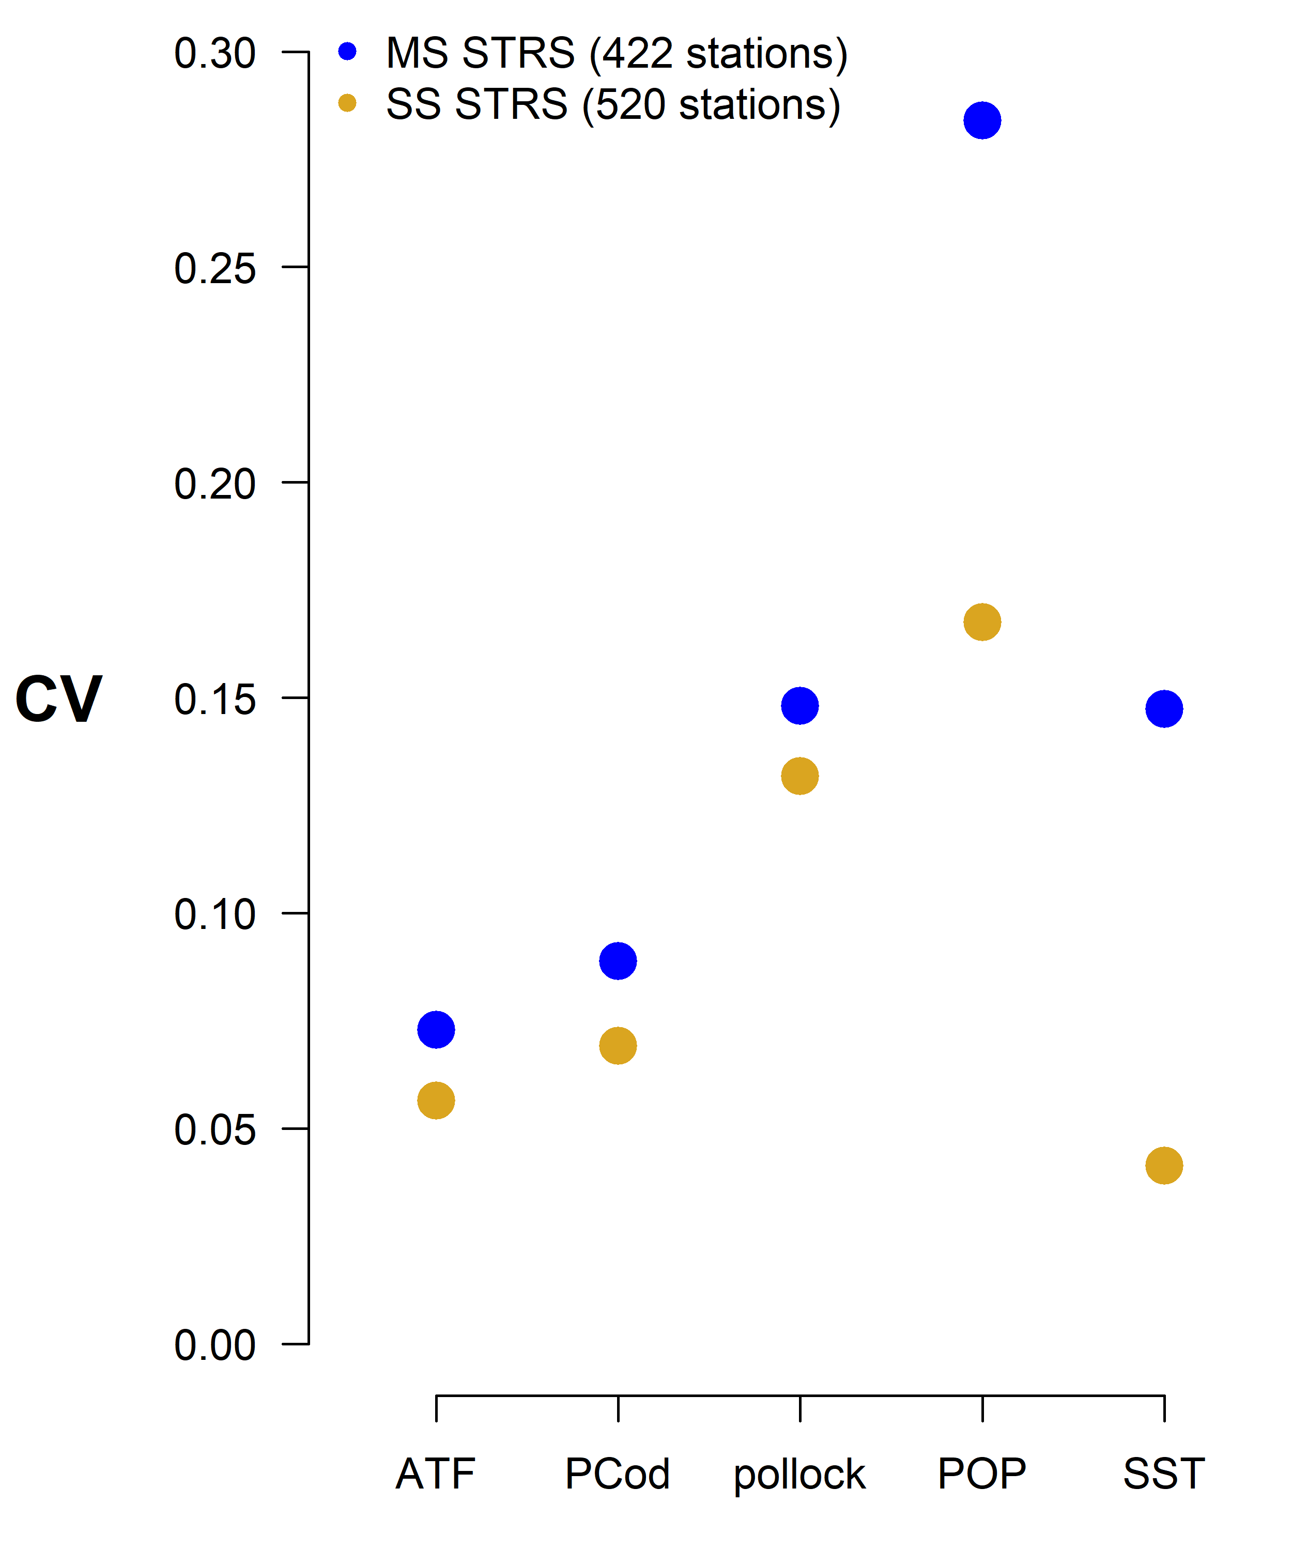

Slide 18
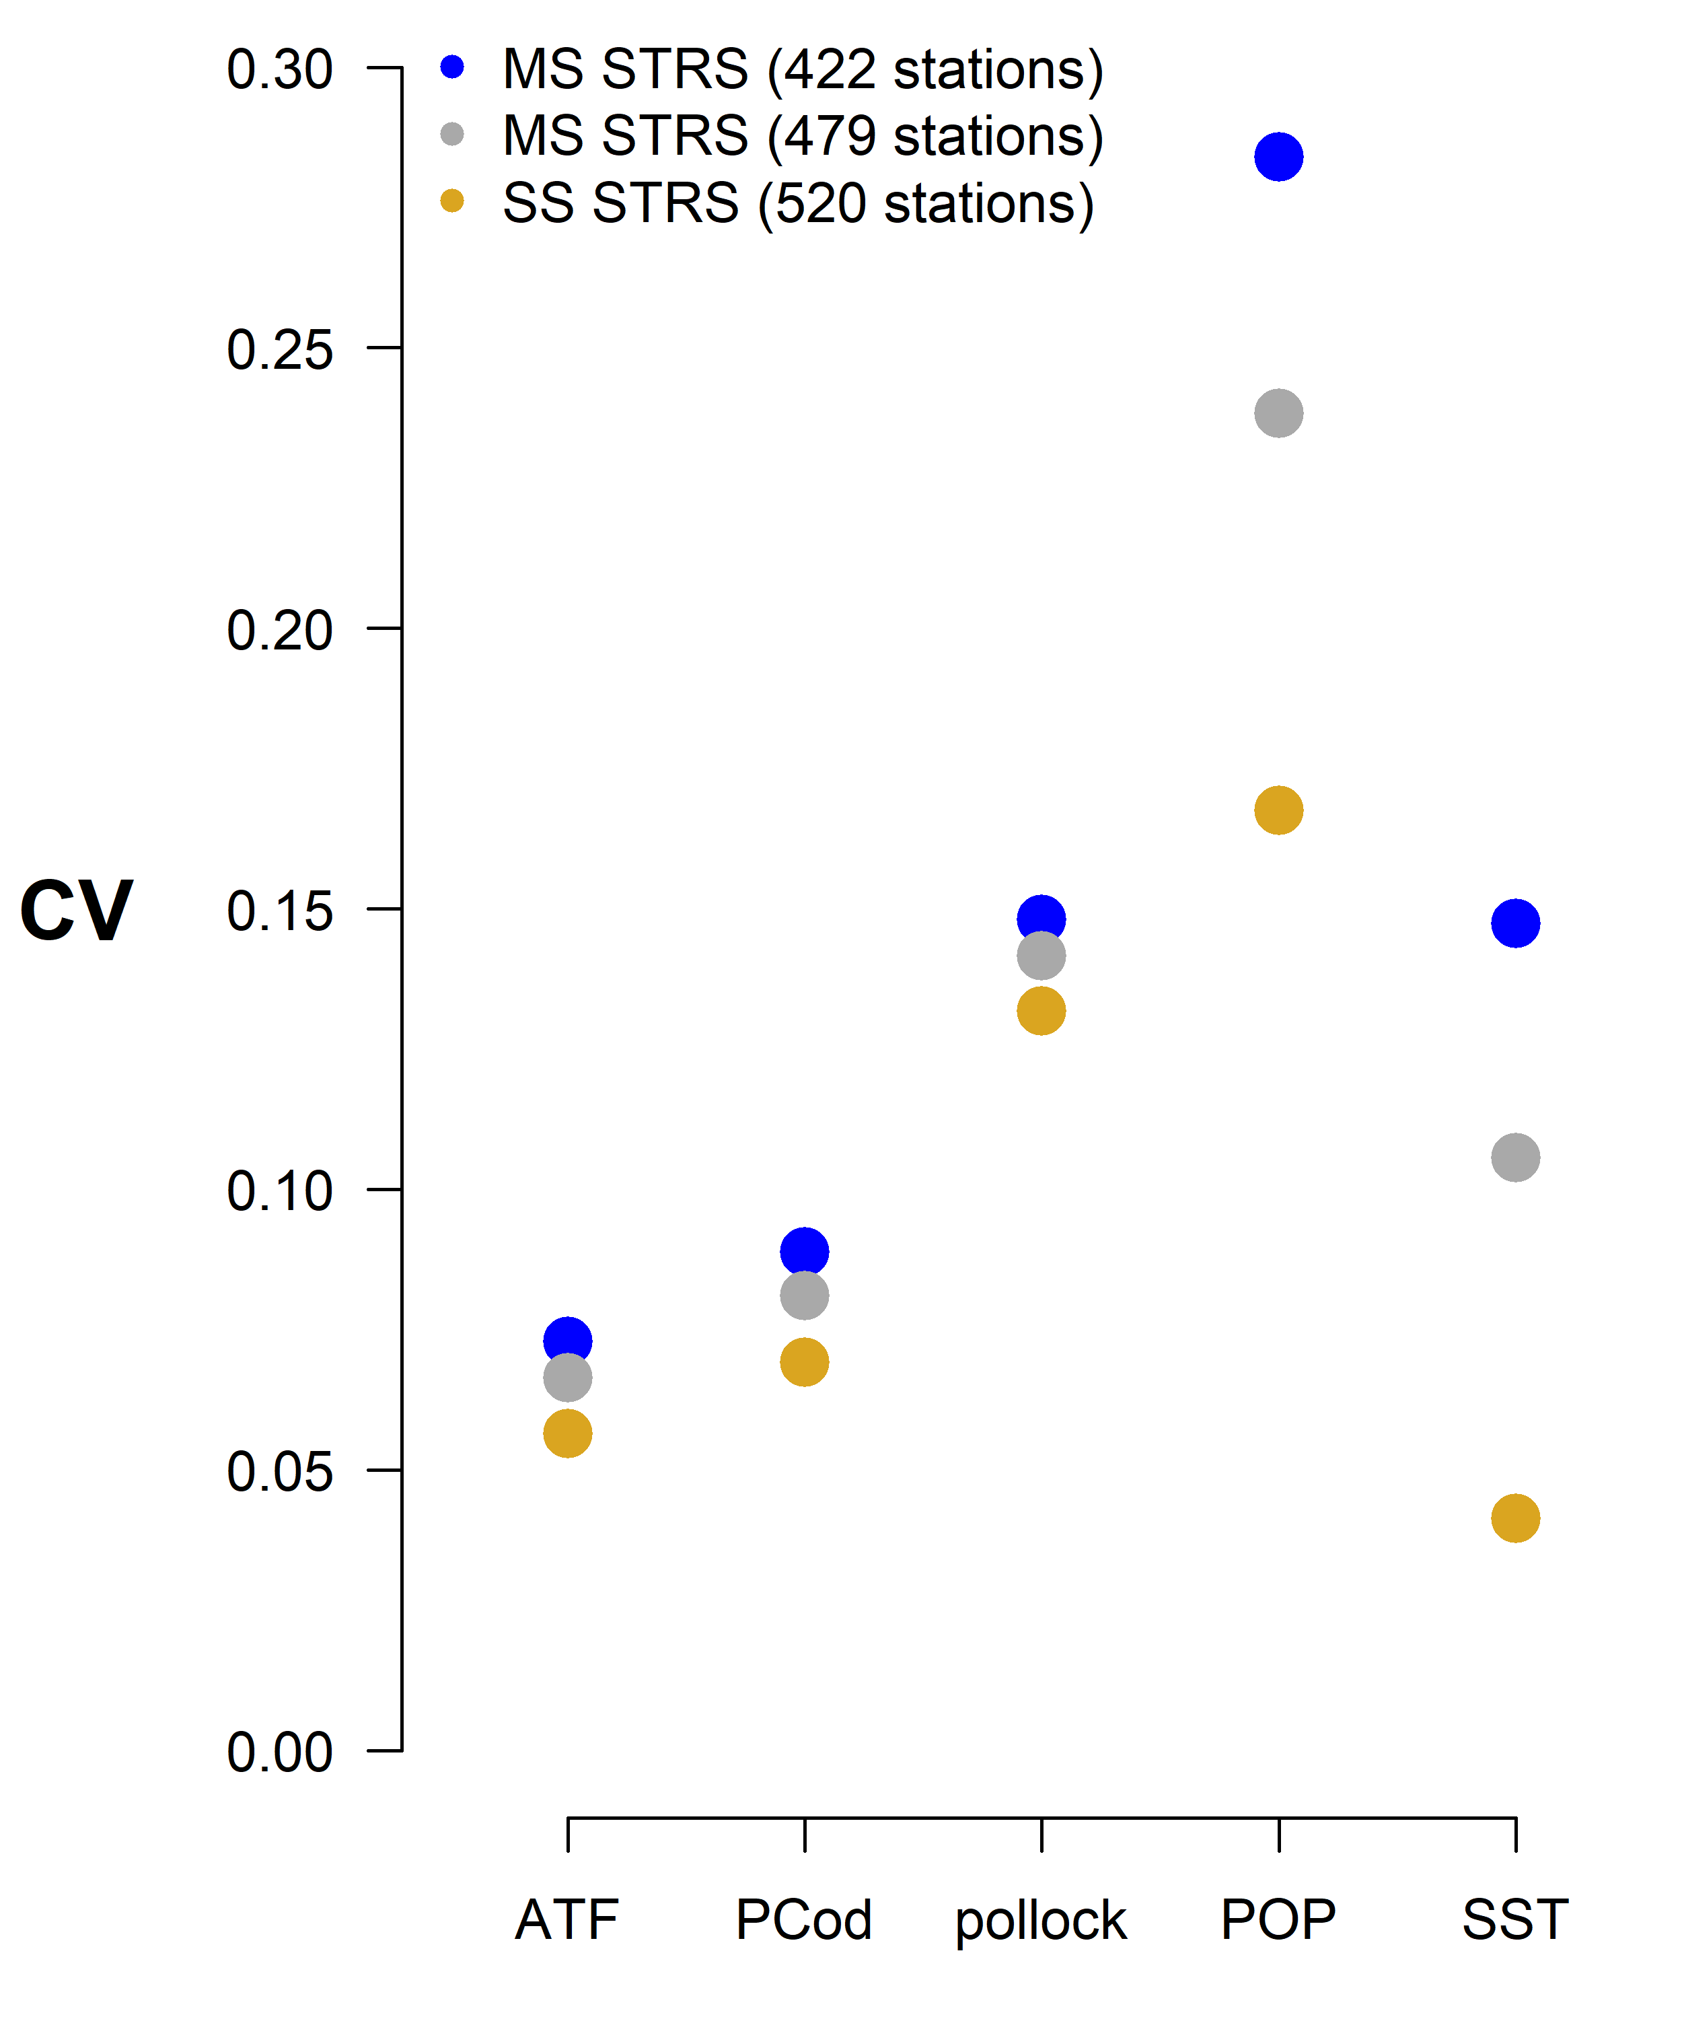

Slide 19
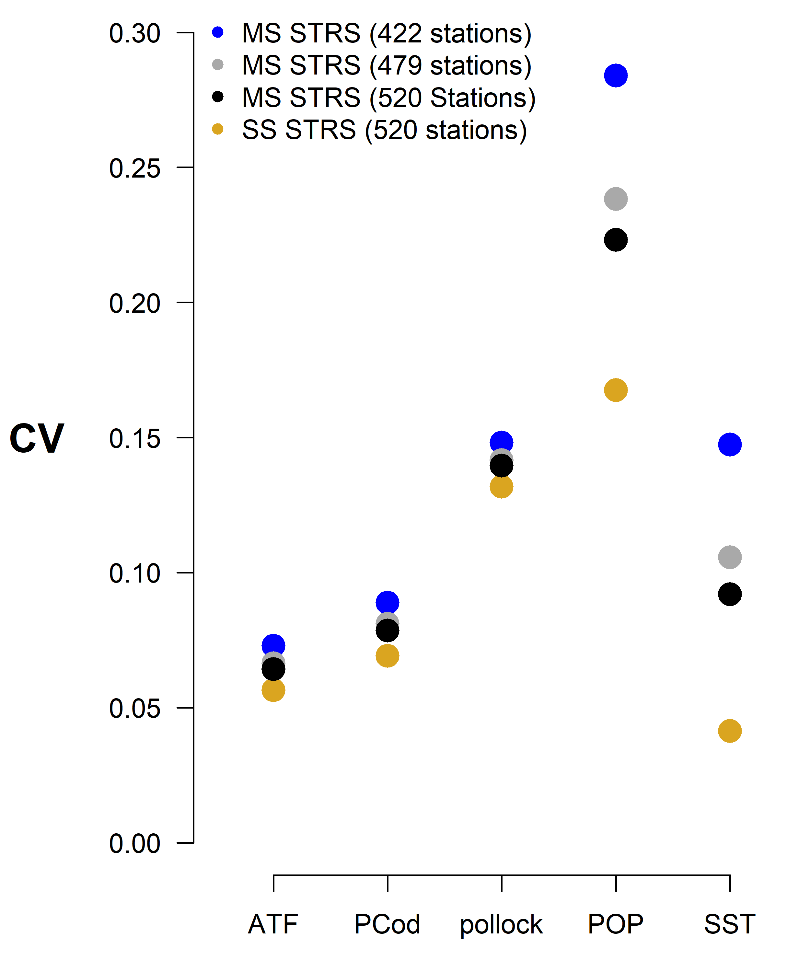

Slide 20
StationAllocationAIGOA R Package
Github repository in our afsc gap products org repo
https://github.com/afsc-gap-products/StationAllocationAIGOA
Holds function to conduct the AI allocation (under MS Neyman allocation) and the GOA allocation (under new restratification and Bethel algorithm)
Nearly finished for the GOA allocation, needs more user testing in the future.

Slide 21
Extra Slides

Slide 22
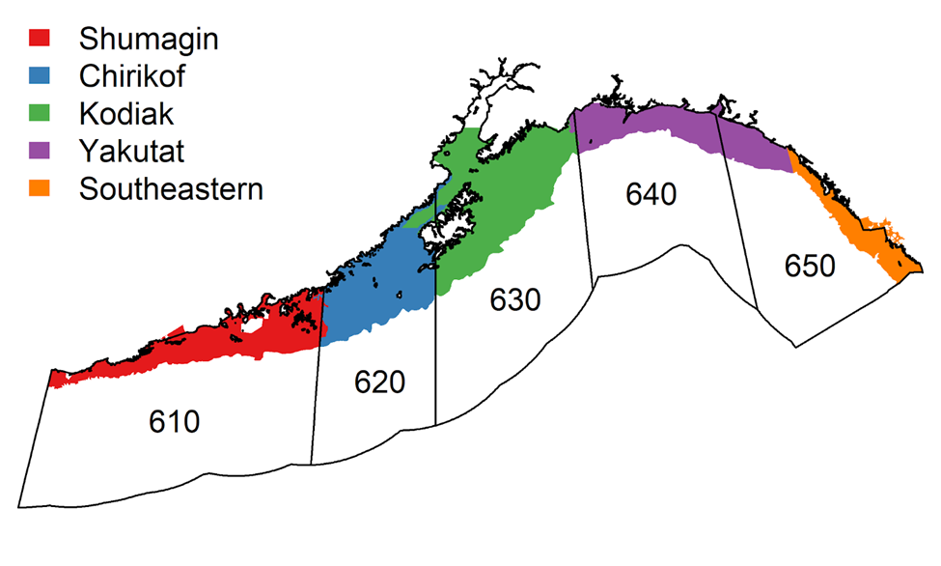
Summary of Restratification
 | Historical Strata (1984-2023) | 2025 Restratification (2025-on)
Stratum variables | INPFC areas Depth Terrain (shelf, gully, slope) | NMFS Statistical Areas Depth *Depth bins are allowed to differ among NMFS areas.
Total strata | 59 strata (54 strata when survey extends to 700 m) | 30 strata (25 strata when survey extends to 700 m)
INPFC areas (colors) with NMFS areas superimposed
Notes:
Here is a summary of those changes. We have two columns: one of survey years 1984 – 2023 and one for 2025 and on, and this brings up two important points. First is that this new stratification will only apply to years 2025-on. We will not be recalculating the time series under this new stratification, nor do we think it is statistically appropriate to do. Second, because we are shifting from one STRS design to another STRS design, given the same assumptions between the two designs, we don’t expect a change in index related to the restratification, this is also highlighted in the tech memo. In other words, the times series is still be continuous with this new ST Random design.
The first change to note is the differences in stratum variables. The historical strata are defined by INPFC management area (which are the filled polygons on the left) and depth, the depth bins of which are consistent across management areas. These strata are also characterized by their terrain, whether it’s a shelf/gully/or slope.
The Gulf has a lot of strata (59 total, 54 when the survey was cut off @700 m). Many of these strata were drawn ad hoc with limited information on bathymetry and other bottom features. A good handful of these strata are also quite small and hard to get good estimates for.
The new stratification is based on NMFS Statistical Areas in lieu of the INPFC area (the areas 610-650 on the left there). This change was made given our discussions with the GOA Plan Team. There was some confusion when communicating to stock assessment on which management areas are relevant so one of the lines of feedback we are requesting from the council is whether these NMFS areas are the relevant management areas to implement the new stratification going forward. The new stratification also has less strata that the historical design. Decreasing the number of strata from 59 to 30 strata increases our flexibility to obtain good stratum estimates while at sea.

