Slide 1
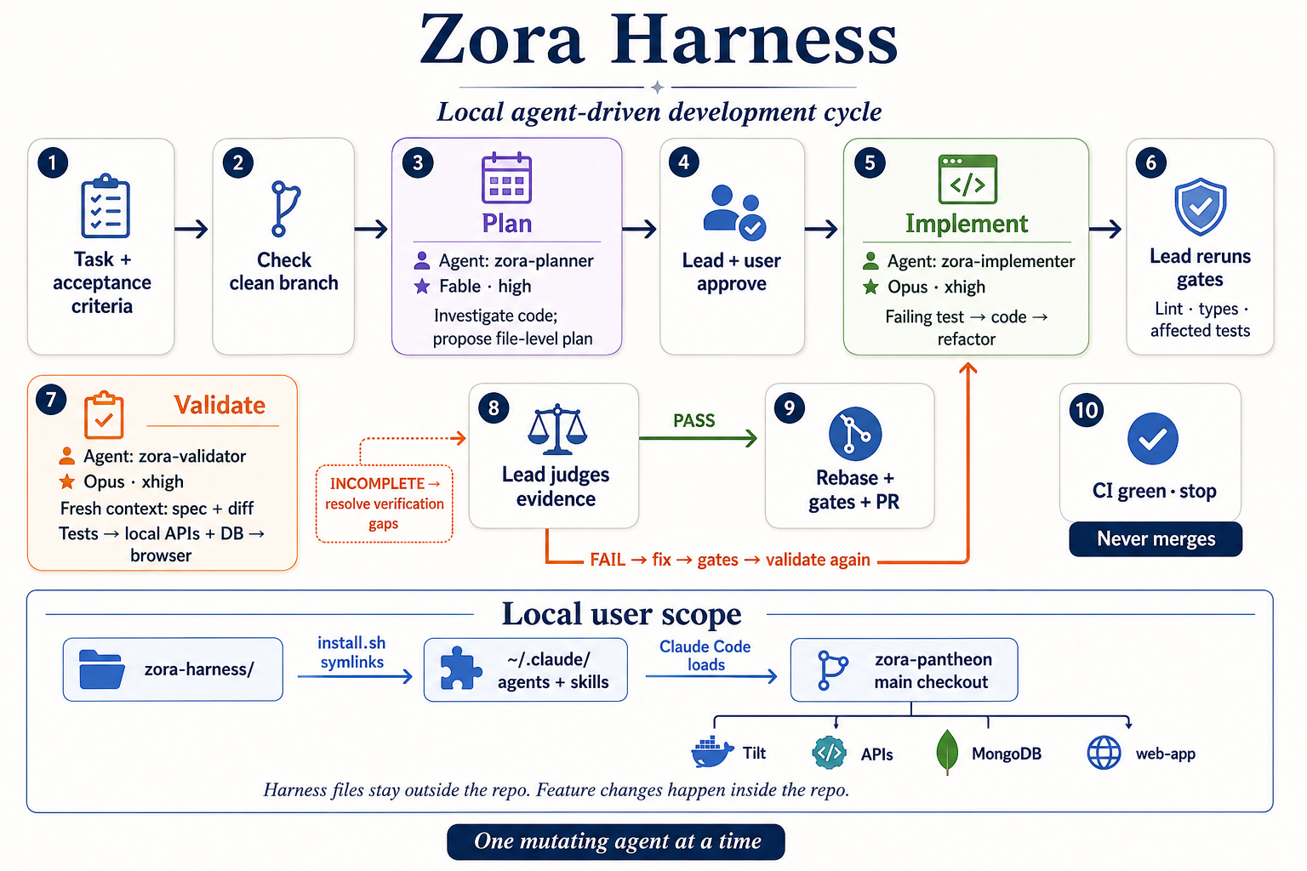
THE DELIVERY LOOP
How the harness guides delivery
A shared view of who plans, builds, checks and decides
ONE MUTATING AGENT AT A TIME
The lead keeps responsibility for scope, evidence and the final decision.
01
Notes:
This is the harness at a glance. It begins with a clear task and acceptance criteria, then moves through planning, approval, implementation, checks and independent validation. The lead remains accountable for decisions. A failure returns to implementation. The process ends with a CI-green pull request, while the user retains the merge decision. The lower strip shows local user scope: the harness lives outside the application repository and is loaded through the user’s Claude Code configuration.
Sources:
/Users/andressalguero/Documents/housenumbers/zora-harness/README.md
/Users/andressalguero/Documents/housenumbers/zora-harness/skills/zora-cycle/SKILL.md

Slide 2
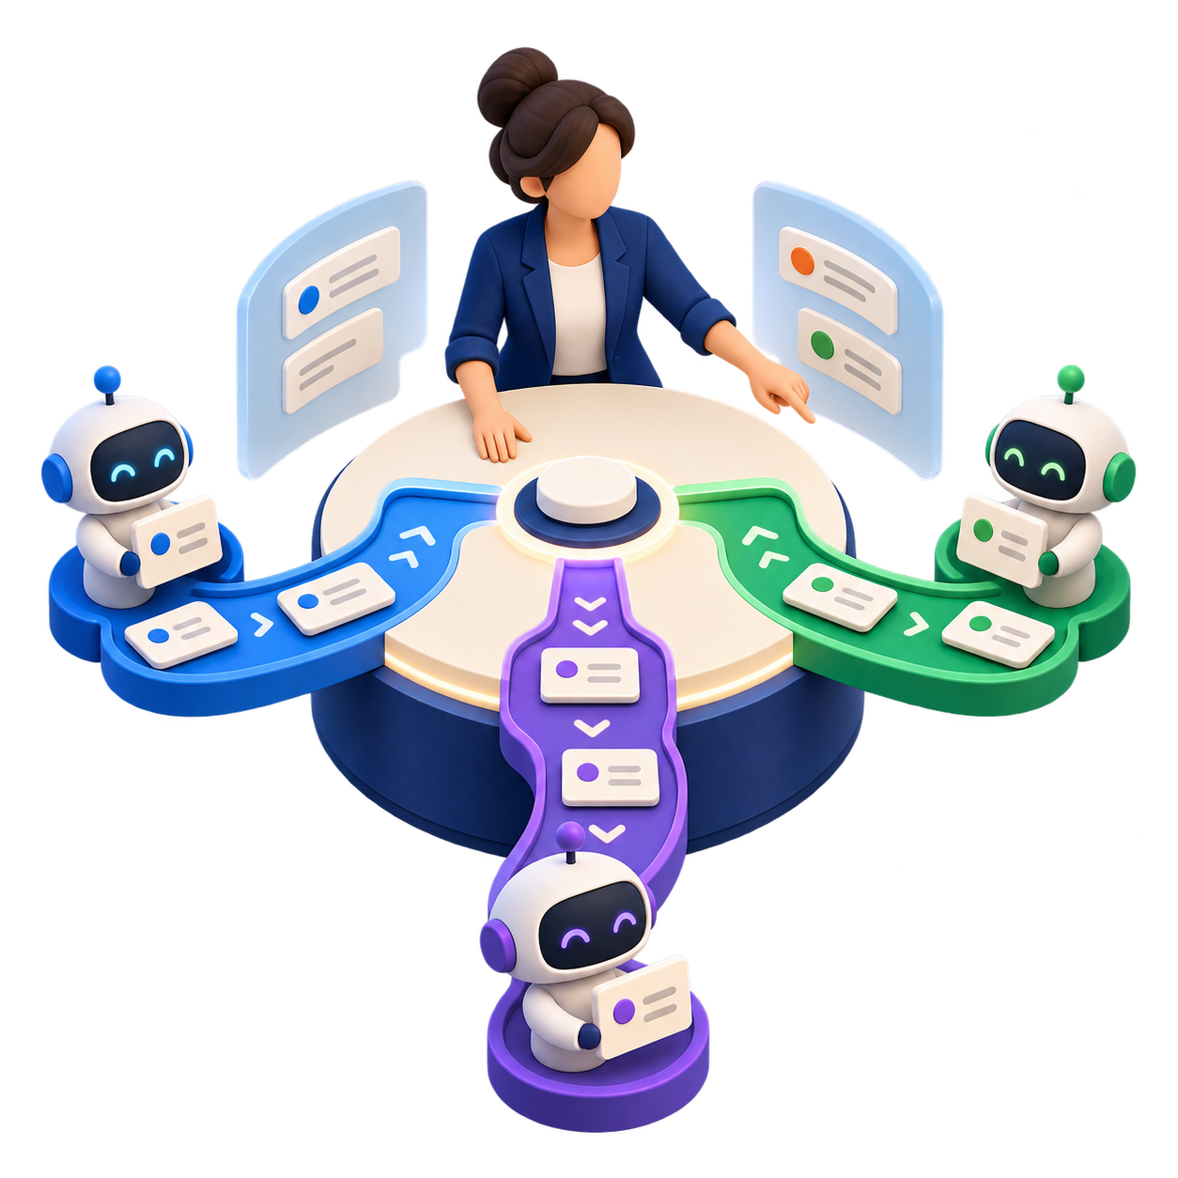
ORCHESTRATION
One person stays in control
The harness gives each agent one clear role while the lead keeps the full picture.
The lead owns the map
Scope, decisions, evidence and the next action stay visible in a working ledger.
Each specialist gets a focused brief
A plan for the builder. Requirements and a diff for an independent validator.
New conversations start safely
Checkpoint the work, check what is live, then continue from the ledger and Git state.
Clear roles. Fresh perspective. Visible accountability.
02
Notes:
The operating model is simple. Claude Code executes the specialist roles and custom skills define their procedures. The lead maintains a durable ledger of approved scope, key decisions, agent identifiers, branch state and evidence. Each agent receives a bounded brief rather than the entire conversation. The validator is intentionally independent: it receives the requirements and the actual change, without the builder’s reasoning. When starting a new conversation, we preserve the state in the ledger, check whether any agent is still running, then resume from the durable artifacts and Git history.
Sources:
/Users/andressalguero/Documents/housenumbers/zora-harness/skills/zora-cycle/SKILL.md
/Users/andressalguero/Documents/housenumbers/zora-pantheon/.agents/skills/orchestrate/SKILL.md
/Users/andressalguero/Documents/housenumbers/zora-pantheon/.agents/skills/subagents/SKILL.md
Generated illustration: orchestration-control-tower.png

Slide 3
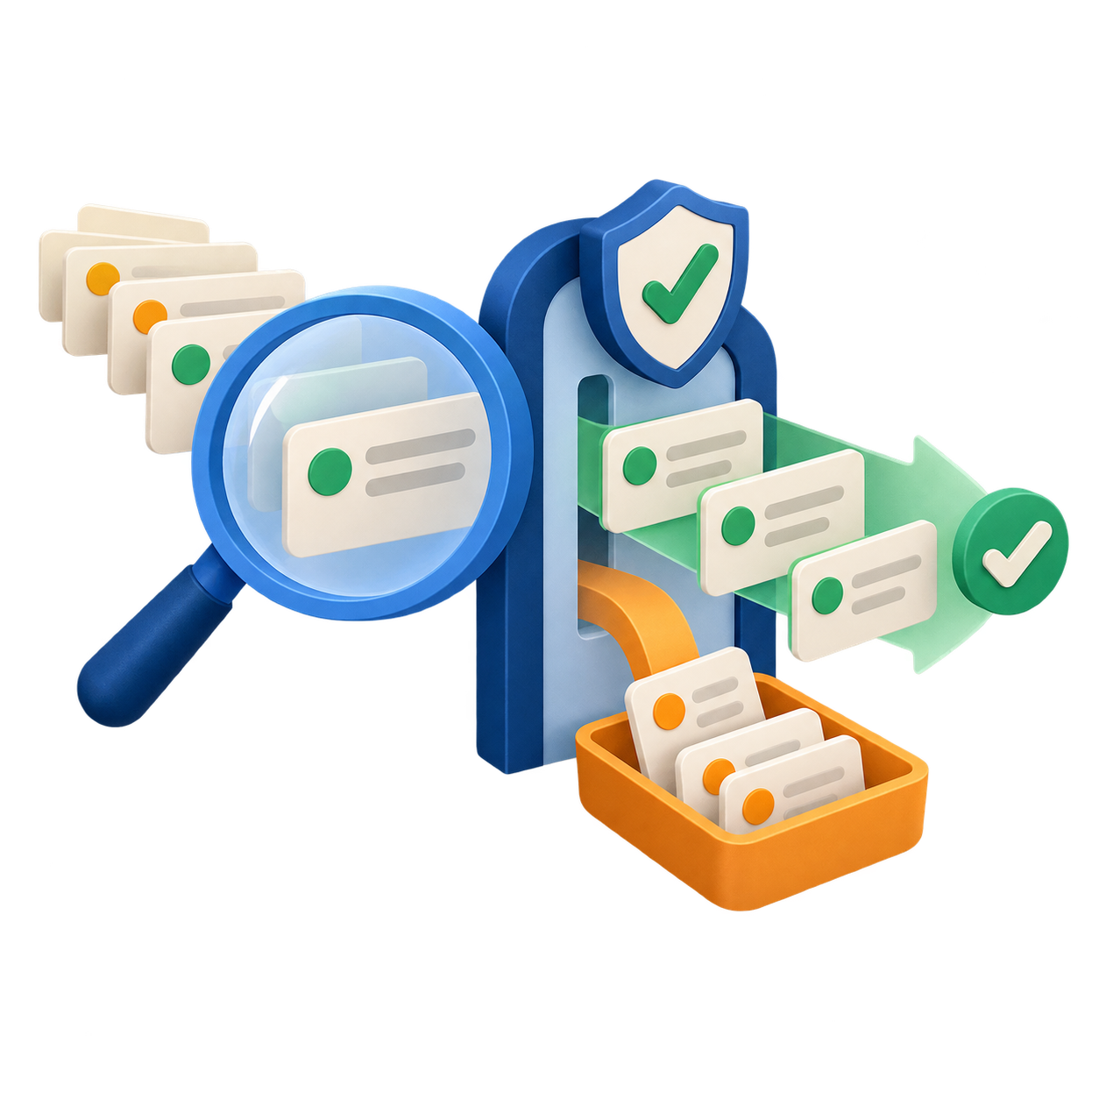
DECISION QUALITY
Ideas need proof before they change the product
Review comments and generated tests become evidence-backed decisions.
1
Confirm the problem
The planner checks the claimed issue against the actual code and product behavior.
2
Challenge the finding
A verifier tries to disprove a significant claim using the source, specification and tests.
3
Decide deliberately
Fix confirmed work, bank useful ideas for later, and reject unsupported changes.
FIX NOW
BANK
REJECT
03
Notes:
This slide addresses the failure mode where agents over-optimize or attempt to repair a problem created by their own test or evaluation. First, the planner must verify the original premise. Correct existing behavior is a valid outcome. Second, a significant review finding gets an independent refutation attempt. The verifier checks the actual source, specification and tests. Finally, the lead makes the decision: fix a confirmed in-scope issue, bank a real but unrelated issue, or reject a claim that is not supported. A generated test never becomes a product requirement just because it fails.
Sources:
/Users/andressalguero/Documents/housenumbers/zora-harness/skills/agent-review/SKILL.md
/Users/andressalguero/Documents/housenumbers/zora-harness/agents/zora-planner.md
/Users/andressalguero/Documents/housenumbers/zora-harness/agents/zora-implementer.md
Generated illustration: decision-filter.png

Slide 4
WHERE THE DESIGN COMES FROM
A research pattern, adapted for real delivery
Inspired by Anthropic’s multi-agent research system and tailored to the Zora environment.
1
2
3
Research pattern
Zora adaptation
Stakeholder outcome
A lead delegates bounded work to specialists with separate contexts.
One writer uses the shared checkout while review and validation remain independent.
The work stays visible, evidence-led and under human control through the PR.
Scope, evidence and ownership stay visible at every handoff.
Read the inspiration
Anthropic research pattern · Claude Code runtime · Custom local skills
04
Notes:
The harness drew inspiration from Anthropic’s multi-agent research system. The shared ideas are a lead-agent and specialist-agent model, bounded task delegation, separate contexts and durable handoffs. Anthropic also notes that software work has fewer truly independent tasks than research. The Zora adaptation therefore sequences changes in the shared checkout while it uses independence where it adds value: planning, review and validation. The intent for stakeholders is simple: visible scope, evidence before change and a named person accountable for the final decision.
Sources:
https://www.anthropic.com/engineering/multi-agent-research-system
/Users/andressalguero/Documents/housenumbers/zora-harness/README.md
/Users/andressalguero/Documents/housenumbers/zora-pantheon/.agents/skills/orchestrate/SKILL.md

