Slide 1
Battle of Neighborhood
A IBM/Coursera Assignment Presentation

Slide 2
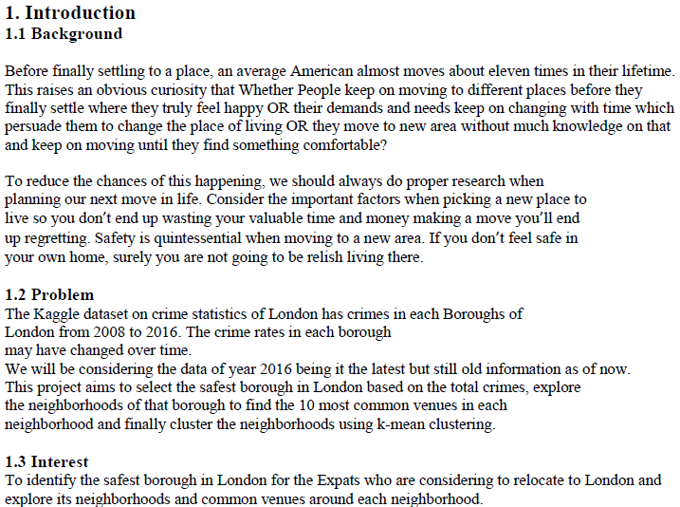

Slide 3
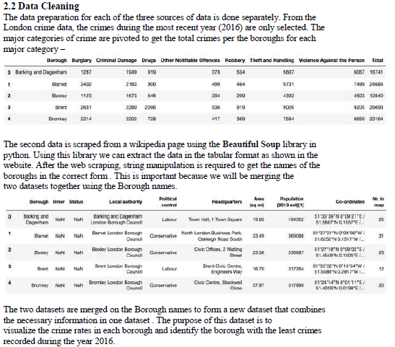

Slide 4
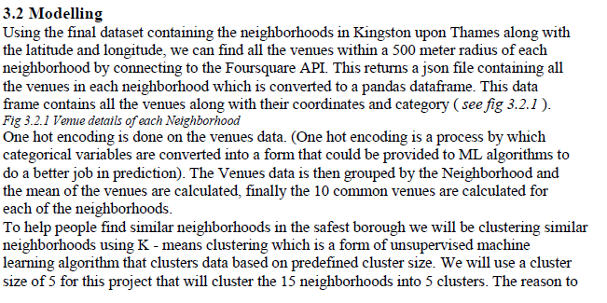

Slide 5
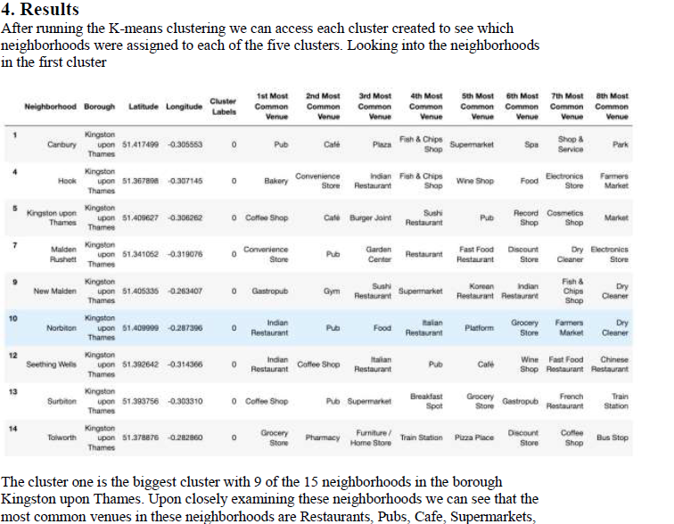

Slide 6
