Slide 1

3D game development with Unity
Supervisor: Candidate:
Erős Bence Dániel Pouria Afshari
Assistant lecturer Computer Science BSc

Slide 2
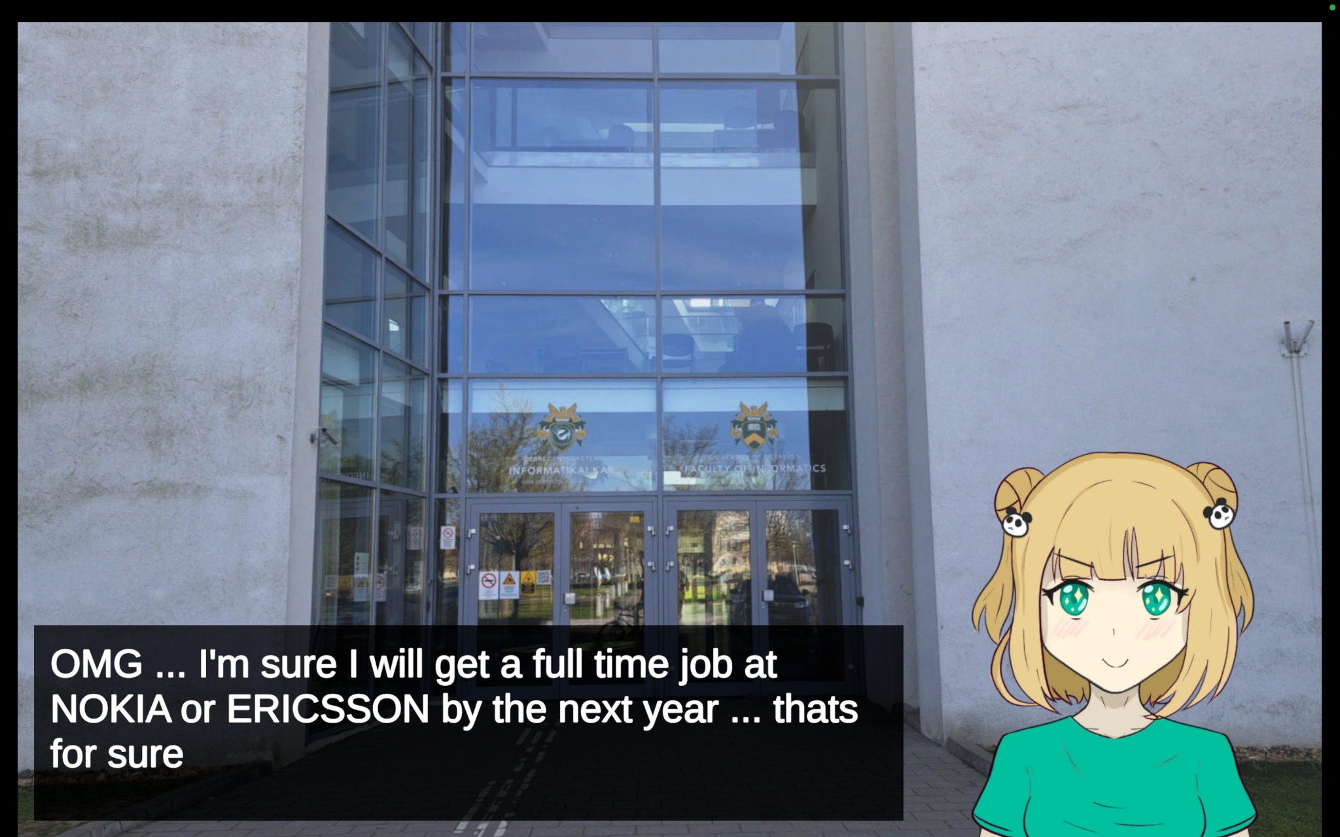
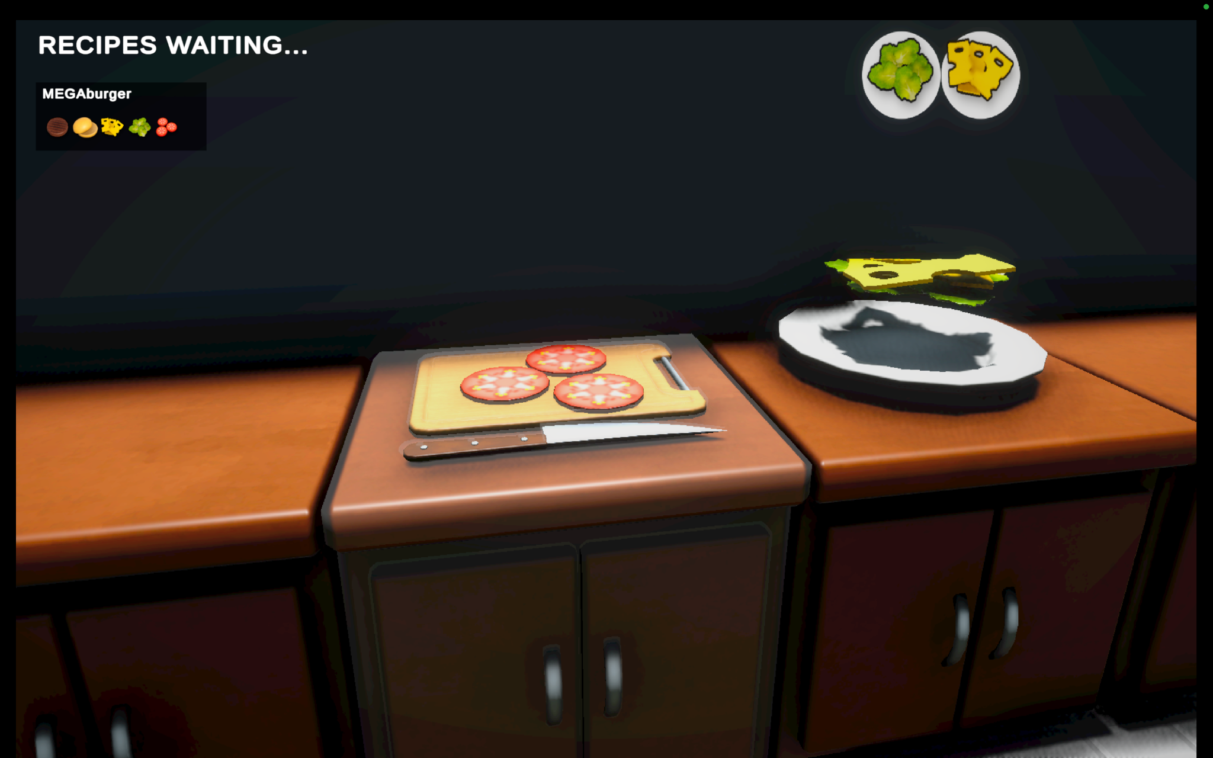
Problem posing:
Balancing storytelling and interactive gameplay.
Highlighting real-world career struggles.
Tasks:
Develop a 3D first-person game with cooking mechanics.
Integrate a 2D visual novel introduction.

Slide 3
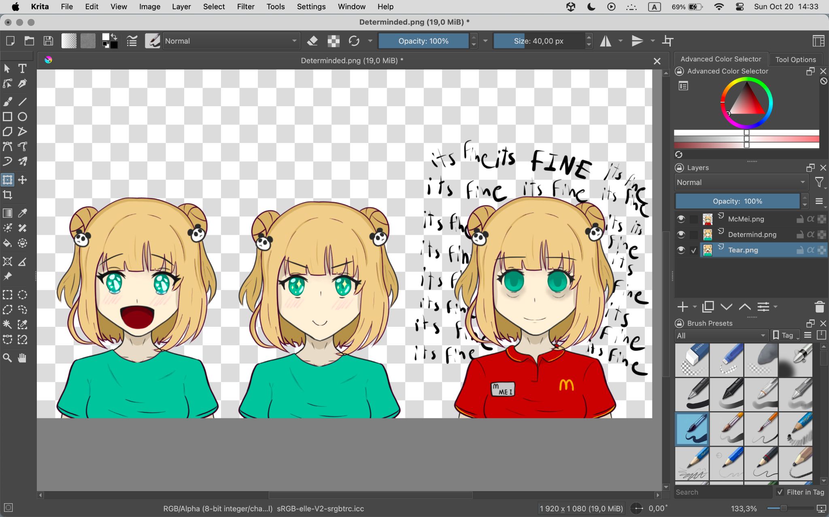
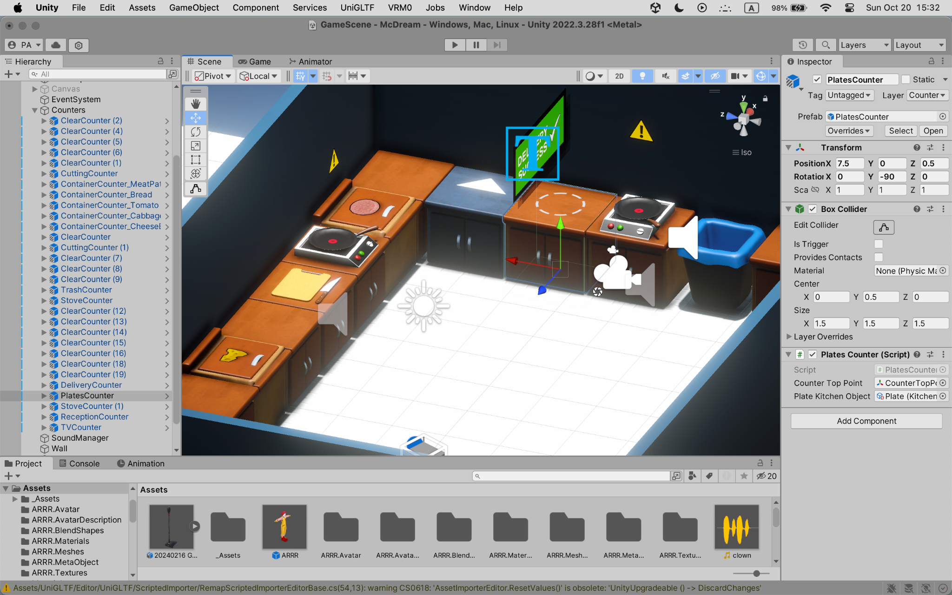
Methods and Technologies
Tools Used:
Unity (Game Engine)
Krita (2D Art)
C# (Scripting)
Methods:
State Machines: For cooking stages (raw → cooking → burned).
Raycasting: Detect and interact with kitchen objects (e.g., stove, counters).
Randomization: Order system generates unpredictable customer requests.

Slide 4
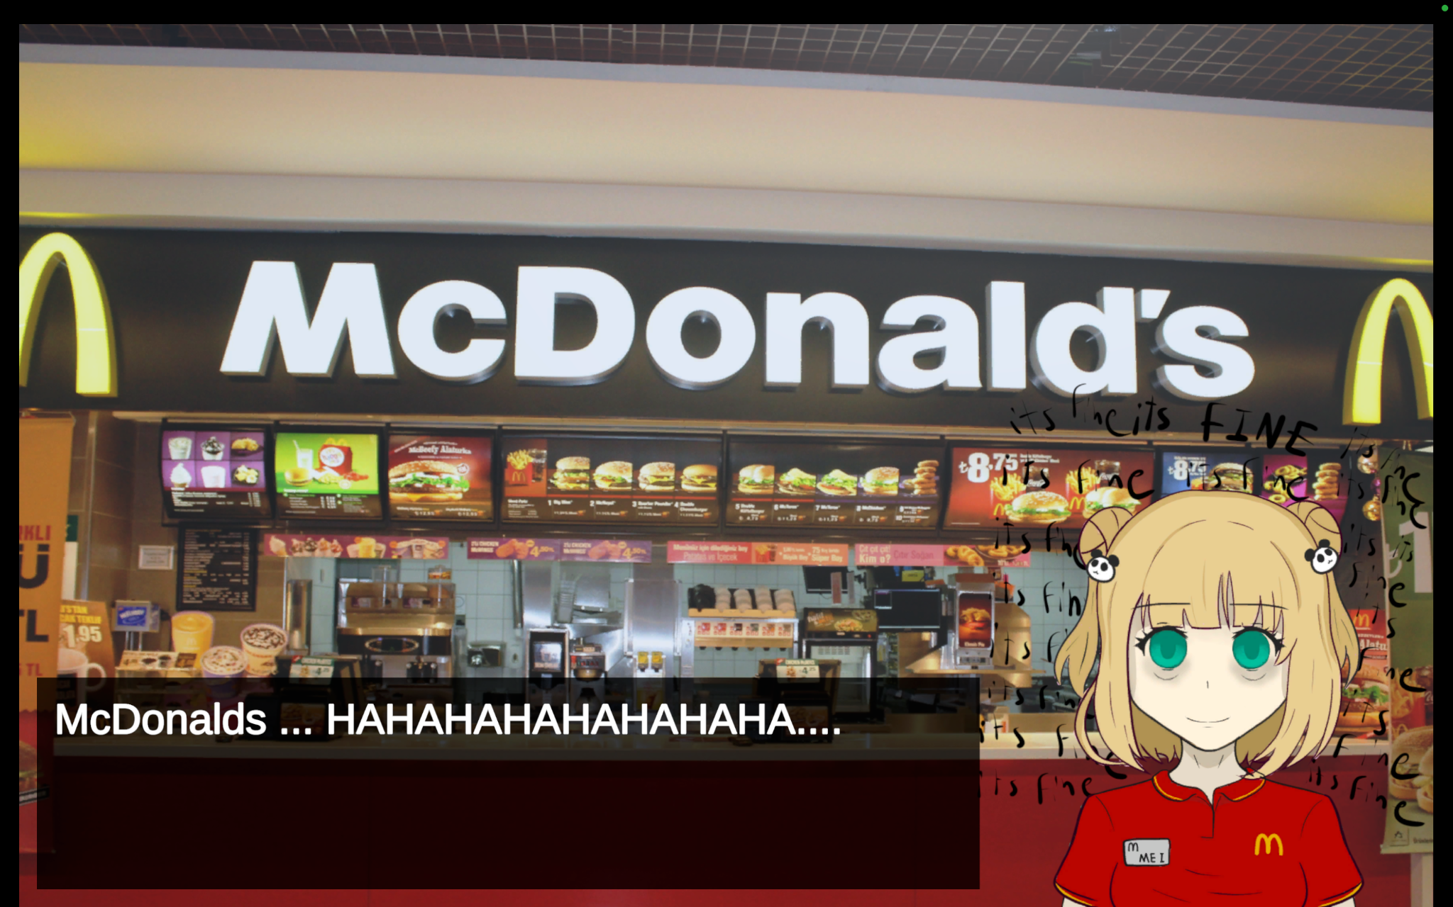
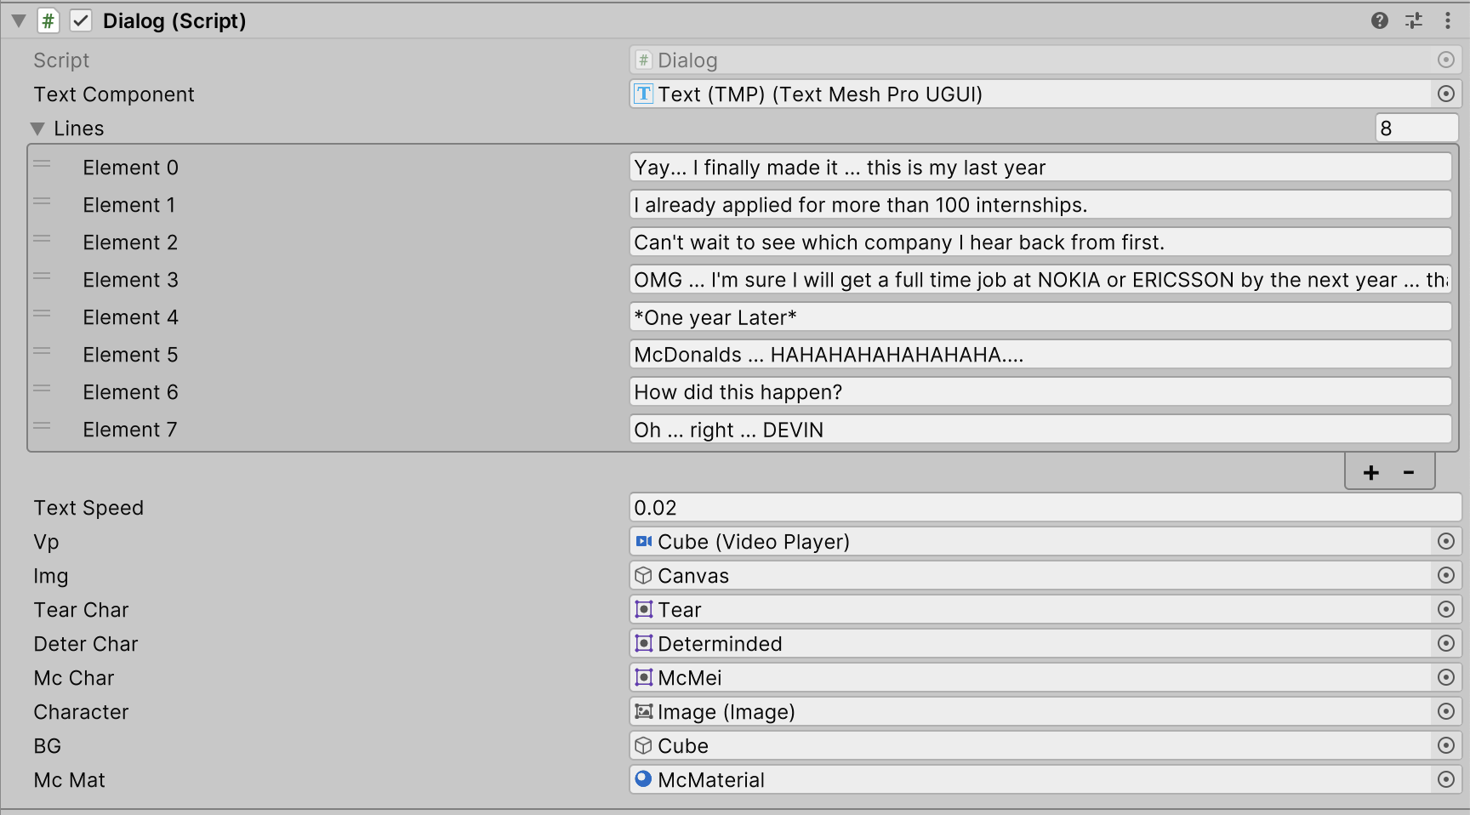
Visual Novel Introduction
2D Storytelling:
Mei’s journey as a struggling computer science graduate.
Visual novel style implemented using custom dialogue systems.
Assets:
Character sprites and backgrounds designed in Krita.
Integration:
Transition from visual novel to gameplay for a seamless player
experience.

Slide 5
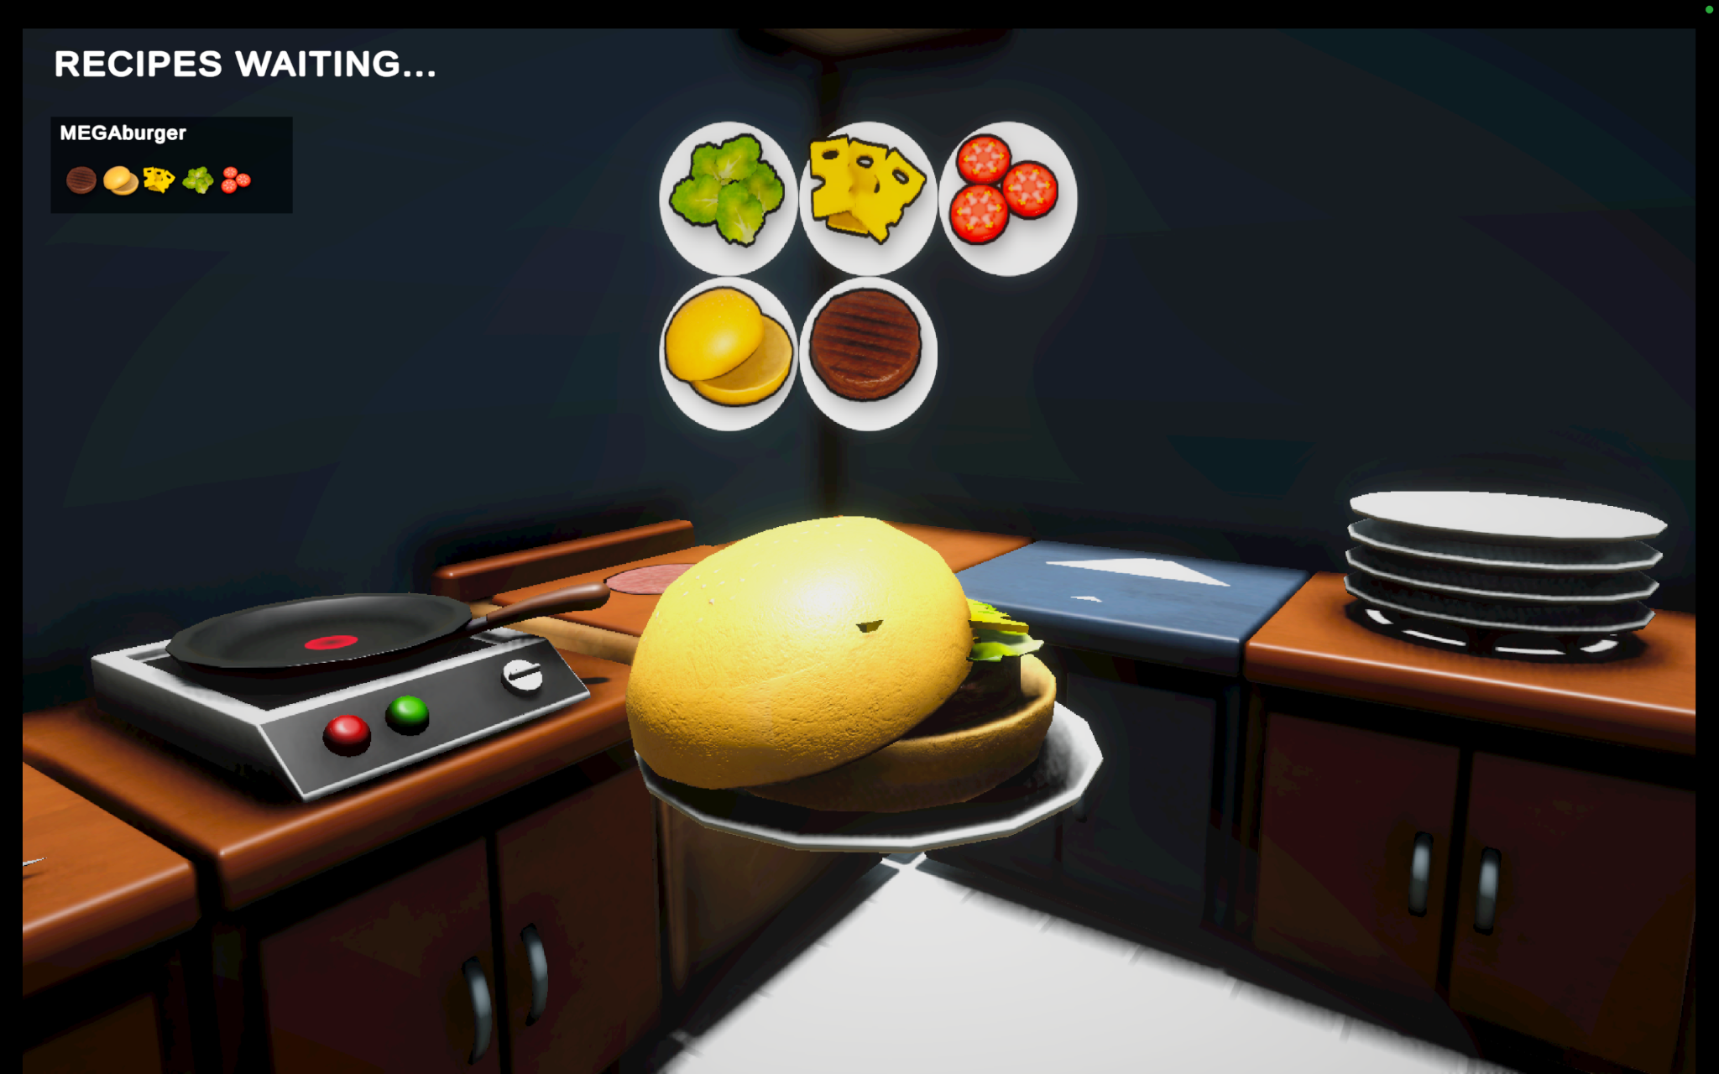
Cooking Simulation Mechanics
Core Gameplay:
Prepare food orders (e.g., burgers, salads) based on dynamic requests.
Manage stations: grill, fryer, and assembly counter.
Cooking Workflow:
Food stages: Raw → Cooking → Cooked → Burned.
Challenges:
Timing and precision in completing orders.

Slide 6
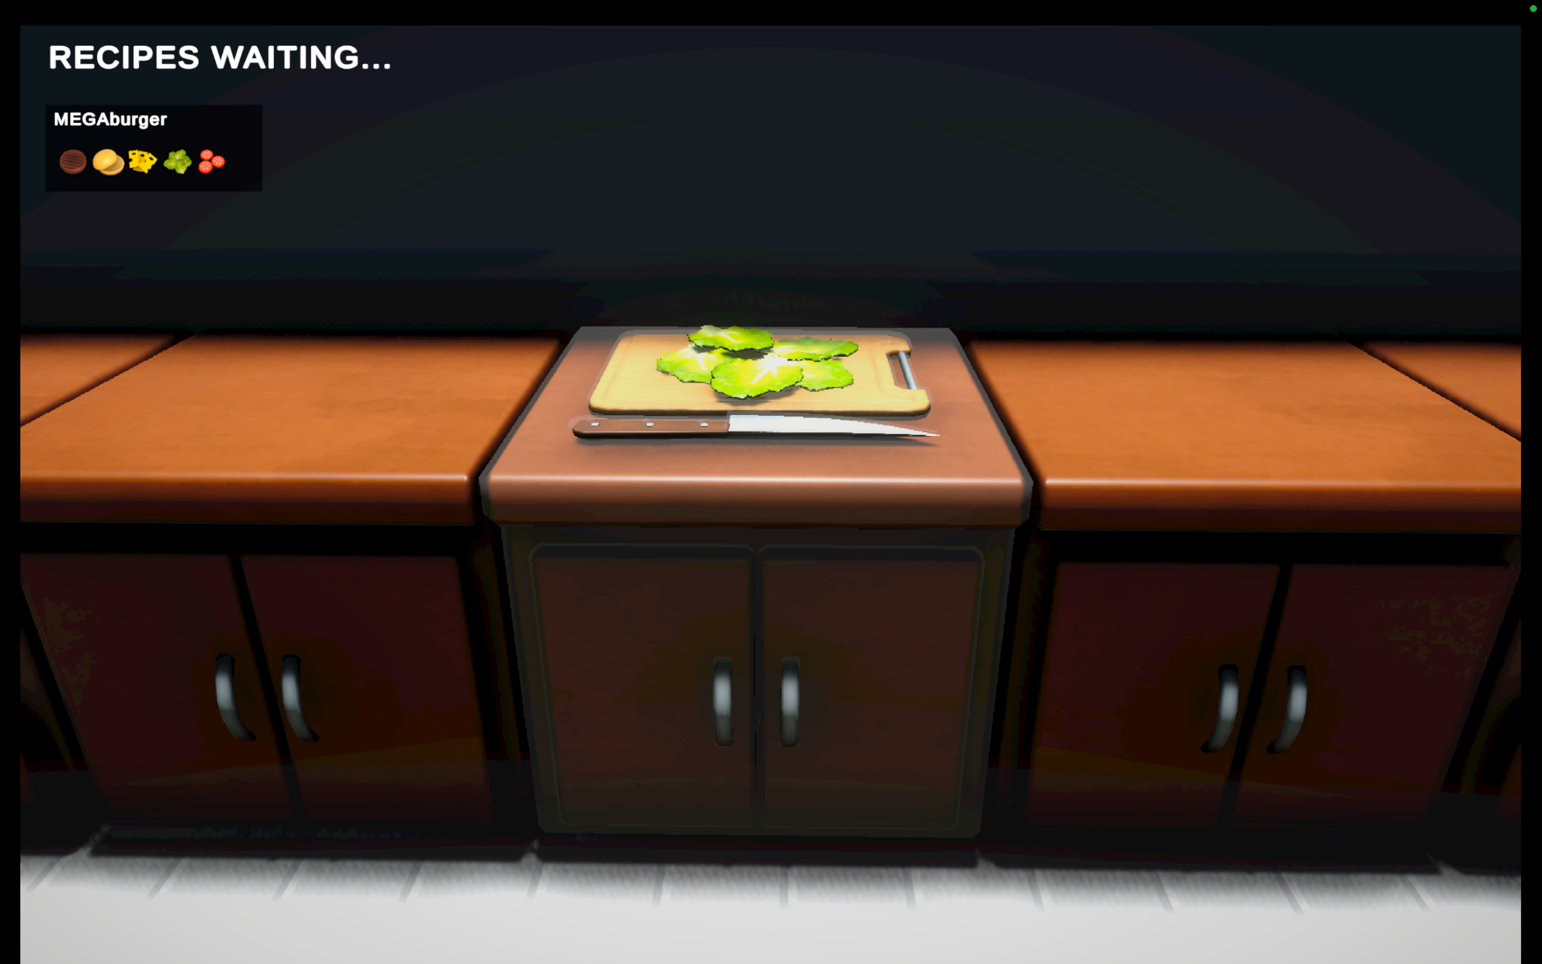
First-Person Controls
Character Movement:
WASD for movement, mouse for looking around.
Smooth navigation implemented with Unity's Character Controller.
Object Interaction:
Raycasting to detect and interact with kitchen items (e.g., stoves, ingredients).
Feedback System:
Visual cues (highlighting objects) and audio feedback when interacting.

Slide 7
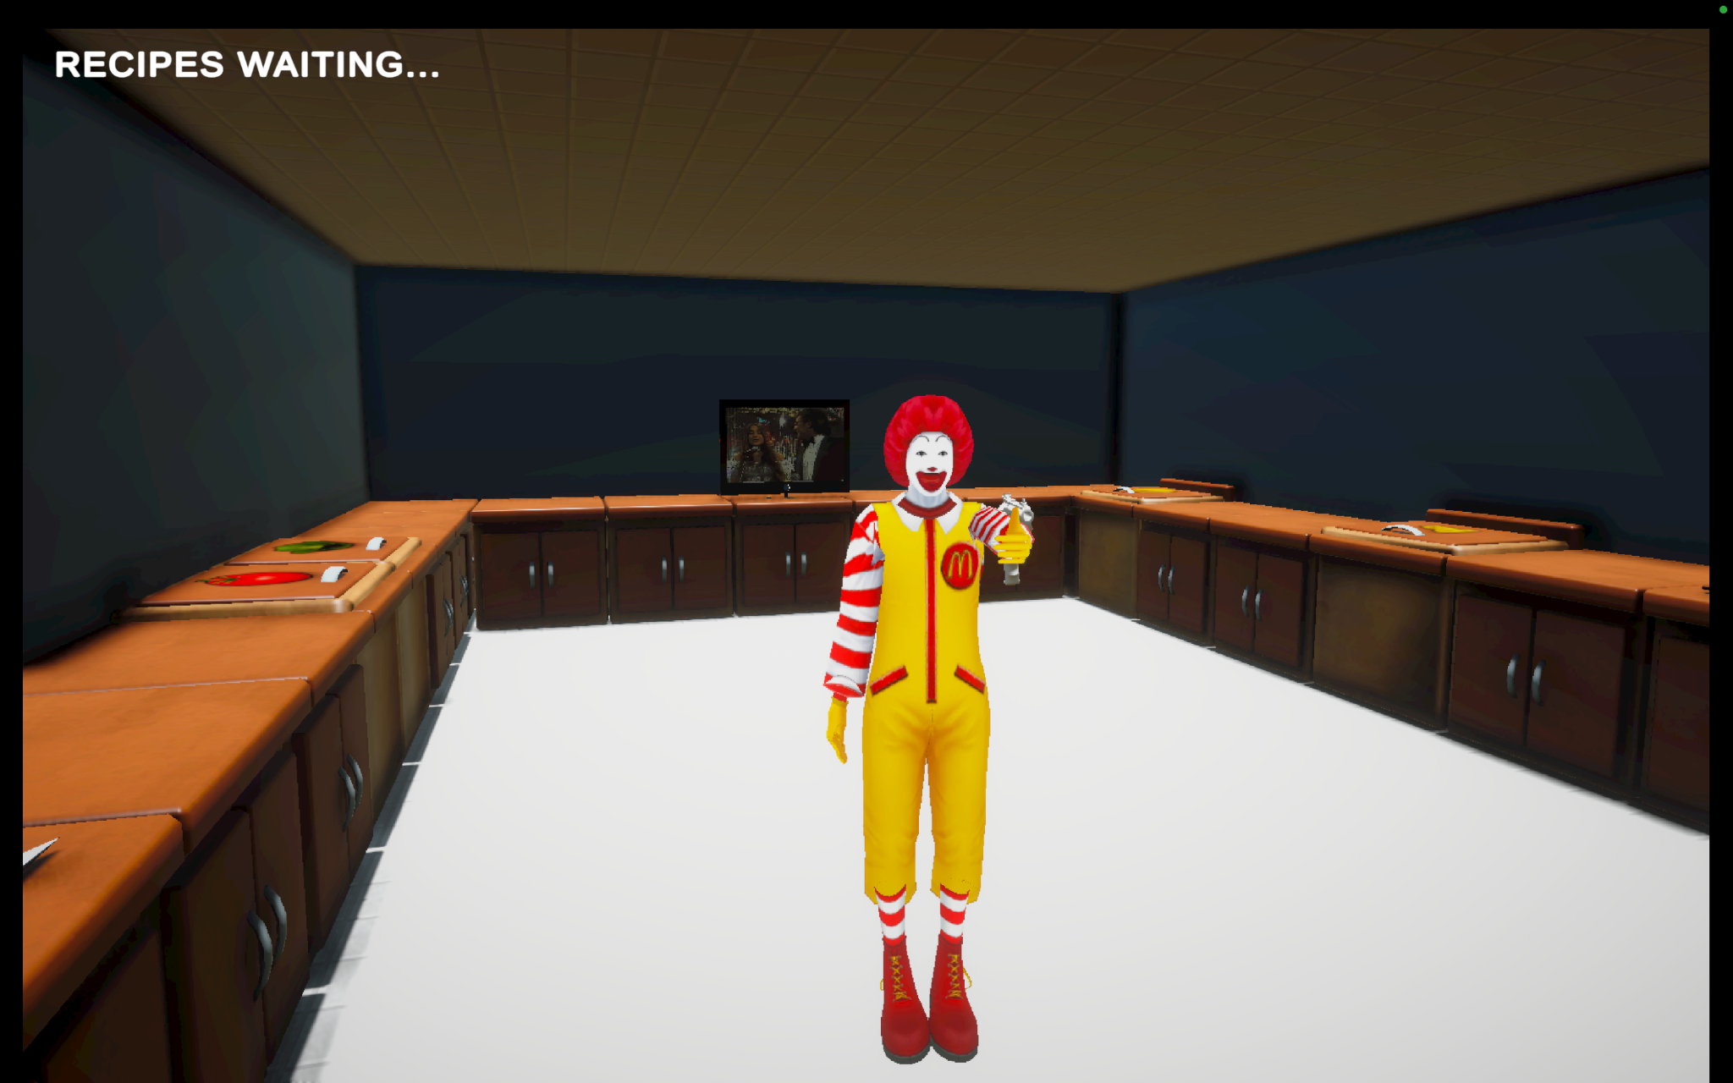
Clown Encounter
Trigger Event:
After completing two orders, the clown appears unexpectedly.
Implementation:
Scripted enemy spawn and movement logic.
Raycasting for detection and interaction.
Purpose:
Break the monotony and add an emotional shock to the gameplay.

Slide 8
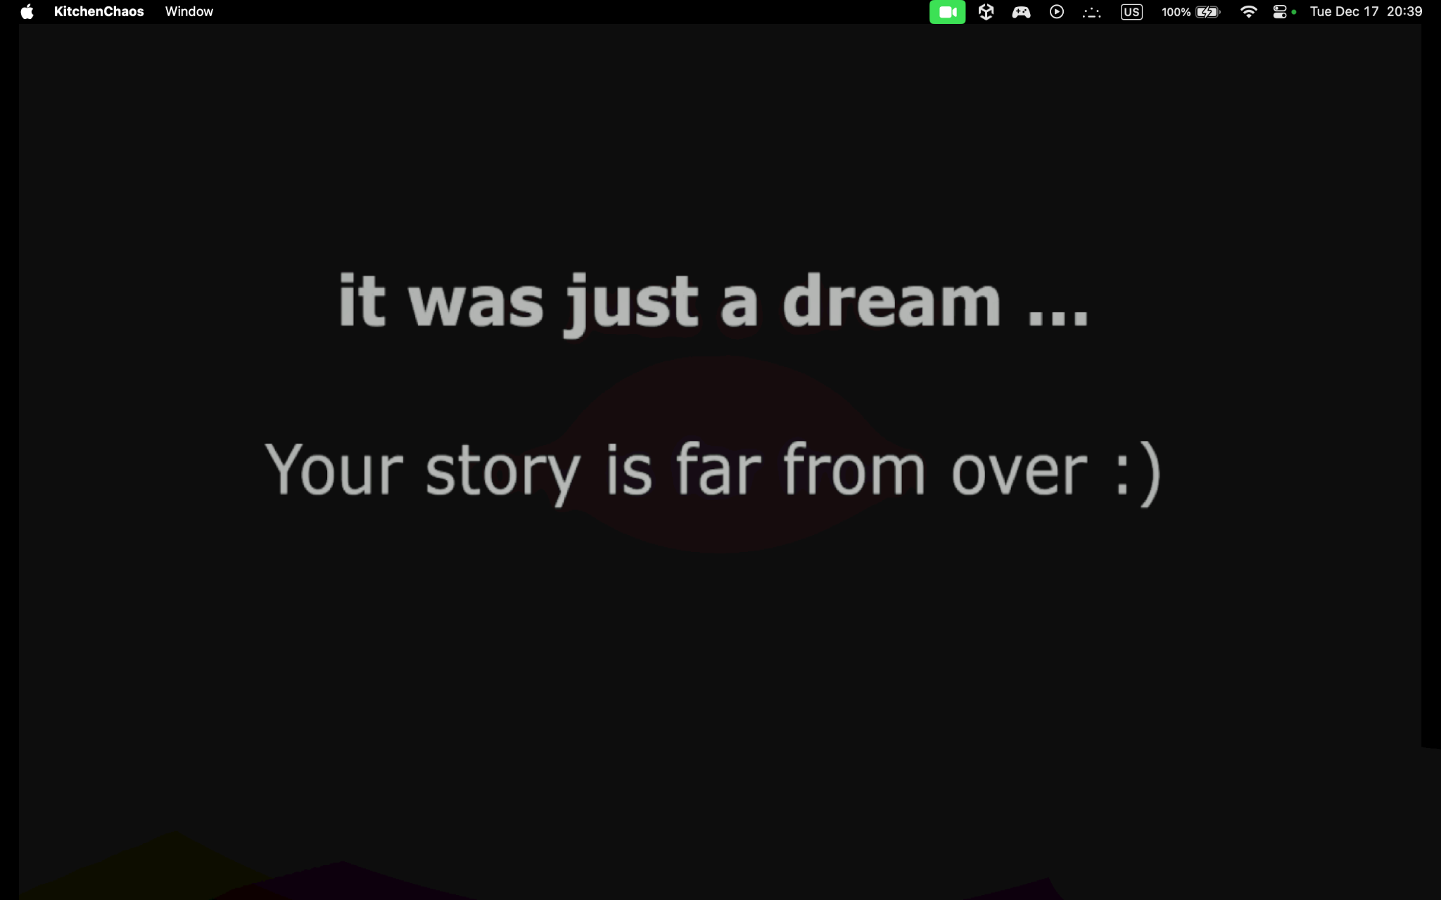
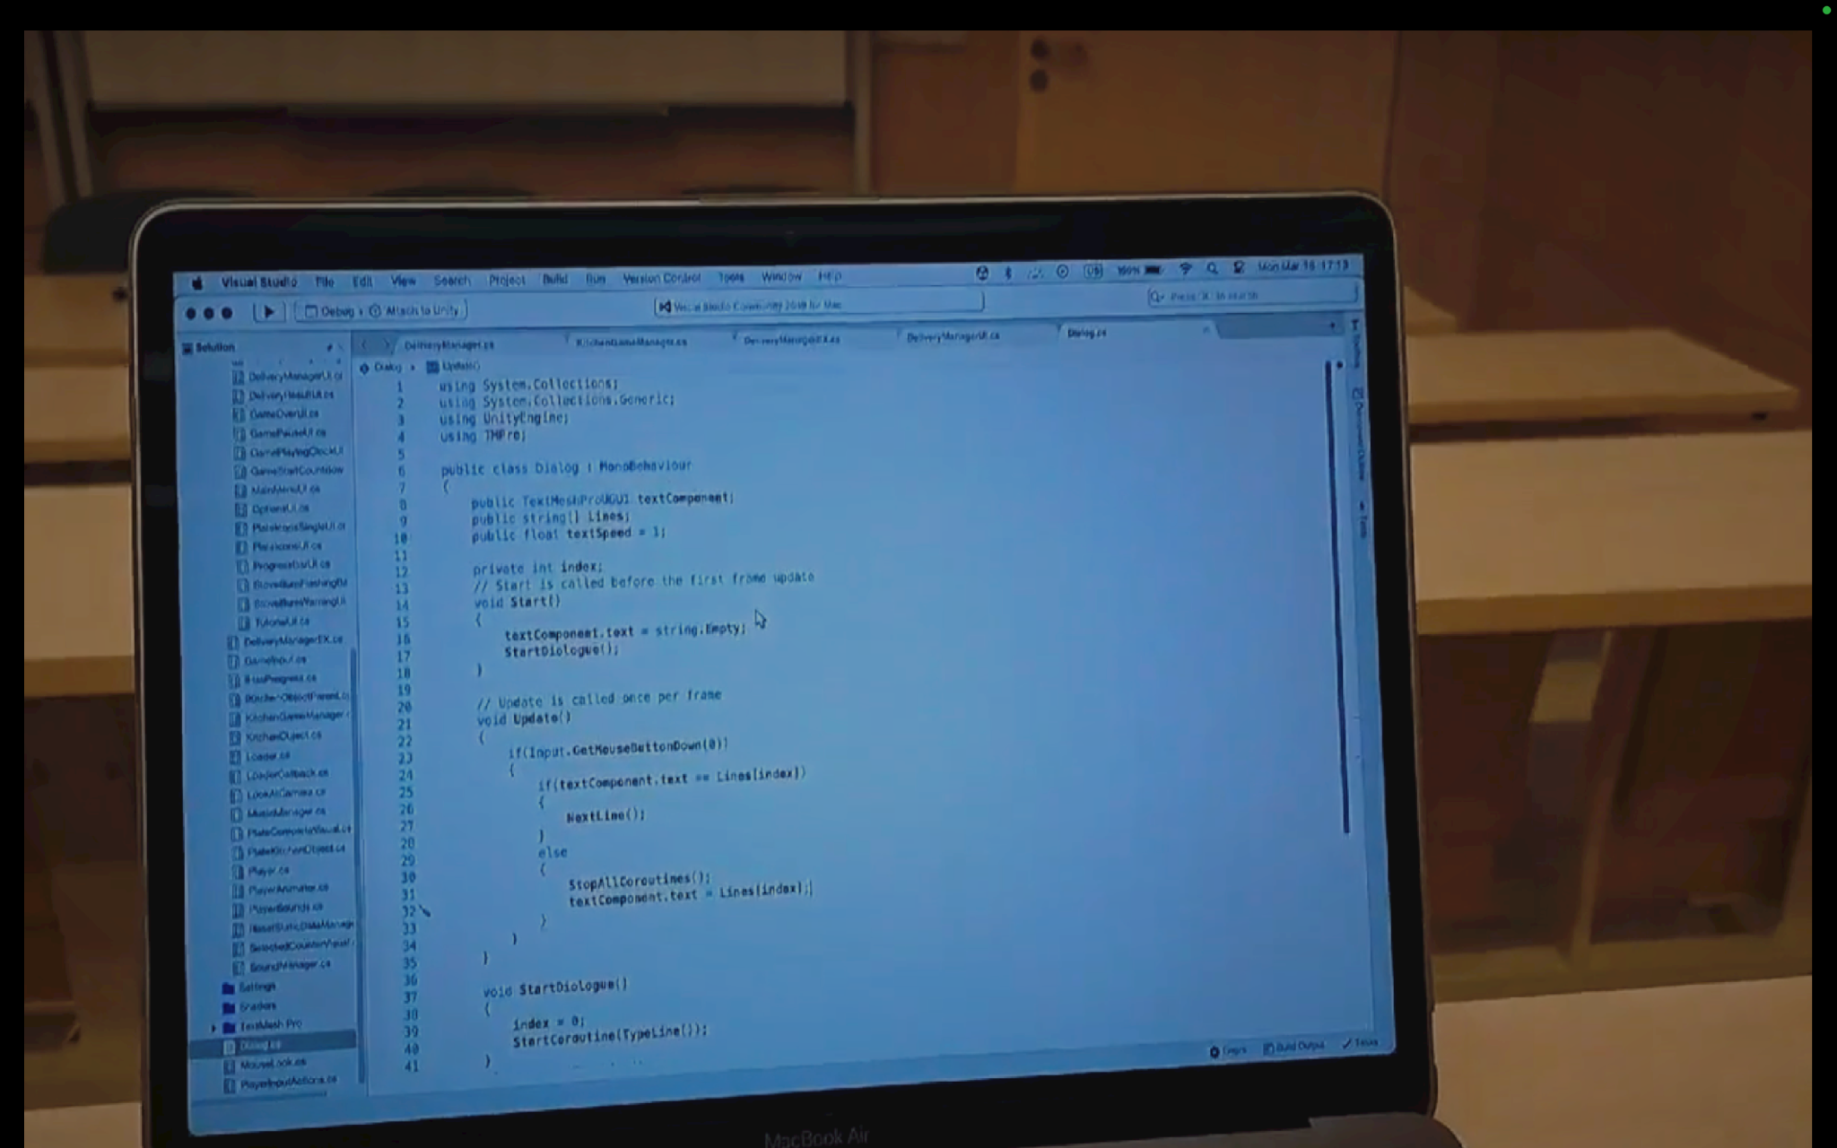
Game Ending and Motivational Message
Ending:
Mei wakes up: It was a dream.
Motivational message: “Your journey is far from over.”
Goal: Inspire players to persevere through challenges.

Slide 9
Conclusions and Future Work
Conclusions:
Successfully combined storytelling and interactive first-person mechanics.
Developed immersive cooking simulation and dynamic gameplay.
Future Work:
Multiplayer Mode: Cooperative gameplay in the kitchen.
VR Support: Full immersion for cooking tasks.
Expanded Storyline: Branching dialogue options for multiple endings.

Slide 10
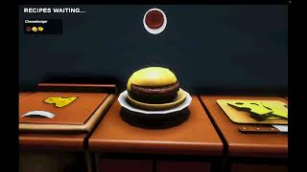
Game play

Slide 11
Thank you!

