Slide 1
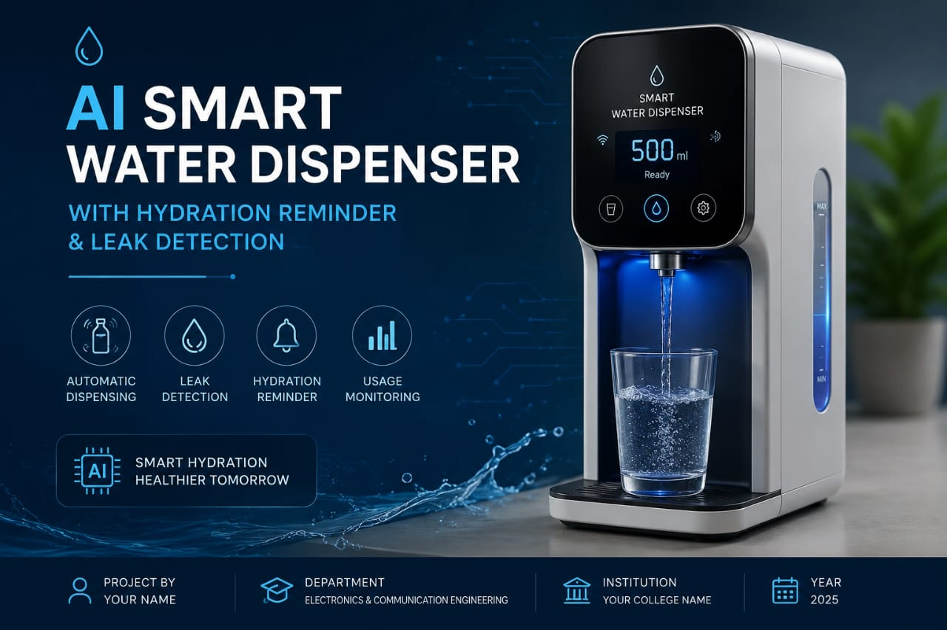

AI Smart Water Dispenser — Implementation Guide
Automated dispensing, hydration reminders, leak detection, and Blynk IoT notifications. Practical step‑by‑step for makers and IoT developers.

Slide 2
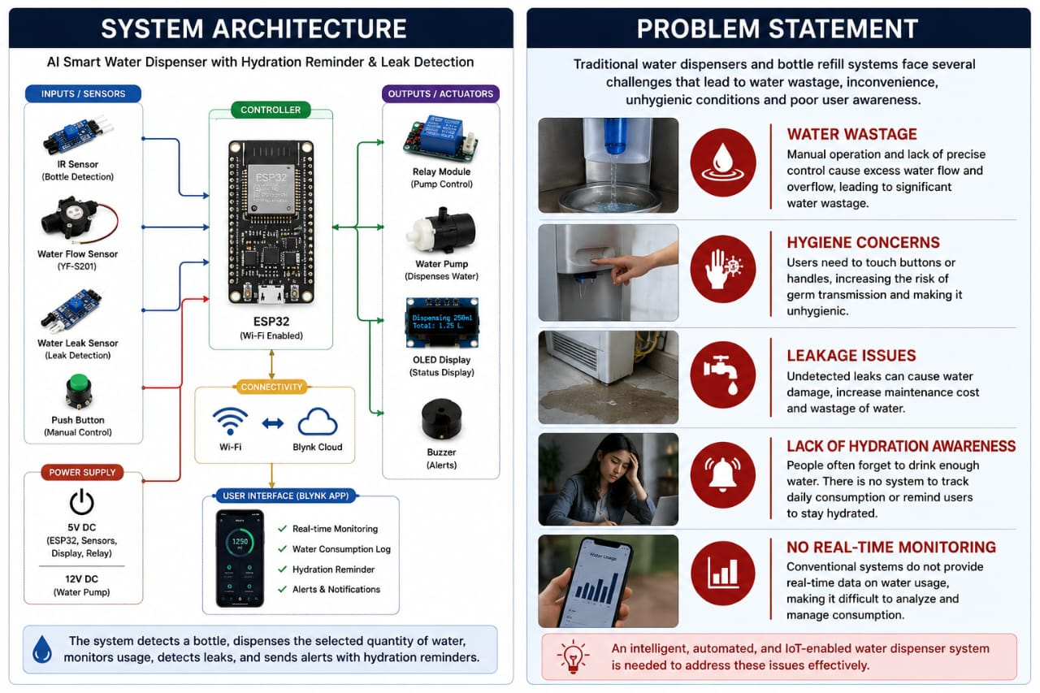

Problem Statement
Common issues
Irregular hydration habits — missed daily intake
Unnoticed leaks causing damage and waste
Manual dispensing inconvenient for elderly/disabled users
Goal: reliable, low-cost DIY device that dispenses water, tracks intake, alerts users and detects leaks.

Slide 3
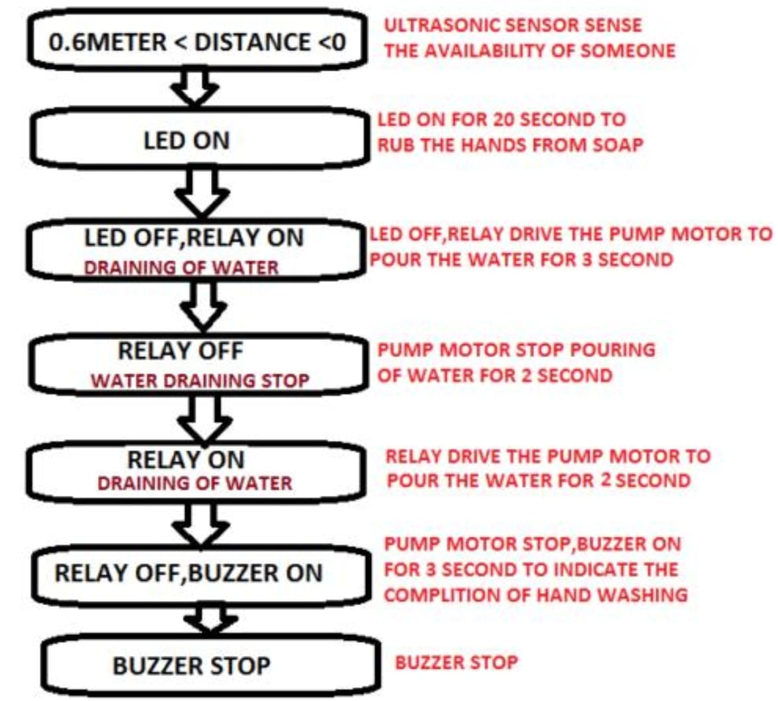
Working Principle (At a glance)
01
Sense
IR sensor or button triggers dispense; flow sensor measures volume; leak sensor monitors surroundings.
02
Control
ESP32 reads sensors, runs logic, controls relay for pump via buck-converted power.
03
Notify
ESP32 sends status & alerts to Blynk; OLED shows local info; buzzer for immediate alarms.
04
Record
Flow sensor tallies daily intake; data logged locally and in Blynk dashboard.

Slide 4
System Architecture
High‑level connections
ESP32: central controller (Wi‑Fi, timers, Blynk client)
Relay → controls 12V pump via LM2596 (5V logic trigger)
Flow sensor → pulse output to ESP32 counter pin
IR sensor / push button → dispense trigger
Leak sensor → interrupt → immediate alert + pump lockout
OLED + buzzer → local UX feedback

Slide 5
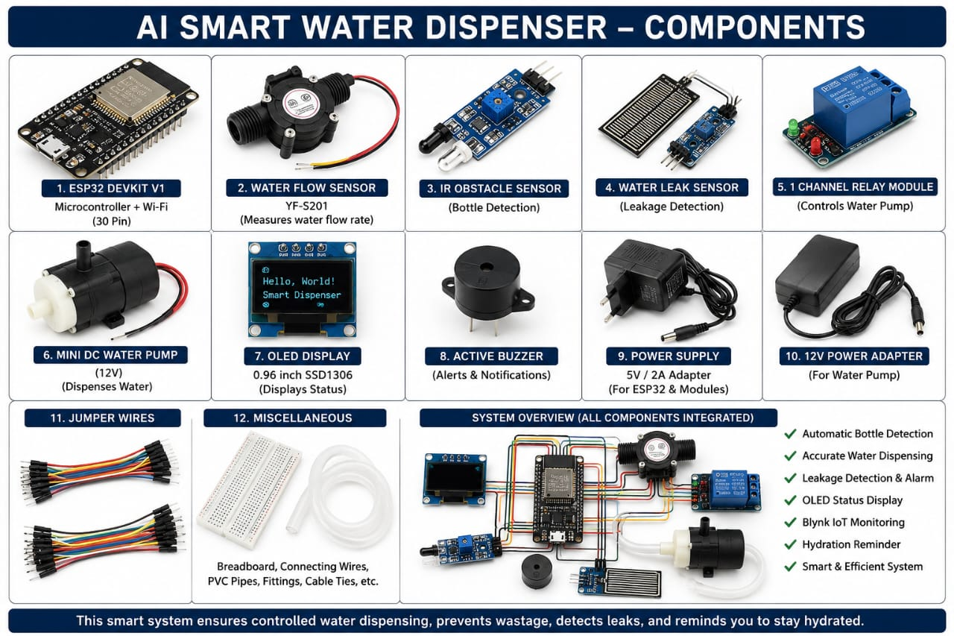
Core quantities: one of each listed part; jumpers/tubing as required. Enclosure and tank sized to use case.

Slide 6
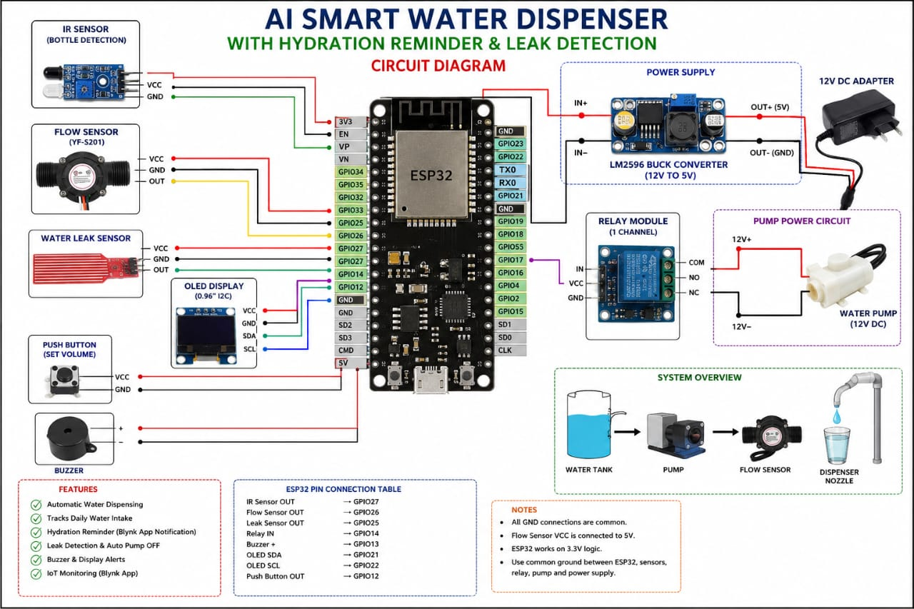
Electrical Connections
Key wiring notes
12V adapter → pump + LM2596 input. LM2596 output = 5V → ESP32 VIN (or 5V pin if recommended).
ESP32 GPIO → relay IN (use common ground). Relay switches 12V to pump.
Flow sensor DATA → ESP32 digital input with interrupt; supply 5V/3.3V per spec.
Leak sensor → analog/digital input (use pull‑up); trigger immediate alarm and disable pump.
OLED I2C → SDA/SCL to ESP32 I2C pins; share ground.

Slide 7
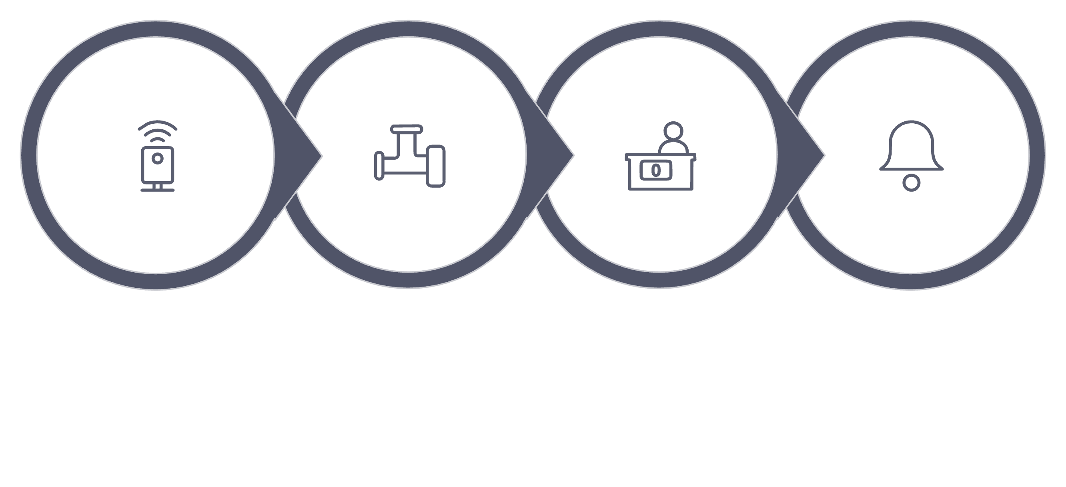
Software & Logic Flow
Detect Trigger
Activate Pump
Count Pulses
Send Alerts
Local logic: debounce triggers, convert flow pulses → mL, maintain daily counter, leak overrides pump and sends immediate alert.

Slide 8
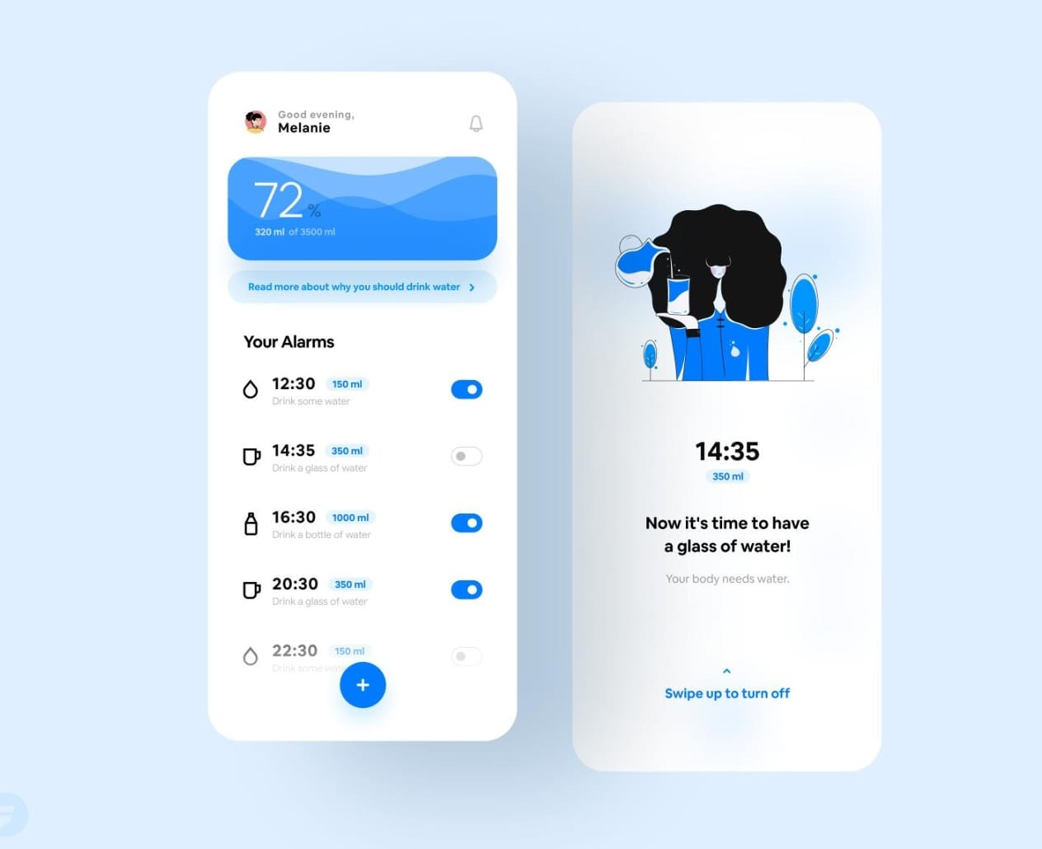
Blynk Integration &
Notifications
What to send to Blynk
Total daily intake (mL)
Last dispense volume & timestamp
Leak status (alarm/clear)
Battery/power status (optional)
Notifications
Push notification when leak detected
Reminder notifications based on schedule or low intake

Slide 9
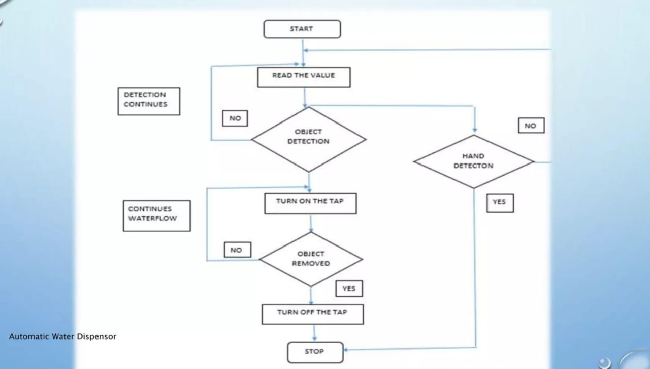
Overflow & Safety Considerations
1
2
Hardware safeguards
Software safeguards
Float valve, overflow sensor in tank, mechanical stop for pump cycles.
Max dispense timeout, pulse sanity checks, leak lockout flag.
3
Power & electrical safety
Fuse on 12V line, proper insulation, waterproof connectors near liquids.

Slide 10
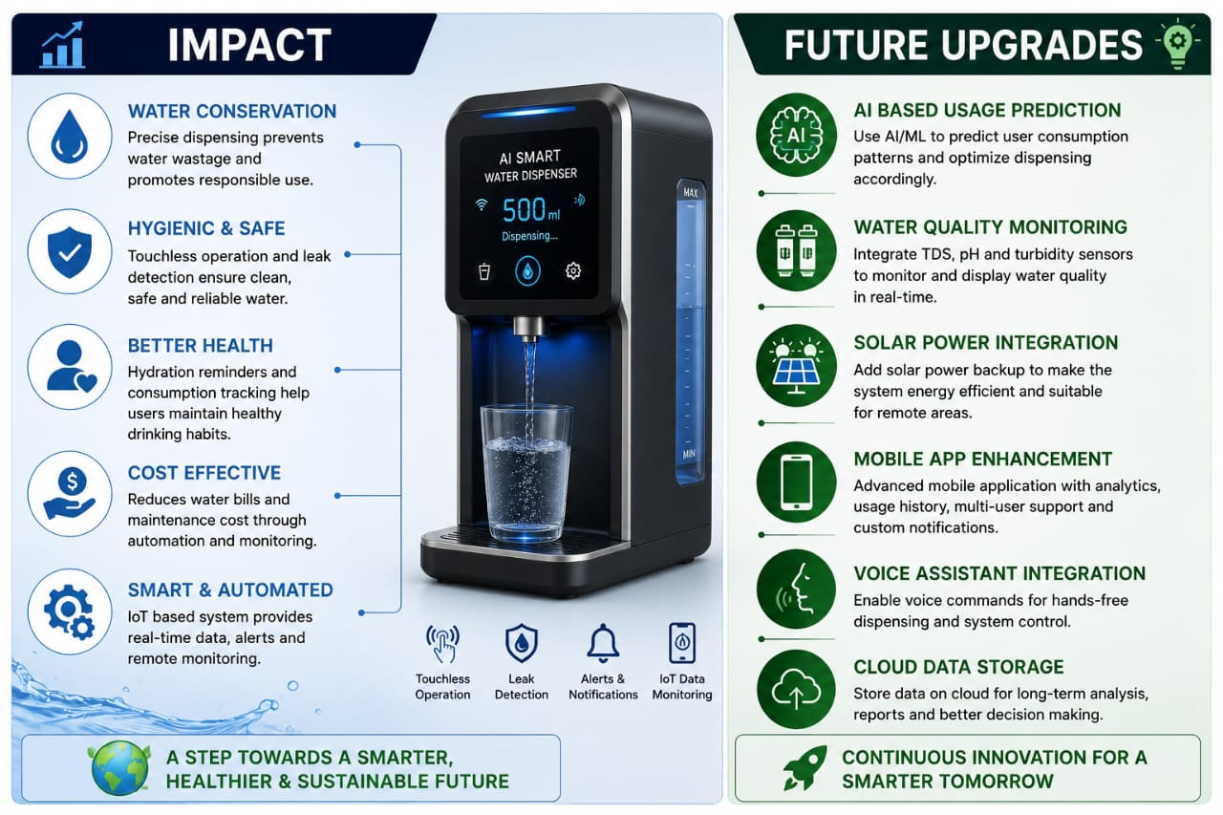
Impact, Uses & Next Steps
Next steps for builders
Prototype on breadboard → test flow calibration
Implement Blynk dashboard widgets (gauge, event log, push alerts)
Enclosure and waterproofing design
Optional: add authentication, local storage (SPIFFS/SD) for resilience
Start small: validate sensors and safety logic before final enclosure.

