Slide 1
CCA Over satellite INITIAL Tuning
Grace Antedomenico, Alex Simoneau, and Jacob Tutlis

Slide 2
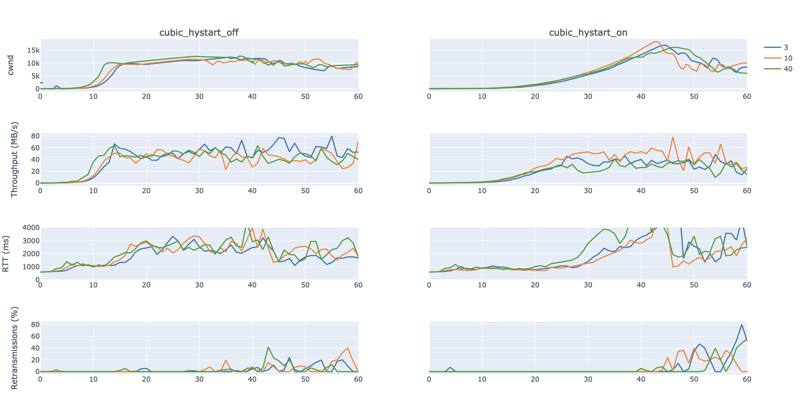
CUBIC (ON vs OFF)

Slide 3
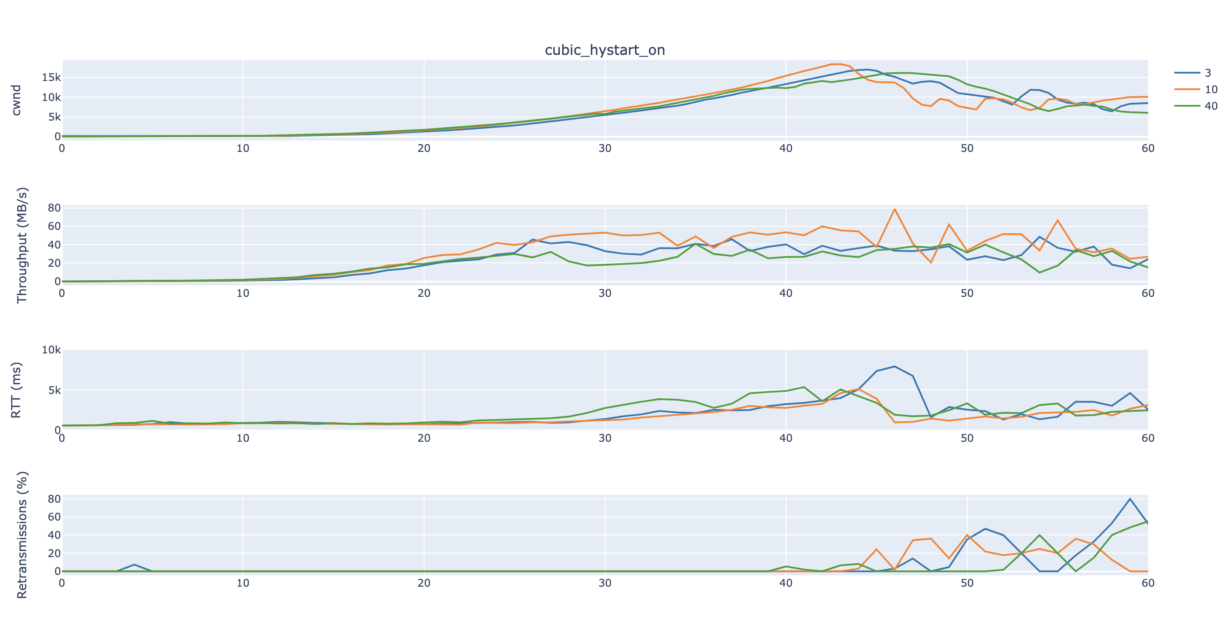
CUBIC (Hystart ON)

Slide 4
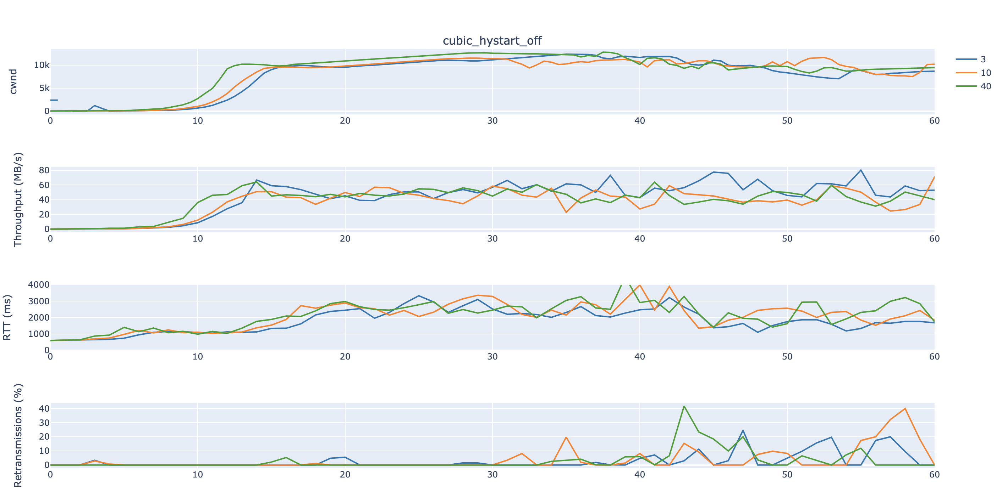
CUBIC (HYSTART OFF)

Slide 5
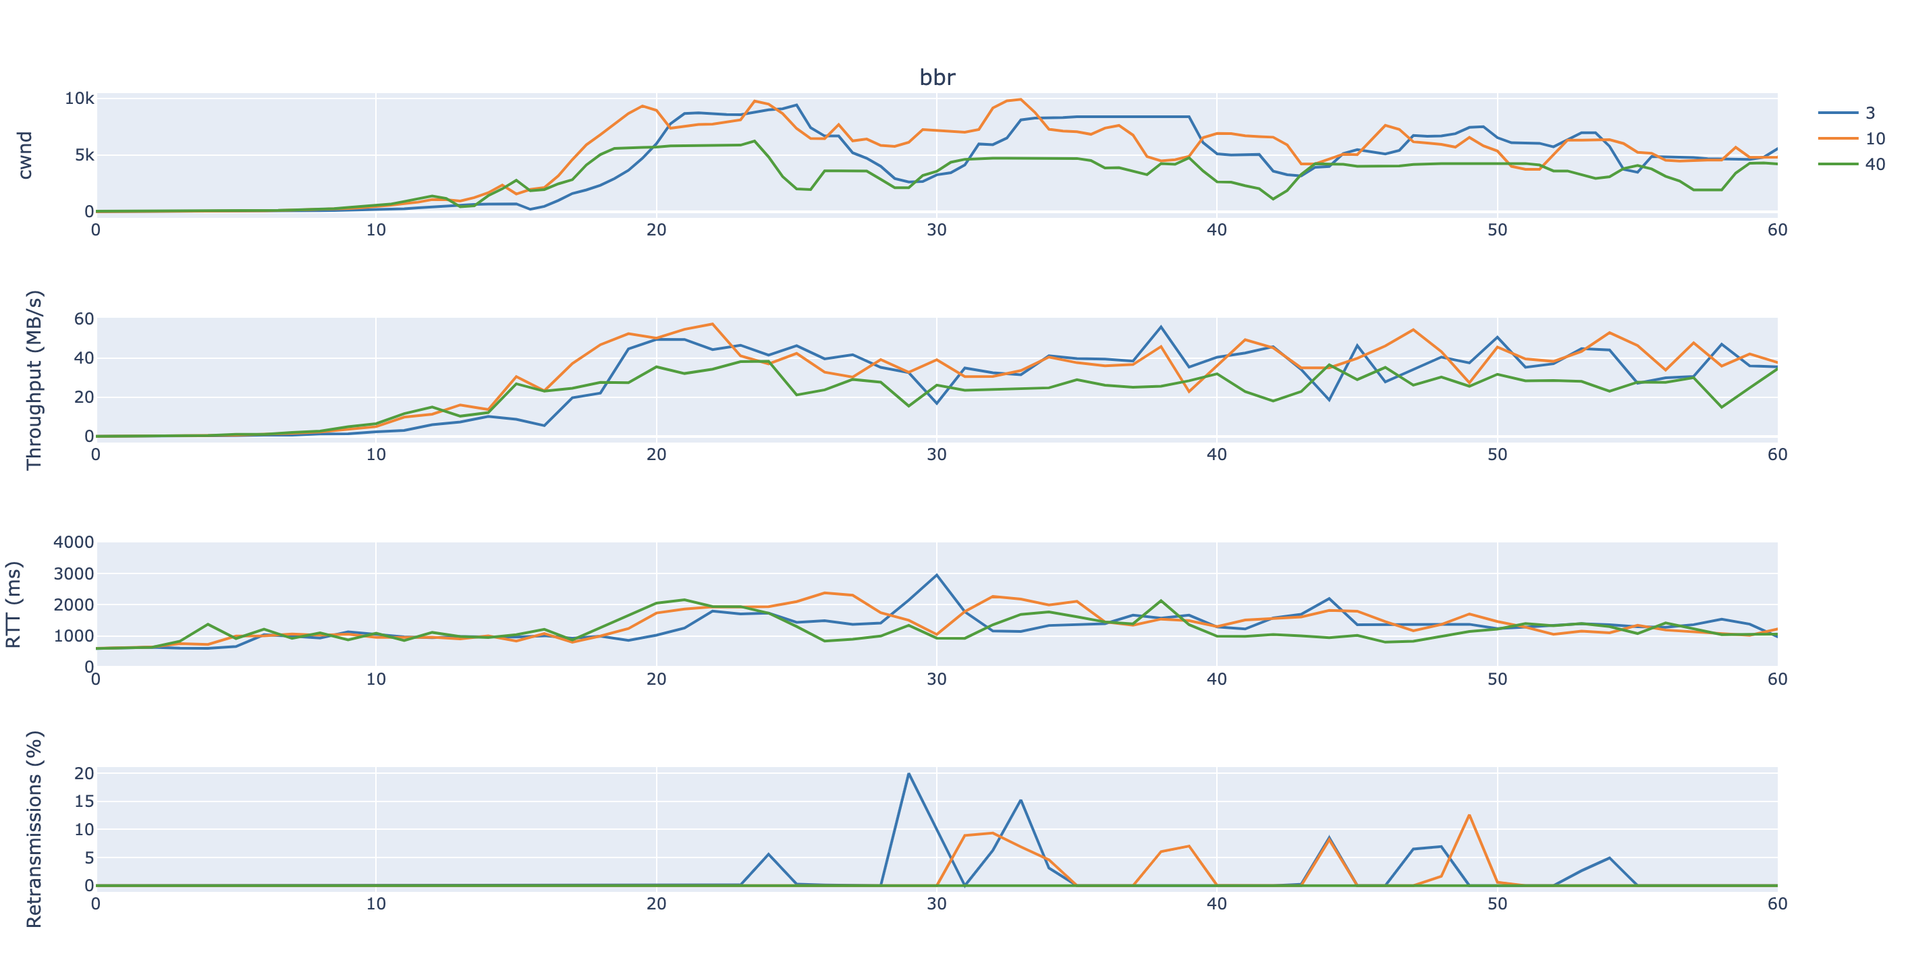
BBR

Slide 6
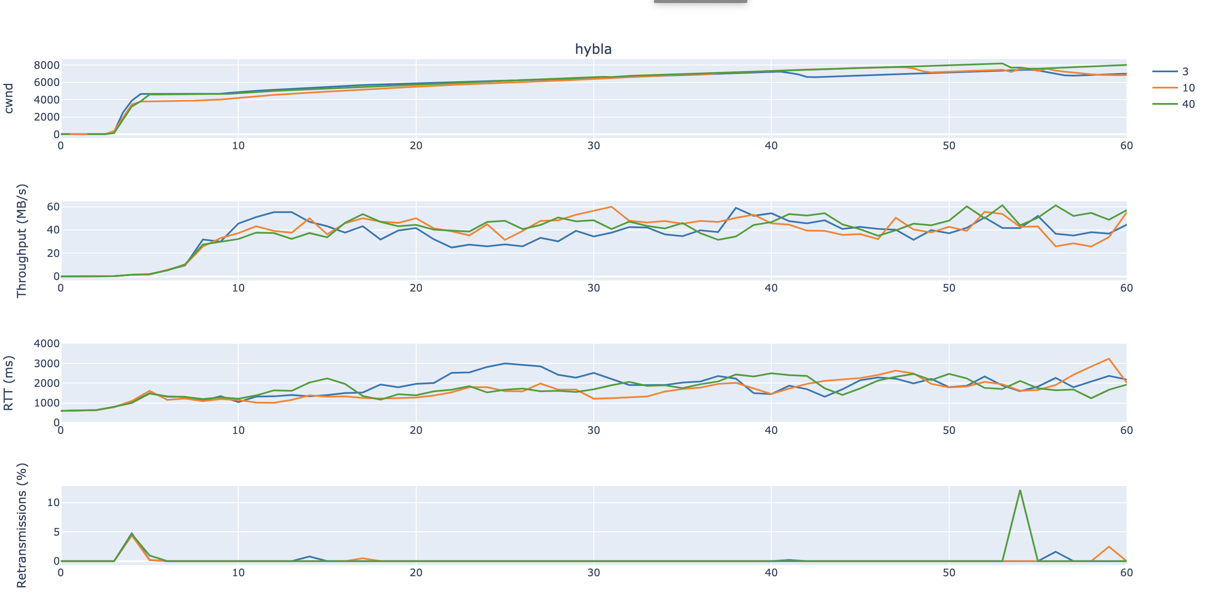
HYBLA

Slide 7
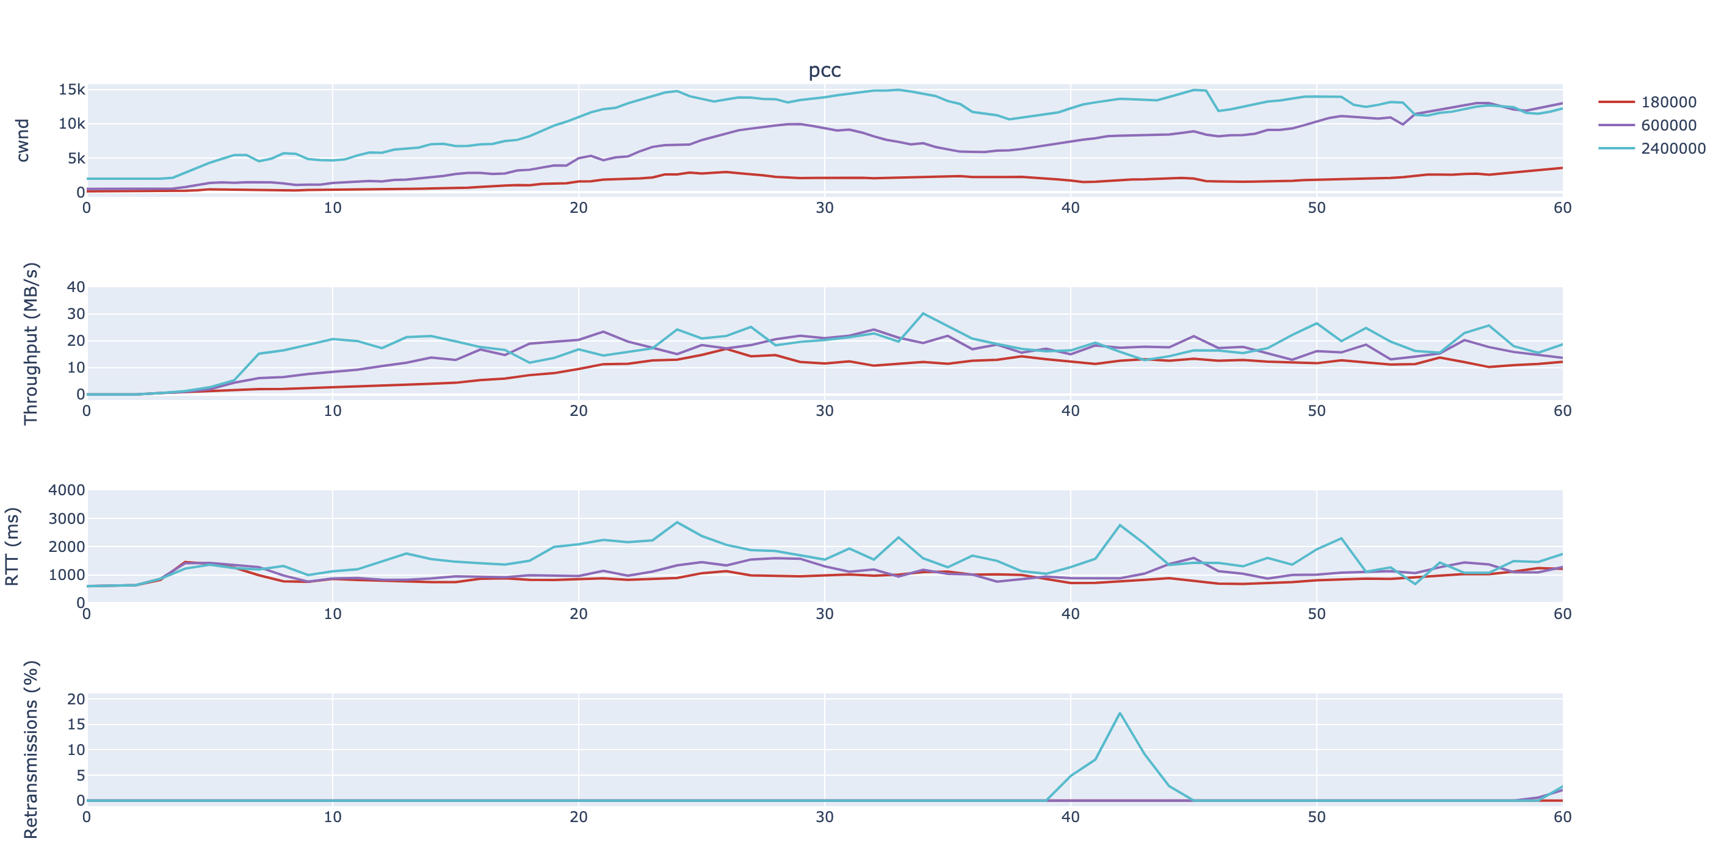
PCC

Slide 8
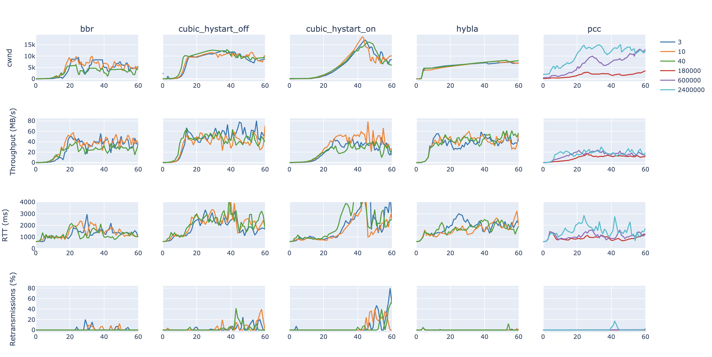
Matrix

