Slide 1
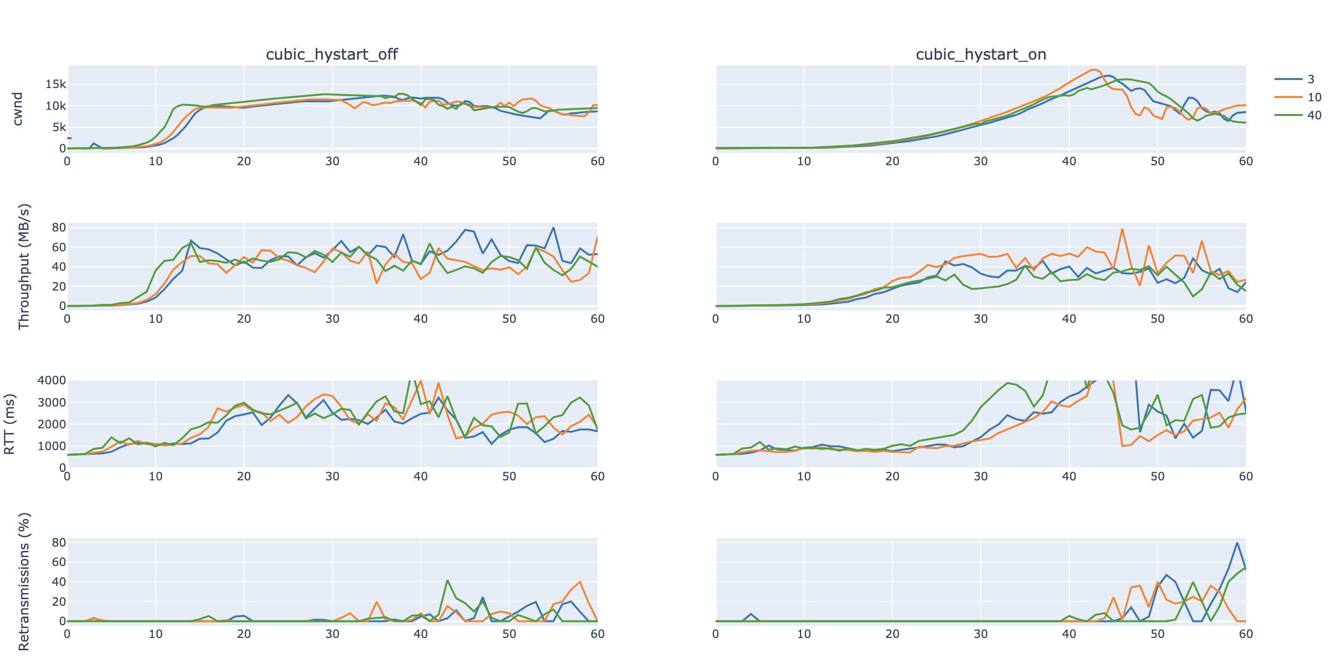
CUBIC (ON vs OFF)

Slide 2
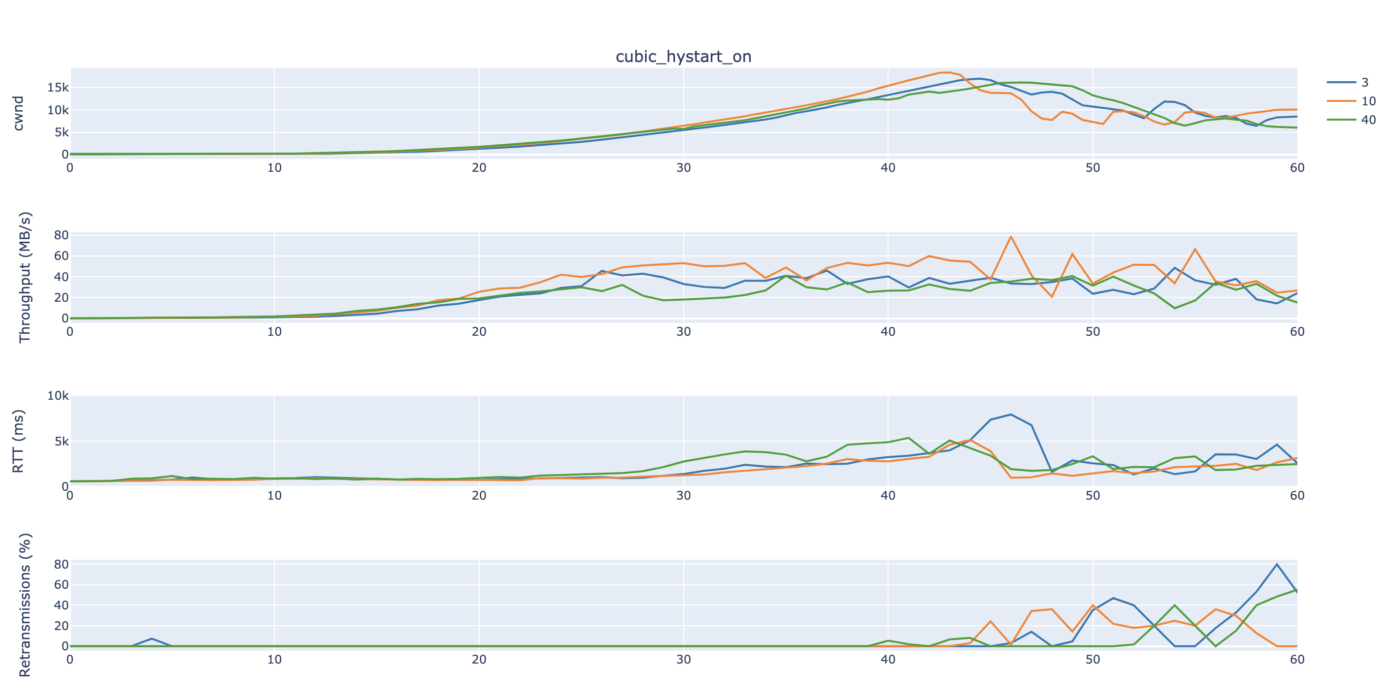
CUBIC (Hystart ON)

Slide 3
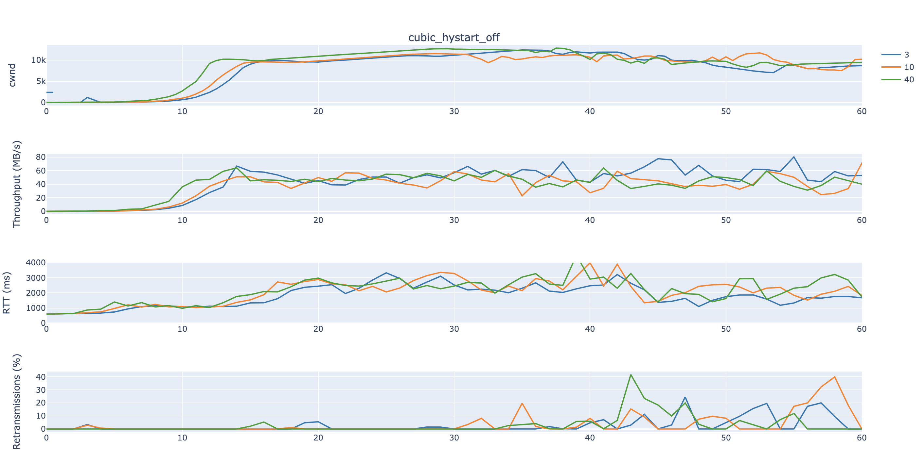
CUBIC (HYSTART OFF)

Slide 4
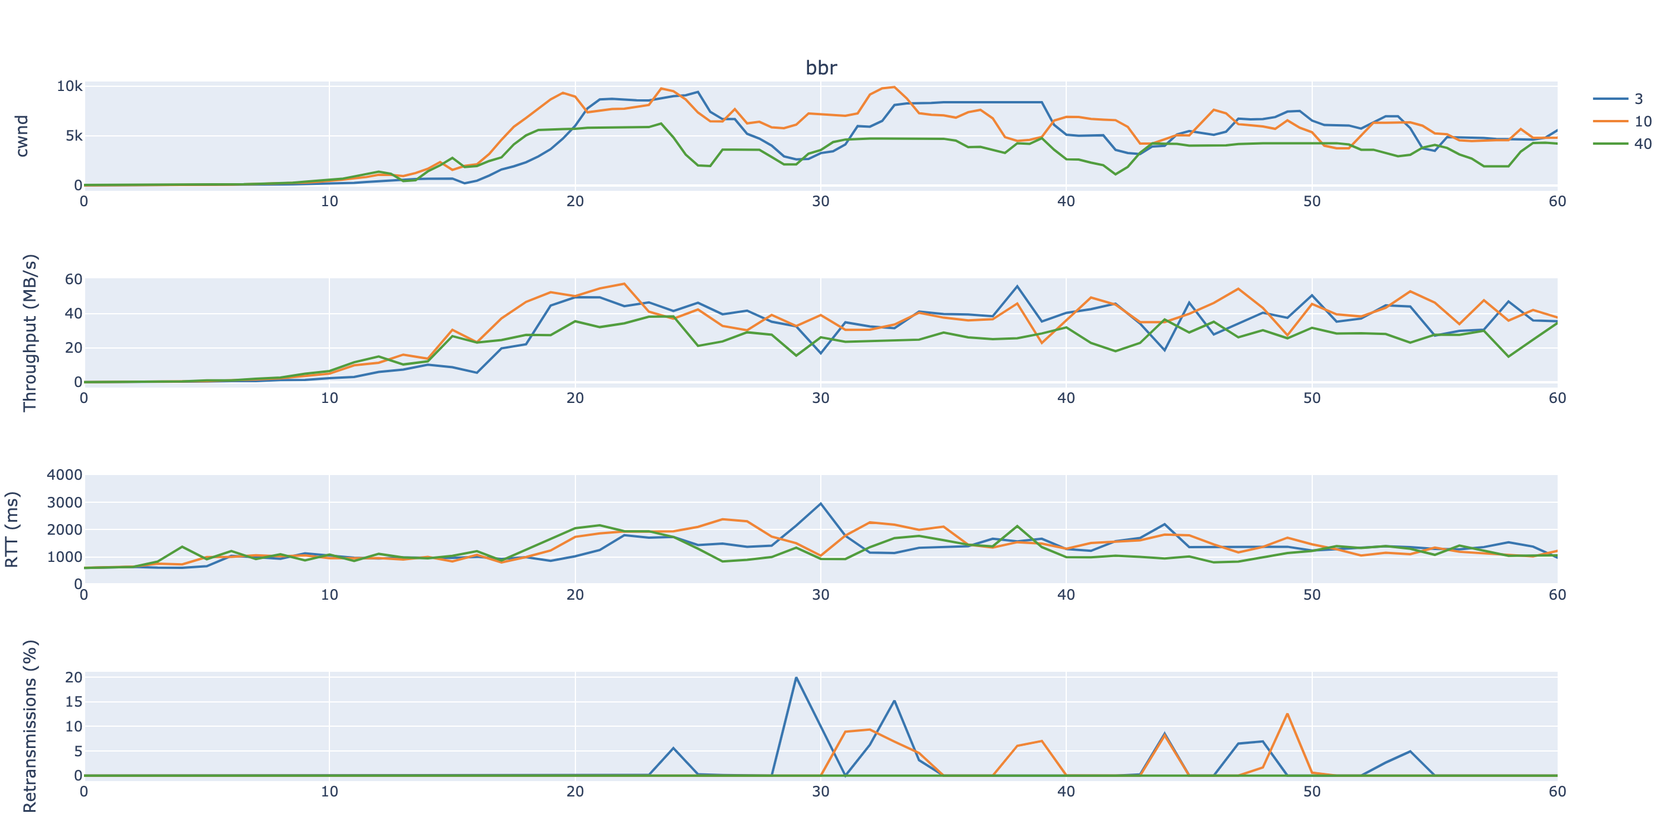
BBR

Slide 5
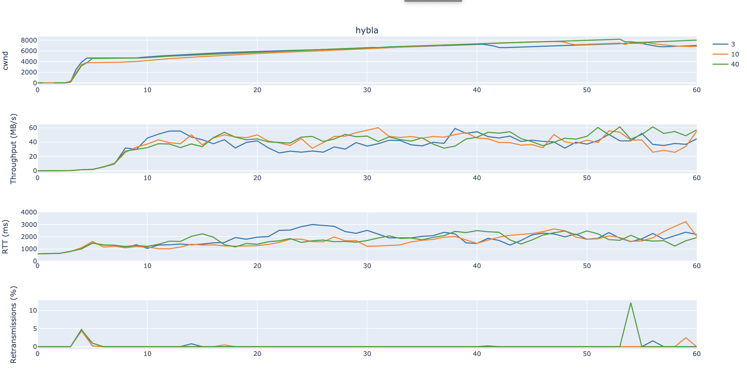
HYBLA

Slide 6
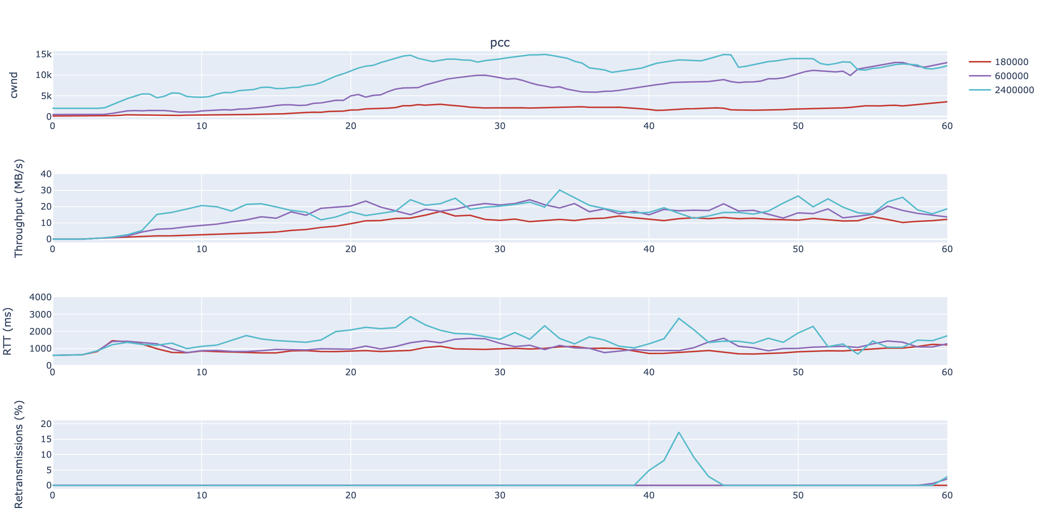
PCC

Slide 7
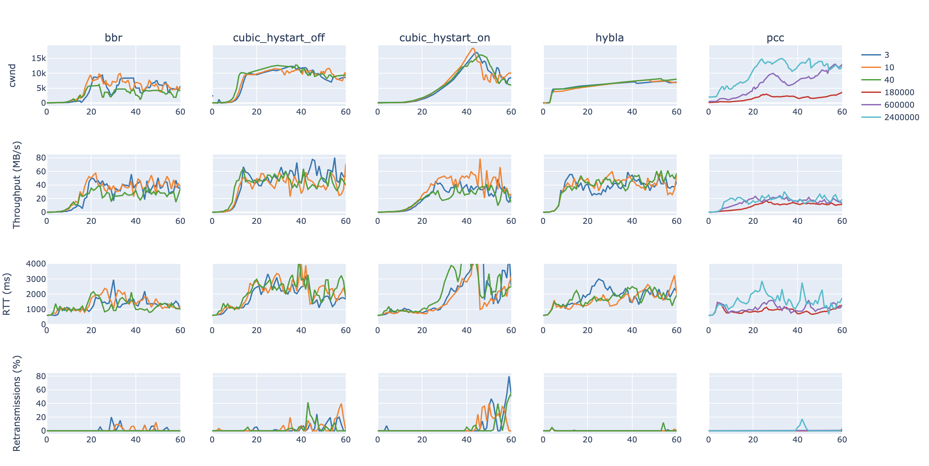
Matrix

Slide 8
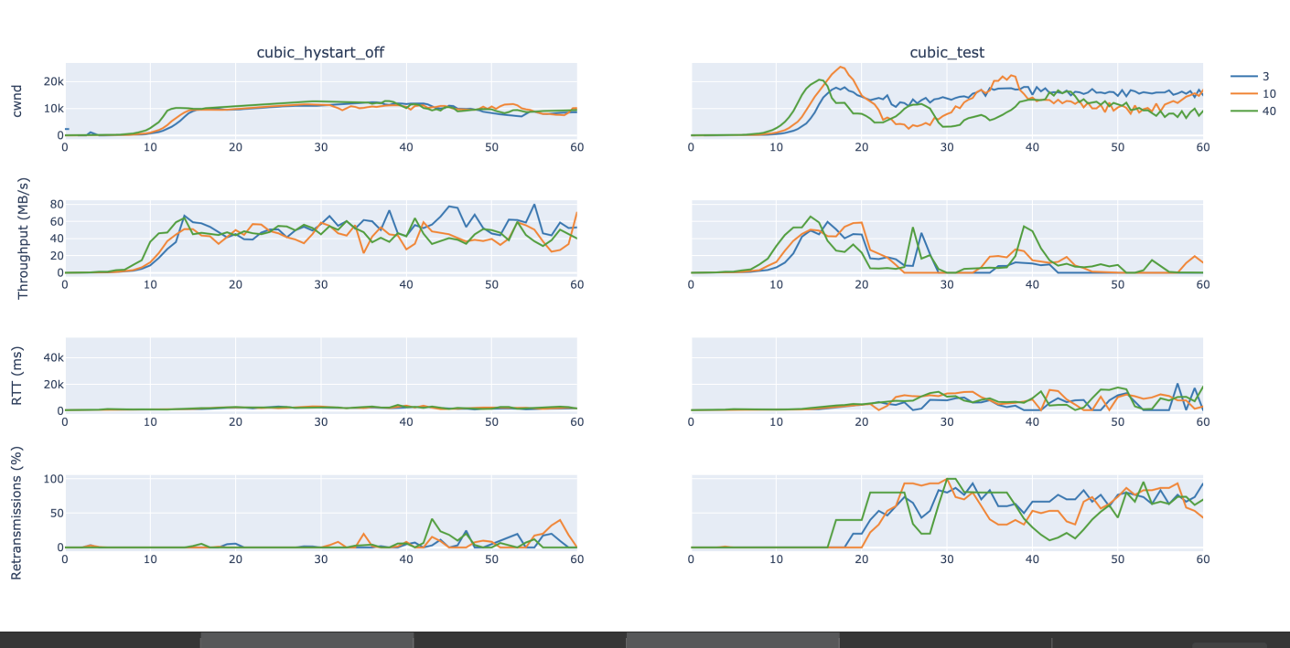
Cubic Hystart off: Default vs no SACKs, and rcwnd 10000

