Slide 1
Initcwnd’s effect on CCA’s

Slide 2
Tests
5 trials of 5 initcwnd sizes
3,5,10,20,40
Used “ip route change default via…”
4 algorithms tested:
CUBIC
BBR
Hybla
PCC (did not use initcwnd)

Slide 3
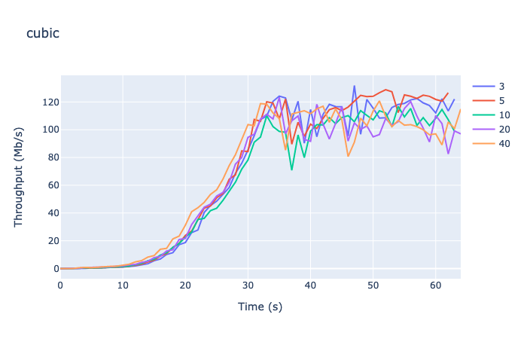
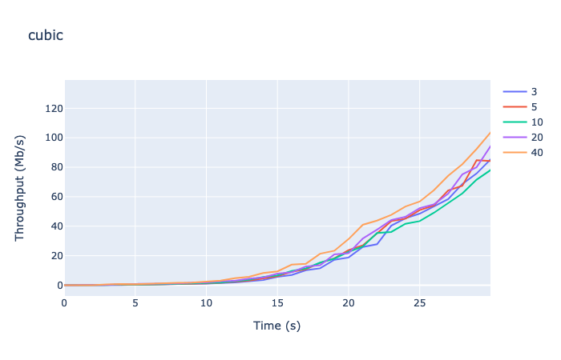
CUBIC
Bandwidth Graph:
First 30 seconds:

Slide 4
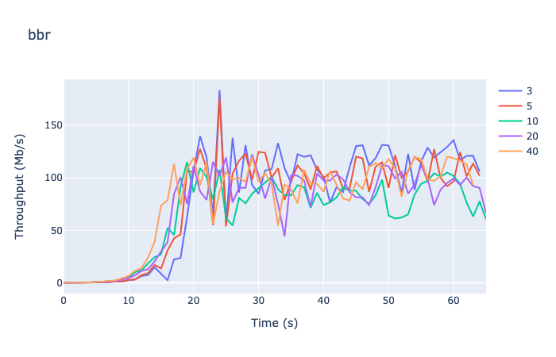
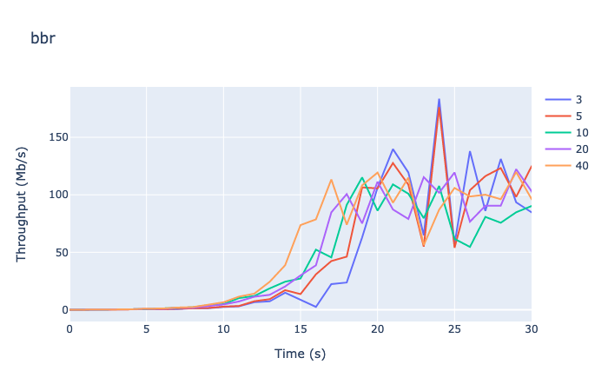
BBR
Bandwidth Graph:
First 30 seconds:

Slide 5
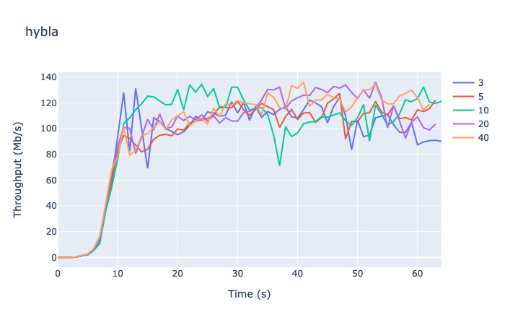
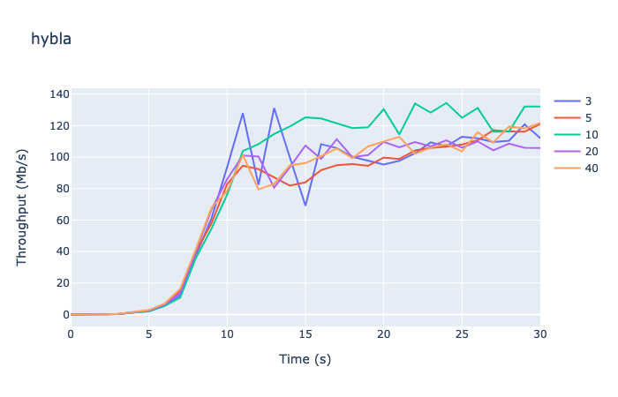
Hybla
Bandwidth Graph:
First 30 seconds:

Slide 6
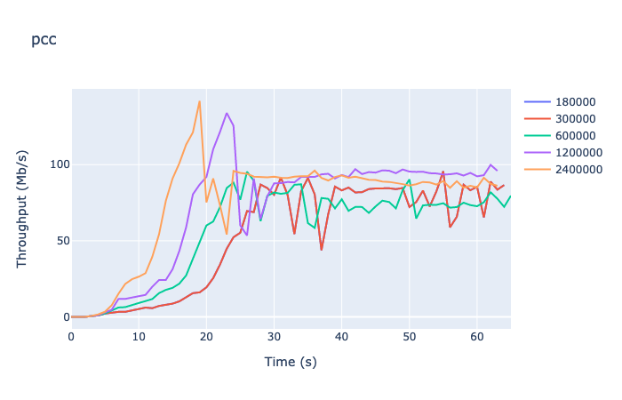
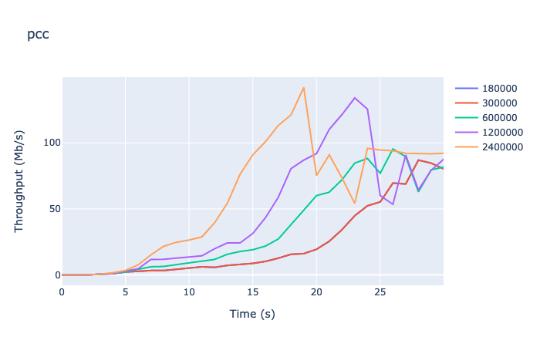
PCC
Bandwidth Graph:
First 30 seconds:

Slide 7
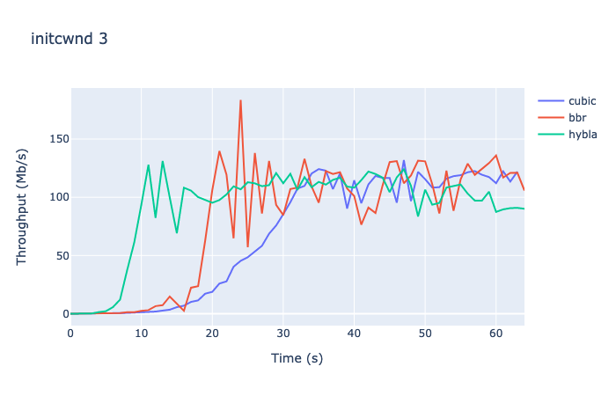
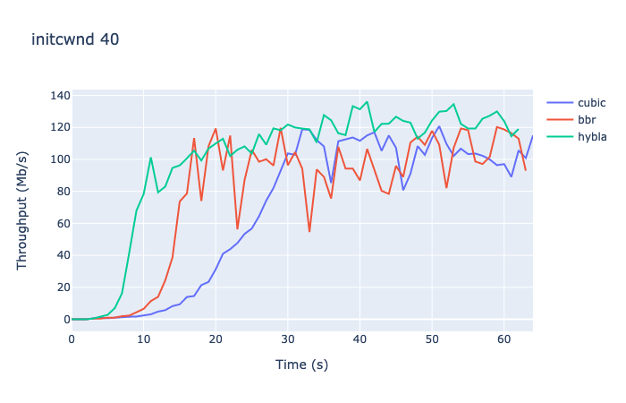
Cross-Algorithm Analysis

