Slide 1
Diversity in Smartphone Usage
Hossein Falaki, Ratul Mahajan, Srikanth Kandula
Dimitrios Lymberopoulos, Ramesh Govindan, Deborah Estrin
UCLA, Microsoft, USC
MobiSys ‘10
June 17, 2010

Slide 2
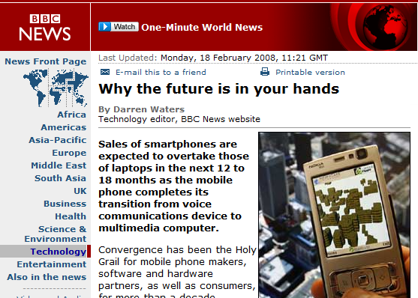
Smartphone Penetration Is on the Rise
Notes:
Smartphones are being adopted at a phenomenal pace
It is no secret any more that smartphones are outselling other computing platforms (such as laptops)
Transitions: Smartphone are such pervasive platforms, but not much has been done in the research community to understand how people use their smartphones

Slide 3

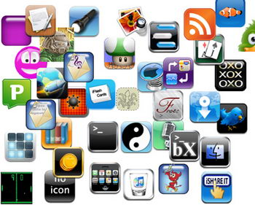
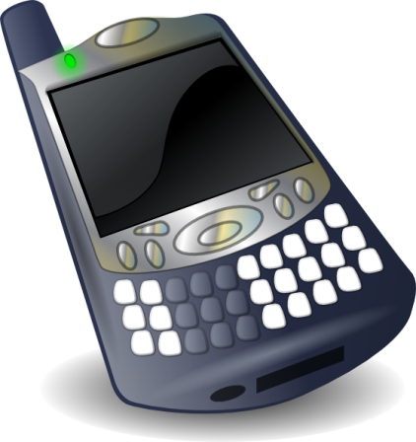

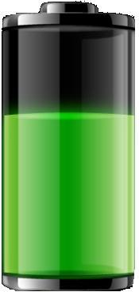
Basic Facts about Smartphone Usage Are Unknown
Notes:
For example, we do not know the answers to simple questions regarding smartphone usage
1. How often does a user interact with the phone? How long does an interaction last?
2. How many applications does a user run? How is user attention spread across applications?
3. How much network traffic does a user generate?
4. How is energy consumed?

Slide 4
Why Do We Need to Know These Facts?
How can we improve smartphone performance and usability?
Everyone is different
Identical users
?
Can we improve resource management on smartphones through personalization?
Notes:
2. Future systems
If smartphone usage is so poorly understood, there are several opportunities to improve their performance by looking into details of usage
Personalization story:
We faced these questions when we started to investigate whether automatic personalization can be used to improve usability and performance of smartphones. By personalization I mean adapting to usage of the individual on the phone.
But we found that basic facts about smartphone usage are not publicly available
We started off by trying to understand how users interact with their smartphones, because it affects our personalization attempts:
If all users are the same we do not need personalized systems and personalization. We can have static policies that work for everybody.
If variation is very high building such a system is going to be challenging. And we will need some framework for learning that despite users differences, applies to all users.

Slide 5








Main Findings
1. Users are quantitatively very diverse in their usage
2. But invariants exist and can be harnessed
Notes:
Users were different by two or three orders of magnitude in every aspect that we studied.
We were surprised by this level of diversity, and this was bad news for our initial goal of personalization
So we started to look for similarities that can be exploited, and we found that there are such similarities. For example users interactions follow specific models (frameworks), only that the parameters are different for different users. The invariants provide the basis for learning user behavior.

Slide 6
Data Sets
Platform | Demographics
Android | 16 high school students 17 knowledge workers
WinMobile | 16 Social Communicators 56 Life Power Users 59 Business Power Users 37 Organizer Practicals
Platform | Information Logged
Android | Screen state App usage Battery level Net traffic per app Call starts and ends
WinMobile | Screen state Applications used
Platform | # Users | Duration
Android | 33 | 7-21 Weeks/user
WinMobile | 222 | 8-28 Weeks/user
Notes:
We used two sets of usage traces across two different platforms: #users and length of study
Demographic information was different in the datasets. Android was based on occupation and age, while WM was based on answers that users provided before the study started
Explain logged information
Social Communicators (SC): “stay connected via voice and text.”
Life Power Users (LPU): “a multi-function device to help them manage their life.”
Business Power Users (BPU): “an advanced PC-companion to enhance their business productivity.”
Organizer Practicals (OP): “a simple device to manage their life.”

Slide 7
Outline
Comprehensive
system view
Interaction
Diversity in interaction
Interaction model
Application
Energy
Diversity in application usage
Application usage model
Diversity in battery usage
Energy drain model
Notes:
We studied Interactions, Applications, Net Traffic, and Energy (refer to paper for Traffic)
Our relatively large user population allows us draw conclusions with high confidence.
Clearly our data is not representing all the smartphone users on the planet, but
Within the demographics that we have we show what can be done to inform system design
Transition: I start with interaction

Slide 8
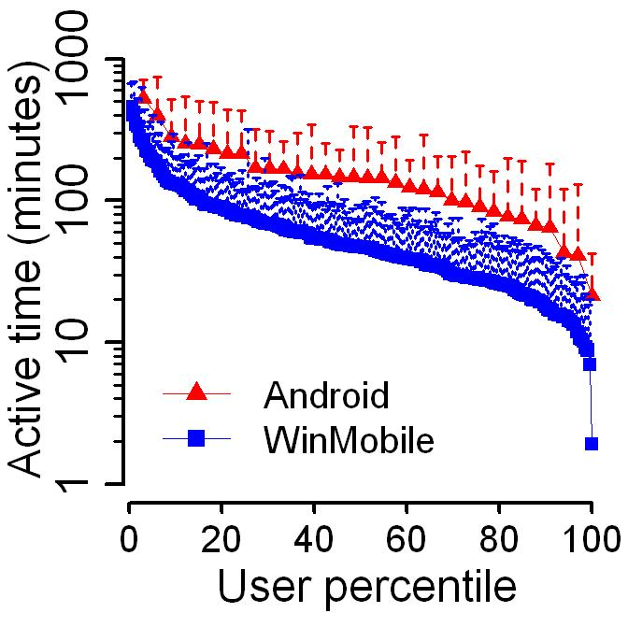
Users have disparate interaction levels
Two orders
Notes:
Explain the x and y axis
Median point: 50% and 40 minutes of interaction
Let’s call this graph “distribution graph”
Significant diversity in total interaction time
Transition: What is the source of this significant diversity? Maybe if we identify it we can handle it better in our systems

Slide 9

Sources of Interaction Diversity
User demographics
Session count
Session length
Application use
Number of applications per session
Notes:
We explored 5 different hypotheses to explain interaction diversity
I will show why “user types” cannot be used to explain the diversity in interaction. You can find in the paper why “application use” and “number of apps per session” do not matter

Slide 10
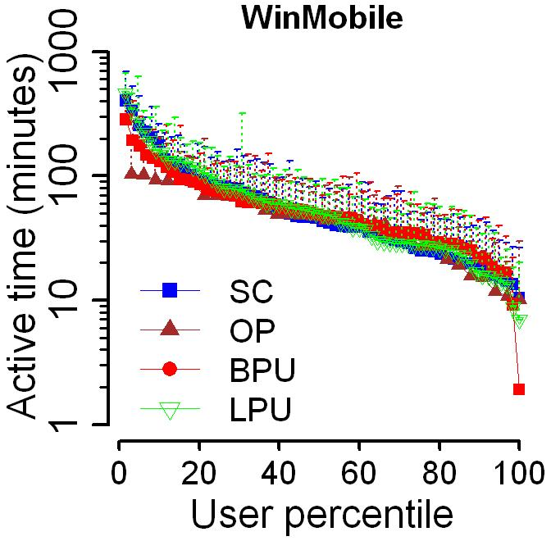
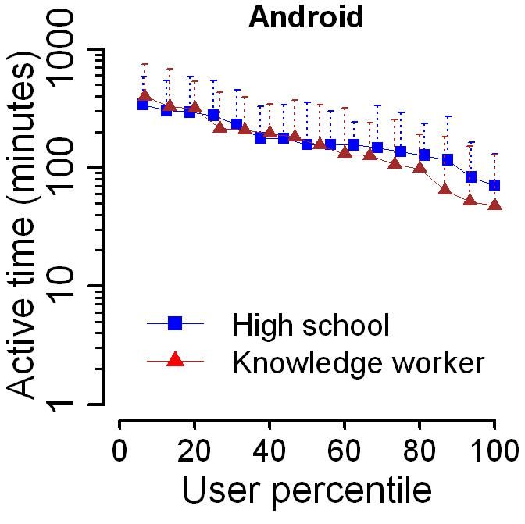
User Demographics Do Not Explain Diversity
Notes:
Both declared user types and types based on occupation cannot explain diversity in usage intensity
Variance within each demographic group matches the total variance

Slide 11
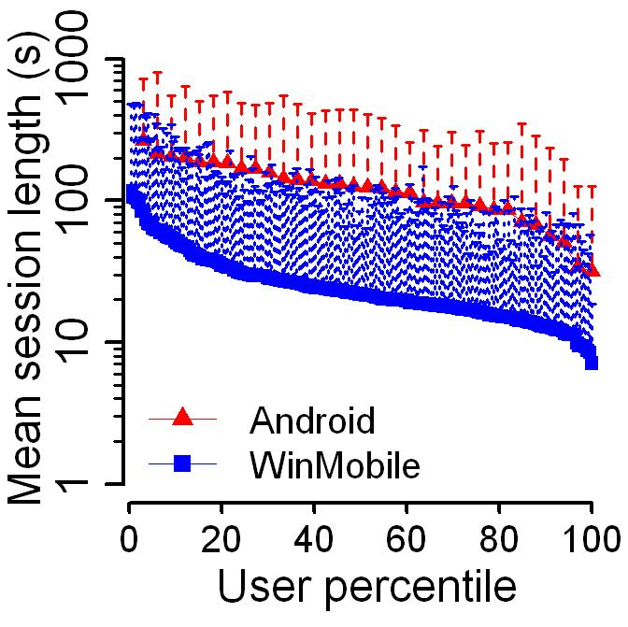
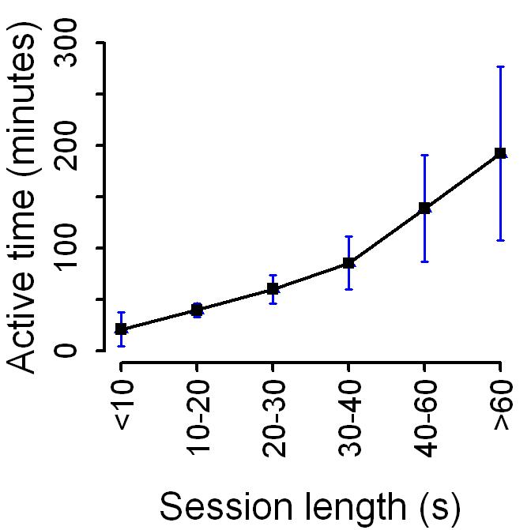
Session Lengths Contribute to Diversity
Notes:
Users are diverse in their mean session length (about one order of magnitude variation across users)
To see whether interaction time depends on mean session length, lets look at the mean and 95% CI of interaction of users with different mean session length. As you can see, users with higher mean session length have higher total interaction per day
Transition: Is the diversity in session length the only parameter contributing to the diversity in interaction?

Slide 12
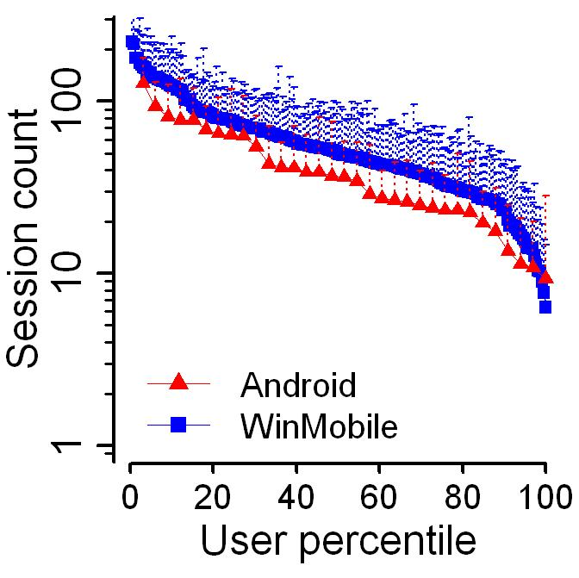
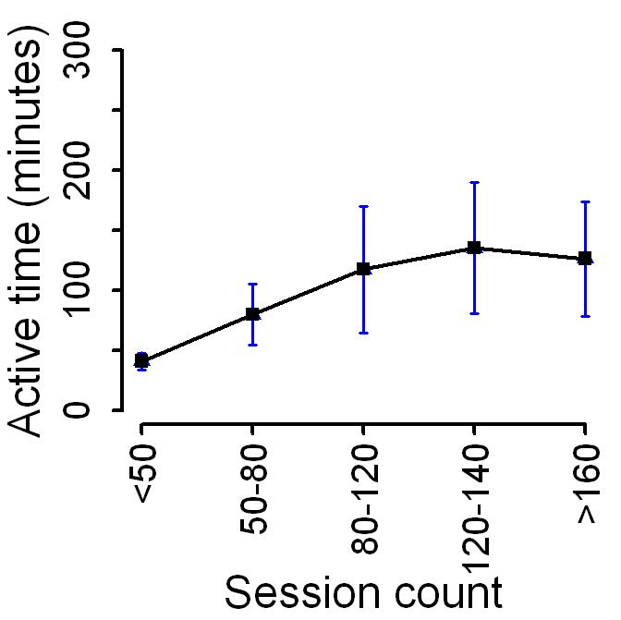
Number of Sessions Contribute to Diversity
Notes:
Users are diverse in the number of interaction per day (about one order of magnitude variation across users)
To see whether interaction time depends on mean the number of interactions, lets look at the mean and 95% CI of interaction of users with different mean session counts. As you can see, users that interaction with their phone more frequently have higher total interaction per day
Conclusions: Both session count and session length are higher for active users
Transition: Are these two factors contributing independently or are they related to each other?

Slide 13
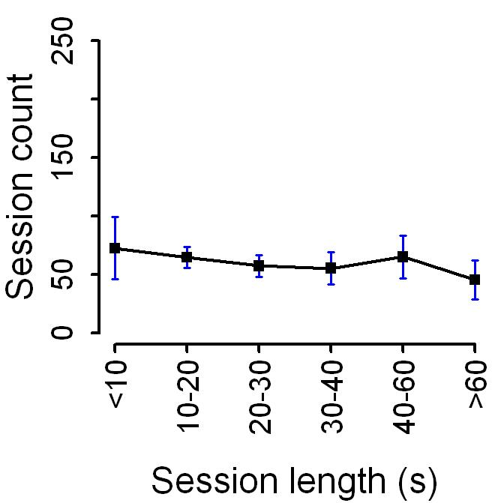
Session Length and Count Are Uncorrelated
Notes:
We found that session length and count both contribute to interaction diversity. Now we need to understand whether these to are independent or not. If they are related, then we need to find what is the common cause.
Message: No correlation between session count and session length

Slide 14
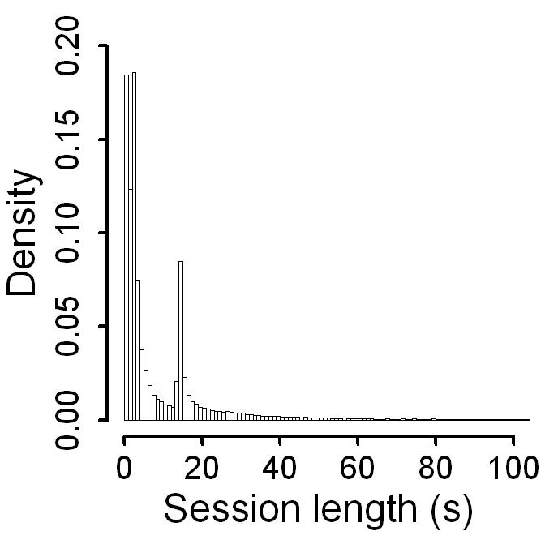
Close Look at Interaction Sessions
Sessions terminated by screen timeout
Exponential distribution
Few very long sessions
Most sessions are short
Shifted Pareto distribution
Notes:
So far users differ in their interactions by two or three orders of magnitude, and that makes building systems such as the one we had in mind hard
Transition: It could really help if there were invariants across all users that we could take advantage of and
Most sessions are short
There is a second spike that corresponds to the screen time out. These are the sessions that the users forgets to explicitly turn off the screen.
There are some very large session in this user’s data (and every other user)
We found that a mixture of exponential and shifted Pareto distributions can well explain the session length of every user (different parameters for different users)
Exponential explains the majority of the sessions that are short
Pareto shift models the second spike
Heavy tail of Pareto explains tail values
Stationarity and independence, considered together, suggest that session length values can be modeled as i.i.d samples from a distribution.
KPSS test: 90% of the users have stationary session length → past behavior is capable of predicting the future.
Ljung-Box test: 96% of the users session length are independent → the current value does not have a strong correlation with previous values

Slide 15
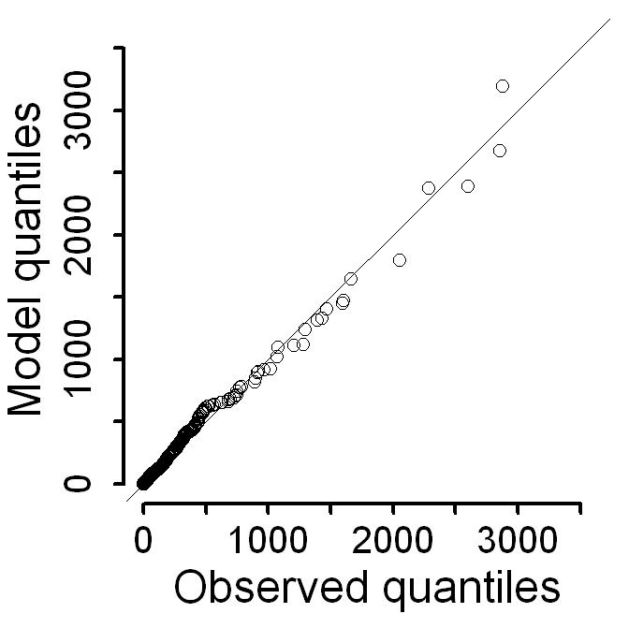
Modeling Interaction Sessions
Extremely long sessions are being modeled well
Notes:
A QQ plot shows how well a model fits to observed values. If all the points are aligned across the X=Y line, the model offers a good fit
Modeling tail values is particularly challenging, and as you can see, our model is doing a good job at the tail
We similarly modeled off-time intervals using a Weibull distribution (paper for more details)

Slide 16
Implications of Interaction Diversity
Diversity
Interaction Models
System Design Implications
System parameters such as timeouts can be tuned based on model parameters
System can be designed with insights from the distributions
Notes:
So far we saw significant diversity in interaction across users. We also observed significant diurnal patterns that I did not present in the interest of time, but you can find in the paper.
However, there are invariances in interactions. These are models that fit well to the seemingly random intervals that the screen is ON or OFF.
We can design systems with the exponential and Pareto distributions in mind (similarly weibull for inactive times)
The parameters can be inferred on the phone and mechanisms can adapt based on the parameters.
Transition: Whenever a user interacts with the phone, he/she runs one or more applications. How is her attention spread across these applications?

Slide 17
Outline
Interaction
Diversity in interaction
Interaction model
Application
Diversity in application usage
Application usage model
Energy
Notes:
We saw how users are diverse in interactions, how about the applications that they run during interactions?
Transition: I start with interaction

Slide 18
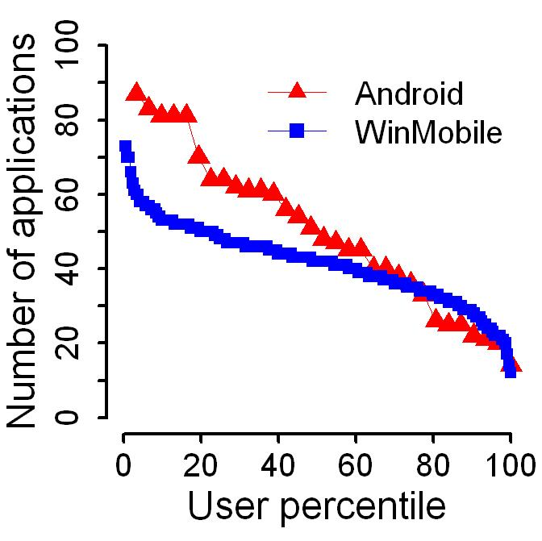
Users Run Disparate Number of Applications
50% of users run more than 40 apps
Notes:
First lets compare the number of applications that different users run.
Call out the max and min -> users are diverse
Large number of applications used by users in both data sets
Transition: But what are these applications?

Slide 19
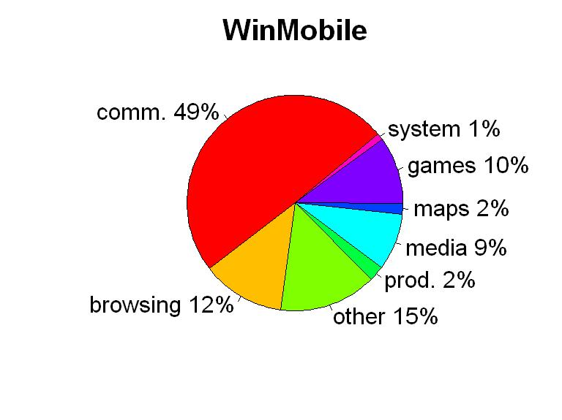
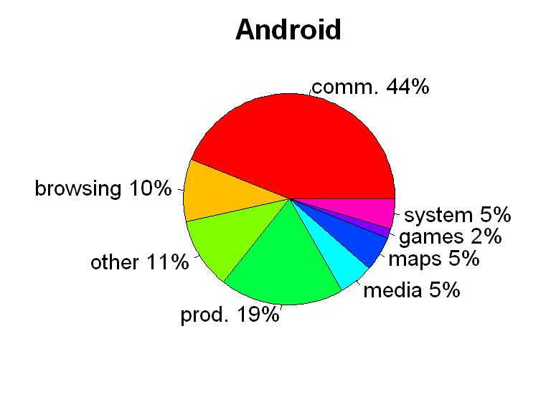
Application Breakdown
Notes:
To get a more clear picture we categorized applications and studied how much time users spend in each category
Usage ratios are similar in both data sets to a first order
On both datasets, communications applications occupy the largest segment, therefore smartphones are primarily communication devices
Browsing ratio is similar across the two datasets too
We studied application sessions as well, while applications in each category do have similarities in terms of the session length, but the same application is used differently by different users.
Transition: But for each individual user how does this look like? We remember users are divers.

Slide 20
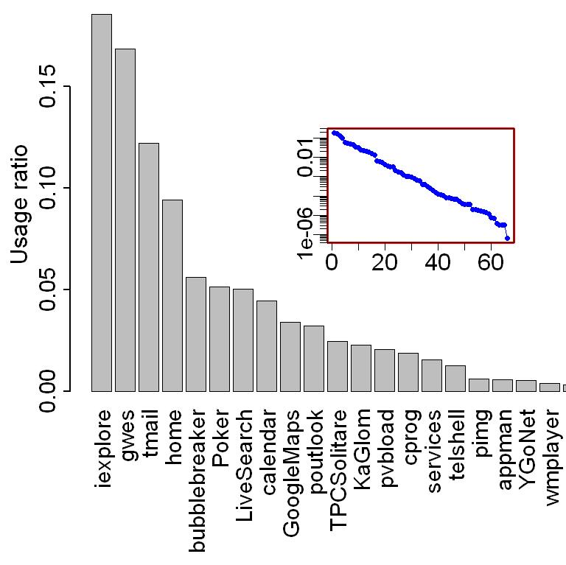
Close Look at Application Popularity
Straight line in semi-log plot appears for all users
Different list for each user
Notes:
Here you can see the time ratio spent on different applications by an example individual (aggregate over all time)
Obviously each user has a different list and a different order of applications
for each user the relative popularity of applications can be modeled by an exponential distribution.
Good news for system optimization
List and parameters are different for each user
Transition: When modeling application popularity this way, what is the error?

Slide 21
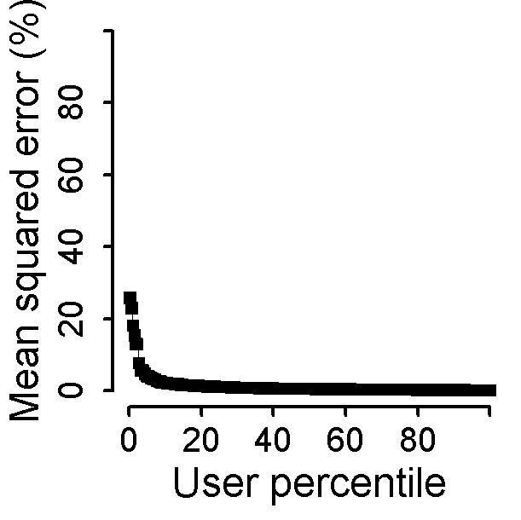
Exponential Distribution Models App Popularity Well
Notes:
Mean squared error of the model is less than 10% for 90% of users

Slide 22
Implications of Application Diversity
Diversity
Application Models
System Design Implications
Most of a user’s attention is focused on a few applications
Optimize the system for the top applications for each user
Notes:
We observed significant diversity in in application usage too. Users run different applications and run them differently.
The invariance in application usage is that application popularity for each user can be modeled with an exponential distribution, off-course parameters are different for different users.
For system designers, the exponential distribution means that most of the users time is spent with a few applications. Therefore, if you improve the performance of those for each user, you can improve the overall phone performance for that user.

Slide 23
Outline
Interaction
Diversity in interaction
Interaction model
Application
Diversity in application usage
Application usage model
Energy
Diversity in energy drain
Predicting energy drain

Slide 24
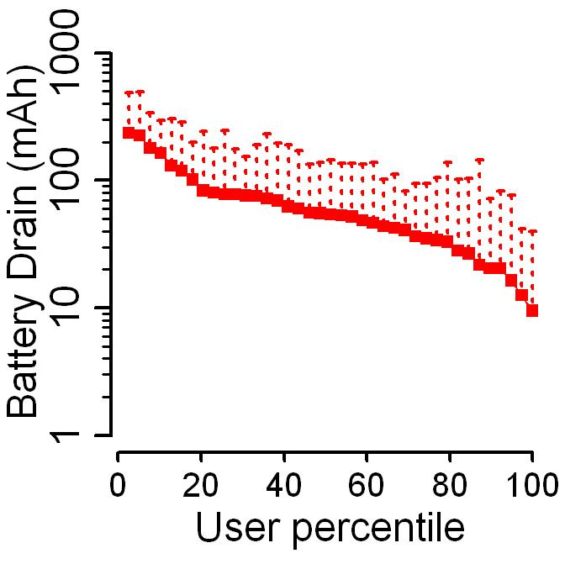
Users Are Diverse in Energy Drain
Two orders
Notes:
Transition: So far we studied intentional aspects of usage, but there are un-intentional aspects such as energy drain and network traffic. We found that users are diverse in these aspects as well.
Energy drain depends on two factors:
user interactions and applications; (dominates)
Platform hardware and software.
We observe about two orders of magnitude of variation in energy drain per hour across the users, which indicates that the first factor is driving energy consumption.
Transition: In addition, the variation in energy drain for each individual user is high too. To understand that better, we need to zoom in and look closer at an individual users drain over time.

Slide 25
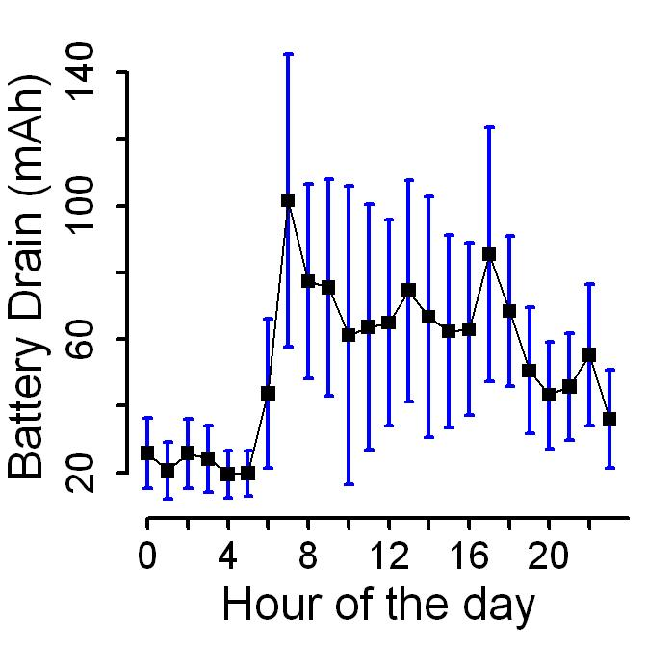
Close Look at Energy Drain
High variation within each hour
Significant variation across time
Notes:
For an example user the drain is not the same throughout the day (has diurnal variations)
High variance in drain during the same hour (high standard deviation lines in the graph)
Transition: These two sources of high variation, indicate that modeling energy drain is challenging. This is why no smartphone today, can tell you accurately how long it will last.

Slide 26
“Trend Table” Based Framework to Model Energy Drain
Notes:
Captures trends (either diurnal or related to usage) in battery drain using tables of consecutive battery readings.
Each table is indexed by a number of consecutive battery readings and also contains the mean and SD of battery drain during the next interval
Given a n consecutive battery readings, the algorithm finds the table with the most similar index, and reports the output from that table.

Slide 27
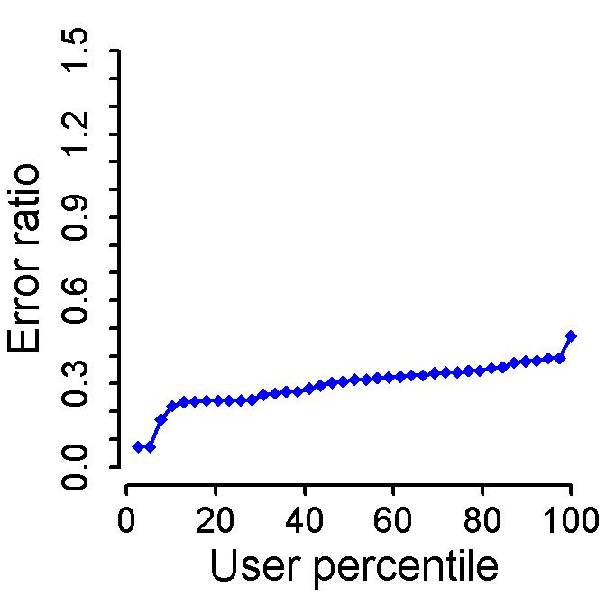
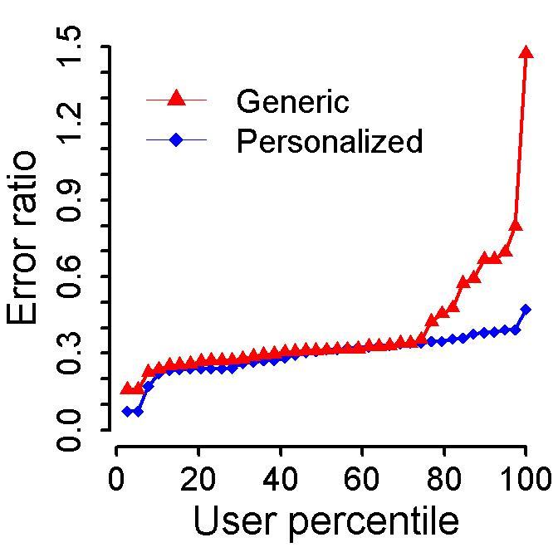
Modeling Energy Drain
Notes:
Note that we are able to predict energy drain with low error ratio
Personalized algorithm performs consistently better than the generic algorithm
Interesting to note that, generic is close to personalized for mid-range users. But for low-end and high-end users, the generic algorithm has higher prediction error.
Conclusion: Personalization can indeed help predicting resource consumption. This is good news.

Slide 28
Conclusions
Users are quantitatively diverse in their usage
Building effective systems for all users is challenging
Static policies cannot work well for all users
Invariants exist and can be harnessed
Users have similar distributions with different parameters.
This significantly facilitates the adaptation task

Slide 29
Diversity in Smartphone Usage
Hossein Falaki
falaki@cs.ucla.edu
MobiSys ‘10
June 17, 2010

