Slide 1
First Service: The Advent of Actionable Tennis Analytics
Jeff Sackmann
jeffsackmann@gmail.com
tennisabstract.com

Slide 2
First Service: Outline
The sorry state of tennis data
The potential of schedule optimization
The Match Charting Project

Slide 3
1. The Sorry State of Tennis Data
Too many cooks in the kitchen
… and no plates.

Slide 4
What’s out there?
“MatchStats”
Most pro matches, publicly available
Umpire Scorecards
All pro matches, rarely available
IBM Point-by-point
Most Grand Slam matches, sort of available
Hawkeye
Some top-tier matches, not available

Slide 5
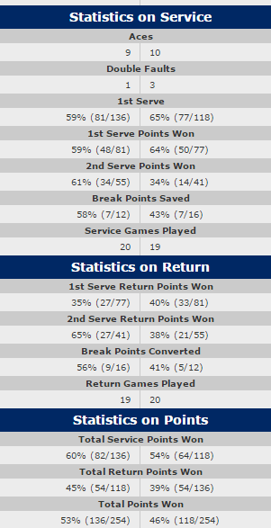
What’s out there: MatchStats

Slide 6

When all you’ve got is MatchStats…

Slide 7
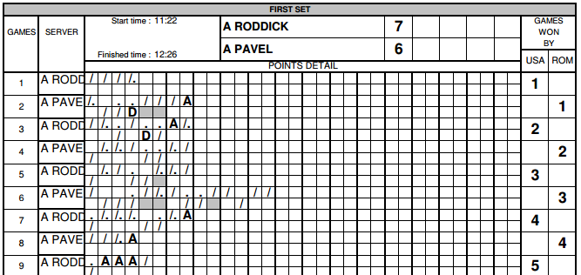
What’s out there: Scorecards

Slide 8
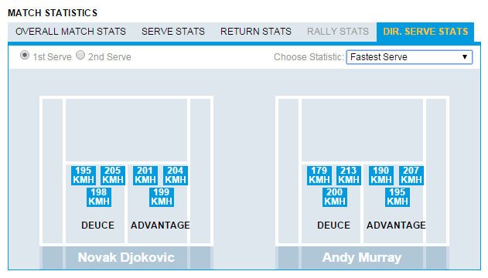
What’s out there: IBM pt-by-pt

Slide 9
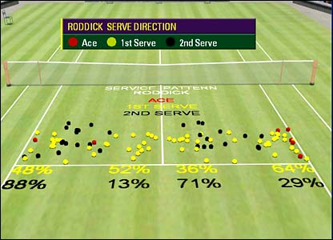
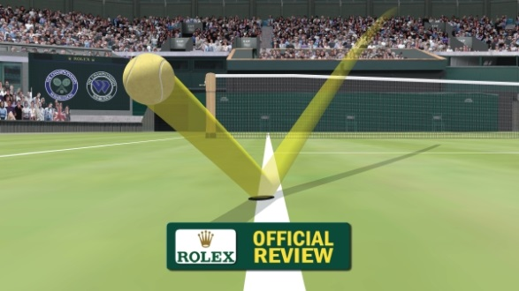
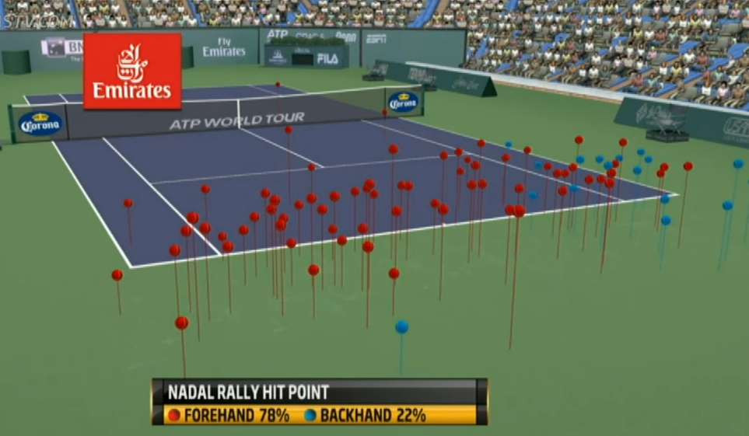
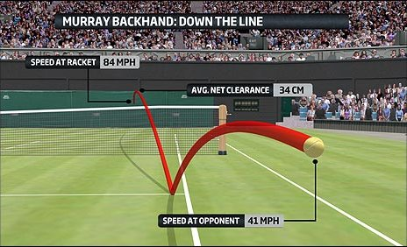
What’s out there: Hawkeye

Slide 10
Complete List of Public APIs Offered by Tennis Tours, Tournaments and Federations:

Slide 11
Why So Little Engagement?
The tennis world is fragmented.
Organizations have treated analytics as something to be sponsored (if they consider it at all).
Individual sports don’t tend to reward use of analytics the way team sports do.
It’s easy to measure each player’s contribution.
Existing analytics (and data sources) have developed for bettors, not players.

Slide 12
Enough whining already…
What can we do with what we have?

Slide 13
2. The Potential of Schedule Optimization
The stakes are high.

Slide 14
Not All Events Are Created Equal
The biggest events on the ATP and WTA tours are mandatory for players who qualify.
Still, every player has some leeway in determining their schedule.
Second-tier players (ranked between #50 and #200) have a huge amount to gain here.

Slide 15
WTA Case Study: DC vs Stanford
Two events played in the same week, in the same country, on the same surface.
Most players who competed in either event could have entered the other.
Stanford (Premier)
Winner gets 470 ranking points and $120,000
Washington (International)
Winner gets 280 ranking points and $43,000

Slide 16
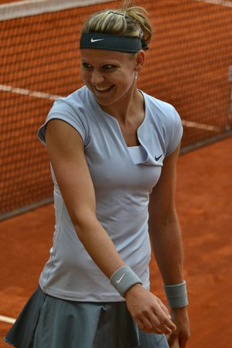
DC vs Stanford: Lucie Safarova
Ranked #17 in the world
Would be top seed and title favorite in DC
Would be #8 seed in Stanford, could face Serena or Radwanska as early as quarterfinals.

Slide 17
DC vs Stanford: Lucie Safarova (2)
Washington: 14% chance of winning the title.
Stanford: 3% chance of winning the title.
Which would you choose?

Slide 18
DC vs Stanford: Lucie Safarova (3)
Washington
Expected points: 87
Exp prize: $11,800
Stanford
Expected points: 95
Exp prize: $21,170

Slide 19
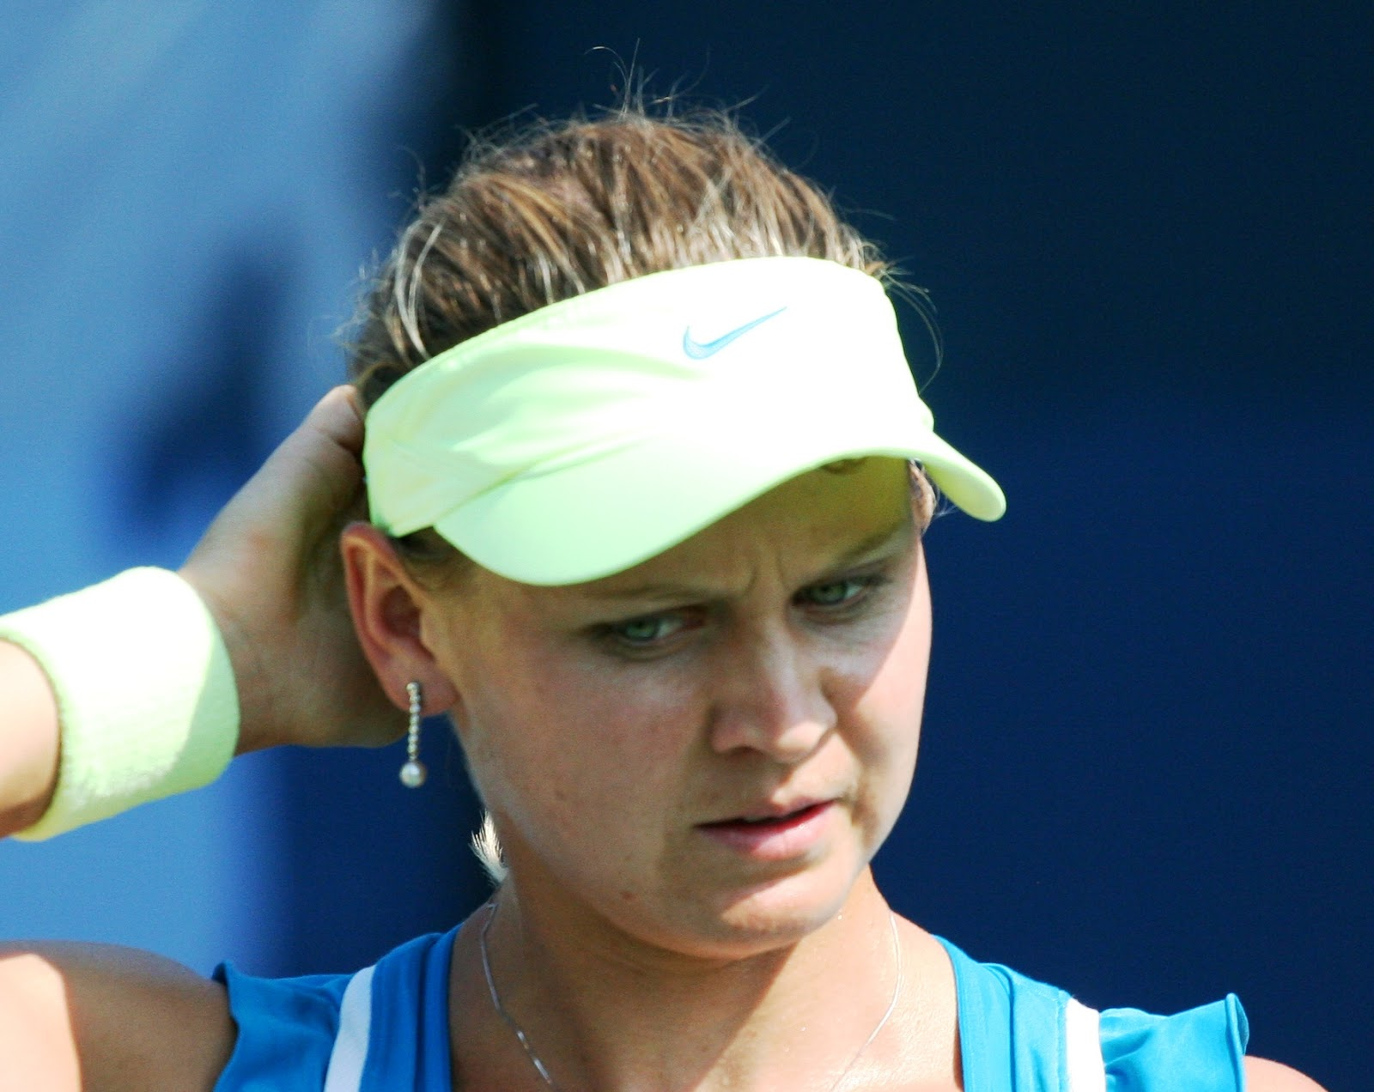
What happened?
First round loss to Kiki Mladenovic:
Ranking points: 1
Prize money: $2,220

Slide 20
DC vs Stanford: The Big Picture
Of 48 direct entrants, 48 would be expected to earn more prize money in Stanford.
Of the 48, 37 would be expected to earn more ranking points in Stanford.
Most of the exceptions were players who would be seeded in DC, but not in Stanford.
Ekaterina Makarova: #2 seed in DC. Would be expected to earn 15% more points in DC.

Slide 21
The Even Bigger Picture
Seeds matter. (Duh.)
If you’ll be seeded at one event but not at the other, go where you’ll be seeded.
(Unless prize money is more important than ranking points. We’ll come back to that.)
If you’ll be seeded at both or unseeded at both, go where the rewards are greater.

Slide 22
Ranking Points > Prize Money
(Except when paying travel expenses.)
Short-term prize money might be necessary, but…
Short-term points → more seeds → long-term points and prize money

Slide 23
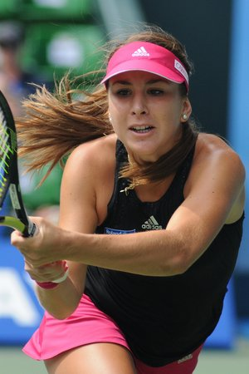
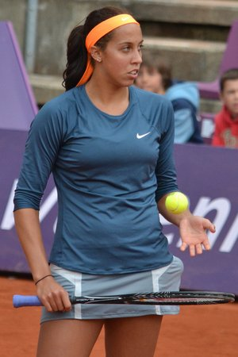
Seeds Really Matter
Belinda Bencic:
#32 seed in Melbourne
Madison Keys
Ranked #33 – unseeded

Slide 24
Seeds Really Matter (2)
Keys got a lucky draw (and played well) but…
Before the draw was made:
Bencic: 46% chance of reaching third round
Keys: 29% chance of reaching third round
More money and more ranking points … all because of the seed!

Slide 25
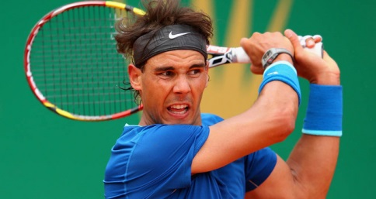
Two Wrinkles (of Many)
Byes
In comparing a similar pair of ATP events, some players who chose the tourney with more points/money would’ve been better off at the smaller event because of a first-round bye.
Unknowns in the draw

Slide 26
Predicting the Future is Hard
Analyzing player choices from 2013 Bucharest (250 points) and Barcelona (500 points and four times the money), many chose wrong…
But if Nadal hadn’t played, their choice would’ve been optimal.
(That said, Nadal on clay is the exception that breaks every model.)

Slide 27
Additional Considerations
Many reasons why players might make an apparently suboptimal choice:
Sponsor commitments
Appearance fees
Past success at the event
Desire for more match play
Prioritizing their doubles schedule

Slide 28
We’ve determined where to play…
What can we say about how to play?

Slide 29
3. The Match Charting Project
Hawkeye data for dummies.

Slide 30
The Problem
Hawkeye data is amazing.
Independent researchers have no (or very limited) access to it.
If we had it, we could do so much of value.
Whining about it doesn’t help.
(I’ve tried. You’ve heard me.)
We’re not going to get it anytime soon.

Slide 31
Solution: Crowdsourced Charting
Lots of fans watch lots of tennis.
Lots of fans want better tennis stats.
(At least they say they do.)
A fan and a spreadsheet can’t replicate Hawkeye cameras, but they can track an awful lot of things, much of it in real time.

Slide 32
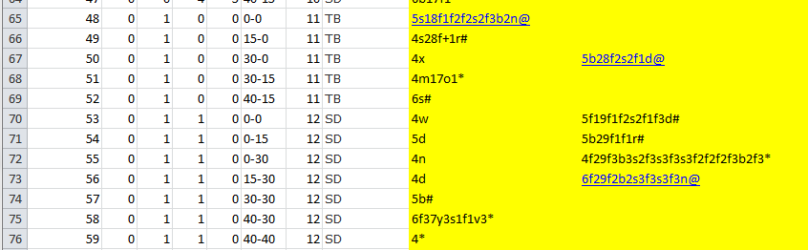
Match Charting Project basics
Here’s what the spreadsheet looks like:

Slide 33
MCP: What We’re Tracking
Every serve:
Direction, type of error, s-and-v approach
Every return:
Type of shot, direction, depth
Every shot:
Type of shot, direction, approach, court position
Every point:
Ending (winner, forced/unforced error, etc.)

Slide 34
MCP: Coverage So Far
One year in:
667 matches
400+ different players
10+ matches for 29 different players
60+ matches for Federer, Nadal, and Halep
30+ contributors
(Did I mention 60+ Halep matches? Just a sec…)

Slide 35
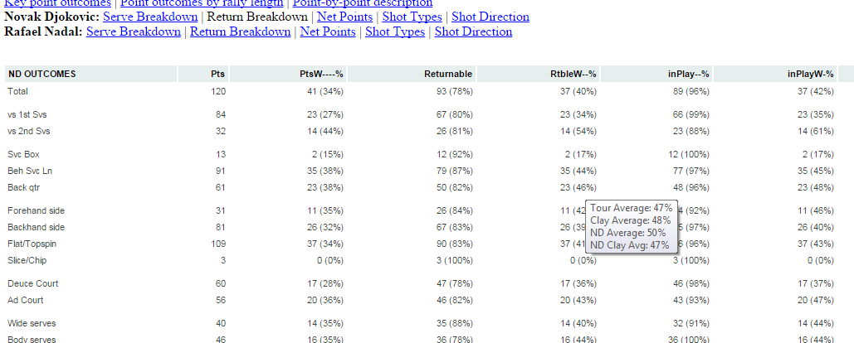
MCP: Sample Output
Djokovic return breakdown, 2014 French Open final:

Slide 36
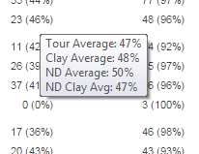
MCP: Sample Output (2)
Easy comparison with tour and player averages, overall and by surface:

Slide 37
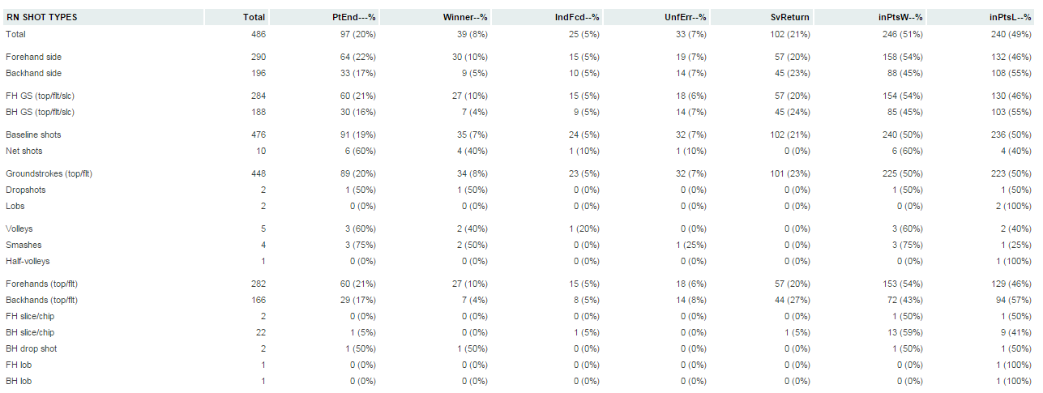
MCP: Sample Output (3)
Success and frequency of every type of shot for Rafael Nadal (2014 French Open final):

Slide 38
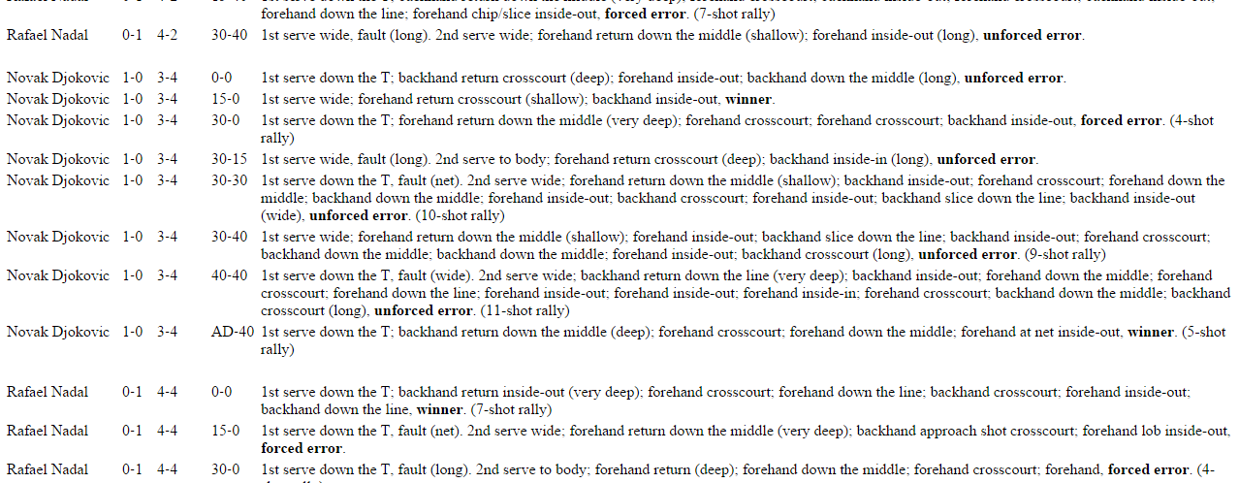
MCP: Sample Output (4)
Full text shot-by-shot:

Slide 39
Player Tendencies: A Sample
Take, for example, 1st serves in the ad court.
(limiting our view to matches between RHs)
Wide and T serves are more effective than serves in the middle of the box (big surprise):
Wide serves: 72.6% of returns put in play
Body serves: 83.9% of returns put in play
T serves: 71.1% of returns put in play
Same trend with point results (34%/43%/34%)

Slide 40
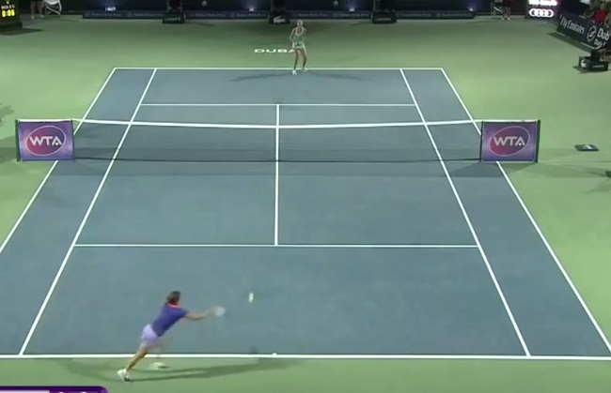
Looks like a weapon…

Slide 41
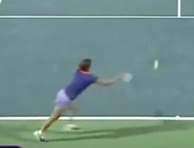
…but not against Simona
Simona Halep:
Same distribution of returns in play (77%/86%/78%)
End result is very different! (39%/47%/46%)
She neutralizes the T serve weapon
(She did win that point)

Slide 42
Digging Deeper: Rally Tactics
Still keeping things simple, categorize all shots by:
In which third of the court they were hit
Which type of shot
To which third of the court they were hit
Example: Corner-to-corner (crosscourt) FH
This gives us 18 permutations: 12 common

Slide 43
Crosscourt Forehand Responses
 | Crosscourt | Up the Middle | Down the Line | Point Win%
AVERAGE | 37.7% | 28.8% | 33.6% | 66.4%
Azarenka | 30.3% | 25.9% | 43.8% | 56.2%
Halep | 35.6% | 30.9% | 33.5% | 66.5%
Radwanska | 37.5% | 28.4% | 34.1% | 65.9%
Sharapova | 34.6% | 24.8% | 40.6% | 59.4%
S. Williams | 39.5% | 32.2% | 28.3% | 71.7%
Wozniacki | 36.2% | 24.3% | 39.5% | 60.5%

Slide 44
Not Digging Too Deep…
That table represents outcomes of just one of twelve common groundstroke permutations.
(Ignoring slices, approach shots, all net play…)
Having a tour-wide dataset is so important:
The differences between players are minor
Even experts can’t look at these numbers without context and have a clue what they’re seeing

Slide 45
…but Deep Enough
Even simplifying the court to three sectors, generally ignoring shot depth, and failing to track speed, there’s a wealth of actionable data here.
It’s a heck of a lot cheaper than Hawkeye.

Slide 46
You Can Help! (And You Should)
It’s easy to find The Match Charting Project (and the hundreds of detailed match reports) via my sites:
tennisabstract.com
heavytopspin.com
You’ll start watching tennis really intently!

Slide 47
Thanks!
Jeff Sackmann
jeffsackmann@gmail.com
tennisabstract.com

