Slide 1


Exo-AI Explorer
Discovering New Worlds with Artificial Intelligence
NASA Space Apps Challenge 2025
Team: Zero Day

Slide 2


The Problem: Hidden Planets in a Sea of Data
NASA's exoplanet search is a classic "needle-in-a-haystack" problem. Missions like Kepler and TESS generate immense, complex datasets that overwhelm human analysis capabilities.
Vast Data Collection
Over 200,000 data points and light curves collected by Kepler, K2, and TESS missions.
Manual Bottleneck
Traditional, visual analysis by scientists is incredibly slow and labor-intensive.
Discovery Delays
Potential exoplanet candidates are delayed, or worse, completely missed in the noise.

Slide 3

Our Solution: Exo-AI, the Cosmic Detective
We have developed an intelligent platform that leverages machine learning to rapidly and accurately sift through NASA data, identifying exoplanet candidates in real time.
Kepler data
Raw telescope time series
False Positive
Non-planetary signal
TESS data
Wide-field photometry
Ensemble ML Model
Candidate Planet
Confirmed Exoplanet
Promising signal ( Validated detection
80%
Classification Accuracy Reliable performance in distinguishing true transit signals from noise.
Instant
Result Speed Provides immediate results, radically accelerating the validation pipeline.
3
Key Features Analyzed Includes planet size, orbital period, and host star characteristics.

Slide 4

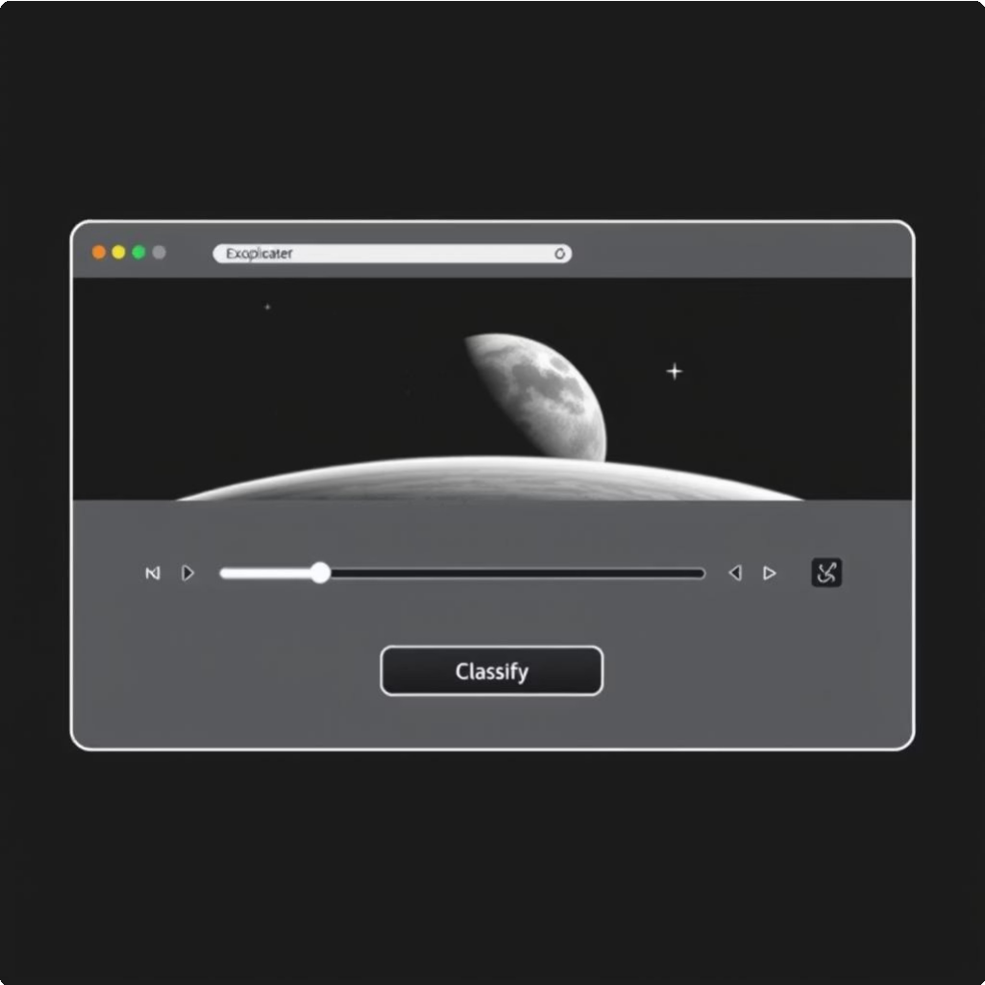


How It Works: Powered by Smart Algorithms
Exo-AI Explorer is built on robust, open-source technologies, ensuring transparency and accessibility for the scientific community.
Technology Stack Live Deployment & Accessibility
Python
Core programming environment for data handling and model development.
Ensemble ML
Random Forest and Gradient Boosting algorithms for high accuracy.
Gradio
Simple, no-code web interface for immediate user interaction.
Deployment: The application is live and operational on Hugging Face Spaces, requiring zero setup.

Slide 5





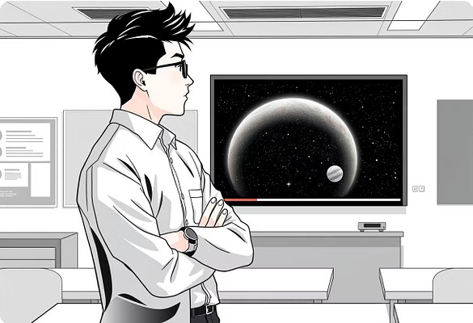
Why It Matters: Democratizing Space Discovery
Exo-AI Explorer doesn't just speed up research4it opens the doors of the cosmos to everyone, fostering global participation in space science.
Accelerated Research
Researchers gain a powerful tool for rapid validation and prioritization of candidates.
Educational Impact
Brings real, raw NASA data and discovery tools into high school and university classrooms.
Global Collaboration
Open-source model encourages continuous improvement and community-
driven innovation.
Citizen Science
Empowers the public to contribute meaningfully to planetary exploration and discovery.

Slide 6
The Journey Has Just Begun: Exo-AI's Future
We are committed to continually expanding Exo-AI Explorer's capabilities and integrating the latest space technology.
Phase 1: Core Model (Now)
Live demonstration, foundational AI model, and public-
facing web interface deployed.
Phase 2: Real-Time Integration (Next) Integrate a real-time data feed from TESS and early data from the James Webb Space Telescope (JWST).
Phase 3: Immersive Visualization (Future)
Develop interactive, 3D visualizations of newly discovered solar systems for research and education.
Phase 4: Mobile Expansion
Create a dedicated mobile application for on-the-go analysis and citizen scientist outreach.
This roadmap ensures Exo-AI remains a leading tool as NASA missions evolve and gather more complex data.

Slide 7

Explore Live!
Thank You from Team Zero Day
We invite the judges and audience to experience the speed and power of the Exo-AI Explorer immediately.
Live Demo Interface
Test the model with sample data and receive instant classifications.
Click here to access the live app

