Slide 1
GUEST SERVICES SCHEDULE

Slide 2
GUEST SERVICES SCHEDULE

Slide 3
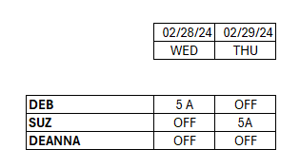
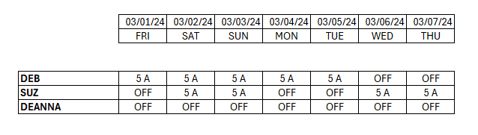
BREAKFAST SCHEDULE

Slide 4
BAR SCHEDULE

