Slide 1
Mobile Computing Project(NewsApp)
K.Sibin - 2020307
Saurabh Jaiswal - 2020331
Aftab Hussain - 2020277

Slide 2

Introduction
NewsApp is a simple Android application developed in Kotlin. It fetches news from an API and displays it in different categories based on their current location. The app also allows users to save their favorite news articles and view them later and also change the language as per their requirements.

Slide 3
Functionalities
selectedTabForNavigationBar and selectedTabForTabRow: These are mutable states that hold the currently selected tab in the navigation bar and the tab row, respectively.
categories and bottomNavigationCategories: These are lists that hold the categories for the tab row and the bottom navigation bar, respectively.
tab0, tab1, tab2, tab3, and saved: These are lists that hold the items for each tab in the tab row and the saved items, respectively.
database: This is an instance of the Room database.
listItemsHomeScreen: This is a mutable state that holds the items to be displayed on the home screen.
changeTabs(tabNumber: Int): This function changes the items displayed on the home screen based on the selected tab.

Slide 4
Functionalities
add To Database(item: Items): This function adds an item to the database.
deleteFromDatabase(item: Items): This function deletes an item from the database.
homeButtonClicked(): This function sets the items on the home screen to the items of the first tab and sets the selected tab in the tab row to the first tab.
savedButtonClicked(): This function retrieves all the saved items from the database and sets the items on the home screen to these saved items.
settingsButtonClicked(): This function sets the items on the home screen to the items of the first tab and sets the selected tab in the tab row to the first tab.
getNews(query: String, fromDate: String, sortBy: String, apiKey: String): This function makes a network request to fetch news based on the provided query, date, sort order, and API key.

Slide 5
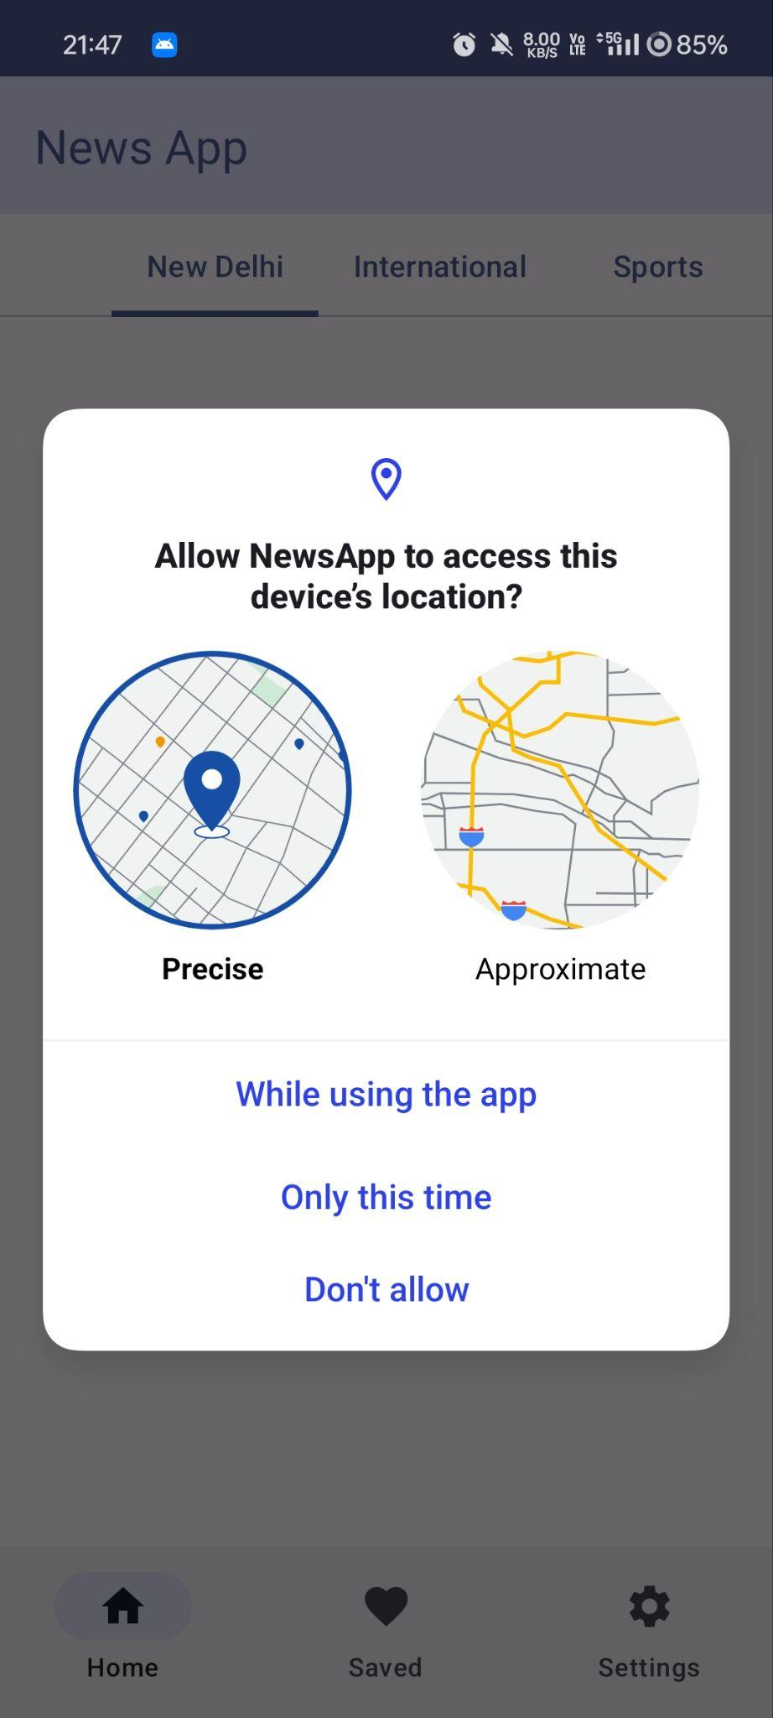
Location Detection

Slide 6
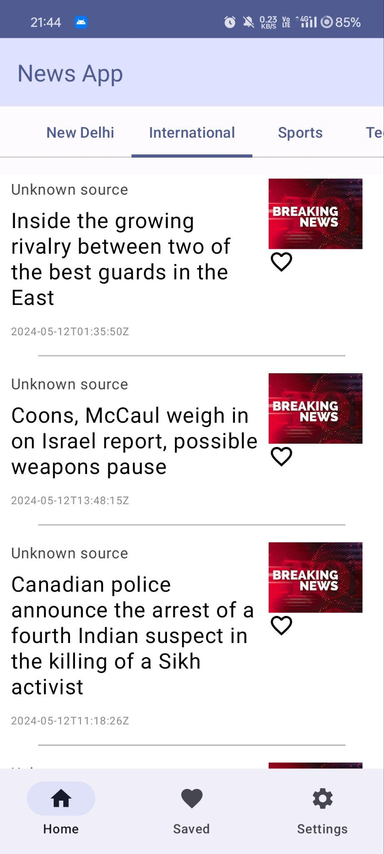
Home Screen

Slide 7
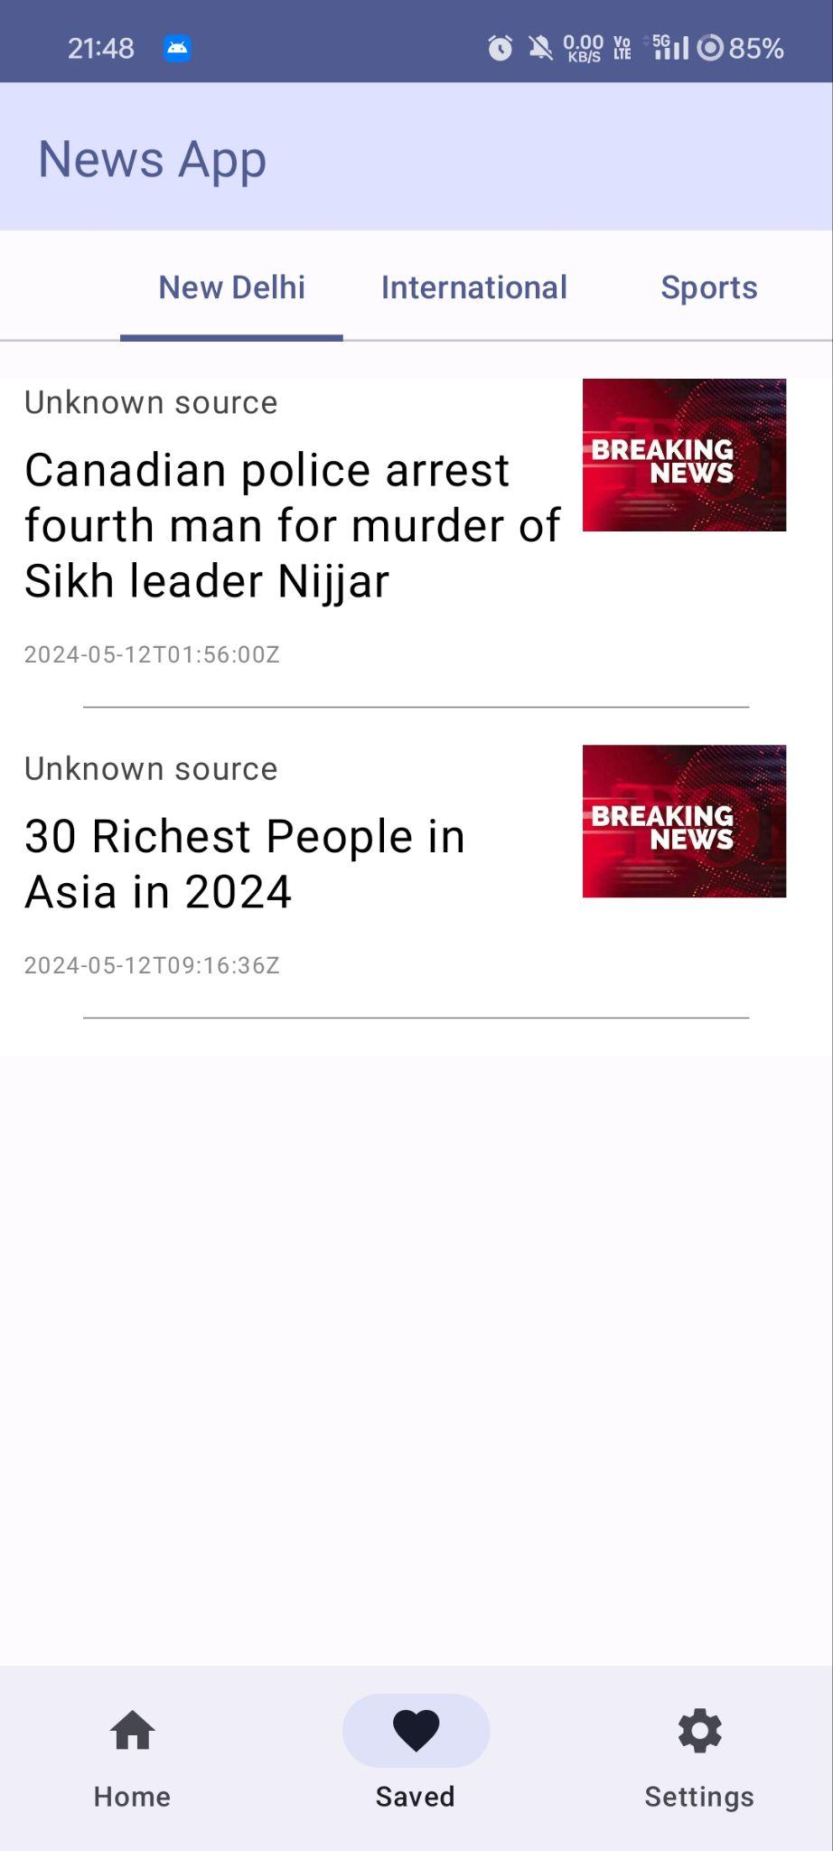
Saved News

Slide 8
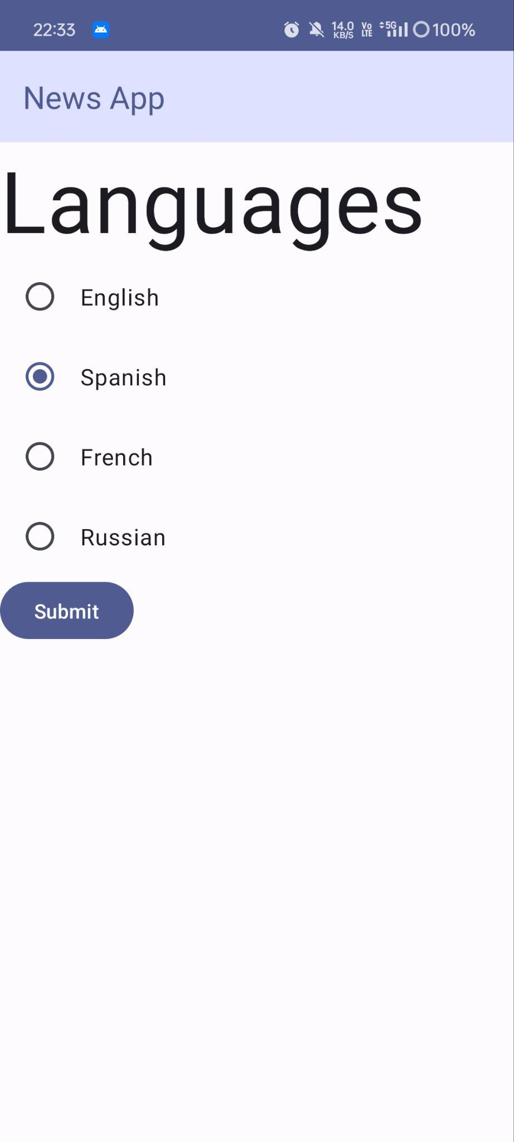
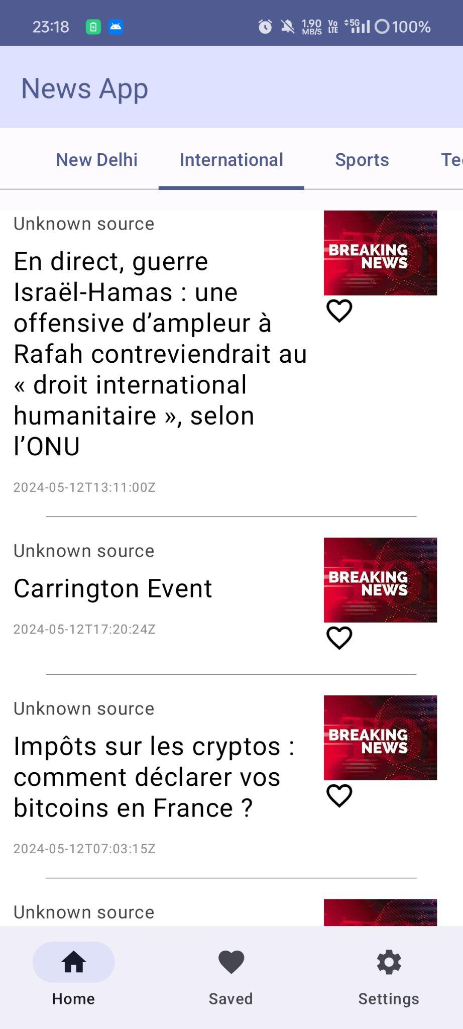
Language Change

Slide 9
Technologies Used
- Kotlin
- Java
- Gradle
- Android Jetpack Compose
- Retrofit for network requests
- Room for local database

Slide 10
THANK YOU

