Slide 1

Prepared By: 19012012024_Vidhi Patel
Internal Guide: Chirag Gami
Little Lady Fashion

Slide 2
Description
Scope
Technology
TABLE OF CONTENT
System Function & Features
System Design
Snap Shot
Conclusion
Future Scope

Slide 3
Description
This application is an website . The central concept of the application is to allow the customer to shop virtually using the Internet and allow customers to buy the items of their desire from the store. In our website in only for ladies’ cloths wear website.
The application was designed into two modules first is for the customers who wish to buy the cloths. Second is for the admin who maintains and updates the information pertaining to the articles and those of the customers.
The end user of this product is a departmental store where the application is hosted on the web and the administrator maintain the database. In this website use can first register your account and after they can view the products, search the products and buy the products.

Slide 4
SCOPE
Online shopping is rising day by day in India. Because India is the country where computer users are increasing day by day so as the online shopping trends are also increasing.
This project covers the online selling of fashion accessories etc. The project shows the product then product details. From the product details, the product can be added to cart and can be bought.

Slide 5
Technology
Front End: HTML, CSS
Back End: Laravel php
Database: Mysql

Slide 6
System Function & Features
Administrator:
Admin can login website.
They can add new product.
They can delete the product.
They can update the product.
They can manage order and they can update order status.

Slide 7
System Function & Features
User:
User can without login registration view the all products.
They can login or register website.
They can search the product.
They can view the product.
They can also cart the product.
They can make order and here only case on delivery available.

Slide 8
System Design
1 Use Case Diagram
2 System flow Diagram
3 Sequence Diagram
4 Activity Diagram
5 Data Flow Diagram

Slide 9
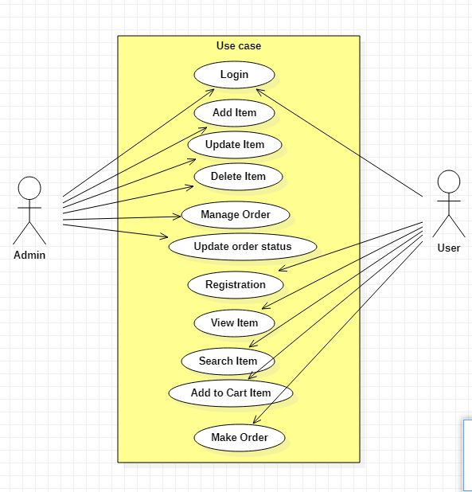
Use Case Diagram

Slide 10
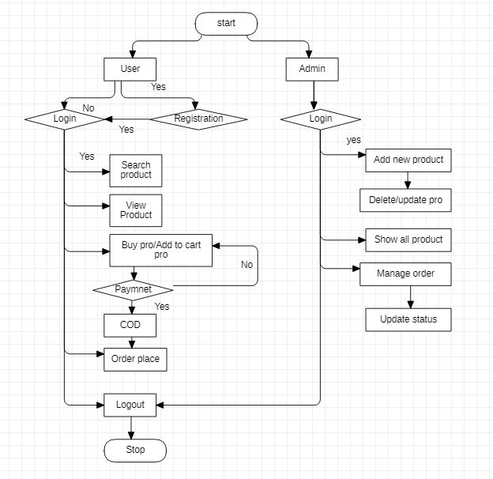
System Flow Diagram

Slide 11
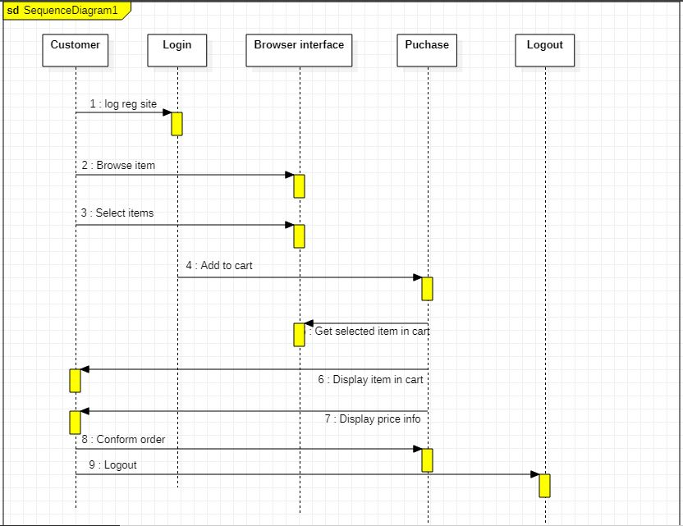
Sequence Diagram user

Slide 12
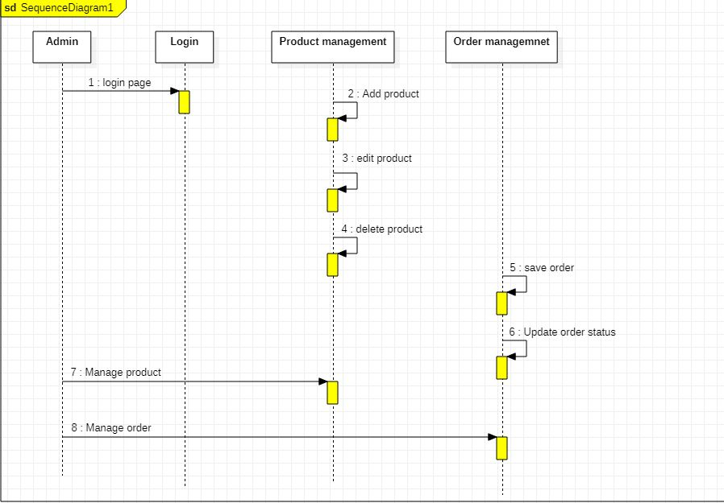
Sequence Diagram Admin

Slide 13
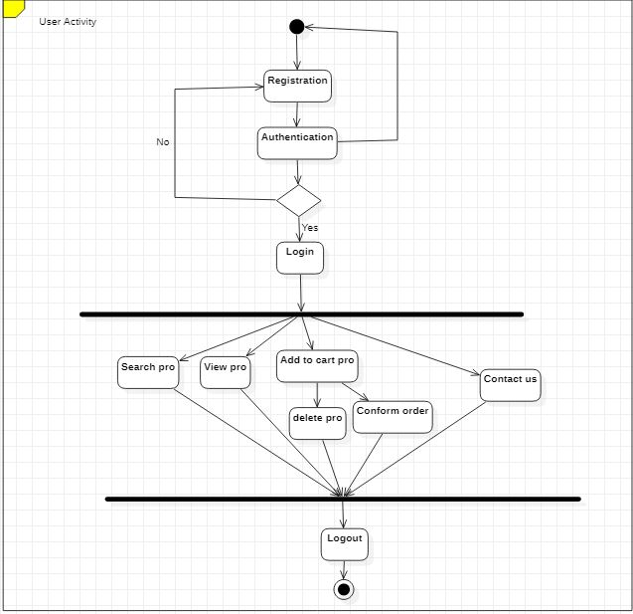
Activity Diagram User

Slide 14
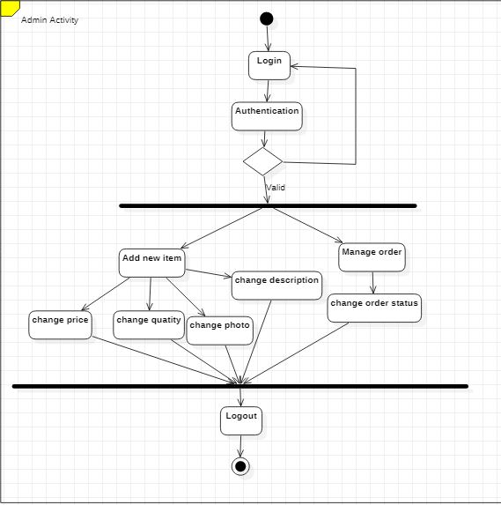
Activity Diagram Admin

Slide 15
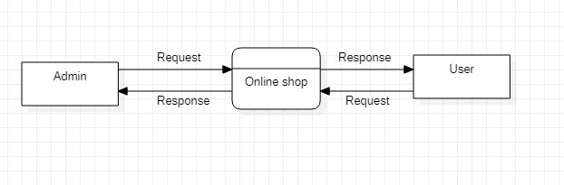
Data Flow Diagram Level 0

Slide 16
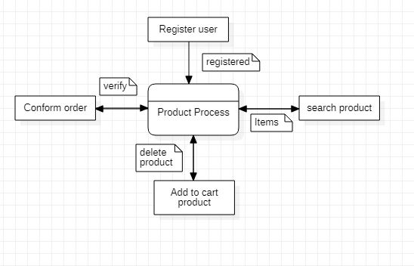
Data Flow Diagram Level 1

Slide 17
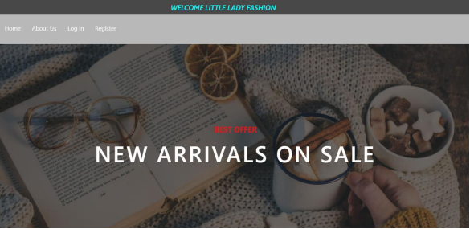
Snap Shot

Slide 18
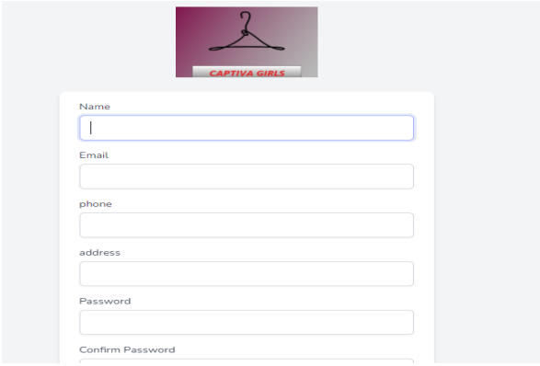
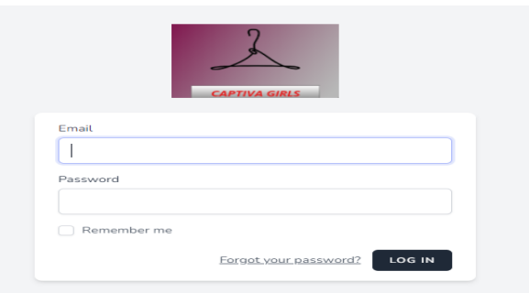
Sign Up
Login

Slide 19
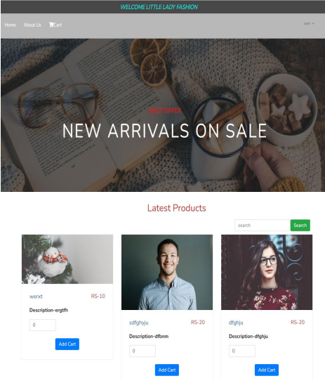
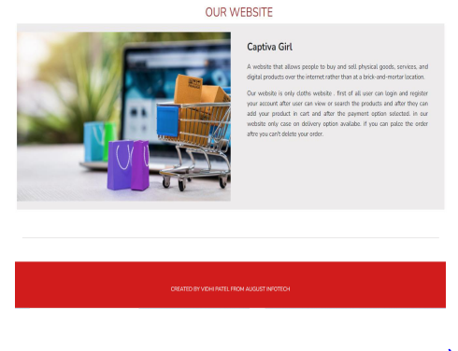
After login Home page

Slide 20
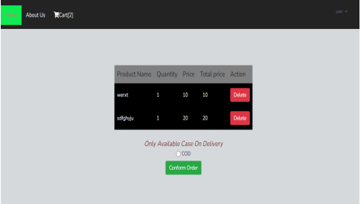
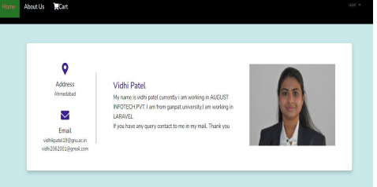
Cart And Contact Us page

Slide 21
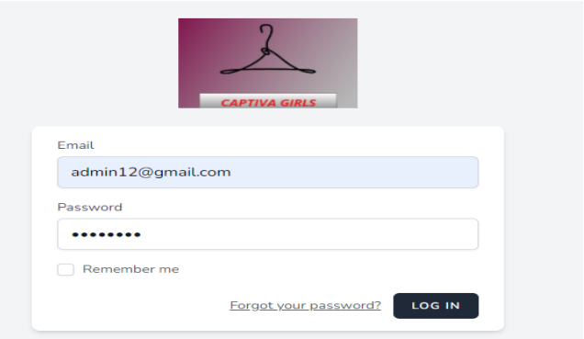
Admin login page

Slide 22
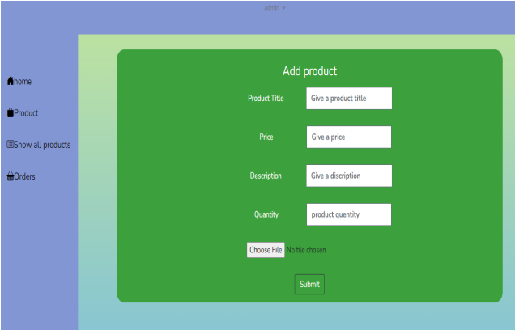
Add new product page

Slide 23
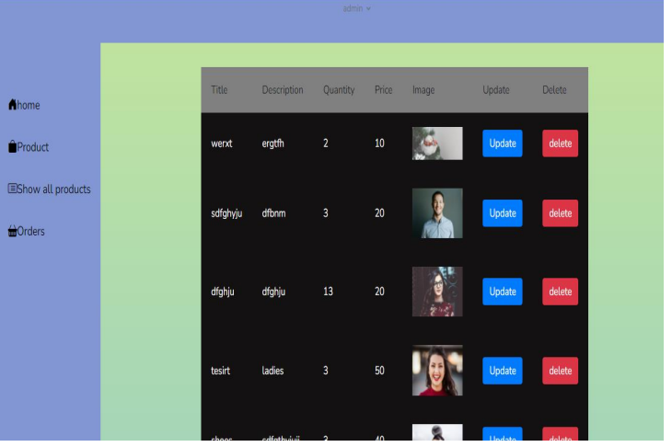
Show all product

Slide 24
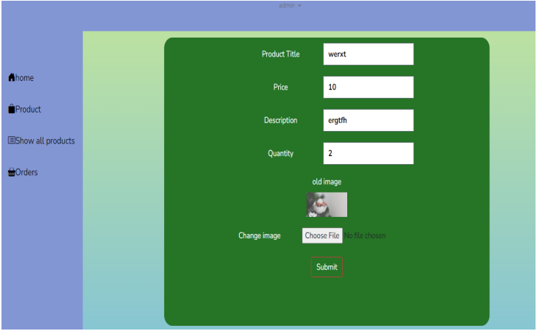
Product Update

Slide 25
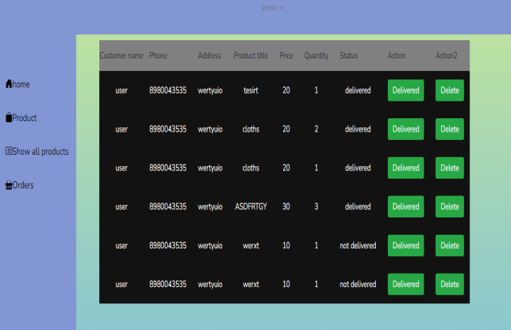
Order page

Slide 26
Conclusion
The ‘Online Shopping’ is designed to provide a web-based application that would make searching, viewing and selection of a product easier. The search engine provides an easy and convenient way to search for products where a user can Search for a product interactively and the search engine would refine the products available based on the user’s input. The user can then view the complete specification of each product. They canal so view the product reviews and also write their own reviews.

Slide 27
Future Scope
There can be several upgrades to the system, with each upgrade further simplifying the E Commerce Website.
In Future we will try work on the payment gateway for purchasing the product.
In Future we will work on categories the product.
In Future we will work better UI.

Slide 28
THANK YOU!!!
Vidhi Patel From August Infotech

