Slide 1
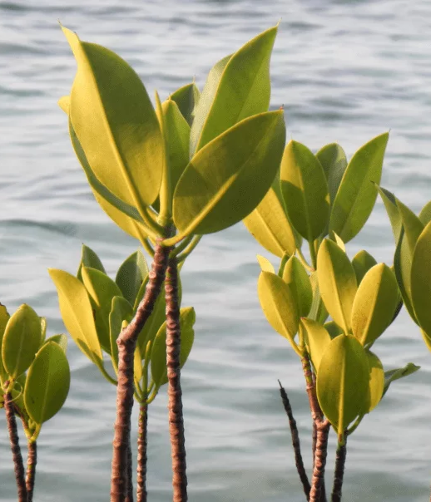
Timar
A Digital Platform for Mangrove Restoration on the Coast of Karachi
Founding Team : Aftab Ahmed Samoo & Haseeb Mudasir

Slide 2
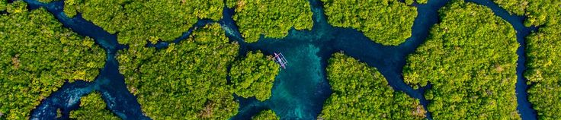
What is Mangrove?
A tree that grows in salt water, where land meets the sea, Its roots stand above the mud and hold the soil in place Called timar in Sindhi and Urdu , Karachi has them at Korangi Creek, Phitti Creek and Sandspit, Pakistan's are in the Indus Delta, the seventh largest in the world!

Slide 3

Problem Statement
“Karachi's mangroves protect the city, yet most citizens do not know they exist, most planted seedlings die untracked, and the groups restoring them have no system to record survival, prove impact or involve the public.”

Slide 4
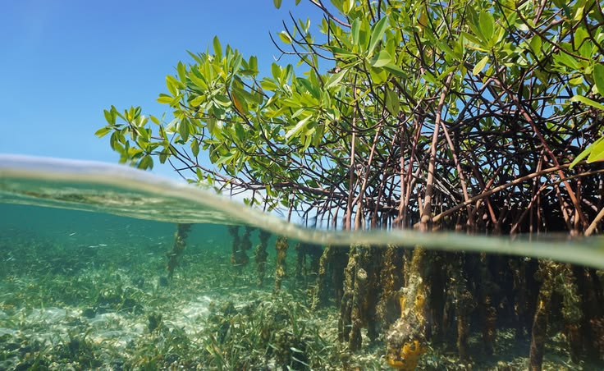
Our Solution,Timar!
A web platform that records what was planted, where, and whether it lived
Book a trip, sponsor a seedling, follow what happens to it
Report illegal cutting with a location and a photo
AI reads field photos, counts seedlings, picks planting sites and watches satellites
Saltwater Marina gets one portal to run all of it

Slide 5
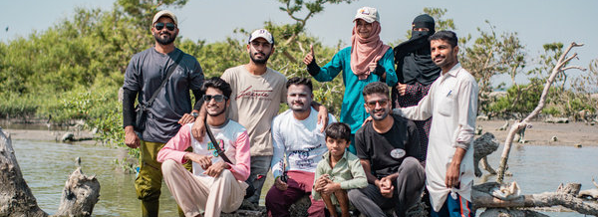
About Saltwater Marina
Saltwater Marina is a community-led mangrove conservation organization from one of Pakistan's oldest fishing communities.

Slide 6
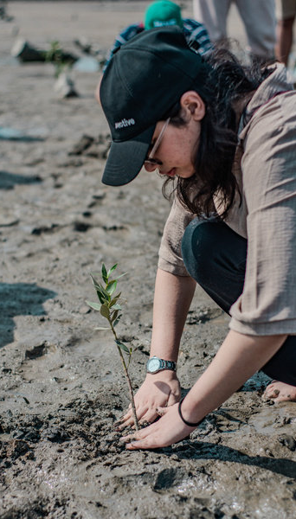
Functional Modules
01
02
03
Accounts and roles
Trip booking
Sponsor a seedling
04
Plot registry and map
05
05
Growth Monitoring
Awareness content

Slide 7

Functional Modules
07
08
09
Volunteer management
Complaint assistant
Public dashboard
10
Company portfolio
11
12
13
Admin
portal
Community
Tab
Media
requests

Slide 8
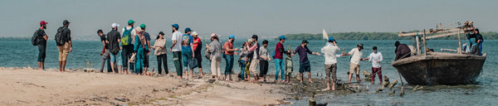
Where AI Is Applied
Plant health classifier
Seedling counter
Site suitability
Change detection
Survival
risk
Healthy, stressed or dead from a photo
Counts seedlings in a field photo
Scores where to plant next
Flags green cover loss from satellite
Predicts which plots will fail

Slide 9
Tools and Technology
Layer | Tools
Frontend | React, Tailwind CSS
Backend | Node.js, Express
AI services | Python, FastAPI
Geospatial | PostgreSQL with PostGIS, Sentinel-2, rasterio

Slide 10
Feature Split
FYP - I | FYP - II
Accounts and roles | Trip booking and sponsorship
Plot registry and map | Volunteer management
Survival surveys and photo timeline | Site suitability model
Awareness content | Satellite change detection
M1 health classifier | Complaint assistant and threat map
M2 seedling counter | Company portfolio and dashboard
Field data collection | Admin portal, community feed

Slide 11
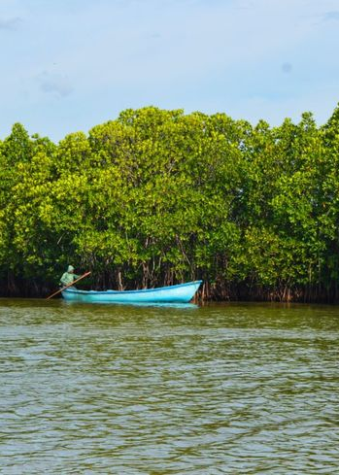
Conclusion
Mangroves protect Karachi, and almost nobody knows it
The failure is not planting, it is tracking and proof
Timar records every plot, measures survival and makes losses visible
Five AI components across image classification, counting, spatial scoring and change detection
Built with a real partner organisation, on real field data

Slide 12
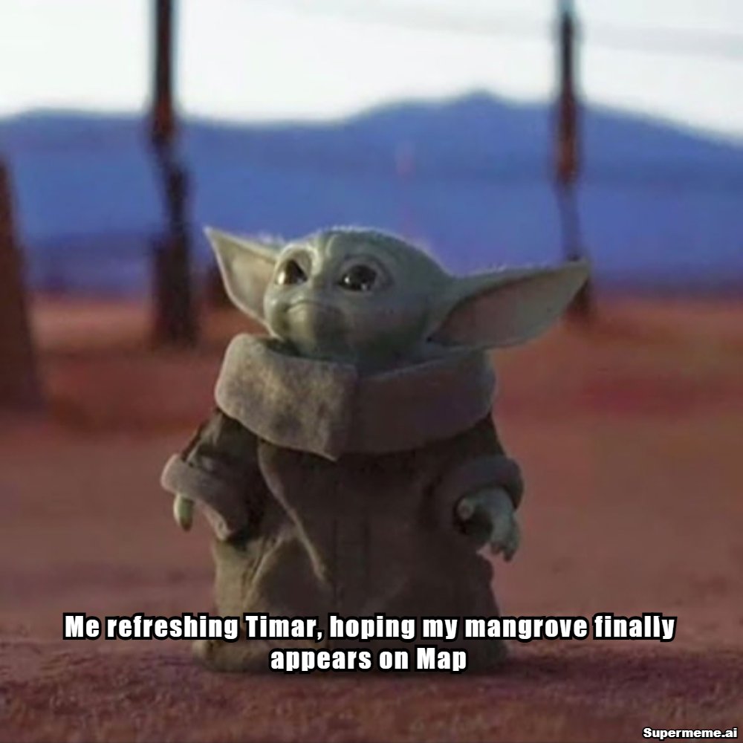
Thank you!

