Slide 1
Alpha Beta Pruning

Slide 2
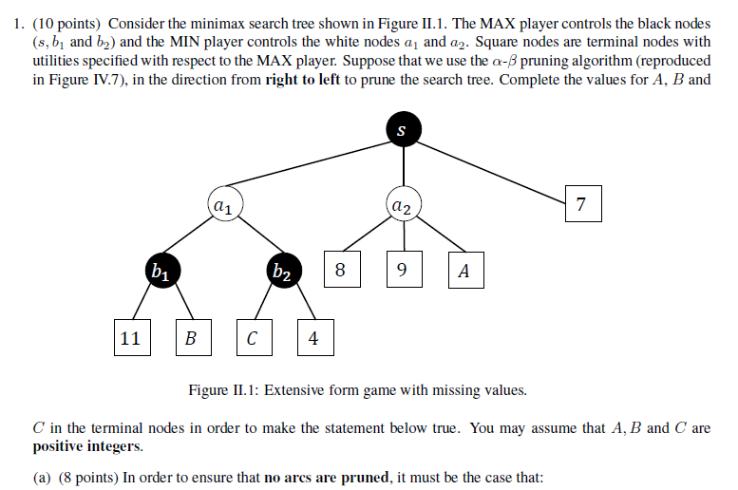
Problem Type: Deduce leaf values to ensure no arc/certain arc is pruned.
Source: CS3243 Midterm 2019 Part II

Slide 3
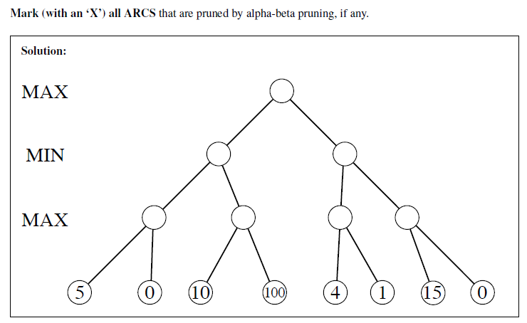
Problem Type: Mark pruned arcs with ‘X’
Source: CS3243 Midterm 2017 Part II

Slide 4
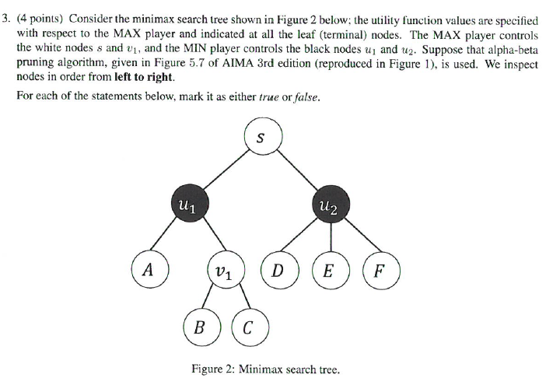
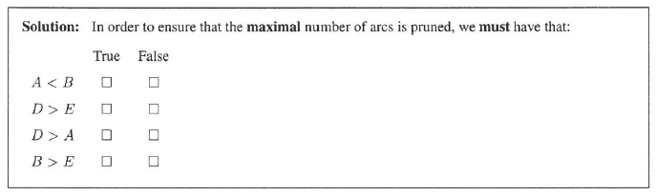
Problem Type: Statement checking on particular condition
Source: CS3243 Finals 1718 Part IV

Slide 5
Minimax

Slide 6
Problem Type: Deduce value at root
Source: CS3243 Midterm 2019

Slide 7
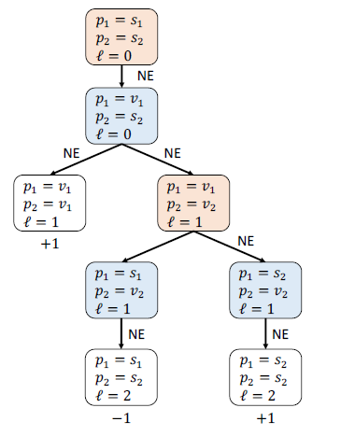
Problem Type: Identify edges corresponding to actions in sub-perfect Nash Equilibria
Source: CS3243 Midterm 2019 Part II

