Slide 1

The Fight against Digital Rights Management
Christopher Carlisle
Notes:
Today I’m going to talk to you about the fight against digital rights management

Slide 2

Overview
Definition
Brief History
Digital Rights Management
DRM - Free
Notes:
We’ll start off with a definition of what digital rights management is, move on to a brief history as to why digital rights management came to be, then we will talk about digital rights managements use in todays world and the problems that come along with it. I will then tell you how we can still have digital content and protect it without the use of DRM. So what is digital rights management?

Slide 3
What is Digital Rights Management (DRM)?
Digital rights management involves specifying and associating rights with digital content, placing controls on the content to enforce rights, enabling access checks, and tracking permission usage and payment.
Notes:
Here is a more formal definition

Slide 4
Brief History
Notes:
Now that we have agreed upon a definition lets go into the brief history

Slide 5

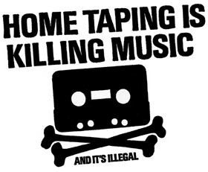
Cassette Tapes
Invented in 1958
In the 1980s the British Phonographic Industry ran a campaign against home taping.
Notes:
Cassette tapes were invented in 1958 and in the 1980s the British Phonographic Industry ran a campaign against home taping. The concern was that the music industry would collapse because people were using their cassettes to record music off of the radio rather than going to the store and purchasing a cassette of the music that they liked. As we know the music industry is still around today

Slide 6


Napster
Notes:
20 years later we had napster. Does everyone know what napster is?

Slide 7


Napster
Napster history: the rise
  January 1999: Napster version 1.0
  May 1999: company founded
  September 1999: first lawsuits
  2000: 80 million users
Napster history: the fall
  Mid 2001: out of business due to lawsuits
  Mid 2001: dozens of P2P alternatives that were harder to touch, though these have gradually been constrained
  2003: growth of pay services like iTunes
Napster history: the resurrection
  2003: Napster reconstituted as a pay service
  2006: still lots of file sharing going on
Notes:
In January 1999 Shawn Fanning a freshman in college at Boston’s NorthEastern University released the napster system, which he wrote over the previous christmas break. In may of 1999 the company was founded and the first set of lawsuits were encountered in september of that same year. By the year 2000 it was reported that there were 80 million people using napster. In mid 2001 after a series of lawsuits the Ninth Circuit Court issued an injunction to stop file sharing on the napster network. And in July of 2001 the network was shutdown. After Napster we saw the rise of other peer to peer file transfer clients like Kazaa and gnutella. These were harder to go after in court because they were more distributed networks. During this period we also saw the rise of pay services like the iTunes store and the Amazon Mp3 store.

Slide 8
Napster: The problem
Servers directory was continually updated
  Always know what music is currently available
  Point of vulnerability for legal action
File transfer was decentralized and done on a peer to peer basis
Locating content was done between the client and the servers.
Notes:
The problem that Napster faced was that the servers provided an index of files that were available. This was a point of vulnerability for legal action because it was aiding in the illegal act of sharing digital media even though file transfer was decentralized and done on a peer to peer basis. This would have been a tougher court battle had they not used a central indexing system.

Slide 9

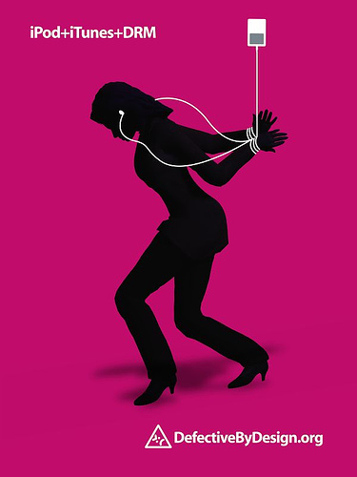
Digital Rights Managment
The “Solution”
Notes:
Because of sharing services like Napster the music industry wanted to put in place a piece of technology that would protect their content from being distributed. This technology was digital rights management software

Slide 10
The problems with DRM
Software is written so that the DRM software works only on proprietary products
When you buy content you do not actually own it. At any time you can lose access to the content that you purchased.
A metaphor for this is having a police officer constantly asking if the owner of a vehicle if they are the owner of said vehicle. The consumer is harassed and deemed guilty until proven innocent. Meanwhile, pirates are enjoying the same content without the protection of DRM.

Slide 11

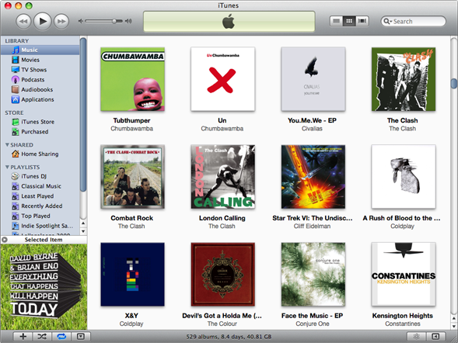
iTunes
Notes:
Here we have an example of software working only on proprietary products

Slide 12

iTunes
First released in 2000 after Apple Inc.
In 2003 Apple introduced iTunes store
Each song is 99¢
Fast, easy, and cheap
Syncing songs with your iPod as simple as pushing a button.
Notes:
Content purchased from iTunes store can only sync with apple products. Your content is locked down and cannot move freely from one device to another.

Slide 13


Amazon
Selling content without authorization of author
“Amazon removed unauthorized editions of the books at the request of the rights holder.” (Mies, 2009)
Never happen with brick and mortar store
With DRM this can happen to anyone

Slide 14


Ubisoft
Assassin’s Creed II released on March 9, 2010
3rd person action adventure game
DRM servers crashed
Legally purchased copies were left unplayable
Pirated copies were being played all weekend
Notes:
Assassins Creed II was released on March 9, 2010. It is a 3rd person action adventure game. The game used a central licensing system which would check with the server to make sure that it is not a pirated copy. On the weekend of the release, the drm servers crashed because they could not handle the load of requests from each copy of the game they sold. This left legally purchased copies unplayable and all of the pirates were playing all weekend.

Slide 15


DRM-Free
Notes:
We need to move to a better way of protecting content.
7:00

Slide 16

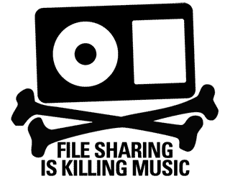
Clear up some myths
Content is still able to be protected without have DRM in place.
Piracy will not cause the movie, book, or music industry to fail
DRM causes people to avoid buying digital content and resorting to piracy instead

Slide 17
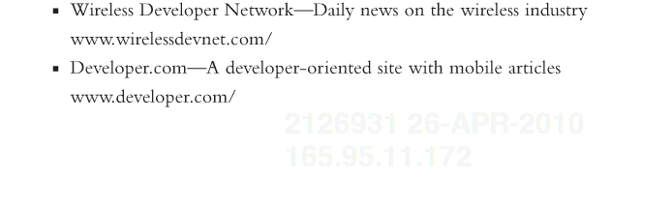
Embed Identifying Content
Notes:
Here is an example of embedded content. If you look closely you will see a unique identifier, the date, and the ip address that this book is being accessed from.

Slide 18


David Pogue
New York Times columnist and author
Released an unprotected version of his Windows book in an experiment with his publisher
Pirated to the skies
However, sales slightly increased

Slide 19

Proof that DRM-free works
O’Reilly Bookpress
  Goes DRM-free in 2009
  Sales increased 104%
2007 2008 2009

Slide 20
Conclusion
DRM does not let you use your content freely
DRM gets in the way
Content can be protected without it

