Slide 1




HELCATS
Heliospheric Cataloguing, Analysis and Techniques Service
R.A. Harrison, J.A. Davies, C. Möstl, A.P. Rouillard,
V. Bothmer, L. Rodriguez, J.P. Eastwood, E.K.J. Kilpua,
P.T. Gallagher, D. Odstrčil & the HELCATS team
EU FP7:
GA no: 606692

Slide 2

Contents
Why?─ Motivation
What? ─ Overview
Who? ─ Participants
How? ─ Structure
Well? ─ Highlights
Want? ─ More information
EU FP7:
GA no: 606692

Slide 3
Why?
FP7 HELCATS (1st May 2014 ─ 1st May 2017) capitalises on European expertise in heliospheric imaging built up over the last decade, particularly by lead involvement in STEREO, whilst also exploiting the wealth of European experience in solar and coronal imaging, and the interpretation of in-situ and radio measurements of solar wind phenomena.
EU FP7:
GA no: 606692

Slide 4
What?
The general aims of HELCATS are to:
catalogue transient (CME) and background (SIR/CIR) structures imaged in the heliosphere by STEREO/HI, including estimated kinematic properties from established and speculative techniques;
verify the kinematic properties, hence assessing the validity of the techniques, by comparing with solar source/coronal observations, and in-situ measurements at multiple points in the heliosphere;
assess the potential for initialising advanced numerical models based on the derived kinematic properties of both the transient and background solar wind;
assess the complementarity of combining heliospheric imagery with radio-based methods to detect structures and diagnose processes in the heliosphere (Type II bursts and IPS);
provide the scientific community with easy access to HELCATS catalogues and methodologies, enabling a much wider exploitation and understanding of heliospheric imaging observations.
EU FP7:
GA no: 606692

Slide 5
Who?
EU FP7:
GA no: 606692
Institute | Short name | Institute Lead
STFC-RAL Space, UK (Coordinator) | STFC | R.A. Harrison
University of Graz, Austria | UNIGRAZ | C. Möstl
University Paul Sabatier / Centre National de la Recherche Scientifique, France (third party) | UPS / CNRS | A.P. Rouillard
University of Göttingen, Germany | UGOE | V. Bothmer
Royal Observatory Belgium, Belgium | ROB | L. Rodriguez
Imperial College London, UK | IMPERIAL | J.P. Eastwood
University of Helsinki, Finland | UH | E.K.J. Kilpua
Trinity College Dublin, Ireland | TCD | P. Gallagher
George Mason University, USA (third party) | GMU | D. Odstrčil

Slide 6
How?
EU FP7:
GA no: 606692
Work Package (WP) |  | WP Lead
1. | Management | R.A. Harrison (STFC)
2. | Producing a definitive catalogue of CMEs imaged by STEREO/HI | J.A. Davies (STFC)
3. | Deriving/cataloguing the kinematic properties of STEREO/HI CMEs based on geometrical and forward modelling | V. Bothmer (UGOE)
4. | Verifying the kinematic properties of STEREO/HI CMEs against in-situ CME observations and coronal sources | C. Möstl (UNIGRAZ)
5. | Producing a definitive catalogue of CIRs imaged by STEREO/HI that includes verified model-derived kinematic properties | A.P. Rouillard (UPS/CNRS)
6. | Initialising advanced numerical models based on the kinematic properties of STEREO/HI CMEs and CIRs | A.P. Rouillard (UPS/CNRS)
7. | Assessing the complementary nature of radio measurements of solar wind transients | J.P. Eastwood (IMPERIAL)
8. | Dissemination | C.H. Perry (STFC)

Slide 7
Well?
The following slides provide a non-exhaustive overview of what has been achieved by HELCATS over the first half of the project…
EU FP7:
GA no: 606692

Slide 8
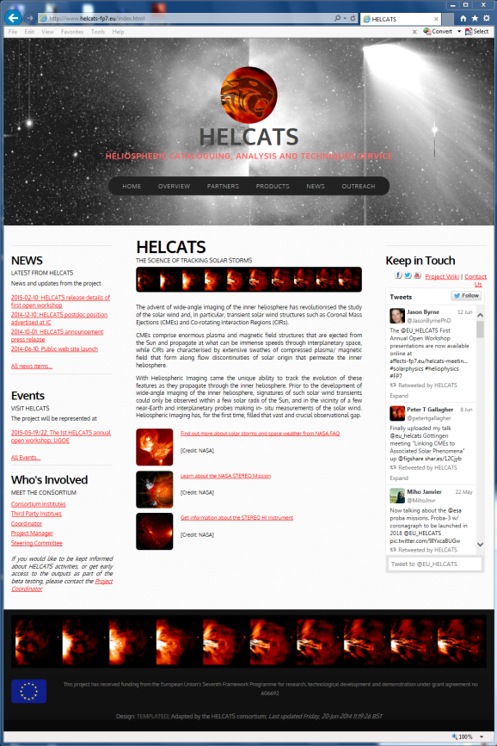
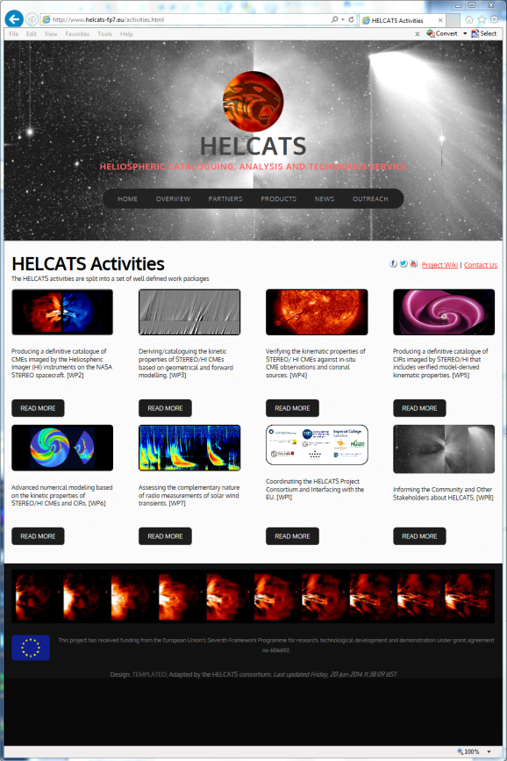
Development of
HELCATS website (WP1)
EU FP7:
GA no: 606692
WP1 covers the formal management of HELCATS.
This includes development and maintenance of project infrastructure, most notably the HELCATS project website.
In particular, the website http://www.helcats-fp7.eu provides access to the products of the project.

Slide 9
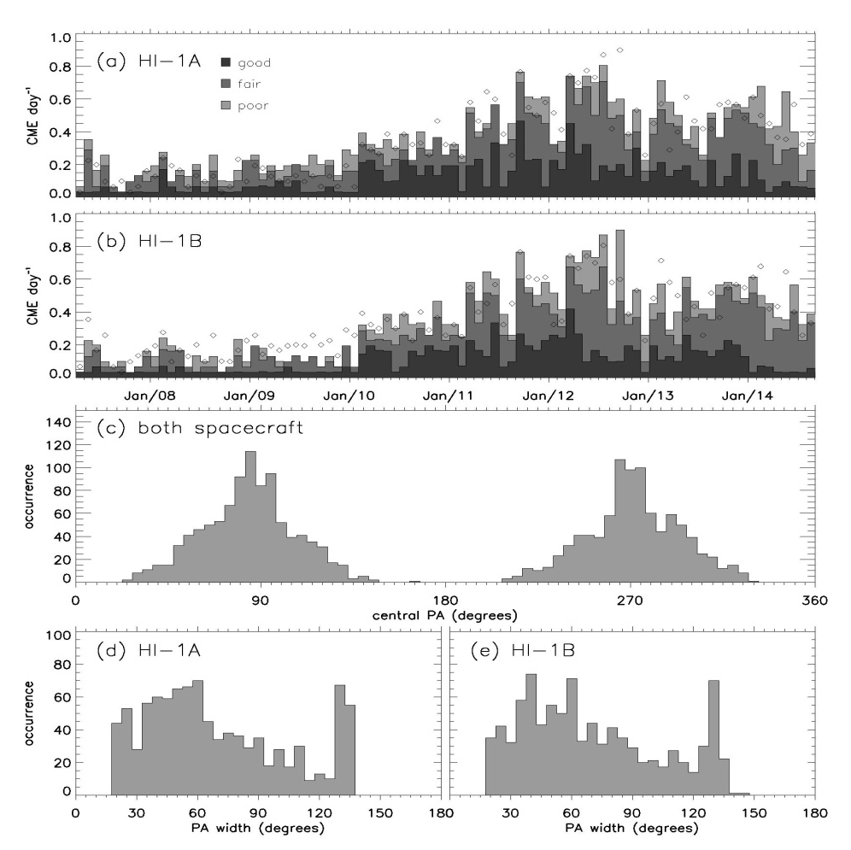
Manual cataloguing of
STEREO/HI CMEs (WP2)
EU FP7:
GA no: 606692
Task 1 of WP2 involves the manual cataloguing of STEREO/HI CMEs via visual inspection of HI-1 data.
The resultant catalogue includes observational properties, e.g. time of first detection, PA centre/width.
The catalogue, accessible from the website, can be retrieved in various formats.
http://www.helcats-fp7.eu/catalogues/wp2_cat.html

Slide 10
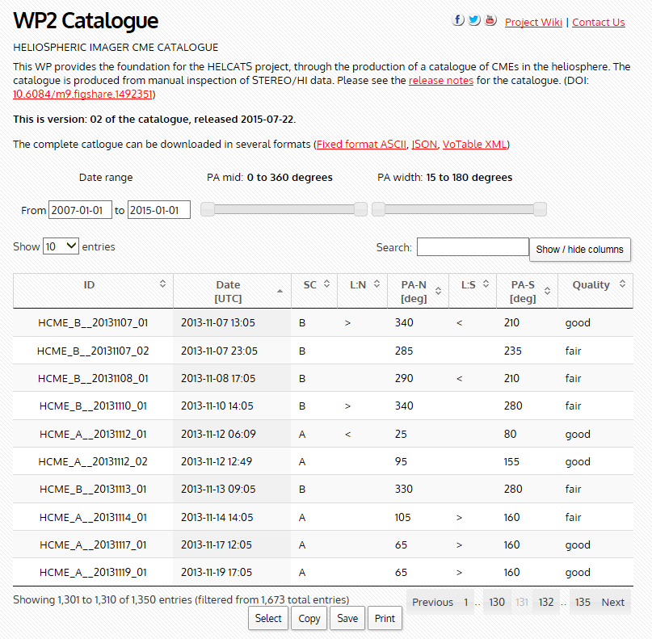
Manual cataloguing of
STEREO/HI CMEs (WP2)
EU FP7:
GA no: 606692
Task 1 of WP2 involves the manual cataloguing of STEREO/HI CMEs via visual inspection of HI-1 data.
The resultant catalogue includes observational properties, e.g. time of first detection, PA centre/width.
The catalogue, accessible from the website, can be retrieved in various formats.
http://www.helcats-fp7.eu/catalogues/wp2_cat.html

Slide 11
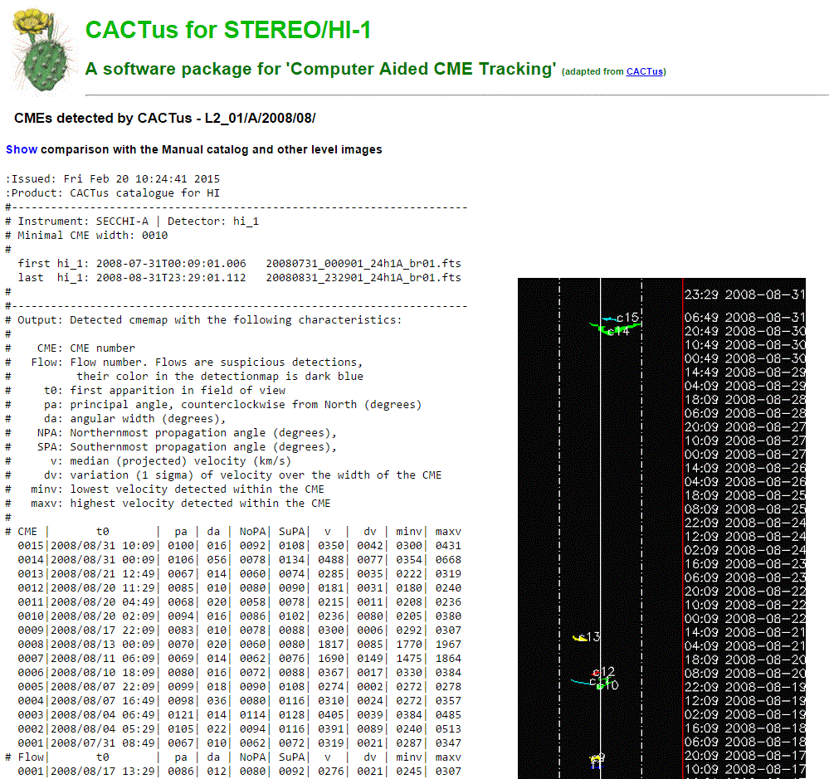
Automatic cataloguing of
STEREO/HI CMEs (WP2)
EU FP7:
GA no: 606692
WP2 also includes (as task 2) an assessment of automatic cataloguing of CMEs in HI-1 data, based on CACTus.
The resultant catalogue is undergoing validation against the manual catalogue, to fine-tune the automatic detection algorithm.
The validated catalogue will be accessible via the website.

Slide 12
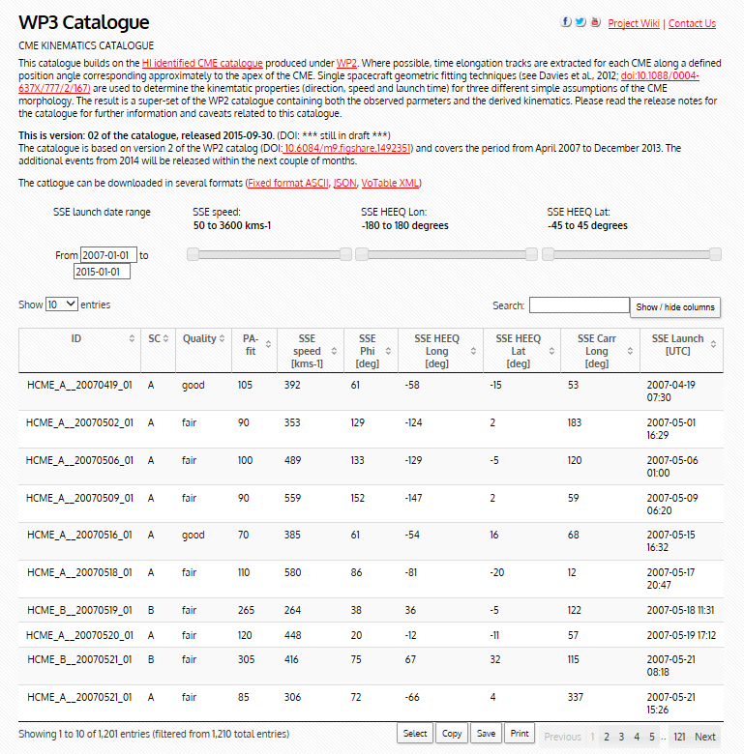
Geometric modelling of
STEREO/HI CMEs (WP3)
EU FP7:
GA no: 606692
WP3.1 entails the geometrical modelling of the WP2 manually-catalogued CMEs.
The WP2 manual catalogue is augmented with CME speed, direction and launch time estimates, from the FPF, SSEF and HMF techniques.
The resultant catalogue is available on the project website, in different formats.
http://www.helcats-fp7.eu/catalogues/wp3_cat.html

Slide 13
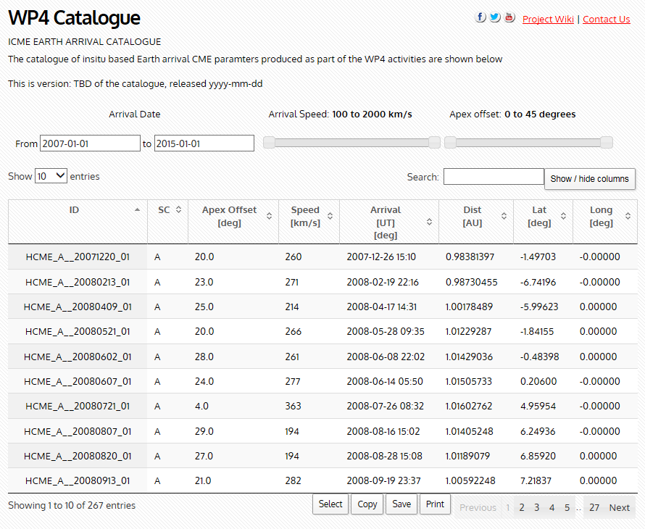
Validation of CME
kinematics (WP4)
EU FP7:
GA no: 606692
WP4 includes the verification of CME kinematic properties (from the previous WPs) by comparison with CME source regions and ICMEs, heliosphere-wide.
The website is currently being populated with parameters of STEREO/HI CMEs predicted to impact in-situ spacecraft. Source catalogues are also being made available.
http://www.helcats-fp7.eu/catalogues/wp4_cat.html

Slide 14
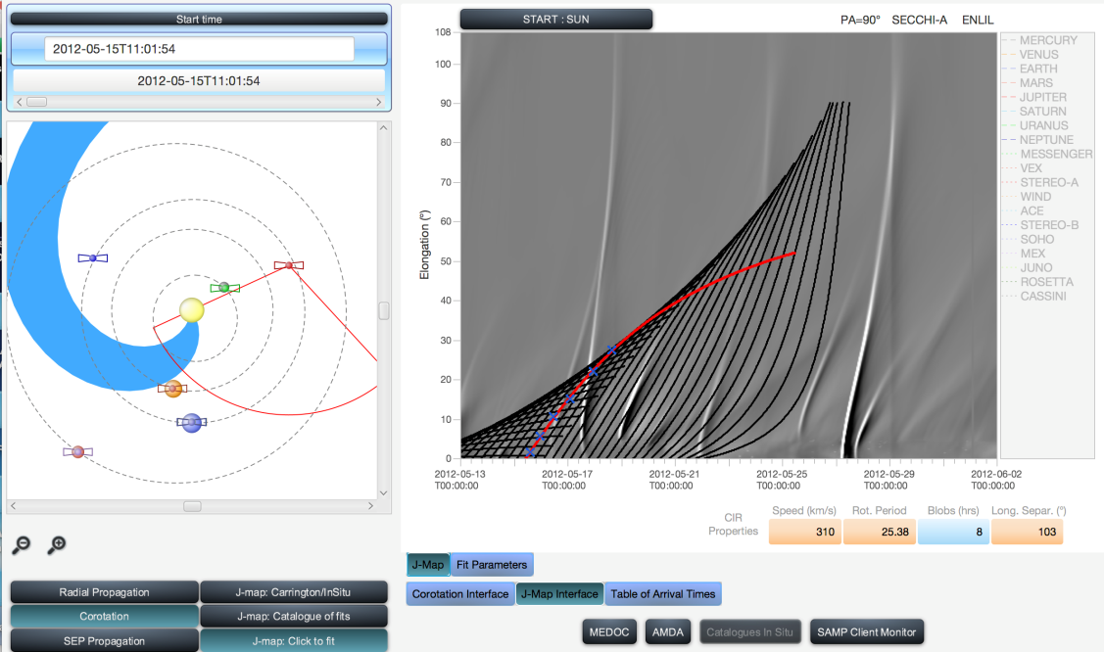
Cataloguing of
STEREO/HI CIRs (WP5)
EU FP7:
GA no: 606692
WP5 comprises an analogous cataloguing, modelling and validation exercise for CIRs.
The STEREO/HI CIR catalogue can be accessed via the IRAP propagation tool and will soon become accessible via the HELCATS website.
WP6 assesses initialisation of MHD models using both the CIR and CME properties.
Example of CIR catalogue output currently available on the IRAP propagation tool (http://propagationtool.cdpp.eu/)

Slide 15
Complementarity of radio measurements (WP7)
EU FP7:
GA no: 606692
See Mario’s HELCATS WP7
talk!

Slide 16
HELCATS
Thank you for your
attention!
Want more information?
See:
http://www.helcats-fp7.eu
Or contact:
Richard.Harrison@stfc.ac.uk (Coordinator)
Jackie.Davies@stfc.ac.uk (Scientific manager)
EU FP7:
GA no: 606692

