Slide 1

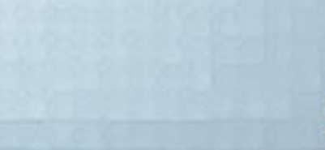
軟 體 設 計
Final Proposal
數據所 RE6081017 莊鈞幃
數據所 RE6084057 蔡昌銘

Slide 2
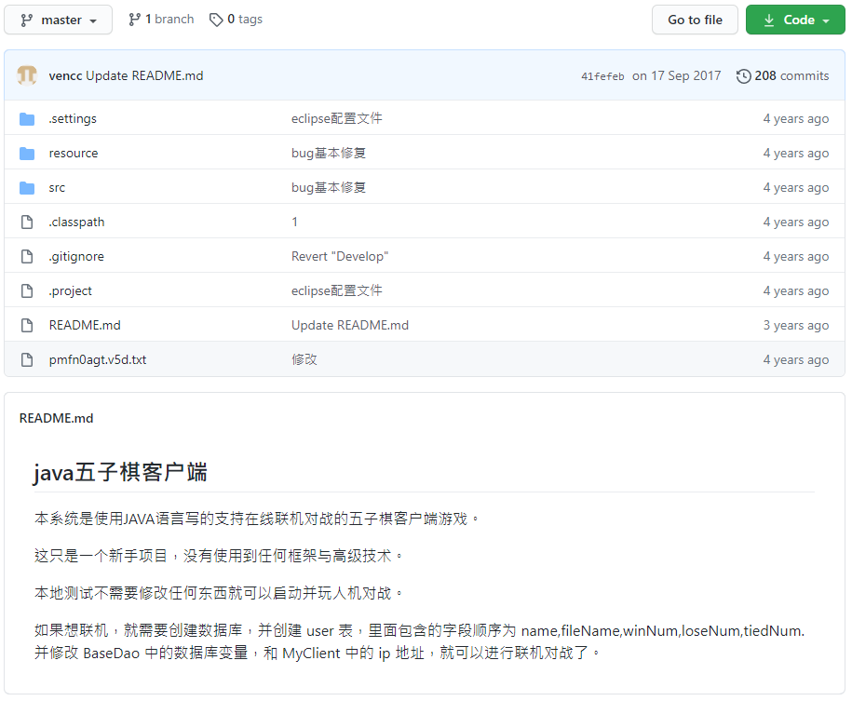
Data Source

Slide 3
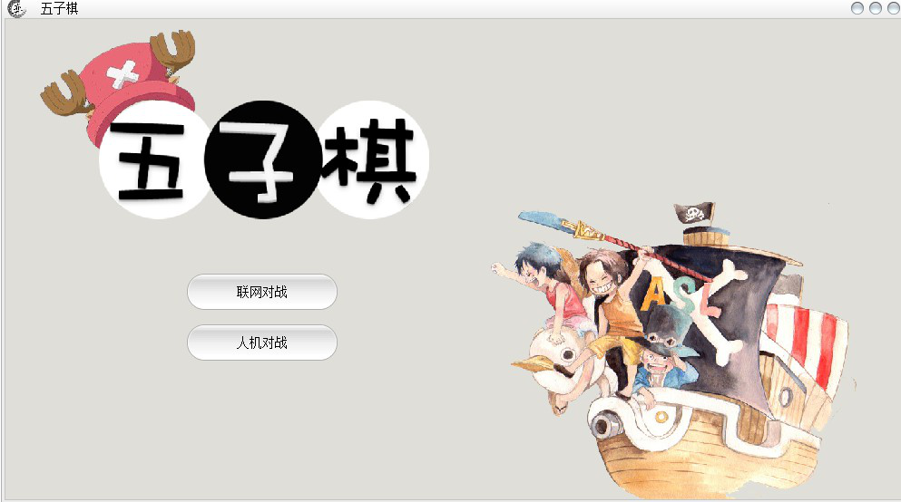
Main UI

Slide 4
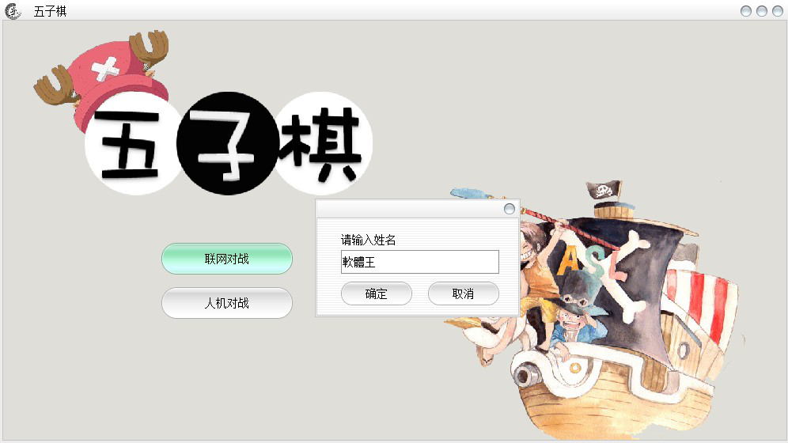
Main UI

Slide 5
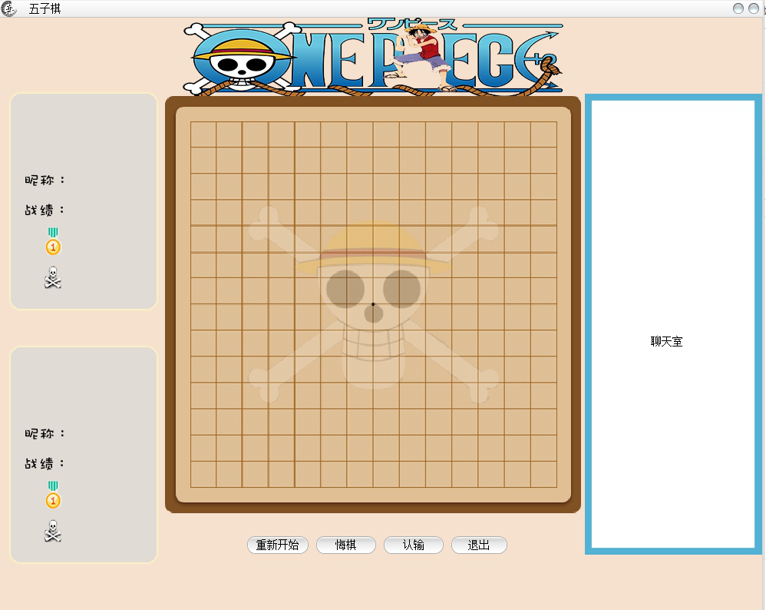
遊戲畫面

Slide 6
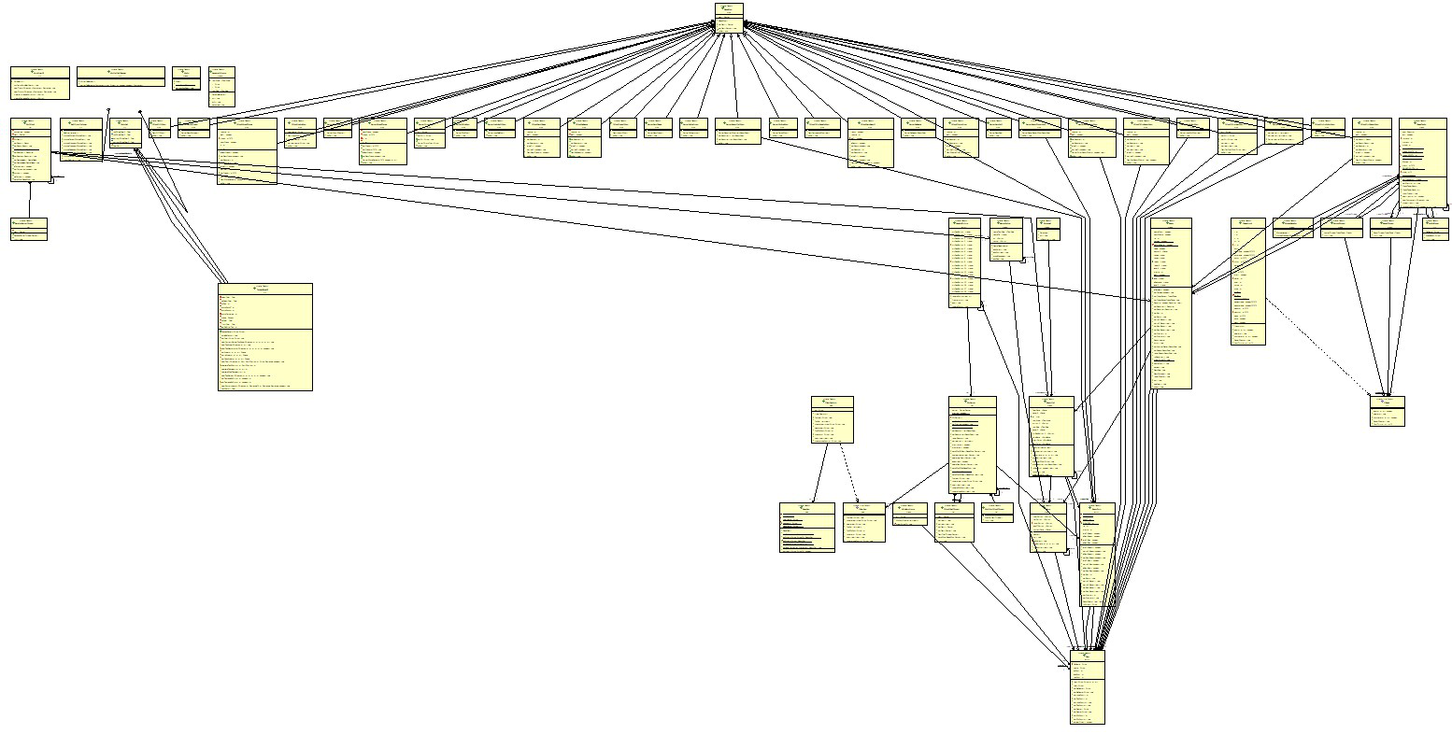
UML

Slide 7
Frameworks
Message
User
Chess Table
Room
UI

Slide 8
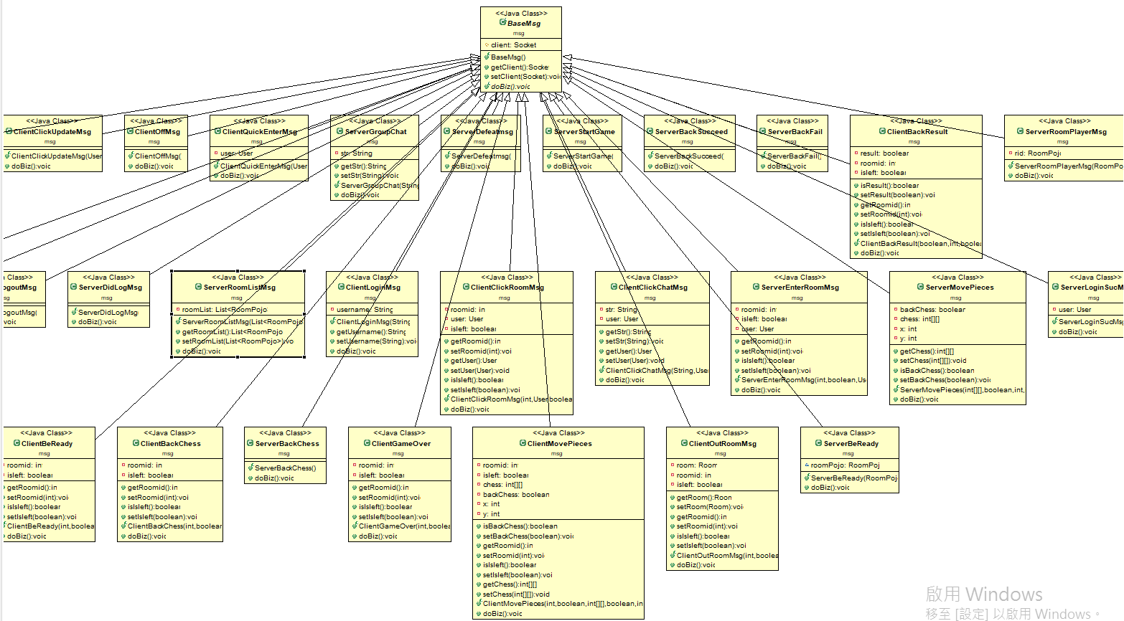
Message

Slide 9
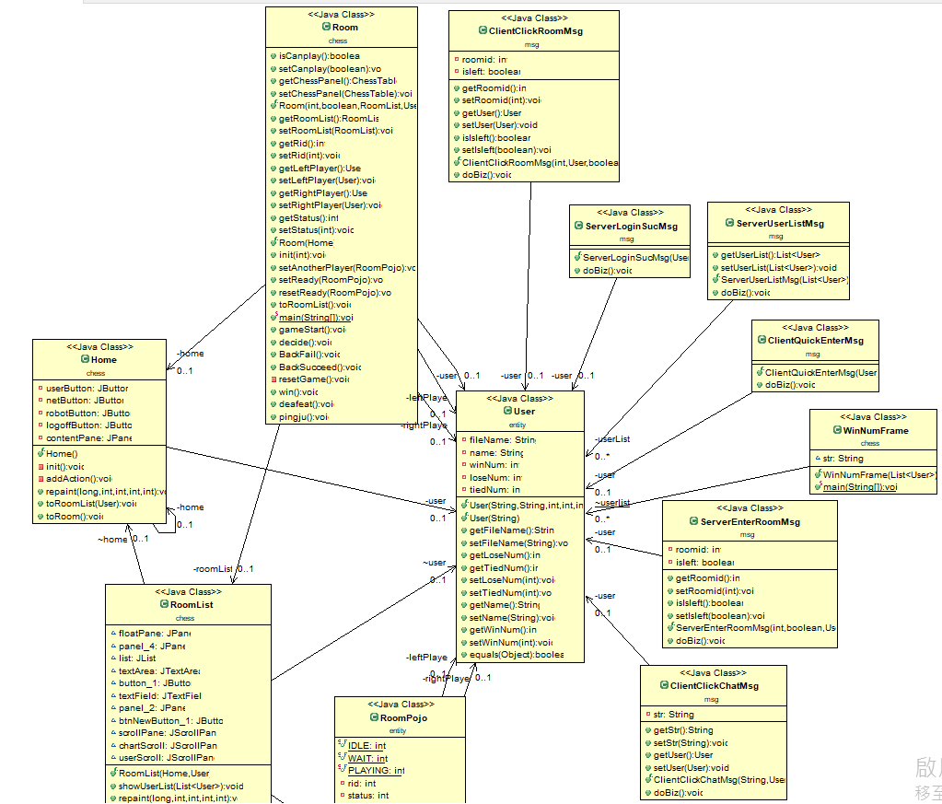
User

Slide 10
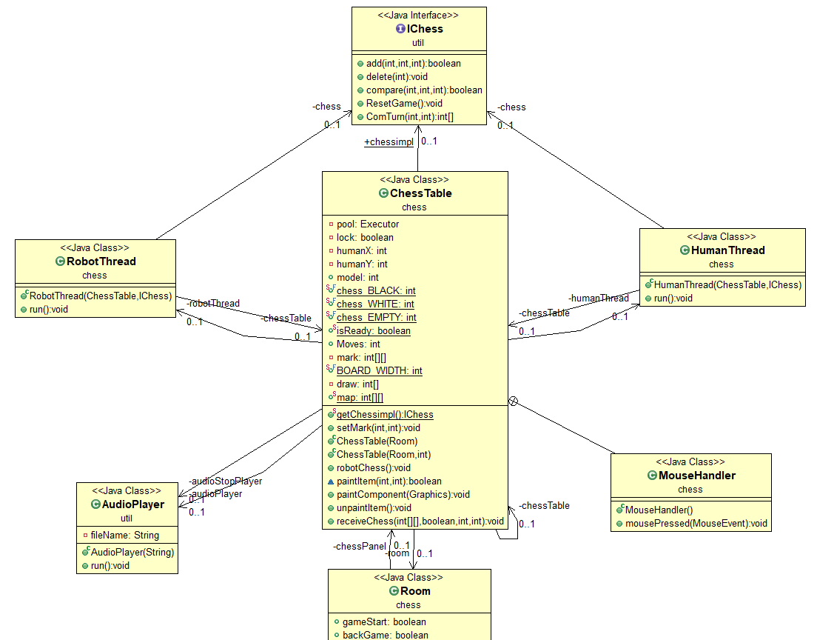
Chess Table

Slide 11
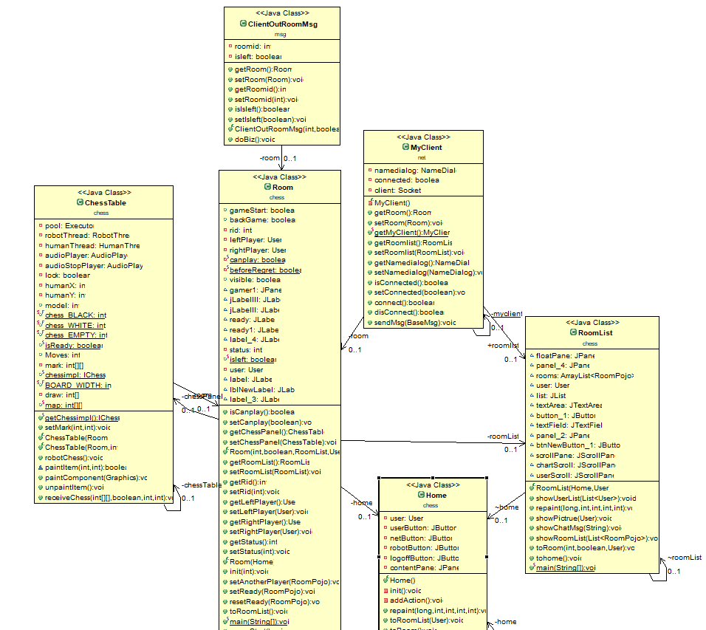
Room

Slide 12
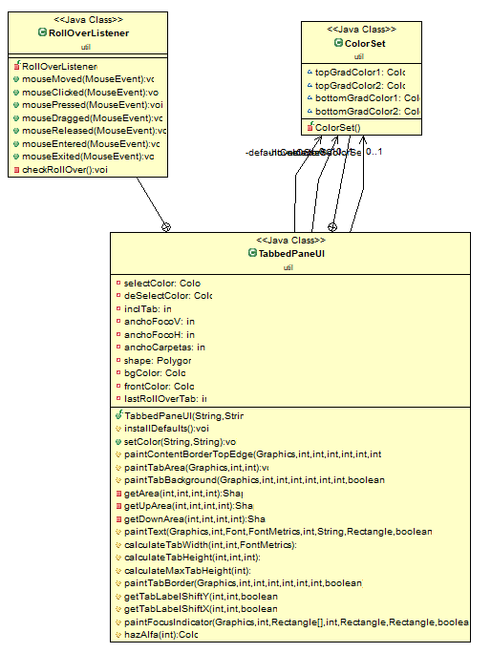
UI

Slide 13
Problem
Room vs. RoomPojo
Messages from BaseMsg
Simplify class such as Room, User, …etc.

