Slide 1

ME 599 J, K / IND E 599 A AI/ML for Smart Manufacturing Classification
Professor Ashis G. Banerjee
April 15 - 20, 2026

Slide 2
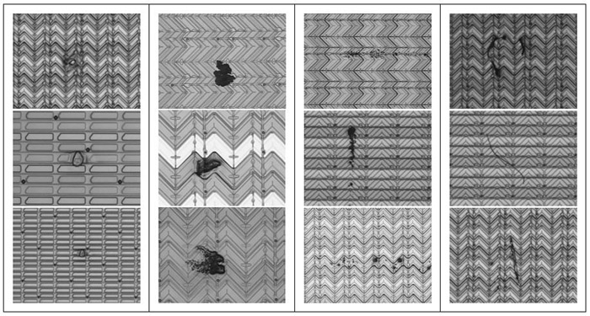

Basics
Process of assigning samples to one or more pre-defined classes or categories
Taxonomy
Binary versus multi-class classification
Single-label versus multi-label classification
Batch versus incremental versus online
Detection of defects during LCD production
Image source: https://smm.sdsu.edu/index.php?mid=research_previous&document_srl=579

Slide 3

Performance Measures
Actual or labeled | Predicted
 | Positive | Negative
Positive | True Positive (TP) | False negative (FN)
Negative | False positive (FP) | True negative (TN)
Binary confusion matrix
Precision = (TP) / (TP + FP)
Recall or sensitivity = (TP) / (TP + FN)
Specificity = (TN) / (TN + FP)
Accuracy = (TP + TN) / (TP + TN+ FP + FN)
F1 score = Harmonic mean of precision and recall
Useful for imbalanced classes
Area under the receiver operating characteristic (ROC) curve (AUC)
ROC: Plot of true positive rate versus false positive rate; sensitivity versus (1-specificity)
For imbalanced data, balanced accuracy and G-mean scores are also used

Slide 4
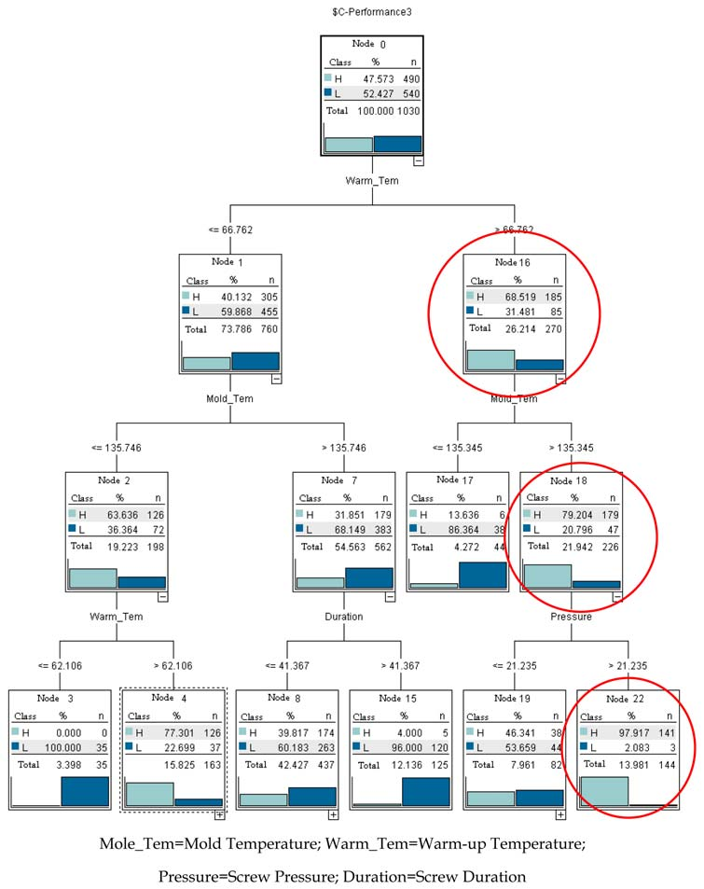

Decision (Classification) Trees
Image source: https://www.intechopen.com/chapters/5958
Modeling of molding process for LED production

Slide 5
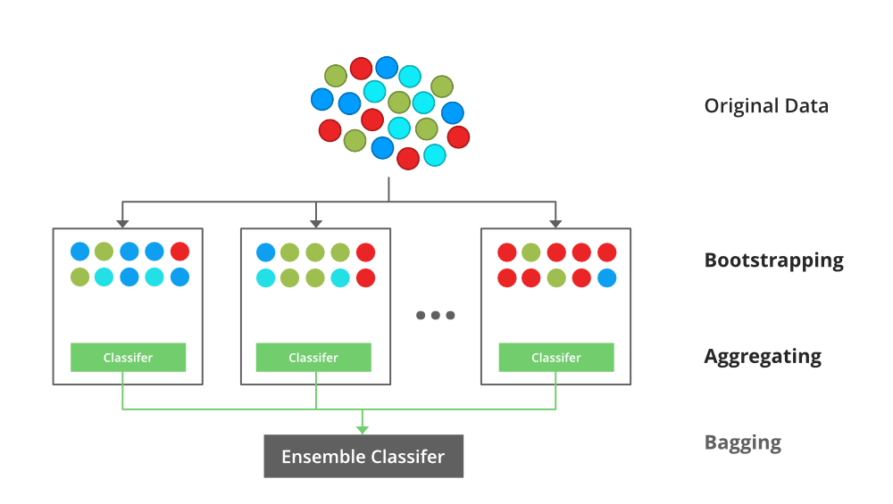
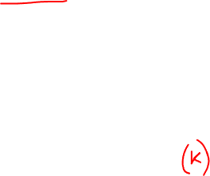
Random Forests
Bootstrapped aggregation or bagging
Decreases variance and avoids overfitting
Training set sampling with replacement
Each classifier is a decision tree
Final predictions are obtained by either taking the average outcome or the most common (majority) outcome

Slide 6
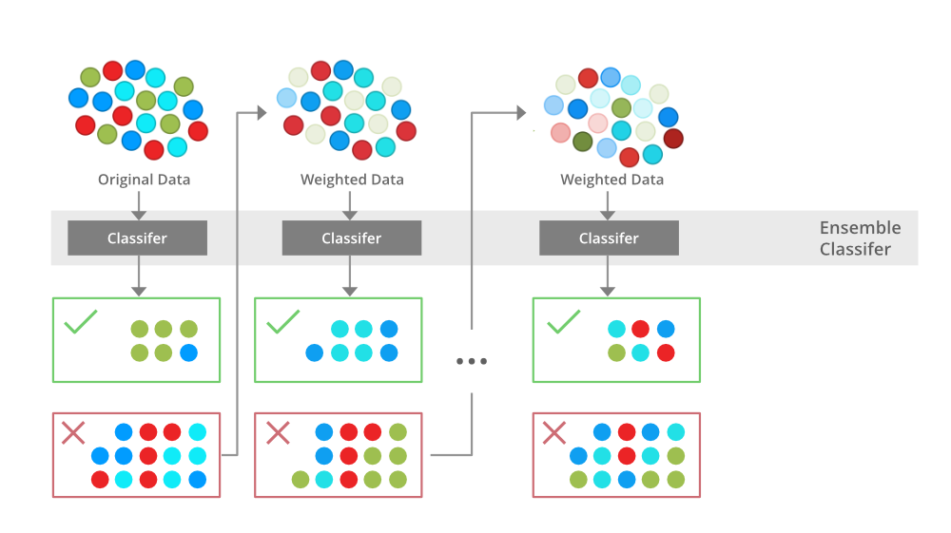
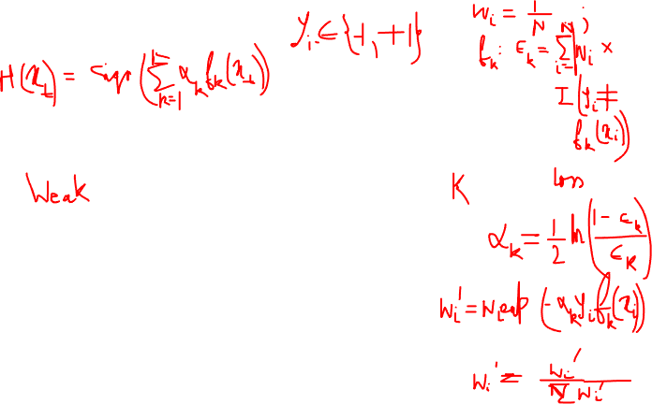
AdaBoost
Adaptive boosting
Helps reduce bias
Increase the weight of the wrongly classified data points and decrease the weights of correctly classified data points; normalize the weights of all the data points

Slide 7
Logistic (Logit) Regression
Models log-odds of a dependent (target / response) variable (binary class) as a linear combination of several independent variables (features)
A logistic function typically converts the log-odds to a probability measure
Sigmoid is the standard logistic function
Logistic (log) loss function, also known as cross entropy loss, is used to assess goodness of fit of the classifier; this is equivalent to maximizing the log-likelihood (or likelihood function) for parameter estimation

Slide 8
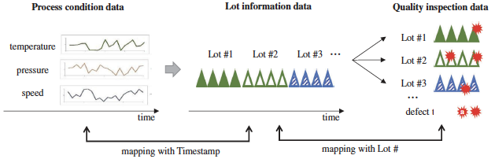
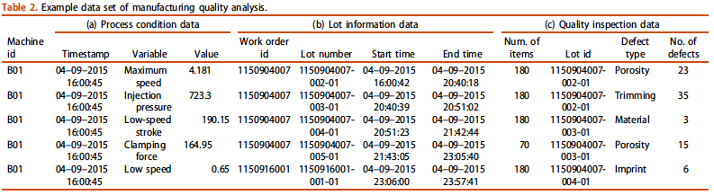
Case Study: Problem
Kim, A., Oh, K., Jung, J.Y. and Kim, B., 2018. Imbalanced classification of manufacturing quality conditions using cost-sensitive decision tree ensembles. International Journal of Computer Integrated Manufacturing, 31(8), pp.701-717.
Main challenge: Quality analysis data set is generally unbalanced because the defective rate is quite low in practice

Slide 9
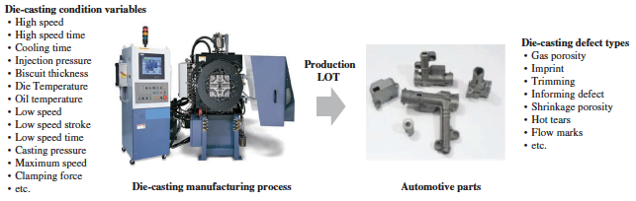
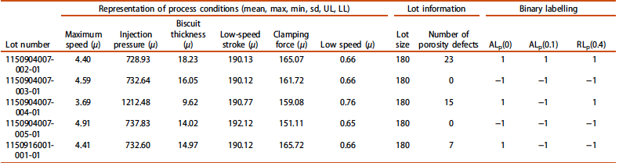
Case Study: Manufacturing Process

Slide 10
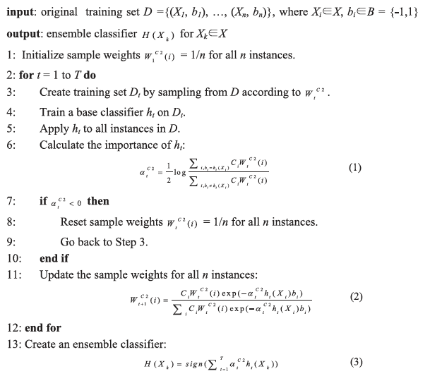
Case Study: Method
New method: A cost-sensitive decision tree ensemble algorithm is adopted to boost the small number of defective cases and assign a higher cost to the misclassification of defective products than that of normal products

Slide 11
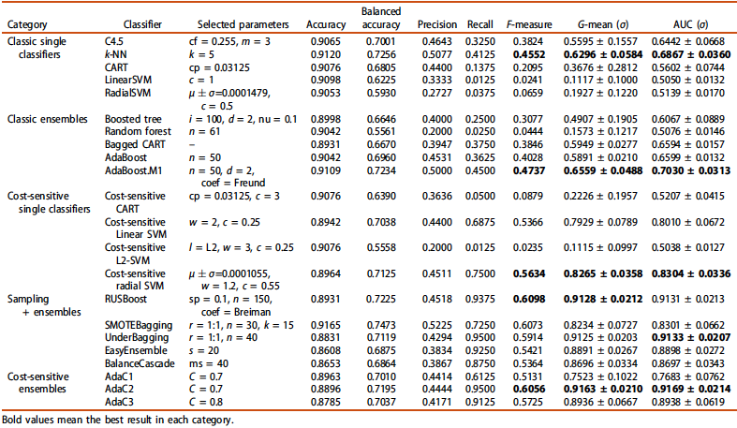

Case Study: Results

